Slide 1


Alternative Search
Formulations and Applications

Slide 2
Example. The four queens puzzle is the problem of putting four chess queens on an 4×4 chessboard such that none of them is able to capture any other using the standard chess queen's moves. That is to say, no two queens should share the same row, column, or diagonal.

Slide 3
( )

Slide 4
Q
( )
((1,1))

Slide 5
Q
Q
( )
((1,1))
((1,1) (2,3))

Slide 6
Q
( )
((1,1))
((1,1) (2,3))

Slide 7
Q
Q
( )
((1,1))
((1,1) (2,3))
((1,1) (2,4))

Slide 8
Q
Q
( )
Q
((1,1))
((1,1) (2,3))
((1,1) (2,4))
((1,1) (2,4) (3.2))

Slide 9
Q
Q
( )
((1,1))
((1,1) (2,3))
((1,1) (2,4))
((1,1) (2,4) (3.2))

Slide 10
Q
( )
((1,1))
((1,1) (2,3))
((1,1) (2,4))
((1,1) (2,4) (3.2))

Slide 11
( )
((1,1))
((1,1) (2,3))
((1,1) (2,4))
((1,1) (2,4) (3.2))

Slide 12
Q
( )
((1,1))
((1,2))
((1,1) (2,3))
((1,1) (2,4))
((1,1) (2,4) (3.2))

Slide 13
Q
Q
( )
((1,1))
((1,2))
((1,1) (2,3))
((1,1) (2,4))
((1,2) (2,4))
((1,1) (2,4) (3.2))

Slide 14
Q
Q
( )
Q
((1,1))
((1,2))
((1,1) (2,3))
((1,1) (2,4))
((1,2) (2,4))
((1,1) (2,4) (3.2))
((1,2) (2,4) (3,1))

Slide 15
Q
Q
( )
Q
Q
((1,1))
((1,2))
((1,1) (2,3))
((1,1) (2,4))
((1,2) (2,4))
((1,1) (2,4) (3.2))
((1,2) (2,4) (3,1))
((1,2) (2,4) (3,1) (4,3))

Slide 16


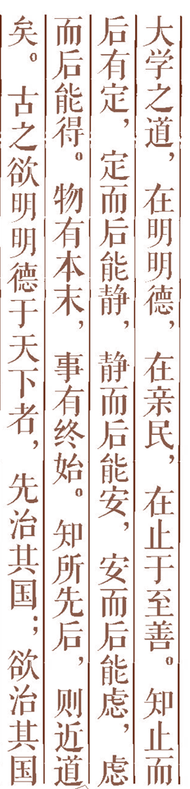
Assignment Problems
Constructive Methods
--Constraint Propagation
3.Heuristic Repair
4.Function Optimization
Outline
回车键即可增加项目内容，输入方便哦~

Slide 17
1. Assignment Problems (赋值问题)
Constraint Satisfaction Problem(CSP)
A CSP is defined by
a set of variables
a domain of values for each variable
a set of constraints between variables
A solution is
an assignment of a value to each variable that satisfies the constraints

Slide 18
Assignment Problems
Assigning values to variables subject to constraints
Examples
Four(Eight)-Queens problem
Crossword puzzles

Slide 19
CSP as a Search Problem
Initial state: empty assignment
Successor function: a value is assigned to any unassigned variable, which does not conflict with the currently assigned variables
Goal test: the assignment is complete
Path cost: irrelevant

Slide 20
The eight queens puzzle is the problem of putting eight chess queens on an 8×8 chessboard such that none of them is able to capture any other using the standard chess queen's moves. That is to say, no two queens should share the same row, column, or diagonal.
1. 92 solutions
2. 12 solutions(not symmetry)

Slide 21
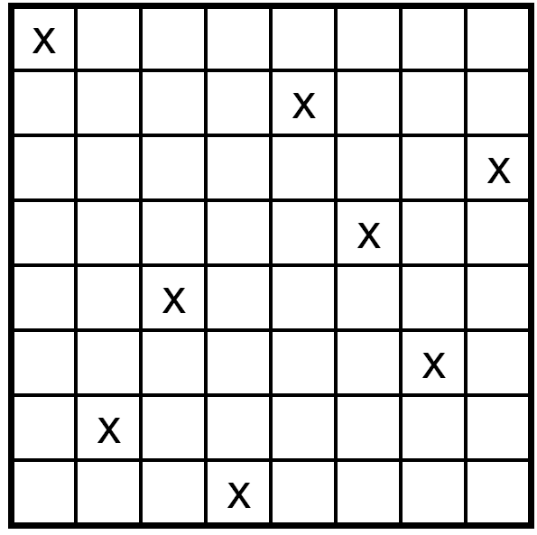
No queen can be placed so that it can capture any of the others, according to the rules of chess
An obvious data structure is 8-by-8 array containing queen(1) or empty(0)

Slide 22
Eight-Queens Problem
We can solve constraint-satisfaction problems by graph-search methods
Constructive method
Repair approach
Function optimization

Slide 23
2. Constructive method
Begin with no assignments
Each operator adds a queen to the array in such a way that the resulting array satisfies constraints among its queens
Constraint propagation technique helps markedly in reducing the size of the search space is the process of determining how the possible values of one variable affect the possible values of other variables.

Slide 24
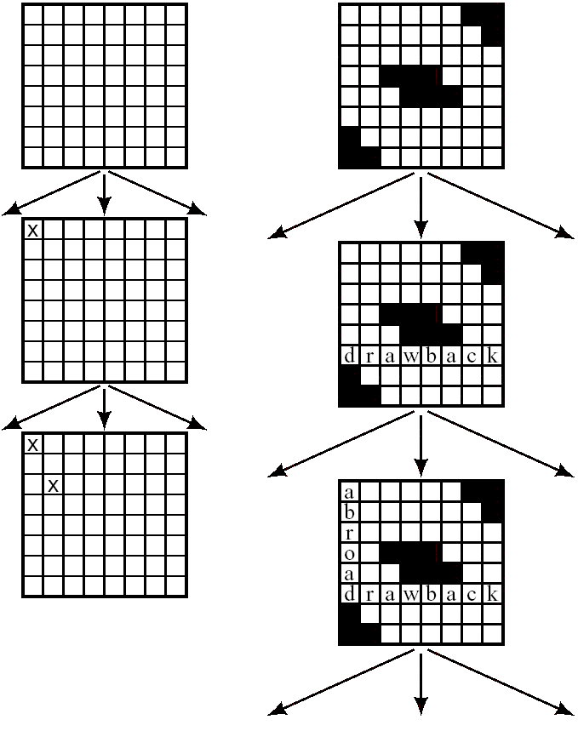

Slide 25
Constraint Propagation (four-queens problem)
Each variable constrains all of the others, so all of the nodes have arcs to all other nodes.
A directed constraint arc(i,j), variable labeling i is constrained by the value of the variable labeling j

Slide 26
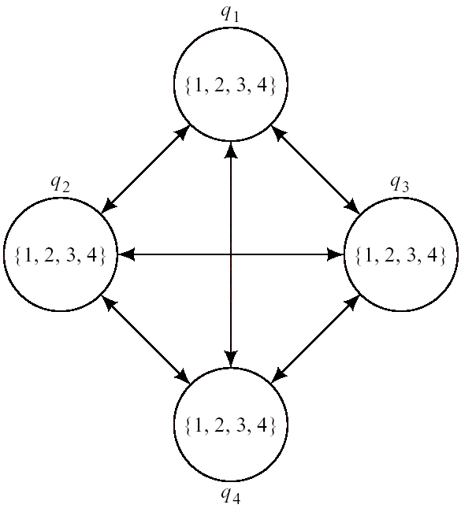
Starting: no assignments

Slide 27
Constraint Propagation
Constraint Graph with q₁ = 1

Slide 28
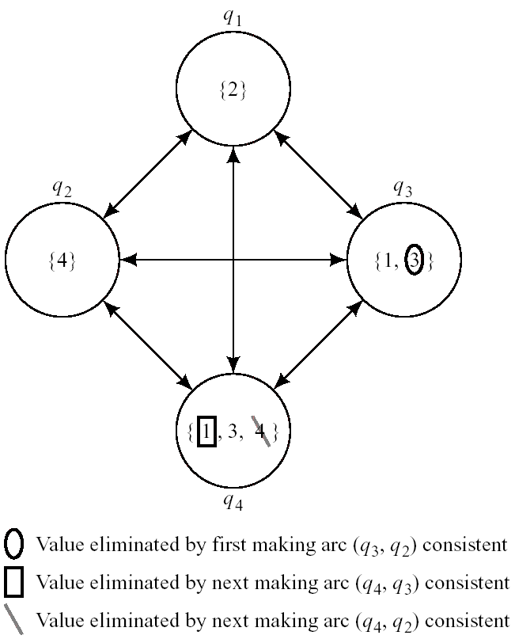
Constraint Graph with q₁ = 2

Slide 29
Ex.: 3-coloring
Variables:
v₁, v₂ , v₃ , v₄ , v₅
Domains:
{1, 2, 3}
Constraints:
v_{i} ≠ v_{j} if v_{i} and v_{j} are adjacent
v₁
v₂
v₃
v₄
v₅

Slide 30
One solution:
v₁ ← 1
v₂ ← 2
v₃ ← 2
v₄ ← 1
v₅ ← 3
v₁
v₂
v₃
v₄
v₅

Slide 31
3.Heuristic Repair
Idea Min-conflicts heuristic: choose a value that results in a minimum number of conflicts with other variables.
Starts with a proposed solution, which most probably does not satisfy the constraints
The operators change a data structure so that it violates fewer constraints

Slide 32
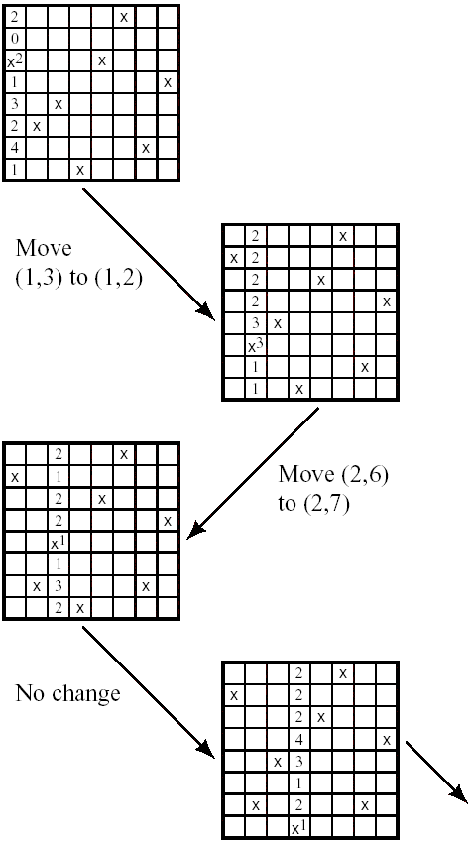
Repair Steps for the Eight-Queens Problem

Slide 33
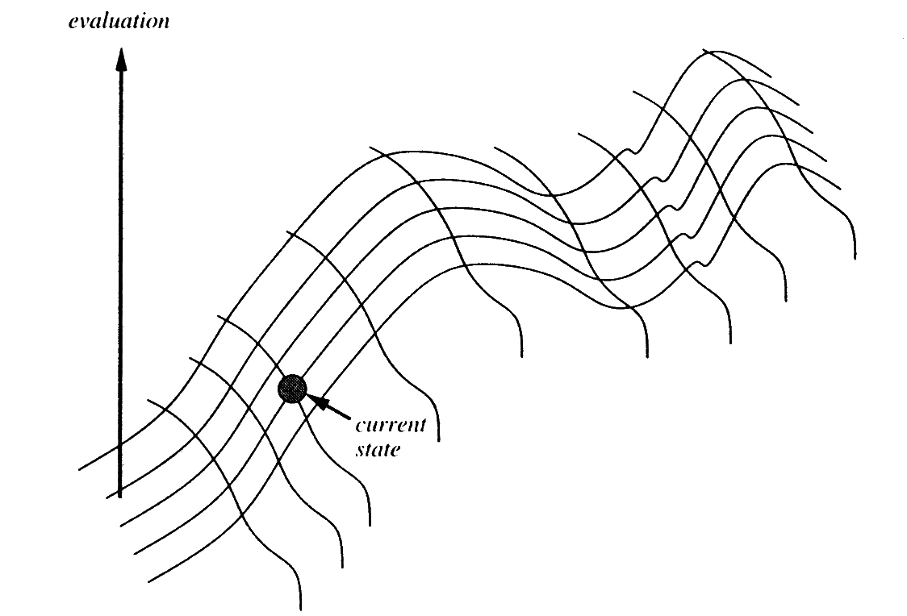
4. Function Optimization
Start with a complete configuration and make modifications to improve its quality.

Slide 34
Hill-climbing
Traversing by moving from one point to that “adjacent” point having the highest elevation

Slide 35
Solving the Two-Color Problem (Hill Climbing)
1. Set the current node, n, to a randomly selected node, n_{0.}
2. Generate the successors of n.
3. If Vb<V(n), exit with n as the best node found so far.
4. Otherwise,set n to n_{b}, and go to step 2.

Slide 36
function HILL-CLIMBING(problem) returns a solution state
inputs: problem, a problem
static: current, a node
next, a node
current ← MAKE-NODE(INITIAL-STATE[problem])
loop do
next ← a highest-valued successor of current
if VALUE[next] < VALUE[current] then return current
current ← next
end

Slide 37
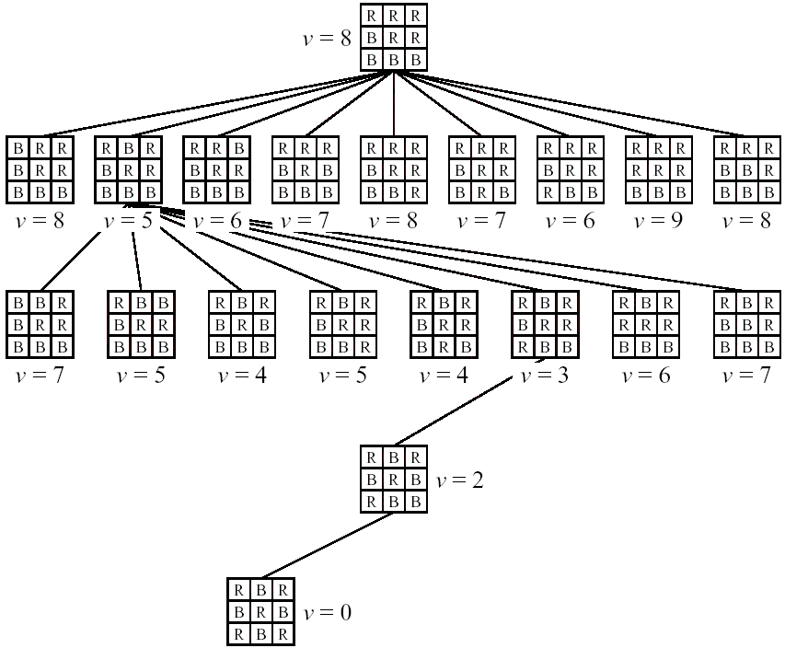

Slide 38
Hill-climbing
To solve local maximal problem
--Several separate hill-climbing, stating at different locations(choose the highest of these)
--Simulated annealing (choose by probability distribution)

Slide 39
Simulated Annealing
function SIMULATED-ANNEALING(problem,schedule) returns a solution state
inputs: problem, a problem
schedule, a mapping from time to “temperature”
static: current, a node
next, a node
T, a “temperature” controlling the probability of downward steps
current ← MAKE-NODE(INITIAL-STATE[problem])
for t ← 1 to ∞ do
T ← schedule[t]
if T=0 then return current
next ← a randomly selected successor of current
ΔE ← VALUE[next] – VALUE[current]
if ΔE > 0 then current ← next
else current ← next only with probability e ^{ΔE/T}

Slide 40
Ex.: 3-coloring
Variables:
v₁, v₂ , v₃ , v₄ , v₅
Domains:
{1, 2, 3}
Constraints:
v_{i} ≠ v_{j} if v_{i} and v_{j} are adjacent
v₁
v₂
v₃
v₄
v₅

Slide 41
One solution:
v₁ ← 1
v₂ ← 2
v₃ ← 2
v₄ ← 1
v₅ ← 3
v₁
v₂
v₃
v₄
v₅

Slide 42
Example: 4-queens
One solution:
x₁ ← 2
x₂ ← 4
x₃ ← 1
x₄ ← 3
x₁
x₂
x₃
x₄
1
Q
2
Q
3
Q
4
Q

Slide 43
Initial assignment
Pick queen in conflict
x₁
Q
x₁
Q
x₂
Q
x₂
2
1
Q
1
x₃
Q
x₃
Q
x₄
Q
x₄
Q
Move to min. conflicts
Pick queen in conflict
x₁
Q
x₁
Q
x₂
Q
x₂
Q
x₃
Q
x₃
0
2
2
Q
x₄
Q
x₄
Q

Slide 44
Move to min. conflicts
x₁
Q
x₂
Q
x₃
Q
x₄
Q

