Slide 1
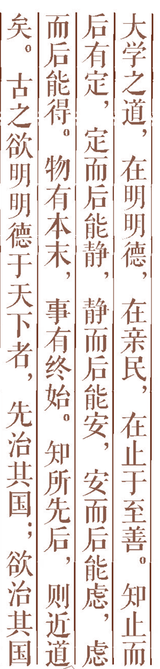
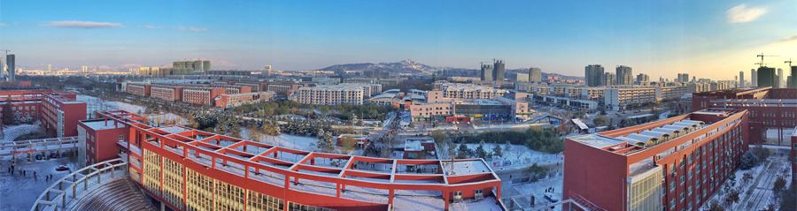

Artificial Intelligence Simulated Annealing Algorithm

Slide 2
Travelling Salesman Problem(TSP)
B
●
7
10
7
10
A
13
●
●
E
6
9
●
C
5
6
10
●
D

Slide 3
Contents:
1.Local search algorithm
2. Simulated Annealing(SA)
3. TSP based on SA
4. Discuss

Slide 4
1.Local search algorithm(1/14)
--Basic Idea
--Combinatorial optimization problem

Slide 5
1.Local search algorithm(2/14)
--Neighborhood
N(S) = {(4, 2, 1, 3),
(1, 4, 2, 3),
(3, 4, 1, 2),
(2, 1, 4, 3),
(2, 3, 1, 4),
(2, 4, 3, 1)}
For example.
Four Queens S=(2, 4, 1, 3)
Q
Q
Q
Q

Slide 6
1.Local search algorithm(3/14)
S = (x₁, x₂, …x_{i-1}, x_{i}, x_{i+1}, …, x_{j-1}, x_{j}, x_{j+1}, …, x_{n})
x_{i-1}
x_{i}
x_{i+1}
x_{i-1}
x_{i}
x_{i+1}
x₂
x_{j-1}
x₂
x_{j-1}
x₁
x_{j}
x₁
x_{j}
x_{n}
x_{j+1}
x_{n}
x_{j+1}
S' = (x₁, x₂, …x_{i-1}, x_{j}, x_{i+1}, …, x_{j-1}, x_{i}, x_{j+1}, …, x_{n})

Slide 7
1.Local search algorithm(4/14)
x_{i-1}
x_{i}
x_{i+1}
x_{i-1}
x_{i}
x_{i+1}
x₂
x_{j-1}
x₂
x_{j-1}
x₁
x_{j}
x₁
x_{j}
x_{n}
x_{j+1}
x_{n}
x_{j+1}

Slide 8
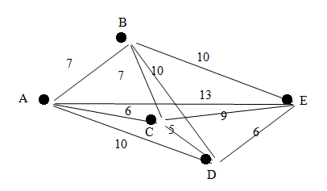
1.Local search algorithm(5/14)
--Initial solution: x₀ = (a, b, c, d, e)
f(x_{b}) = f(x₀) = 38
--Neighborhood of x₀
P = {(a, c, b, d, e), (a, d, c, b, e),
(a, e, c, d, b), (a, b, d, c, e),
(a, b, e, d, c), (a, b, c, e, d)}

Slide 9
First Cycle
1.Local search algorithm(6/14)
x_{n} = (a, c, b, d, e),
f(x_{n}) = 42,
f(x_{n}) > f(x_{b}),
P = P – {x_{n}}
= {(a, d, c, b, e), (a, e, c, d, b),
(a, b, d, c, e), (a, b, e, d, c),
(a, b, c, e, d)}

Slide 10
Second Cycle
1.Local search algorithm(7/14)
x_{n} = (a, d, c, b, e),
f(x_{n}) = 45,
f(x_{n}) > f(x_{b}),
P = P – {x_{n}}
= {(a, e, c, d, b),
(a, b, d, c, e),
(a, b, e, d, c),
(a, b, c, e, d)}

Slide 11
third cycle
1.Local search algorithm(8/14)
x_{n} = (a, e, c, d, b),
f(x_{n}) = 44,
f(x_{n}) > f(x_{b}),
P = P – {x_{n}}
= {(a, b, d, c, e),
(a, b, e, d, c),
(a, b, c, e, d)}

Slide 12
Fourth Cycle
1.Local search algorithm(9/14)
x_{n} = (a, b, d, c, e),
f(x_{n}) = 44,
f(x_{n}) > f(x_{b}),
P = P – {x_{n}} =
{(a, b, e, d, c),
(a, b, c, e, d)}

Slide 13
Fifth Cycle
1.Local search algorithm(10/14)
x_{n} = (a, b, e, d, c),
f(x_{n}) = 34,
f(x_{n}) < f(x_{b}),
x_{b} = (a, b, e, d, c),
P = {(a, e, b, d, c), (a, d, e, b, c),
(a, c, e, d, b), (a, b, d, e, c),
(a, b, c, d, e), (a, b, e, c, d)}

Slide 14
Sixth Cycle
1.Local search algorithm(11/14)
x_{n} = (a, e, b, d, c),
f(x_{n}) = 44,
f(x_{n}) > f(x_{b}),
P = P – {x_{n}}
= {(a, d, e, b, c), (a, c, e, d, b),
(a, b, d, e, c), (a, b, c, d, e),
(a, b, e, c, d)}

Slide 15
Seventh cycle
1.Local search algorithm(12/14)
x_{n} = (a, d, e, b, c),
f(x_{n}) = 39, f(x_{n}) > f(x_{b}),
P = P – {x_{n}}
= {(a, c, e, d, b),
(a, b, d, e, c),
(a, b, c, d, e),
(a, b, e, c, d)}

Slide 16
Eighth cycle--11th cycle
1.Local search algorithm(13/14)
x_{n} = (a, c, e, d, b),
f(x_{n}) = 38,
f(x_{n}) > f(x_{b}),
P = P – {x_{n}} = {(a, b, d, e, c),
(a, b, c, d, e), (a, b, e, c, d)}
….
P = P – {x_{n}} = {}
x_{b} = (a, b, e, d, c), f(x_{b}) = 34。

Slide 17
1.Local search algorithm(14/14)
A
B

Slide 18
2. Simulated Annealing(SA)
--is an extension of the local search algorithm
-- An improved local search algorithm based on metal degradation process
-- First proposed by Metropolis in 1953
-- successfully applied simulated annealing algorithm to combinatorial optimization problems in 1983.

Slide 19
2.1 Basic concepts(1/2)
Dissolution Process:
The arrangement of particles changes from an ordered state to a completely disordered state
Annealing process:
From disorder to order direction, until the temperature is very low, the particles rearranged in a certain structure

Slide 20
2.1 Basic concepts(2/2)
Metropolis rules
Boltzmann statistics
K > 0 is the Boltzmann constant

Slide 21
2.2 Change of Boltzmann statistics with T
--Two different states of energy at the same temperature
--At high temperatures
--Low temperature conditions
--When the temperature drops

Slide 22
Two different states of energy at the same temperature
E(i)＜E(j) ：
E(i)＜E(j)， ＜ 1

Slide 23
At high temperatures

Slide 24
Low temperature conditions
-- Sm represent the set of minimum energy states of the system
-- Em is the minimum energy of the system

Slide 26
When
the
temperature
drops

Slide 28
3.Discussion
conditions for reaching the minimum energy state??

