Slide 1
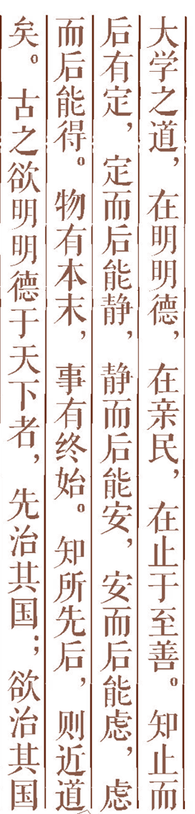


Artificial Intelligence Chapter 12 Adversarial Search

Slide 2
MAX

Slide 3
Contents:
1.Two-Agent Games-Grid-Space World
2. Minimax Procedure-- Tic-Tac-Toe
3. The Alpha-Beta Procedure
4. Search Efficiency

Slide 4
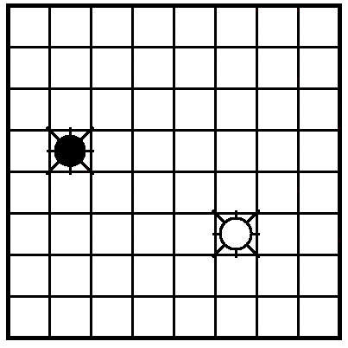
1.Two-Agent Games-Grid-Space World
-- “Black” and “White”
--The actions of the agents are interleaved.
--Goal of agents
White : to be in the same cell with Black
Black : to prevent this from happening

Slide 5
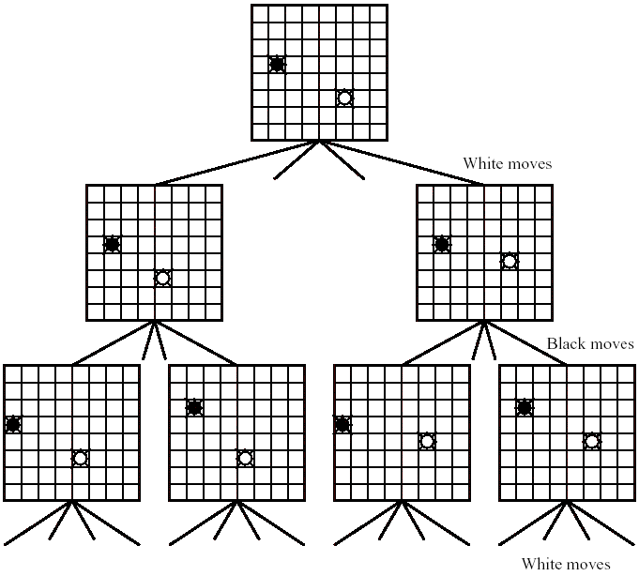
After settling on a first move, the agent makes the move, senses what the other agent does, and then repeats the planning process in sense/plan/act fashion.

Slide 6
Properties of Two-Agent Games
--two-agent, perfect information, zero-sum games
--Two agents move in turn until either one of them wins or the result is a draw.
--Each player has a complete model of the environment and of its own and the other’s possible actions and their effects.

Slide 7
2. Minimax Procedure-- Tic-Tac-Toe
Two player : MAX and MIN
Task : find a “best” move for MAX
MAX node at even-numbered depths
MIN node at odd-numbered depths

Slide 8
Complete search of most game graphs is impossible.
For Chess, 10⁴⁰ nodes, 10²² centuries to generate the complete search graph
Heuristic search techniques do not reduce the effective branching factor sufficiently to be of much help.
Can use either breadth-first, depth-first, or heuristic methods, except that the termination conditions must be modified.

Slide 9
Estimate of the best-first move
static evaluation function to the leaf nodes--measure the “worth” of the leaf nodes.
MAX cause the evaluation function to have a positive value
MIN cause the evaluation function to have negative value
Values near zero correspond to game positions not particularly favorable to either MAX or MIN.

Slide 10
Evaluation function of Tic-Tac-Toe
Evaluation function e(p) of a position p
h1(P)_{MAX赢} = +∞
h1(P)_{MAX输} = -∞
h1(P)_{平} = ０
h1(P)_{MAX赢} = +∞
h1(P)_{MAX输} = -∞
h1(P)_{平} = ０

Slide 11
p is not a winning for either player,
e(p) = (no. of complete rows, columns, or diagonals that are still open for MAX) - (no. of complete rows, columns, or diagonals that are still open for MIN)
h(p)_{MAX} = 6 – 4 = 2
h(p)_{MＩＮ} = 4 – 6 = - 2

Slide 12
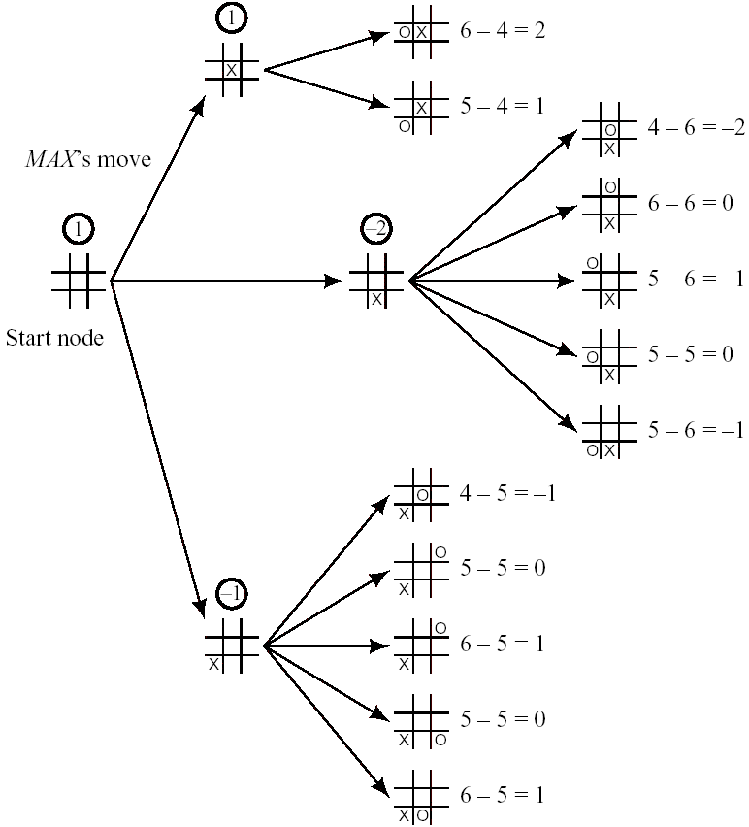
First move

Slide 13
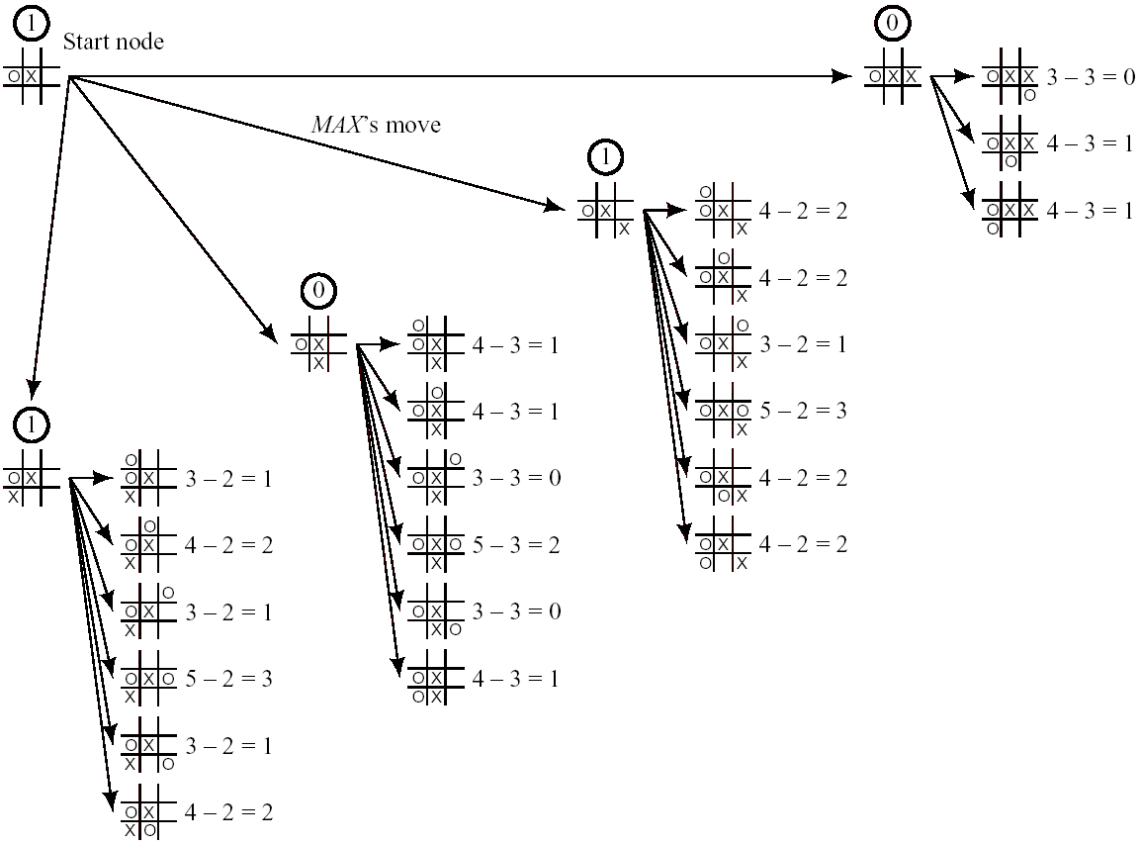

Slide 14
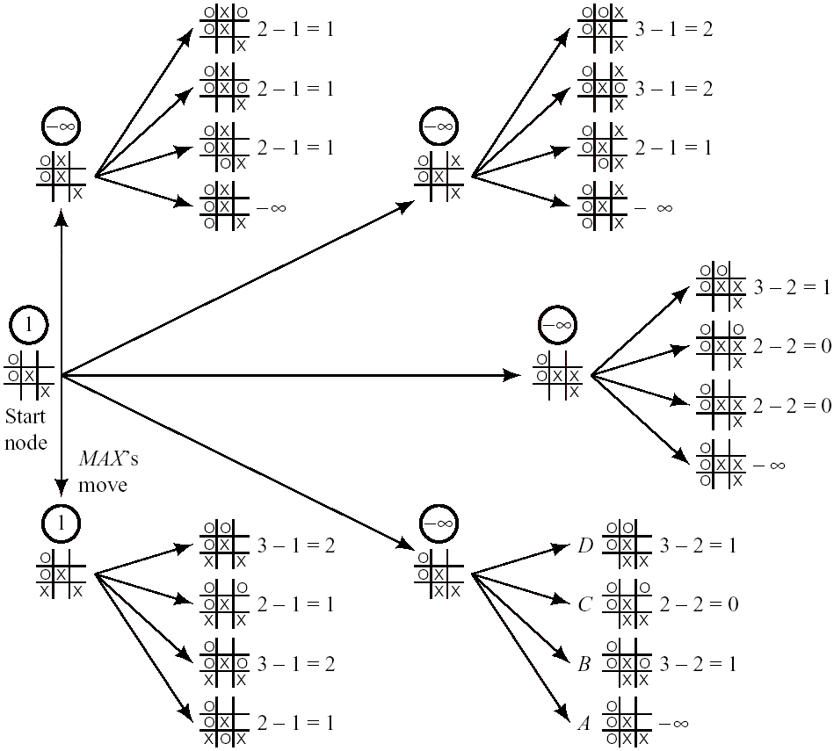

Slide 15
MAX-MIN Algorithm
Function MAX-MIN-DECISION(state) returns an action
inputs: state (current state in game)
v← MAX-VALUE(state)
return the action in SUCCESSORS(state) with value v
Function MAX-VALUE(state) returns a utility value
if TERMINAL-TEST(state) then return UTILITY(state)
v← -∞
for a, s in SUCCESSORS(state) do v← MAX(v, MIN-VALUE(s))
return v (a=action招数)
Function MIN-VALUE(state) returns a utility value
if TERMINAL-TEST(state) then return UTILITY(state)
v← +∞
for a, s in SUCCESSORS(state) do v← MIN(v, MAX-VALUE(s))
return v

Slide 16
3. The Alpha-Beta Procedure
h(3) ≤ 17
h(3) ≥ 25

Slide 17
The alpha values of MAX nodes can never decrease.
n
n1

Slide 18
The Beta value of MIN nodes can never increase.
n
n1

Slide 19
Alpha cut-off: Search can be discontinued below any MIN node having a beta value less than or equal to the alpha value of any of its MAX node ancestors.
m
α值
β值

Slide 20
Alpha cut-off: Search can be discontinued below any MIN node having a beta value less than or equal to the alpha value of any of its MAX node ancestors.
m
α值
β值

Slide 21
Beta cut-off: Search can be discontinued below any MAX node having an alpha value greater than or equal to the beta value of any of its MIN node ancestors.
m
β值
α值

Slide 22
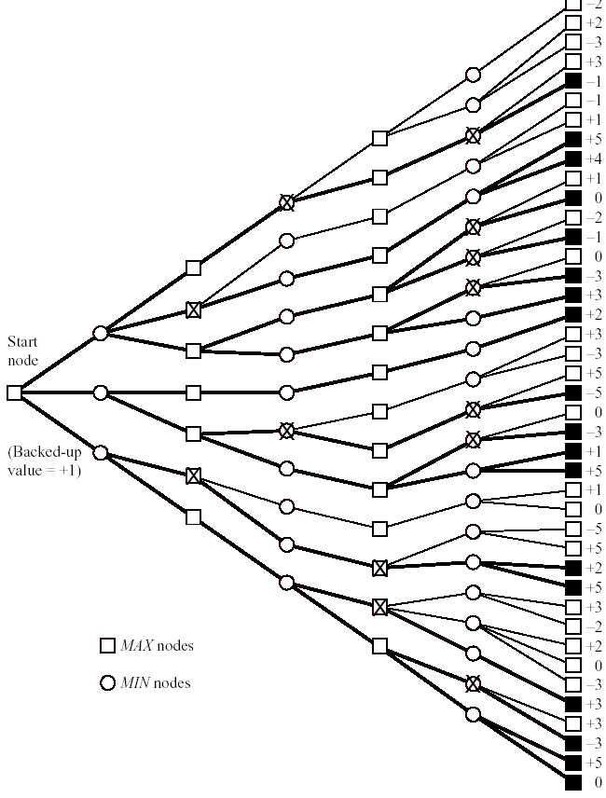

Slide 23
α-β algorithm
Function MAX-VALUE(state,α, β ) returns a utility value
inputs: state
α, the value of the best alternative for MAX along the path to state
β, the value of the best alternative for MIN along the path to state
if TERMINAL-TEST(state) then return UTILITY(state)
v← -∞
for a, s in SUCCESSORS(state) do
v← MAX(v, MIN-VALUE(s,α, β ))
if v≥β then return v
α ← MAX(α, v)
return v

Slide 24
4 Search Efficiency
Notation
b : depth of tree
d : number of successors of every node (except a tip node)
b^{d} : number of tip nodes
Suppose that an alpha-beta procedure generated successors in the order of their true backed-up values.
This order maximizes the number of cut-offs that will minimizes the number of tip nodes generated.
N_{d} : this minimal number of tip nodes

Slide 25
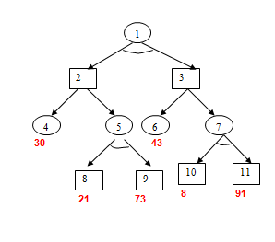
Exc.

