Slide 1


Char 2: Uninformed Search

Slide 2





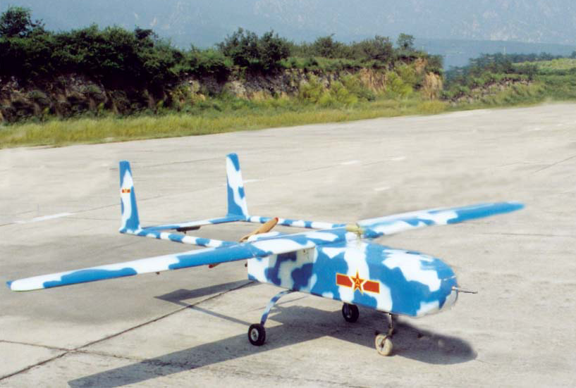
What is AI?

Slide 3

CONTENT
1.Motivation
2.Uninformed search?
3.Uninformed search methods
1. Depth-first search
2. Breadth-first search
3. Iterative deepening search
4. Bi-directional search

Slide 4
Objectives:
You should
be able to formulate a search problem.
be able to evaluate a search algorithm on the basis of completeness, optimality, time complexity, and space complexity.
be able to compare, contrast, classify, and implement various search algorithms including breadth-first, uniform-cost, depth-first, depth-limited, iterative deepening, bi-directional.

Slide 5

1. Motivation
Search strategies are important methods for
many approaches to problem-solving
The use of search requires an abstract
formulation of the problem and the available
steps to construct solutions.
Search algorithms are the basis for many
optimization and planning methods.

Slide 6
Problem solving by search
Represent the problem as STATES and OPERATORS that transform one
state into another state. A solution to the problem is an OPERATOR
SEQUENCE that transforms the INITIAL STATE into a GOAL STATE.
Finding the sequence requires SEARCHING the STATE SPACE by
GENERATING the paths connecting the two.
Notes:
引导学员思考经销商管理的方面，注重框架性思维的培训

Slide 7
many problems can be viewed as reaching a goal state from a given starting point
often there is an underlying state space that defines the problem and its possible solutions in a more formal way
the space can be traversed by applying operators to proceed from one state to the next

Slide 8
formulate appropriate problems as search tasks
initial state, goal state, operators, cost
know the fundamental search strategies and algorithms
uninformed search
breadth-first, depth-first, uniform-cost, iterative deepening, bi-directional
informed search
best-first (greedy, A*), heuristics, memory-bounded, iterative improvement
evaluate the suitability of a search strategy for a problem
completeness, time & space complexity, optimality

Slide 9
Basic concepts (1)
State: finite representation of the world at a given time.
Operator: a function that transforms a state into another (also called rule, transition, successor function, production, action).
Initial state: world state at the beginning.
Goal state: desired world state (can be several)
Goal test: test to determine if the goal has been reached.
Solution: The sequence of actions that get you from the initial state to the goal state.

Slide 10
Reachable state: a state for which there exists a sequence of operators to reach it.
State space: set of all reachable states from initial state (possibly infinite).
Cost function: a function that assigns a cost to each operation.
Performance:
cost of the final operator sequence
cost of finding the sequence

Slide 11
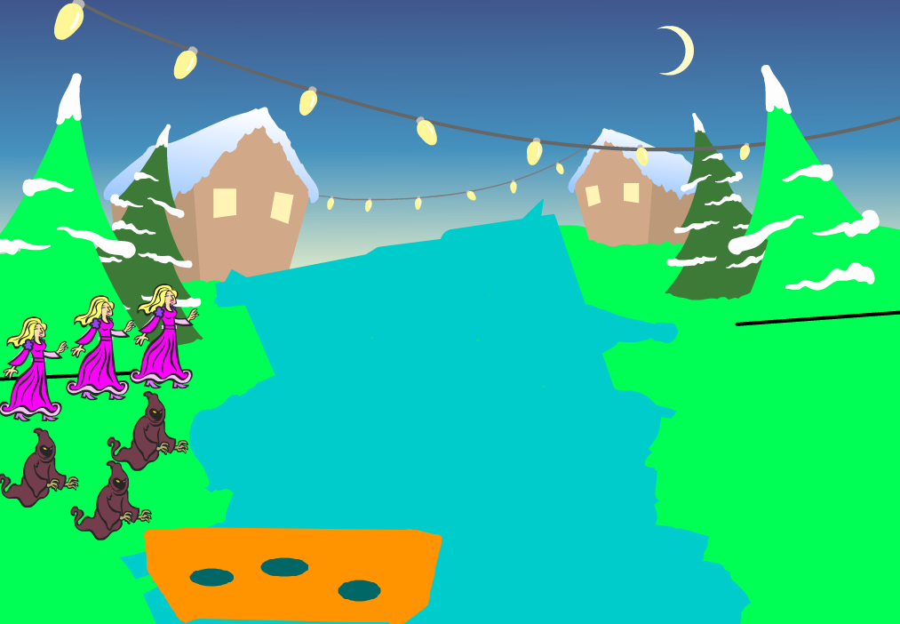
Example: the missionaries and wildlings crossing the river problem
S0=(3,3,1) | S1=(3,2,1) | S2=(3,1,1) | S3=(3,0,1)
S4=(3,3,0) | S5=(3,2,0) | S6=(3,1,0) | S7=(3,0,0)
S8=(2,3,1) | S9=(2,2,1) | S10=(2,1,1) | S11=(2,0,1)
S12=(2,3,0) | S13=(2,2,0) | S14=(2,1,0) | S15=(2,0,0)
S16=(1,3,1) | S17=(1,2,1) | S18=(1,1,1) | S19=(1,0,1)
S20=(1,3,0) | S21=(1,2,0) | S22=(1,1,0) | S23=(1,0,0)
S24=(0,3,1) | S25=(0,2,1) | S26=(0,1,1) | S27=(0,0,1)
S28=(0,3,0) | S29=(0,2,0) | S30=(0,1,0) | S31=(0,0,0)
States: S=(Nx,Ny,C)
State set:

Slide 12
Operators:
L(1,0), L(2,0), L(1,1), L(0,1), L(0,2)
R(1,0), R(2,0), R(1,1), R(0,1), R(0,2)

Slide 13
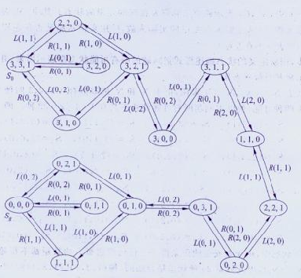
Search Graph

Slide 14
Uninformed Search?
Simply searches the state space.
Can only distinguish between goal state and
non-goal state.
Sometimes called Blind search as it has no
information or knowledge about its domain.
Notes:
引导学员思考经销商管理的方面，注重框架性思维的培训

Slide 15
Uninformed Search Characteristics
Blind Searches have no preference as to which state (node) that is expanded next
The different types of blind searches are characterised by the order in which they expand the nodes.
This can have a dramatic effect on how well the search performs when measured against the four criteria we defined in an earlier lecture

Slide 16
Uninformed (Blind) Search Methods
Methods that do not use any specific knowledge
about the problem.
These are:
Depth-first search
Breadth-first search
Non deterministic search
Iterative deepening search
Bi-directional search

Slide 17
1. Depth-first Search
Expand the tree as deep as possible, returning to upper levels when needed.

Slide 18
Depth-first search= Chronological backtracking
S
Select a child
convention: left-to-right
Repeatedly go to next child, as long as possible.
Return to left-over alternatives (higher-up) only when needed.
A
B
C
E
D
F
G
ICS611

Slide 19
8-puzzle example
depth bound: 5
operator order: left → up → right → down
2
8
3
1
2
3
1
6
4
8
4
7
5
7
6
5

Slide 20
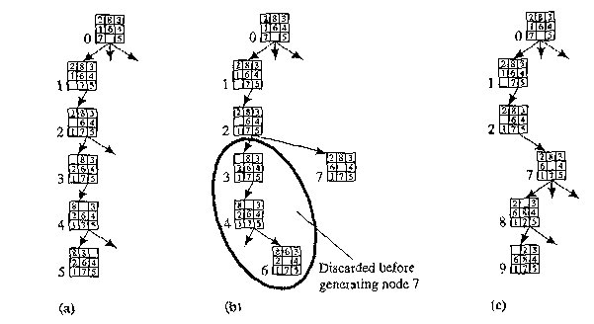

Slide 21
Depth-first algorithm:
1. QUEUE <-- path only containing the root;
2. WHILE QUEUE is not empty
AND goal is not reached
DO remove the first path from the QUEUE;
create new paths (to all children);
reject the new paths with loops;
add the new paths to front of QUEUE;
3. IF goal reached
THEN success;
ELSE failure;

Slide 22
4
4
3
A
B
C
S
5
5
G
4
3
D
2
E
4
F
1. QUEUE <-- path only containing the root;
2. WHILE QUEUE is not empty
AND goal is not reached
DO remove the first path from the QUEUE;
create new paths (to all children);
reject the new paths with loops;
add the new paths to front of QUEUE;
3. IF goal reached
THEN success;
ELSE failure;
ICS611

Slide 23
Trace of depth-first for running example:
(S) S removed, (SA,SD) computed and added
(SA, SD) SA removed, (SAB,SAD,SAS) computed, (SAB,SAD) added
(SAB,SAD,SD) SAB removed, (SABA,SABC,SABE) computed, (SABC,SABE) added
(SABC,SABE,SAD,SD) SABC removed, (SABCB) computed, nothing added
(SABE,SAD,SD) SABE removed, (SABEB,SABED,SABEF) computed, (SABED,SABEF)added
(SABED,SABEF,SAD,SD) SABED removed, (SABEDS,SABEDA.SABEDE) computed, nothing added
(SABEF,SAD,SD) SABEF removed, (SABEFE,SABEFG) computed, (SABEFG) added
(SABEFG,SAD,SD) goal is reached: reports success
ICS611

Slide 24
Evaluation criteria:
Completeness
Does the algorithm always find a path?
(for every state space such that a path exits)
Speed (worst time complexity) :
What is the highest number of nodes that may need to be created?
Memory (worst space complexity) :
What is the largest amount of nodes that may need to be stored?
Expressed in terms of:
d = depth of the tree
b = (average) branching factor of the tree
m = depth of the shallowest solution

Slide 25
Note: approximations !!
In our complexity analysis, we do not take the built-in loop-detection into account.
The results only ‘formally’ apply to the variants of our algorithms WITHOUT loop-checks.
Studying the effect of the loop-checking on the complexity is hard:
overhead of the checking MAY or MAY NOT be compensated by the reduction of the size of the tree.
Also: our analysis DOES NOT take the length (space) of representing paths into account !!

Slide 26
Completeness (depth-first)
Complete??
No: fails in infinite-depth spaces, spaces with loops
Modify to avoid repeated states along path ⇒ complete in finite spaces
IMPORTANT:
This is due to integration of LOOP-checking in this version of Depth-First (and in all other algorithms that will follow) !
IF we do not remove paths with loops, then Depth-First is not complete (may get trapped in loops of a finite State space)
Note: does NOT find the shortest path.

Slide 27
4
4
3
A
B
C
S
5
5
G
4
3
D
2
E
F
3
S
4
4
A
D
2
5
5
B
D
A
E
4
5
2
4
5
4
C
2
E
4
5
E
B
B
F
4
4
5
4
4
3
D
F
B
F
C
E
A
C
G
3
4
3
4
G
C
G
F
3
G

Slide 28
Speed (depth-first)
In the worst case:
the (only) goal node may be on the right-most branch,
d
b
G
Time complexity == b^{d} + b^{d-1} + … + 1 = b^{d+1} -1
Thus: O(b^{d})
b - 1

Slide 29
Memory (depth-first)
Largest number of nodes in QUEUE is reached in bottom left-most node.
Example: d = 3, b = 3 :
...
QUEUE contains all nodes. Thus: 7.
In General: ((b-1) * d) + 1
Order: O(d*b)

Slide 30
2. Breadth-first Search
Expand the tree layer by layer, progressing in depth.
In other words,
Expand root node first
Expand all nodes at level 1 before expanding level 2
OR
Expand all nodes at level d before expanding nodes at level d+1

Slide 31
Breadth-First Search

Slide 32
Breadth-first search:
S
A
Move downwards, level by level, until goal is reached.
D
B
D
A
E
C
E
E
B
B
F
D
F
B
F
C
E
A
C
G
G
C
G
F
G

Slide 33
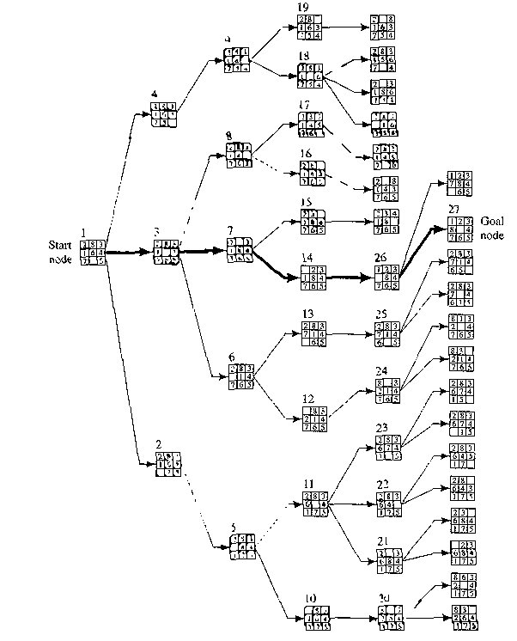

Slide 34
Breadth-first algorithm:
1. QUEUE <-- path only containing the root;
2. WHILE QUEUE is not empty
AND goal is not reached
DO remove the first path from the QUEUE;
create new paths (to all children);
reject the new paths with loops;
add the new paths to back of QUEUE;
3. IF goal reached
THEN success;
ELSE failure;
ONLY
DIFFERENCE !

Slide 35
Trace of breadth-first for running example:
(S) S removed, (SA,SD) computed and added
(SA, SD) SA removed, (SAB,SAD,SAS) computed, (SAB,SAD) added
(SD,SAB,SAD) SD removed, (SDA,SDE,SDS) computed, (SDA,SDE) added
(SAB,SAD,SDA,SDE) SAB removed, (SABA,SABE,SABC) computed, (SABE,SABC) added
(SAD,SDA,SDE,SABE,SABC) SAD removed, (SADS,SADA, SADE) computed, (SADE) added
etc, until QUEUE contains:
(SABED,SABEF,SADEB,SADEF,SDABC,SDABE,SDEBA,SDEBC, SDEFG) goal is reached: reports success

Slide 36
Completeness (breadth-first)
Complete
even for infinite implicit NETS !
Would even remain complete without our loop-checking.
Note: ALWAYS finds the shortest path.

Slide 37
Speed (breadth-first)
If a goal node is found on depth m of the tree, all nodes up till that depth are created.
m
d
b
G
Thus: O(b^{m})
note: depth-first would also visit deeper nodes.

Slide 38
Memory (breadth-first)
Largest number of nodes in QUEUE is reached on the level m of the goal node.
m
d
b
G
QUEUE contains all and nodes. (Thus: 4) .
In General: b^{m}
This usually is MUCH worse than depth-first !!
G

Slide 39
Exponential Growth (breadth-first)
Time and memory requirements for breadth-first search, assuming a branching factor of 10, 100 bytes per node and searching 1000 nodes/second

Slide 40
Exponential Growth - Observations
Space is more of a factor to breadth first search than time
Time is still an issue. Who has 35 years to wait for an answer to a level 12 problem (or even 128 days to a level 10 problem)
It could be argued that as technology gets faster then exponential growth will not be a problem. But even if technology is 100 times faster we would still have to wait 35 years for a level 14 problem and what if we hit a level 15 problem!

Slide 41
Practical evaluation:
1.Depth-first search:
IF the search space contains very deep branches without solution, THEN Depth-first may waist much time in them.
2. Breadth-first search:
Is VERY demanding on memory !
Solutions ??
Non-deterministic search
Iterative deepening

Slide 42
Non-deterministic search:
1. QUEUE <-- path only containing the root;
2. WHILE QUEUE is not empty
AND goal is not reached
DO remove the first path from the QUEUE;
create new paths (to all children);
reject the new paths with loops;
add the new paths in random places in QUEUE;
3. IF goal reached
THEN success;
ELSE failure;

Slide 43
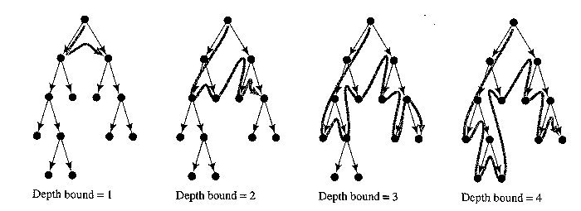
3. Iterative deepening Search
Restrict a depth-first search to a fixed depth.
If no path was found, increase the depth and restart the search.

Slide 44
Depth-limited search:
1. DEPTH <-- <some natural number>
QUEUE <-- path only containing the root;
2. WHILE QUEUE is not empty
AND goal is not reached
DO remove the first path from the QUEUE;
IF path has length smaller than DEPTH
create new paths (to all children);
reject the new paths with loops;
add the new paths to front of QUEUE;
3. IF goal reached
THEN success;
ELSE failure;

Slide 45
Iterative deepening algorithm:
1. DEPTH <-- 1
2. WHILE goal is not reached
DO perform Depth-limited search;
increase DEPTH by 1;

Slide 46
Iterative deepening: the best ‘blind’ search.
Complete: yes - even finds the shortest path (like breadth first) .
Memory: b*m (combines advantages of depth- and breadth-first)
Speed:
If the path is found for Depth = m, then how much time was waisted constructing the smaller trees??
b^{m-1} + b^{m-2} + … + 1 = b^{m} -1 = O(b^{m-1})
b - 1
While the work spent at DEPTH = m itself is O(b^{m})
In general: VERY good trade-off

Slide 47
4. Bi-directional Search
Compute the tree from the start node and from a goal node, until these meet.
IF you are able to EXPLICITLY describe the GOAL state, AND
you have BOTH rules for FORWARD reasoning AND BACKWARD reasoning:
Goal
Start

Slide 48
Bi-directional algorithm:
1. QUEUE1 <-- path only containing the root;
QUEUE2 <-- path only containing the goal;
2. WHILE both QUEUEi are not empty
AND QUEUE1 and QUEUE2 do NOT share a state
DO remove their first paths;
create their new paths (to all children);
reject their new paths with loops;
add their new paths to back;
3. IF QUEUE1 and QUEUE2 share a state
THEN success;
ELSE failure;

Slide 49
Properties (Bi-directional):
Complete: Yes.
Speed: If the test on common state can be done in constant time (hashing):
2 * O(b^{m/2}) = O(b^{m/2})
Memory: similarly: O(b^{m/2})

Slide 50
