Slide 1


Chapter 14 Resolution in the Propositional Calculus

Slide 2
Overview
2. Knowledge Representation and Reasoning
2.2 Resolution in Propositional Calculus
Notes:
引导学员思考经销商管理的方面，注重框架性思维的培训

Slide 3

14 Resolution in Prop Cal
Resolution inference rule
Conversion to CNF
Refutations
Refutation Search Strategies
Horn Clauses

Slide 4

4.1 Resolution rule
Combination of earlier rules
applied to clauses
Clause
disjunction of literals
alternatively: set of literals
special case: empty clause (False)

Slide 5
Resolution of clauses
From
C1 = {λ} ∪ Σ1 and C2 = {¬λ} ∪ Σ2
infer
C = Σ1 ∪ Σ2
C is a resolvent of C1 and C2
λ: atom resolved upon

Slide 6
Soundness
If {λ} ∪ Σ1 & {¬λ} ∪ Σ2 are true
then Σ1 ∪ Σ2 is, too
How?
λ is either true or false
true: Σ2 must be true
false: Σ1 must be true
→ whatever the value, Σ1 ∪ Σ2 is true
can also be shown with truth table

Slide 7
14.2 Conversion to CNF
Aim
take any wff
convert it to conjunction of clauses
in order to use resolution inference
How?
eliminate implications
push negations in (DeM, elimination)
use assoc & distrib laws

Slide 8
Procedure for step 3
Write DNF wffs as a matrix
rows: literals of each conjunct
select a literal in each row
make a disjunction (clause) of these
make all possible selections
result: conjunction of these
Simplifications
absorption, P v ¬P
Subsumption: keep the `strongest’ one

Slide 9
14.3 Resolution refutations
Resolution: sound, not complete
P ∧ R |= P ∨ R
What we can show, is that
negation of P ∨ R (¬P ∧ ¬R) is inconsistent with P ∧ R
and thus (by contradiction) that P ∧ R |= P ∨ R

Slide 10
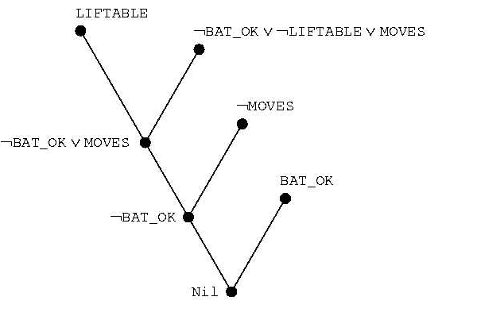
Resolution Refutation Tree

Slide 11
General procedure
Aim: show that Δ |= ω
convert Δ to set of clauses
convert ¬ ω to clause form
combine the above to a single set Γ
apply (iteratively) resolution to Γ
add results to Γ
until an empty clause is produced
or Γ does not change any more

Slide 12
Known results
Completeness of resolution
if Δ |= ω then
resolution refutatation will (eventually) produce the empty clause
resolution is refutation complete
Decidability of Prop Calc
if Δ is finite and not Δ |= ω then
refutation procedure terminates without producing the empty clause

Slide 13
14.4 Search strategies
How to efficiently
perform resolutions until empty clause is inferred
not all possible resolutions are essential in deriving the empty clause
Ordering strategies
which clauses should be used = ’which node to expand next’
terminology
original clauses: 0th level resolvents
(i + 1)th level: resolvent of ith & jth (j < i)

Slide 14
14.4.1 Ordering…
Breadth-first strategy
work level by level
Depth-first
clause with highest level (with choices left)
Unit preference
prefer clauses consisting of a single literal
only these make the resulting clauses shorter

Slide 15
14.4.2 Refinement strategies
Only certain resolutions allowed
don’t say anything about ordering
some complete, some not
Set of support
C2 is a descendant clause of C1 if C2 is a resolvent of either
C1 and some other clause
a descendant of C1 and some other clause
strategy
Let S = ¬ ω and it’s descendants
choose other clause always from S
complete!

Slide 16
Refinement strategies...
Linear Input (aka linear resolution)
at least one clause is from the original set
not refutation complete
Ancestry filtering: one clause is
either member of the original set
or ancestor of the other clause
refutation complete

Slide 17
14.5 Horn Clauses
Special type of a clause
at most one positive literal
Three types
facts (single atoms)
rules (one pos, m > 0 neg)
queries, goals (all neg)

