Slide 1
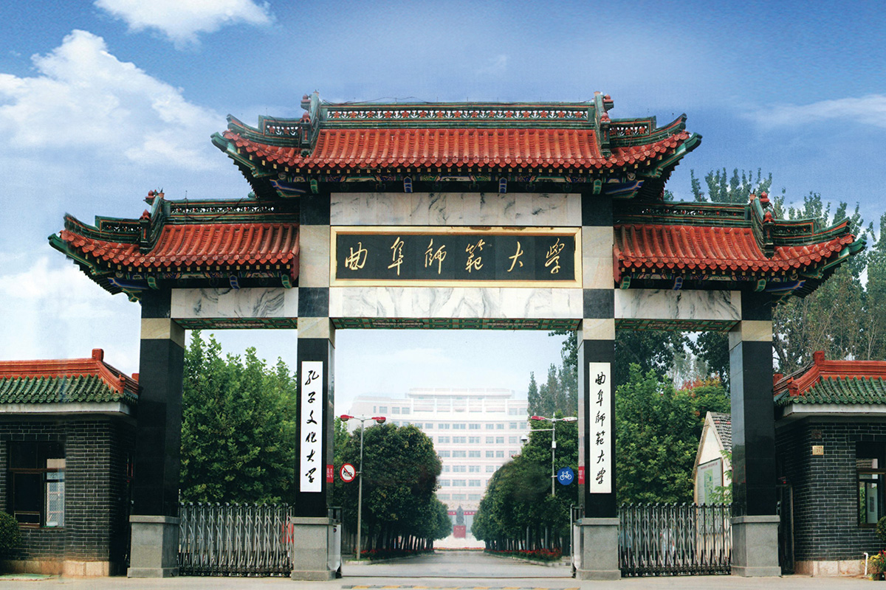

Chapter 15 The Predicate Calculus

Slide 2
Overview
2 Knowledge Representation and Reasoning
2.3 Predicate Calculus

Slide 3

15 Predicate Calculus
Motivation
Language, syntax
Semantics
Quantification
Semantics of quantifiers
Predicate Calculus as a language for KR

Slide 4

15.1 Motivation
Anyone passing the artificial intelligence
exam and winning the lottery is happy.
2) But anyone who studies or is lucky can pass all their exams.
3) Bush did not study but he is lucky.
4) Anyone who is lucky wins the lottery.
How to translate the statements into Propostions in PC?

Slide 5
15.1 Motivation
Limitations in prop. calculus
block_b same as block_b_on_c?
atoms: no internal structure
on_a_b & on_b_c have nothing in common
we need a language that can refer to objects in the world (as well as make claims about it)

Slide 6
Talking about objects…
on_b_c => ¬clear_c (etc.)
on(x,y) => ¬clear(y) !!??
Language with this capability
1st order predicate calculus
symbols for objects, relations and functions (and variables)

Slide 7
15.2 Language & syntax
Components (alphabet)
object constants
function constants (arity)
relation constants (arity)
logical connectives, parentheses, comma
Language will be extended later
Notes:
引导学员思考经销商管理的方面，注重框架性思维的培训

Slide 8
Terms & wffs
Terms (words of the language)
Object constants are terms
If f is a n-ary function and t1,…,tn are terms then f(t1,…,tn) is a term
Wffs
atoms: relations of n terms (arity)
sentences built from atoms and logical connectives

Slide 9
15.3 Semantics
15.3.1 Worlds
What we can talk about?
individuals of the world
anything we can name with an object constant
functions on individuals
map n individuals to an individual
relations over individuals
sets of n-tuples
unary relations: properties

Slide 10
15.3.2 Interpretations
Value assignment of constants
objects → objects in the world etc.
denotation: set of such assignments
domain: set of objects to which we assign the constants
Value of atoms
True iff the relation holds in the world

Slide 11
Example
Blocks world
individuals A, B, C, Floor
relations On/2 and Clear/1
Fig 15.1 & Table 15.1
On(A,B), Clear(B), On(C,Fl)
On(C,Fl) ∧ ¬ On(A,B)

Slide 12
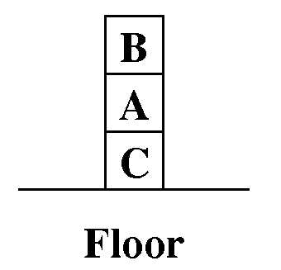
Mapping between Predicate Calculus & World
Predicate calculus
World
A
B
C
Floor
On={<B,A>, <A,C>, <C,Floor>}
Clear={<B>}
Notes:
引导学员思考经销商管理的方面，注重框架性思维的培训

Slide 13
15.3.3 Models & such
Same definitions as in prop case
wff S is true in I: I satisfies S
interpretations satisfying wff S are models of S
S true in all interpretations: valid
S false in all: inconsistent
logical entailment
logical equivalence

Slide 14
15.3.4 Knowledge
Set of formulas Δ: knowledge of agent
a.k.a knowledge base
ω∈Δ: agent ‘knows’ ω
Fig 15.2: 3 models for ‘knowledge’
note: not necessary to bind object names to blocks world
the more formulas the less models

Slide 15
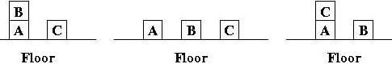
Three Blocks-World Situations

Slide 16
15.4 Quantification
Want to say
every object has certain property: ‘infinite conjunction’
at least one object has certain property: ‘infinite disjunction’
Way to do it
variable symbols & quantification

Slide 17
More syntax...
Variable symbols (terms, too)
‘unknown but unique’ individuals
Quantification symbols
∀: universal (all)
∃: existential (exists)
Wff
x variable & S wff: ((Qx) S) is a wff
closed wffs

Slide 18
Things to note
(∀ x)(∀ y) S ≡ (∀ y)(∀ x) S
→ we can abbreviate (∀ x, y) S
similarly (∃ x)(∃ y) S ≡ (∃ y)(∃ x) S
Mixtures don’t work this way
(∀ x)(∃ y) S NOT eq. (∃ y)(∀ x) S
(∃ x)(∀ y) S NOT eq. (∀ y)(∃ x) S
Renaming
Higher order logics?

Slide 19
15.5 Semantics of quantifiers
15.5.1 Universal quantifiers
(∀ x) S is true
in some given interpretation
iff S is true for all possible assignments of x to objects in the domain
Example
(∀ x) (On(x,C) ⊃ ¬Clear(C))
true in Fig 15.2?

Slide 20
15.5.2 Existential quantifiers
Semantics...
(∃ x) S is true
in some given interpretation
iff S is true in at least one assignment of x to objects in the domain
Equivalences
DeMorgan laws
Variable renaming

Slide 21
15.5.4 Rules of Inference
Old rules work
generalizations of Prop Calc
New rules
Universal instantiation
Existential generalization
Both sound

Slide 22
15.6 Pred Calc as a language for KR
Major problem of AI (or KR)
what to say, not how to say it
we have a language for representing and reasoning
how to use it?
Conceptualization: first step in KR
conceptualize the world in terms of objects, functions and relations
many possibilities, some better

Slide 23
15.6.1 Conceptualization
Next step
invent predicate calculus expressions
intended meaning: the concepts we just found
Final step
write wffs that are satisfied in our intended world
if our knowledge precludes some interpretation, it should not be a model

Slide 24
Grounding
Robot (agent) applications
at least some facts have to be known true or false
sensory inputs!
grounding of atoms
other atoms defined via these primitive ones
Mathematic/theoretical apps can work without grounding

Slide 25
15.6.2 Examples
Package delivery in an office
Necessary concepts
property of being a package: Package(p)
location of objects: Inroom(p,r)
size (being smaller): Smaller(p1,p2)
Sample statements
“All packages in room 27 are smaller than ones in 28”
“Every package in 27 is smaller than one of the ones in 27” (ambiguous!)

Slide 26
Examples...
Notion of time?
Package A arrived before B
Arrived(p, t), Before(t1, t2)
Conceptualization is not easy
How to deal with mass nouns?
“A in 28 contains one quart of milk”
is ’milk’ an object with properties (color)
what if it’s made of 2 pints (= 1 quart)
2 objects or one?

Slide 27
Discussion
Much debate
Is (predicate) logic is an appropriate language for KR?
one reason: formal (Tarski) semantics does not always ’match’ with real-world knowledge
At least many working real-life applications exist

