Slide 1
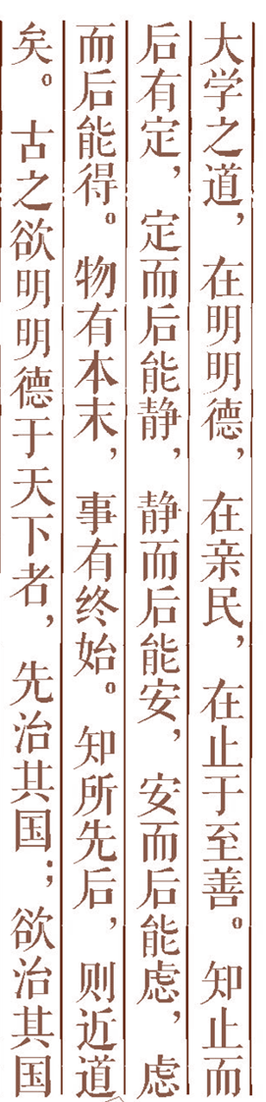


Resolution Theorem Proving in the Predicate Calculus 谓词演算中的归结定理证明

Slide 2
Think hard the following questions
Question one
Statements:
1) “Maomao is a dog.” and
2) “all dogs are animals.” and
3) “all animals will die.”
How to prove that “Maomao will die.”

Slide 3
Question two
Facts:
Anyone passing the
artificial intelligence
exam and winning the
lottery is happy.
2) But anyone who studies or is lucky can pass all their exams.
3) Bush did not study but he is lucky.
4) Anyone who is lucky wins the lottery.
Goal: Is Bush happy?

Slide 4
Question three
Facts:1) The robot knows that all of the packages in room 27 are smaller than any of the ones in room 28.
2) The robot knows that package A is either in room 27 or in room 28(but not which).
3) It knows that package B is in room 27 and that package B is not smaller than package A.
Goal:Which Room is package A in? .

Slide 5
问题的谓词语言描述
W1 ∧ W2 ∧ … ∧ Wn |=w
“W1 ∧ W2 ∧ … ∧ Wn→w ”是永真式；
“¬ (W1 ∧ W2 ∧ … ∧ Wn) ∨ w ”是永真式；
“ ¬[¬(W1 ∧ W2 ∧ … ∧ Wn) ∨ w] ”是永假式或不可满足的；
“W1 ∧ W2 ∧ … ∧ Wn ∧¬w ”是永假式或矛盾式或不可满足的。
符号说明： ¬和~都表示否定；

Slide 6
Resolution in the Predicate Calculus
Resolution Refutation(归结反演)
Answer Extraction (答案提取)
Additional Readings and Discussion

Slide 7

Resolution in the Predicate Calculus
1.1 Key idea of the resolution in the predicate calculus
1.2 Discuss about resolution
1.3 Using Resolution to Prove
Theorem(定理)

Slide 8
1.1 Key idea of the resolution
Key idea: From two parent clauses we can infer a new clause, called the resolvent(归结式) of the two. The resolvent is computed by taking the disjunction of the two clauses and then eliminating the complimentary pair.
A ∨ B
~B
A
if we know the first two has to
be true,then A has to be true.

Slide 9
思考
Consider clauses：
P(f(y),A) ∨ Q(B,C)
~ P(x,A) ∨ R(x,C)

Slide 10
If we have a literal λ(ξ) in one clause and a literal ~λ(τ) in another clause,where τ is a term that does not contain ξ,substitute τ for ξ in the first clause and resolve.

Slide 11
Substitution(置换)
Substitution is denoted by a set of ordered pairs:
s = [τ1/ξ1, τ2/ξ2, . . . , τn/ξn]
τ i/ξi means that τi replaces ξi in the scope of the substitution.
注意： ξi 一定不能在τ I中出现。

Slide 12
Unifiable expressions
Two expressions ω1 and ω2 are unifiable, if there exists a substitution s such that ω1s = ω2s.

Slide 13
1.2 Discuss about Resolution
Resolution is a technique for proving theorems in the predicate calculus.
Resolution is a sound inference rule, when used to produce a refutation, is also complete.

Slide 14
1.3 Using Resolution to Prove Theorem
How to prove Δ|= ω:
Step 1. Negate ω,
Step 2. Convert this negation to clause form,
Step 3. Add it to the clause form of Δ.
Step 4. Then apply resolution until the empty
clause is deduced.

Slide 15
思考题
Step 4. Then apply resolution until the empty clause is deduced.
为什么说产生空子句，就说明Δ|= ω.

Slide 16
Resolution Refutation(归结反演)
2.1 Key Idea of Resolution Refutation;
2.2 Resolution Refutation Procedure;
2.3 Discuss about Resolution Refutation;
2.4 Example;
2.5 Simplification Strategies

Slide 17
2.1 Key idea
Theorem proving systems are designed to produce proofs by contradiction or refutation. In resolution refutation, we first negate the goal wff and then attempt to derive a contradiction.
Resolution Refutation Systems are based in the following principle:
Γ |= ϕ iff Γ ∪ {~ϕ} |= contradiction.

Slide 18
2.2 Resolution refutation procedure
In general, to prove Γ |= ϕ, proceeds as follows:
1. Convert the wffs in Γ to clausal form?.
2. Negate the formula ϕ to be proved and convert the resulting formula, ~ ϕ to clausal form.

Slide 19
3. Combine the clauses resulting form steps 1 and 2 into a single set, Δ.
4. Iteratively apply resolution to the clauses in Δ and add the results to Δ either until there are no more resolvents that can be added or until the empty clause is produced.

Slide 20
Note: What is clausal form?
A formula is in clausal form if it is in PCNF(前束合取范式) and the prefix consists only of universal quantifiers（全称量词）.
A formula is in prenex conjunctive normal form (PCNF) if it has the form Q1x1 _____ QnxnM, where the Qi are quantifiers and M is quantifier-free formula in conjunctive normal form. The sequence of quantifiers is called the prefix （前缀）and M is called the matrix（母式）.

Slide 21
How to convert a wff to clausal form
Eliminate implication signs
e.g ∀x (Human(x) →∃y Is-father(y,x))
⇒ ∀x (¬Human(x)∨∃y Is-father(y,x))
2. Reduce scope of negation signs
∀x (¬Human(x)∨∃y Is-father(y,x))
3. Standardize variables, so that each quantifier has its own variable symbol.
∀x (¬Human(x)∨∃y Is-father(y,x))
4. Eliminate existential quantifiers by introducing Skolem functions
∀x (¬Human(x)∨Is-father(f(x),x))

Slide 22
5. Convert to prenex form
6. Put the matrix in Conjunctive Normal Form
7. Eliminate universal quantifiers
8. Eliminate ∧ symbols by treating wffs as sets of clauses

Slide 23
2.3 Discuss about resolution refutation
Important results
Completeness of resolution refutation:
the empty clause will be produced by the resolution refutation procedure if Γ |= ϕ, thus we say that predicate calculus resolution is refutation complete.
Decidability of predicate calculus resolution refutation: We say that resolution refutation in predicate calculus is semi-decidable as it terminates by generating the empty clause if Γ |= ϕ, but it may never terminate if Γ |≠ ϕ.

Slide 24
2.4 Examples e.g 1
Statements:
1) “Fido is a dog.” and
2) “All dogs are animals.” and
3) “All animals will die.”
We wish to prove that “Fido will die”.

Slide 25
Step1:Convert these Statements to wffs
Statements | Well-formed Formulas
1) Fido is a dog. | Dog(Fido)
2) All dogs are animals. | x: [Dog(x)→Animal(x)]
3) All animals will die. | y:[Animal(y) →Die(y)]

Slide 26
Step2: Convert these wffs to clause form:
Predicate Form | Clause Form
x: [Dog(x)→Animal(x)] | ¬ Dog(x) V Animal(x)
Dog(Fido) | Dog(Fido)
y:[Animal(y) →Die(y)] | ¬ Animal(y) V Die(y)

Slide 27
Step3: Negate the conclusion
Negation of the conclusion “Fido will die” is ¬die(Fido).

Slide 28
Step4: Resolution refutation procedure
1.¬Dog(x) V Animal(x)
2. Dog(Fido)
3. ¬Animal(y) V Die(y)
4.¬Die(Fido)
5. Animal(Fido) 1 and 2 {Fido/x}
6. Die(Fido) 3 and 5 {Fido/y}
7. Empty Clause 4 and 6
初
始
子
句
归
结
过
程

Slide 29
Resolution refutation tree
¬Dog(x) V Animal(x) Dog(Fido)
Animal(Fido) ¬ Animal(y) V Die(y)
Die(Fido) ¬Die(Fido)
Empty Clause

Slide 30
2.4 Examples e.g 2
Facts:
1) Anyone passing the Artificial Intelligence exam and winning the lottery is happy.
2) Anyone who studies or is lucky can pass all their exams.
3) Ali did not study but he is lucky.
4) Anyone who is lucky wins the lottery.
Goal: Is Ali happy?

Slide 31
Step1:Convert these Statements to Wffs
1) Anyone passing the AI Exam and winning the lottery is happy.
X:[pass(x,AI) Λ win(x, lottery) →happy(x)]
2) Anyone who studies or is lucky can pass all their exams.
X Y [studies(x) V lucky(x) →pass(x,y)]
3) Ali did not study but he is lucky
¬ study(ali) Λ lucky(ali)
4) Anyone who is lucky wins the lottery.
X: [lucky(x) →win(x,lottery)]

Slide 32
Step2:Convert these wffs to clause form
¬pass(X,AI) V ¬win(X,lottery) V happy(X)
¬study(Y) V pass(Y,Z)
¬lucky(W) V pass(W,V)
¬study(ali)
Lucky(ali)
¬lucky(u) V win(u,lottery)

Slide 33
Step3: Negate the conclusion
Negation of “Is Ali happy?” is ¬happy(ali).

Slide 34
Step4: Resolution refutation
1.¬pass(X,AI) V ¬win(X,lottery) V happy(X)
2.¬study(Y) V pass(Y,Z)
3.¬lucky(W) V pass(W,V)
4.¬study(ali)
5.Lucky(ali)
6.¬lucky(u) V win(u,lottery)
7.¬happy(ali)
初
始
子
句

Slide 35
8. ¬pass(u,AI) V ¬lucky(u) V happy(u)
1) and 6) { u/X}
9. ¬pass(ali,AI) V ¬lucky(ali)
8) and 7) { ali/ u }
10. ¬ pass(ali,AI) 5) and 9)
11. ¬lucky(ali) 3) and 10)
12.Nil 5) and 11).
归
结
过
程

Slide 36
¬pass(X,AI) V ¬win(X,lottery) V happy(X)
{ u/X} win(u,lottery) V ¬lucky(u)
¬pass(u,AI) V happy(u) V ¬lucky(u)
{ali/u} ¬happy(ali)
lucky(ali) ¬pass(ali,AI) V ¬lucky(ali)
¬ pass(ali,AI) ¬lucky(v) V pass(v,w)
{Ali/v,AI/w}
¬lucky(ali) lucky(ali)

Slide 37
2.4 Examples e.g 3
Facts:1)The robot knows that all of the packages in room 27 are smaller than any of the ones in room 28. 2)The robot knows that package A is either in room 27 or in room 28(but not which). 3)It knows that package B is in room 27 and that package B is not smaller than package A.
Goal:The robot wants to prove that package A is in Room 27 .

Slide 38
Step1:Convert these Statements to predicates(1)
the robot knows that all of the packages in room 27 are smaller than any of the ones in room 28.
That is:
Abbreviate relations & convert to clauses

Slide 39
Step1:Convert these Statements to predicates(2)
2) the robot knows that package A is either in room 27 or in room 28(but not which). It knows that package B is in room 27 and that package B is not smaller than package A. That is:
1.
2.
3.
4.
5.

Slide 40
Step2: Negate the conclusion
The robot wants to prove that package A is in Room 27 – therefore using resolution refutation, the negated wff is:

Slide 41
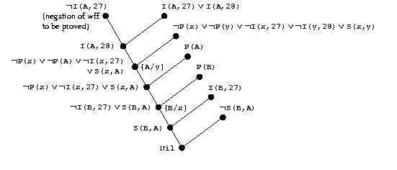
Step3: Resolution refutation

Slide 42
课堂 练习 Ex.1
Facts: 1) Whoever reads is literate.
2) Dolphins are not literate.
3) Some dolphins are intelligent.
Prove: Some who are intelligent cannot read.

Slide 43
Whoever reads is literate.
(∀x) (R(x) → L(x))
Dolphins are not literate
(∀x) (D(x) → ~L(x))
Some dolphins are intelligent
(∃x) (D(x) ∧ I(x))
Prove: Some who are intelligent cannot read.
(∃x) (I(x) ∧ ~R(x))

Slide 44
Clause form
~ R(x) ∨ L(x): (∀x) (R(x) → L(x))
2) ~ D(y) ∨ ~L(y) : (∀x) (D(x) → ~L(x))
3) D(a) : (∃x) (D(x) ∧ I(x))
4) I(a)
5) ~ I(z) ∨ R(z) : (∃x) (I(x) ∧ ~R(x))

Slide 45
Resolution refutation
⑤~ I(z) ∨ R(z) : ④ I(a)
{a/z}
~R(a) ① ~ R(x) ∨ L(x)
{a/x}
L(a) ② ~ D(y) ∨ ~L(y)
{a/y}
~ D(a) ③ D(a)
Nil

Slide 46
Ex.2
1.Tiger and savages animals are fierce or destructives.
2.If there is something destructive in the room, then something in the room will get damaged.
3.Tim is a tiger.
4.Tim is a savage animal.
5.Tim is in the room but it is not fierce.
Prove using resolution that something in the room will get damaged.

Slide 47
2.5 Simplification strategies(1)
Simplification strategies
Sometimes a set of clauses can be simplified by elimination of certain clauses or elimination of certain literals in the clauses.
Elimination of tautologies
Any clause containing a literal and its negation may be eliminated. E.g. p(x) v q(y) v ~ q(y) ==> T
Procedural attachment
Sometimes it is possible to evaluate the truth values of literals: ψ v F ==> ψ
e.g. p(x) V q(y) V ( 3 >7) ==> p(x) V q(y)
since we already know that 3>7 is false.

Slide 48
2.5 Simplification strategies(2)
Elimination by subsumption
Def. A clause {Li} subsumes a clause {Mi} if there exists a substitution s such that {Li}s is a subset of {Mi}. e.g. p(x) subsumes p(y) v q(z);
p(x) subsumes p(a);
p(x) subsumes p(a) v q(z)
A clause in an unsatisfiable set that is subsumed by another clause in the set can be eliminated without affecting the unsatisfiability of the rest of the set.

Slide 49
Extracting answers from Resolution Refutations
3.1 Extracting answers from Resolution Refutations;
3.2 Universally quantified variables
in goals;
3.3 Example

Slide 50
3.1 Extracting answers from Resolution Refutations(1)
Many applications of theorem-proving systems involve proving formulas containing existentially quantified variables and finding values or instances for these variables. To get an answer the proof method has to be constructive.
E.g. “If Fido goes wherever John goes and if John is at school, where is Fido?”

Slide 51
3.1 Extracting answers from Resolution Refutations (2)
To answer this question first we must have to proof of the goal: ∃z. at(fido,z)
Next: we must extract the answer to the question from this refutation tree. In order to do that we proceed as follows:
(a) append to each clause arising from the negation of the goal wff its own negation.
(b) Following the structure of the refutation tree, perform the same resolutions as before until some clause is obtained at the root.
(c) Use the clause at the root as an answer statement.

Slide 52
3. 1 Extracting answers from Resolution Refutations (3)
Extracting the answer involves converting a refutation tree (with NIL at the root) to a proof tree with some statement at the root that can be used as an answer. The conversion involves converting every clause arising from the negation of the goal into a tautology.

Slide 53
Another example:
For all x, y, there exists a z, such that if parent(x,y) & parent(y,z) → grandfather(x,z)
And, everyone has a parent: ∀x.∃y.parent(x,y)
Question: “Do there exists individuals x and y such that x is the grandparent of y.” it can be expressed as: ∃x.∃y.g(x, y)

Slide 54
3.2 Universally quantified variables in goals
A problem when a universal quantified variable appears on the goal is that after the goal is negated we have an existencially quantified variable which is Skolemized and a function is introduced. What is the meaning of this Skolem function and how it has to be interpreted when extracting the answer?

Slide 55
3.2.Universally quantified variables in goals
Steps:
A resolution-refutation tree is found by some search process. The unification subsets of the clauses of the tree are marked.
New variables are substituted for any Skolem functions occurring in the clauses that result from the negation of the goal wff.
The clauses resulting from the negation of the goal wff are converted into tautologies by appending to them their own negations.

Slide 56
3.2.Universally quantified variables in goals
4. A modified proof tree is produced modeling the structure of the original refutation tree. Each resolution in the modified tree uses a unification set determined by the unification set used by the corresponding resolution in the refutation tree.
The clause at the root of the modified tree is the answer statement extracted by these process.

Slide 57
3.3 Example
Facts:1)The robot knows that all of the packages in room 27 are smaller than any of the ones in room 28. 2)The robot knows that package A is either in room 27 or in room 28(but not which). 3)It knows that package B is in room 27 and that package B is not smaller than package A.
Goal:The robot wants to know that which Room is package A in? .

Slide 58
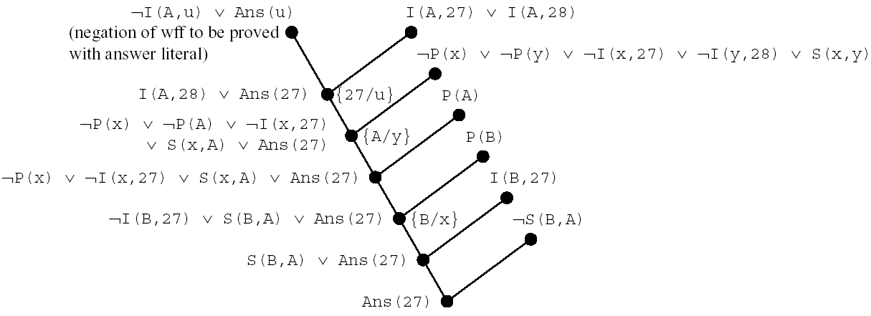
3.3 Example

Slide 59
Additional Readings and Discussion
Mathematicians (humans) use much more commonly `natural deduction’ instead of resolution
Successful application areas
math problems
program verification & synthesis
Semantic attachment
explicit (intended) interpretation of some structures

Slide 60
Schoolwork:Ex.1
Facts:
1.Tiger and savages animals are fierce or destructives.
2.If there is something destructive in the room, then something in the room will get damaged.
3.Tim is a tiger.
4.Tim is a savage animal.
5.Tim is in the room but it is not fierce.
Prove using resolution that something in the room will get damaged.

