Slide 1



Artificial Intelligence Chapter 7 Agents That Plan
<能规划的Agent>

Slide 2
Question one:what is artificial intelligence?
Definition one: AI is the science and engineering of making intelligent machines, especially intelligent
computer programs. It is related to the similar task of using computers to understand human intelligence, but AI does not have to confine itself to methods that are biologically observable. -John McCarthy
Definition two: AI, broadly defined, is concerned with intelligent behavior in artifacts. Intelligent behavior, in turn, involves perception, reasoning, communication, and acting in complex environments.

Slide 3
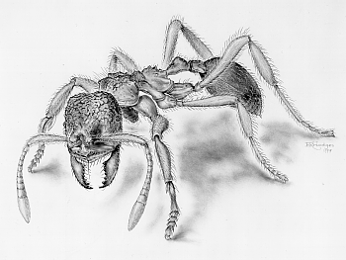
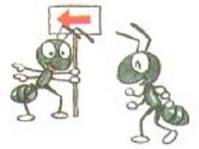
Insects
capable of learning and memorizing
primitive social interactions
simple visual and olfactory perception{嗅觉} (compound eyes)
coordinated movements of legs to master
different types of terrains{地形}

Slide 4

Reptiles
good capability of vision (eye movements)
able to learn certain behaviors
hunting abilities
still very primitive social interactions

Slide 5
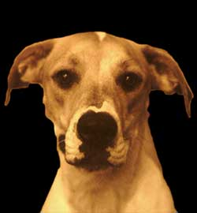

Higher Mammals
very powerful senses
produce sounds but no language
complex social interactions
probably consciousness and basic feelings
that are related to our own

Slide 6
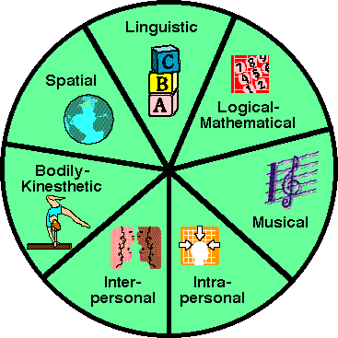
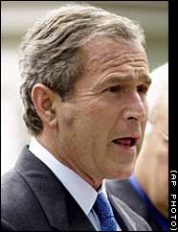
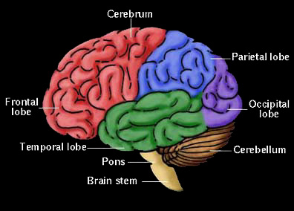
Humans
complex social behaviors
able to learn high-level syntactic languages
extremely long phase of learning (upbringing)
consciousness, self-awareness, abstract thinking
awareness of past and future, planning capability

Slide 7
Question two: what is agent?
[Wooldridge and Jennings 1995, page 2] "... a hardware or (more usually) software-based computer system that enjoys the following properties:
autonomy: agents operate without the direct intervention of humans or others, and have some kind of control over their actions and internal state;
social ability: agents interact with other agents (and possibly humans) via some kind of agent-communication language;
reactivity: agents perceive their environment, (which may be the physical world, a user via a graphical user interface, a collection of other agents, the INTERNET, or perhaps all of these combined), and respond in a timely fashion to changes that occur in it;
pro-activeness: it do not simply act in response to their environment, it is able to exhibit goal-directed behavior by taking the initiative."

Slide 8


7.1 Memory Versus Computation
7.2 State-Space Graphs<状态空间>
Outline
7.3 Searching Explicit State Spaces
7.4 Feature-Based State Spaces
7.5 Graph Notation

Slide 9
7.1 Memory Versus Computation
Memory-based implementation<基于存储的实现>
The action is selected by designer.
Agent would require large amounts of memory.
Designer would require foresight in anticipating appropriate reactions for all possible situations.
Computation-based implementation<基于计算的实现>
It will reduce the agent’s memory requirements and the burden on the designer.
The designer specifies the computation instead of all possible situations.
-Automatically learned or evolved,

Slide 10
Computations
Predict the consequences of the actions possible in
any given situation.
If these consequence-predicting computations could be automatically learned or evolved, the agent would be able to select appropriate actions even in those environments that a designer might not have been able to foresee.
An agent must have a model of the world it inhabits and models of the effects of its actions on its model of the world.

Slide 11
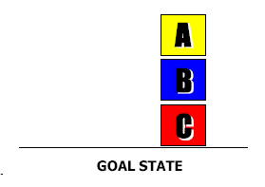
7.2 State-Space Graphs
Grid-space world containing 3 toy blocks (A, B, C).All initially are on the floor.
A
B
C
The task is to stack blocks so that A is on top of B and B is on top of C and C is on the floor.

Slide 12
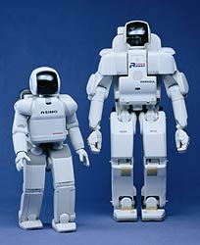
Robots
built by humans
coordinated body movements
little learning capabilities
no real social interaction or language
no consciousness or self-awareness

Slide 13
??
A
B
C
Two models:one represents the world state before the action, one represents the world state after the action is taken.
Schema:move(x, y) – x can be A, B, C and y can be A, B, C and floor.
Operators :move(A, C) , move(A, B) …

Slide 14
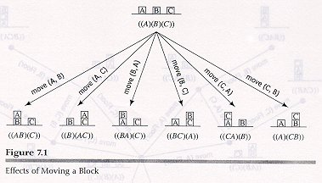

Slide 15


The “monkey and bananas” problem
The problem statement: A monkey is in a laboratory room containing a box, a knife and a bunch of bananas.
The bananas are hanging from the ceiling out of the reach of the monkey. How can the monkey obtain the bananas?
?

Slide 16
7.2 State-Space Graphs
Directed graph
A most useful structure for keeping track of the effects of several alternative sequences of actions.
Node
Representations of the individual worlds
Iconic or feature
Arc
Operators

Slide 17
7.2 State-Space Graphs
State-space graph
A graph representing all of the possible actions and situations
Any of the nodes in the graph can be taken to represent a goal situations.

Slide 18
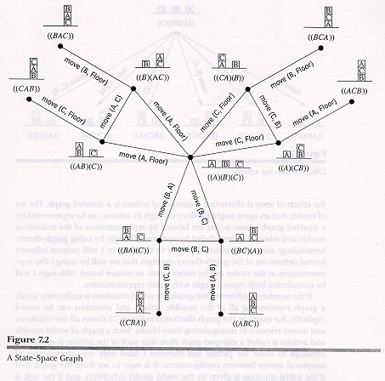
State-space graph is a graph of world models and actions.

Slide 19
7.2 State-Space Graphs
Plan
A sequence of the operators labeling the arcs along a path to a goal.
Planning is searching for such a sequence.
Projecting
The process of predicting a sequence of world states resulting from a sequence of actions.

Slide 20
7.3 Searching Explicit State Spaces
Search methods for explicit graphs involve propagating over the nodes of the graph.
Label the start node with a 0.
Propagate successively larger integers out in waves along the arcs until an integer hits the goal.
Trace a path back from the goal to the start along a decreasing sequence of numbers.
Expansion
Puts marks on all of the marked node’s unmarked neighbors.
markers

Slide 21
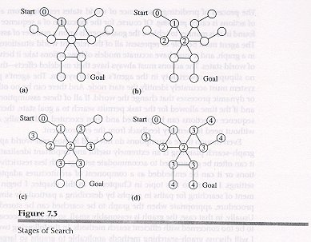
A Breadth-First Search

Slide 22
7.4 Feature-Based State Spaces
Feature-Based graphs need a way to describe how an action affects features.
STRIPS [Fikes & Nilsson, 1971]
Define an operator by 3 lists
Precondition list specifies those features that must have value 1 and 0 in order that the action can be applied.
Delete list specifies those features that will have their values changed from 1 to 0.
Add list specifies those features that will have their values changed from 0 to 1.

Slide 23
7.4 Feature-Based State Spaces
Neural Networks:
Train a neural network to learn to predict the value of a feature vector at time t from its value at time t-1 and the action taken at time t-1. [Jordan & Rumelhart 1992].
After training, the prediction network can be used to compute the feature vectors that would result from various actions.
Computed features in turn could be used as new inputs to the network to predict the feature vector two steps ahead, and so on.

Slide 24
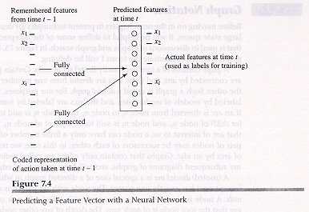

Slide 25
7.5 Graph Notation
A graph consists of a set of nodes.
Arcs connect certain pairs of nodes.
A directed graph
Arcs are directed from one member of the pair to the other.
Successor (child)
Parent
An undirected graph
Edges are undirected arcs.
Contain only edges.

Slide 26
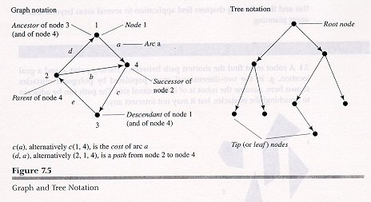

Slide 27
7.5 Graph Notation
Tree is a special case of a graph.
A directed tree:
A root node has no parent.
Each has exactly one parent except root.
A leaf node has no successors.
Depth of any node is defined to be the depth of its parent plus 1. ( The root node is of depth zero.)
An undirected tree:
There is only one path along edges between any pair of nodes.

Slide 28
7.5 Graph Notation
A path of length k from node n₁ to node n_{k}.
A sequence of nodes with each n_{i+1} a successor of n_{i} for i=1,…,k-1
Accessible:
Exist a path from one node to other node.
Descent, Ancestor
Optimal path:
Path having minimal cost between two nodes.
A spanning tree:
A tree including all nodes in a graph

Slide 29
Exercise:
7.3:missionary and Cannibals

