Slide 1
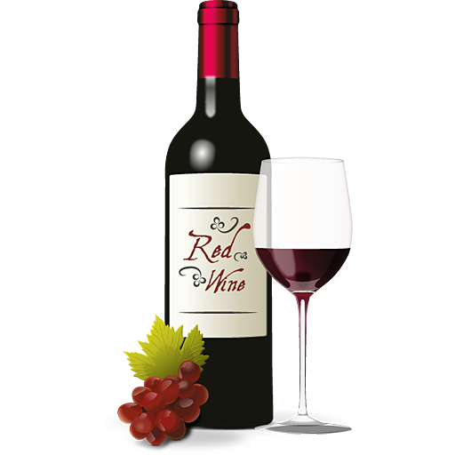
Machine Learning on Wine data set
Elias Berglin, Gustav Nilsson
Det här fotot av Okänd författare licensieras enligt CC BY-NC
Notes:
We have used the wine data set and decided on doing artificial neural network and decision tree to predict if the wine is good or bad.

Slide 2
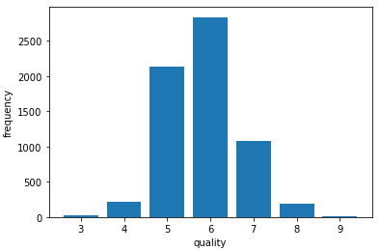
Data Understanding
Examine data using info()
Normalize Data
Split Quality
Bad <= 5
Good > 5
Notes:
The different attributes had different ranges, so we decided that Normalizing the Data to be a value between 1 and 0 to prevent the models from thinking different features weigh differently was necessary.
We also plotted the frequency of the different score to determine where to split between good and bad wine. We figured splitting at 5 was reasonable so there is about the same number of wines above and below the split.
(Elias)

Slide 3
Data Preparation
No null values
Combine data set
Split the data into a test and train set
Normalize all the features values
Change the target variable to “Good” or “Bad”
Notes:
When examining we found no null values
We decided to combine both the red and white wine datasets into one using a concatenation function. Total instances 6497
We also decided on a 20/80 split between testing and training data
And we normalized the data with sklearns MinMaxScaler function
Lastly, we changed the target variable to be either “Good” or “Bad” depending on if the wine is above or below 5 in quality score.
(GUSTAV)

Slide 4
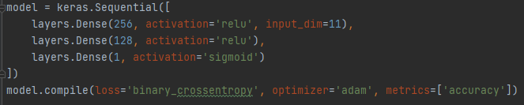
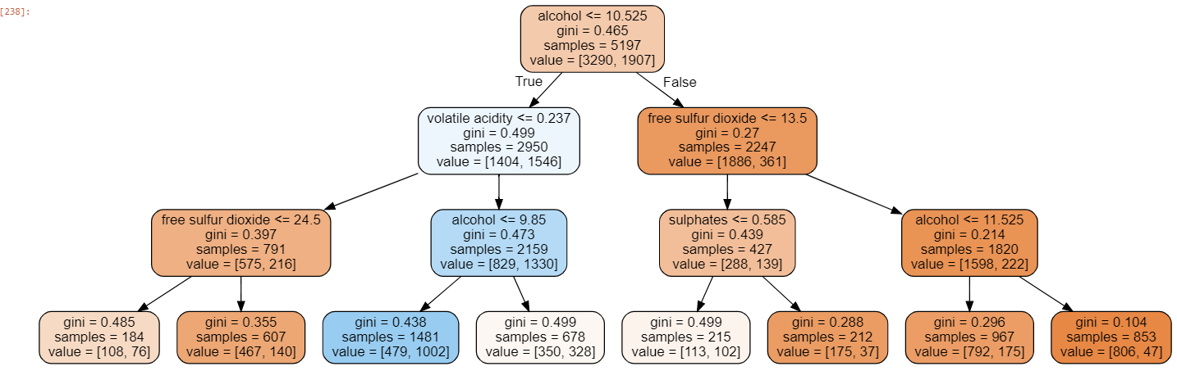
Models
ANN
Classification
Regression
Decision Tree
Classification
Notes:
ANN:
We made an ANN model for both classifying Data and we tried to make a regression model to try and predict scores but with bad accuracy
The models was made using TensorFlow and training was accelerated with a GPU.
The classification model consists of 3 layers. The two first layers use relu for activation and the output layer uses sigmoid and gives a value between 1 and 0
The metric used here is Accuracy. For regression, the metric was Mean Square Error
Adam was used as an optimizer for both models
Decision Tree:
We used sklearns classification decision tree with a depth of 3 to create the decision tree model.
And as seen in the model alcohol was the primary feature it looked at when classifying if it is a good or a bad wine.
However, the lower nodes shifted from time to time and were less consistent.

Slide 5
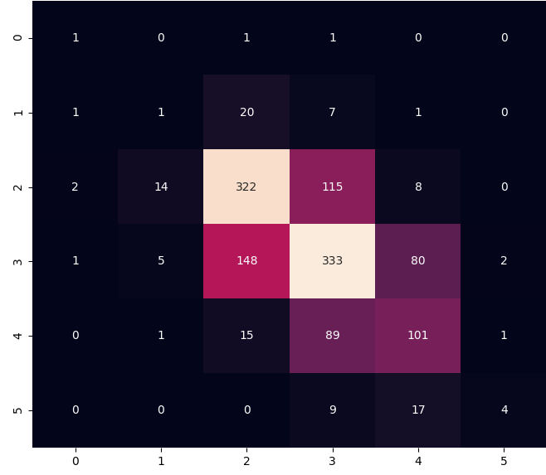
ANN – Regression
MSE: 0.48
Correct Guesses: 762
Accuracy: 59%
Notes:
Here is the regression results:
Mean Square error 0.48
Total correct guesses 762 of 1300 testing instances
Accuracy of 59%

Slide 6
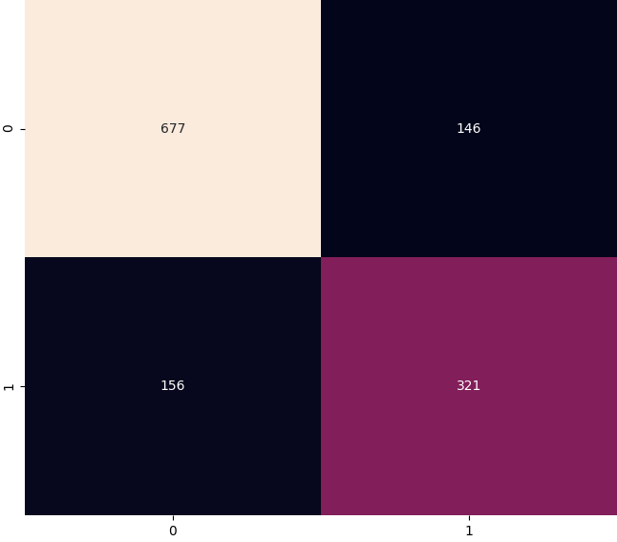
ANN – Classification
Accuracy: 77%
True Positive Rate: 72%
True Negative Rate: 87%
Notes:
The Classification model Result
Accuracy of 77%
True Positive Rate of 72%
True Negative Rate of 87%

Slide 7
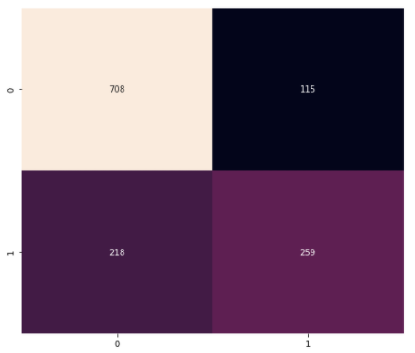
Decision Tree – Classification
Confusion Matrix
Accuracy = 74%
True Positive Rate: 69%
True Negative Rate: 86%

Slide 8
Conclusion
ANN Better Overall
Regression
Decision Tree was less consistent than ANN
Alcohol most important feature for tree
Notes:
Our ANN classifier got a better accuracy, True Positive Rate and True Negative Rate
Regression did not provide good enough accuracy
This led to our decision for choosing Classification as the primary method.
Decision Tree was less consistent than ANN, meaning if we tried to run it several times it differed more than what ANN did.
We could also see that alchohol was the most important feature by far compared to the other features when training, the higher alchohol was, the higher the quality.

