Slide 1



Statistical Analysis and Machine Learning of ABA Pro Bono Services
UW ADA
Hanson Mo, Lisa Li, Minhao Zhang, Qirui Wang

Slide 2
Question Analysis
Improve economic between clients and attorneys
The ABA would like to promote their services to more clients, recruit volunteers to respond with the right knowledge at the right time.
Analyze time series data
Predict the trend of future question

Slide 3
Data preprocessing and cleaning
1. Merging table:
Clients + Questions on variable ClientUno
Attorney + Attorneytimeentries on variable AttorneyUno
2. replacing NaNs with numerical values
3. Filtering out ineligible clients

Slide 4
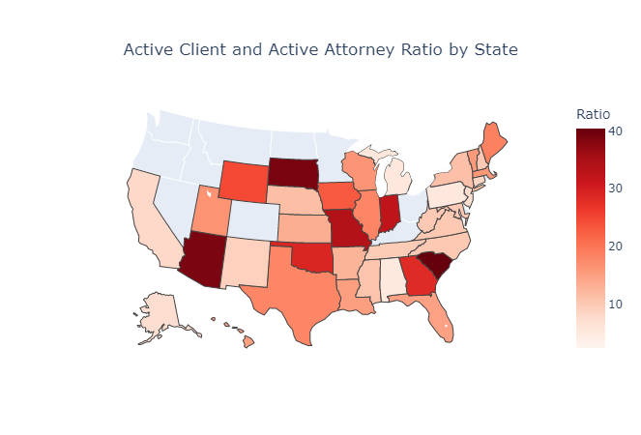
Improve economic between clients and attorneys
Notes:
Here, we plot the ratio of active clients to active attorneys by states. States with darker color means the ratio is high while the states with lighter color means the ratio is low. Thus, we could spend more in advertising to attract attorneys in states with darker color.

Slide 5
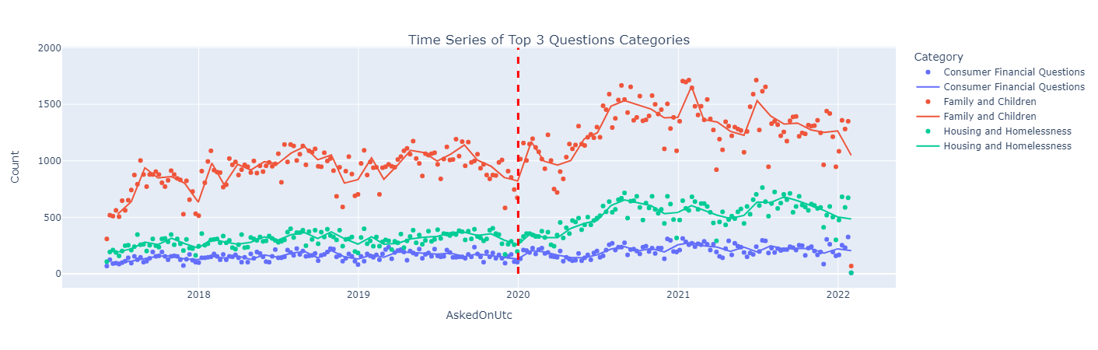
Time series data
Weekly scatter plot is adjusted to match monthly average
Notes:
Secondly, we rank the top 3 question categories by clients and plot the time series of it. We can notice these 3 questions has an increasing pattern in the long term. There are two possible explanations, one is the beginning of covid-19 which we plot a dotted line here and we did a statistical test on the theory and the proportion of healthe related in covid-19 period is statistical significantly larger than other time periods. However, we also need to consider other possibilities like the growth of the platform. We could promote our services to organizations or online websites related to frequently asked questions to reachout to more clients. For example, making advertisement in church or support groups if we anticipate the rise of fimaily and children questions.

Slide 6
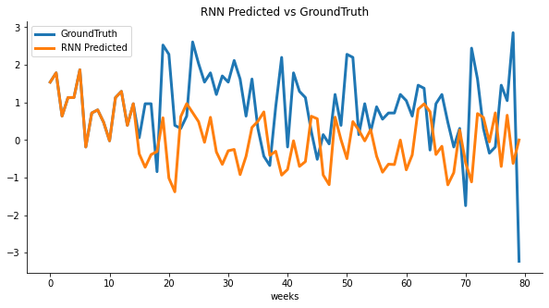
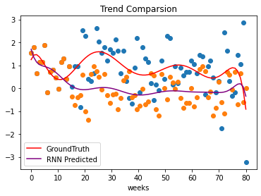
Prediction of consumer financial questions
Encoder-Decoder technique used for converting an input sequence into a fixed-length vector representation and then decoding this vector to an output sequence. Predict the trend of these categories in the following months by using LSTM(Long short-term memory networks) technique
Notes:
Blue points: ground truth
Orange: RNN predicted values
Red Line: trend of ground truth values
Purple Line: trend of predicted valeus
The third is the most important solution we could provide for ABA. We deveople a deep learining system using encoder-Decoder and recurrent Neural Network with long-short-term memroy. The system is able to predict the future trend of a certain topic. For example, if we look at the graph on the left. The blue line is the ground truth and the prediction is in yellow color. On the right, when t=20, 40, 70 point on the board, the trend is correctly predicted. Based on these predictions, ABA can increase ads. spending on attorneys specialized in these topics. Here is only one example, we could apply it to others and predict the future trend. With more data at hand, we can improve this system to be better.

Slide 7
Conclusion
Partner with law firms and corporations in states to encourage attorneys to partice in Pro bono service.
Promote our services to organizations or online websites related to frequently asked questions using targeted to reachout to more clients.
According to the prediction, prepare more or less attorneys in correspnding categories.
Notes:
In conclusion, we suggest ABA to

