Slide 1






The project
Gamayun News Site
Multilingual and modular CMS built with Laravel 5.2
Administrator panel
Reader view
News
Users management
Galleries
Creating, editing and deleting article entries
Creating, editing and deleting users
and website translation

Slide 2
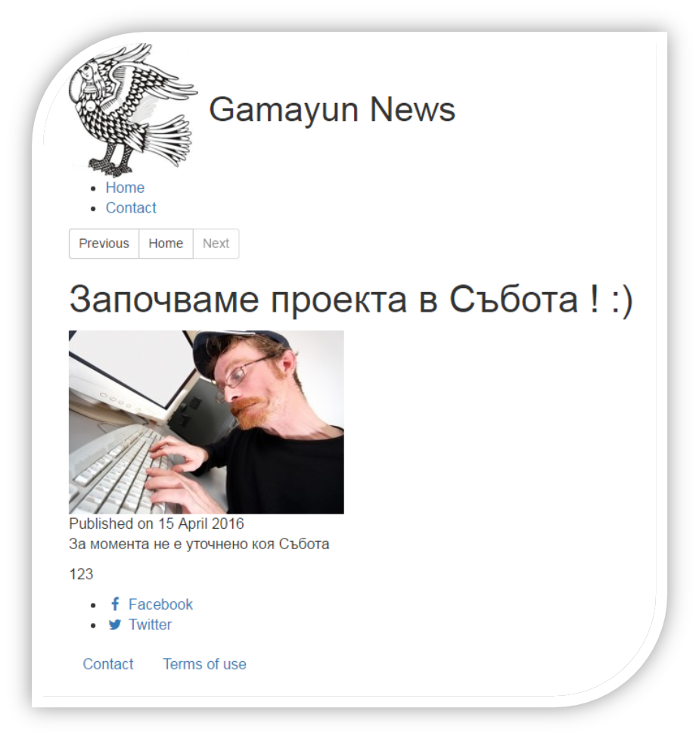
Article Page

Slide 3
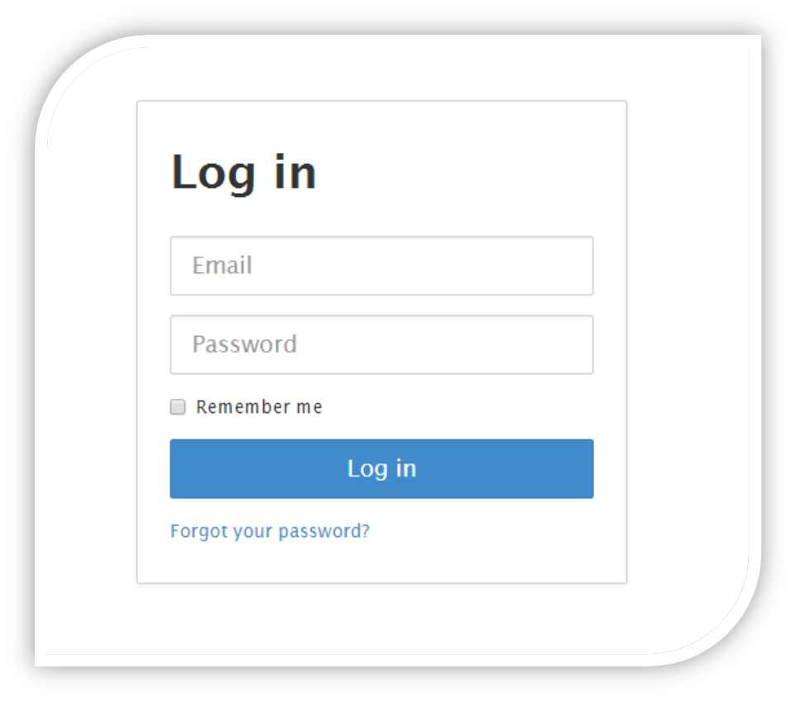
Login dialogue

Slide 4










The team
Worked with several communication tools and weekly meetings
Assigned Project Roles:
Daniel Rodriguez the Developer
Evelina Paceva the PM
Ivaylo Arsov the Automation engineer
Iva Mladenova the QA Specialist
Natalia Nikolova the QA Specialist
Nikolay Borimechkov the UX specialist
Teodor Kolev the Business Analyst

Slide 5
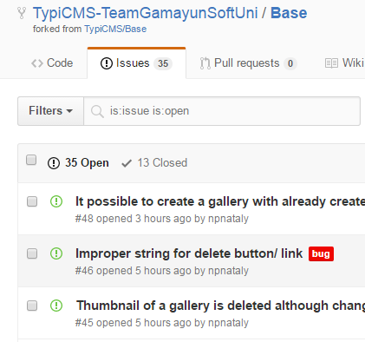
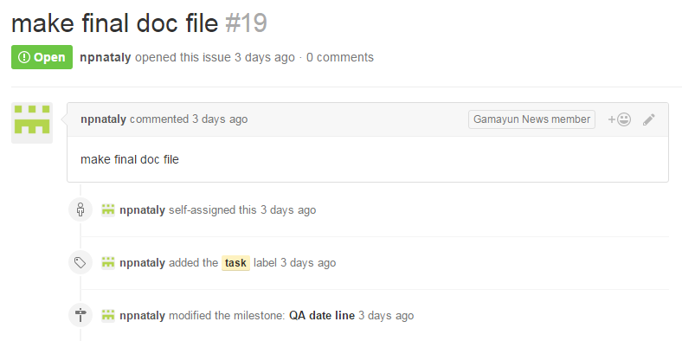
GitHub
We used GitHub to
Contain the CMS Repository
Assign tasks to each other
Track progress
Report issues

Slide 6

Our software requirement specification
Gives
An overall description of the product
Uses
The use cases format to specify requirements
Tracks
The process of the SRS creation with a detailed Revision History

Slide 7

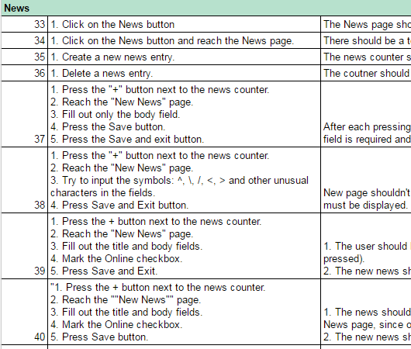



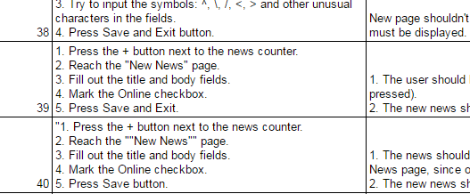
Test Cases
Based on the SRS
We have written over 300 test cases for the Gamayun CMS
Automated tests written on Java and using Selenium WebDriver

Slide 8


Are
there
any
Questions?

