Slide 1
Urban Air Pollution Challenge
Machine Learning Project: Predicting Daily PM2.5 Concentrations Using Machine Learning
Integrating Ground-Based Sensors, GFS (Global Forecast System) Weather Data and Sentinel-5P Satellite Observations
Kueshi Sémanou Dahan, contact: dkueshi09@gmail.com

Slide 2
Goal
The objective of this challenge is to predict PM2.5 particulate matter concentration in the air every day for each city: predict daily PM2.5 concentration for each city.
PM2.5 = fine particulate matter <2.5 µm.
Target variable: target = daily mean PM2.5 concentration.
Train set contains observed PM2.5 measurements.
Test set contains locations/dates for which PM2.5 must be predicted.
Question
Can weather and satellite-derived atmospheric variables accurately predict daily PM2.5 concentrations?

Slide 3
Data Preparation & Predictors (1/1)
Raw data (TrainData=82 feature and 30,557 observations, TestData=77 feature and 16136 observations)
Identify target
Remove target-derived variables
Remove ID/date variables
Handle missing values
Feature Engineering Highly correlated feature pairs
(|correlation| >= 0.95): (one feature of the pair has been removed
54 predictors (features)
Sources | Examples | Role
Ground sensors | PM2.5 daily mean | Target
GFS weather | Humidity, temperature, wind | Predictors
Sentinel-5P | NO₂, CO, SO₂, O₃, HCHO, CH₄, aerosols | Predictors
Target (Target mean predicted PM2.5 particulate matter)
target_min
target_max
target_variance
target_count
Place_ID
Place_ID X Date
Date and correlated features (20)

Slide 4
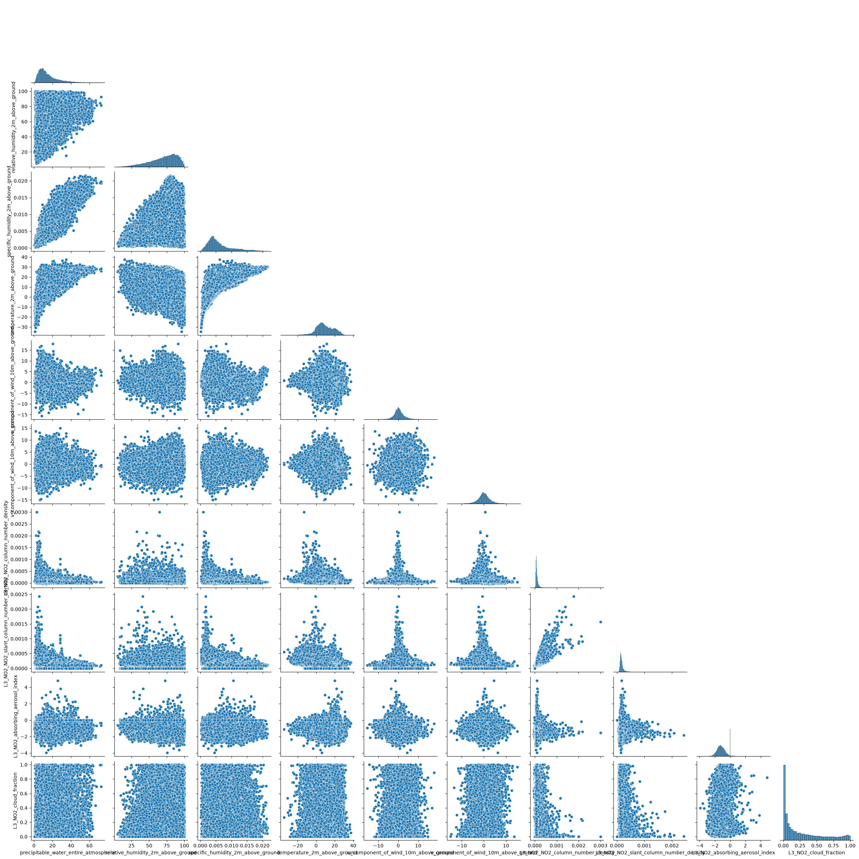
EDA(1/1)
Scatterplot Matrix: show the distribution of a single variable

Slide 5
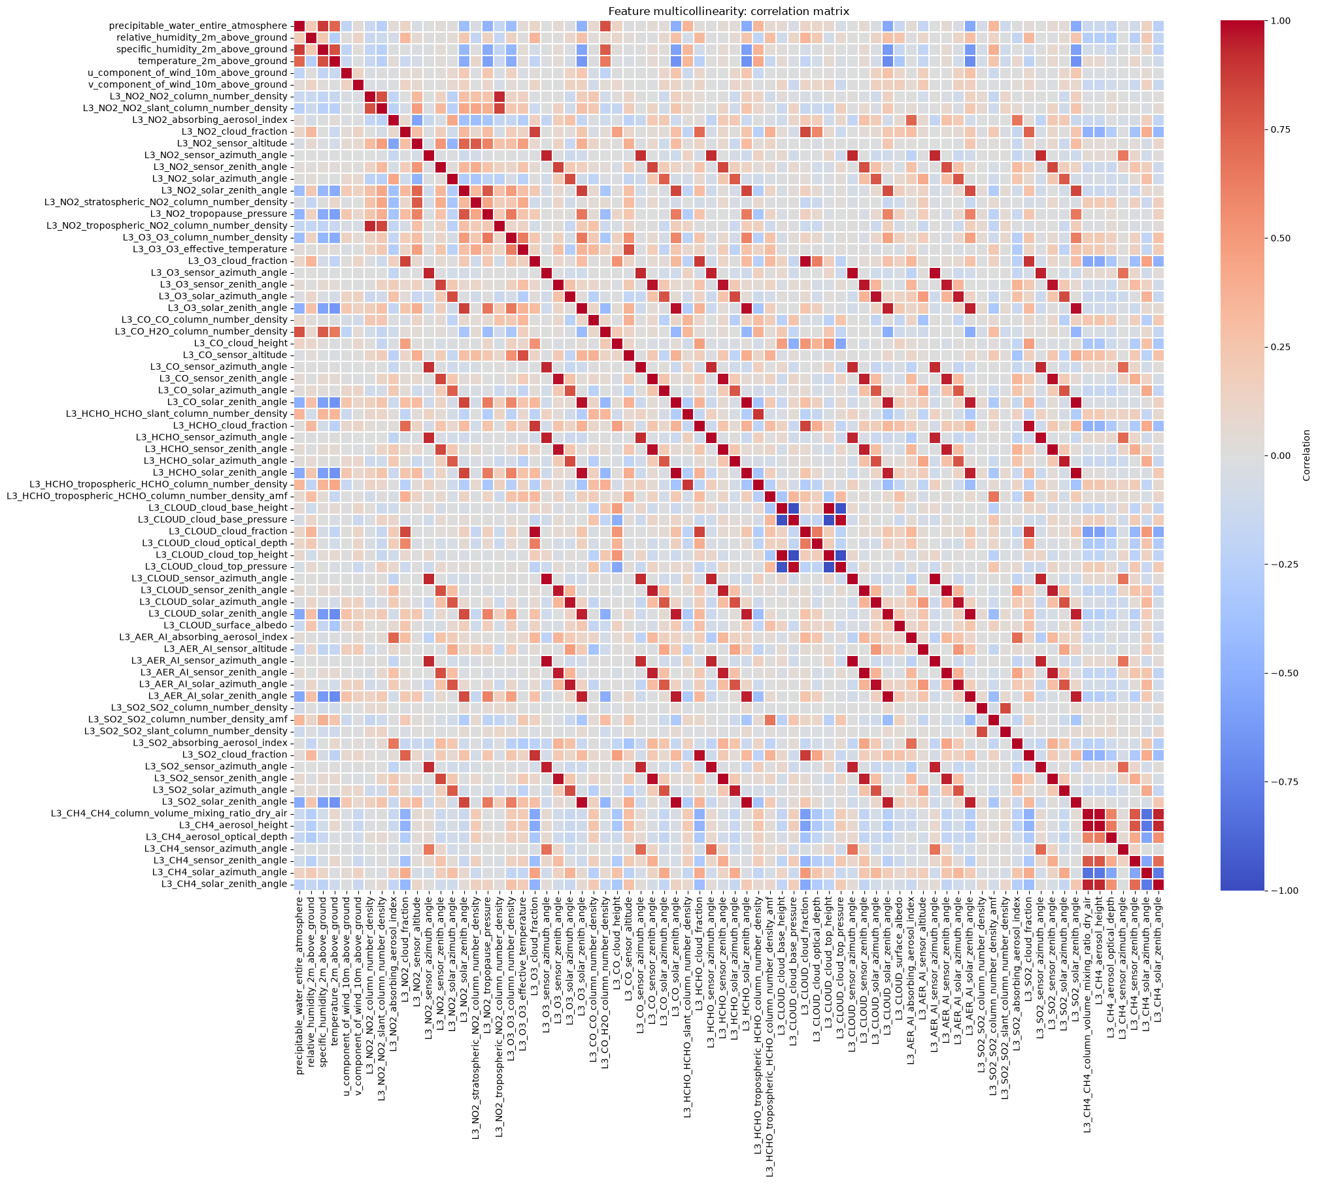
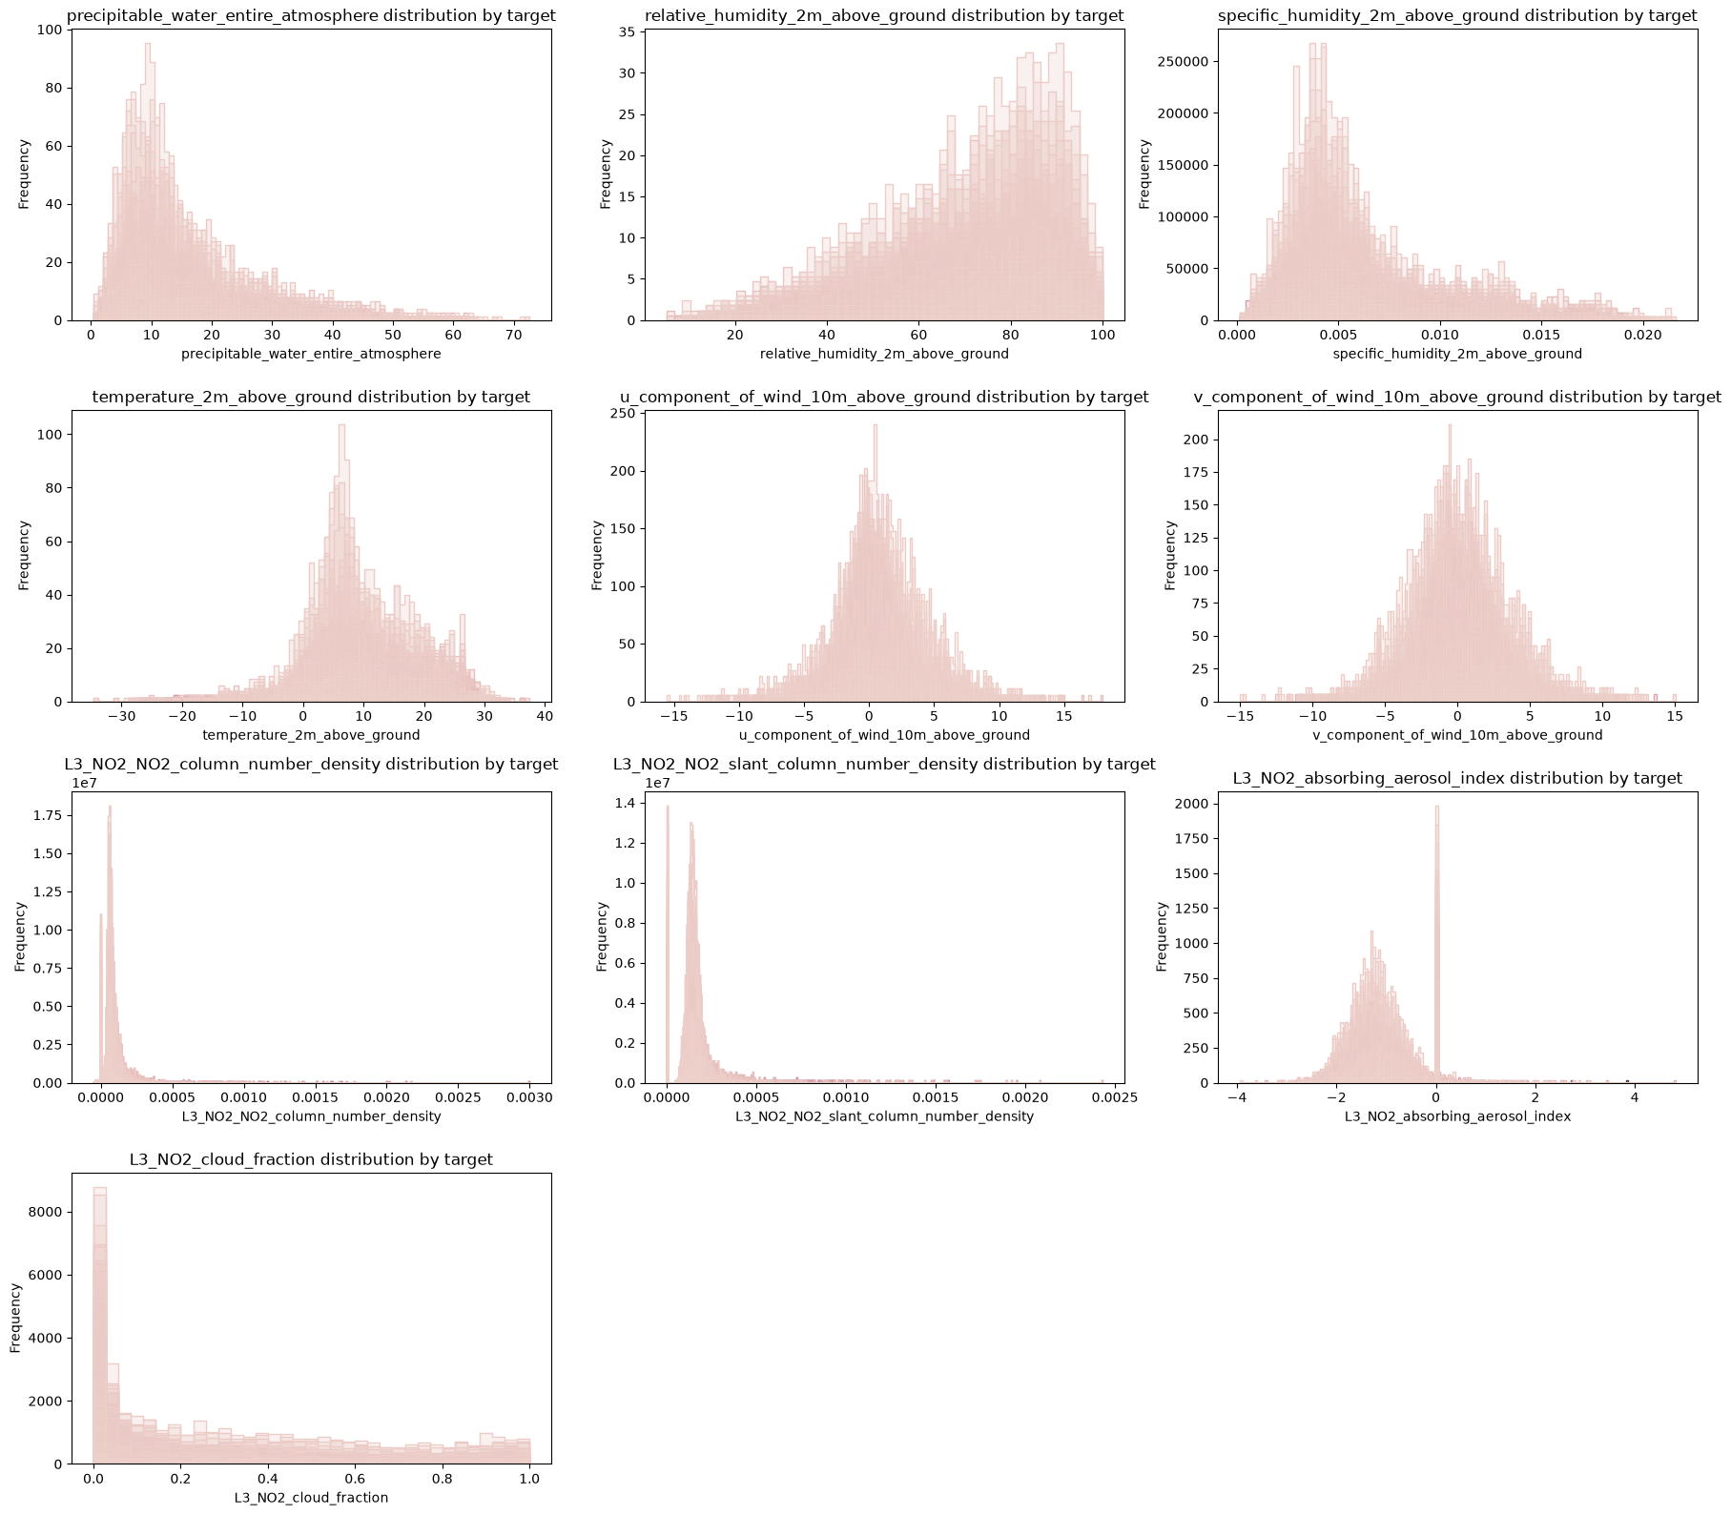
EDA(1/2)
Features (10) distribution frequency by target
Multicollinearity of the features

Slide 6
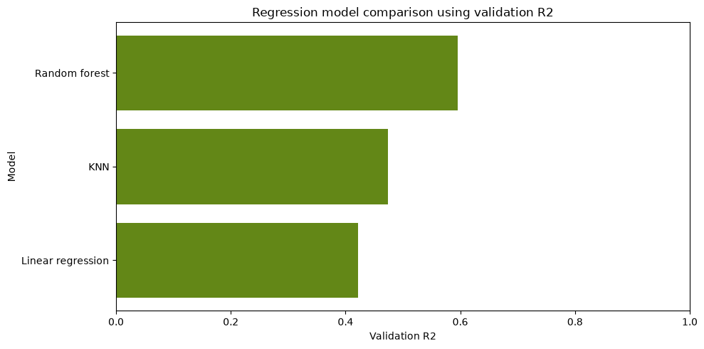
Key Insights: Prediction(1/1)
Engineering
Train / Validation Split
Preprocessing/build the pipelines
Feature Selection
Model Training
Hyperparameter / Feature Selection
Validation
Model Comparison
Model | RMSE | MAE | R²
Random Forest | 29.482 | 20.491 | 0.596
KNN | 33.628 | 23.566 | 0.474
Linear Regression | 35.257 | 25.961 | 0.422
Random Forest, K-Nearest Neighbors (KNN), Linear Regression

Slide 7
Key Insights: Feature Selection & Permutation importance (1/2)
54 predictors
SelectKBest + GridSearchCV
Optimal feature subset
Model | Best CV RMSE | Optimal number of features (K)
Random Forest | 31.970 | 40
KNN | 34.630 | 40
Linear Regression | 36.809 | 54
Model | Validation RMSE | Validation MAE | Validation R²
Feature-selected Random Forest | 29.732 | 20.657 | 0.589
Feature-selected KNN | 32.334 | 22.452 | 0.514
Feature-selected Linear Regression | 35.257 | 25.961 | 0.422

Slide 8
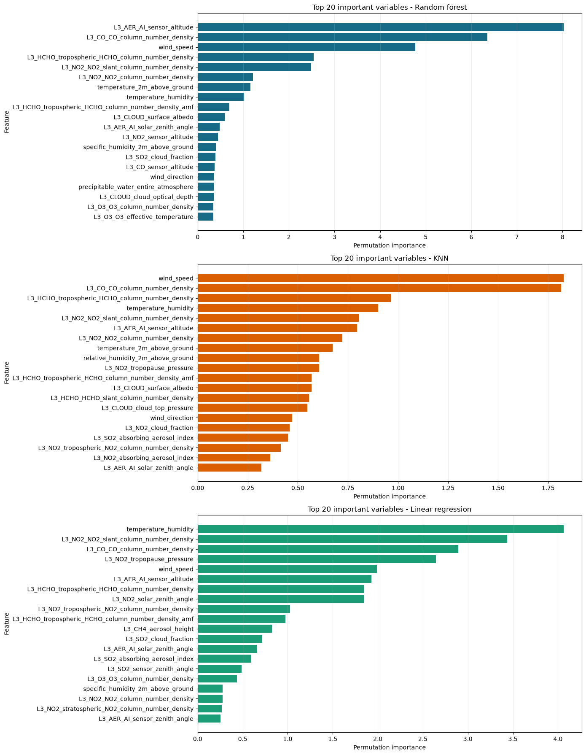
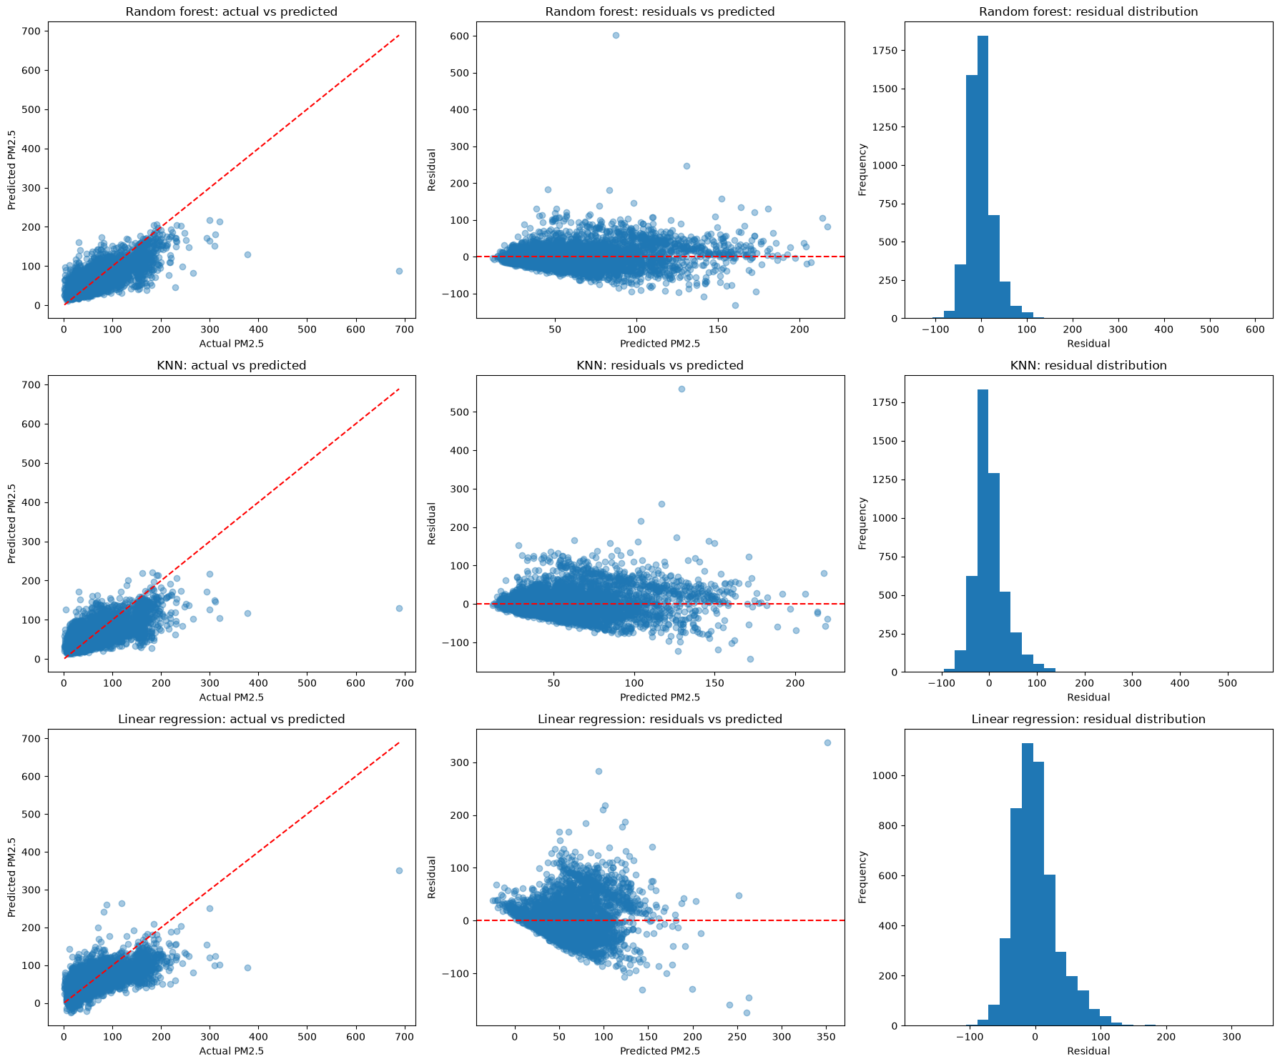
Key Insights: Permutation importance & Residual analysis (1/3)
Residual analysis for the models
top 20 important variables for each model

Slide 9
Conclusions
1. Random Forest performed best
R² ≈ 0.60 on the validation data.
2. Environmental predictors contain substantial information about PM2.5
Weather and atmospheric composition variables provide useful predictive signals.
3. Feature selection reduced dimensionality
54 predictors: 40 selected predictors for Random Forest.
4. Feature selection did not increase predictive accuracy
Performance remained very similar, suggesting that the additional variables contained useful complementary information.
5. Final objective
The selected Random Forest was used to generate PM2.5 predictions for the unseen test observations.

Slide 10






