Slide 1
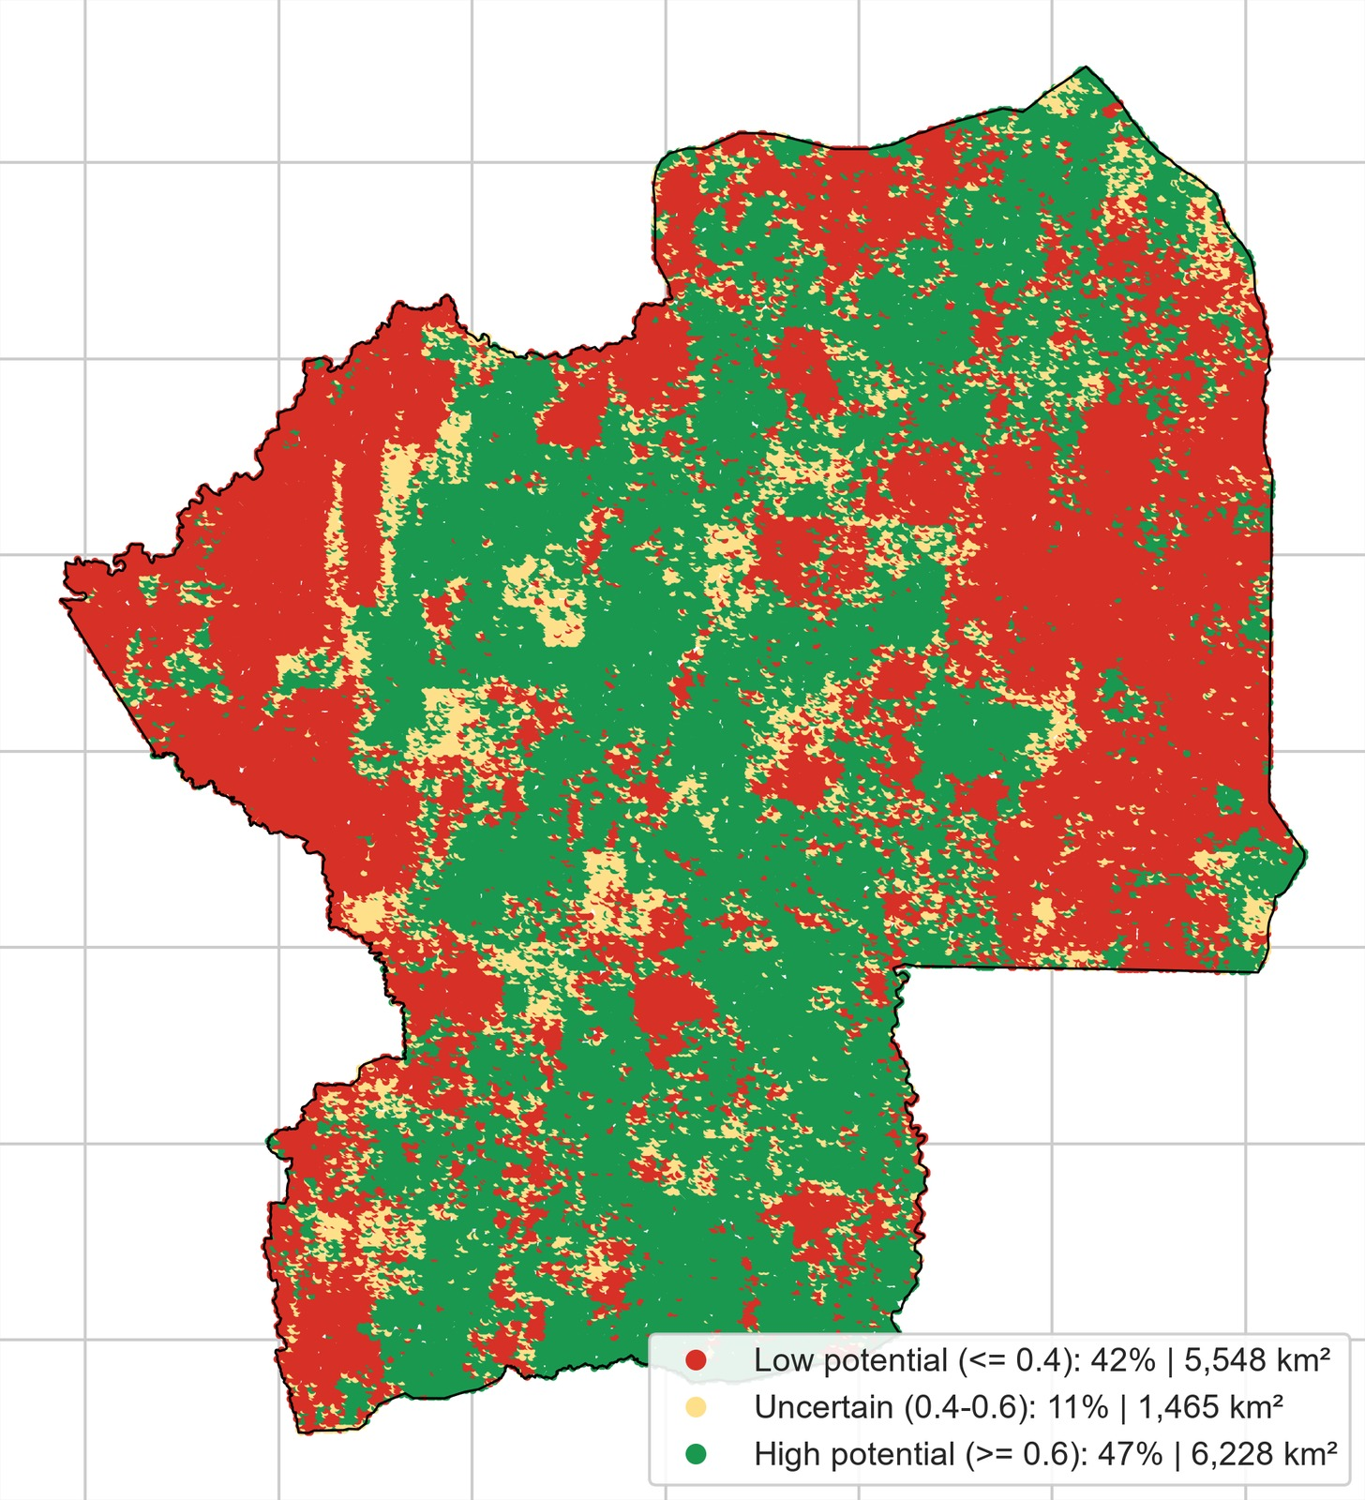
AgroRestore AI
Predicting where forest restoration and agriculture projects are most likely to succeed
Kueshi Semanou Dahan
Team NeuralRoots
neuefische Data Science Bootcamp · Capstone Demo Day
Centrale Region, Togo: restoration potential
Notes:
Hello, I'm Kueshi Semanou Dahan from team NeuralRoots. My project is AgroRestore AI. In one sentence: it predicts where land restoration and agriculture projects are most likely to succeed, so that NGOs and development banks put their money in the right places. The map on the right is the final product: every 250 m site in the Centrale Region of Togo, scored green for high potential and red for low.

Slide 2




Restoration money is lost on the wrong sites
STEP 1 · BUSINESS UNDERSTANDING
Who invests
NGOs and development banks fund reforestation, agroforestry and new farmland in West Africa.
Our question
Which places are most likely to regreen and suitable for agriculture, and which should funders avoid?
How sites are chosen today
Often by expert judgement and accessibility, with little data on how the land has actually behaved.
What it costs
A site that never regreens means lost seedlings, labour and loans, and less trust for the next project.
Notes:
Step one of the data science life cycle is understanding the business problem. NGOs and development banks spend a lot of money on restoring degraded land and on new agriculture projects. But sites are usually chosen by expert judgement and by how easy they are to reach, not by data on how the land has actually behaved over time. When a site fails to regreen, the seedlings, labour and loans are lost. So the question for this project is: using 20 years of satellite data, which places are most likely to regreen and are suitable for agriculture, and which ones should funders avoid?

Slide 3






Following the data science life cycle
OUR APPROACH
1
2
3
4
5
6
Business
Define success: where restoration pays off
Data
17 satellite + 2 OpenStreetMap layers
Preparation
Sample 99,913 sites, build target, EDA
Modelling
4 models, spatial cross-validation
Evaluation
Held-out blocks, drivers, opportunity map
Deployment
Streamlit app to explore and score sites
Outcome: an opportunity map that sorts every 250 m site into high, uncertain and low potential.
Notes:
I followed the data science life cycle, the same order as in my AgroRestoreAI notebook. Business understanding, then data acquisition from Google Earth Engine and OpenStreetMap, data preparation and exploration, modelling with four models, evaluation on places the models never saw, and finally deployment as a Streamlit app. The dots at the top right of each slide show where we are in this cycle.

Slide 4
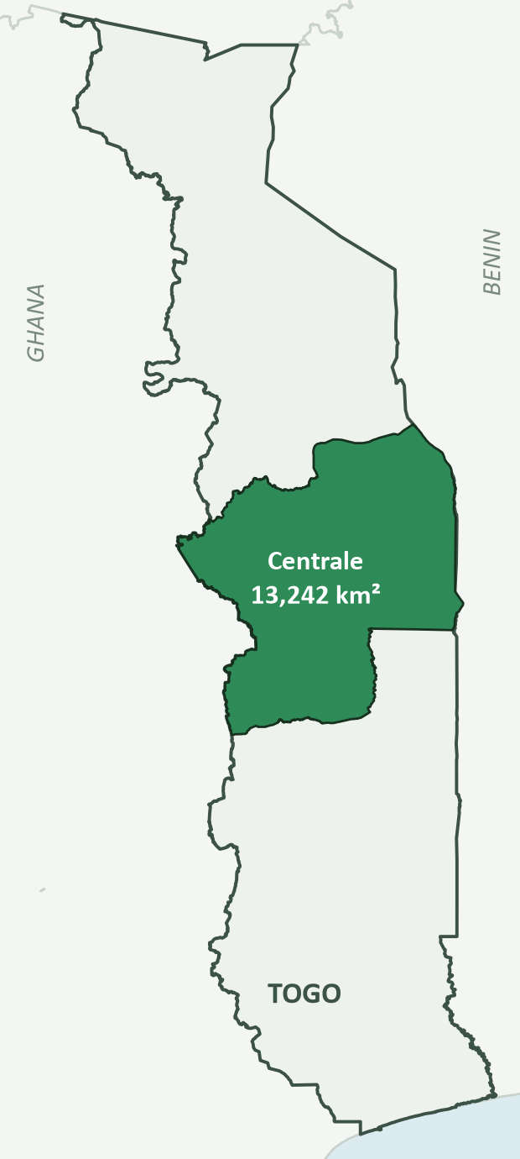






Study area and 20 years of satellite data
STEP 2 · DATA ACQUISITION
13,242
km² in Centrale Region, Togo
Climate
CHIRPS rainfall, TerraClimate temperature and soil moisture
Soil
iSDAsoil organic carbon and pH, 0–20 cm
99,913
sites on a 250 m grid
Terrain
SRTM elevation and slope
Land cover
ESA WorldCover built-up and water
2006–2025
climate, vegetation, fire
Protection & access
WDPA protected areas; OSM roads and settlements
Vegetation & fire
MODIS NDVI and burned area
17
layers via Google Earth Engine
Notes:
Step two is data acquisition. The study area is the Centrale Region of Togo, about 13,000 square kilometres. Using Google Earth Engine, I stacked 17 layers at 250 m, the native resolution of the soil and NDVI data: rainfall, temperature and soil moisture; soil carbon and pH; elevation and slope; land cover; protected areas; and 20 years of MODIS vegetation and fire data. From OpenStreetMap I added two access layers: distance to the nearest road and to the nearest settlement. Then I sampled about 100,000 random sites across the region.

Slide 5
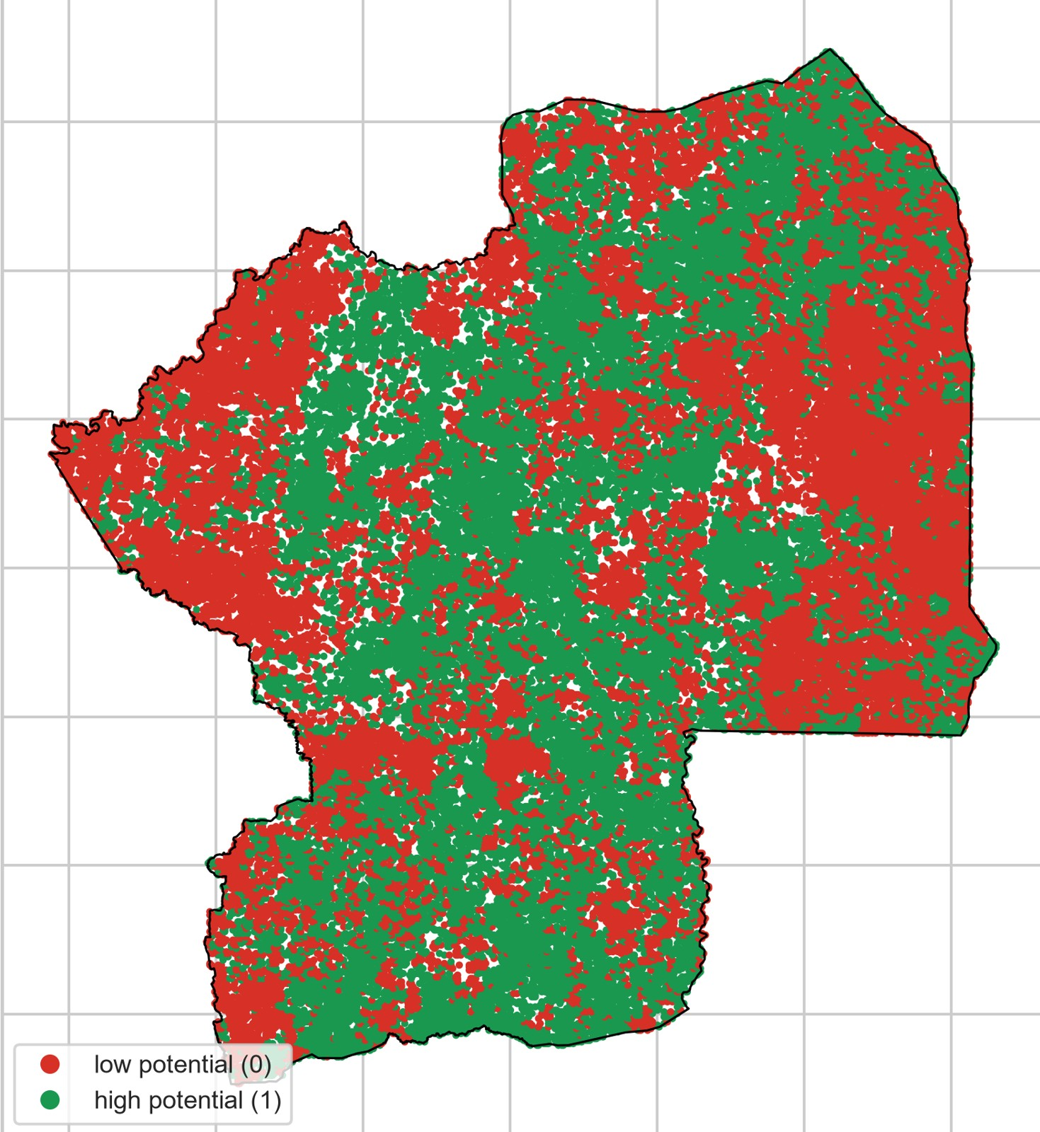
Turning 20 years of greening into a target
STEP 3 · DATA PREPARATION & EDA
Target: NDVI trend, the slope of annual mean greenness 2006–2025
Low
bottom 30%
Dropped
40%
almost no change
High
top 30%
≤ −0.0007 NDVI/yr
≥ +0.0009 NDVI/yr
59,948 balanced sites kept for training, with 17 predictors
Cleaning: sites missing a critical layer dropped; only layers with more than 95% valid values used
Notes:
Step three is data preparation. The key decision is the target. I used the NDVI trend: how much greener or browner each site became from 2006 to 2025. The top 30% of sites became the high-potential class, the bottom 30% the low-potential class, and the ambiguous middle 40% was dropped. That leaves about 60,000 balanced sites, described by 17 predictors. The map on the left shows these labels: green for regreening, red for declining. Sites missing a critical layer were dropped, and only layers with more than 95% valid values were used as predictors.

Slide 6
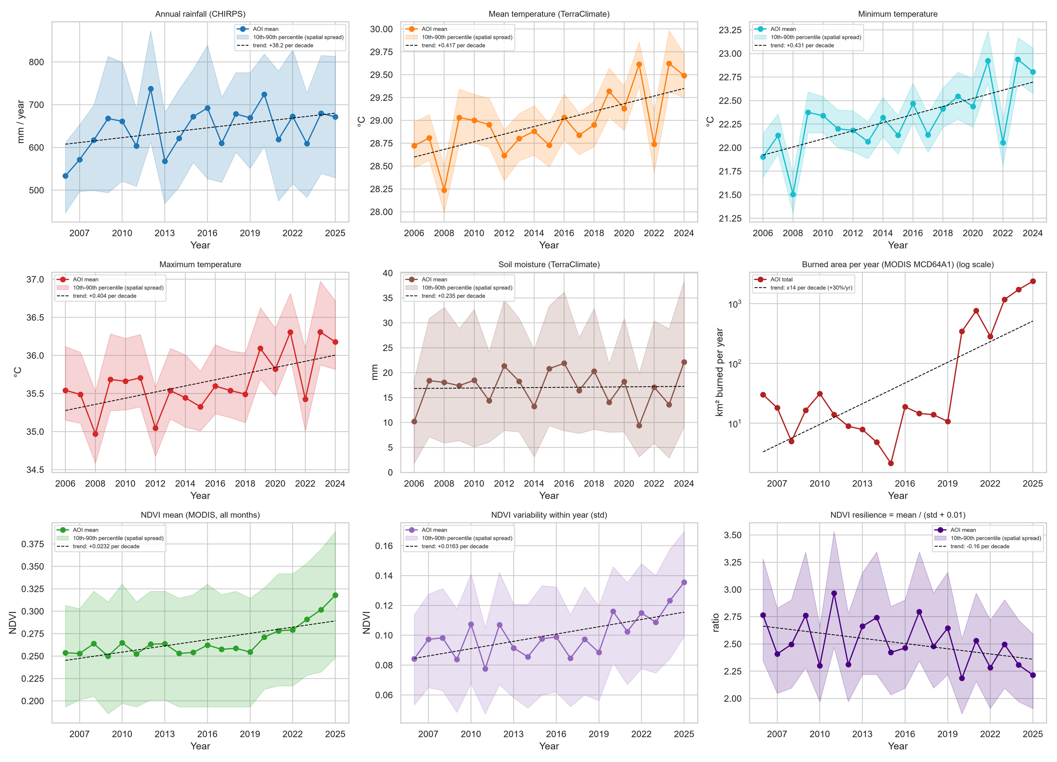




20 years of change: hotter, greener, more fire
STEP 3 · EXPLORATORY DATA ANALYSIS
Warming
Mean, min and max temperature: about +0.4 °C per decade
Slightly wetter
Rainfall +38 mm per decade; soil moisture flat
Greening
NDVI mean rising since 2019; resilience falling
More fire
Burned area low until 2019, then up to about 2,400 km² in 2025
Notes:
Still in step three, the exploratory analysis. This is the yearly figure from my notebook: the regional average per year, the shaded band shows how much sites differ, and the dashed line is the trend per decade. All three temperatures rose by about 0.4 degrees per decade. Rainfall rose by about 38 mm per decade, while soil moisture stayed flat. Vegetation greenness rose clearly since 2019, but its resilience fell. Burned area is on a log scale, because it was small and stable until 2019, between about 2 and 30 square kilometres a year, then jumped from 2020 onwards to about 2,400 square kilometres in 2025. That is roughly 14 times more per decade. The region is changing fast, which is why a 20-year trend is a better guide than a single snapshot.

Slide 7
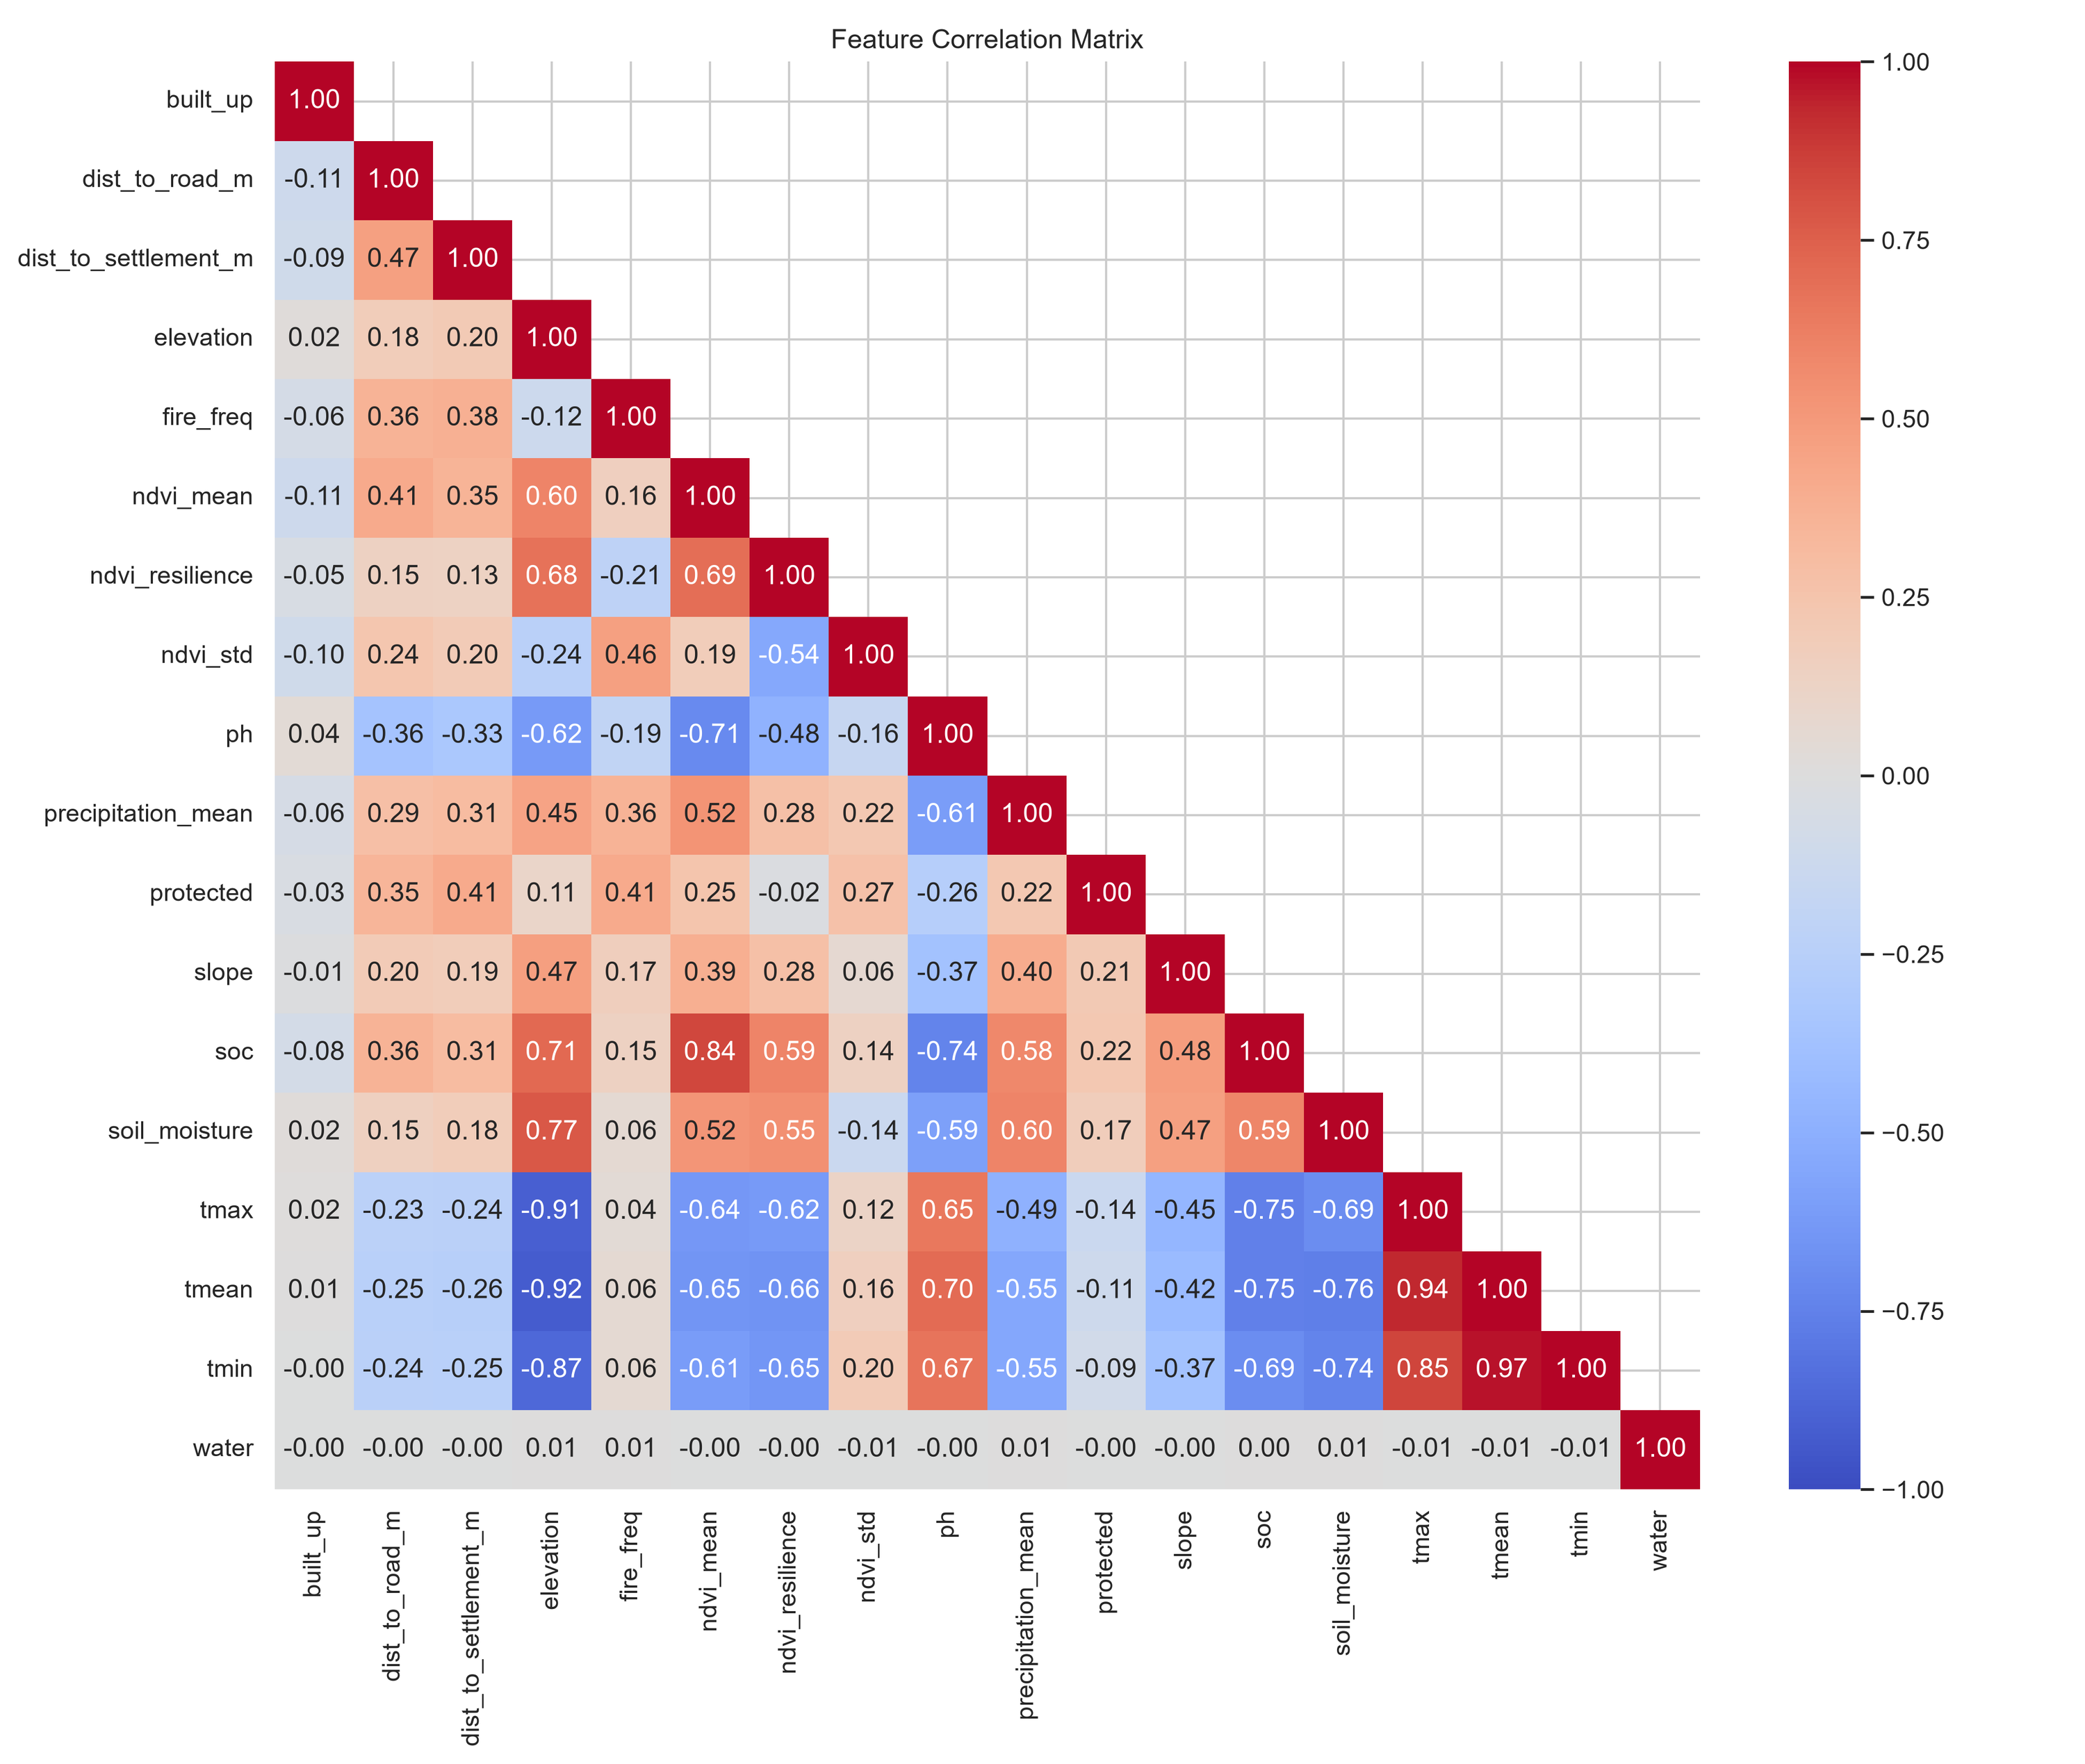


Conditions move together
STEP 3 · EXPLORATORY DATA ANALYSIS
Temperature mirrors elevation
ρ −0.87 to −0.92: higher ground is cooler
Soil carbon tracks greenness
ρ 0.84 between soil carbon (soc) and NDVI mean
Wetter soils sit higher up
ρ 0.77 between soil moisture and elevation
So what: tree models cope with correlated inputs, but one driver can stand in for another.
Notes:
This is the correlation matrix from my notebook, using Spearman correlation. Many conditions move together. The three temperature layers are almost a mirror image of elevation: higher ground is cooler. Soil carbon goes with greener vegetation, and soil moisture is higher at higher elevation. The new access layers add one more pattern: sites far from roads and settlements burn more often and are more often protected, with correlations around 0.35 to 0.4. This matters for interpretation: Random Forest and XGBoost handle correlated inputs well, but when we later rank drivers, one variable can stand in for another. So I read the importance ranking as groups of conditions, water, terrain and temperature, rather than single variables.

Slide 8
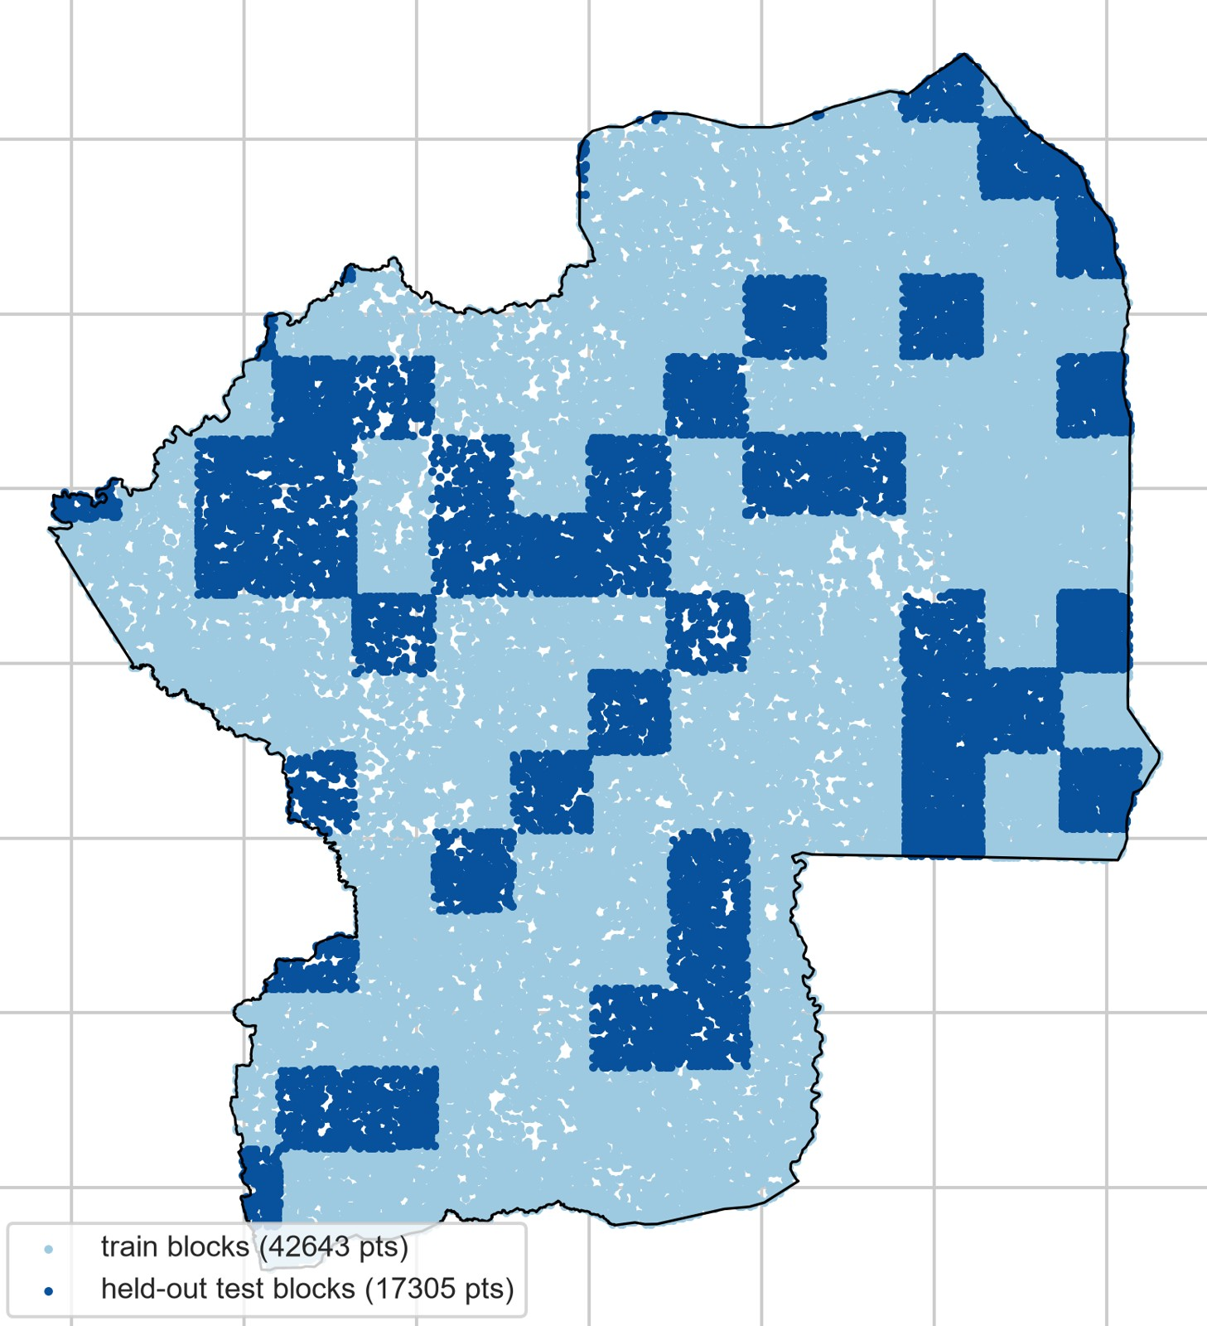



Spatial validation: tested on places never seen
STEP 4 · MODELLING
Why not a random split?
Neighbouring sites look alike, so a random split leaks answers and inflates scores.
10 km blocks
49 whole blocks (17,305 sites) held out as the final test; 114 blocks for training.
Tuning
Grouped 5-fold cross-validation on the training blocks, scored on F1 macro.
Four models compared:
Random Forest
XGBoost
Logistic Regression
CNN, 5×5 patches
Notes:
Step four is modelling, and the most important choice here is validation. Neighbouring pixels look alike, so a random split would let the model cheat by memorising its neighbours. Instead I cut the region into 10 km blocks and held out whole blocks, the dark blue squares, as the final test. Tuning used grouped 5-fold cross-validation on the training blocks only. I compared four models: Random Forest, XGBoost, logistic regression as a simple baseline, and a 2D convolutional network that looks at a 5 by 5 pixel patch around each site.

Slide 9
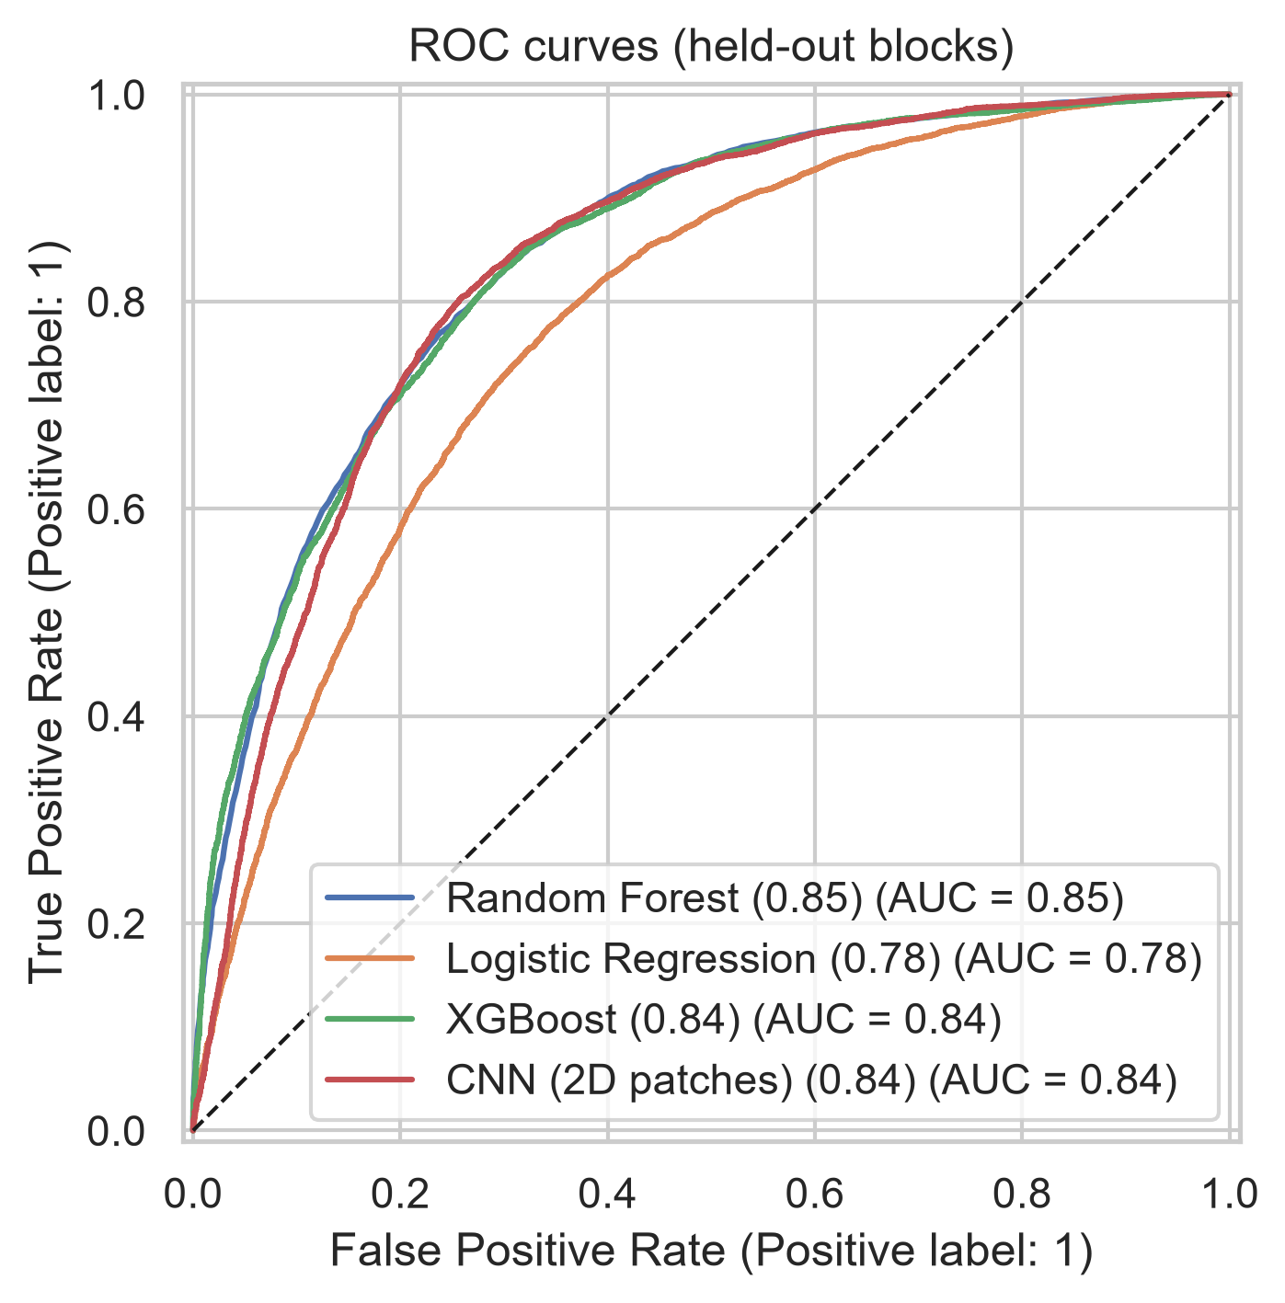
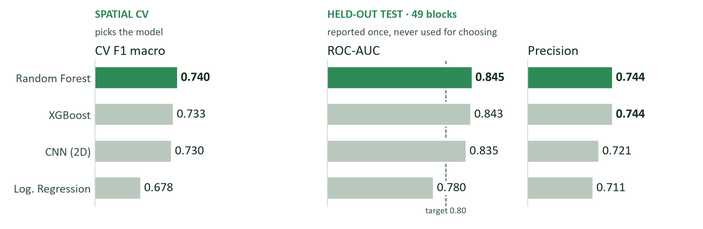
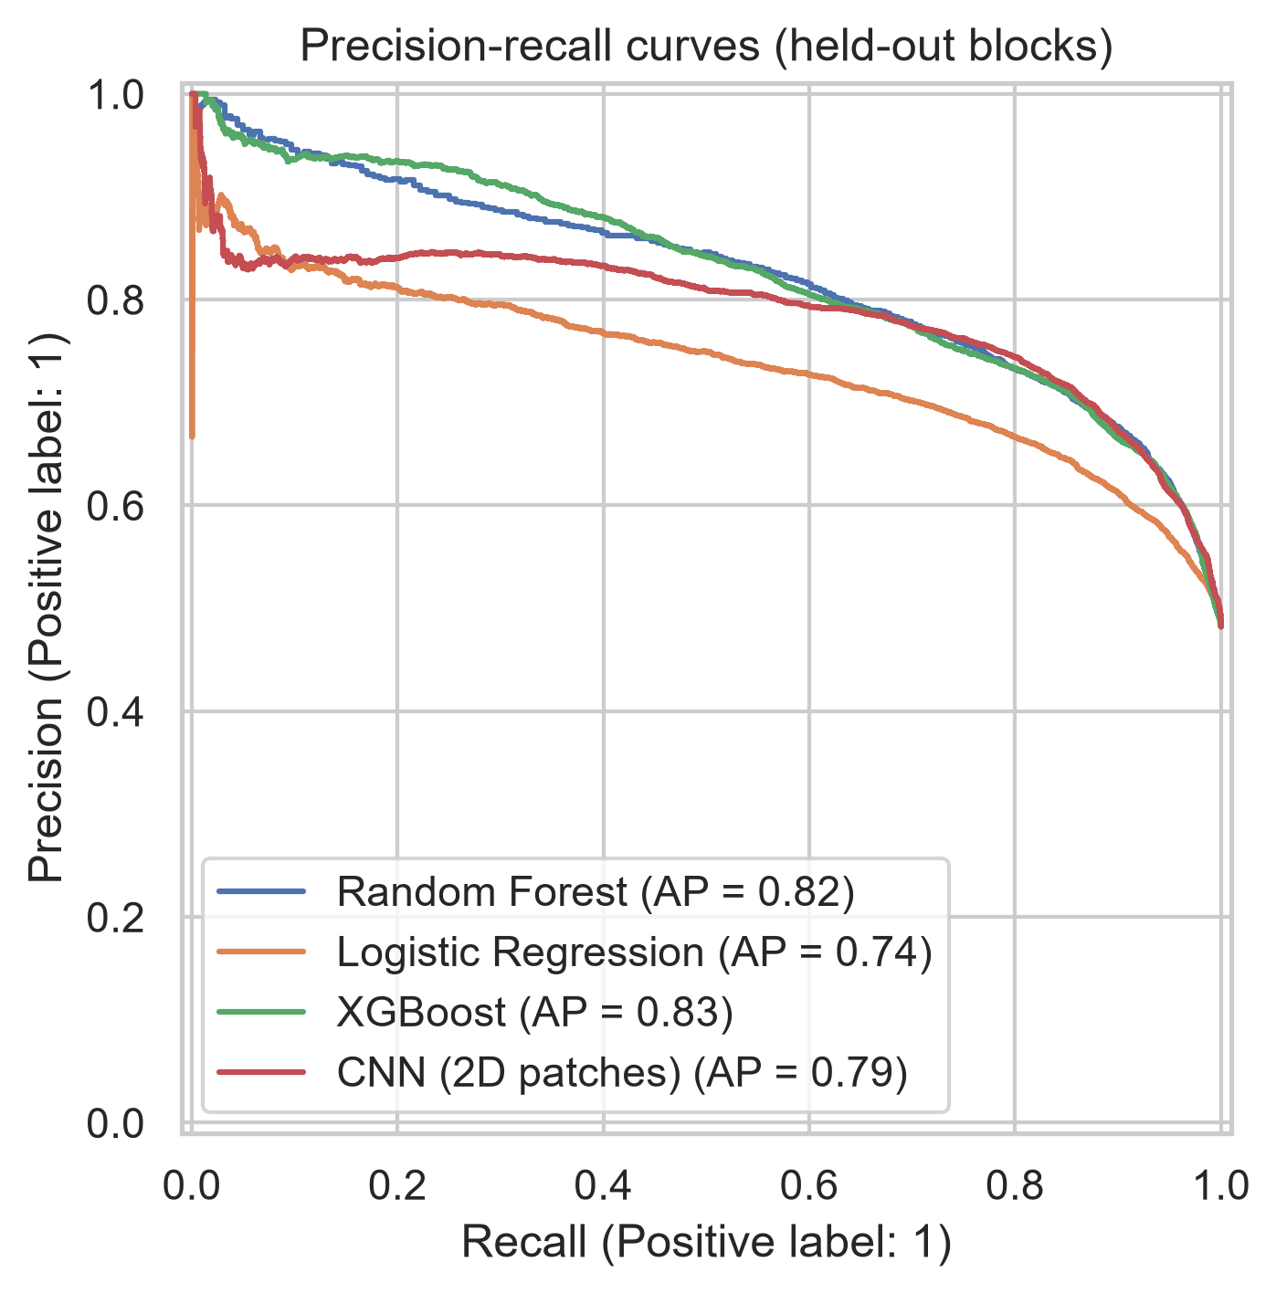
Why Random Forest was selected
STEP 5 · EVALUATION
Targets: ROC-AUC ≥ 0.80, met by RF, XGBoost and CNN.
Fair test: the test set is used once, for reporting, never for choosing.
Precision: of the sites a model flags high, the share that really regreened.
Notes:
Step five is evaluation. Since the scores are so close, here is exactly how the model was chosen. On the left is the selection metric: F1 macro from spatial cross-validation on the training blocks only. Random Forest scores highest, 0.740, just ahead of XGBoost and the CNN. On the right are the scores on the 49 held-out test blocks. On the test blocks Random Forest also has the highest ROC-AUC, 0.845; the CNN has a slightly higher test F1 and XGBoost a slightly higher PR-AUC, but I did not pick on the test set, because then the test score would no longer be an honest estimate. Honestly, the top three are practically tied, within 0.01. Random Forest won on cross-validation, and it is also the simplest to run, because it needs no image patches, and the easiest to explain. I also added precision for the high class: of all the sites Random Forest flags as high potential, 74% really regreened, the same as XGBoost. For a funder, that is the hit rate of the shortlist. All three meet both targets; logistic regression is clearly weaker, which tells us the relationships are non-linear.

Slide 10




What drives restoration potential
STEP 5 · EVALUATION
#1
#2
#3
#4
Soil moisture
Rainy-season water in the soil (Jul–Oct): the strongest signal
Vegetation stability
NDVI variability and resilience of the starting vegetation
Elevation
Terrain, and the temperature gradient that comes with it
Min. temperature
Night-time heat that stresses young plants
How we know: permutation importance on the held-out blocks. Random Forest and XGBoost agree on the top two; road and settlement distance rank mid-table.
Notes:
Which conditions drive the predictions? I measured permutation importance on the held-out blocks: shuffle one variable and see how much the score drops. For Random Forest and XGBoost, soil moisture in the rainy season is by far the most important, followed by how stable the existing vegetation is, then elevation and minimum temperature. The new access layers, distance to settlements and roads, rank in the middle. The CNN relies more on soil organic carbon, soil moisture and elevation. For funders, the message is: water availability and terrain matter most when choosing a site.

Slide 11
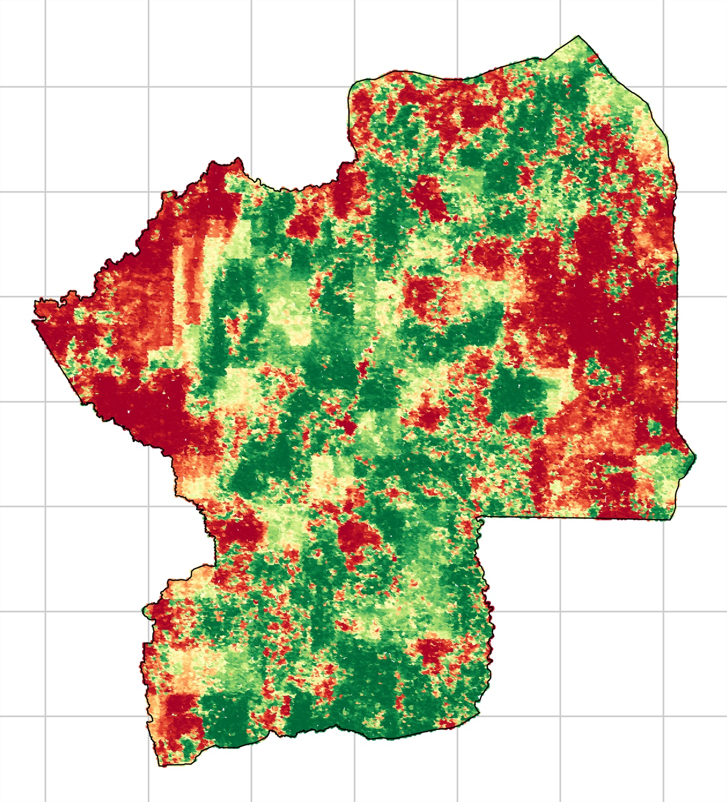
The opportunity map: every site scored
STEP 5 · RESULTS
Random Forest, 99,913 sites
High
P ≥ 0.60
Uncertain
0.40 – 0.60
Low
P ≤ 0.40
Green belt through the centre; low potential in the far west and east.
Probability of high potential
Tiers at 0.40 and 0.60
Notes:
Here is the result: the Random Forest scores all 99,913 sites. On the left, the probability of high potential; on the right, the same scores grouped into three tiers with thresholds at 0.4 and 0.6. You can see a clear green belt running through the centre of the region, and large low-potential zones in the far west and in the east.

Slide 12
Random Forest rates 47% of the region high
STEP 5 · RESULTS (RANDOM FOREST)
6,228 km²
47% of region
High potential
Prioritise for restoration and agroforestry investment
1,465 km²
11% of region
Uncertain
Verify in the field before committing funds
13,242
km² scored
5,548 km²
42% of region
Low potential
Avoid, or plan different interventions (soil and water first)
Notes:
These tiers come from the selected Random Forest model. Translated into area: about 6,230 square kilometres, 47% of the region, is high potential. 11% is uncertain, and 42% is low potential. Each tier comes with a recommendation: prioritise the high tier for investment, verify the uncertain tier in the field before committing money, and avoid the low tier or plan different interventions there, like soil and water conservation first.

Slide 13
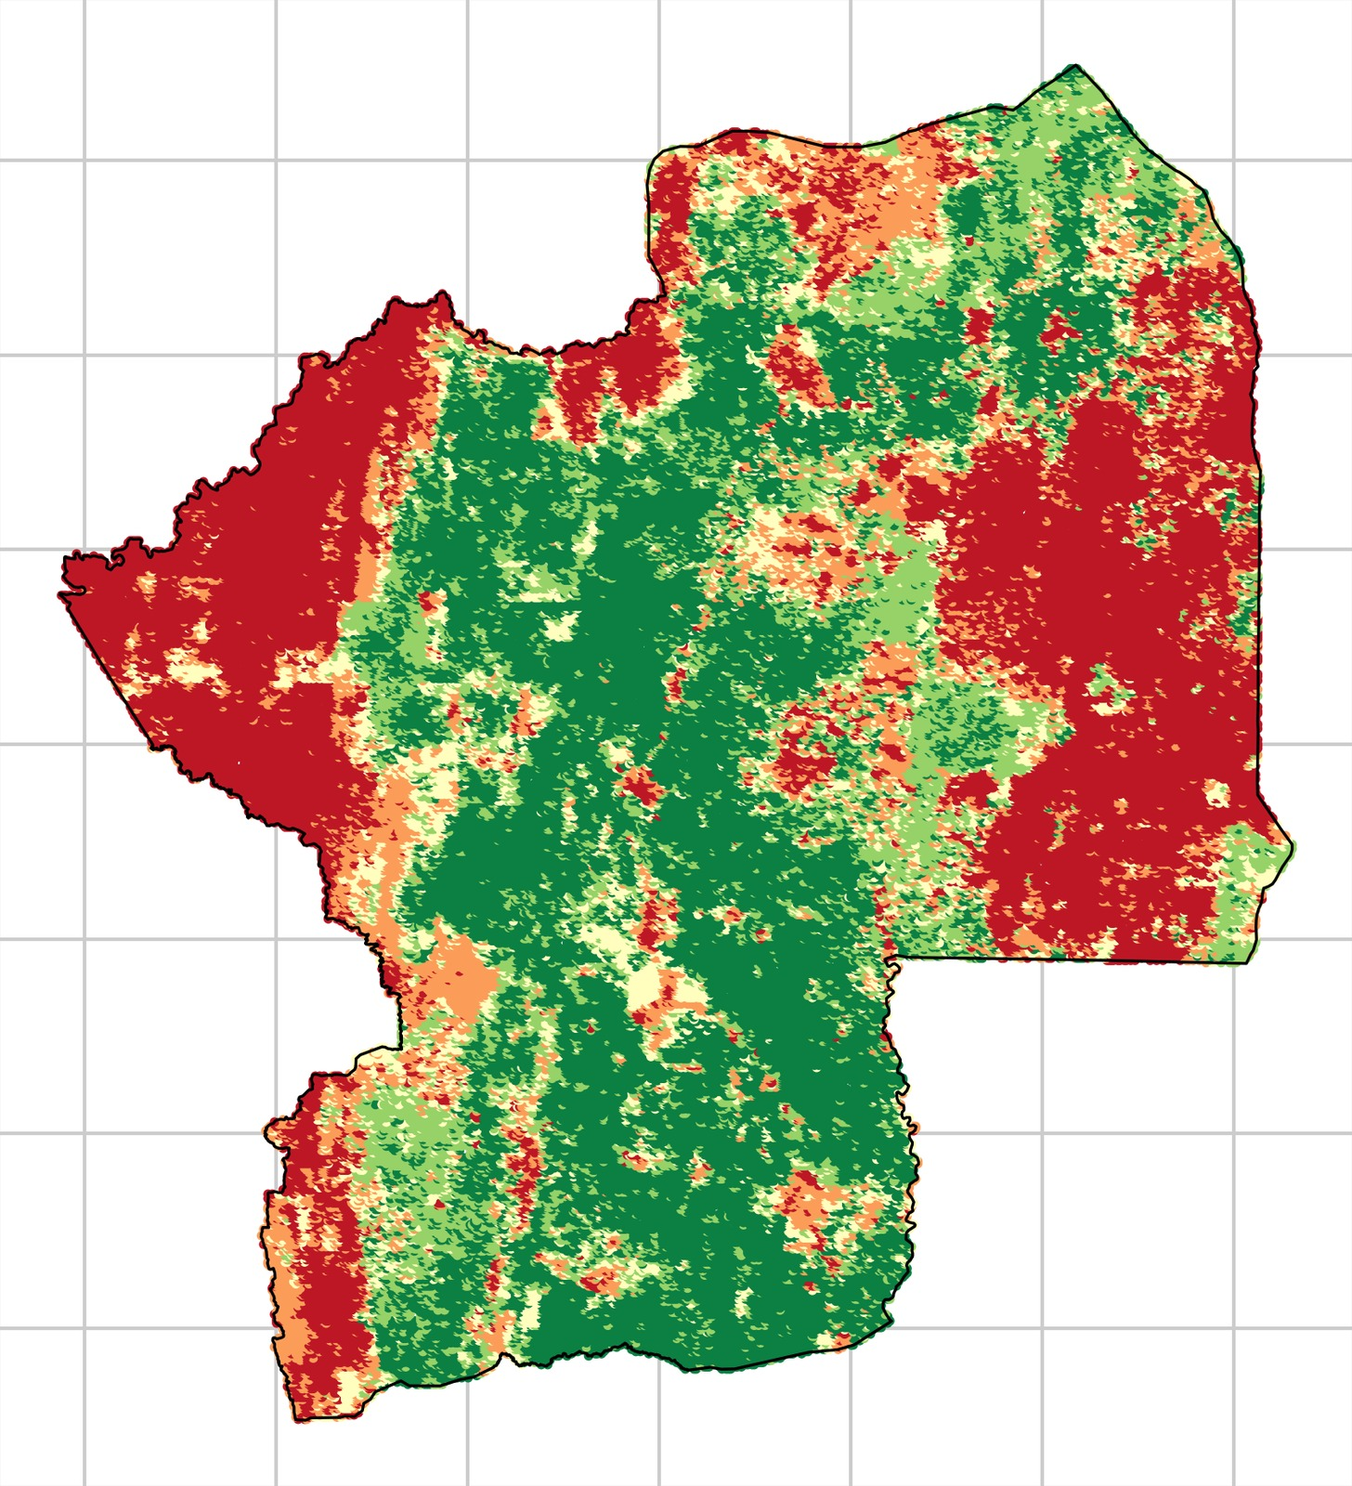
Where all four models agree, risk is lowest
STEP 5 · RESULTS (ALL FOUR MODELS)
4 of 4 say high
34%
Priority zones for investment
of sites: all four models say high
3 of 4
2 of 4
1 of 4
0 of 4
27%
Avoid zones
of sites: all four models say low
Random Forest alone rates 47% high. Requiring all four models to agree narrows it to 34%: fewer sites, more confidence.
Notes:
For a bank, the question is also: how sure are we? This map counts how many of the four models predict high. Note the difference with the previous slide: 47% was Random Forest alone. Requiring all four models to agree is stricter, so it drops to 34% of the sites; these are the most robust priority zones. In 27%, all four agree on low: these are robust avoid zones. Where the models disagree, that is exactly where a field visit adds the most value.

Slide 14
Only high-potential land pays back
STEP 5 · RESULTS (COST AND RETURN)
USD per hectare over 20 years, in today's money (10% discount rate)
+249
USD/ha NPV
Agriculture, high potential
ROI +11%; pays back on 70% of these sites
−437
USD/ha NPV
Forest, high potential
Carbon credits at 15.6 USD/t do not yet cover the costs
< 0
NPV, both uses
Low potential
ROI −84% to −92%: avoid, or fix soil and water first
NPV = expected return − cost. ROI = NPV ÷ cost. Expected return = revenue × P(high) × fire risk. Inputs: FAO, IPCC, World Bank, WFP, Ecosystem Marketplace.
Notes:
New in the project: cost and return. For every site I added the cost of two general land uses, forest restoration and agriculture, using reference data from FAO, IPCC, the World Bank and WFP, plus site extras: distance to roads and settlements, slope, fire frequency and acidic soil. The expected return is the revenue if the project succeeds, times the model's probability P, reduced by fire risk. Everything is summed over 20 years and converted to today's money at a 10% discount rate. NPV is expected return minus cost; ROI is NPV divided by cost. The result: on high-potential land, agriculture pays back, +249 dollars per hectare, an ROI of 11%, on 70% of those sites. Forest restoration earns only carbon credits, and at today's average price of 15.6 dollars per tonne it loses 437 dollars per hectare. On low-potential land, both uses lose money. So the model's tiers translate directly into investment advice.

Slide 15
The carbon price decides when forests pay
STEP 5 · RESULTS (COST AND RETURN)
Mean NPV per hectare on high-potential sites, 20 years, 10% discount rate
15.6
USD/t today
Market price
Average reforestation credit, 2023 (Ecosystem Marketplace)
≈ 28
USD/t
Break-even
Forest restoration on high-potential land starts to pay back
40
USD/t
Forest wins
Better use on 95% of high-potential sites, ROI +43%
Forest revenue = carbon credits only: 8.9 tCO₂e/ha/yr (IPCC 2019), 80% sold, from year 4. Agriculture does not depend on the carbon price.
Notes:
Why does forest restoration lose money? Its only revenue in my model is carbon credits: about 8.9 tonnes of CO2 per hectare per year, based on IPCC growth rates for young African dry forest, of which 80% is sold. This chart shows how the NPV of forest restoration on high-potential land changes with the carbon price. At today's average of 15.6 dollars per tonne it is negative. It breaks even at about 28 dollars, and at 40 dollars it becomes the better land use on 95% of high-potential sites, with an ROI of 43%. Agriculture, the dashed line, does not depend on the carbon price. In the Streamlit app, investors can move the carbon price, discount rate, horizon and tier thresholds themselves.

Slide 16






From notebook to decision tool: Streamlit app
STEP 6 · DEPLOYMENT
Overview
Opportunity map
Explore the data
Model performance
Question, data, method, key scores and tier areas
Per-model map, adjustable thresholds, CSV export
Conditions per tier, scores per variable, correlations
Results, targets, tuning gain, feature importance
Cost and return
Score a site
Score a new region
Cost, expected return, NPV and ROI per hectare for high and low potential; carbon price slider
Pick a site, change its conditions, get scores from all models
Type a place name: Earth Engine data, four model scores, range warnings
Notes:
Step six is deployment. All results are in a Streamlit web app with seven pages. [Switch to the live demo here.] Overview; the opportunity map, where you can change thresholds, hide protected areas and download the sites as CSV; data exploration; model performance; the new cost and return page, where investors see cost, expected return, NPV and ROI per hectare for high and low potential land and can change the carbon price, discount rate, horizon and tier thresholds; scoring a single site by changing its conditions; and scoring a completely new region by typing its name. The app pulls the same layers from Earth Engine and warns when conditions fall outside the training range.

Slide 17





How an NGO or bank would use AgroRestore AI
BUSINESS VALUE
1. Screen
Filter the map to high-potential sites where all four models agree
2. Shortlist
Remove protected areas, rank by NPV and ROI, export as CSV
3. Verify
Send field teams first to the shortlist and to uncertain sites
4. Invest & monitor
Fund the verified sites and track NDVI after planting
The goal: put money and field visits where the land has the best chance, and steer it away from the 27% of sites every model rates low, to cut the cost of failed projects.
Notes:
How would a funder use this in practice? First, screen: filter to high-potential sites where all four models agree. Second, shortlist: remove protected areas, rank the sites by NPV and ROI on the cost and return page, and export. Third, verify: field teams visit the shortlist first, and the uncertain sites. Fourth, invest in verified sites and monitor them with the same NDVI data. The goal is to reduce the financial risk of failed projects by focusing money and field effort where the land has the best chance.

Slide 18


Next steps
CONCLUSION
01
02
03
Field validation
Test the predictions against restoration project records and field surveys
More regions
Train across several regions of Togo and West Africa so new areas score reliably
Local cost data
Use real project budgets; add timber, fruit and biodiversity income
Notes:
To take AgroRestore AI further, three next steps. First and most important, validate the predictions against real restoration project records and field surveys. Second, train across several regions so the model scores new areas reliably. And third, the cost and return analysis uses reference values from FAO, IPCC and the World Bank; I want to replace them with real project budgets from Togo, and add other forest income such as timber, fruit and biodiversity credits.

Slide 19
Thank you
Questions? Live demo of the Streamlit app on request.
0.76 / 0.85
F1 macro / ROC-AUC on unseen blocks
6,228 km²
high-potential land in Centrale Region
34%
of sites rated high by all four models
Kueshi Semanou Dahan · Team NeuralRoots · AgroRestore AI
Notes:
To sum up: AgroRestore AI predicts restoration potential with an F1 of 0.76 and an AUC of 0.85 on places it has never seen. It identifies about 6,230 square kilometres of high-potential land, and 34% of sites where all four models agree. Thank you, I'm happy to take questions or show more of the app.

