Slide 1

Introduction to data science
Instructor: Dr. Subhasish Mazumdar
Student: Ali Ghadimzadeh Alamdari

Slide 2
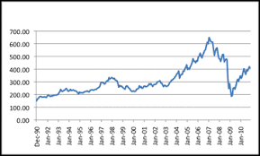
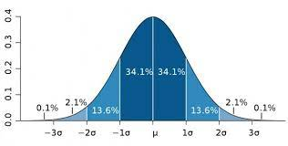
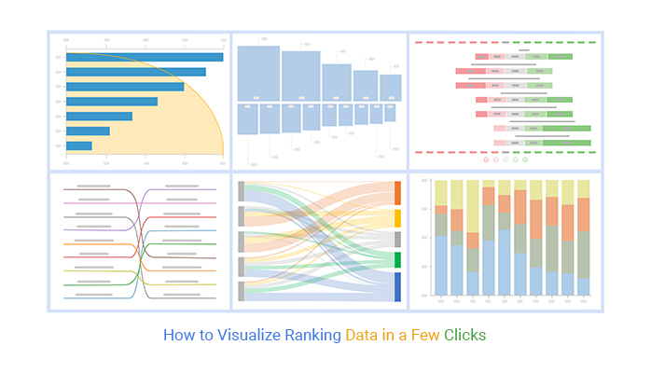
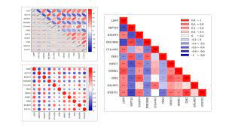
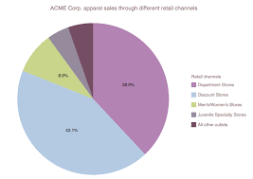
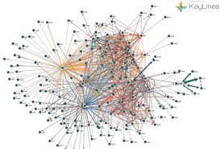
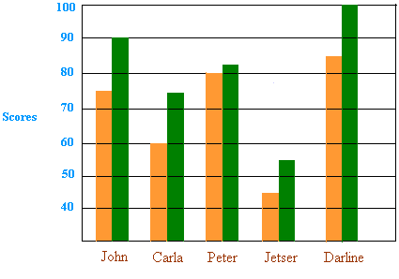
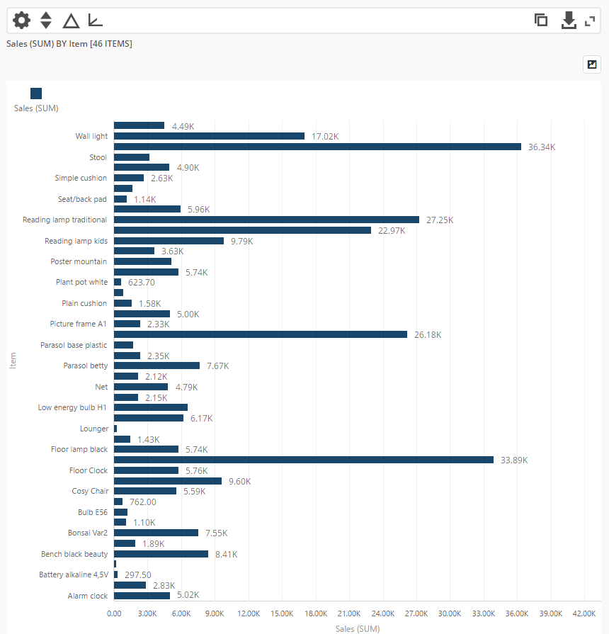
Relationships
in graphs
Time series
Distribution
Ranking
Correlation
Part to whole
Geospatial
Deviation
Nominal
comparison

Slide 3
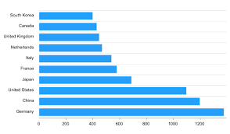
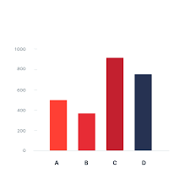
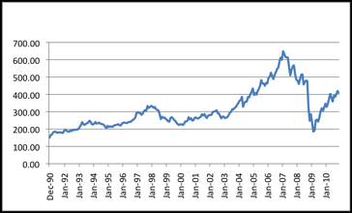
Time series
How something changed over a time.
Powerful way to view patterns and trends.
Famous example of closing price of stock.
Graph design solutions
Horizontal bars and horizontal boxes should not be used.
Vertical bars should be avoided when focusing on detecting trend because shape of bars distracts reader from shape of the data.
Connecting lines best describes the trends over time.

Slide 4
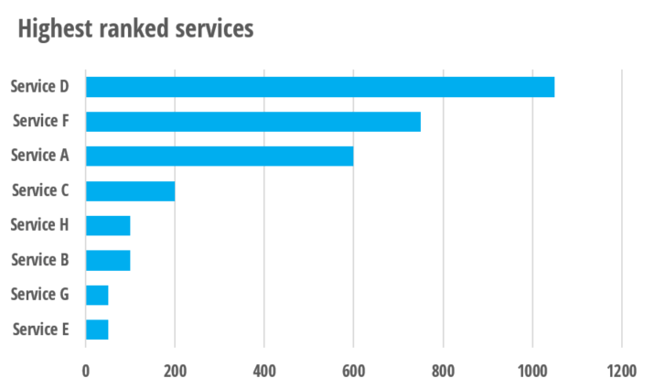
Ranking
Sorted by size from lowest to highest or vice versa.
Graph design solutions
The representing data should be sorted. If not, it is only nominal comparison.

Slide 5
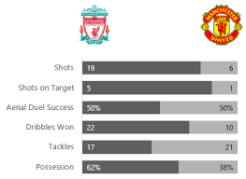
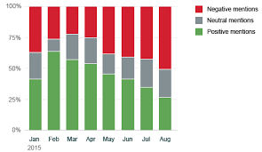

Part to whole
Individual values compared to whole values.
Typical example of sales attributed to various sales region.
Graph design solutions
Vertical and horizontal percentage bars are useful.

Slide 6
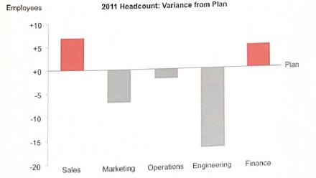
Deviations
How one or more set of quantitative values defer from a reference set of values.
For instance: the degree to which actual worker productivity differs from target productivity.
Graph design solutions
Double bar comparison graph with a reference value.
Or considering showing the difference between two value in percent or quantitative value.

Slide 7

Correlation
a mutual relationship or connection between two or more quantitative value.
Positive correlation means the values rise together and negative correlation meaning vice versa relationship.

Slide 8
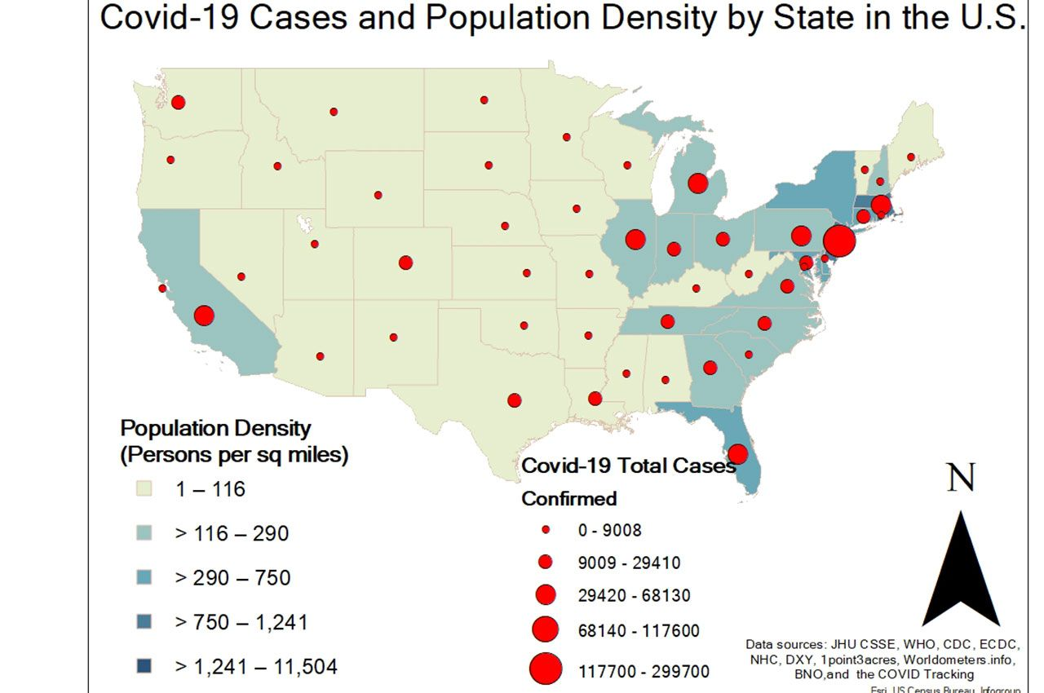
Geospatial
Quantitative values relating to a location.
Corona virus infection in each country.

Slide 9
Nominal comparison
Merely display a set of discrete quantitative values to be easily and compared.

