Slide 1
Forest Management and Modeling
Max Hachemeister, Aparna Ajayan, Olajide Faneye

Slide 2
Status quo

Slide 3
Species and Structure
Species | ~Age (Years) | Structural unit
Scots Pine | 120 | Dominant
European Beech | 60 | Second layer
Norway Spruce | 40 | Planted Group
Sessile Oak | 40 | Single Trees

Slide 4
Climate and nutrition
Parameter | Value | Misc
Growth District | 99.10.19 | Tramper Platte
Soil freshness | m | Medium fresh
Nutrition | M2 | Slightly better medium

Slide 5
Mixture Recommendation
Species | Mixture class (%)
Scots pine | <= 50
European Beech | <= 50
Norway Spruce | 0
Sessile Oak | <= 50
Brandenburg Species Mixture Recommendation

Slide 6
Stakeholder
Private owner
“Set in and forget it”
Passive income
Pension fund
Resilience and sustainability
  as long as it’s easy
  should be reflected in the resale value

Slide 7
Target mixture
Species | Mixture (%)
Scots pine | 40
European Beech | 20
Norway Spruce | 0
Sessile Oak | 40

Slide 8
Modeling

Slide 9
Initial tree stand parameters
Species | N / ha | G (m²)
Scots pine | 282 | 31
European beech | 525 | 9
Norway spruce | 28 | .6
Sessile oak¹ | 18 | .2

Slide 10
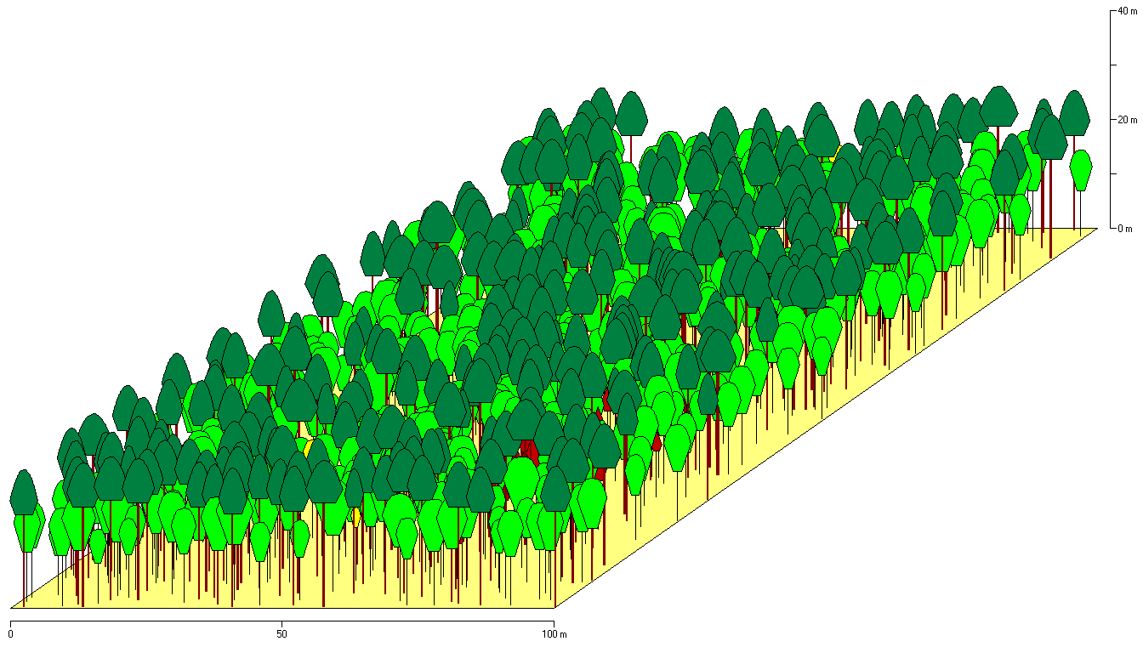
Initial tree stand side view

Slide 11
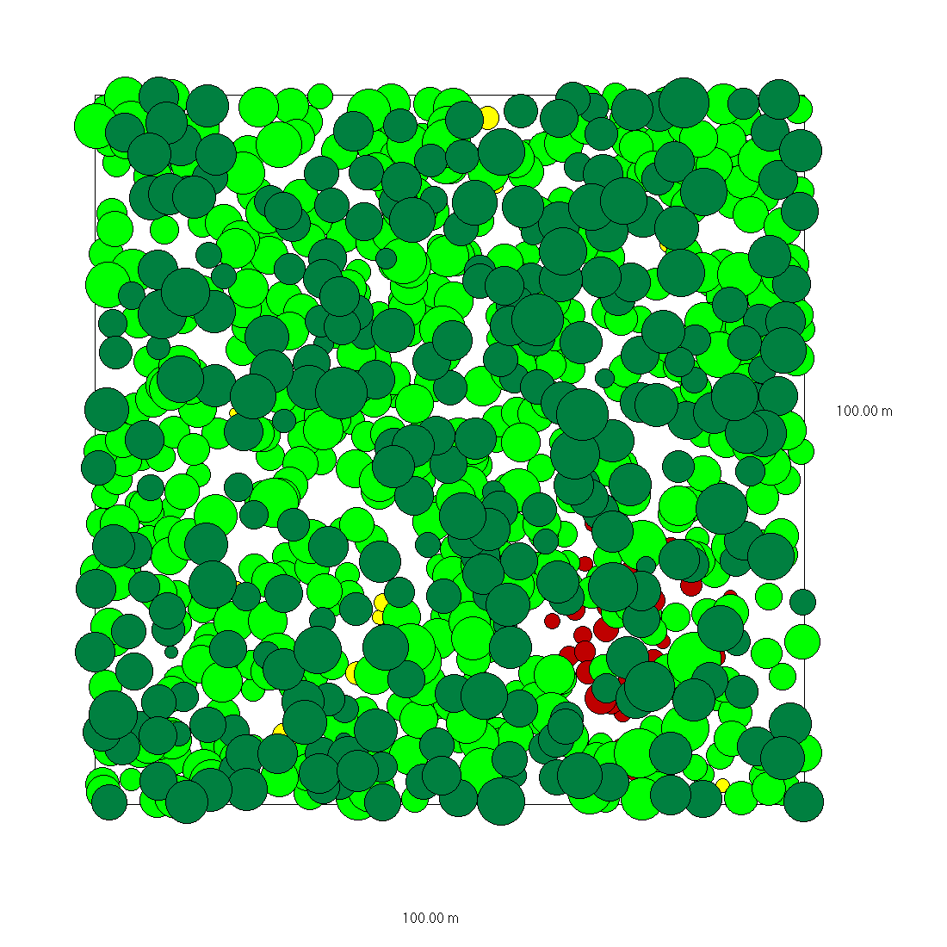
Initial tree stand top view

Slide 12
Thinning parameters

Slide 13
BAS - Business as usual
No Management

Slide 14
SIAFI - Set it and forget it
Parameter Class | Parameter | Value
Frequency | Management periods | 5 years
Intensity | Release radius | 4 m
 | Maximum harvest | 150 m³
Future Crop Trees

Slide 15
SIAFI - Set it and forget it
Species | Future Crop Trees ² / ha | Thinning regime
Scots pine | 80 | light
European beech |  | heavy
Norway spruce
Sessile oak
Future Crop trees

Slide 16
Notes
1. $d_{g}$ was set manually to $12 cm$
2. ${\left(N \text{Future trees mono}\right)}_{i}×{\left(\text{Target proportion}\right)}_{i}$ // $i=Species$

