Slide 1
Burning Man

Slide 2
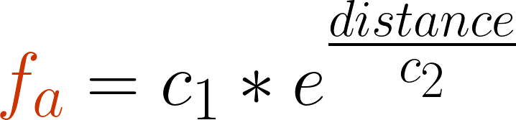
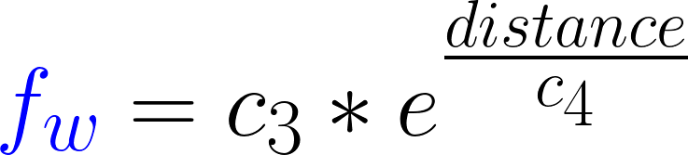
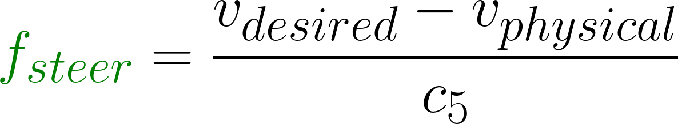
Social Force Model
Sign
Notes:
{\color{Orange} f_{a}} = c_1*e^ \frac{distance}{c_2}
{\color{Blue} f_{w} }= c_3*e^ \frac{distance}{c_4}
{\color{DarkGreen} f_{steer} }= \frac{v_{desired}- v_{physical}}{c_5}
https://www.codecogs.com/latex/eqneditor.php
1)The model consists of agents, that behave like particles in Newtonian Mechanics. To get the particles to behave like humans, we just define a bunch of forces.
2) We define a repelling force between agents and between agents and walls. As humans like to have their personal space, they don't want to stand too close to a wall or to close to another human. If two agents stand very close to each other, then the repelling force should be much bigger. This is why we use e to the power of the distance.
3) Perhaps the most important force is the steering force. It lets the agents move in the direction they want. The force just tries to accelerate the agent to his desired velocity, which is in our case in the direction of the closest sign.
4) We came up with another force, that models the formation of groups. To achieve this, we defined a linear attraction between agents. This way, we get the particles to form groups.
5) It also makes sense to define a sliding friction between agents and between agents and walls. Since the same thing happens in real life.
6) We can also define a friction between the ground and the agent. Such that the agents slow down if there is no force acting upon them. This is very important to get reasonable results.
7) There are many other intricacies one could think of. For example some papers propose a orientation dependent repulsion. This should model the fact, that the people want to have more space in the direction they walk. But as our main goal was simulating a crowd in a building, we kept things as simple as possible.

Slide 3
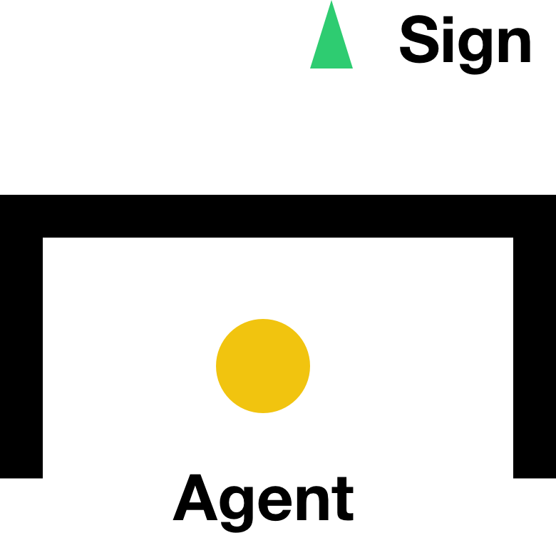
Implementation: Raytracing

Slide 4
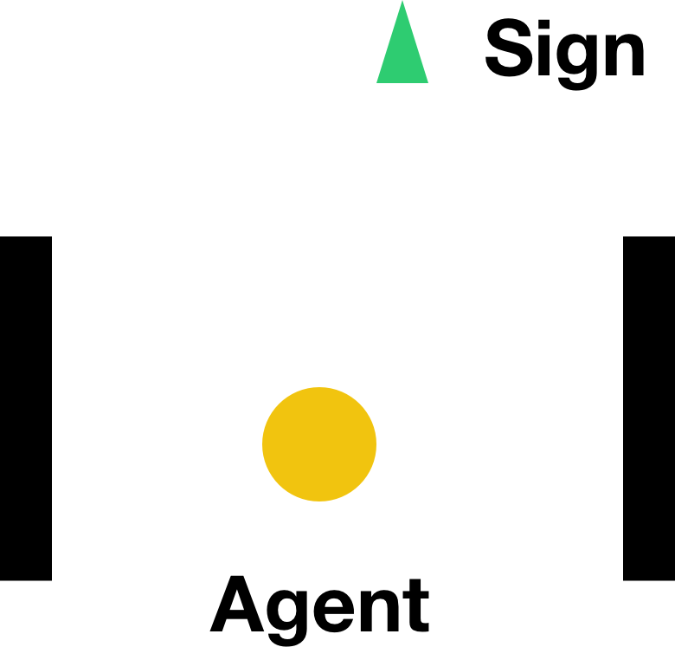
Implementation: Raytracing

Slide 5
Implementation: Raytracing

Slide 6
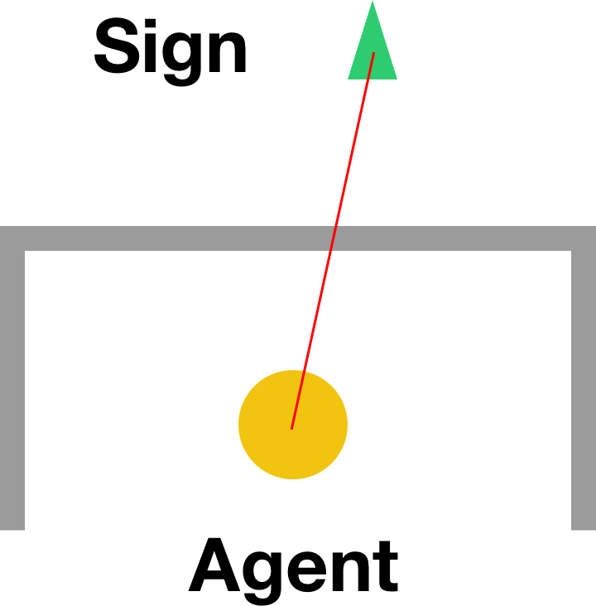

Slide 7
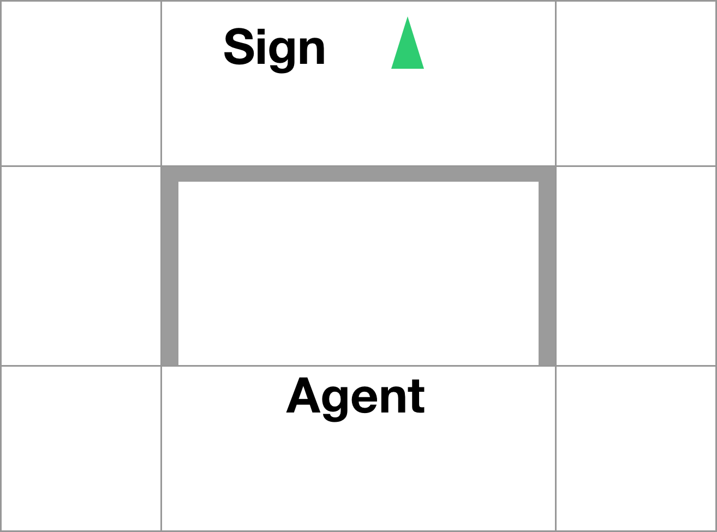

Slide 8
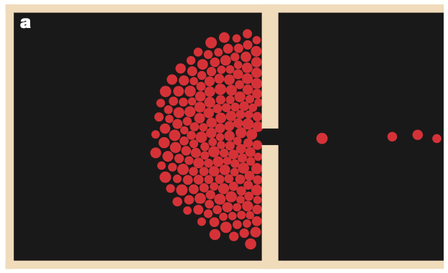
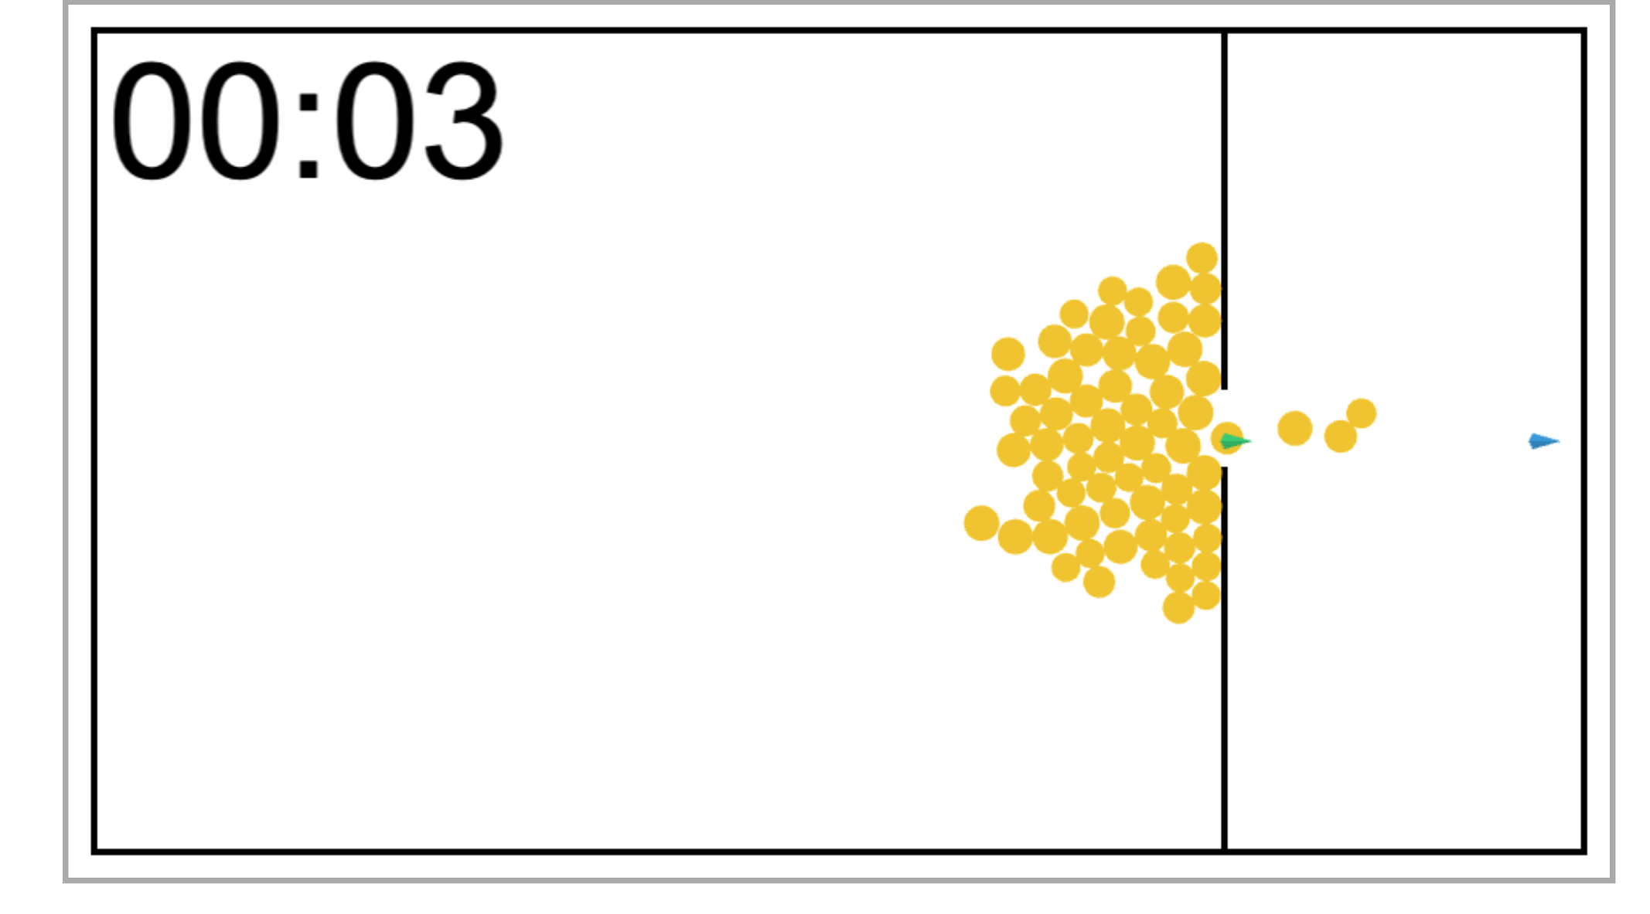
Experiment 1: small door
Experiment from the paper “Simulating dynamical features of escape panic” ¹
Experiment 1 from our Complex System Model
[1] Dirk Helbing, Illes Farkas, and Tamas Vicsek. Simulating dynamic features of escape panic. Nature, 407:487-490, 09 2000

Slide 9
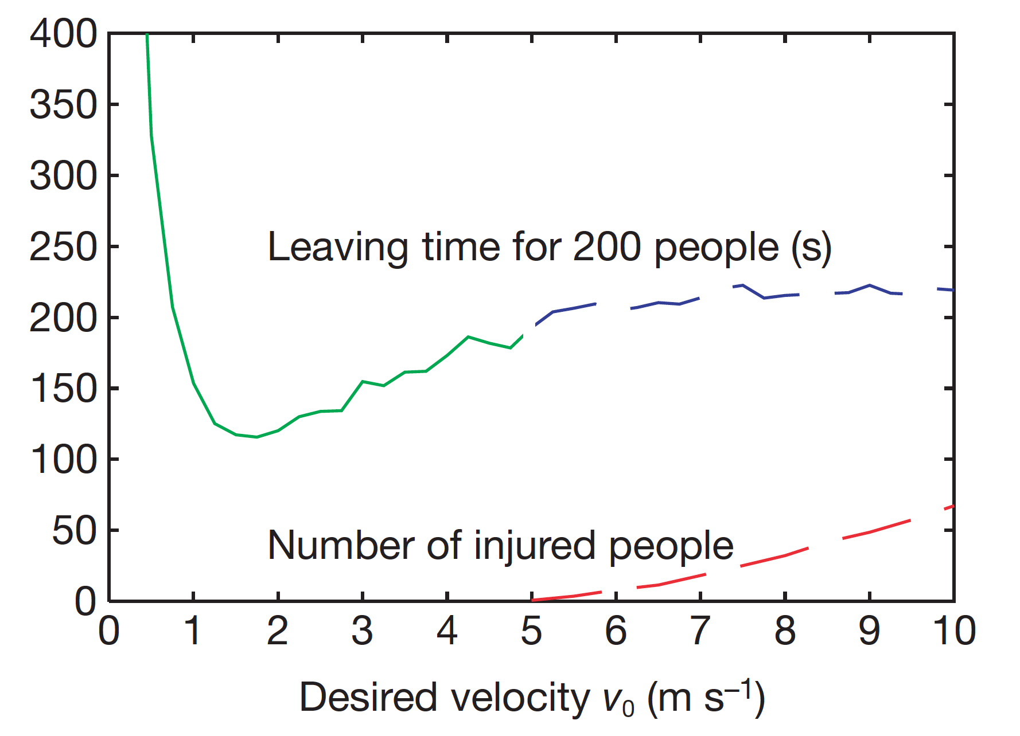
Statistical plot from the paper Simulating dynamical features of escape panic¹
[1] Dirk Helbing, Illes Farkas, and Tamas Vicsek. Simulating dynamic features of escape panic. Nature, 407:487-490, 09 2000

Slide 10
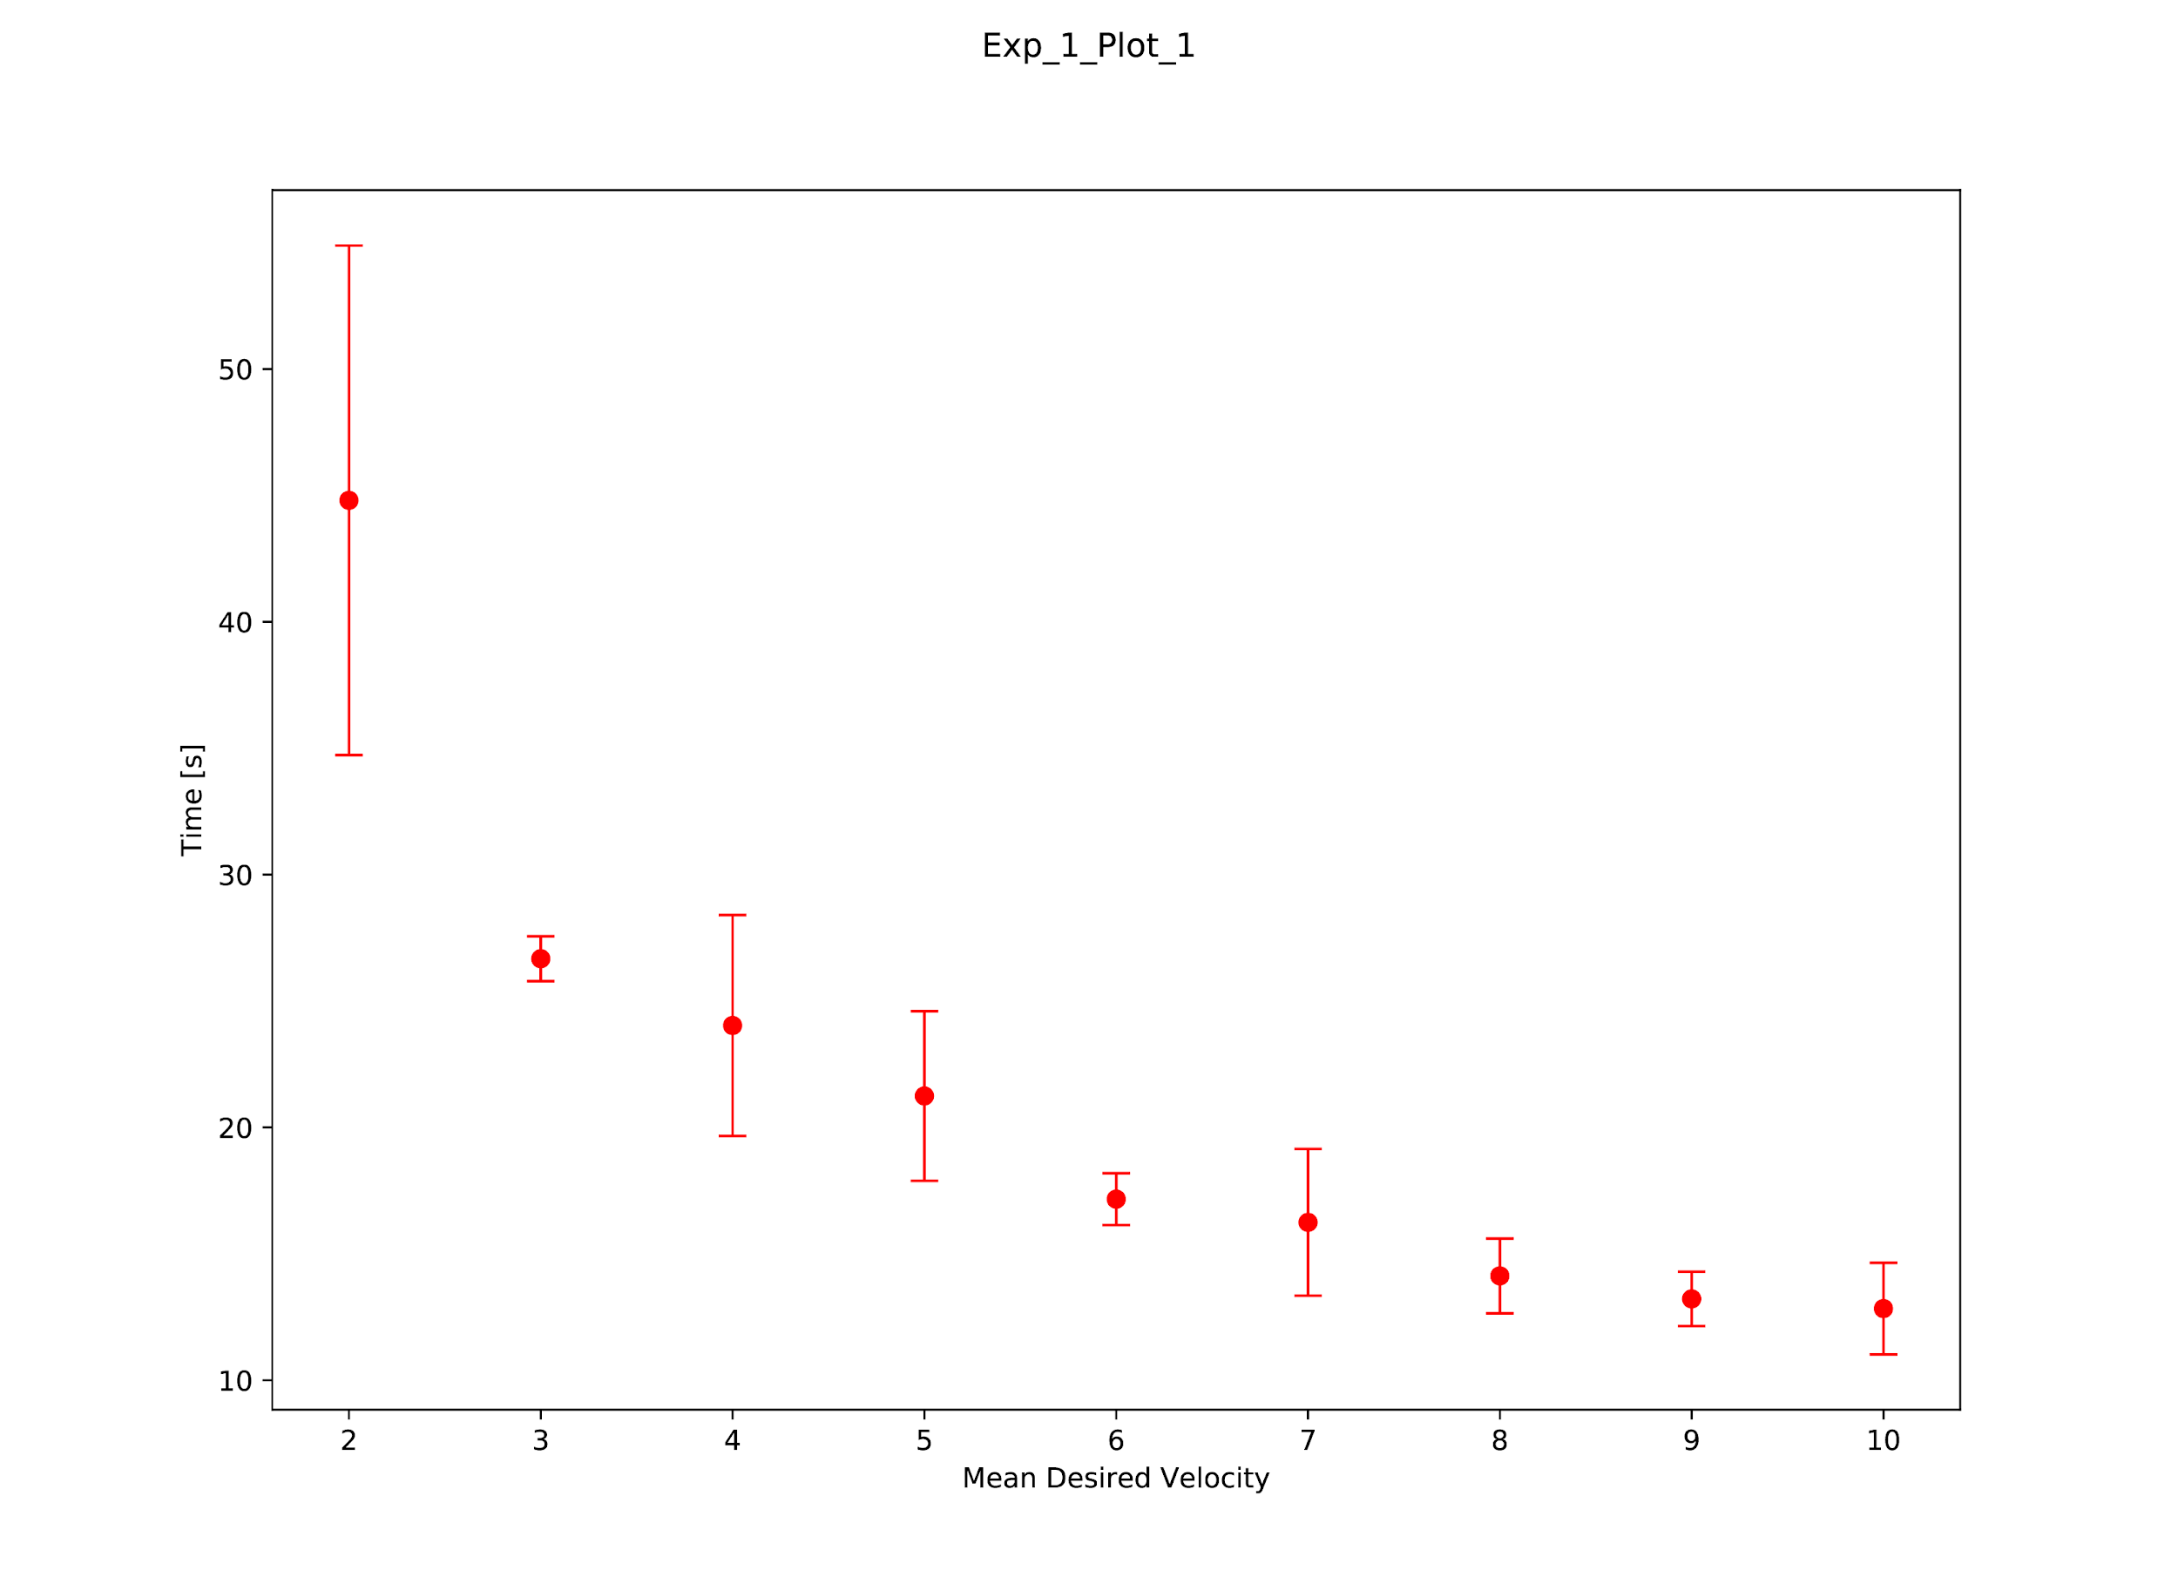
Statistical plot from the paper Simulating dynamical features of escape panic¹

Slide 11
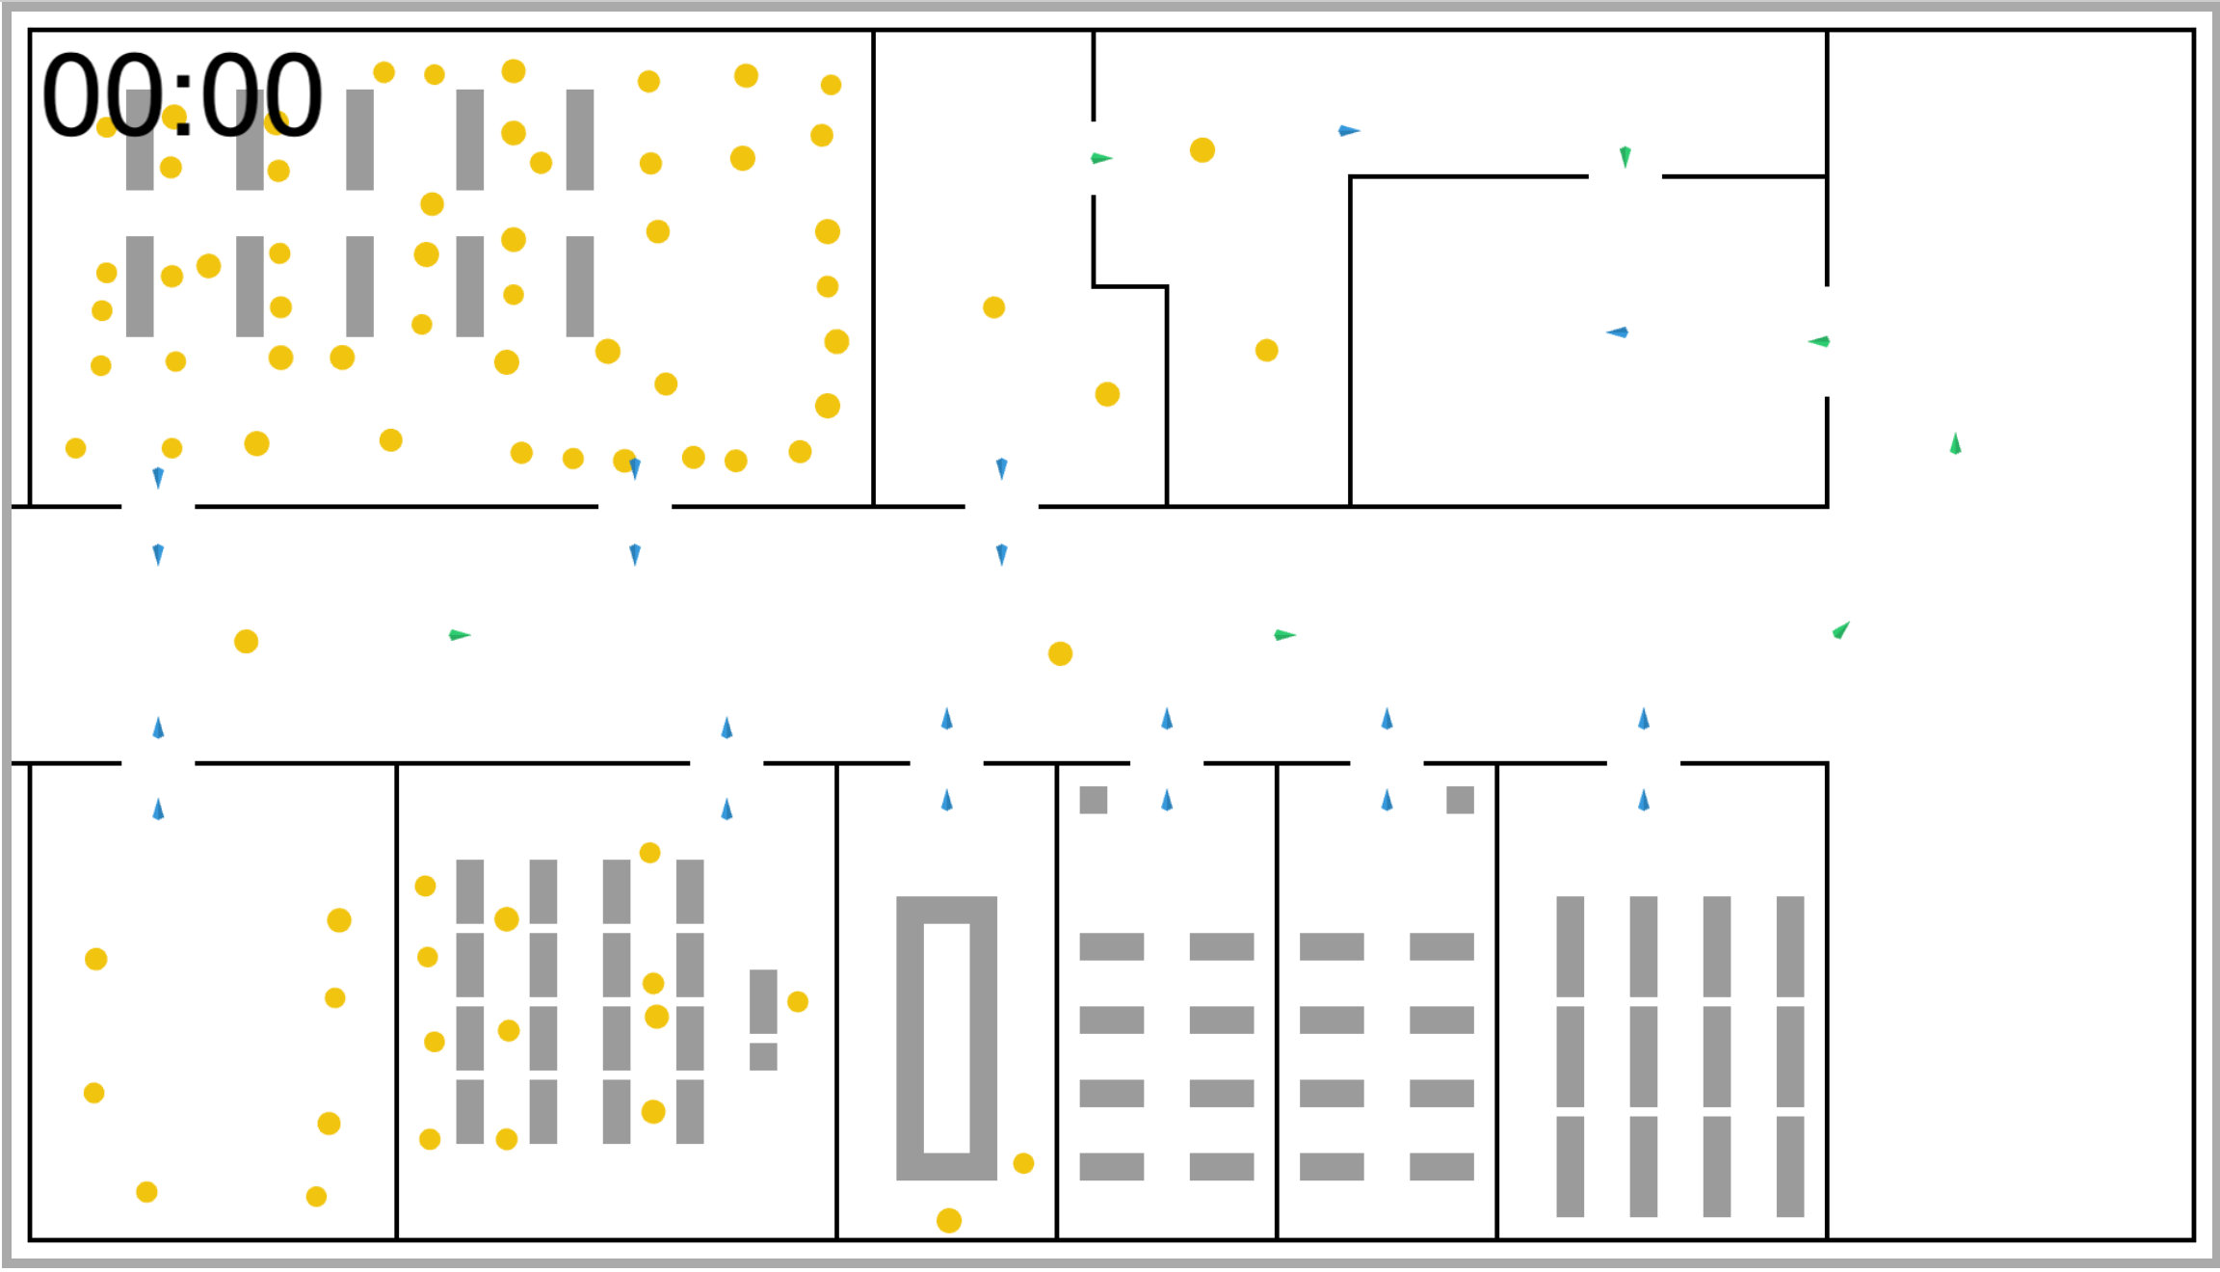
Experiment 2: Polysnack

Slide 13
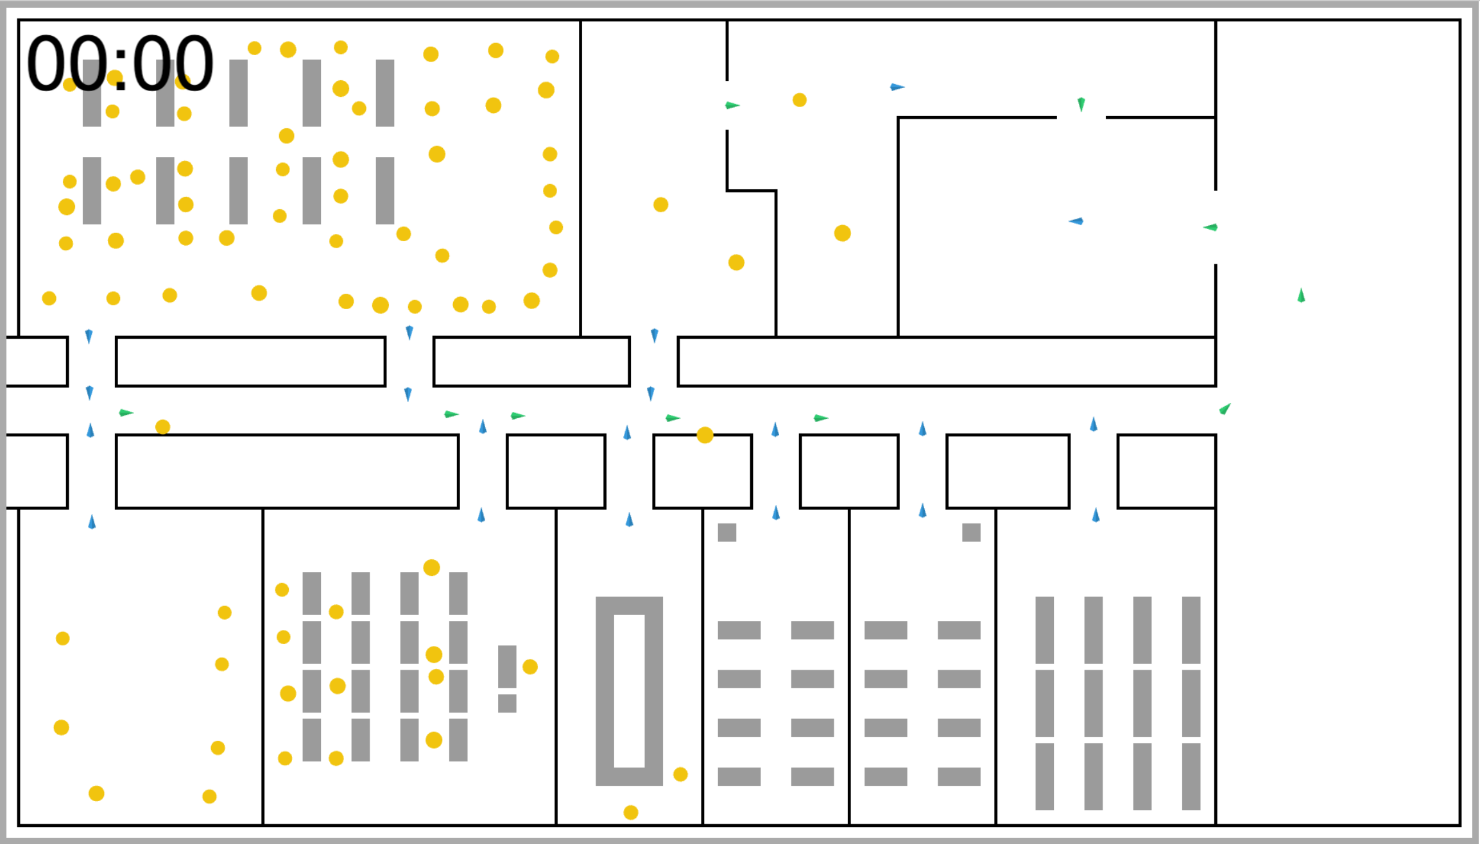

Slide 16
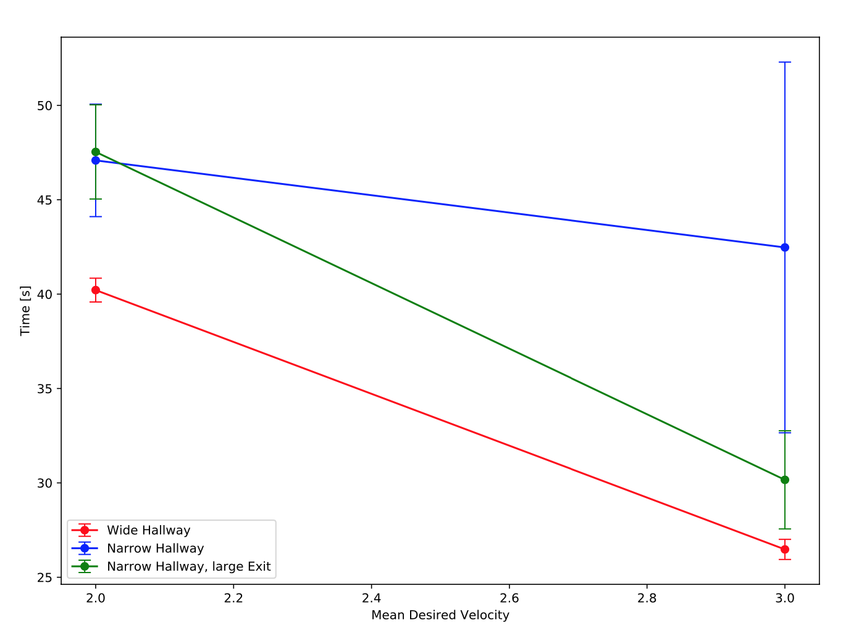

Slide 17
Further Development
Notes:
-add fire and other hazards to see how people behave if one escape route is blocked
-build model more around real world data from studies and around si units
-

Slide 18

Further Development
Notes:
-add fire and other hazards to see how people behave if one escape route is blocked
-build model more around real world data from studies and around si units
-import building plans
-

Slide 19
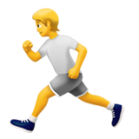
Further Development
Notes:
-add fire and other hazards to see how people behave if one escape route is blocked
-build model more around real world data from studies and around si units
-

Slide 20

Further Development
Notes:
-add fire and other hazards to see how people behave if one escape route is blocked
-build model more around real world data from studies and around si units
-

