Slide 1
Marvel vs DC Universe Analysis - Insights & Findings
Exploring Audience Reception, Critical Evaluations, and Financial Performance

Slide 2
Key Insights
• Marvel generally has higher IMDb ratings, while DC scores better on Metascore.
• Certain genres perform better financially than others.
• Financial success correlates with strong audience engagement and critical acclaim.
• Directors and lead actors have a significant impact on audience reception.

Slide 3
Exploratory Data Analysis (EDA)
• Distribution of ratings across Marvel and DC movies.
• Analysis of box office earnings and trends.
• Genre popularity trends.

Slide 4
Model Insights & Analysis
• Machine learning models were used to classify and predict movie ratings.
• Various models like Logistic Regression, Random Forest, and SVM were considered.
• Accuracy, precision, and recall metrics help in evaluating their performance.
• Feature importance analysis helps identify key factors influencing ratings.

Slide 5
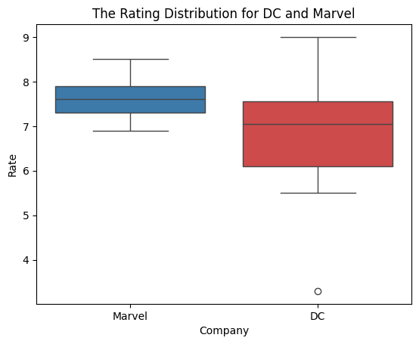
Visualization & Findings

Slide 6
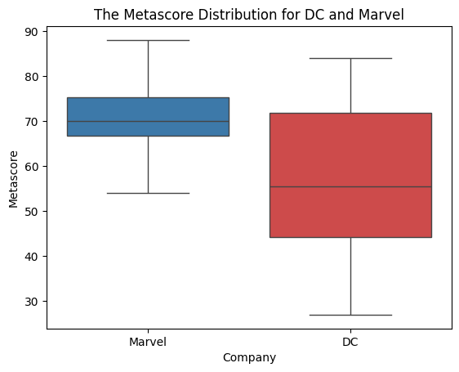
Visualization & Findings

Slide 7
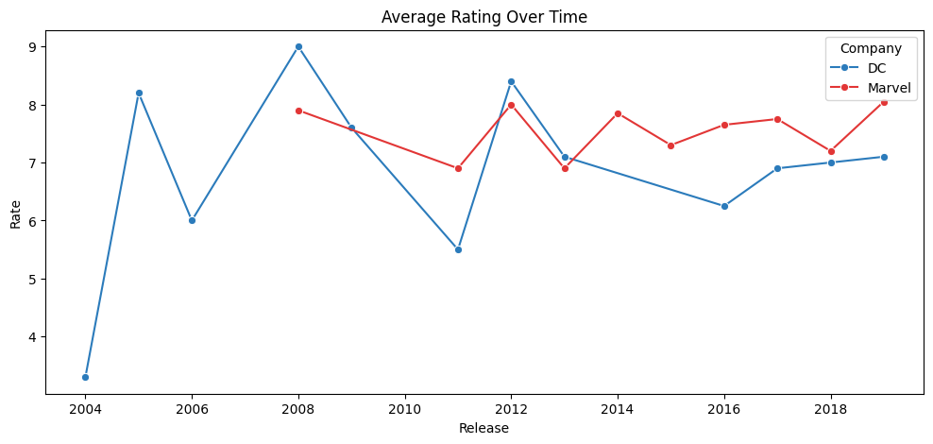
Visualization & Findings

Slide 8
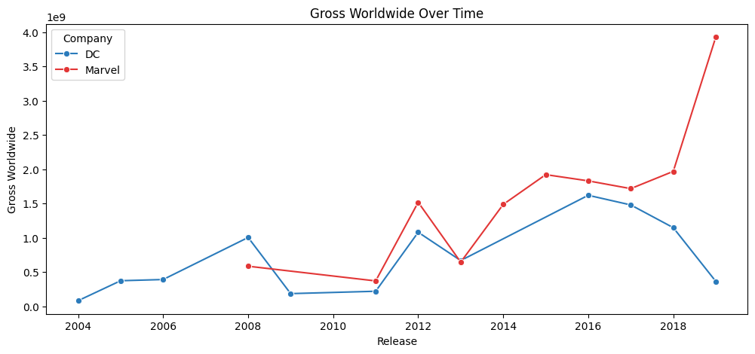
Visualization & Findings

Slide 9
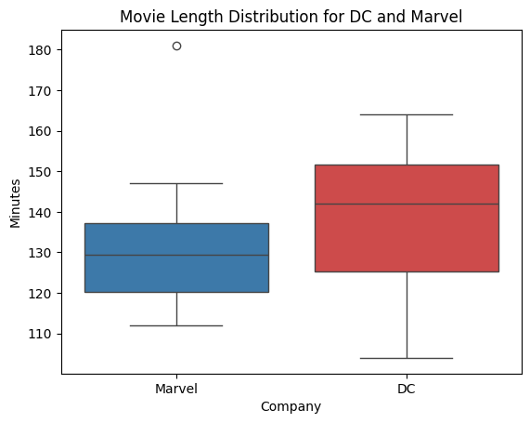
Visualization & Findings

Slide 10
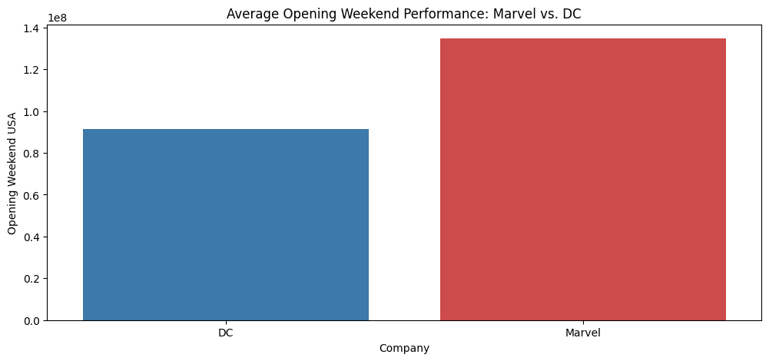
Visualization & Findings

Slide 11
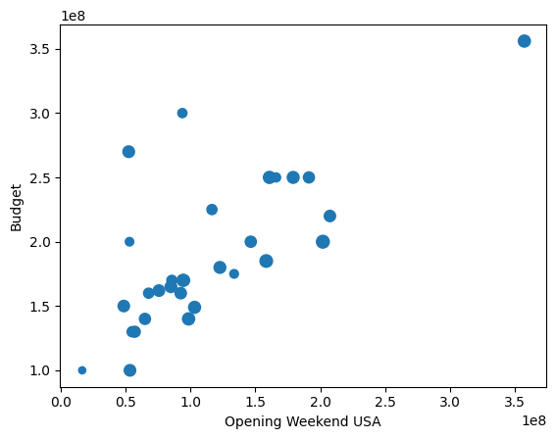
Visualization & Findings

Slide 12
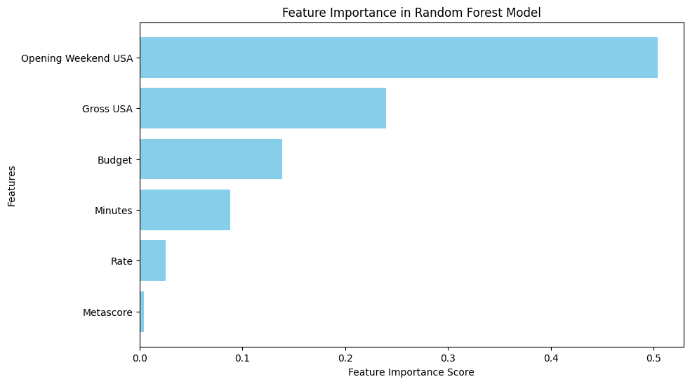
Visualization & Findings

