Slide 1
Workplace project – Marvel vs DC
Produced By: Tyrelle Brandt

Slide 2
Table of contents
01
02
03
04
Overview
EDA
Project Overview and objectives
Exploratory Data Analysis
Models
Conclusion
Various models like Logistic Regression, Random Forest, and SVM were considered.
Findings and Recommendations

Slide 3
01
Overview

Slide 4
Purpose:
The broad aim of this project was to investigate and compare Marvel and DC superhero productions with respect to audience acceptance, critics' scores, length, and commercial performance. This practically assists in understanding what factors drive to realize or fail in each franchise.

Slide 5
Key Data Components
Comparison of production attributes (titles, release years, genres, runtimes, age ratings, directors, leading actors).
Analysis of audience reception (IMDb scores, number of votes) and critical evaluations (Metascore).
Exploration of financial performance (USA gross earnings).

Slide 6
Data Analysis Approach
Data Preparation:
Exploratory Data Analysis (EDA):
Modelling and Evaluation:
Conclusion and References:
Importing Packages, Loading Data, and Data Cleaning.
Visualizations and summary statistics.
Feature Engineering, Modelling, and Model Performance.
Summary of findings and sourcing information.

Slide 7
Project Objective and goals
Data-driven production recommendations
Superhero genre evolution & impact
Insightful findings for stakeholders.
Audience reception by demographic
Key success and failure factors

Slide 8
02
EDA
Exploratory Data Analysis

Slide 9
Data Characteristics
The Dataset contains :
39 rows
10 columns
All column types: object, float, integer
39 unique titles
Currency dollars ($)

Slide 10
Data Cleaning Analysis
Noted the following during the analysis was done: Check for NULL: 0 Check for duplicates: 0
Stripped all white spaces.
Dropped all null values.
Dropped un-named: 0 column

Slide 11
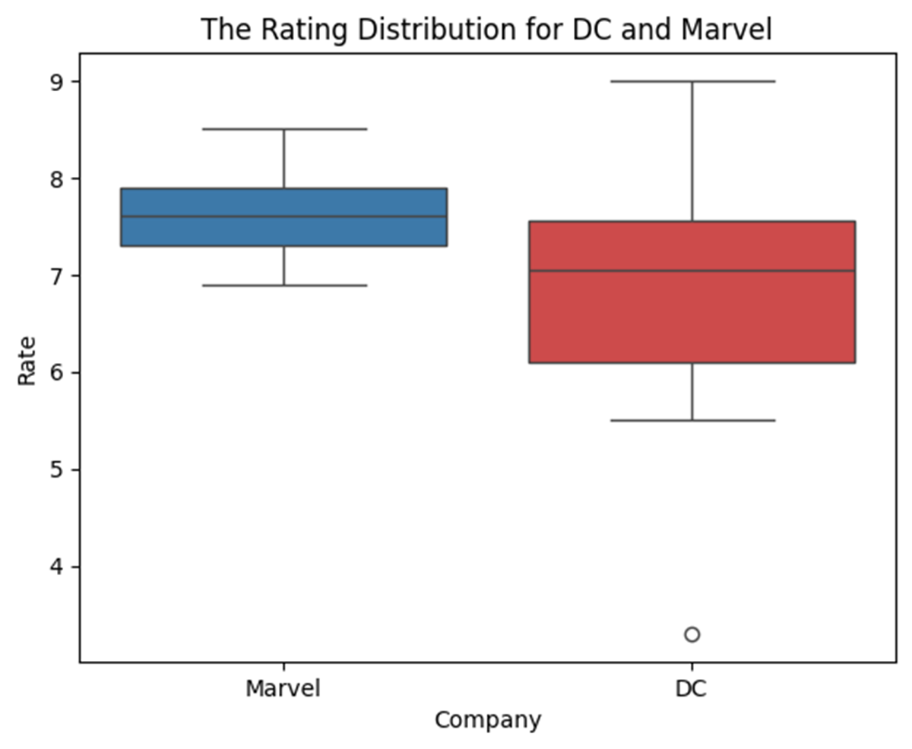
IMDd (Rate) Scores – Audience
Company Rate
DC 6.821429
Marvel 7.581250

Slide 12
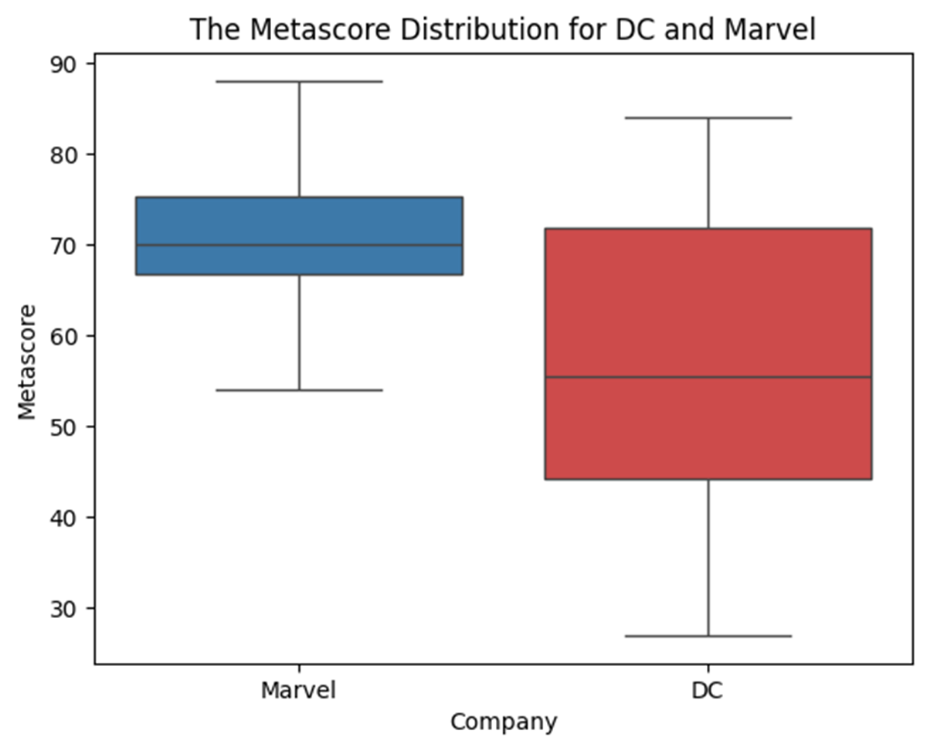
Metascores – Critics
Company Metascore
DC 58
Marvel 71.0625

Slide 13
Conclusion:
Marvel consistently performs better than DC in both user ratings (IMDb) and metascores.
The higher IMDd ratings and metascores for Marvel indicate better audience and critical reception, likely due to their more consistent tone, better character development, and success in building a cinematic universe.
DC, on the other hand, faces more mixed reception due to inconsistent movie tones, critical reception issues, and challenges in creating a unified cinematic universe, although recent successes like Wonder Woman and Aquaman suggest improvements.
DC has greater variability, with both high highs (The Dark Knight) and low lows.

Slide 14
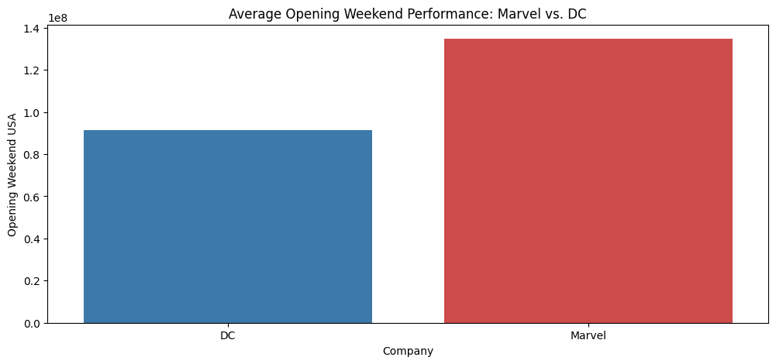
Opening Weekend Earnings
Conclusion:
Average Opening Weekend: DC’s - 91.46 million dollars. Marvel’s - 134.73 million dollars.
Marvel's blockbuster hits like Endgame significantly boost its average opening weekend earnings, making them about 50% higher than DC's. This is driven by Marvel’s interconnected universe and strong fanbase. DC has successful films but lacks consistent, franchise-wide momentum, leading to more variable box office results.

Slide 15
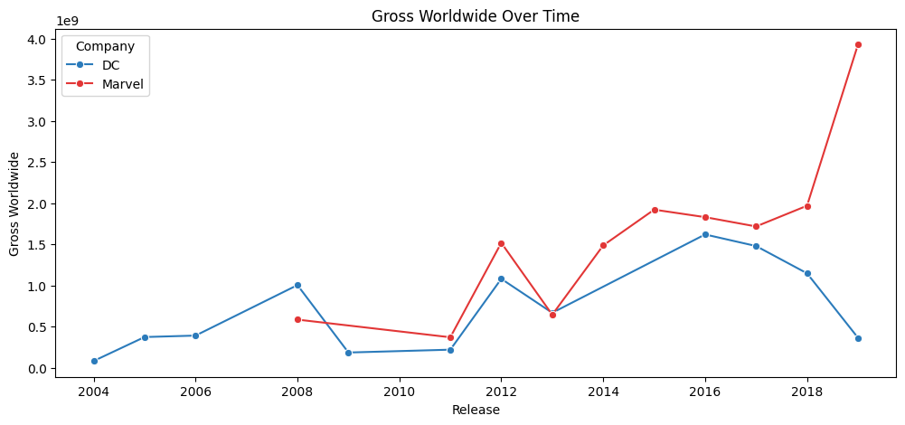
Gross Worldwide Earnings
Conclusion:
From 2004–2007, both Marvel and DC struggled at the box office. Marvel's fortunes changed after launching the MCU in 2008, leading to a surge in earnings and hitting $3.93 billion globally by 2019. DC saw growth after 2012, peaking in 2016 with Batman v Superman, but their earnings remained inconsistent, dropping sharply by 2019 due to mixed film reception.

Slide 16
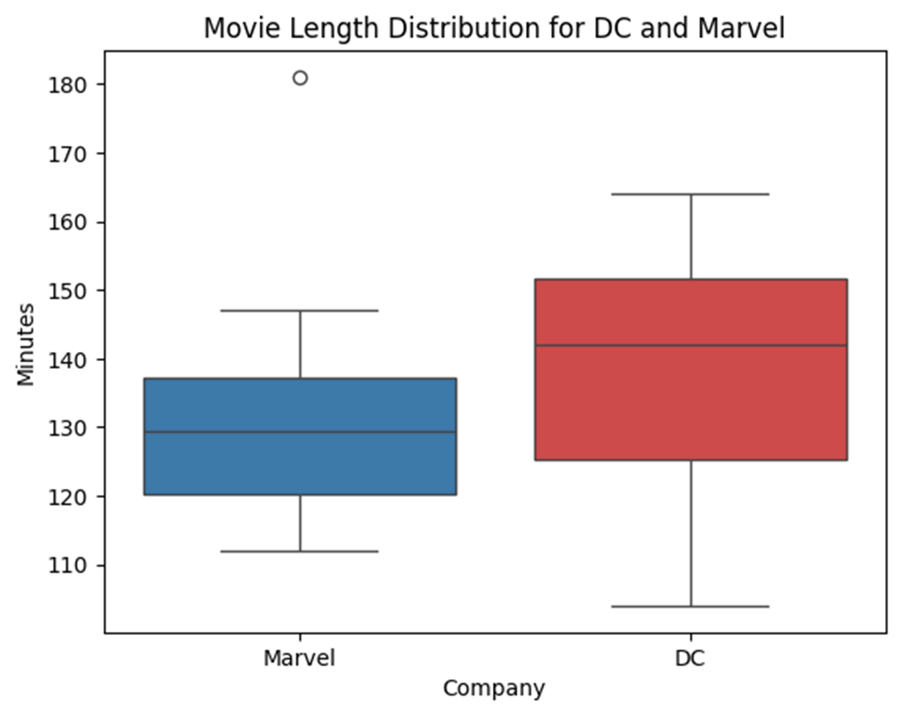
Runtime Analysis
Conclusion:
Average Length of Movies:
Movies by DC tend to be longer, running for about 138.8 minutes on the average. Marvel movies are shorter, with an approximate average of 131.9 minutes.
This therefore implies that while DC may wish to structure each of its productions to be more elaborate or epic, Marvel could be favoring somewhat tighter narratives.

Slide 17
03
Models
Vizualisation of models used in EDA

Slide 18
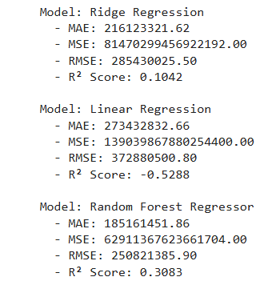
Model Comparison
The Random Forest Regressor emerged as the best performing model, achieving the lowest error metrics—including MAE (Mean Absolute Error), MSE (Mean Squared Error), and RMSE (Root Mean Squared Error)—and the highest R² Score, indicating it captures the non-linear patterns in the dataset effectively.
In contrast, Linear Regression performed poorly, even worse than a simple mean-based prediction, making it unsuitable for this dataset, which likely contains complex interactions and non-linear trends.

Slide 19
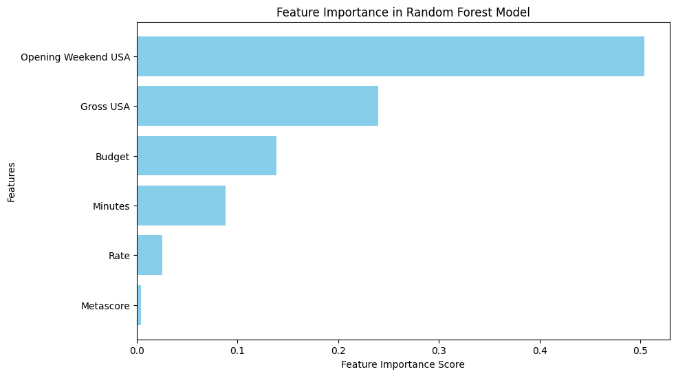
Steps to improve RFR model
Hyperparameter tuning: Optimize the number of trees and depth for Random Forest.
Try boosting models: May improve accuracy further.
Feature engineering: Explore additional factors affecting revenue. (Image displayed)
Added features are:
Budget Efficiency: Revenue earned relative to budget.
Opening Weekend Impact: Earnings reliance on debut weekend.
Time-Based Revenue Efficiency: Revenue earned per minute of runtime.

Slide 20
04
Conclusion

Slide 21
Summary
Data Preparation:
Not much data cleaning was needs as everything was in order. Stripping the white spaces mainly.
Findings:
- Marvel productions outperform DC in both audience reception and financial success, especially during opening weekends.
- DC movies tend to be longer, but this doesn’t necessarily lead to better scores or higher earnings.
- Interconnected storytelling, as adopted by Marvel, has proven to be a powerful driver of loyalty and box office results.
- DC has potential in character depth and unique tones (e.g., Joker), but would benefit from a more consistent strategic direction.
Recommendations:
- DC should unify its brand while using its strength in standalone films. - Marvel should maintain its universe strategy and explore new genres. - Researchers can expand analysis through sentiment, demographics, and time-based trends.

