Slide 1
Public Drunkenness in Mission
By Tyler Ho for AT Computer Science

Slide 2
Prediction
Mission has a higher amount of public drunkenness crimes.

Slide 3
What is Public Drunkenness?
There was no category for public drunkenness in the dataset, so I generalized to all Liquor Law Violations

Slide 4
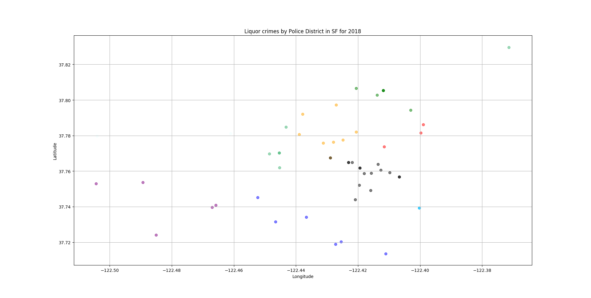
All Liquor Crimes in San Francisco
Mission District is Black

Slide 5
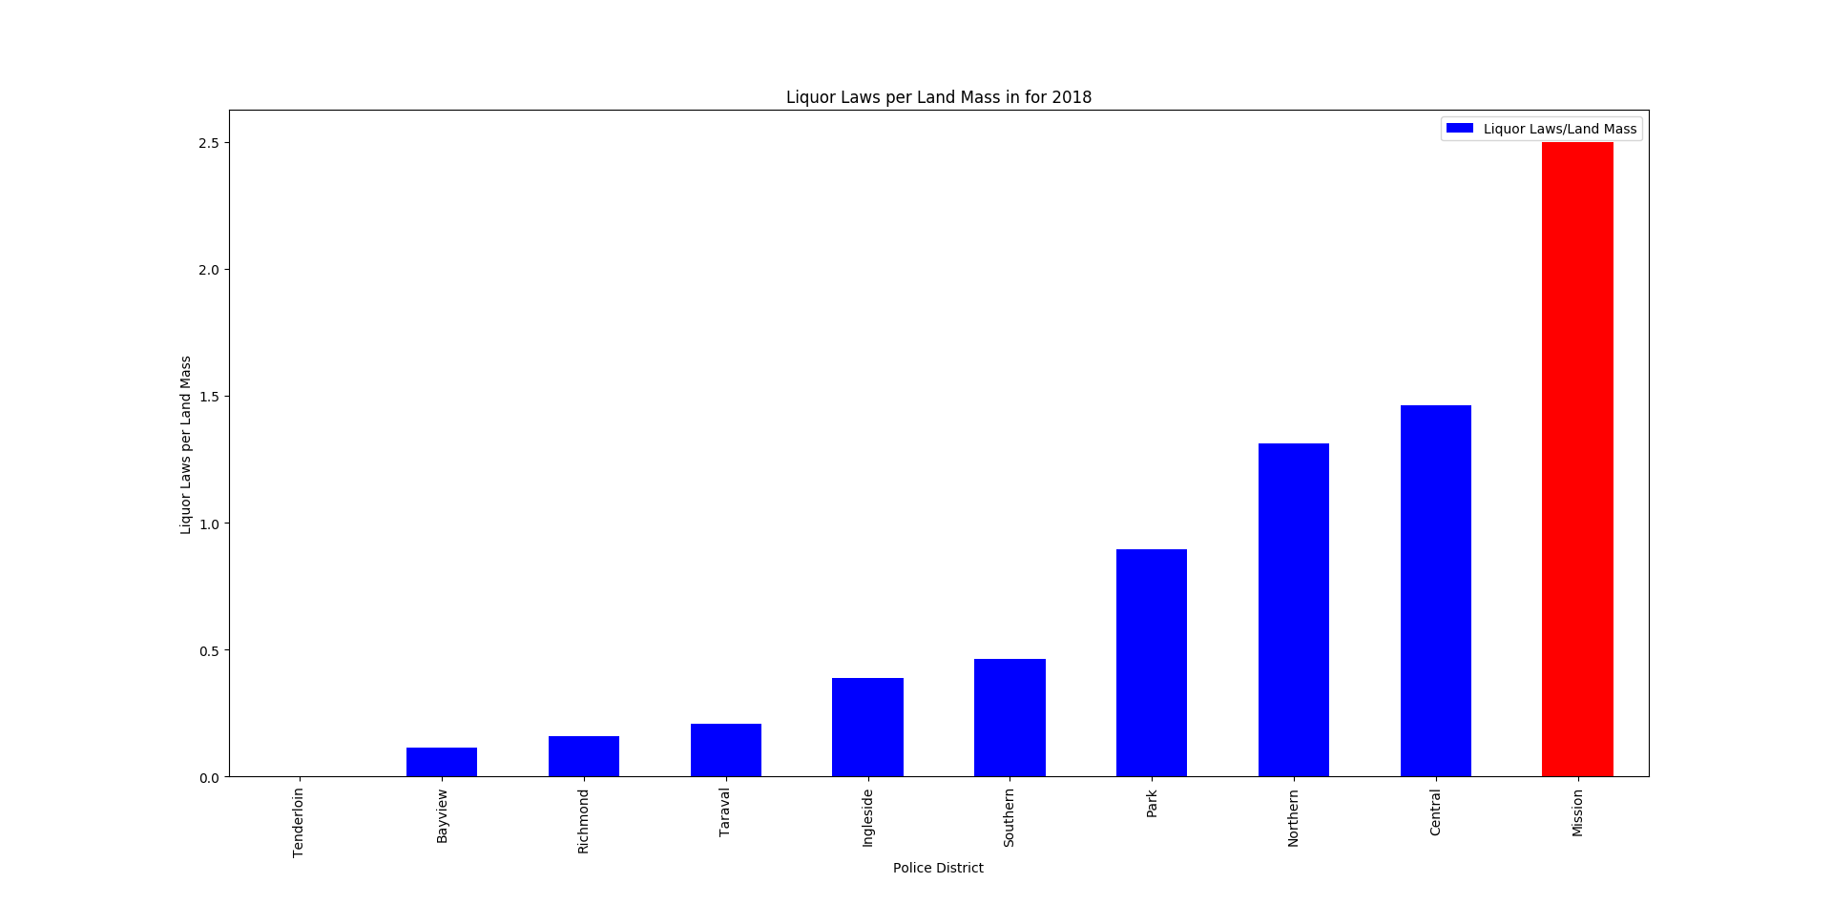
Liquor Crimes per Land Mass

Slide 6
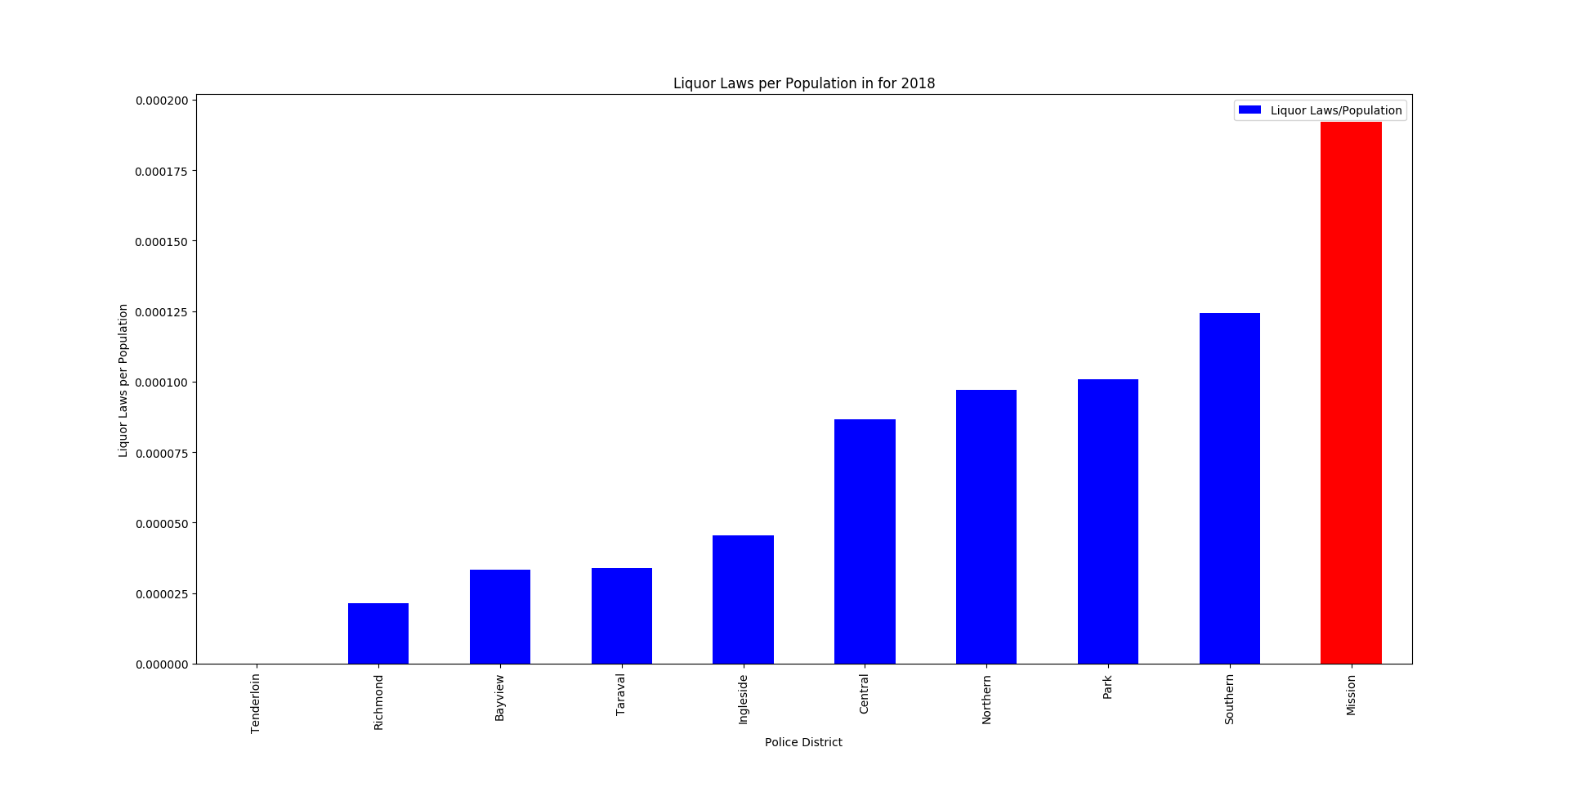
Liquor Crimes per Population

Slide 7
Public Drunkenness in Mission Conclusion
Mission has the most liquor crimes in terms of per population and per land mass by a large margin.
Due to this large margin, it can be inferred that public drunkenness in highest in Mission.

Slide 8
Muggings in Fisherman’s Wharf and Union Square
By Tyler Ho for AT Computer Science

Slide 9
Prediction
Fisherman’s Wharf and Union Square would have higher mugging rates because of the high amounts of tourists that visit.

Slide 10
What are Muggings?
Dictionary
Mugging: An assault upon a person especially with the intent to rob.
Robbery: The act or an instance of unlawfully taking the property of another by the use of violence or intimidation.
I determined “Robbery – Street” to be parallel with Mugging and thus, it will be used for all data concerning Muggings

Slide 11
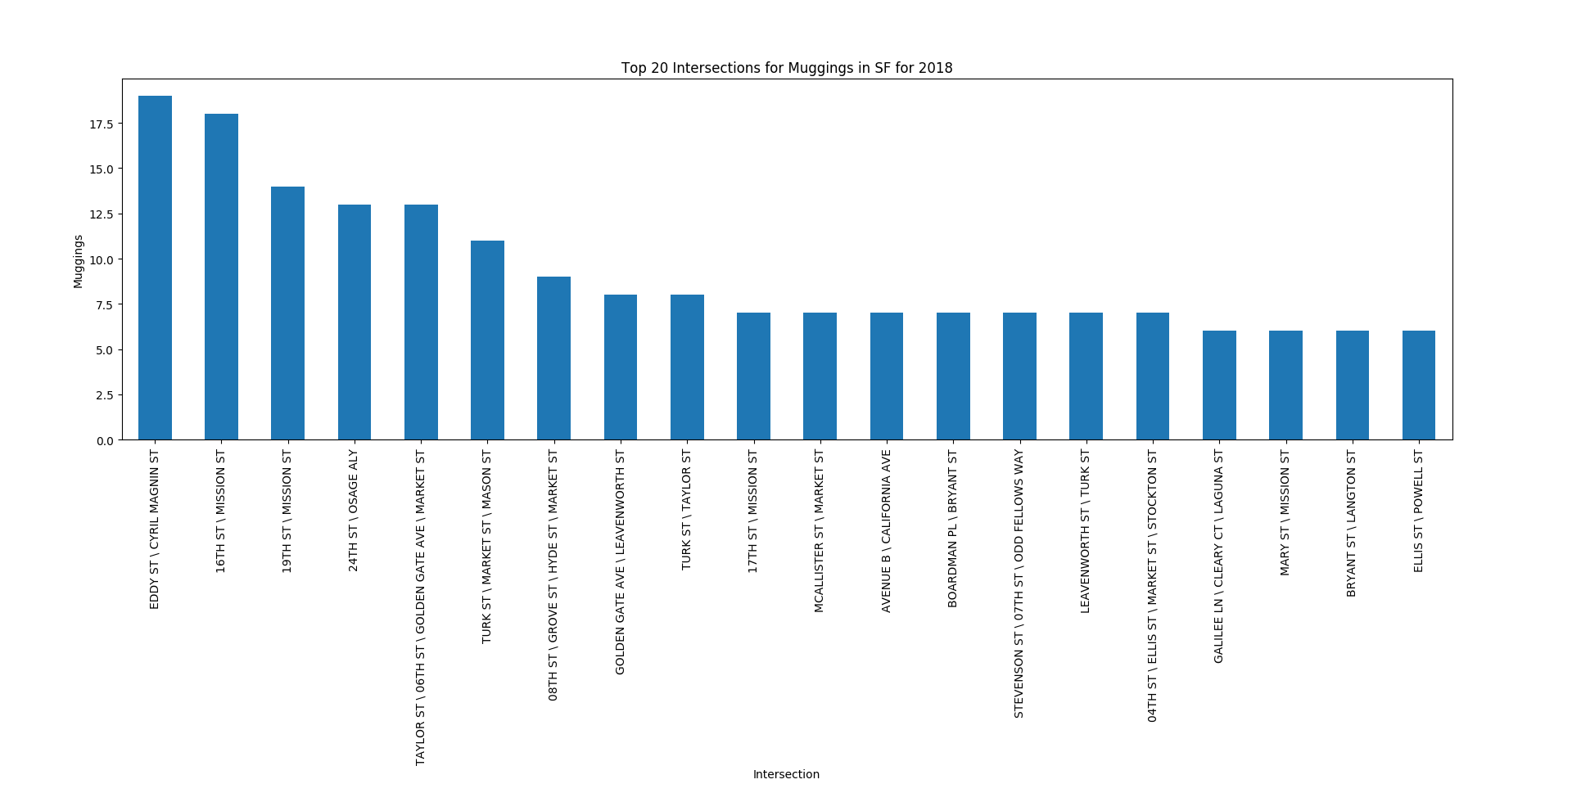
Top 20 Intersections by Muggings
Union Square
- Post St\Powell St
- Post St\Stockton St
- Geary St\Powell St
- Geary St\Stockton St
- Maiden Ln\ Stockton St
Fisherman’s Wharf
- Jefferson St\Taylor St

Slide 12
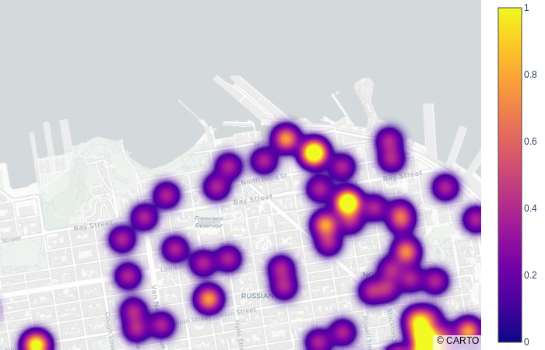
Density Heat Map of Muggings – Fisherman’s Wharf
Since Fisherman’s Wharf has much more muggings than most of the intersection near it, I concluded that being a tourist destination increases the amount of muggings at Fisherman’s Wharf

Slide 13
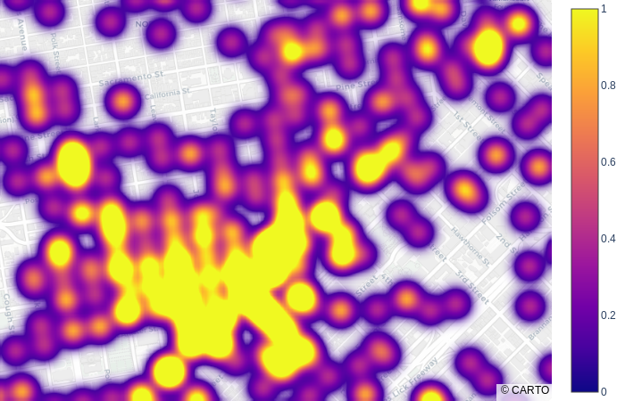
Density Heat Map of Muggings – Union Square
Since the Union Square does not have drastically more muggings compared to the area surrounding it, I concluded that muggings in Union Square are not increased by being a tourist destination

Slide 14
Muggings at Tourist Destinations Conclusion
While the number of muggings at Fisherman’s Wharf were impacted by it being a tourist destination, Union Square did not stand out from the surrounding area as a mugging hot spot and neither were included in the top 20 intersections by muggings.
Being a tourist destination increases muggings but only minimally.

