Slide 1
Predicting Used Car Prices in Kenya
Leveraging Machine Learning for accurate price estimation
Munene Jackson
Kelvin Mwaura
Marion Achieng
Gerald Mwangi
Benedict Kuloba

Slide 2
Overview
The used car market in Kenya is dynamic and rapidly evolving.
Determining fair prices for used cars is challenging due to factors like engine, mileage, transmission and many more.
This project aims to create a machine learning model to predict used car prices accurately.

Slide 3
Objectives
01.
02.
03.
Predict Used Car Prices in Kenya.
Identify key factors influencing car prices.
Create a user-friendly tool for buyers and sellers to make informed decisions.

Slide 4
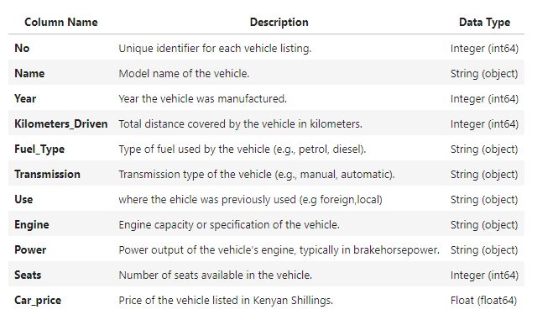
Data Overview
The dataset for this project was collected from various car bazaars and showrooms in Nairobi County and nearby areas, including car listings up to 2021. The dataset consists of 11 columns and six thousand entries.

Slide 5
EDA
We examined the distribution and dispersion of different features and how these features influence each other.
Out of 11 columns we used 8 features to train our predictive models.

Slide 6
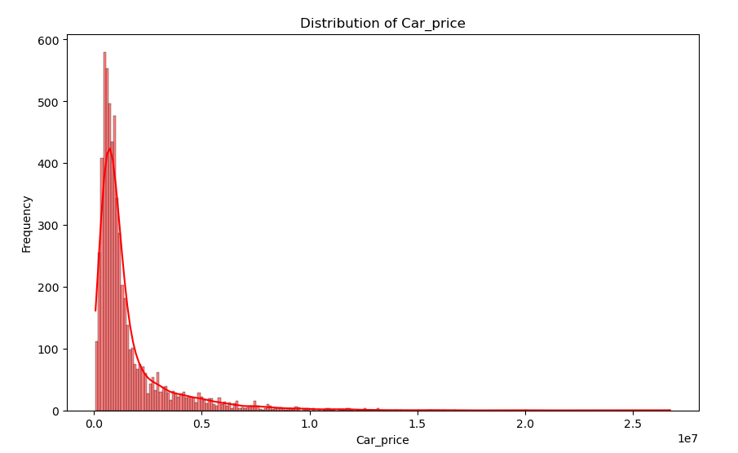
EDA
Univariate Analysis
We made use of Histograms and bar graphs to show distribution of each variable independently.
This shows that a lot of used cars are priced below half a million kenyan shilling, according to this dataset.

Slide 7
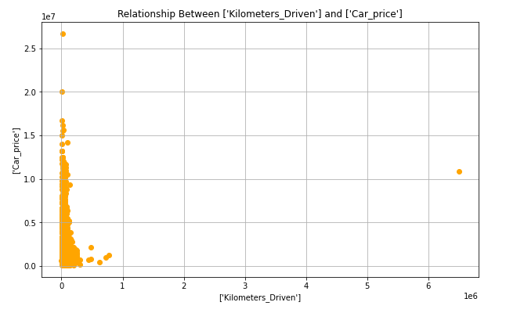
Bivariate Analysis
We used scatter plots and correlation matrix to display how some of these features influence price.
In this scatter plot, we notice that the lower the mileage of a vehicle, the higher its price is.

Slide 8
Modeling
Feature Selection
Best Models
We used 8 of the features from the many to predict the car prices, these features include: Tested various regression models:
Year
Mileage
Engine
Seats
Fuel type
Transmission
Use
Brand
After evaluating all of the regression models used, below are the best performing models in order:
Catboost Regression
XGBoost Regressor
Ridge Regressor
CatBoost Regressor
KNN Regressor

Slide 9
Key Findings
Age
Mileage
Observed a strong negative correlation between car age and price.
Older cars tend to have lower prices due to depreciation.
Strong negative correlation between mileage and price.
Cars with higher mileage are generally priced lower due to wear and tear.
Engine and Power
Brand
Positive correlation between engine size, power, and price.
Cars with larger engines and higher power output tend to be priced higher.
Certain brands and models command higher prices due to their reputation, reliability, and demand.
Luxury brands and popular models tend to retain their value better.

Slide 10
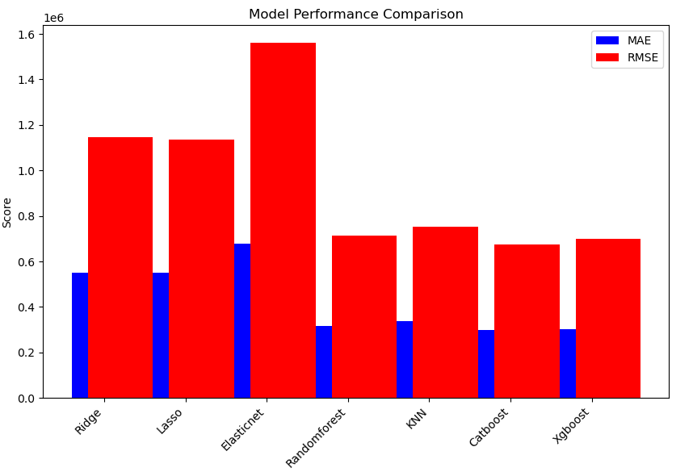
Catboost Regression
Catboost Regressor achieved the best performance with:
MAE: Ksh. 298,328.91
MSE: Ksh. 674,239.7467
R²: 0.86754

Slide 11
Recommendations
For Buyers
Leverage Data Insights: Use data-driven insights to make informed purchasing decisions, ensuring a fair price for the car's condition and specifications.
For Sellers
Competitive Pricing: Set competitive prices based on the car's age, condition, and market demand to attract potential buyers.
Market Trends: Stay informed about market trends and preferences, such as the growing demand for eco-friendly vehicles, to adjust pricing strategies accordingly.
For Car Dealers
Inventory Management: Optimize inventory management by understanding the demand for different car types and models.
Customer Education: Educate customers about the key factors influencing car prices and provide transparent information to build trust.

Slide 12
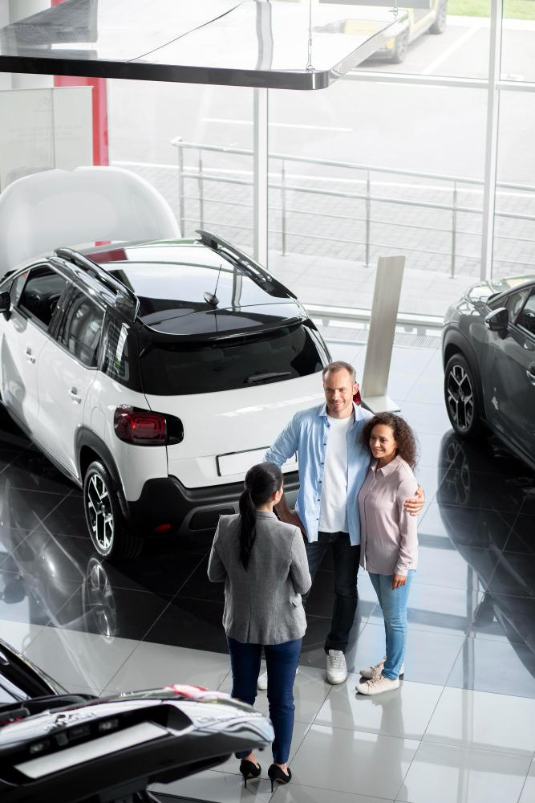
Conclusion
The developed machine learning model offers a reliable tool for predicting used car prices in Kenya.
The model empowers users to make informed decisions based on data-driven insights.
Future work can focus on refining the model and incorporating additional features for even greater accuracy, and also help stakeholders filter cars by Brand then Model.

Slide 13
Thanks!
Do you have any questions?
https://www.linkedin.com/in/jackson-mwaniki/
https://www.linkedin.com/in/marion-achieng-0747712a3/
https://www.linkedin.com/in/benedict-kuloba-76954512a/
https://www.linkedin.com/in/kelvin-mwaura-a642351a2/

