Slide 1

HR Attrition Data Analysis
Tyrone Muhammad Sunday, December 15, 2024
Notes:
Good day and thank you for your time. Today we will be discussing insights and most importantly solutions related to HR attrition data.

Slide 2

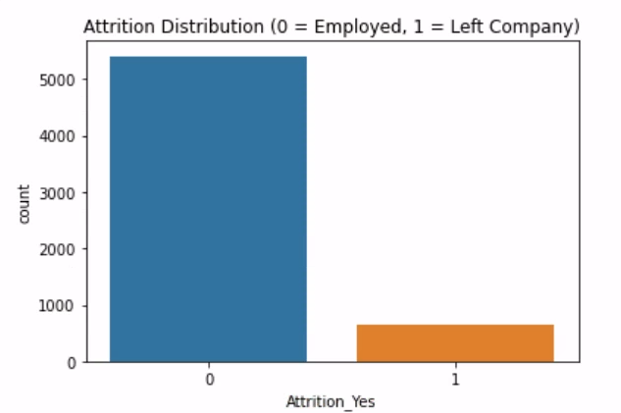
Attrition Data Analysis: Goals
Present the opportunity increase retention and create a better working environment
Review the HR data demographics patterns
Explore departmental particulars and job requirements
Notes:
Our goals are to see the data and find the story it tells us. Based on this story, we are hoping to impact retention across various demographics within the company. We clearly retain the majority but have room for improvement.

Slide 3
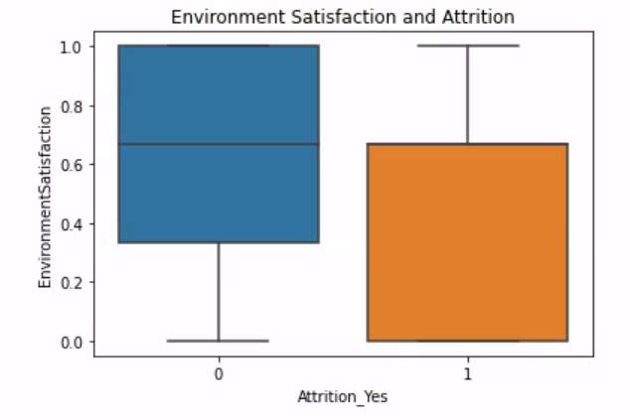
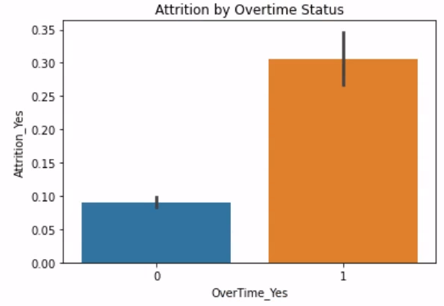
Attrition Data Analysis: Findings
It is clear to see lower ratings come from those who leave the company
Working beyond the regular shift overtime could relate to a non-satisfactory view of the work environment
Insights on those dissatisfied who left the company strongly align with mostly those working overtime
Notes:
Initial findings show that the lion's share of those who have left the company yeah have a low satisfaction or view of the company. Additionally, of those who have left the company the majority appear to work overtime as a norm. A correlation between these insights give us an opportunity to staff departments to offset the need to work overtime and create a more satisfactory work environment.

Slide 4

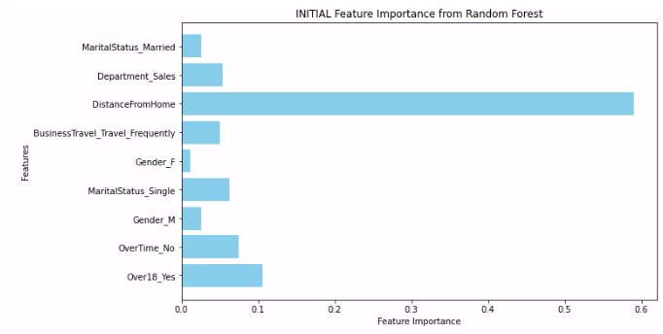



Top 10 Attrition Features (Initial Overall Analysis)
Those who left come from many demographics
Male and female
Married and single
Young and old
Notes:
Viewing the overall top 10 features of those who have left this place that this trend is wide raging across genders age and family makeup. This wide demographic means that changes could impact a large portion other staff with better retention rates.

Slide 5
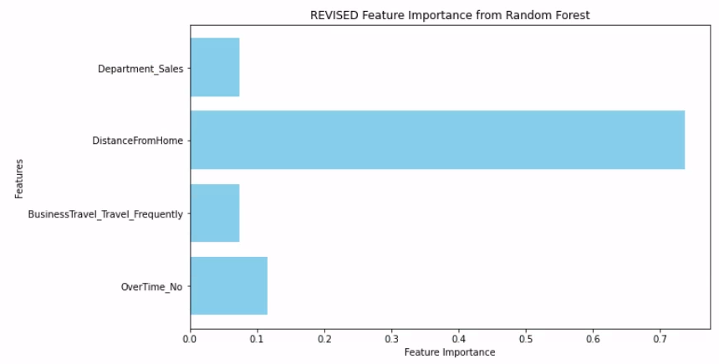
Main Attrition Areas (Revised Closer Analysis)
Work travel
Excessive business travel
Potential time management struggles
Sales Department moral
Notes:
A subset of four dominant categories of those who left the company shows that distance from home as well as business travel has impact. Working far away from home is a key factor of dissatisfaction. Lastly, there may be opportunities to explore overtime and the management of daily tasks. These four primary areas show potential work dissatisfaction main sources. Addressing these head-on gives us the opportunity to lessen our attrition numbers.

Slide 6

HR Attrition Analysis: Impact Suggestions
Consider more opportunities for remote work
Increase of virtual
Enhance sales incentives
Offer time management trainings
Notes:
Offering more opportunities for remote work along with the increase of virtual meetings to lessen the need for business travel could impact attrition. Enhanced sales incentives along with time management trainings could positively impact both sales staff as well as those unable to work overtime.

Slide 7

Questions
Notes:
Thank you.

