Slide 1

Manufacturing Defects Analysis
Tyrone Muhammad, BSDA. CPC
Notes:
Welcome to my presentation on Manufacturing Defect Analysis.
This project focuses on identifying and reducing defects in the welding process of electronic boards.

Slide 2
Problem Statement
The Manual Finish production area has experienced rising welding defects, failing to meet IPC-A-610E standards. Common defects include solder bridges, excessive solder, and lifted components, leading to compromised reliability and increased labor costs. A data-driven approach aims to reduce defects by 20% and improve production capacity.
Notes:
The Manual Finish area has been experiencing rising welding defects, impacting production quality and efficiency.
Our goal is to identify the key defects and provide data-driven solutions to improve the process.

Slide 3
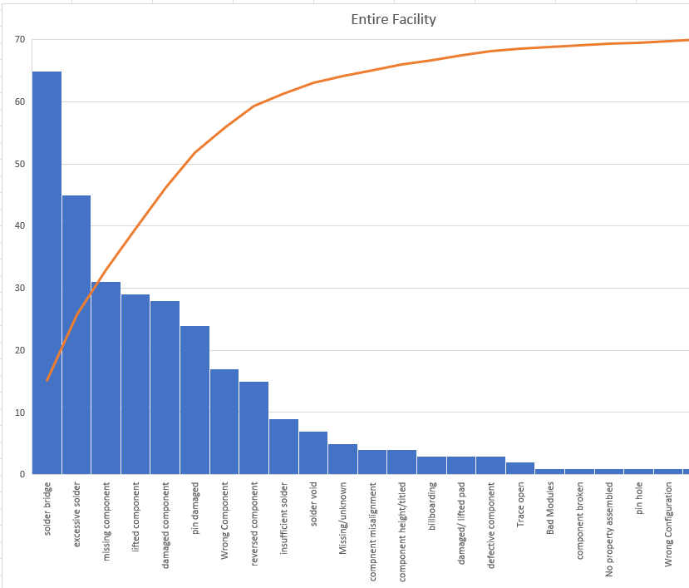
Pareto Analysis – Entire Facility
Top Defects:
- Solder Bridge (65 defects)
- Excessive Solder (45 defects)
- Missing Component (31 defects)
These defects account for 46% of all issues, making them high-priority areas for improvement.
Notes:
A Pareto analysis showed that solder bridges, excessive solder, and missing components account for 46% of defects.
Addressing these key issues will lead to major improvements.

Slide 4
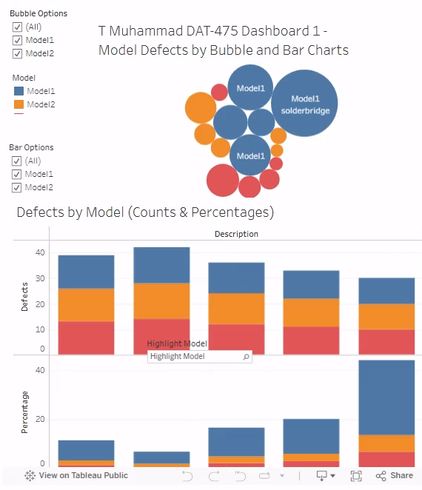
Tableau Dashboard 1 of 2
https://public.tableau.com/app/profile/tyrone.muhammad/viz/T_Muhammad_DAT_475_Proj_3A/TMuhammadDashboad1
Notes:
Additional monitoring dashboards have been developed to highlight defects and trends across models. These dashboards are interactive to pinpoint models or defect as desired.

Slide 5
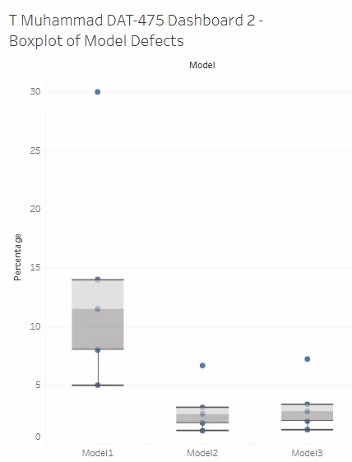
Tableau Dashboard 2 of 2 Boxplot Comparisons
https://public.tableau.com/app/profile/tyrone.muhammad/viz/T_Muhammad_DAT_475_Proj_3B/Dashboard2

Slide 6
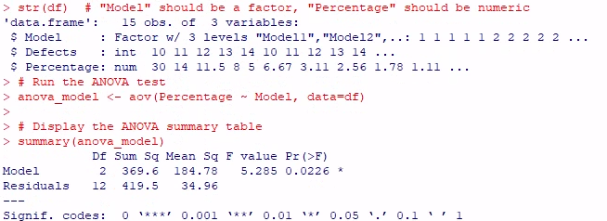
Hypothesis Testing (ANOVA Test)
The dataset DATAAnova2.csv was imported into R and examined to ensure proper structure.
The dependent variable, Percentage (defect rate), was analyzed across the independent variable, Model (production lines).
A one-way ANOVA test was conducted at a 0.05 significance level to determine if there were significant differences in defect rates between production lines.
Notes:
To determine whether defect rates differ across production lines, we performed a hypothesis test using one-way ANOVA.Null Hypothesis (H₀): No significant difference in defect rates between production lines.Alternative Hypothesis (Hₐ): At least one production line has a significantly different defect rate.
The ANOVA test showed a significant difference in defect rates between production lines, meaning some lines perform worse than others.

Slide 7
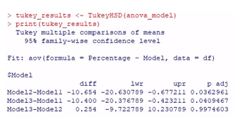
Additional Analysis – Tukey’s HSD
Since the ANOVA test confirmed significant differences, a Tukey’s HSD test was performed to determine which production lines differed.
Notes:
A Tukey’s HSD test was conducted to identify which production lines differ.Findings: Model1 has significantly higher defect rates than Model2 and Model3 (p-values: 0.0363, 0.0409).No significant difference was found between Model2 and Model3 (p = 0.9975).

Slide 8
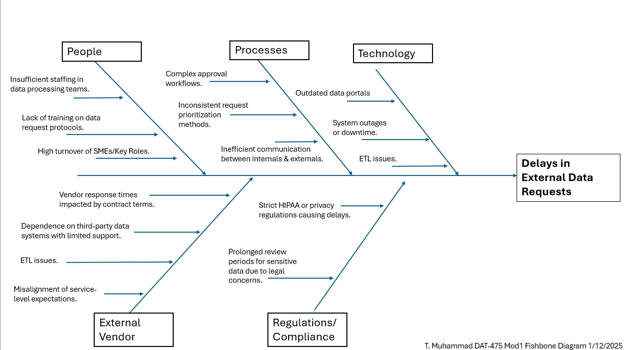
Fishbone Diagram – Root Cause Analysis
Notes:
A root cause analysis using a Fishbone Diagram identified six key factors contributing to defects:
Methods
Machines
Materials
Manpower
Measurement
Environment

Slide 9
Production Line Comparison
- Model 1: High rate of solder bridges, indicating machine alignment issues.
- Model 2: Frequent insufficient solder defects, likely due to wave soldering inconsistencies.
- Model 3: Mixed defects (lifted components, solder bridges), pointing to handling or process issues.
Targeted improvements are needed for each line based on defect patterns.
Notes:
Model1 has the highest defect rate, indicating issues with machine calibration, operator training, or materials. Model 2 and Model 3 perform similarly and can serve as benchmarks.

Slide 10
Key Findings and Next Steps
Key Findings:
- Top 3 defects (solder bridges, excessive solder, lifted components) account for 82% of issues.
- Root causes include process inconsistencies, equipment malfunctions, and material issues.
- Defect patterns vary across production lines.
Next Steps:
- Standardize soldering processes.
- Upgrade and maintain equipment.
- Enhance operator training.
- Implement real-time quality monitoring.
Notes:
Improve machine maintenance
Enhance operator training
Implement stricter quality control measures
Monitor defect rates using real-time dashboards
These actions will help optimize Model1’s performance.

Slide 11

Questions & Discussion
Thank you for your attention. I'm happy to answer any questions.
Notes:
Our analysis has provided insights into defect trends and their root causes. By implementing these recommendations, the company can improve quality, efficiency, and cost savings. Thank you for your time. I welcome any questions.

