Slide 1

P1 Chapter 14 :: Exponentials & Logarithms
jfrost@tiffin.kingston.sch.uk
www.drfrostmaths.com @DrFrostMaths
Last modified: 20th October 2017

Slide 2

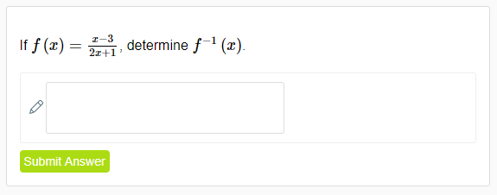
Use of DrFrostMaths for practice
Register for free at:
www.drfrostmaths.com/homework
Practise questions by chapter, including past paper Edexcel questions and extension questions (e.g. MAT).
Teachers: you can create student accounts (or students can register themselves).

Slide 3
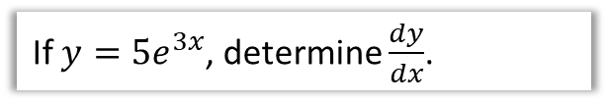
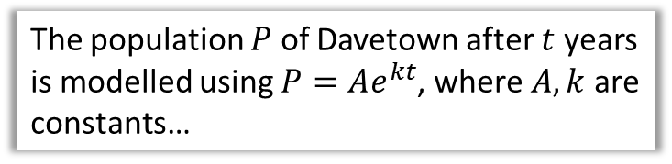

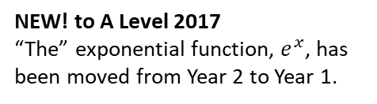
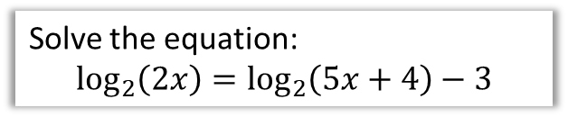
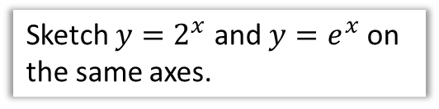
Chapter Overview
You have encountered exponential expressions like $y=2^{x}$ before, but probably not ‘the’ exponential function $y=e^{x}$. Similarly, you will learn that the inverse of $y=2^{x}$ is $y=\log_{2}{x}$.
1:: Sketch exponential graphs.
2:: Use an interpret models that use exponential functions.
Sketch $y=2^{x}$ and $y=e^{x}$ on the same axes.
The population $P$ of Davetown after $t$ years is modelled using $P=Ae^{kt}$, where $A,k$ are constants…
NEW! to A Level 2017
“The” exponential function, $e^{x}$, has been moved from Year 2 to Year 1.
NEW! to A Level 2017
Again, moved from Year 2.
3:: Be able to differentiate $e^{kx}$.
4:: Understand the log function and use laws of logs.
If $y=5e^{3x}$, determine $\frac{dy}{dx}$.
Solve the equation:
$$\log_{2}\left(2x\right)=\log_{2}\left(5x+4\right)−3$$
5:: Use logarithms to estimate values of constants in non-linear models.
(This is a continuation of (2))

Slide 4
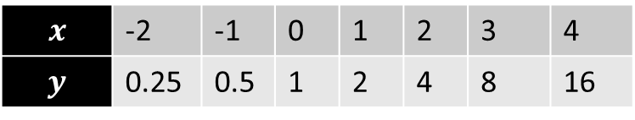

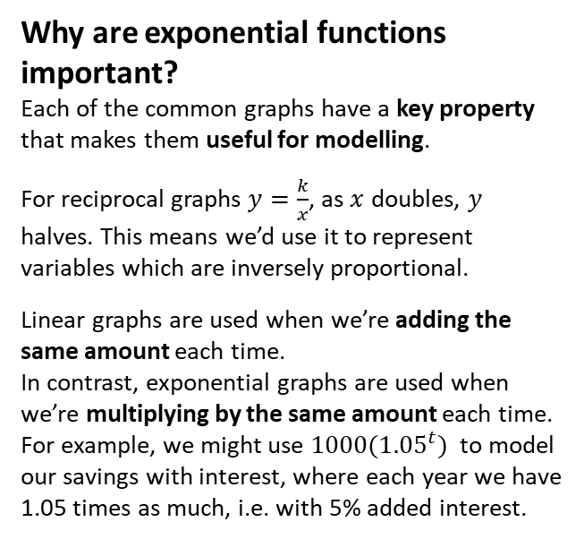

8
20
16
12
8
4
-4
$$y=2^{x}$$
$$x$$ | -2 | -1 | 0 | 1 | 2 | 3 | 4
$$y$$ | 0.25 | 0.5 | 1 | 2 | 4 | 8 | 16
?
?
?
?
?
?
?
Fro Note: Ensure that you can distinguish between a $x^{a}$ (e.g. polynomial) term and an $a^{x}$ exponential term. In the former the variable is in the base, and in the letter the variable is in the power. $2^{x}$ behaves very differently to $x^{2}$, both in its rate of growth (i.e. exponential terms grow much faster!) and how it differentiates.
Why are exponential functions important?
Each of the common graphs have a key property that makes them useful for modelling.
For reciprocal graphs $y=\frac{k}{x}$, as $x$ doubles, $y$ halves. This means we’d use it to represent variables which are inversely proportional.
Linear graphs are used when we’re adding the same amount each time.
In contrast, exponential graphs are used when we’re multiplying by the same amount each time. For example, we might use ${1000(1.05}^{t})$ to model our savings with interest, where each year we have 1.05 times as much, i.e. with 5% added interest.
-2 -1 1 2 3 4 5 6 7
Notes:
Get students to sketch axes and tables in their books.

Slide 5















Contrasting exponential graphs
On the same axes sketch $y=3^{x}, y=2^{x}$, $y={1.5}^{x}$
?
The $y$-intercept is always 1.
$$y$$
$$y=3^{x}$$
If $x<0$, the larger the base, the smaller the $y$ value:
$$3^{x}<2^{x}<{1.5}^{x}$$
$$y=2^{x}$$
If $x>0$, the larger the base, the larger the $y$ value:
$${1.5}^{x}<2^{x}<3^{x}$$
$$y={1.5}^{x}$$
$$1$$
$$x$$
On the same axes sketch $y=2^{x}$ and $y={\left(\frac{1}{2}\right)}^{x}$
?
Three important notes:
$y=2^{x}$ is said to be “exponential growing” whereas $y={\left(\frac{1}{2}\right)}^{x}$ is said to be “exponentially decaying”, because it’s getting smaller (halving) each time $x$ increases by 1.
$y={\left(\frac{1}{2}\right)}^{x}$ is a reflection of $y=2^{x}$ in the line $x=0$. Proof: If $f\left(x\right)=2^{x}$, $f\left(−x\right)=2^{−x}=\frac{1}{2^{x}}={\left(\frac{1}{2}\right)}^{x}$
${\left(\frac{1}{2}\right)}^{x}$ would usually be written $2^{−x}$. You should therefore in general be able to recognise and sketch the graph $y=a^{−x}$.
$$y$$
$$y={\left(\frac{1}{2}\right)}^{x}$$
$$y=2^{x}$$
$$1$$
$$x$$

Slide 6




Graph Transformations
Sketch $y=2^{x+3}$
?
$$y$$
The ‘change’ to $2^{x}$ is ‘inside the function’ (i.e. input $x$ is replaced with $x+3$).
So a translation to the left by 3.
Ensure you work out the new $y$-intercept.
$$y=2^{x+3}$$
$$8$$
$$x$$

Slide 7
Exercise 14A
Pearson Pure Mathematics Year 1/AS
Pages 313-314

Slide 8
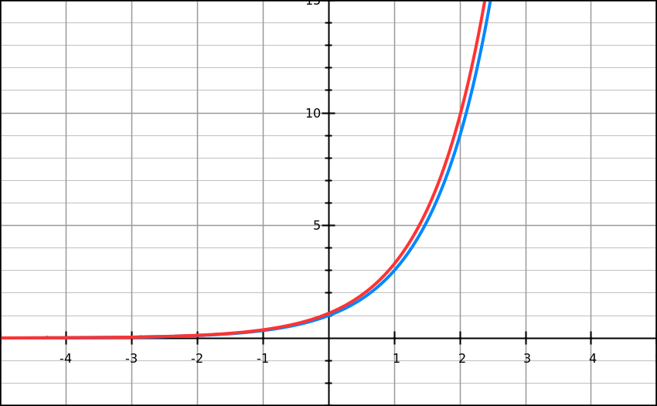
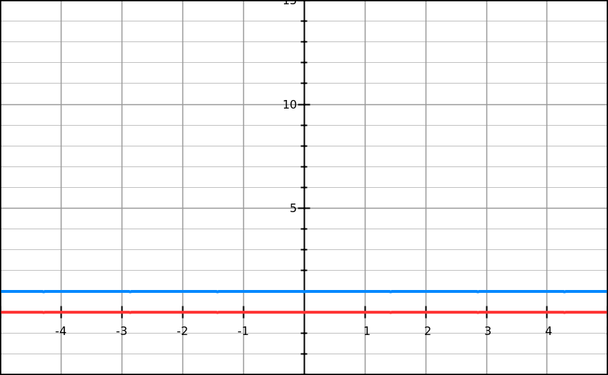
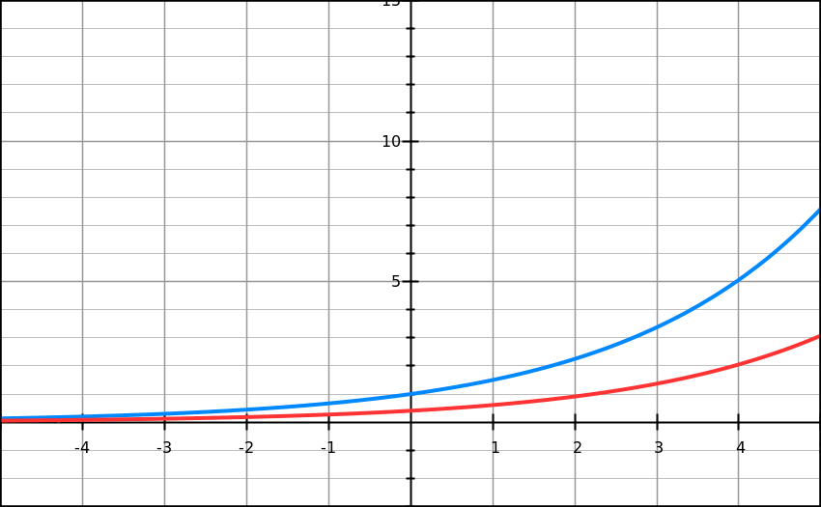
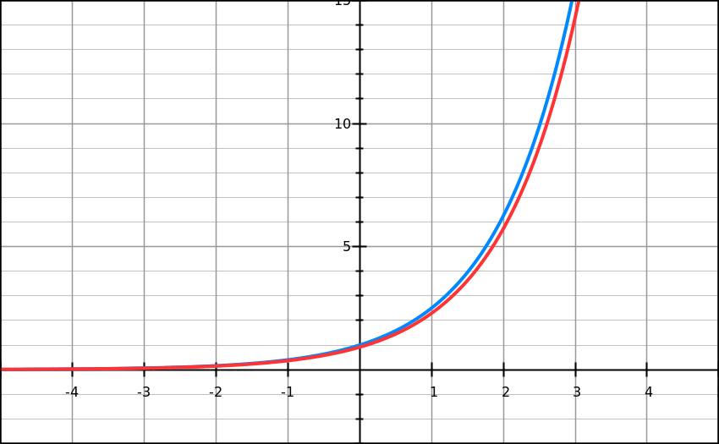
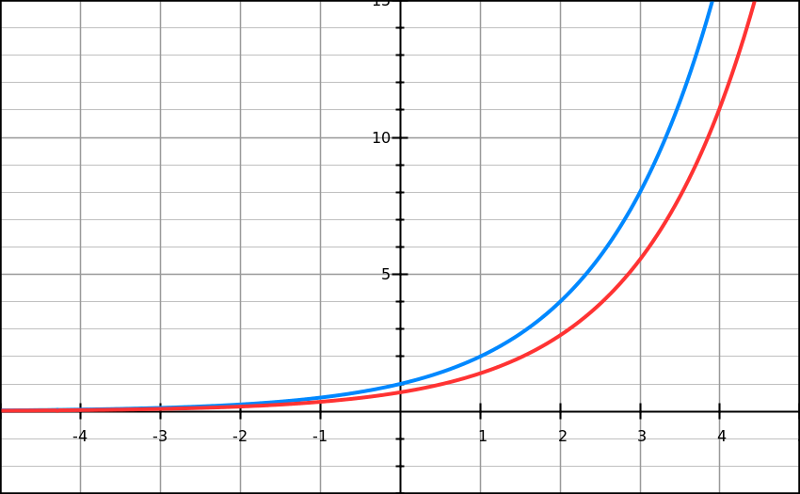
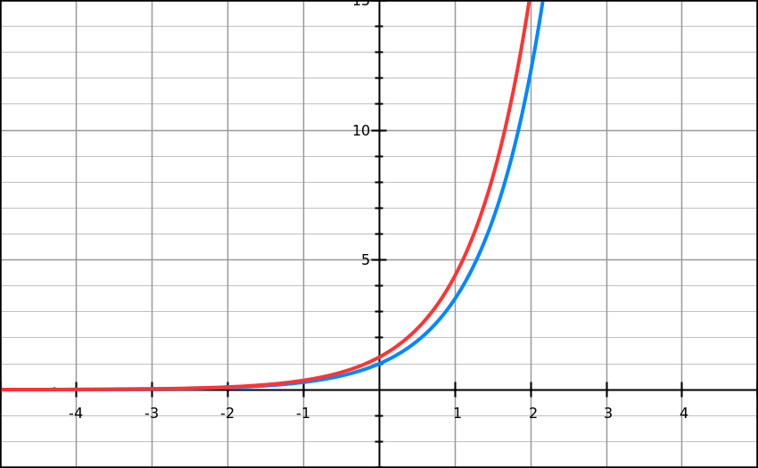













$y=e^{x}$
Click
You won’t yet be able to differentiate general exponential functions $y=a^{x}$ until Year 2.
But I’ve calculated the gradient functions for you – click the black arrow to reveal the graph and gradient function.
Function
Gradient
$$y=1^{x}$$
$$\frac{dy}{dx}=0$$
>
$$y={1.5}^{x}$$
$$\frac{dy}{dx}=0.41×{1.5}^{x}$$
>
$$y=2^{x}$$
$$\frac{dy}{dx}=0.69×2^{x}$$
>
$$y={2.5}^{x}$$
$$\frac{dy}{dx}=0.92×{2.5}^{x}$$
>
$$y=3^{x}$$
$$\frac{dy}{dx}=1.10×3^{x}$$
>
$$y={3.5}^{x}$$
$$\frac{dy}{dx}=1.25×{3.5}^{x}$$
>
Compare each exponential function against its respective gradient function. What do you notice?

Slide 9


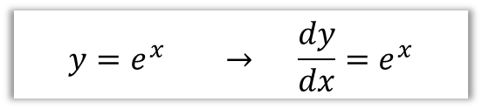

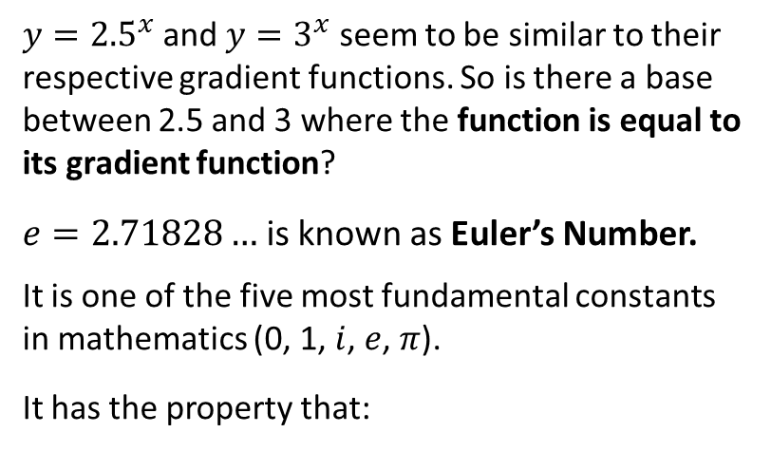

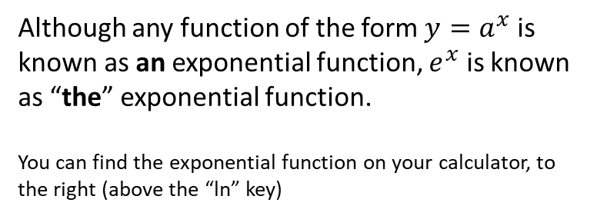
$y=e^{x}$
Function
Gradient
$y={2.5}^{x}$ and $y=3^{x}$ seem to be similar to their respective gradient functions. So is there a base between 2.5 and 3 where the function is equal to its gradient function?
$e=2.71828…$ is known as Euler’s Number.
It is one of the five most fundamental constants in mathematics (0, 1, $i$, $e$, $π$).
It has the property that:
$$y=1^{x}$$
$$\frac{dy}{dx}=0$$
>
$$y={1.5}^{x}$$
$$\frac{dy}{dx}=0.41×{1.5}^{x}$$
>
$$y=2^{x}$$
$$\frac{dy}{dx}=0.69×2^{x}$$
>
$$y={2.5}^{x}$$
$$\frac{dy}{dx}=0.92×{2.5}^{x}$$
>
$$y=e^{x}$$
$$\frac{dy}{dx}=1.10×3^{x}$$
$$y=3^{x}$$
$$\frac{dy}{dx}=e^{x}$$
>
>
$$y={3.5}^{x}$$
$$\frac{dy}{dx}=1.25×{3.5}^{x}$$
>
$$y=e^{x} → \frac{dy}{dx}=e^{x}$$
Although any function of the form $y=a^{x}$ is known as an exponential function, $e^{x}$ is known as “the” exponential function.
You can find the exponential function on your calculator, to the right (above the “ln” key)

Slide 10

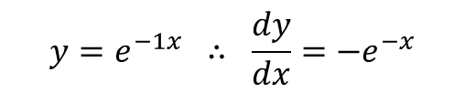

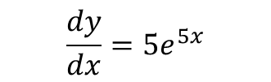


Differentiating $y=ae^{kx}$
! If $y=e^{kx}$, where $k$ is a constant, then $\frac{dy}{dx}=ke^{kx}$
Different $e^{5x}$ with respect to $x$.
Note: This is not a standalone rule but an application of something called the ‘chain rule’, which you will encounter in Year 2.
?
$$\frac{dy}{dx}=5e^{5x}$$
Different $e^{−x}$ with respect to $x$.
?
$$y=e^{−1x} ∴ \frac{dy}{dx}=−e^{−x}$$
Different $4e^{3x}$ with respect to $x$.
?
Note: In general, when you scale the function, you scale the derivative/integral.
$$\frac{dy}{dx}=12e^{3x}$$

Slide 11




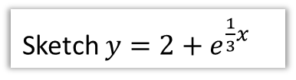






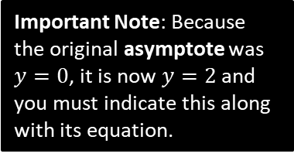








More Graph Transformations
Sketch $y=e^{3x}$
Sketch $y=5e^{−x}$
?
?
$$y$$
$$y=e^{3x}$$
$$y$$
Note: Recall the shape of a $y=a^{−x}$ graph.
5 is ‘outside’ function, so stretch of scale factor 5 on $y$-axis.
Input $x$ is being replaced with $3x$, so stretch of scale factor $\frac{1}{3}$ on $x$-axis.
$$y=e^{x}$$
$$y=5e^{−x}$$
$$y=e^{x}$$
$$1$$
$$5$$
$$x$$
$$1$$
$$x$$
Sketch $y=2+e^{\frac{1}{3}x}$
?
$$y=2+e^{\frac{1}{3}x}$$
$$y$$
We have a stretch on $x$-axis by scale factor 3, and a translation up by 2.
$$y=e^{x}$$
Important Note: Because the original asymptote was $y=0$, it is now $y=2$ and you must indicate this along with its equation.
$$3$$
$$y=2$$
$$1$$
$$x$$

Slide 12




Test Your Understanding
Sketch $y=e^{−2x}−1$
?
$$y$$
$$y=e^{−2x}−1$$
$$y=e^{−2\left(0\right)}−1=0$$
$$x$$
$$y=−1$$

Slide 13
Exercise 14B
Pearson Pure Mathematics Year 1/AS
Pages 316-317

Slide 14

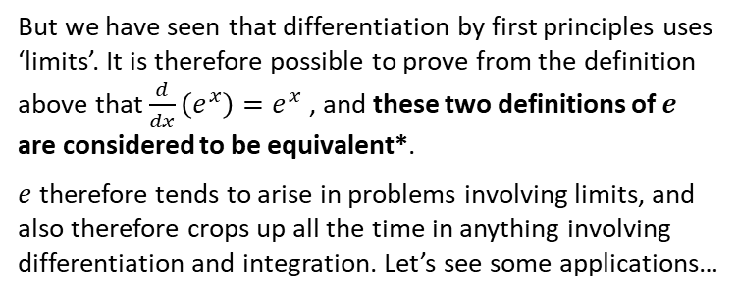
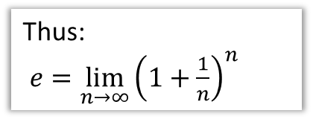

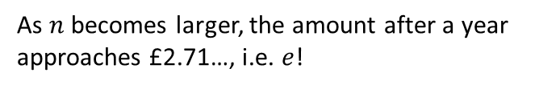
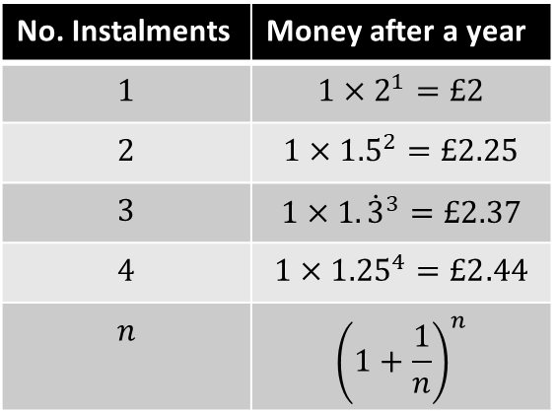
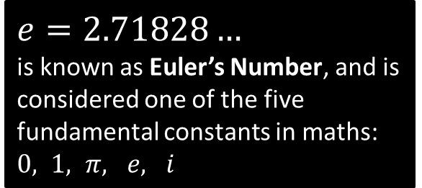
Just for your interest…
Where does $e$ come from, and why is it so important?
$e=2.71828…$
is known as Euler’s Number, and is considered one of the five fundamental constants in maths: $0, 1, π, e, i$
Its value was originally encountered by Bernoulli who was solving the following problem:
You have £1. If you put it in a bank account with 100% interest, how much do you have a year later? If the interest is split into 2 instalments of 50% interest, how much will I have? What about 3 instalments of 33.3%? And so on…
Thus:
$e=\lim_{n→∞}{{\left(1+\frac{1}{n}\right)}^{n}}$
No. Instalments | Money after a year
$$1$$ | $$1×2^{1}=£2$$
$$2$$ | $${1×1.5}^{2}=£2.25$$
$$3$$ | $$1×1.{\dot{3}}^{3}=£2.37$$
$$4$$ | $${1×1.25}^{4}=£2.44$$
$$n$$ | $${\left(1+\frac{1}{n}\right)}^{n}$$
But we have seen that differentiation by first principles uses ‘limits’. It is therefore possible to prove from the definition above that $\frac{d}{dx}\left(e^{x}\right)=e^{x}$ , and these two definitions of $e$ are considered to be equivalent*.
$e$ therefore tends to arise in problems involving limits, and also therefore crops up all the time in anything involving differentiation and integration. Let’s see some applications…
As $n$ becomes larger, the amount after a year approaches £2.71…, i.e. $e$!
*You can find a full proof here in my Graph Sketching/Limits slides: http://www.drfrostmaths.com/resources/resource.php?rid=163

Slide 15


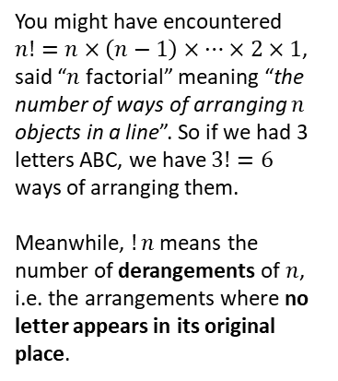

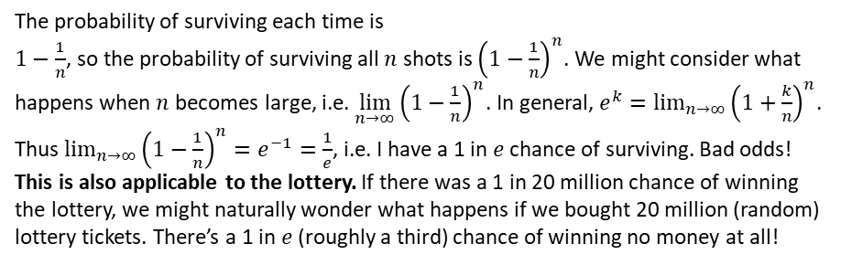

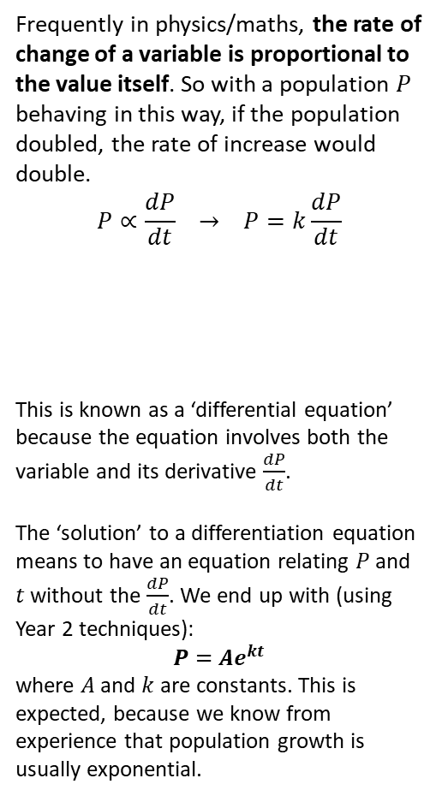

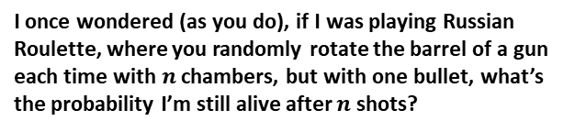
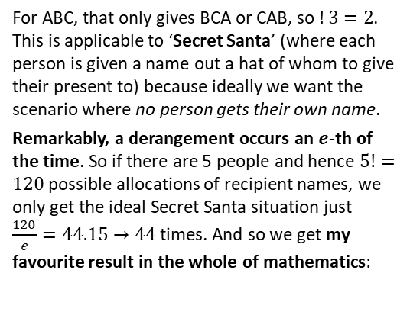

Application 2: Russian Roulette
A scene from one of Dr Frost’s favourite films, The Deer Hunter.
Application 1: Solutions to many ‘differential equations’.
I once wondered (as you do), if I was playing Russian Roulette, where you randomly rotate the barrel of a gun each time with $n$ chambers, but with one bullet, what’s the probability I’m still alive after $n$ shots?
Frequently in physics/maths, the rate of change of a variable is proportional to the value itself. So with a population $P$ behaving in this way, if the population doubled, the rate of increase would double.
$$P∝\frac{dP}{dt} → P=k\frac{dP}{dt}$$
This is known as a ‘differential equation’ because the equation involves both the variable and its derivative $\frac{dP}{dt}$.
The ‘solution’ to a differentiation equation means to have an equation relating $P$ and $t$ without the $\frac{dP}{dt}$. We end up with (using Year 2 techniques):
$$P=Ae^{kt}$$
where $A$ and $k$ are constants. This is expected, because we know from experience that population growth is usually exponential.
The probability of surviving each time is $1−\frac{1}{n}$, so the probability of surviving all $n$ shots is ${\left(1−\frac{1}{n}\right)}^{n}$. We might consider what happens when $n$ becomes large, i.e. $\lim_{n→∞}{{\left(1−\frac{1}{n}\right)}^{n}}$. In general, $e^{k}=\lim_{n→∞}{{\left(1+\frac{k}{n}\right)}^{n}}$. Thus $\lim_{n→∞}{{\left(1−\frac{1}{n}\right)}^{n}}=e^{−1}=\frac{1}{e}$, i.e. I have a 1 in $e$ chance of surviving. Bad odds!
This is also applicable to the lottery. If there was a 1 in 20 million chance of winning the lottery, we might naturally wonder what happens if we bought 20 million (random) lottery tickets. There’s a 1 in $e$ (roughly a third) chance of winning no money at all!
$$P$$
Application 3: Secret Santa
$$t$$
You might have encountered $n!=n×\left(n−1\right)×…×2×1$, said “$n$ factorial” meaning “the number of ways of arranging $n$ objects in a line”. So if we had 3 letters ABC, we have $3!=6$ ways of arranging them.
Meanwhile, $!n$ means the number of derangements of $n$, i.e. the arrangements where no letter appears in its original place.
For ABC, that only gives BCA or CAB, so $!3=2$. This is applicable to ‘Secret Santa’ (where each person is given a name out a hat of whom to give their present to) because ideally we want the scenario where no person gets their own name.
Remarkably, a derangement occurs an $e$-th of the time. So if there are 5 people and hence $5!=120$ possible allocations of recipient names, we only get the ideal Secret Santa situation just $\frac{120}{e}=44.15→44$ times. And so we get my favourite result in the whole of mathematics:
ABC,
ACB,
BAC,
BCA,
CAB,
CBA
$$!n=\left[\frac{n!}{e}\right]$$
(where $[…]$ means round)

Slide 16

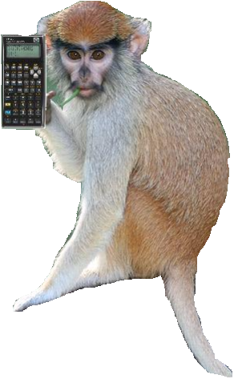


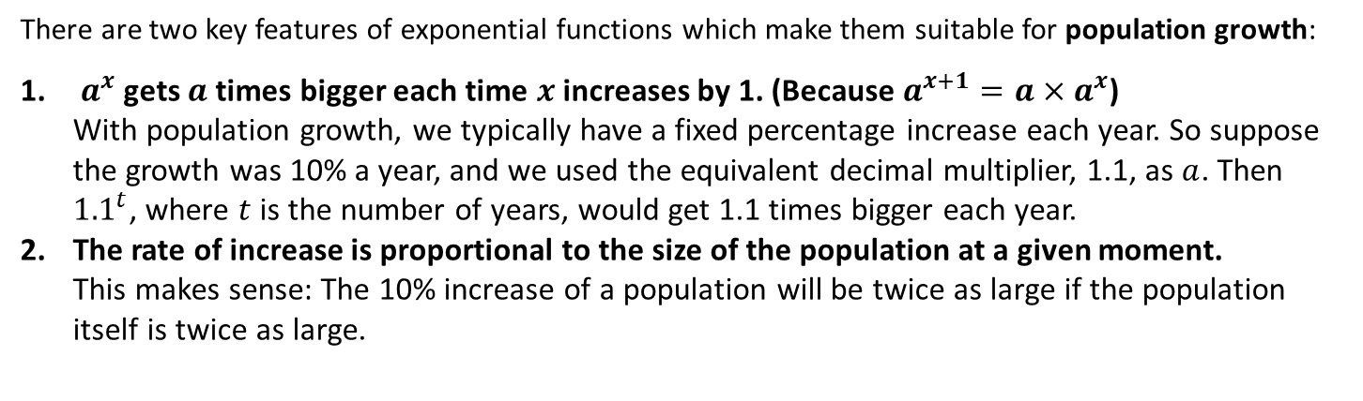
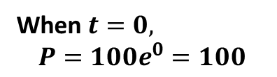


Exponential Modelling
There are two key features of exponential functions which make them suitable for population growth:
$a^{x}$ gets $a$ times bigger each time $x$ increases by 1. (Because $a^{x+1}=a×a^{x}$) With population growth, we typically have a fixed percentage increase each year. So suppose the growth was 10% a year, and we used the equivalent decimal multiplier, 1.1, as $a$. Then ${1.1}^{t}$, where $t$ is the number of years, would get 1.1 times bigger each year.
The rate of increase is proportional to the size of the population at a given moment. This makes sense: The 10% increase of a population will be twice as large if the population itself is twice as large.
Suppose the population $P$ in The Republic of Dave is modelled by $P=100e^{3t}$ where $t$ is the numbers years since The Republic was established.
$$P$$
What is the initial population?
?
When $t=0,$ $$P=100e^{0}=100$$
What is the initial rate of population growth?
?
$$\frac{dP}{dt}=300e^{3t}$$
When $t=0,\frac{dP}{dt}=300$
$$t$$
“Use of Technology” Monkey says:
When I’m not busy eating ticks off other monkeys, I use the $e^{□}$ key. I can also use [ALPHA] [$e$] to get $e$ without a power.

Slide 17


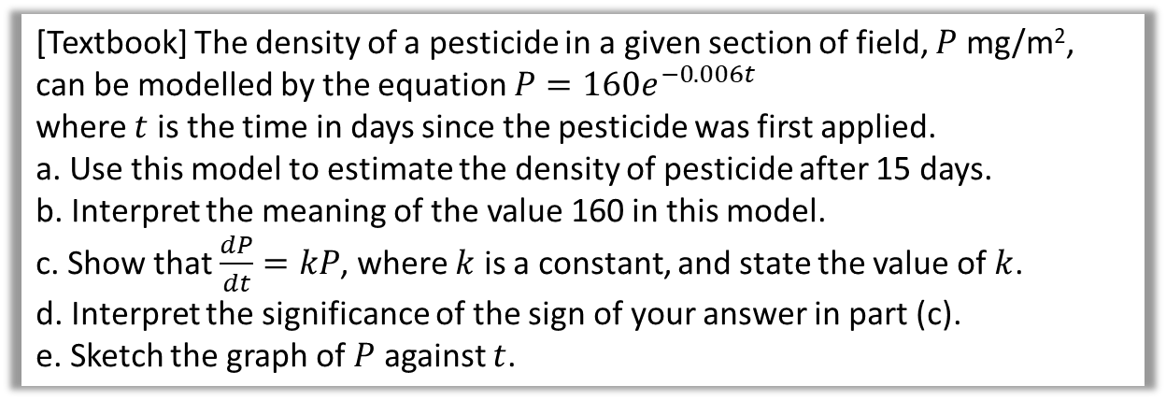


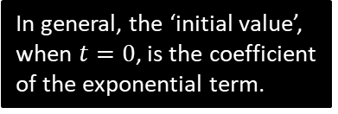
Another Example
[Textbook] The density of a pesticide in a given section of field, $P$ mg/m², can be modelled by the equation $P=160e^{−0.006t}$
where $t$ is the time in days since the pesticide was first applied.
a. Use this model to estimate the density of pesticide after 15 days.
b. Interpret the meaning of the value 160 in this model.
c. Show that $\frac{dP}{dt}=kP$, where $k$ is a constant, and state the value of $k$.
d. Interpret the significance of the sign of your answer in part (c).
e. Sketch the graph of $P$ against $t$.
When $t=15, P=160e^{−0.006(15)}$ $$=145.2 mg/m^{2}$$
When $t=0$, then $P=160$. Thus 160 is the initial density of pesticide in the field.
$$\frac{dP}{dt}=\left(160×−0.006\right)e^{−0.006t} \\ =−0.96e^{−0.006t} ∴k=−0.96$$
The rate is negative, thus the density of pesticide is decreasing.
a
?
In general, the ‘initial value’, when $t=0$, is the coefficient of the exponential term.
b
?
$$P$$
Recall that if the power in the exponential term is negative, we have an exponential decay graph, which gradually decreases towards 0.
If in doubt, just try a large value of $t$.
Don’t forget to put in the 160!
?
c
?
160
d
?
$$t$$

Slide 18
Exercise 14C
Pearson Pure Mathematics Year 1/AS
Pages 318-319

Slide 19










Logarithms
You know the inverse of many mathematical operations; we can undo an addition by 2 for example by subtracting 2. But is there an inverse function for an exponential function?
Function
Inverse
12
4
$$x×3$$
$$x÷3$$
4
?
7
4
$$x+3$$
$$x−3$$
4
?
16
4
$$x^{2}$$
$$\sqrt{x}$$
4
?
1024
4
$$x^{5}$$
$$\sqrt[5]{x}$$
4
?
81
4
$$3^{x}$$
$$\log_{3}{x}$$
4
?
Such functions are known as logarithms, and exist in order to provide an inverse to exponential functions.

Slide 20



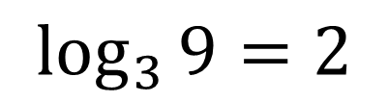

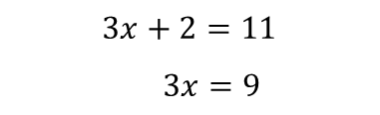











Interchanging between exponential and log form
! $\log_{a}{n}$ (“said log base $a$ of $n$”) is equivalent to $a^{x}=n$. The log function outputs the missing power.
$$3^{2}=9$$
$$\log_{3}{9}=2$$
Here are two methods of interchanging between these forms.
Pick your favourite!
Method 1: ‘Missing Power’
Method 2: Do same operation to each side of equation.
Note first the base of the log must match the base of the exponential.
$\log_{2}{8}$ for example asks the question “2 to what power gives 8?”
Since KS3 you’re used to the idea of doing the same thing to each side of the equation that ‘undoes’ whatever you want to get rid of.
$$3x+2=11$$
$$3x=9$$
We can imagine inserting the output of the log just after the base. Click the button!
$$\left(−2\right)$$
$$\left(−2\right)$$
“log base $a$” undoes “$a$ to the power of” and vice versa, as they are inverse functions.
$$=$$
$$log$$
$$3$$
Click to start Fro-manimation
$$8$$
$$=3$$
$$2$$
$$\log_{2}{8}=3$$
$$8=2^{3}$$
$$\left(2^{□}\right)$$
$$\left(2^{□}\right)$$

Slide 21













Examples
?
$$\log_{3}\left(\frac{1}{27}\right)=−3$$
$$\log_{5}{25}=2$$
Think: “5 to the power of what gives you 25?”
?
?
$$\log_{3}{81}=4$$
$$\log_{2}\left(\frac{1}{16}\right)=−4$$
?
?
$$\log_{2}{32}=5$$
?
?
$$\log_{10}{1000}=3$$
$$\log_{a}\left(a^{3}\right)=3$$
?
$$\log_{4}{1}=0$$
! $\log_{a}{1}=0$ for all $a$.
$$\log_{4}\left(−1\right)=$$
?!!??
NOPE
$$\log_{4}{4}=1$$
?
While a log can output a negative number, we can’t log negative numbers.
Strictly Just For Your Interest: However, if we were to expand the range (i.e. output) of the log function to allow complex numbers (known as the ‘complex logarithm’), then we in fact get $\log_{4}{(−1)}=\frac{iπ}{\ln\left(4\right)}$. It’s probably better if you purge these last few sentences from your memory and move along…
$$\log_{2}\left(\frac{1}{2}\right)=−1$$
?

Slide 22










With Your Calculator
There are three buttons on your calculator for computing logs:
I couldn’t think of a word that rhymed with ‘ln’ so I recorded it for you.
?
$$\log_{□}{□}$$
$$\log_{3}{7}=1.77124… \\ \log_{5}{0.3}=−0.74807…$$
?
$ln$ of $x$
$$\ln{10}=2.30258… \\ \ln{e}=1$$
$$ln$$
?
?
$ln$ is the “natural log of $x$”, meaning “log to the base $e$”, i.e. it the inverse of $e^{x}$.
$$\ln\left(x\right)=\log_{e}\left(x\right)$$
We will use it more extensively later this chapter.
$$log$$
$$\log{100}=2$$
?
Just like the $√$ symbol without a number is $\sqrt[2]{□}$ by default, $log$ without a base is base 10 by default when used on your calculator (although confusingly “$log$” can mean “$ln$” in mathematical papers)

Slide 23


Exercise 14D
Pearson Pure Mathematics Year 1/AS
Pages 320-321
Non-calculator!
Extension
2
[MAT 2013 1F] Three positive numbers $a,b,c$ satisfy
$$\log_{b}{a}=2 \\ \log_{b}\left(c−3\right)=3 \\ \log_{a}\left(c+5\right)=2$$
This information:
specifies $a$ uniquely;
is satisfied by two values of $a$;
is satisfied by infinitely many values of $a$;
is contradictory
If we take exponents of the three equations:
$$a=b^{2}, c−3=b^{3}, c+5=a^{2}$$
Hence eliminating $a$ and $c$ we get
$$b^{3}+3=b^{4}−5 ⇒ b^{3}\left(b−1\right)=8$$
We are only interested in positive solutions to $b$. Note that $b^{3}\left(b−1\right)$ is negative for $0<b<1$ and then both $b^{3}$ and $b−1$ are positive and increasing for $b>1$. So there is only one positive solution to the equation ($b=2$, so that $a=4, c=11$). Answer is (a).
1
[MAT 2015 1J] Which is the largest of the following numbers?
A) $\frac{\sqrt{7}}{2}$ B) $\frac{5}{4}$ C) $\frac{\sqrt{10!}}{3\left(6!\right)}$
D) $\frac{\log_{2}{30}}{\log_{3}{85}}$ E) $\frac{1+\sqrt{6}}{3}$
(Official solution) Squaring all answers results in (A) $\frac{7}{4}$ which is larger than (B) $\frac{25}{16}$. After squaring (C) it simplifies to $\frac{10×9×8×7}{9×6!}$ which further simplifies to $\frac{7}{9}$ which is smaller than (A).
$\log_{2}{30}≈5$ and $\log_{3}{(85)}≈4$, hence (D) is smaller than (A) after squaring. Comparing (A) with (E) after squaring results in a comparison of $\frac{7}{4}$ and $\frac{7+2\sqrt{6}}{9}$. As $2<\sqrt{6}<3$, (E) squared must be less than $\frac{13}{9}$ and hence less than $\frac{7}{4}$. The answer is (A).
?
?

Slide 24




8
4
3
2
1
-1
-2
$$y=\log_{2}{x}$$
$$x$$ | 0.25 | 0.5 | 1 | 2 | 4 | 8
$$y$$ | -2 | -1 | 0 | 1 | 2 | 3
?
?
?
?
?
?
The log graph isn’t defined for $x≤0$
The gradient gradually decreases but remains positive (log is an “increasing function”)
Root is 1.
-2 -1 1 2 3 4 5 6 7
We have a vertical asymptote $x=0$
Notes:
Get students to sketch axes and tables in their books.

Slide 25



Laws of Logs
! Three main laws:
$$\log_{a}{x}+\log_{a}{y}=\log_{a}{xy} \\ \log_{a}{x}−\log_{a}{y}=\log_{a}\left(\frac{x}{y}\right) \\ \log_{a}\left(x^{k}\right)=k\log_{a}{x}$$
Special cases:
$$\log_{a}{a}=1 (a>0, a≠1) \\ \log_{a}{1}=0 \left(a>0, a≠1\right) \\ \log\left(\frac{1}{x}\right)=\log\left(x^{−1}\right)=−\log\left(x\right)$$
Not in syllabus (but in MAT/PAT):
$$\log_{a}{b}=\frac{\log_{c}{b}}{\log_{c}{a}}$$
The logs must have a consistent base.
i.e. You can move the power to the front.
We often try to avoid leaving fractions inside logs.
So if the answer was:
$$\log_{2}\left(\frac{1}{3}\right)$$
You should write your answer as: $−\log_{2}{3}$
Reciprocating the input negates the output.
This is known as changing the base. So to get $\log_{2}{9}$ in terms of log base 3:
$$log_{2}9=\frac{log_{3}9}{log_{3}2}=\frac{2}{log_{3}2}$$

Slide 26




Examples
Write as a single logarithm:
$\log_{3}{6}+\log_{3}{7}$
$\log_{2}{15}−\log_{2}{3}$
$2\log_{5}{3}+3\log_{5}{2}$
$\log_{10}{3}−4\log_{10}\left(\frac{1}{2}\right)$
Write in terms of $\log_{a}{x}$, $\log_{a}{y}$ and $\log_{a}{z}$
$\log_{a}{(x^{2}yz^{3}})$
$\log_{a}\left(\frac{x}{y^{3}}\right)$
$\log_{a}\left(\frac{x\sqrt{y}}{z}\right)$
$\log_{a}\left(\frac{x}{a^{4}}\right)$
$$\log_{3}{42}$$
$$\log_{2}{5}$$
$$\log_{5}{9}+\log_{2}{8}=\log^{5}{72}$$
$$\log_{10}{3}−\log_{10}\left(\frac{1}{16}\right)=\log_{10}48$$
?
$$\log_{a}{(x^{2}yz^{3}})=\log_{a}{(x^{2}})+\log_{a}{y}+\log_{a}{z^{3}} \\ =2\log_{a}{x}+\log_{a}{y}+3\log_{a}{z}$$
$$\log_{a}\left(\frac{x}{y^{3}}\right)=\log_{a}{(x)}−\log_{a}\left(y^{3}\right) \\ =\log_{a}{x}−3\log_{a}{y}$$
$$\log_{a}\left(xy^{\frac{1}{2}}\right)−\log_{a}{z}=\log_{a}{x}+\log_{a}\left(y^{\frac{1}{2}}\right)−\log_{a}{z} \\ =\log_{a}{x}+\frac{1}{2}\log_{a}\left(\frac{1}{2}\right)−\log_{a}{z}$$
$$\log_{a}\left(\frac{x}{a^{4}}\right)=\log_{a}{x}−4\log_{a}{a}=\log_{a}{x}−4$$
a
a
?
b
?
?
b
?
c
?
d
c
?
?
d

Slide 27



Anti Laws
These are NOT LAWS OF LOGS, but are mistakes students often make:
?
$$\log_{a}\left(b+c\right)=\log_{a}{b}+\log_{a}{c}$$
There is no method to simplify the log of a sum, only the sum of two logs!
✗ FAIL
$${\left(\log_{2}{x}\right)}^{3}=3\log_{2}{x}$$
?
The power must be on the input (here the $x$), but here the power is around the entire log.
✗ FAIL

Slide 28




Solving Equations with Logs
Solve the equation $\log_{10}{4}+2\log_{10}{x}=2$
This is a very common type of exam question.
The strategy is to combine the logs into one and isolate on one side.
?
$$\log_{10}{4}+\log_{10}{x^{2}}=2 \\ \log_{10}\left(4x^{2}\right)=2 \\ 4x^{2}={10}^{2} \\ x^{2}=25 \\ x=5$$
We’ve used the laws of logs to combine them into one.
Use your favourite method of rearranging. Either do “10 the power of each side” to “undo” the log, or the “insert the 2 between the 10 and $4x^{2}$” method.
The subtle bit: You must check each value in the original equation. If $x=−5$, then we’d have $\log_{10}\left(−5\right)$ but we’re not allowed to log a negative number.

Slide 29


Test Your Understanding
Edexcel C2 Jan 2013 Q6
$$\log_{2}{{\left(x+15\right)}^{2}}−\log_{2}{x}=6 \\ \log_{2}\left(\frac{{\left(x+15\right)}^{2}}{x}\right)=6 \\ 2^{6}=\frac{{\left(x+15\right)}^{2}}{x} \\ 64x={\left(x+15\right)}^{2} \\ 64x=x^{2}+30x+225 \\ x^{2}−34x+225=0$$
$$\left(x−25\right)\left(x−9\right)=0 \\ x=25 or x=9$$
a
?
Those who feel confident with their laws could always skip straight to this line.
?
b
These are both valid solutions when substituted into the original equation.

Slide 30


Exercise 14E
Pearson Pure Mathematics Year 1/AS
Pages 323-324
These are all strictly non-calculator!
Extension
[MAT 2002 1F] Observe that $2^{3}=8$, $2^{5}=32$, $3^{2}=9$ and $3^{3}=27$. From these facts, we can deduce that $\log_{2}{3}$ is:
between $1\frac{1}{3}$ and $1\frac{1}{2}$
between $1\frac{1}{2}$ and $1\frac{2}{3}$
between $1\frac{2}{3}$ and $2$
none of the above
4
1
[AEA 2010 Q1b] Solve the equation
$$\log_{3}\left(x−7\right)−\frac{1}{2}\log_{3}{x}=1−\log_{3}{2}$$
[AEA 2008 Q5i] Anna, who is confused about the rules of logarithms, states that
$${\left(\log_{3}{p}\right)}^{2}=\log_{3}{(p^{2}}) \\ \log_{3}\left(p+q\right)=\log_{3}{p}+\log_{3}{q}$$
However, there is a value for $p$ and a value for $q$ for which both statements are correct. Find their values.
[MAT 2007 1I] Given that $a$ and $b$ are positive and
$$4{\left(\log_{10}{a}\right)}^{2}+{\left(\log_{10}{b}\right)}^{2}=1$$
what is the greatest possible value of $a$?
2
Solutions on next slide.
3

Slide 31



Solutions to Extension Exercises
1
[AEA 2010 Q1b] Solve the equation
$$\log_{3}\left(x−7\right)−\frac{1}{2}\log_{3}{x}=1−\log_{3}{2}$$
Solution: $x=\frac{49}{4}$
[AEA 2008 Q5i] Anna, who is confused about the rules of logarithms, states that
$${\left(\log_{3}{p}\right)}^{2}=\log_{3}{(p^{2}}) \\ \log_{3}\left(p+q\right)=\log_{3}{p}+\log_{3}{q}$$
However, there is a value for $p$ and a value for $q$ for which both statements are correct. Find their values.
First equation:
$${\left(\log_{2}{p}\right)}^{2}=2\log_{3}{p} \\ ∴\log_{3}{p}\left(\log_{3}{p}−2\right)=0 \\ \log_{3}{p}⇒p=1 \\ \log_{3}{p}=2 ⇒ p=9$$
Second equation:
$$\log_{3}\left(p+q\right)=\log_{3}\left(pq\right) \\ ∴p+q=pq ⇒ q=\frac{p}{p−1} ∴p≠1 \\ p=9, q=\frac{9}{8}$$
3
[MAT 2007 1I] Given that $a$ and $b$ are positive and
$$4{\left(\log_{10}{a}\right)}^{2}+{\left(\log_{10}{b}\right)}^{2}=1$$
what is the greatest possible value of $a$?
To make $a$ as large as possible we make ${\left(\log_{10}{b}\right)}^{2}$ as small as possible. Anything squared is at least 0: $b=1$ will achieve this.
$$∴4{\left(\log_{10}{a}\right)}^{2}=1 \\ \log_{10}{a}=±\frac{1}{2} \\ a=\sqrt{10}$$
?
?
2
?
4
[MAT 2002 1F] Observe that $2^{3}=8$, $2^{5}=32$, $3^{2}=9$ and $3^{3}=27$. From these facts, we can deduce that $\log_{2}{3}$ is:
between $1\frac{1}{3}$ and $1\frac{1}{2}$
between $1\frac{1}{2}$ and $1\frac{2}{3}$
between $1\frac{2}{3}$ and $2$
none of the above
Suppose that $\log_{2}{3}>\frac{3}{2}$. Taking 2 to the power of each side:
$$3>2^{\frac{3}{2}} → 3^{2}>2^{3} → 9>8$$
This is true, so answer is not (A).
Next try $\log_{2}{3}>\frac{5}{3}$
$$3>2^{\frac{5}{3}} → 3^{3}>2^{5} → 27>32$$
This is not true, so answer is (B).
?

Slide 32




Solving equations with exponential terms
Solve $3^{x}=20$
?
Applying $\log_{3}$ to each side of the equation:
$$x=\log_{3}{20}=2.727 (to 3dp)$$
This is often said “Taking logs of both sides…”
Solve $5^{4x−1}=61$
?
Applying $\log_{5}$ to each side of the equation:
$$4x−1=\log_{5}{61} \\ x=\frac{\log_{5}{61}+1}{4}=0.889 (to 3dp)$$

Slide 33




Solving equations with exponential terms
Solve $3^{x}=2^{x+1}$
Why can we not apply quite the same strategy here?
Because the exponential terms don’t have the same base, so we can’t apply the same log.
We ‘take logs of’/apply log to both sides, but we need not specify a base. $log$ on its own may either mean $\log_{10}$ (as per your calculator) or $\log_{e}$ (in academic circles, as well as on sites like WolframAlpha), but the point is, the base does not matter, provided that the base is consistent on both sides.
?
? Solution
$$\log{3^{x}}=\log{2^{x+1}} \\ x\log{3}=\left(x+1\right)\log{2} \\ x\log{3}=x\log{2}+\log{2} \\ x\log{3}−x\log{2}=\log{2} \\ x\left(\log{3}−\log{2}\right)=\log{2} \\ x=\frac{\log{2}}{\log{3}−\log{2}} \\ =1.7095$$
Logs in general are great for solving equations when the variable is in the power, because laws of logs allow us to move the power down.
This then becomes a GCSE-style ‘changing the subject’ type question. Just isolate $x$ on one side and factorise out.
It doesn’t matter what base you use to get the final answer as a decimal, provided that it’s consistent. You may as well use the calculator’s ‘log’ (no base) key.

Slide 34






Test Your Understanding
1
Solve $3^{2x−1}=5$, giving your answer to 3dp.
3
Solve $2^{x}3^{x+1}=5$, giving your answer in exact form.
?
?
$$2x−1=\log_{3}{5} \\ x=\frac{\log_{3}{5}+1}{2}=1.232$$
$$\log{2^{x}3^{x+1}}=\log{5} \\ \log{2^{x}}+\log{3^{x+1}}=\log{5} \\ x\log{2}+\left(x+1\right)\log{3}=\log{5} \\ x\log{2}+x\log{3}+\log{3}=\log{5} \\ x \left(\log{2}+\log{3}\right)=\log{5}−\log{3} \\ x=\frac{\log{5}−\log{3}}{\log{2}+\log{3}}$$
which could be simplified to:
$$x=\frac{\log{5}−\log{3}}{\log{6}}$$
2
Solve $3^{x+1}=4^{x−1}$, giving your answer to 3dp.
?
$$\log{3^{x+1}}=\log{4^{x−1}} \\ \left(x+1\right)\log{3}=\left(x−1\right)\log{4} \\ x\log{3}+\log{3}=x\log{4}−\log{4} \\ x\log{4}−x\log{3}=\log{3}+\log{4}$$
$$x\left(\log{4}−\log{3}\right)=\log{3}+\log{4} \\ x=\frac{\log{3}+\log{4}}{\log{4}−\log{3}}=8.638$$

Slide 35



Exercise 14F
Pearson Pure Mathematics Year 1/AS
Page 325
Extension
2
[MAT 2013 1J] For a real number $x$ we denote by $[x]$ the largest integer less than or equal to $x$. Let $n$ be a natural number. The integral
$$\int_{0}^{n}{\left[2^{x}\right]} dx$$
equals:
$\log_{2}\left(\left(2^{n}−1\right)!\right)$
$n 2^{n}−\log_{2}\left(\left(2^{n}\right)!\right)$
$n 2^{n}$
$\log_{2}\left(\left(2^{n}\right)!\right)$
1
[MAT 2011 1H] How many positive values $x$ which satisfy the equation:
$$x=8^{\log_{2}{x}}−9^{\log_{3}{x}}−4^{\log_{2}{x}}+\log_{0.5}{0.25}$$
$$x={\left(2^{3}\right)}^{\log_{2}{x}}−{\left(3^{2}\right)}^{\log_{3}{x}}−{\left(2^{2}\right)}^{\log_{2}{x}}+2 \\ x=2^{3\log_{2}{x}}−3^{2\log_{3}{x}}−2^{2\log_{2}{x}}+2 \\ x=2^{\log_{2}{x^{3}}}−3^{\log_{3}{x^{2}}}−2^{\log_{2}{x^{2}}}+2 \\ x=x^{3}−x^{2}−x^{2}+2 \\ x^{3}−2x^{2}−x+2=0 \\ x^{2}\left(x−2\right)−1\left(x−2\right)=0 \\ \left(x^{2}−1\right)\left(x−2\right)=0 \\ \left(x+1\right)\left(x−1\right)\left(x−2\right)=0$$
This has 2 positive solutions.
?
(Warning: This one really is very challenging, even for MAT)

Slide 36

















Solution to Extension Question 2
$$y$$
[MAT 2013 1J] For a real number $x$ we denote by $[x]$ the largest integer less than or equal to $x$. Let $n$ be a natural number. The integral
$$\int_{0}^{n}{\left[2^{x}\right]} dx$$
equals:
$\log_{2}\left(\left(2^{n}−1\right)!\right)$
$n 2^{n}−\log_{2}\left(\left(2^{n}\right)!\right)$
$n 2^{n}$
$\log_{2}\left(\left(2^{n}\right)!\right)$
$$y=2^{x}$$
$$2^{n}$$
$$5$$
$$4$$
$$3$$
$$2$$
$$1$$
$$\log_{2}{5}$$
$$x$$
$$\log_{2}{1}$$
$$\log_{2}{2}$$
$$\log_{2}{3}$$
$$\log_{2}{2^{n}}$$
$$\log_{2}{4}$$
This biggest challenge is sketching the graph! Because of the rounding down, the graph jumps up 1 at a time, giving a bunch of rectangles. We can use logs to find the corresponding $x$ values at which these jumps occur, which progressively become closer and closer together. The last $y$ value is $2^{n}$, thus the last $x$ value is $\log_{2}{2^{n}}=n$.
The area, using the rectangles, is thus:
$$1\left(\log_{2}{2}−\log_{2}{1}\right)+2\left(\log_{2}{3}−\log_{2}{2}\right)+3\left(\log_{2}{4}−\log_{2}{3}\right)+…+\left(2^{n}−1\right)\left(\log_{2}{2^{n}}−\log_{2}\left(2^{n}−1\right)\right) \\ =\log_{2} 2{−\log_{2}{1}+2\log_{2}{3}−2\log_{2}{2}+3\log_{2}{4}−3\log_{2}{3}+…+\left(2^{n}−1\right)\log_{2}{2^{n}}−\left(2^{n}−1\right)\log_{2}{{(2}^{n}−1) }} \\ =−\log_{2}{2}−\log_{2}{3}−…−\log_{2}\left(2^{n}−1\right)+\left(2^{n}−1\right)\log_{2}{2^{n}} \\ =−(\log_{2}\left(2×3×4×…×\left(2^{n}−1\right)\right)+n\left(2^{n}−1\right) \\ =n 2^{n}−\log_{2}\left(\left(2^{n}\right)!\right)$$

Slide 37










Natural Logarithms
We have previously seen that $y=\log_{a}{x}$ is the inverse function of $y=a^{x}$.
We also saw that $e^{x}$ is “the” exponential function.
The inverse of $e^{x}$ is $\log_{e}{x}$, but because of its special importance, it has its own function name!
! The inverse of $y=e^{x}$ is $y=\ln{x}$
?
Since “$e$ to the power of” and “$ln$ of” are inverse functions, they cancel each other out!
$$\ln{e^{x}}=x \\ e^{\ln{x}}=x$$
?
Solve $e^{x}=5$
Solve $2\ln{x}+1=5$
?
?
“ln both sides”.
On the LHS it cancels out the “$e$ to the power of”
$$\ln{x}=2 \\ x=e^{2}$$
$$x=\ln{5}$$
Do “$e$ to the power of” each side. On the LHS it cancels out the ln.

Slide 38




Quadratics in $e^{x}$
In previous chapters we’ve already dealt with quadratics in disguise, e.g. “quadratic in sin”. We therefore just apply our usual approach: either make a suitable substitution so the equation is then quadratic, or (strongly recommended!) go straight for the factorisation.
Solve $e^{2x}+2e^{x}−15=0$
Solve $e^{x}−2e^{−x}=1$
?
?
Note that $e^{2x}={\left(e^{x}\right)}^{2}$ therefore
$$\left(e^{x}+5\right)\left(e^{x}−3\right)=0 \\ e^{x}=−5 or e^{x}=3$$
Exponential functions are always positive therefore:
$$x=\ln{3}$$
First write negative powers as fractions:
$$e^{x}−\frac{2}{e^{x}}=1 \\ {\left(e^{x}\right)}^{2}−2=e^{x} \\ {\left(e^{x}\right)}^{2}−e^{x}−2=0 \\ \left(e^{x}+1\right)\left(e^{x}−2\right)=0 \\ e^{x}=−1 or e^{x}=2 \\ x=\ln{2}$$

Slide 39





Test Your Understanding
Solve $\ln\left(3x+1\right)=2$
Solve $e^{2x}+5e^{x}=6$
?
?
$$3x+1=e^{2} \\ x=\frac{e^{2}−1}{3}$$
$$e^{2x}+5e^{x}−6=0 \\ \left(e^{x}+6\right)\left(e^{x}−1\right)=0 \\ e^{x}=−6 or e^{x}=1 \\ x=\ln{1}=0$$
Solve $2^{x}e^{x+1}=3$ giving your answer as an exact value.
?
$$\ln{2^{x}e^{x+1}}=\ln{3} \\ \ln{2^{x}}+\ln{e^{x+1}=\ln{3}} \\ x\ln{2}+x+1=\ln{3} \\ x\left(\ln{2}+1\right)=\ln{3}−1 \\ x=\frac{\ln{3}−1}{\ln{2}+1}$$

Slide 40
Exercise 14G
Pearson Pure Mathematics Year 1/AS
Page 327-328

Slide 41

Graphs for Exponential Data
In Science and Economics, experimental data often has exponential growth, e.g. bacteria in a sample, rabbit populations, energy produced by earthquakes, my Twitter followers over time, etc.
Because exponential functions increase rapidly, it tends to look a bit rubbish if we tried to draw a suitable graph:
But suppose we took the log of the number of transistors for each computer. Suppose the number of transistors one year was $y$, then doubled 2 years later to get $2y$.
When we log (base 2) these:
$$y → \log_{2}{y} \\ 2y → \log_{2}{(2y)}=\log_{2}{2}+\log_{2}{y} \\ =1+\log_{2}{y}$$
The logged value only increased by 1! Thus taking the log of the values turns exponential growth into linear growth (because each time we would have doubled, we’re now just adding 1), and the resulting graph is a straight line.
Take for example “Moore’s Law”, which hypothesised that the processing power of computers would double every 2 years. Suppose we tried to plot this for computers we sampled over time:
If we tried to force all the data onto the graph, we would end up making most of the data close to the horizontal axis. This is not ideal.
Number of transistors
log(transistors)
2000
Year
Year
1970
1980
1990
1970
1980
1990
2000

Slide 42

Graphs for Exponential Data
Because the energy involved in earthquakes decreases exponentially from the epicentre of the earthquake, such energy values recorded from different earthquakes would vary wildly.
The Richter Scale is a logarithmic scale, and takes the log (base 10) of the amplitude of the waves, giving a more even spread of values in a more sensible range.
(The largest recorded value on the Richter Scale is 9.5 in Chile in 1960, and 15 would destroy the Earth completely – evil scientists take note)
The result is that an earthquake just 1 greater on the Richter scale would in fact be 10 times as powerful.
Richter Scale

Slide 43



Other Non-Linear Growth
$$y$$
We would also have similar graphing problems if we tried to plot data that followed some polynomial function such as a quadratic or cubic.
We will therefore look at the process to convert a polynomial graph into a linear one, as well as a exponential graph into a linear one…
$$y=2x^{3}$$
$$x$$

Slide 44














Turning non-linear graphs into linear ones
Case 1: Polynomial $→$ Linear
Case 2: Exponential $→$ Linear
Suppose our original model was a polynomial one*:
$$y=ax^{n}$$
Then taking logs of both sides:
$$\log{y}=\log{ax^{n}} \\ \log{y}=\log{a}+n\log{x}$$
We can compare this against a straight line:
$$Y=mX+c$$
Suppose our original model was an exponential one:
$$y=ab^{x}$$
Then taking logs of both sides:
$$\log{y}=\log{ab^{x}} \\ \log{y}=\log{a}+x\log{b}$$
Again we can compare this against a straight line:
$$Y=mX+c$$
If $y=ax^{n}$, then the graph of $\log{y}$ against $\log{x}$ will be a straight line wih gradient $n$ and vertical intercept $\log{a}$.
If $y=ab^{x}$, then the graph of $\log{y}$ against $x$ will be a straight line with gradient $\log{b}$ and vertical intercept $\log{a}$.
$$\log{y}$$
$$\log{y}$$
$$\log{a}$$
$$\log{a}$$
$$\log{x}$$
$$x$$
* We could also allow non-integer $n$; the term would then not strictly be polynomial, but we’d still say the function had “polynomial growth”.
The key difference compared to Case 1 is that we’re only logging the $y$ values (e.g. number of transistors), not the $x$ values (e.g. years elapsed). Note that you do not need to memorise the contents of these boxes and we will work out from scratch each time…
In summary, logging the $y$-axis turns an exponential graph into a linear one. Logging both the $x$ and $y$-axis turns a polynomial graph into a linear one.

Slide 45








Example
[Textbook] The graph represents the growth of a population of bacteria, $P$, over $t$ hours. The graph has a gradient of 0.6 and meets the vertical axis at $\left(0,2\right)$ as shown.
A scientist suggest that this growth can be modelled by the equation $P=ab^{t}$, where $a$ and $b$ are constants to be found.
Write down an equation for the line.
Using your answer to part (a) or otherwise, find the values of $a$ and $b$, giving them to 3 sf where necessary.
Interpret the meaning of the constant $a$ in this model.
$$log⁡(P)$$
$$2$$
$$t$$
?
a
$$\log{P}=0.6t+2$$
Equation of straight line is $y=mx+c$ where here:
$$y=\log{P}, m=0.6, c=2, x=t$$
b
Just like on previous slide, start with the model then log it:
$$P=ab^{t} \\ \log{P}=\log{a}+t\log{b}$$
Comparing with our straight line equation in (a):
$$\log{a}=2 → a={10}^{2}=100 \\ \log{b}=0.6 → b={10}^{0.6}=3.98 \left(3sf\right)$$
?
Recall that $\log{a}$ means $\log_{10}{a}$
?
c
$a$ gives the initial size of the bacteria population.
Recall that the coefficient of an exponential term gives the ‘initial value’.

Slide 46








Example
[Textbook] The table below gives the rank (by size) and population of the UK’s largest cities and districts (London is number 1 but has been excluded as an outlier).
City B’ham Leeds Glasgow Sheffield Bradford
Rank, $R$ 2 3 4 5 6
Population, $P$ 1 000 000 730 000 620 000 530 000 480 000
The relationship between the rank and population can be modelled by the formula:
$P=aR^{n}$ where $a$ and $n$ are constants.
Draw a table giving values of $\log{R}$ and $\log{P}$ to 2dp.
Plot a graph of $\log{R}$ against $\log{P}$ using the values from your table and draw the line of best fit.
Use your graph to estimate the values of $a$ and $n$ to two significant figures.
Textbook Error: They use $R=aP^{n}$ but then plot $\log{P}$ against $\log{R}$.
c
First get equation of straight line:
$$m=\frac{Δy}{Δx}=\frac{5.68−6.16}{0.77−0.05}=−0.67$$
$c=6.2$ (reading from the graph)
$$∴\log\left(P\right)=−0.67\log\left(R\right)+6.2$$
As with previous example, let’s log the original model so we can compare against our straight line:
$$P=aR^{n} \\ \log{P}=\log{a}+n\log{R}$$ Comparing this with our straight line:
$$\log{a}=6.2 → a={10}^{6.2}=1600000 \left(2sf\right) \\ n=−0.67$$
$$log R$$ | 0.30 | 0.48 | 0.60 | 0.70 | 0.78
$$log P$$ | 6 | 5.86 | 5.79 | 5.72 | 5.68
?
a
?
b
?
$$log⁡(P)$$
Let’s use these points on the line of best fit to determine the gradient.
6.4
6.0
5.6
5.2
$$\left(0.05, 6.16\right)$$
$$\left(0.77, 5.68\right)$$
$$\log{R}$$
0.2 0.4 0.6 0.8

Slide 47






Test Your Understanding
Reflections: Consider what we’re doing in this whole process in case you don’t understand why we’re doing all of this:
We want to find the parameters of a model, e.g. $P=ab^{t}$ that best fits the data (in this case the parameters we want to find are $a$ and $b$).
If the data had a linear trend, then this would be easy! We know from KS3 that we’d just plot the data, find the line of best fit, then use the gradient and $y$-intercept to work out the $m$ and $c$ in our linear model.
But the original data wasn’t linear, and it would be harder to draw an ‘exponential curve of best fit’.
We therefore log the model so that the plotted data then roughly forms a straight line, and then we can then draw a (straight) line of best fit.
The gradient and $y$-intercept of this line then allows us to estimate the parameters $a$ and $b$ in the original model that best fit the data.
The process of finding parameters in a model, that best fits the data, is known as regression.
Dr Frost’s wants to predict his number of Twitter followers $P$ (@DrFrostMaths) $t$ years from the start 2015. He predicts that his followers will increase exponentially according to the model $P=ab^{t}$, where $a,b$ are constants that he wishes to find.
He records his followers at certain times. Here is the data:
Years $t$ after 2015: 0.7 1.3 2.2
Followers $P$: 2353 3673 7162
Draw a table giving values of $t$ and $\log{P}$ (to 3dp).
A line of best fit is drawn for the data in your new table, and it happens to go through the first data point above (where $t=0.7$) and last (where $t=2.2$). Determine the equation of this line of best fit. (The $y$-intercept is 3.147)
Hence, determine the values of $a$ and $b$ in the model.
Estimate how many followers Dr Frost will have at the start of 2020 (when $t=5$).
a
$$m=\frac{3.855−3.372}{2.2−0.7}=0.322 \\ c=3.147 \\ ∴\log{P}=0.322t+3.147$$
?
b
?
$$t$$ | 0.7 | 1.3 | 2.2
$$log P$$ | 3.372 | 3.565 | 3.855
c
?
d
?
$$P=ab^{t} \\ \log{P}=\log{a}+t\log{b} \\ ∴\log{a}=3.147 → a=1403 \\ \log{b}=0.322 →b=2.099$$
$$P=1403{\left(2.099\right)}^{t}$$
When $t=5, P=57164$

Slide 48
Exercise 14H
Pearson Pure Mathematics Year 1/AS
Page 331-333

Slide 49
The End

