Slide 1

Stack Overflow Developer Survey 2019: Key Findings
Eduard Tiron
18-02-2023

Slide 2

OUTLINE
Executive Summary
Introduction
Methodology
Results
Visualization – Charts
Dashboard
Discussion
Findings & Implications
Conclusion
Appendix

Slide 3

EXECUTIVE SUMMARY
This study summarizes key findings found after analyzing the data collected in the 2019 Stack Overflow Developer Survey.
The analysis yielded insights regarding the following:
Most popular languages, databases, and other technologies (at the time of data collection)
Attitudes reflecting which technologies will become most popular in future demographics (e.g. the gender gap among developers)
These findings are relevant particularly to current and aspiring developers, recruiters, educators, and policy makers.

Slide 4

INTRODUCTION
The online programming knowledge sharing platform, Stack Overflow, has been conducting the Stack Overflow Annual Developer Survey since 2011,.
Its primary objective is to gather data regarding technology usage and trends among developers.
In this analysis, a subset of the 2019 dataset was examined (present dataset: N = 11398; original dataset N ≈ 90000).
Audience: Developers (current and aspiring), HR professionals, educators, policy makers...

Slide 5

METHODOLOGY
Data Source: 2019 Stack Overflow Developer Survey
Link to Stack Overflow’s annual survey data and results
Data Wrangling: A portion of the dataset (provided by IBM) was loaded and cleaned using SQL and Python’s pandas library.
Cleaning procedure: Duplicates removal, data imputation, data normalization
Link to dataset provided by IBM
Analysis & Visualization: EDA and data visualization were conducted using various Python libraries and Cognos. Specifically, the following measures were examined:
Technologies (i.e., languages, databases, platforms, and web frames) used in 2019
Most desired technologies for the next year
Demographics (i.e., gender, country, age, and education).

Slide 6
RESULTS: Compensation & demographics
First, descriptive statistics regarding demographics and total annual compensation were computed.
Sample size after compensation outlier removal:
N = 10,519 (vs. before removal: N = 11,398).
The respondents had a median age of 29, and were predominantly male (i.e., 93.5% male vs. 6.5% female).
Median compensation: $52,704 USD per year.
Compensation and Age were positively correlated:
r = .40.
Median compensation was higher for women than men:
$54,956 vs $52,339.

Slide 7
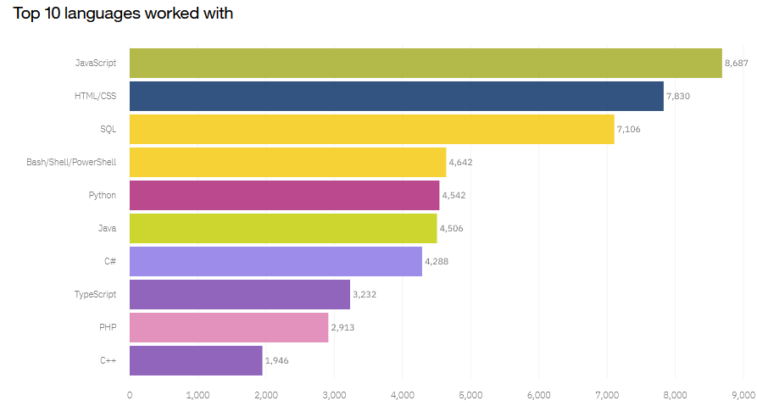
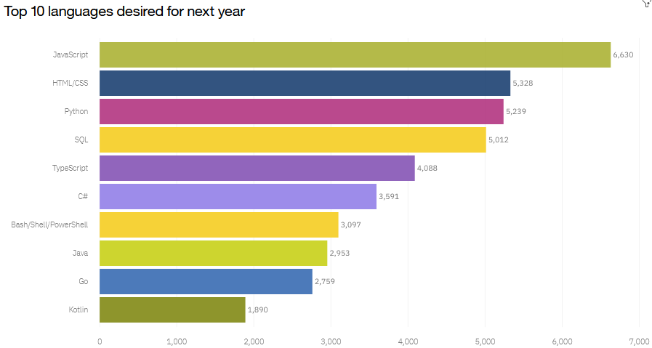
PROGRAMMING LANGUAGE TRENDS

Slide 8
PROGRAMMING LANGUAGE TRENDS - FINDINGS & IMPLICATIONS
Findings
• Javascript and HTML/CSS were the most popular in 2019 and will likely remain so the following year.
• SQL was popular in 2019 and will likely remain so, but will be surpassed by Python.
• Increasing interests in Python and TypeScript.
• Decreasing interest in PowerShell/Bash.
Implications
• Web development is still in high demand, and
Javascript and HTML/CSS remain the dominant
languages—however, TypeScript may catch up in
the future.
• SQL remains the preferred language for big data
storage and querying—it’s not likely to go away
anytime soon.
• Python’s rising popularity likely reflects the growth
of AI and ML work.

Slide 9
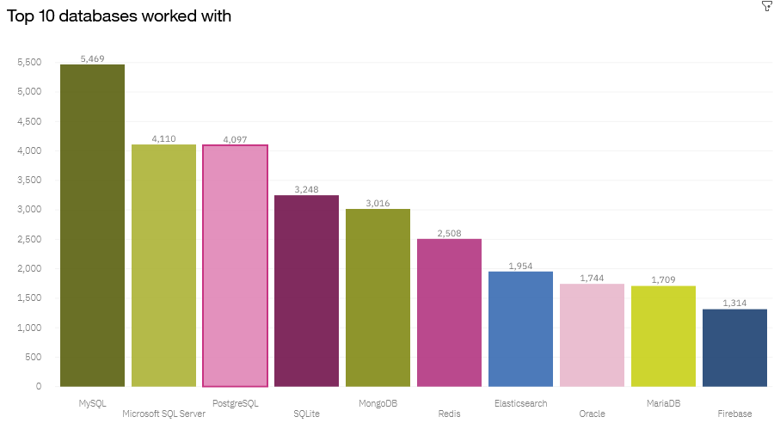
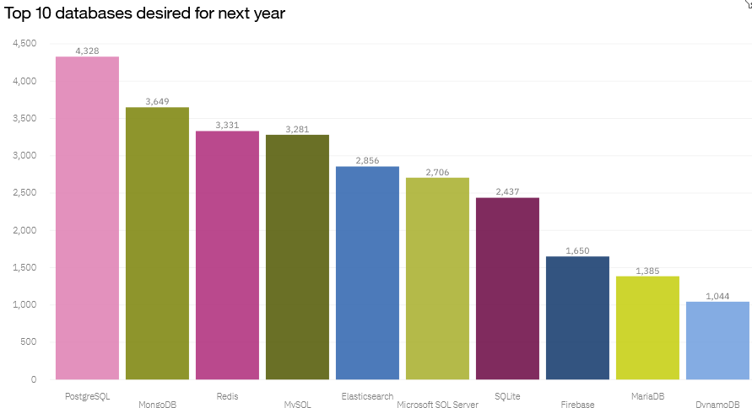
DATABASE TRENDS

Slide 10
DATABASE TRENDS - FINDINGS & IMPLICATIONS
Findings
• SQL database programs were the most popular in 2019, with MySQL in the lead.
• PostgreSQL is gaining popularity over other SQL database programs, and it was the overall most desired database for the next year.
• MongoDB was popular in 2019 and gaining interest.
• Increasing interest in Elasticsearch.
Implications
• There appears to be increasing developer preference toward open-source database programs.
• NoSQL database programs are gaining popularity, which likely reflects a growing need to handle non-relational and unstructured data.
• Current and aspiring data analysts should develop competence in NoSQL in addition to SQL database programs.

Slide 11
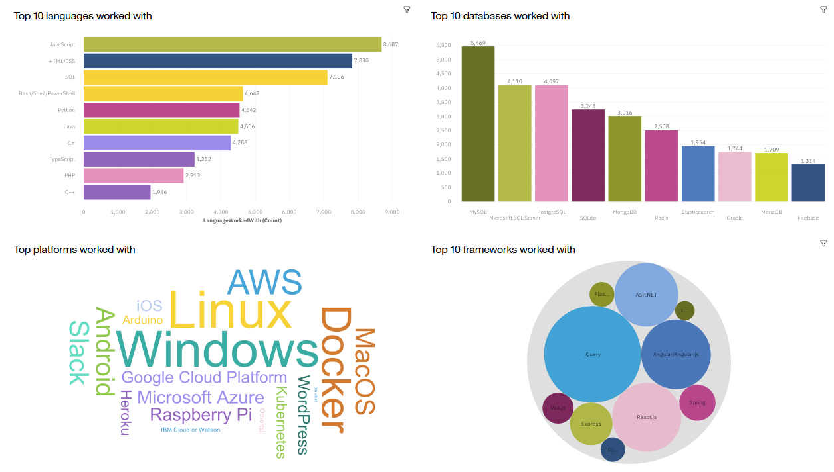
DASHBOARD
The following link contains the Cognos dashboard summarizing:
a) current technology use
b) future technology trend
c) demographics of the survey respondents
Link

Slide 12
DASHBOARD TAB 1

Slide 13
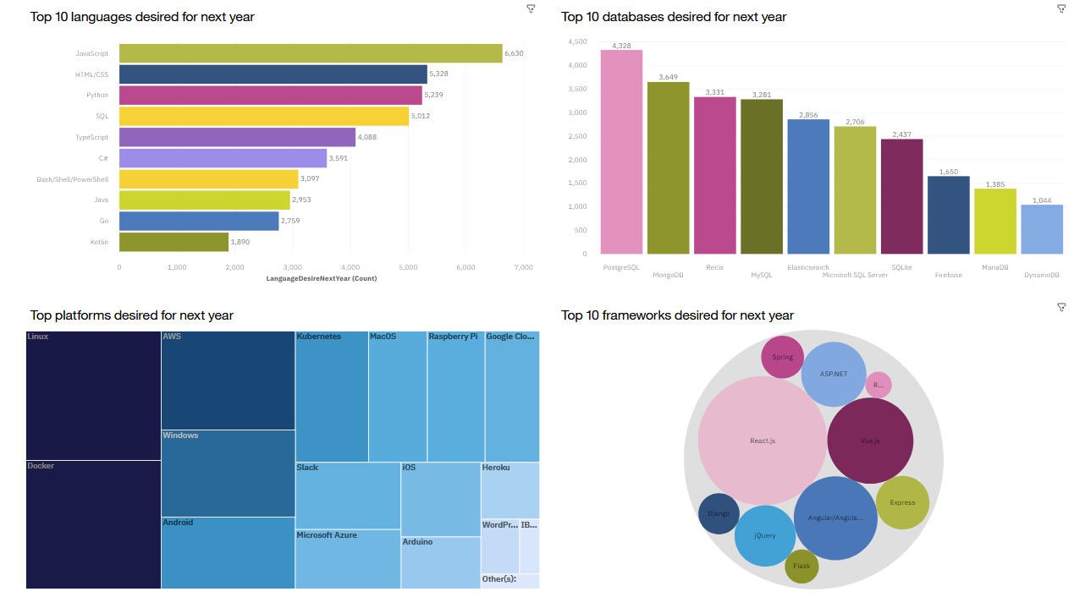
DASHBOARD TAB 2

Slide 14
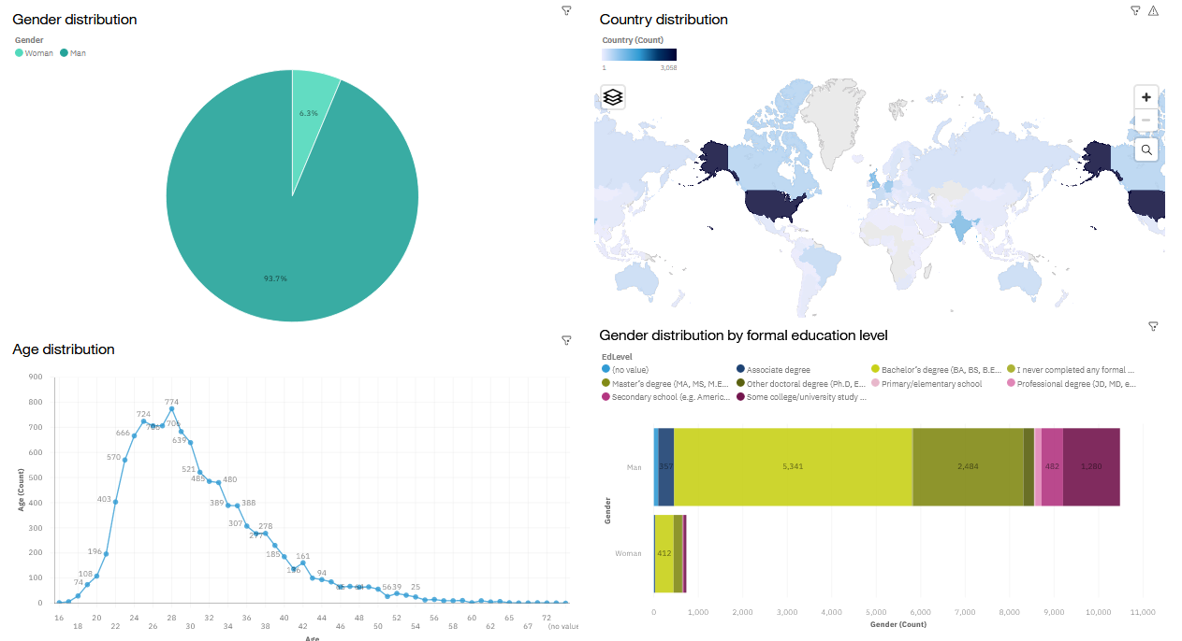
DASHBOARD TAB 3

Slide 15

DISCUSSION
Taken together, the findings yield insights into the following questions:
What kinds of developer technologies are in top demand?
Which technologies should prospective developers and data professionals be learning?
Which technologies should educators place more emphasis on teaching in upcoming years?
What does the distribution of annual compensation for developers look like?
What is the developer demographic like? Is there a gender representation gap?

Slide 16
OVERALL FINDINGS & IMPLICATIONS
Findings
• High usage and interest in Javascript and HTML/CSS remain high usage. There’s also increasing interest in Typescript.
• Increasing interest in Python.
• High usage and interest in SQL. MySQL had the highest usage in 2019, but PostgreSQL is gaining interest and was the overall most desired database program for the next year
• NoSQL database programs gaining interest, of which MongoDB was the most used in 2019 and desired for the next year.
• A severe gender representation gap (in favor of men), despite median compensation being slightly higher for women.
• Technology divide between countries.
Implications
• Web development is still in high demand. Current and prospective developers may consider picking up Typescript in addition to Javascript and HTML/CSS.
• With the growing need to handle big data and perform AI and ML work, data professionals should continue to enhance SQL competence but also enhance competence with NoSQL database programs and Python.
• Businesses need to adapt to changing technology preferences, especially in terms of talent acquisition and development.
• Policy makers, educators, and organizations should work to minimize the gender representation gap in addition to the technology divide between countries.

Slide 17

CONCLUSION
A subset of data collected as part of the 2019 Stack Overflow Developer Survey was examined.
The findings yielded numerous insights into the technologies most used and desired by developers in addition to the developer demographic.
These insights should be particularly relevant for current and prospective developers aiming to remain competitive, businesses aiming to upskill their talent, educators in the field, and policy makers aiming to address gender and economic issues.

Slide 18
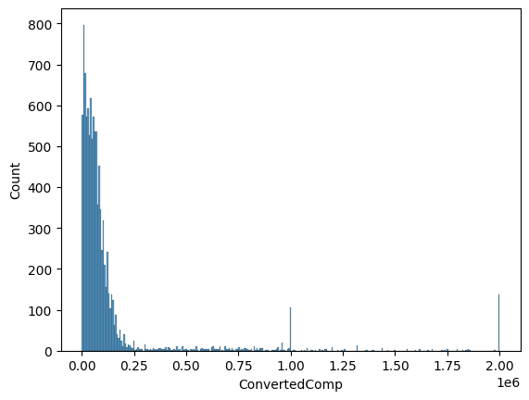
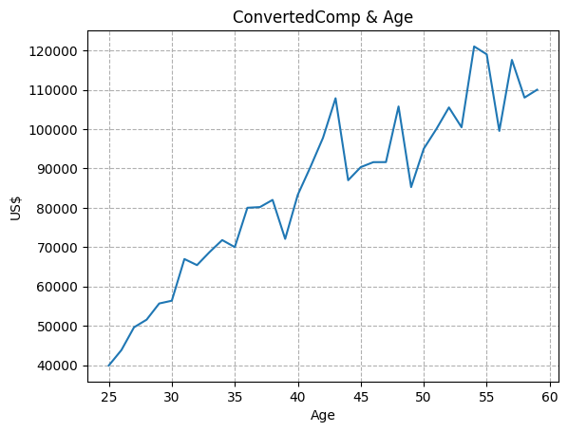
APPENDIX: Annual compensation
Distribution of annual compensation
Annual compensation by age

Slide 19
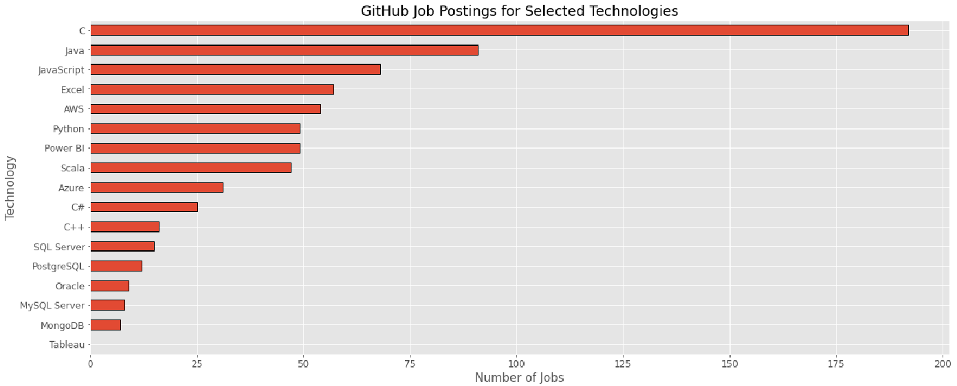
JOB POSTINGS

Slide 20
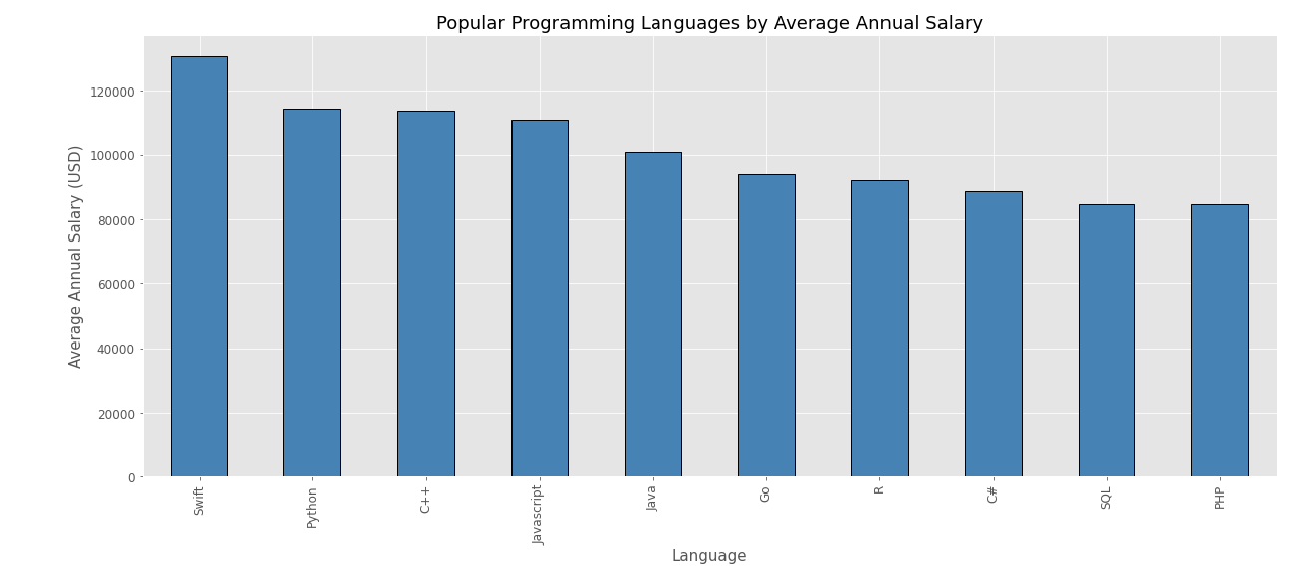
POPULAR LANGUAGES

