Slide 1
https://www.youtube.com/watch?v=Nj-hdQMa3uA

Slide 2
Review of Regression Mediation and Moderation

Slide 3
Applied Statistical Analysis
EDUC 6050
Week 11
Finding clarity using data

Slide 4
Today
Categorical Outcomes

Slide 5
Categorical Outcomes
For simple research questions
Not controlling for other factors
Doesn’t provide a lot of information
(ie., only tells us difference or not)
Logistic
Regression
Chi
Square
Simple
Complex
CHI SQUARE ACTIVITY
Notes:
Activity:
Start with Goodness of Fit first with a milk chocolate (get expected frequencies and counts for each color of M&M or Skittle)
Then Test of Independence across milk chocolate, crispy, and minis.
Answer some questions together as a class

Slide 6
General
Requirements
ID | X | Y
1 | 0 | 0
2 | 2 | 1
3 | 1 | 0
4 | 2 | 1
5 | 0 | 1
6 | 0 | 1
7 | 2 | 0
8 | 1 | 0
One or more categorical variables
Test of Independence
Goodness of Fit

Slide 7
Hypothesis Testing with Chi Square (Independence)
The same 6 step approach!
Examine Variables to Assess Statistical Assumptions
State the Null and Research Hypotheses (symbolically and verbally)
Define Critical Regions
Compute the Test Statistic
Compute an Effect Size and Describe it
Interpreting the results

Slide 8
Examine Variables to Assess Statistical Assumptions
1
Basic Assumptions
Independence of data
Appropriate measurement of variables for the analysis
Expected frequency 5+

Slide 9
Examine Variables to Assess Statistical Assumptions
1
Basic Assumptions
Independence of data
Appropriate measurement of variables for the analysis
Expected frequency 5+
Individuals are independent of each other (one person’s scores does not affect another’s)

Slide 10
Examine Variables to Assess Statistical Assumptions
1
Basic Assumptions
Independence of data
Appropriate measurement of variables for the analysis
Expected frequency 5+
Here we need interval/ratio outcome

Slide 11
Examine Variables to Assess Statistical Assumptions
1
Basic Assumptions
Variance around the line should be roughly equal across the whole line
Independence of data
Appropriate measurement of variables for the analysis
Expected frequency 5+

Slide 12
Examine Variables to Assess Statistical Assumptions
1
Examining the Basic Assumptions
Independence: random sample
Appropriate measurement: know what your variables are
Expected frequency 5+: Check expected frequencies

Slide 13
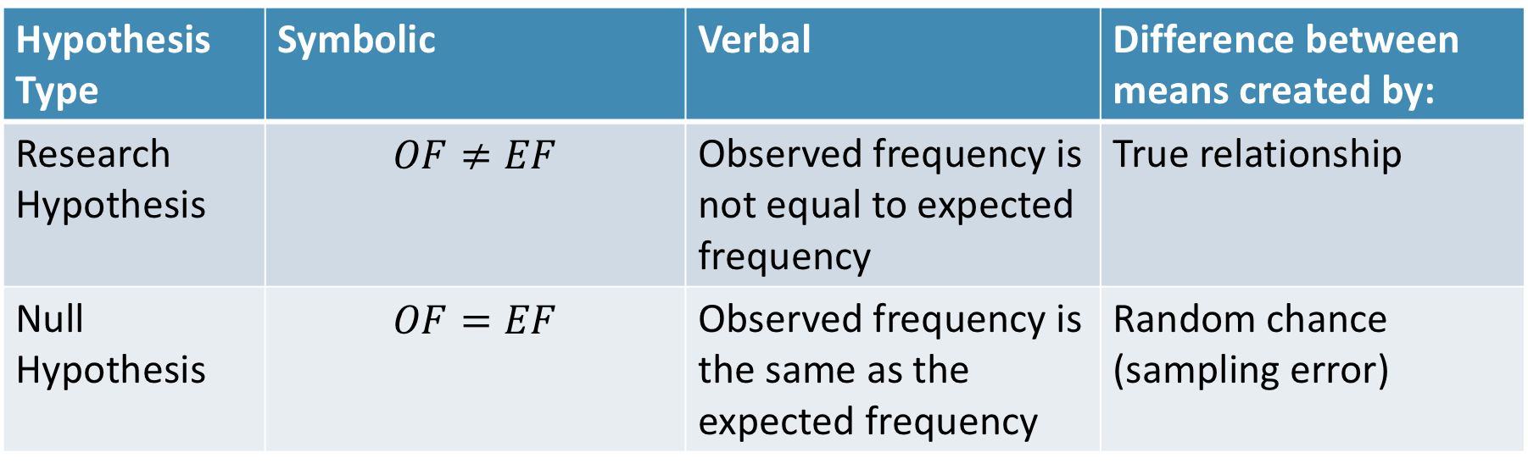
State the Null and Research Hypotheses (symbolically and verbally)
2
Hypothesis Type | Symbolic | Verbal | Difference between means created by:
Research Hypothesis | $$OF≠EF$$ | Observed frequency is not equal to expected frequency | True relationship
Null Hypothesis | $$OF=EF$$ | Observed frequency is the same as the expected frequency | Random chance (sampling error)
Notes:
Null and research hypotheses are mutually exclusive (they cover all possible outcomes)

Slide 14
Define Critical Regions
3
How much evidence is enough to believe the null is not true?
generally based on an alpha = .05
Use software’s p-value to judge if it is below .05

Slide 15
Compute the Test Statistic
4
Jamovi
Tutorial

Slide 16
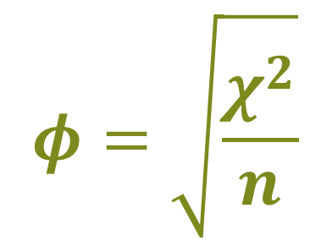
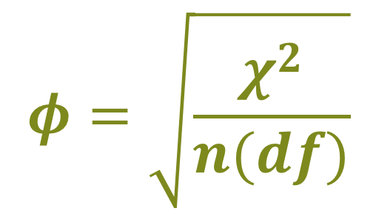
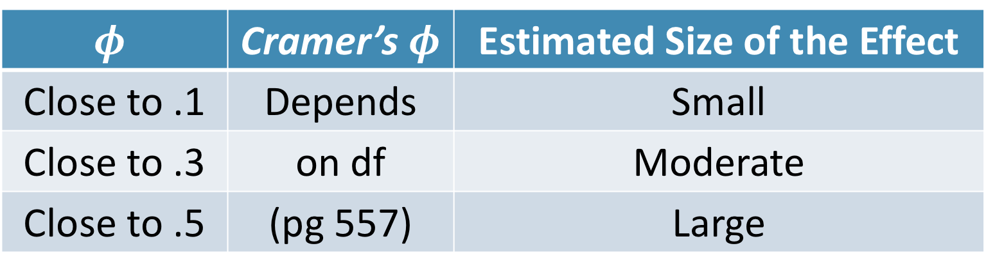
Compute an Effect Size and Describe it
5
$$φ=\sqrt{\frac{χ^{2}}{n}}$$
$$φ=\sqrt{\frac{χ^{2}}{n(df)}}$$
Cramer’s
“Phi”
$$φ$$ | Cramer’s $φ$ | Estimated Size of the Effect
Close to .1 | Depends | Small
Close to .3 | on df | Moderate
Close to .5 | (pg 557) | Large

Slide 17
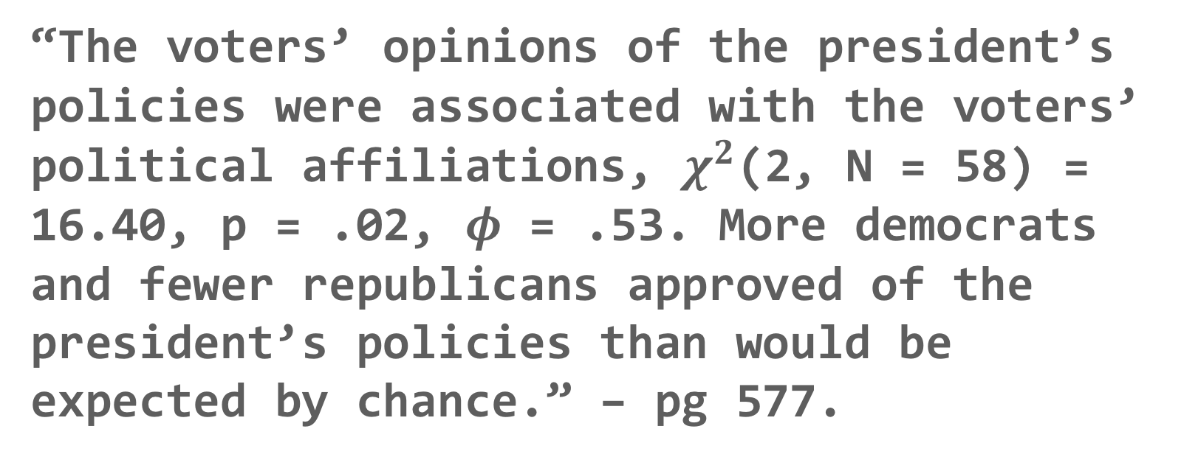
Interpreting the results
6
“The voters’ opinions of the president’s policies were associated with the voters’ political affiliations, $χ^{2}$(2, N = 58) = 16.40, p = .02, $φ$ = .53. More democrats and fewer republicans approved of the president’s policies than would be expected by chance.” – pg 577.

Slide 18
Break Time

Slide 19
Review

Slide 20
Questions?

Slide 21
Next week:
Review!!

