Slide 1
Applied Statistical Analysis
EDUC 6050
Week 6
Finding clarity using data

Slide 2
Today
Hypothesis Testing with Related Samples T-tests
Confidence Intervals
Chapters 7 and 8 in Book

Slide 3

Review
$$?= \frac{X − μ}{{SD}/{√N}}$$
What test is this for
What situations can be do hypothesis testing for (before what we are talking about today)?
What types of t-tests did you read about this week?
3

Slide 4
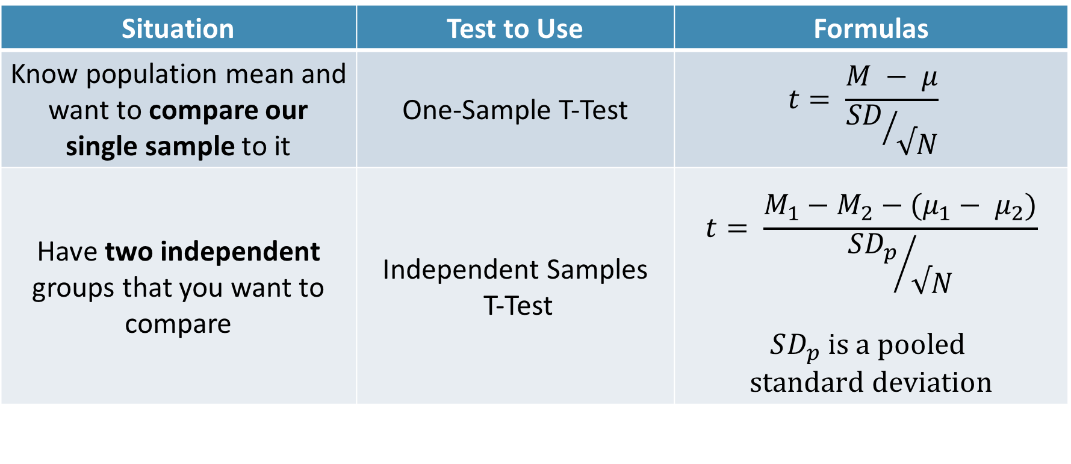
Independent Samples T-test
Situation | Test to Use | Formulas
Know population mean and want to compare our single sample to it | One-Sample T-Test | $$t= \frac{M − μ}{{SD}/{√N}}$$
Have two independent groups that you want to compare | Independent Samples T-Test | $$t= \frac{M_{1}−M_{2}−(μ_{1}− μ_{2})}{{SD_{p}}/{√N}}$$ $$SD_{p} is a pooled$$ $$standard deviation$$

Slide 5
Still using the same t-distribution
Notes:
As your sample size increases, the t gets closer and closer to the normal distribution

Slide 6
Requirements
ID | Outcome | Group
1 | 8 | 1
2 | 8 | 1
3 | 9 | 1
4 | 7 | 1
5 | 7 | 2
6 | 9 | 2
7 | 5 | 2
8 | 5 | 2
Need a DV on an interval/ratio scale,
IV defines two different groups
The groups are independent (not repeated measures)

Slide 7
Hypothesis Testing with T-Tests
The same 6 step approach!
Examine Variables to Assess Statistical Assumptions
State the Null and Research Hypotheses (symbolically and verbally)
Define Critical Regions
Compute the Test Statistic
Compute an Effect Size and Describe it
Interpreting the results

Slide 8
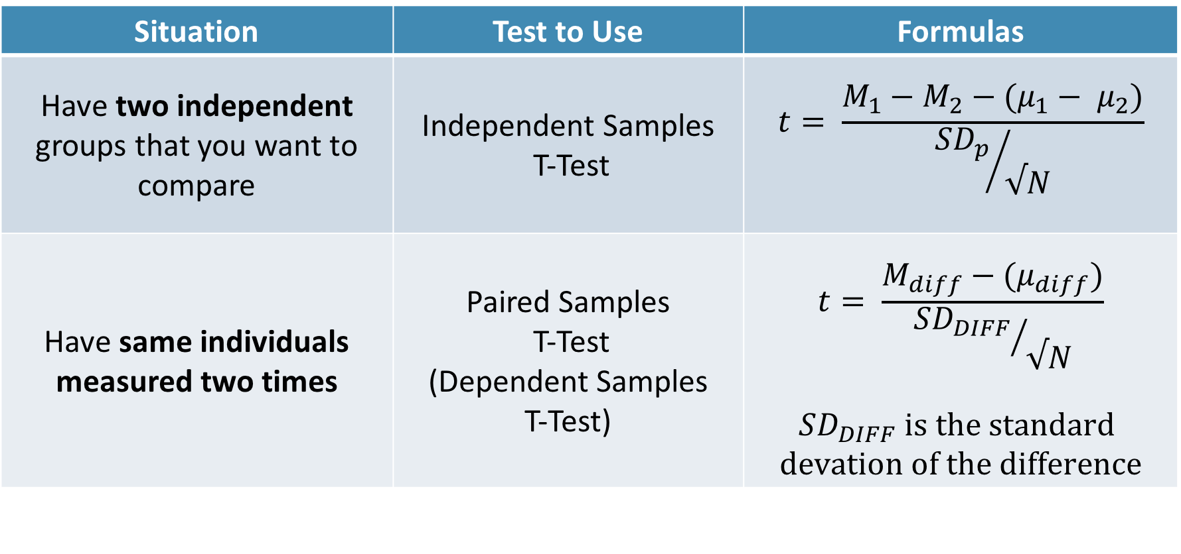
Paired Samples T-test
Situation | Test to Use | Formulas
Have two independent groups that you want to compare | Independent Samples T-Test | $$t= \frac{M_{1}−M_{2}−(μ_{1}− μ_{2})}{{SD_{p}}/{√N}}$$
Have same individuals measured two times | Paired Samples T-Test (Dependent Samples T-Test) | $$t= \frac{M_{diff}−(μ_{diff})}{{SD_{DIFF}}/{√N}}$$ $$SD_{DIFF} is the standard$$ $$devation of the difference$$

Slide 9
Requirements
ID | Time 1 | Time 2
1 | 8 | 7
2 | 8 | 8
3 | 9 | 6
4 | 7 | 6
5 | 7 | 8
6 | 9 | 5
7 | 5 | 3
8 | 5 | 3
Need a DV on an interval/ratio scale,
IV defines two time points
Same individuals measured twice

Slide 10
Examine Variables to Assess Statistical Assumptions
1
Basic Assumptions
Independence of data
Appropriate measurement of variables for the analysis
Normality of distributions
Homogeneity of variance

Slide 11
Examine Variables to Assess Statistical Assumptions
1
Basic Assumptions
Independence of data
Appropriate measurement of variables for the analysis
Normality of distributions
Homogeneity of variance
Individuals are independent of each other (one person’s scores does not affect another’s)

Slide 12
Examine Variables to Assess Statistical Assumptions
1
Basic Assumptions
Independence of data
Appropriate measurement of variables for the analysis
Normality of distributions
Homogeneity of variance
Here we need two interval/ratio DVs (one for each time point)
Notes:
For t-test, DV needs to be interval/ratio

Slide 13
Examine Variables to Assess Statistical Assumptions
1
Basic Assumptions
Independence of data
Appropriate measurement of variables for the analysis
Normality of distributions
Homogeneity of variance
The outcome needs to be normal (for small samples)

Slide 14
Examine Variables to Assess Statistical Assumptions
1
Basic Assumptions
Independence of data
Appropriate measurement of variables for the analysis
Normality of distributions
Homogeneity of variance
The variances of the two time points should be equal

Slide 15
Examine Variables to Assess Statistical Assumptions
1
Examining the Basic Assumptions
Independence: random sample
Appropriate measurement: know what your variables are
Normality: Histograms, skew and kurtosis
Homogeneity: Levene’s Test

Slide 16
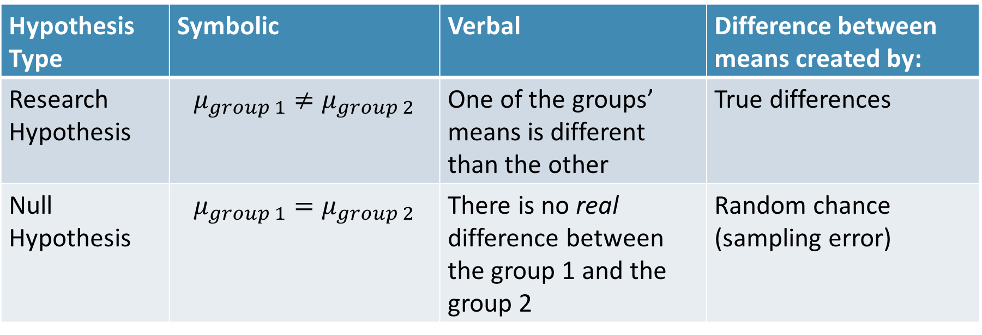
State the Null and Research Hypotheses (symbolically and verbally)
2
Hypothesis Type | Symbolic | Verbal | Difference between means created by:
Research Hypothesis | $$μ_{group 1}≠μ_{group 2}$$ | One of the groups’ means is different than the other | True differences
Null Hypothesis | $$μ_{group 1}=μ_{group 2}$$ | There is no real difference between the group 1 and the group 2 | Random chance (sampling error)
Notes:
Null and research hypotheses are mutually exclusive (they cover all possible outcomes)

Slide 17
Define Critical Regions
3
How much evidence is enough to believe the null is not true?
Before analyzing the data, we define the critical regions (generally based on an alpha = .05)

Slide 18
Define Critical Regions
3
We decide on an alpha level first
Then calculate the critical value (based on sample size)

Slide 19

Define Critical Regions
3
We decide on an alpha level first
Then calculate the critical value (based on sample size)
I’ll provide a table for you for the t values
Base on alpha and a specific df
$$df=N_{1}+N_{2} − 2$$
Notes:
If our computed t value is beyond 2.05 OR our p-value is below .05, then we REJECT the null (the findings are statistically significant)

Slide 20
Define Critical Regions
3
We decide on an alpha level first
Then calculate the critical value (based on sample size)
I’ll provide a table for you for the t values
Base on alpha and a specific df
$$df=N_{1}+N_{2} − 2$$
Notes:
If If our computed t value is beyond 2.05 OR our p-value is below .05, then we REJECT the null (the findings are statistically significant)

Slide 21


Define Critical Regions
3
We decide on an alpha level first
Then calculate the critical value (based on sample size)
$$t_{critical, 29}=2.05$$
So our critical regions is defined as:
$$α= .05$$
$$t_{critical, 29}=2.05$$
Notes:
If our computed t value is beyond 2.05 OR our p-value is below .05, then we REJECT the null (the findings are statistically significant)

Slide 22
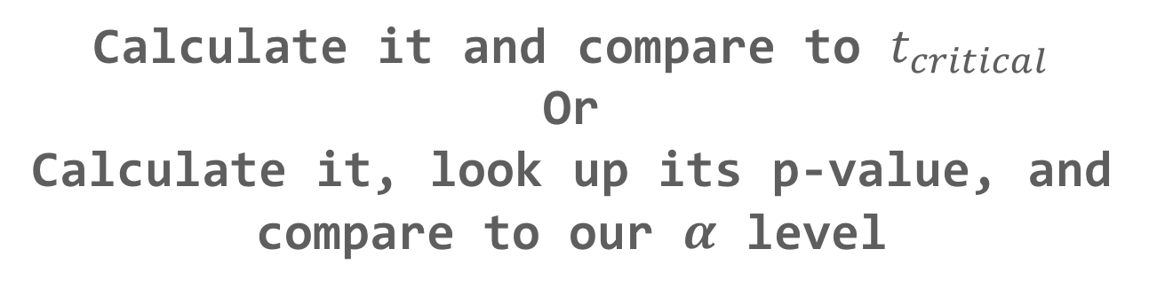
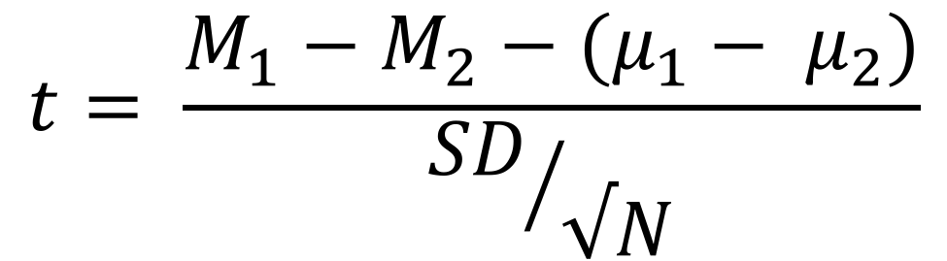
Compute the Test Statistic
4
$$t= \frac{M_{1}−M_{2}−(μ_{1}− μ_{2})}{{SD}/{√N}}$$
The SEM, $μ$, and M will be given to you
Calculate it and compare to $t_{critical}$
Or
Calculate it, look up its p-value, and compare to our $α$ level

Slide 23
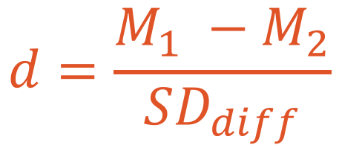
Compute an Effect Size and Describe it
5
One of the main effect size estimates is Cohen’s d
$$d=\frac{M_{1} −M_{2}}{SD_{diff}}$$
d | Estimated Size of the Effect
Close to .2 | Small
Close to .5 | Moderate
Close to .8 | Large

Slide 24
Interpreting the results
6
Put your results into words
Use the example on page XX as a template

Slide 25
Break Time

Slide 26
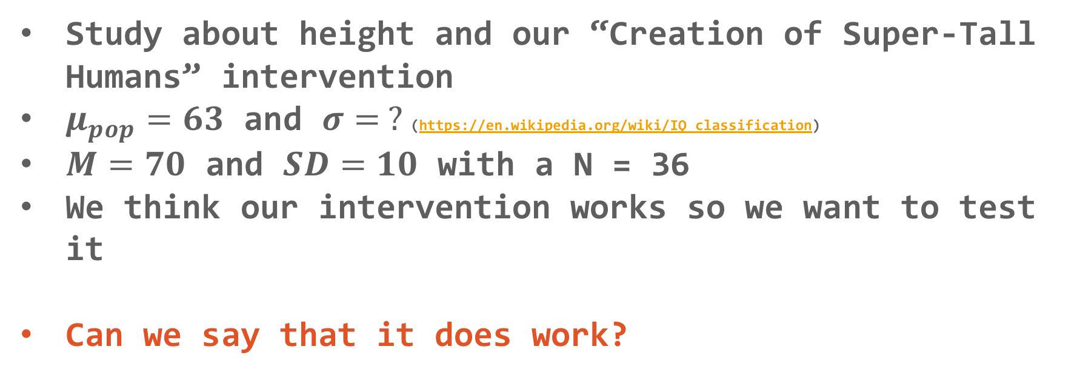
Hypothesis Testing with T-tests
Let’s practice!
Study about height and our “Creation of Super-Tall Humans” intervention
$μ_{pop}=63$ and $σ= ?$(https://en.wikipedia.org/wiki/IQ_classification)
$M=70$ and $SD=10$ with a N = 36
We think our intervention works so we want to test it
Can we say that it does work?

Slide 27
Let’s use
Jamovi
Paired Samples T-test

Slide 28
Questions?

Slide 29
Next week:
Hypothesis Testing with T-tests and Confidence Intervals
Chapters 7 and 8 in Book
Keep updating your Statistical Organizer

