Slide 1
Applied Statistical Analysis
EDUC 6050
Week 4
Finding clarity using data

Slide 2
Today
Hypothesis Testing with Z Scores (continued)
Chapters 6 and 7 in Book

Slide 3
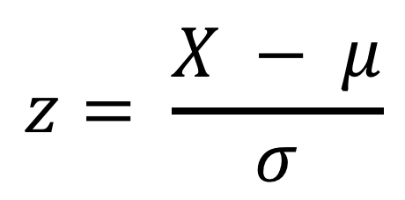
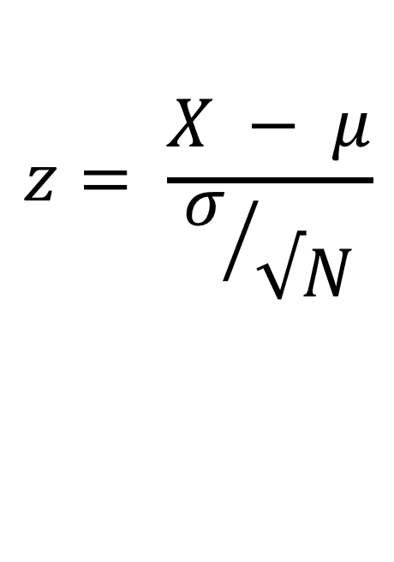
Review
$$z= \frac{X − μ}{σ}$$
Which formula is for individual z scores and which is for z scores for sample means?
What are the six steps to hypothesis testing?
What are we trying to accomplish with hypthesis testing?
$$z= \frac{X − μ}{σ/{√N}}$$
3

Slide 4
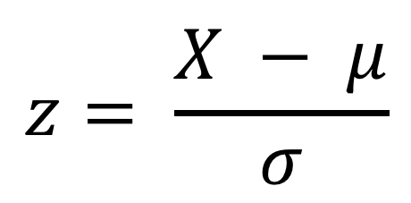
Z-Scores for an Individual Point
$$z= \frac{X − μ}{σ}$$
Tells us:
If the score is above or below the mean
How large (the magnitude) the deviation from the mean is to other data points
Notes:
What units are z scores in?
Standard deviation units

Slide 5
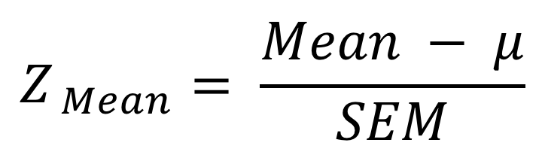
The Z for a Sample Mean
$$Z_{ Mean}= \frac{Mean − μ}{SEM}$$
This is important because of what we will talk about in Chapter 6
Hypothesis Testing with Z Scores

Slide 6
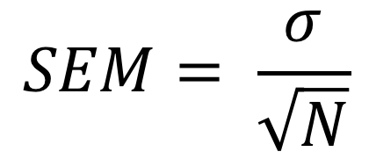
Standard Error of the Mean
“SEM” or “SE”
Depends on sample size (bigger sample, smaller SEM)
Tells us, if we were to collect many samples, how much the sample means would vary
$$SEM= \frac{σ}{\sqrt{N}}$$

Slide 7
Z-Score and the Standard Normal Curve
Notes:
This only works if the distribution of the raw scores are normally-distributed!

Slide 8
Hypothesis Testing with Z Scores
We’ll use a 6-step approach
We’ll use this throughout the class so get familiar with it
Examine Variables to Assess Statistical Assumptions
State the Null and Research Hypotheses (symbolically and verbally)
Define Critical Regions
Compute the Test Statistic
Compute an Effect Size and Describe it
Interpreting the results

Slide 9
Examine Variables to Assess Statistical Assumptions

Slide 10
State the Null and Research Hypotheses (symbolically and verbally)
We’ll use a 6-step approach
We’ll use this throughout the class so get familiar with it
Examine Variables to Assess Statistical Assumptions
State the Null and Research Hypotheses (symbolically and verbally)
Define Critical Regions
Compute the Test Statistic
Compute an Effect Size and Describe it
Interpreting the results

Slide 11
Define Critical Regions
We’ll use a 6-step approach
We’ll use this throughout the class so get familiar with it
Examine Variables to Assess Statistical Assumptions
State the Null and Research Hypotheses (symbolically and verbally)
Define Critical Regions
Compute the Test Statistic
Compute an Effect Size and Describe it
Interpreting the results

Slide 12
Compute the Test Statistic
We’ll use a 6-step approach
We’ll use this throughout the class so get familiar with it
Examine Variables to Assess Statistical Assumptions
State the Null and Research Hypotheses (symbolically and verbally)
Define Critical Regions
Compute the Test Statistic
Compute an Effect Size and Describe it
Interpreting the results

Slide 13
Compute an Effect Size and Describe it
We’ll use a 6-step approach
We’ll use this throughout the class so get familiar with it
Examine Variables to Assess Statistical Assumptions
State the Null and Research Hypotheses (symbolically and verbally)
Define Critical Regions
Compute the Test Statistic
Compute an Effect Size and Describe it
Interpreting the results

Slide 14
Interpreting the results
We’ll use a 6-step approach
We’ll use this throughout the class so get familiar with it
Examine Variables to Assess Statistical Assumptions
State the Null and Research Hypotheses (symbolically and verbally)
Define Critical Regions
Compute the Test Statistic
Compute an Effect Size and Describe it
Interpreting the results

Slide 15
Break Time

Slide 16
Review of Z-Scores (Chapter 4)
What does a z-score about an individual point tell us?
Is it possible to make a specific probability statement about a z-score if the distribution is normal?
What proportion of scores are between z-scores of 0 and 1? (hint: use shading and the appendix)

Slide 17
Review of Sample Mean Distributions (Chapter 5 and Intro to 6)
Why is understanding the distribution of sample means important?
What does the standard error of the mean tell us?
How would we get a smaller SEM?
What are the steps in the 6-step approach?

Slide 18
Another look at
Jamovi and Excel
Standardizing (getting z-scores)

Slide 19
Questions?

Slide 20
Next week:
Hypothesis Testing with Z Scores (continued)
Chapters 6 and 7 in Book
Keep updating your Statistical Organizer

