Slide 1
Applied Statistical Analysis
EDUC 6050
Week 13½
“What Are The Odds?”
Finding clarity using data

Slide 2
What are odds?

Slide 4

$$\frac{Probability of Yes}{Probability of No}$$
odds =
What are the odds of getting heads with a fair coin?
What are the odds of something that happens 66% of the time?

Slide 5
$$\frac{Probability of Yes}{Probability of No}$$
odds =
Big Odds = High probability of yes compared to no
Small Odds = Low probability of yes compared to no

Slide 6
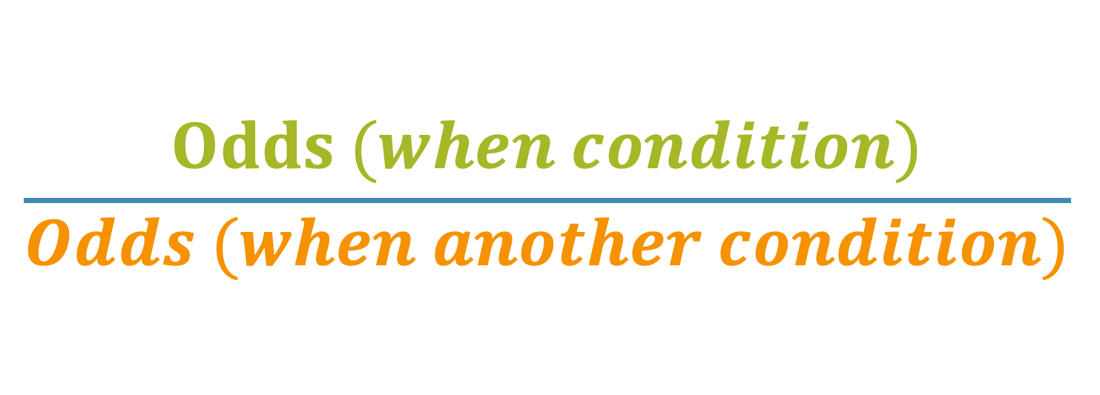
$$\frac{Odds (when condition)}{Odds (when another condition)}$$
Odds
Ratio
=
Often, we are looking at the odds of something happening when one condition is happening vs. the odds of something happening when another condition is happening

Slide 7
$$\frac{Odds (when condition)}{Odds (when another condition)}$$
Odds
Ratio
=
Odds Ratio of lung cancer when smoker vs. not a smoker
One estimate = 103!!
https://www.ncbi.nlm.nih.gov/pmc/articles/PMC3296911/

