Slide 2
An Introduction to Statistics An Active Learning Approach
Chapter 2: Central Tendancy

Slide 3
Topics to Cover
Compute and interpret the mean, the median, and the mode
Identify when to use the mean, the median, or the mode when describing a distribution’s central tendency

Slide 4
Central Tendency
The “center” of scores
Mean
the arithmetic average
Median
the middle score
Mode
the most frequently occurring score
Notes:
Learning Objective: Compute and interpret the mean, the median, and the mode

Slide 5
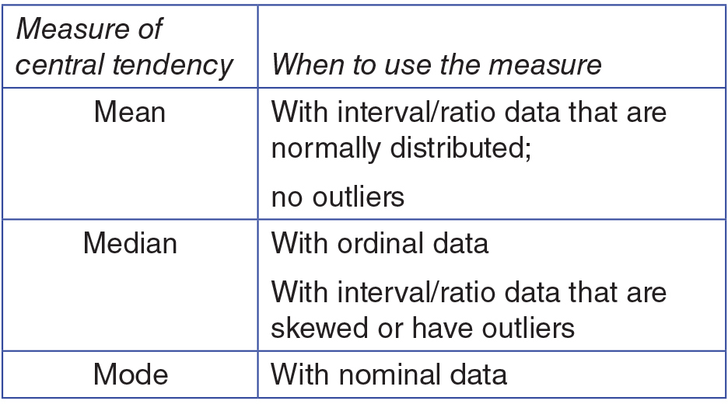
Figure 2.1: When to Use Measures of Central Tendency
Notes:
Learning Objective: Identify when to use the mean, the median, or the mode when describing a distribution’s central tendency
Figure 2.1 from p. 41

Slide 6
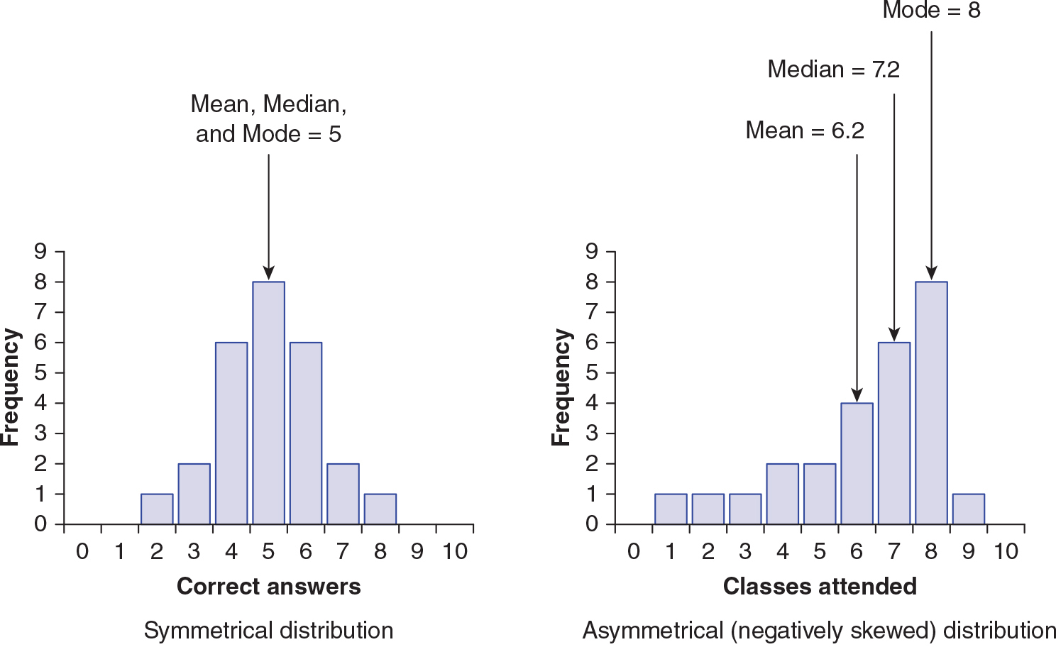
Figure 2.2: A Bar Graph of Symmetrical Data (Correct Answers) and a Bar Graph of Negatively Skewed Data (Classes Attended)
Notes:
Learning Objective: Identify when to use the mean, the median, or the mode when describing a distribution’s central tendency
Figure 2.2 from p. 42

Slide 7

Computing the Mean
Add the scores and divide by the number of scores
Statistical formula:
M - sample mean
∑X - sum of x
N - number of scores
Notes:
Learning Objective: Compute and interpret the mean, the median, and the mode
p. 43

Slide 8
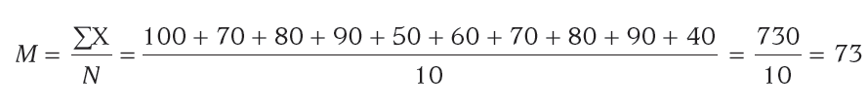
Computing the Mean
Example
Notes:
Learning Objective: Compute and interpret the mean, the median, and the mode
p. 43

Slide 9
Computing the Mean
Computing the mean from a frequency distribution
∑(Xf) – multiply each score by the number of people who had the score to get ∑X
Notes:
Learning Objective: Compute and interpret the mean, the median, and the mode
p. 43

Slide 10
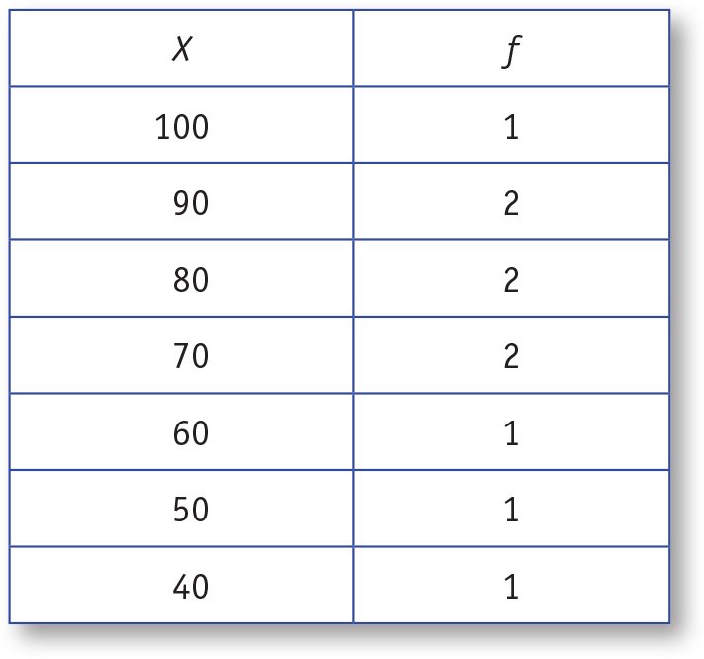
Table 2.1: Frequency Distribution Table of Variable Scores
Notes:
Learning Objective: Compute and interpret the mean, the median, and the mode
Figure 2.1 from p. 41

Slide 11
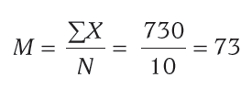
Computing the Mean
Computing the mean from a frequency distribution
Example
Notes:
Learning Objective: Compute and interpret the mean, the median, and the mode
p. 44
Refer to the frequency distribution in Table 2.1, p. 43.
“First you multiply each score by its frequency, then you add all those values together, and finally you divide by N.” p. 44

Slide 12
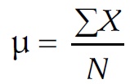
Computing the Mean
Computing the population mean
Statistical formula:
μ - population mean; Greek letter “myoo”
Notes:
Learning Objective: Compute and interpret the mean, the median, and the mode
“Greek letters are used to represent population parameters . . . while Arabic letters are used to represent sample statistics.” p. 45

Slide 13
Find the Median
The median is the midpoint of a distribution of scores.
Begin by putting scores in order from lowest to highest.
Notes:
Learning Objective: Compute and interpret the mean, the median, and the mode

Slide 14
Find the Median
When N is odd, there is one middle score.
7, 7, 6, 6, 6, 5, 4, 3, 1
When N is even, compute the average of the two middle scores. Add 70 and 80, then divide by 2. The median is 75.
40, 50, 60, 70, 70, 80, 80, 90, 90, 100
Notes:
Learning Objective: Compute and interpret the mean, the median, and the mode
For the second example, the two middle scores are 70 and 80. Their average is 75, which is the median.

Slide 15
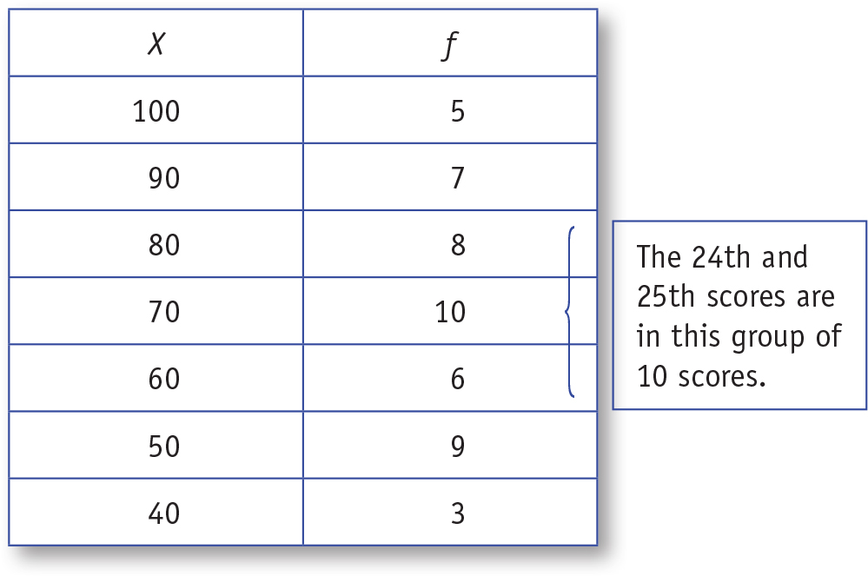
Table 2.3: Frequency Distribution Table for a Larger Set of Scores With Median Identified.
Notes:
Learning Objective: Compute and interpret the mean, the median, and the mode
p. 46
Both middle scores are 70, so the median is 70 for this distribution.

Slide 16
Find the Mode
The mode is the most frequently occurring score in the distribution.
To locate the mode in the frequency distribution table, you look for the measurement category (X value) with the highest frequency.
Notes:
Learning Objective: Compute and interpret the mean, the median, and the mode

Slide 17
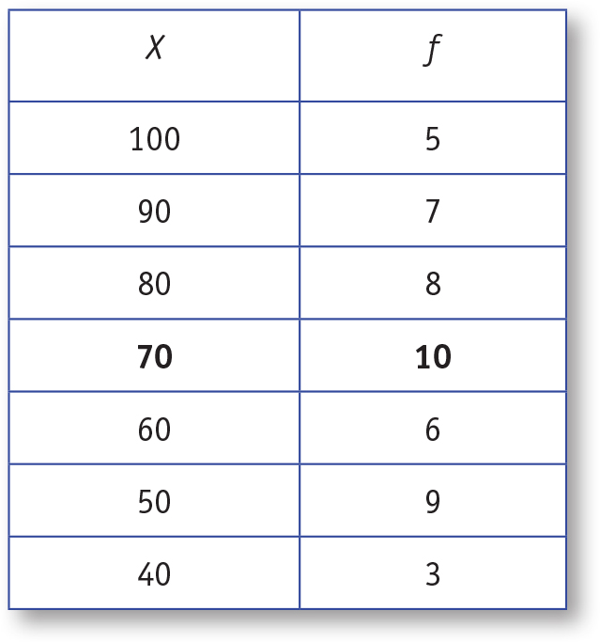
Table 2.4: Frequency Distribution Table for a Larger Set of Scores With the Mode Bolded
Notes:
Learning Objective: Compute and interpret the mean, the median, and the mode
p. 46
Both middle scores are 70, so the median is 70 for this distribution.

Slide 18
SPSS
Compute and interpret the mean, the median, and the mode
Notes:
Learning Objective: Compute and interpret the mean, the median, and the mode

Slide 19
SPSS Data File
To compute measures of central tendency using SPSS, you will need to begin by entering the data.
You cannot enter a frequency distribution table into SPSS; instead you must enter individual scores.

Slide 20
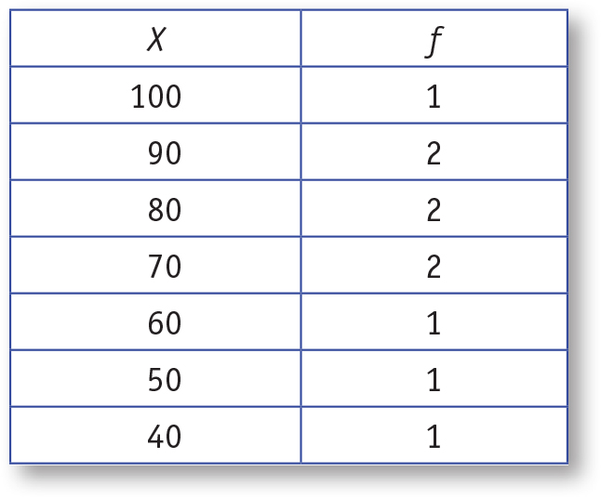
Table 2.5: Frequency Distribution Table of the Variable Called Scores.
Notes:
Learning Objective: Compute and interpret the mean, the median, and the mode
p. 48

Slide 21
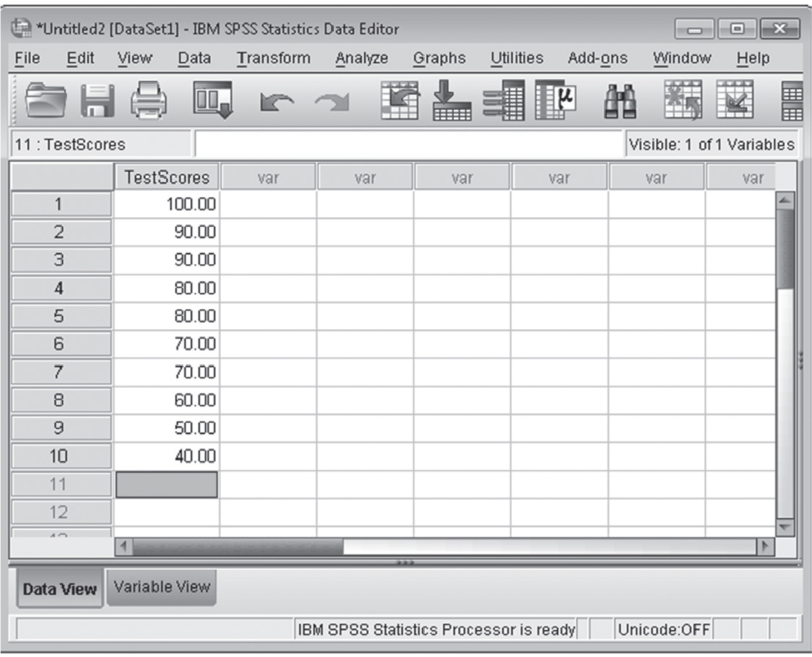
Figure 2.3: SPSS Screenshot of the Data Entry Screen of the Variable Labeled Test Scores.
Notes:
Learning Objective: Compute and interpret the mean, the median, and the mode
p. 48

Slide 22
Obtaining Measures of Central Tendency Using SPSS
Click on the Analyze menu. Choose Descriptive Statistics and then Frequencies (see Figure 2.4).
Move the variable(s) of interest into the Variable(s) box (see Figure 2.5).
Make sure the Display Frequency Tables box is checked if you want a frequency distribution table. Uncheck the box if you do not want a frequency table.
Notes:
Learning Objective: Compute and interpret the mean, the median, and the mode

Slide 23
Obtaining Measures of Central Tendency Using SPSS
Click on the Statistics button.
Click on the boxes for mean, median, and mode, and then click on the Continue button (see Figure 2.6).
Click OK.
Notes:
Learning Objective: Compute and interpret the mean, the median, and the mode

Slide 24
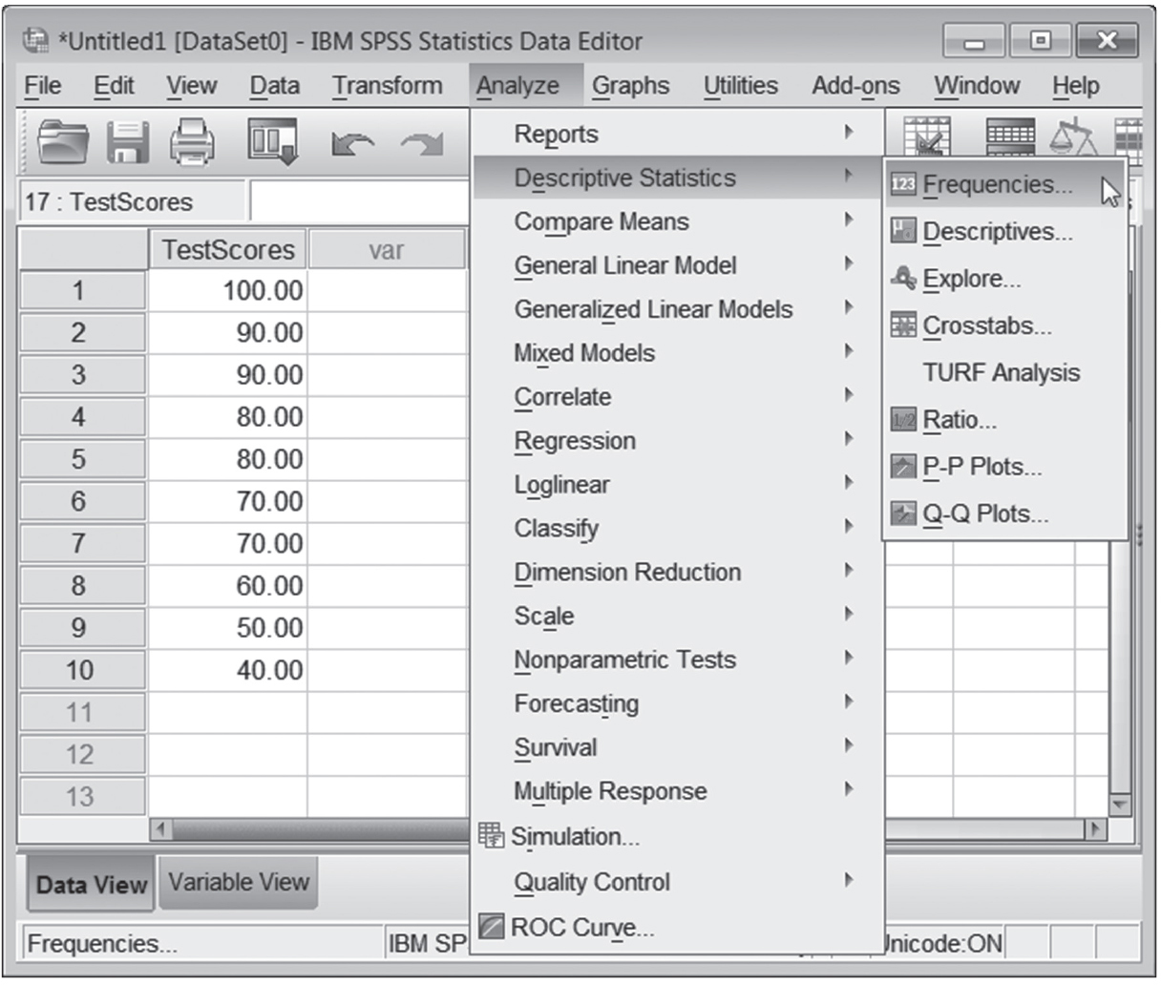
Figure 2.4: SPSS Screenshot of the Analyze Menu for Descriptive Statistics.
Notes:
Learning Objective: Compute and interpret the mean, the median, and the mode
p. 49

Slide 25
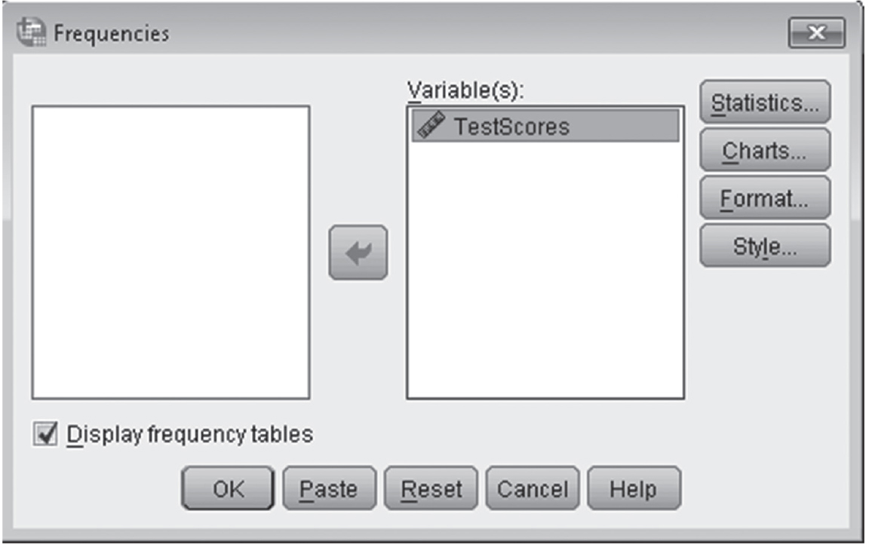
Figure 2.5: SPSS Screenshot of Choosing the Variables for Descriptive Statistics.
Notes:
Learning Objective: Compute and interpret the mean, the median, and the mode
p. 49

Slide 26
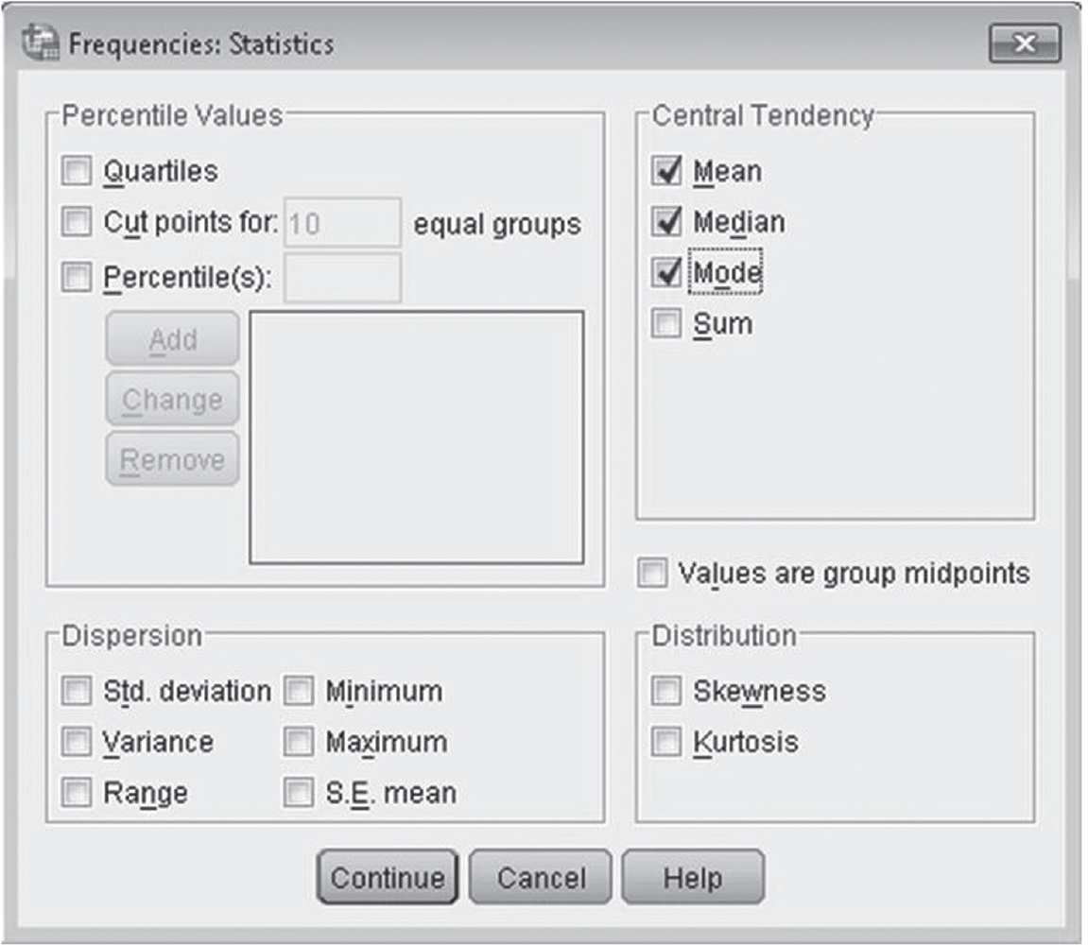
Figure 2.6: SPSS Screenshot of Choosing Measures of Central Tendency.
Notes:
Learning Objective: Compute and interpret the mean, the median, and the mode
p. 50

Slide 27
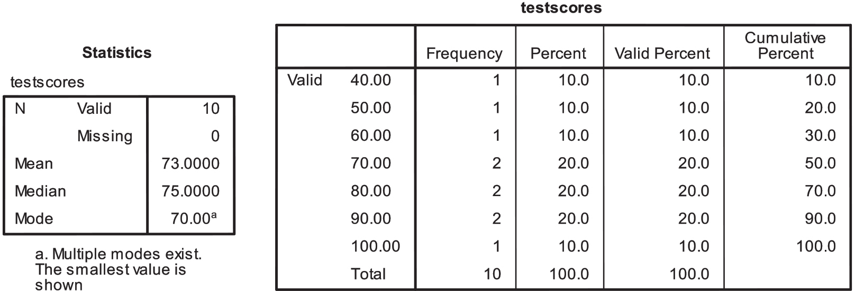
Figure 2.7: SPSS Output for the Central Tendency of the Variable Score.
Notes:
Learning Objective: Compute and interpret the mean, the median, and the mode
“Note that this data file had multiple modes because three different test scores each had a frequency of 2. SPSS only tells you one mode, but it does make a note that there are additional modes. To find the other modes, you need to look at the
frequency distribution table.”
p. 51

