Slide 2
An Introduction to Statistics An Active Learning Approach
Chapter 4: z Scores

Slide 3
Topics to Cover
Compute and interpret a z score for a given raw score
Solve for X if given a z score
Explain what the sign of a z score indicates
Explain what the absolute value of a z score indicates

Slide 4
Topics to Cover
Locate a z score within a distribution
Use a unit normal table to determine the proportion of scores above or below any given z score

Slide 5
z For a Single Score

Slide 6
z For a Single Score
is used to locate a score in a distribution of scores
indicates if a given score is very good (far above the mean), very bad (far below the mean), or average (close to the mean).
can help you compare two scores from different distributions
Notes:
Learning Objective: Compute and interpret a z score for a given raw score

Slide 7
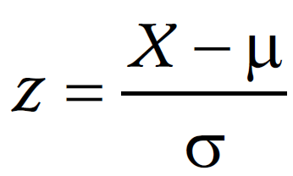
Computing a z for an Individual Score
first compute the deviation between the score and the population mean (X − μ)
then divide this difference by the standard deviation
Notes:
Learning Objective: Compute and interpret a z score for a given raw score

Slide 8
Interpreting the z for a Single Score
z Scores should be interpreted as the proportion of standard deviation units a given raw score is away from the mean of the distribution.
If z is positive, the given score was above the average score.
The farther the absolute value of the z score is from 0, the more the score deviates from the mean.
Notes:
Learning Objective: Compute and interpret a z score for a given raw score
Learning Objective: Explain what the sign of a z score indicates
Learning Objective: Explain what the absolute value of a z score indicates

Slide 9
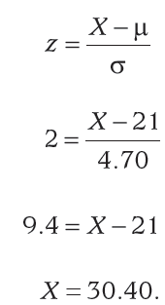
Using X to Find Important “Cut Lines”
Find X, given that z = 2, m = 21, and s = 4.70
Notes:
Learning Objective: Solve for X if given a z score
“A raw score of 30.40 on this test represents performance that is 2 standard deviations above the
population mean (i.e., very good performance!).” p. 98

Slide 10
z Scores and the Standard Normal Curve
Normal distributions are symmetrical, meaning their left and right sides are identical so the mean, the median, and the mode are all the s.
Second, they are bell shaped, so they follow a 68–95–99 rule.
Normal curves are extremely common in research situations.
Notes:
“The key point is that normal curves are quite common and you should understand
the 68–95–99 rule, that approximately 68% of scores are between the z scores +1 and -1, 95% are
between +2 and -2, and 99% are between +3 and -3.” p. 99

Slide 11
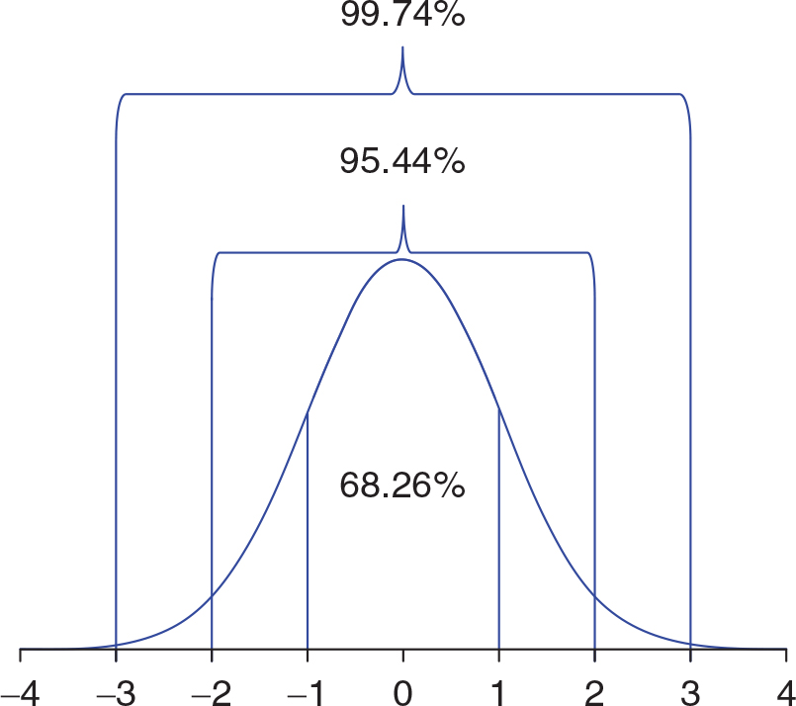
Figure 4.1: Percentage of Scores Between Standard Deviations in a Normal Distribution
Notes:
p. 99

Slide 12
Example 1: Positive z Score
Use a unit normal table to determine the proportion of scores above or below any given z score
Notes:
Learning Objective: Use a unit normal table to determine the proportion of scores above or below any given z score

Slide 13
Compute the z Score
Harriet asks you to help her compare her ACT score of 22 to others’ ACT scores.
Compute her z score, where the population mean score on the ACT is μ = 21, with a standard deviation of σ = 4.70.
Notes:
Learning Objective: Use a unit normal table to determine the proportion of scores above or below any given z score
This is from the example for ACT scores with a mean of 21 and standard deviation of 4.70. p. 97

Slide 14
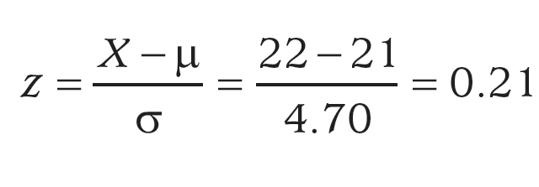
Compute the z Score
Notes:
Learning Objective: Use a unit normal table to determine the proportion of scores above or below any given z score
This is from the example for ACT scores with a mean of 21 and standard deviation of 4.70. p. 97

Slide 15
Compute the z Score
percentile rank
the percentage of scores that are equal to or lower than a score.
Notes:
Learning Objective: Use a unit normal table to determine the proportion of scores above or below any given z score
This is from the example for ACT scores with a mean of 21 and standard deviation of 4.70. p. 97

Slide 16
Draw a Normal Distribution, and Shade the Area You Are Interested in
Sketch a normal curve like that shown in Figure 4.2
Locate the z score on this curve and place a mark at that location
Determine if the problem you’re trying to solve requires you to find the area to the left of z or to its right
Shade to the left for proportions less than or equal to z
Notes:
Learning Objective: Use a unit normal table to determine the proportion of scores above or below any given z score
This is from the example for ACT scores with a mean of 21 and standard deviation of 4.70. p. 97

Slide 17
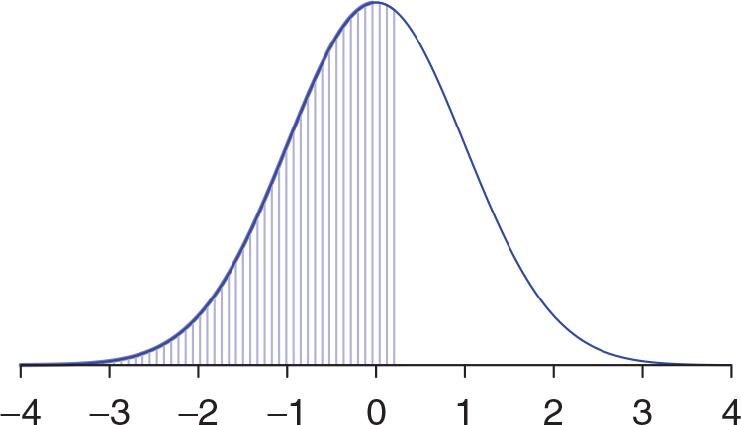
Figure 4.3: A z Distribution With the Target Area Below z < 0.21 Shaded
Notes:
p. 101

Slide 18
Use a Unit Normal Table (Appendix A) to Find the Area of the Shaded Proportion of the Curve
If the shaded area is more than 50% of the distribution, use the body column in the table.
If the shaded area is less than 50% of the distribution, use the tail column in the table.
Notes:
Learning Objective: Use a unit normal table to determine the proportion of scores above or below any given z score
This is from the example for ACT scores with a mean of 21 and standard deviation of 4.70. p. 97

Slide 19
Use a Unit Normal Table (Appendix A) to Find the Area of the Shaded Proportion of the Curve
Find the z score of 0.21 in the z score column of Appendix A and read the value next to that z score in the body column of the table.
Use the body column because the shaded area is more than 50% of the distribution.
The body column indicates that the proportion of scores equal to or less than a z score of +0.21 is .5832.
Notes:
Learning Objective: Use a unit normal table to determine the proportion of scores above or below any given z score
p. 102

Slide 20
Use a Unit Normal Table (Appendix A) to Find the Area of the Shaded Proportion of the Curve
Therefore, 58.32% of the population of ACT scores were equal to or lower than Harriet’s ACT score of 22.
In other words, Harriet is at the 58.32nd percentile.
Notes:
Use a unit normal table to determine the proportion of scores above or below any given z score
Learning Objective: Learning Objective: Locate a z score within a distribution
p. 102

Slide 21
Example 2: Negative z Score
Use a unit normal table to determine the proportion of scores above or below any given z score
Notes:
Learning Objective: Use a unit normal table to determine the proportion of scores above or below any given z score

Slide 22
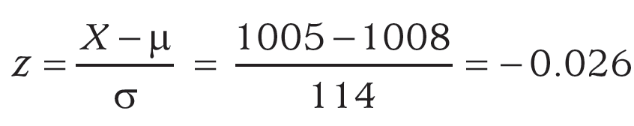
Compute the z Score
Antonio took the SAT. He wants to know the percentile rank of his combined math and verbal score on the SAT, which was 1005.
The mean combined math–verbal score on the SAT is
μ = 1008, with a standard deviation of 114.
Notes:
Learning Objective: Use a unit normal table to determine the proportion of scores above or below any given z score
Example is SAT scores with a combined math-verbal mean of 1008 and a standard deviation of 114, for Antonio who scored 1005.
p. 102

Slide 23
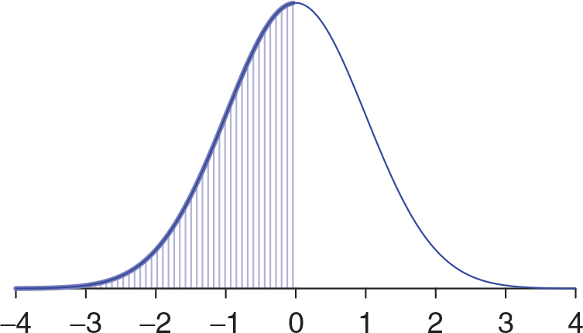
Figure 4.4: A z Distribution With the Target Area Below z < −0.026 Shaded
Notes:
Learning Objective: Use a unit normal table to determine the proportion of scores above or below any given z score
Example is SAT scores with a combined math-verbal mean of 1008 and a standard deviation of 114, for Antonio who scored 1005.
p. 102

Slide 24
Draw a Normal Distribution, and Shade the Area You Are Interested in
Draw a normal distribution locate the z score of −0.026.
Shade the area under the curve that is less than the z score of −0.026.
This is done in Figure 4.4.
Notes:
Learning Objective: Use a unit normal table to determine the proportion of scores above or below any given z score
This is from the example for ACT scores with a mean of 21 and standard deviation of 4.70. p. 97

Slide 25
Use a Unit Normal Table to Find the Area That Is Shaded
For this example, you want to know the proportion of z scores that are less than a negative z score of −0.026.
The unit normal table does not include negative values. Therefore, you will always look up the absolute value of the z score you compute (i.e., in this case, you would look up 0.026).
Notes:
Learning Objective: Use a unit normal table to determine the proportion of scores above or below any given z score
p. 102

Slide 26
Use a Unit Normal Table to Find the Area That Is Shaded
The table in this book only goes two places past the decimal, round 0.026 to 0.03.
Look up 0.03, to find that the proportion of scores in the tail column is 0.4880.
Notes:
Learning Objective: Use a unit normal table to determine the proportion of scores above or below any given z score
“Therefore, approximately 48.80% of the students who took the SAT had combined math–verbal SAT scores that were equal to or lower than Antonio’s score of 1005.”
p. 102

Slide 27
Use a Unit Normal Table to Find the Area That Is Shaded
If the shaded area is more than half of the distribution, use the body column.
If the shaded area is less than half of the distribution, use the tail column.
In this case, less than half of the distribution is shaded, so we use the tail column for the z score of 0.026.
Notes:
Learning Objective: Use a unit normal table to determine the proportion of scores above or below any given z score
p. 102

Slide 28
Example 3: Proportion Between Two z Score
Use a unit normal table to determine the proportion of scores above or below any given z score
Notes:
Learning Objective: Use a unit normal table to determine the proportion of scores above or below any given z score

Slide 29
Draw a Normal Distribution, and Shade the Area You Are Interested in
Professor Jones wanted to know the proportion of students with ACT scores between a z score +1 a z score of −1.
Draw the distribution of ACT scores and sketch in the area you are trying to find. This has been done in Figure 4.5.
Notes:
Learning Objective: Use a unit normal table to determine the proportion of scores above or below any given z score
Example is SAT scores with a combined math-verbal mean of 1008 and a standard deviation of 114, for Antonio who scored 1005.
p. 102

Slide 30
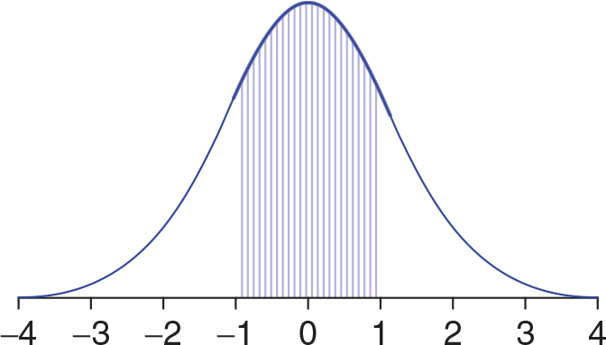
Figure 4.5: A z Distribution With the Target Area Between z = −1 and z = +1 Shaded.
Notes:
Learning Objective: Use a unit normal table to determine the proportion of scores above or below any given z score
Example

Slide 31
Use a Unit Normal Table to Find the Area That Is Shaded
Determine the entire area greater than a z score of −1.
Because this is greater than 50% of the distribution, we look in the body column for the z score of 1 and find 0.8413.
However, we aren’t interested in everything greater than 1.
Notes:
Learning Objective: Use a unit normal table to determine the proportion of scores above or below any given z score

Slide 32
Use a Unit Normal Table to Find the Area That Is Shaded
Specifically, we want to exclude the area greater than the z score of +1, or the area in the tail for a z score of 1, which is 0.1587.
The area (proportion) that we’re interested in, between the z scores of −1 and +1, is 0.8413 − 0.1587 = 0.6826.
Notes:
Learning Objective: Use a unit normal table to determine the proportion of scores above or below any given z score

Slide 33
Use a Unit Normal Table to Find the Area That Is Shaded
Therefore, 68.26% of all ACT scores are between 1 standard deviation below the population mean and 1 standard deviation above the population mean.
In other words, most people (approximately 68% of them) have ACT scores between 16.3 (i.e., 21 − 4.7) and 25.7 (i.e., 21 + 4.7).
Notes:
Learning Objective: Use a unit normal table to determine the proportion of scores above or below any given z score
Recall the mean was 21 and the standard deviation was 4.70 for ACT scores.

