Slide 2
An Introduction to Statistics An Active Learning Approach
Chapter 5: The Distribution of Sample Means and z for a Sample Mean

Slide 3
Topics to Cover
Explain how a distribution of sample means is created
Explain how a random sample is obtained
Determine the mean, the standard deviation, and the shape of a distribution of sample means

Slide 4
Topics to Cover
Explain what the standard error of the mean measures
Explain the central limit theorem and why it is important
Explain the law of large numbers

Slide 5
Topics to Cover
Compute a z for a sample mean
Use the z for a sample mean and a unit normal table to determine how likely a given sample mean is to occur

Slide 6
Sampling and Sampling Error
Explain what the standard error of the mean measures

Slide 7
Sampling and Sampling Error
Inferential statistics
using sample statistics to infer population parameters

Slide 8
Sampling and Sampling Error
Sampling error
the discrepancy between a sample statistic and a population parameter.
Researchers minimize sampling error with good sampling procedures.
Notes:
Learning Objective: Explain what the standard error of the mean measures

Slide 9
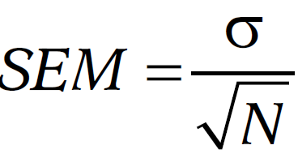
Computing Sampling Error
Divide the standard deviation of the population by the square root of N.
Referred to as the standard error of the mean (SEM).
Notes:
Learning Objective: Explain what the standard error of the mean measures

Slide 10
Computing Sampling Error: Example 1
You want to do a study of reading comprehension with a sample of 10 people and want to know how much sampling error you could expect.
A reading comprehension test has a population mean of 500 with a standard deviation of 100.
Notes:
Learning Objective: Explain what the standard error of the mean measures

Slide 11
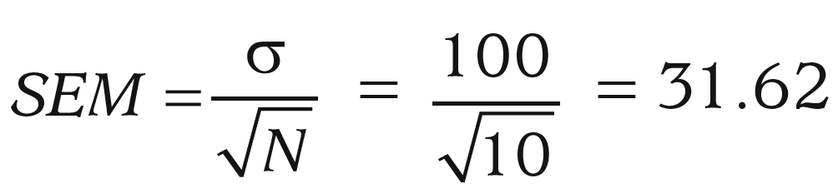
Computing Sampling Error: Example 1
The SEM tells you that if you did your study with a sample of 10 people, the typical distance you would expect between your sample mean and the true population parameter would be 31.62.
Notes:
Learning Objective: Explain what the standard error of the mean measures

Slide 12
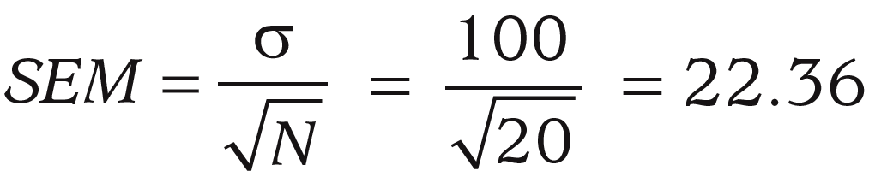
Computing Sampling Error: Example 2
What if you doubled your sample size to 20?
In this case, your sampling error would decrease from 31.62 to 22.36.
Notes:
Learning Objective: Explain what the standard error of the mean measures

Slide 13
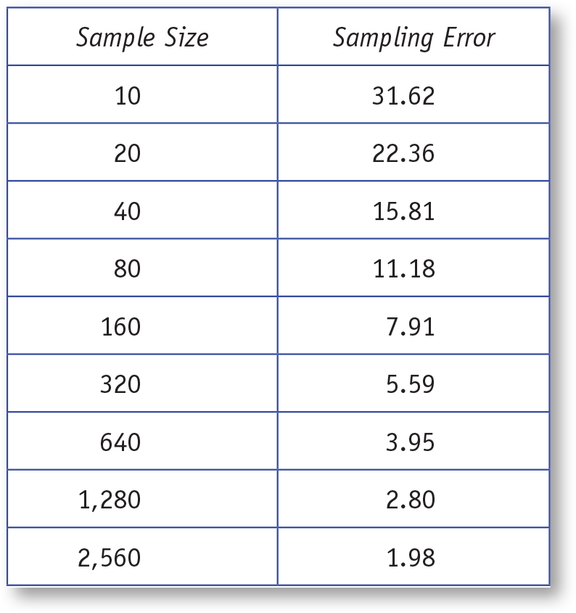
Table 5.1: Relationship Between Sample Size and Sampling Error With σ = 100
Notes:
Learning Objective: Explain what the standard error of the mean measures
“If you estimate your expected sampling error with increasingly large samples, you would find that as your sample size increases, sampling error decreases (see Table 5.1). Although reduced sampling error is important, you must also weigh the costs and diminishing returns of obtaining increasingly large samples when deciding on your study’s sample size. In this example, increasing the sample size by 30 people from 10 to 40 cuts the sampling error in half. However, to cut sampling error in half again, you would have to add another 120 people to the sample.” p. 115

Slide 14
Distribution of Sample Means
Explain how a distribution of sample means is created

Slide 15
Distribution of Sample Means
distribution of sample means
is the population of all possible random sample means for a study conducted with a given sample size.
For example, every possible combination of 25 people from a population of 100,000.
Notes:
Learning Objective: Explain how a distribution of sample means is created p. 115

Slide 16
Distribution of Sample Means
To illustrate a distribution of sample means, we will work with a small population of four scores: 10, 12, 14, 16
Using a sample size of N = 2, list all possible combinations of two scores from the population.
Notes:
Learning Objective: Explain how a distribution of sample means is created p. 115

Slide 17
Distribution of Sample Means
Sample with replacement so that each score has an equal probability of being selected for the first and second score in a sample.
Table 5.2 shows all 16 possible samples.
Column 4 shows the means for each sample.
Notes:
Learning Objective: Explain how a distribution of sample means is created
Learning Objective: Explain how a random sample is obtained
Random Sampling: Sampling so that each score has an equal probability of being selected from the population. p. 115

Slide 18
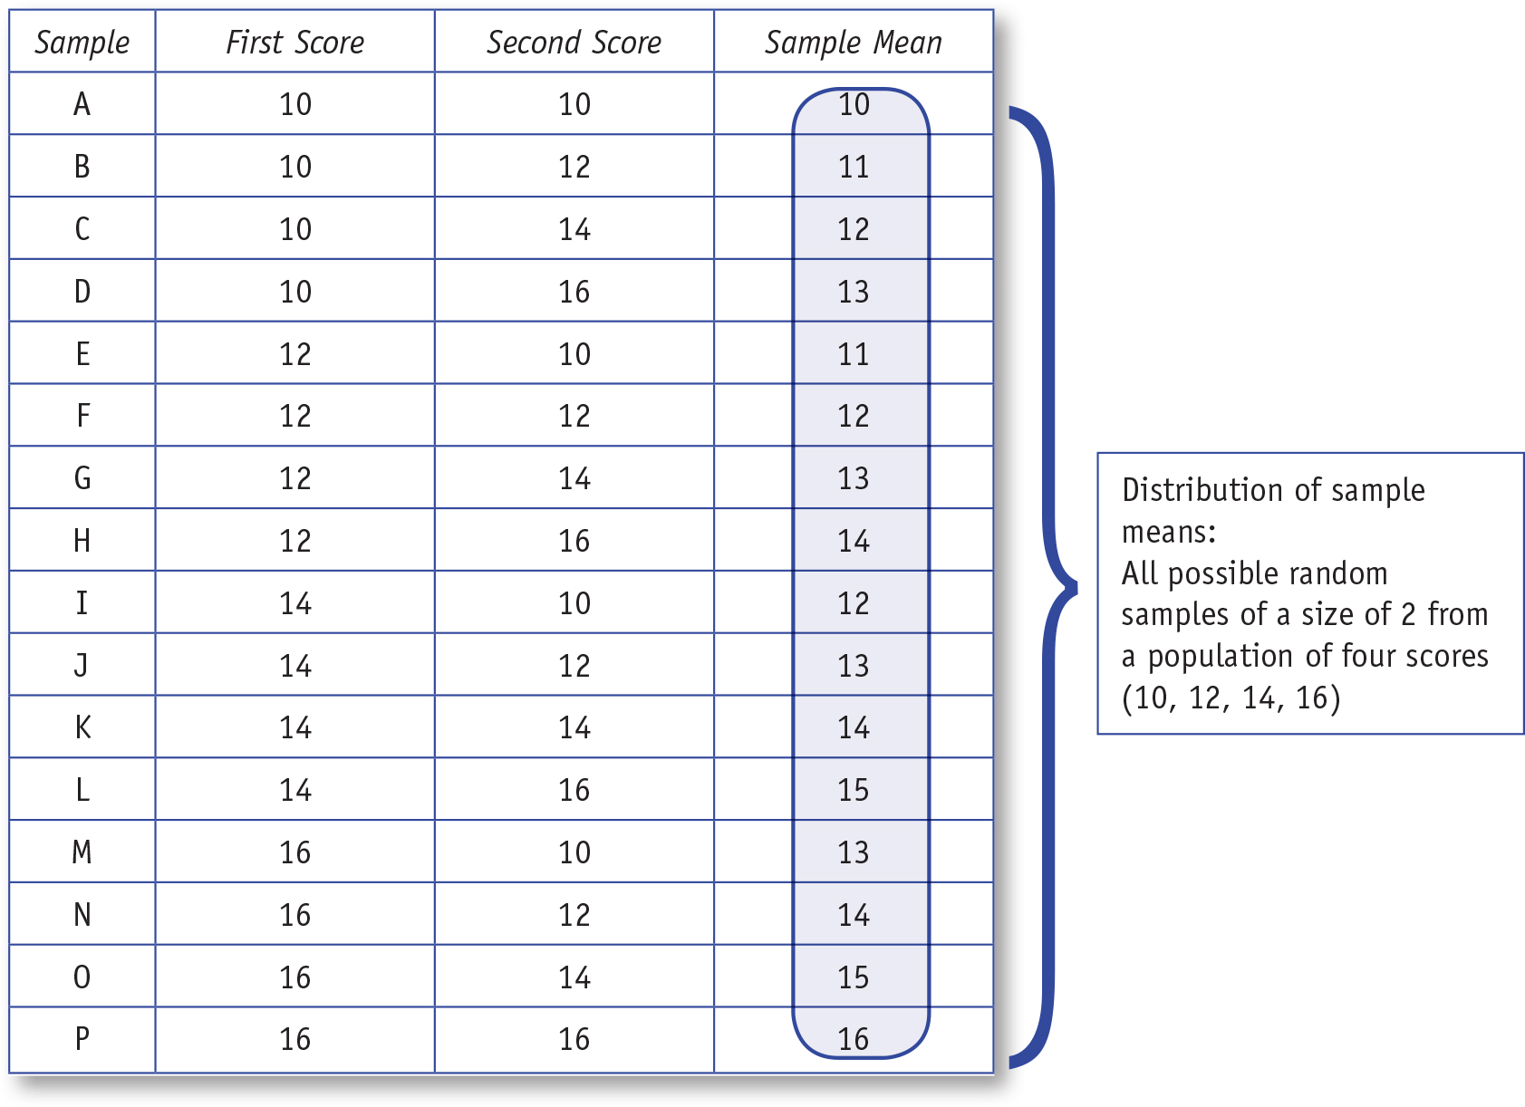
Table 5.2: Distribution of Sample Means for Population of Four Scores and a Sample Size of 2
Notes:
Learning Objective: Explain how a distribution of sample means is created
“When obtaining random samples, it is important to sample with replacement. Thus, each score has an equal probability of being selected for the first score in a sample as well as the second score in a sample.” p. 116

Slide 19
Distribution of Sample Means
Column 4 is the distribution of sample means;
It is the list of all sample means that are possible when the sample size is 2.
Notes:
Learning Objective: Explain how a distribution of sample means is created

Slide 20
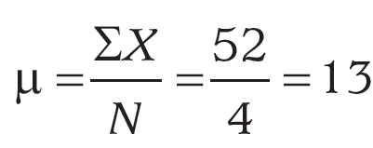
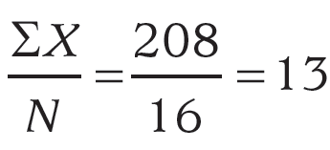
Distribution of Sample Means
The mean of the 4 population of scores was 13.
The mean of the distribution of 16 sample means is also 13.
Notes:
Learning Objective: Determine the mean, the standard deviation, and the shape of a distribution of sample means

Slide 21
Distribution of Sample Means
The mean of the distribution of sample means is always equal to the mean of the population.
It is common for randomly selected samples to have a mean that is the same or similar to the population mean.
Figure 5.1 shows the frequency bar graph of the distribution of sample means.
Notes:
Learning Objective: Determine the mean, the standard deviation, and the shape of a distribution of sample means
“The sample means that are close to the population mean of 13 are common, and the sample means far from the population mean are relatively rare. In other words, sample means with low amounts of sampling error are common, and those with lots of sampling error are rare.” P. 118

Slide 22
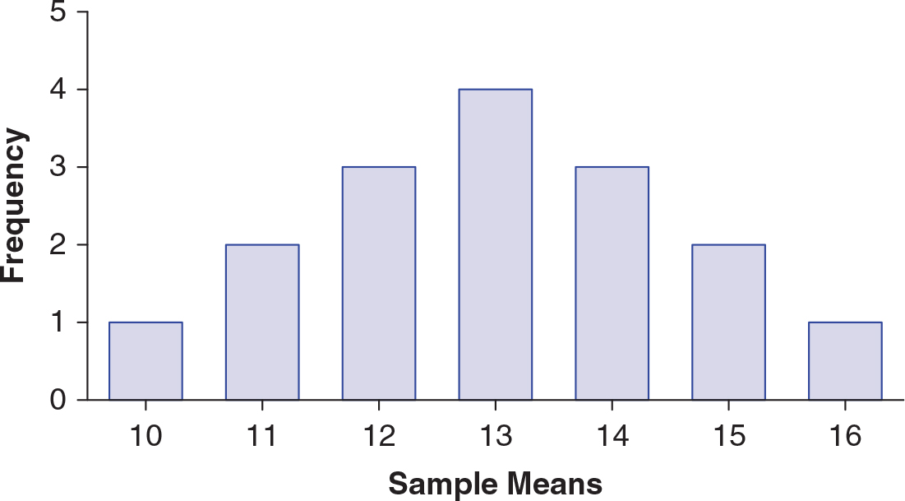
Figure 5.1: Distribution of Sample Means for Samples of 2 From a Population of Four Scores
Notes:
Learning Objective: Determine the mean, the standard deviation, and the shape of a distribution of sample means

Slide 23
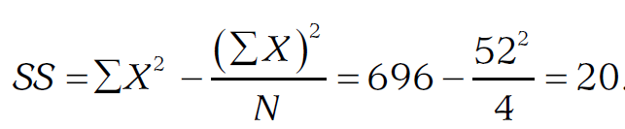
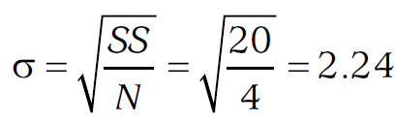
Distribution of Sample Means
The standard deviation of the original population of 4 scores (10, 12, 14, 16) was 2.24.
Notes:
Learning Objective: Determine the mean, the standard deviation, and the shape of a distribution of sample means

Slide 24
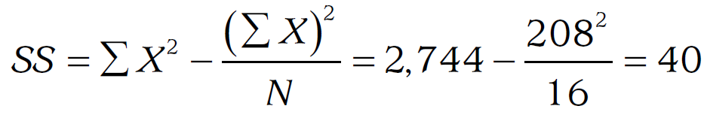
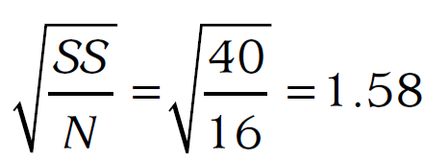
Distribution of Sample Means
The standard deviation of the distribution of 16 sample means is 1.58.
Notes:
Learning Objective: Determine the mean, the standard deviation, and the shape of a distribution of sample means

Slide 25
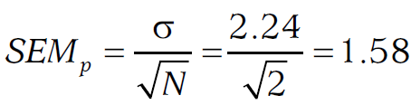
Distribution of Sample Means
Standard error of the mean (SEM)
The standard deviation of the distribution of sample means
the typical distance between the possible sample means and the population mean
Notes:
Learning Objective: Explain what the standard error of the mean measures
p. 119
“This value is identical to the standard deviation of the 16 sample means in the distribution
of sample means . . . the mean of the distribution of sample means is always equal to the populations
mean, μ, and the standard deviation is always equal to the SEM,” the population standard deviation divided by the square root of N.
“it measures the standard or typical amount of sampling error expected in a given study.” p. 121

Slide 26
Distribution of Sample Means
A graph of the distribution of sample means, shown in Figure 5.1, is approximately normally distributed (i.e., bell shaped).
Notes:
Learning Objective: Determine the mean, the standard deviation, and the shape of a distribution of sample means

Slide 27
Distribution of Sample Means
Central limit theorem (CLT)
describes that the distribution of sample means has
a mean equal to the population mean, μ
a standard deviation equal to the standard error of the mean, SEM
a shape that is normal as long as the sample size is at least 30 or the original population has a normal shape
Notes:
Learning Objective: Determine the mean, the standard deviation, and the shape of a distribution of sample means
Learning Objective: Explain the central limit theorem and why it is important

Slide 28
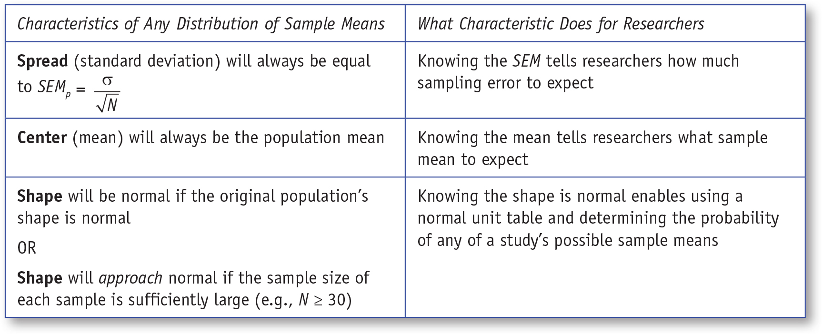
Table 5.3: Three Components of the CLT and What They Do for Researchers
Notes:
Learning Objective: Determine the mean, the standard deviation, and the shape of a distribution of sample means
“The CLT is powerful because (1) it suggests that samples tend to have means similar to the population from which they were drawn and (2) it enables us to compute the typical amount of sampling error any study is likely to generate.” p. 119

Slide 29
Law of Large Numbers
As N increases, the sample statistic (e.g., the sample mean) is a better estimate of the population parameter (e.g., the population mean).
Notes:
Learning Objective: Explain the law of large numbers

Slide 30
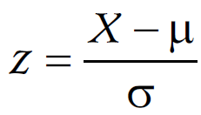
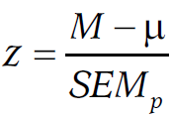
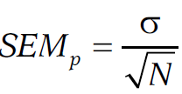
z For a Sample Mean
z for an individual score
z for a sample mean
Notes:
Learning Objective: Compute a z for a sample mean
“for both formulas, the obtained z score is a ratio of the observed difference over the difference
expected due to sampling error” p. 123

Slide 31
Example: Computing and Interpreting the z for a Sample Mean
Compute a z for a sample mean
Notes:
Learning Objective: Compute a z for a sample mean

Slide 32
Example
Suppose you are a federal official investigating 16 loan officers at a company you suspect of illegal mortgage practices.
The mean income of all loan officers in the company is μ = 50,000 with a standard deviation of σ = 12,000.
Notes:
Learning Objective: Compute a z for a sample mean
“for both formulas, the obtained z score is a ratio of the observed difference over the difference
expected due to sampling error” p. 123

Slide 33
Example
The mean income for the 16 loan officers suspected of cheating is US$55,000.
What is the probability that the suspected employees’ mean income was US$55,000 (i.e., US$5,000 higher than the company mean income) merely because of a coincidence (i.e., due to sampling error)?
Notes:
Learning Objective: Compute a z for a sample mean
“for both formulas, the obtained z score is a ratio of the observed difference over the difference
expected due to sampling error” p. 123

Slide 34
Step 1: Compute the Observed Deviation
Find the deviation between the sample mean (M) and the population mean (μ).
Notes:
Learning Objective: Compute a z for a sample mean
“for both formulas, the obtained z score is a ratio of the observed difference over the difference
expected due to sampling error” p. 123

Slide 35
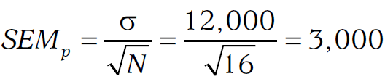
Step 2: Compute the Deviation Expected by Sampling Error
Next, compute the standard error of the mean.
Notes:
Learning Objective: Compute a z for a sample mean
“for both formulas, the obtained z score is a ratio of the observed difference over the difference
expected due to sampling error” p. 123

Slide 36
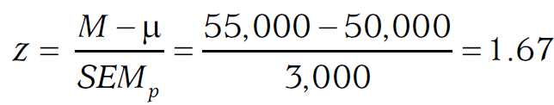
Step 3: Compute the z for a Sample Mean
To compute the z for a sample mean, divide the observed mean difference by the expected amount of sampling error (SEM)
Notes:
Learning Objective: Compute a z for a sample mean
“the obtained z score is a ratio of the observed difference over the difference
expected due to sampling error” p. 123

Slide 37
Step 4: Locate the z Score in the Distribution
Locate the z score on the z curve and determine if you need to use the tail or body probability from Appendix A.
The wording of the question indicates you want to know the probability of a sample of 16 people with a mean of US$55,000 or higher due to sampling error.
Notes:
Learning Objective: Use the z for a sample mean and a unit normal table to determine how likely a given sample mean is to occur
Because US$55,000 is greater than the mean of US$50,000, the shaded portion is less than 50%, and relates to the tail of the distribution.

Slide 38
Step 5: Look up the z Score
Use the unit normal table to determine the probability of obtaining a z score of 1.67.
The area of the distribution higher than 1.67 is the smaller part of the distribution, and so we look at the tail column for the z of 1.67 and find it is 0.0475.
Notes:
Learning Objective: Use the z for a sample mean and a unit normal table to determine how likely a given sample mean is to occur

Slide 39
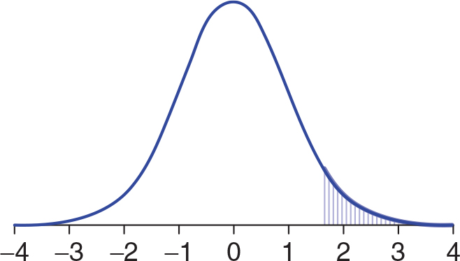
Figure 5.3: A z Distribution With the Target Area Below z > 1.67 Shaded
Notes:
Learning Objective: Use the z for a sample mean and a unit normal table to determine how likely a given sample mean is to occur

Slide 40
Step 6: Interpret the z Score
The fact that the mean income of the 16 suspects was higher than the company’s mean income was unlikely to be due to chance or sampling error.
Perhaps the employees’ salaries were higher due to illegal activities.
Notes:
Learning Objective: Use the z for a sample mean and a unit normal table to determine how likely a given sample mean is to occur

Slide 41
Step 6: Interpret the z Score
When the sample size is 16, the probability of getting a sample mean income of US$55,000 or greater is 0.0475.
Another way of saying this is that 4.75% of all possible sample means based on 16 people have a mean equal to or greater than $55,000.
Notes:
Learning Objective: Use the z for a sample mean and a unit normal table to determine how likely a given sample mean is to occur

Slide 42
Exact Probabilities Versus Probability Estimates
Probability statements derived from research are estimates rather than exact probabilities because:
the central limit theorem is based on random sampling, but
researchers are most often working with nonrandom samples.
The actual probability might be a bit higher or a bit lower.
Notes:
Learning Objective: Use the z for a sample mean and a unit normal table to determine how likely a given sample mean is to occur

