Slide 2
An Introduction to Statistics An Active Learning Approach
Chapter 6: Hypothesis Testing With z Scores

Slide 3
Topics to Cover
Write null and research hypotheses using population parameters and words
Compute a z for a sample mean
Determine whether or not you should reject the null hypothesis

Slide 4
Topics to Cover
Compute and interpret the effect size (d) of a study
Summarize study results using American Psychological Association (APA) style

Slide 5
Topics to Cover
Identify examples of Type I error, Type II error, and statistical power
Provide a detailed description of a p value, critical value, and obtained value

Slide 6
Introduction to Hypothesis Testing
The hypothesis-testing process is powerful because it can be applied to such a wide range of topics.
It can help all of us make better, more informed decisions, if we know how to use it.

Slide 7
Hypothesis Testing With z for a Sample Mean Example (One-Tailed)
Notes:
Learning Objective: Write null and research hypotheses using population parameters and words
Learning Objective: Compute a z for a sample mean
Learning Objective: Determine whether or not you should reject the null hypothesis
Learning Objective: Compute and interpret the effect size (d) of a study
Learning Objective: Summarize study results using American Psychological Association (APA) style
Learning Objective: Identify examples of Type I error, Type II error, and statistical power
Learning Objective: Provide a detailed description of a p value, critical value, and obtained value

Slide 8
Introduction to Hypothesis Testing
Suppose a teacher redesigns her history course so students take frequent quizzes prior to taking exams.
The mean score on the final exam for the 25 new students in her course was M = 80.
All past students are considered the population and the 25 new students are considered a sample.

Slide 9
Introduction to Hypothesis Testing
The mean score on this same final exam for all past students who took the course with her before she required frequent quizzing was 75 points with a standard deviation of 10 points (μ = 75, σ = 10).

Slide 10
Introduction to Hypothesis Testing
With hypothesis testing, you can determine if the sample of students who took frequent quizzes scored “significantly” better than the previous students who did not take quizzes.
If the quizzes helped the sample, perhaps requiring quizzes for all future students would help them as well.

Slide 11
Introduction to Hypothesis Testing
You can use the hypothesis-testing process and the z for a sample mean you learned in the previous chapter to determine if the 5-point difference is likely to be due to sampling error or if it is likely to have been created by the new frequent quizzing process.

Slide 12
Step 1: Examine Variables to Assess Statistical Assumptions
Independence of data assumption
This means that each participant’s score within a condition is independent of all other participants’ scores within that same condition.

Slide 13
Step 1: Examine Variables to Assess Statistical Assumptions
Appropriate measurement of variables for the analysis assumption
For hypothesis tests using a z for a sample mean, this assumption means that the independent variable (IV) must identify a group of people who are different from the population in some way, and the dependent variable (DV) must be measured on an interval or ratio scale of measurement.

Slide 14
Step 1: Examine Variables to Assess Statistical Assumptions
Normality of distributions assumption
This means that the distribution of sample means for each condition must have a normal shape.

Slide 15
Step 1: Examine Variables to Assess Statistical Assumptions
Homogeneity of variance assumption
When conducting a z for a sample mean, this assumption means that the variances in each condition of the study are similar.

Slide 16
Step 2: State the Null and Research Hypotheses
In this example, the teacher predicts that frequent quizzing will increase test scores.
The null and research hypotheses are mutually exclusive and together encompass all possible outcomes.
They are always written in terms of population parameters.
Notes:
Learning Objective: Write null and research hypotheses using population parameters and words

Slide 17
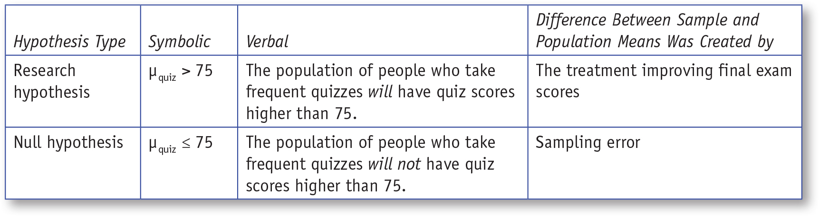
Table 6.1: Symbolic and Verbal Representations of the Null and Research Hypotheses for the z for a Sample Mean
Notes:
Learning Objective: Write null and research hypotheses using population parameters and words

Slide 18
Step 3: Define the Critical Regions
The critical region is the collection of all z score values that are so rare if the null is true that if any one of these z scores occurs, it suggests that the null hypothesis is probably false.
Notes:
Learning Objective: Write null and research hypotheses using population parameters and words

Slide 19
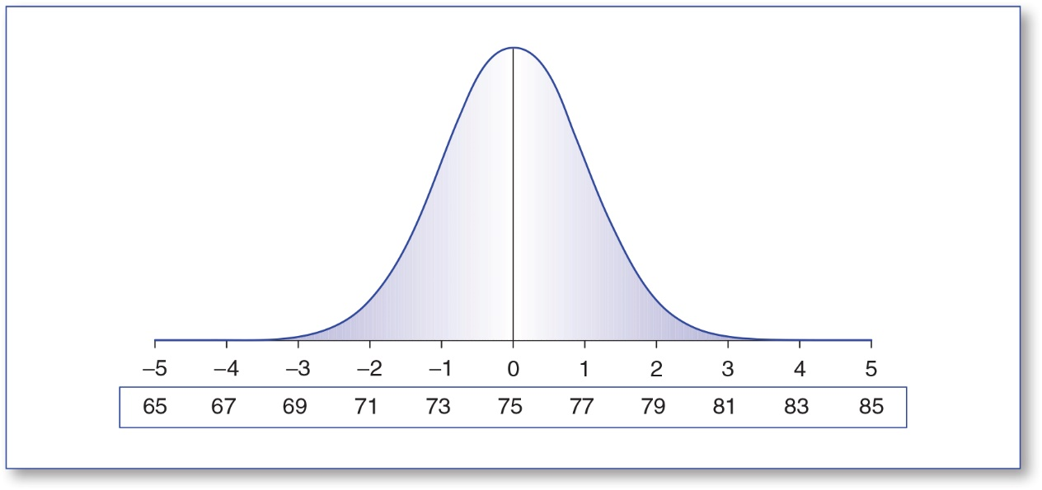
Figure 6.1: A Distribution of Sample Means With a z Number Line (Top) and a Sample Mean Number Line (Bottom)
Notes:
Learning Objective: Determine whether or not you should reject the null hypothesis

Slide 20
Step 3: Define the Critical Regions
Alpha level (α)
The .05 cutoff value that is used to identify which z scores are unlikely if the null is true
Notes:
Learning Objective: Determine whether or not you should reject the null hypothesis
P. 152 “The alpha level cutoff can be converted into a z score cutoff by looking up .05 in the tail column of the unit normal table and finding the z score with a tail of .05.”

Slide 21
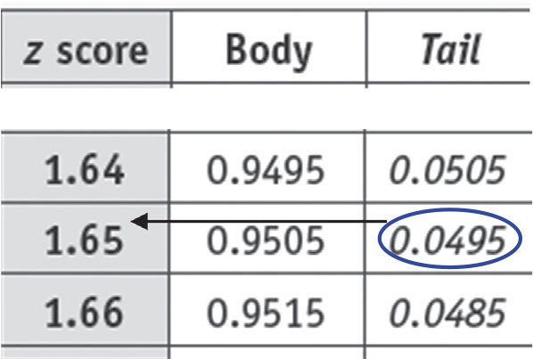
Figure 6.2: Finding The z Critical Value That Defines the Critical Region When the α Value Is .05)
Notes:
Learning Objective: Determine whether or not you should reject the null hypothesis
P. 152 “The alpha level cutoff can be converted into a z score cutoff by looking up .05 in the tail column of the unit normal table and finding the z score with a tail of .05.”

Slide 22
Step 3: Define the Critical Regions
Critical value
the value located at the beginning of unlikely z score area (the shaded area)
z Scores equal to or greater than the critical value are considered unlikely to occur if the null is true.
Notes:
Learning Objective: Provide a detailed description of a p value, critical value, and obtained value
Learning Objective: Determine whether or not you should reject the null hypothesis
p. 153 “The critical value separates the distribution into two regions: (1) z scores that are likely to occur if
the null hypothesis is true and (2) z scores that are unlikely to occur if the null hypothesis is true.”

Slide 23
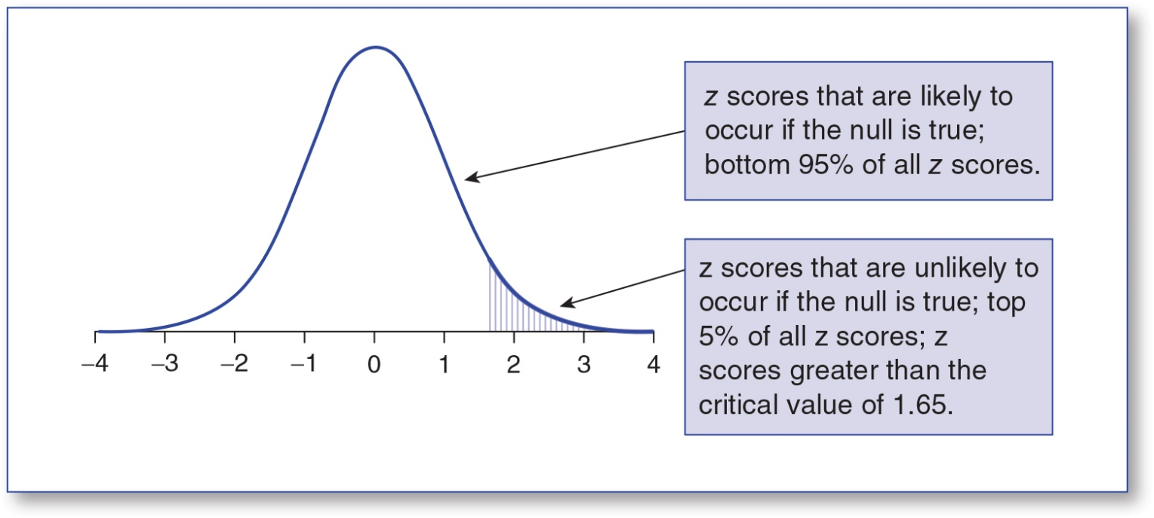
Figure 6.3: The Critical Value That Defines the Critical Region When the α Value Is .05)
Notes:
Learning Objective: Determine whether or not you should reject the null hypothesis
p. 153
“It is important to note that the research hypothesis for the frequent quizzing example predicts that
scores will be higher when using frequent quizzing than when not using frequent quizzing. Because the
research hypothesis predicted that the sample mean would be greater than the population mean, the
critical value is positive (i.e., +1.65). However, if the research hypothesis had predicted a lower sample
mean than the population mean, the critical value would be negative (i.e., -1.65), and the shaded area,
called the critical region, would have been on the negative tail of the above distribution.”

Slide 24
Step 3: Define the Critical Regions
Critical region—region of rejection
The critical value separates the distribution into two regions:
z Scores that are likely to occur if the null hypothesis is true and
z Scores that are unlikely to occur if the null hypothesis is true.
Notes:
Learning Objective: Provide a detailed description of a p value, critical value, and obtained value

Slide 25
Step 4: Compute the Test Statistic (z for a Sample Mean)
4a. Compute the Observed Deviation Between the Sample Mean and the Population Mean
4b. Compute the Deviation Expected Due to Sampling Error
4c. Compute the z for a Sample Mean
Notes:
Learning Objective: Compute a z for a sample mean

Slide 26

4a. Compute the Observed Deviation Between the Sample Mean and the Population Mean
Find the deviation between the sample mean and the population mean.
Notes:
Learning Objective: Compute a z for a sample mean

Slide 27
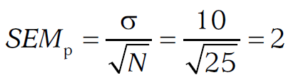
4b. Compute the Deviation Expected Due to Sampling Error
Compute the expected amount of sampling error given the sample size.
Notes:
Learning Objective: Compute a z for a sample mean

Slide 28
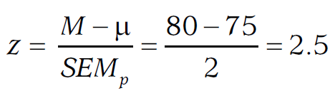
4c. Compute the z for a Sample Mean
Compute the obtained z score associated with the obtained sample mean.
Notes:
Learning Objective: Compute a z for a sample mean

Slide 29
Step 4: Compute the Test Statistic (z for a Sample Mean)
The obtained z score of 2.5 is more extreme than the critical value of 1.65.
It is in the region of rejection.
You can conclude that the z score of 2.5 is unlikely to be due to sampling error and that the unexpectedly high z score results from frequent quizzing improving test scores.
Notes:
Learning Objective: Determine whether or not you should reject the null hypothesis
p. 155
“based on these results, it seems like the frequent quizzing improved test scores. However, when reporting these results, one should be cautious. Although unlikely, it is possible that the result occurred due to sampling error. Therefore, when reporting the results, one
should say things like “the evidence suggests” that frequent quizzing improves test scores and avoid
saying things like “these results prove” that frequent quizzing improves test scores.”

Slide 30
Step 4: Compute the Test Statistic (z for a Sample Mean)
If the null is true, a z score of 2.5 has a probability of .0062, this is called the p value.
Whenever the z score is in the critical region, the p value will be smaller than the α value.
Notes:
Learning Objective: Determine whether or not you should reject the null hypothesis Learning Objective: Provide a detailed description of a p value, critical value, and obtained value

Slide 31
Step 4: Compute the Test Statistic (z for a Sample Mean)
Two ways to determine whether you should reject the null hypothesis
if the obtained z score is in the critical region
if the p value is less than the alpha value
Notes:
Learning Objective: Determine whether or not you should reject the null hypothesis

Slide 32
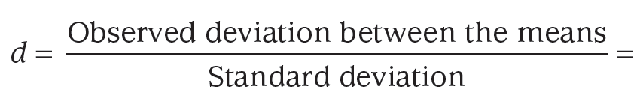
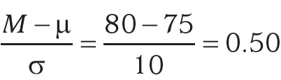
Step 5: Compute an Effect Size, and Describe It as Small, Medium, or Large
An effect size is an index of the difference between the sample mean and the population mean.
Notes:
Learning Objective: Determine whether or not you should reject the null hypothesis

Slide 33
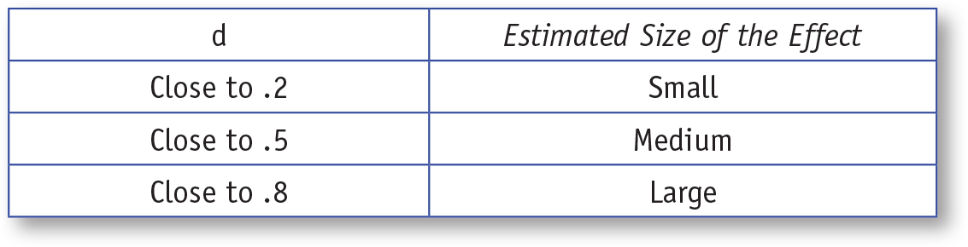
Table 6.2: General Guidelines for Interpreting d
Notes:
Learning Objective: Determine whether or not you should reject the null hypothesis

Slide 34
Step 6: Interpreting the Results of the Hypothesis Test Using a z for a sample mean.
The exam scores of students who took frequent quizzes over the material (M = 80, SD = 9.50) were significantly higher than the scores of those who did not take frequent quizzes (μ = 75, σ = 10), z(N = 25) = 2.50, p = .0062, d = .50.
Notes:
Learning Objective: Summarize study results using American Psychological Association (APA) style

Slide 35
What Does it Mean to Describe Something as “Statistically Significant”?
Statistically significant means that
the results were unlikely to be created by sampling error
the obtained z value was in the critical region
Notes:
Learning Objective: Summarize study results using American Psychological Association (APA) style

Slide 36
Errors in Hypothesis Testing
Learning Objective: Identify examples of Type I error, Type II error, and statistical power

Slide 37
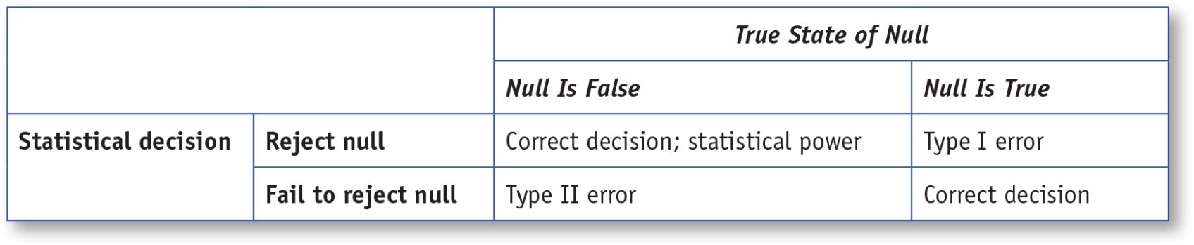
Table 6.3: Situations Defining Type I Error, Type II Error, and Statistical Power
Notes:
Learning Objective: Determine whether or not you should reject the null hypothesis

Slide 38
Errors in Hypothesis Testing
Type I error
when you incorrectly reject the null
Type II error
when you incorrectly fail to reject the null
Statistical power
probability of correctly rejecting the null
Notes:
Learning Objective: Identify examples of Type I error, Type II error, and statistical power

Slide 39
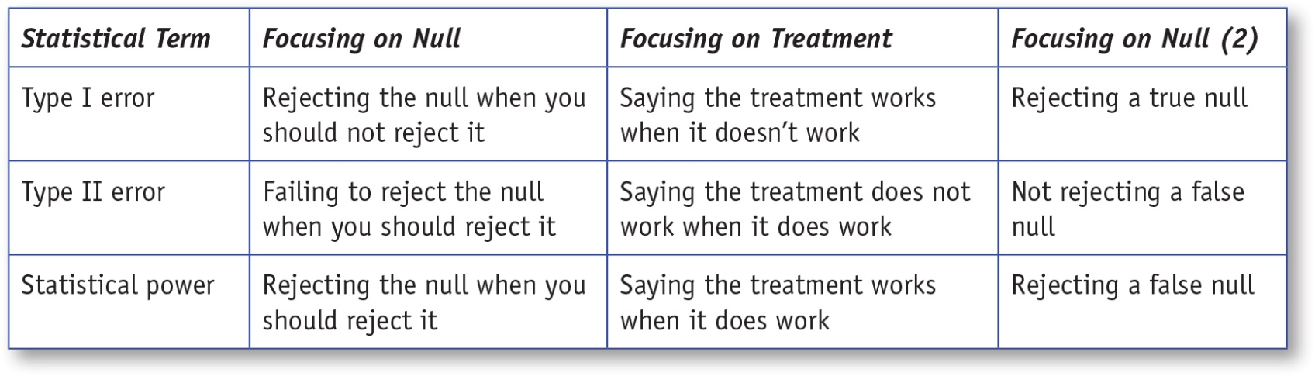
Table 6.4 : Situations Defining Type I Error, Type II Error, and Statistical Power
Notes:
Learning Objective: Determine whether or not you should reject the null hypothesis

Slide 40
Hypothesis Testing Rules
Whenever the p value is less than the α level, the null hypothesis is unlikely to be true and you should reject it.
In general, if you want to minimize Type I errors, choose an alpha of .01,
if you want to maximize statistical power, choose an α of .05.
Notes:
Learning Objective: Summarize study results using American Psychological Association (APA) style
“The logic of this decision is that if a z score has a low probability
if the null is true and that z score still happens, then the null hypothesis probably is not true.” p. 160

Slide 41
What is a p Value?
p Value
the probability of getting an obtained value or a more extreme value assuming the null hypothesis is true.
It is used by researchers to determine whether or not they should reject a null hypothesis.
Notes:
Learning Objective: Provide a detailed description of a p value, critical value, and obtained value

Slide 42
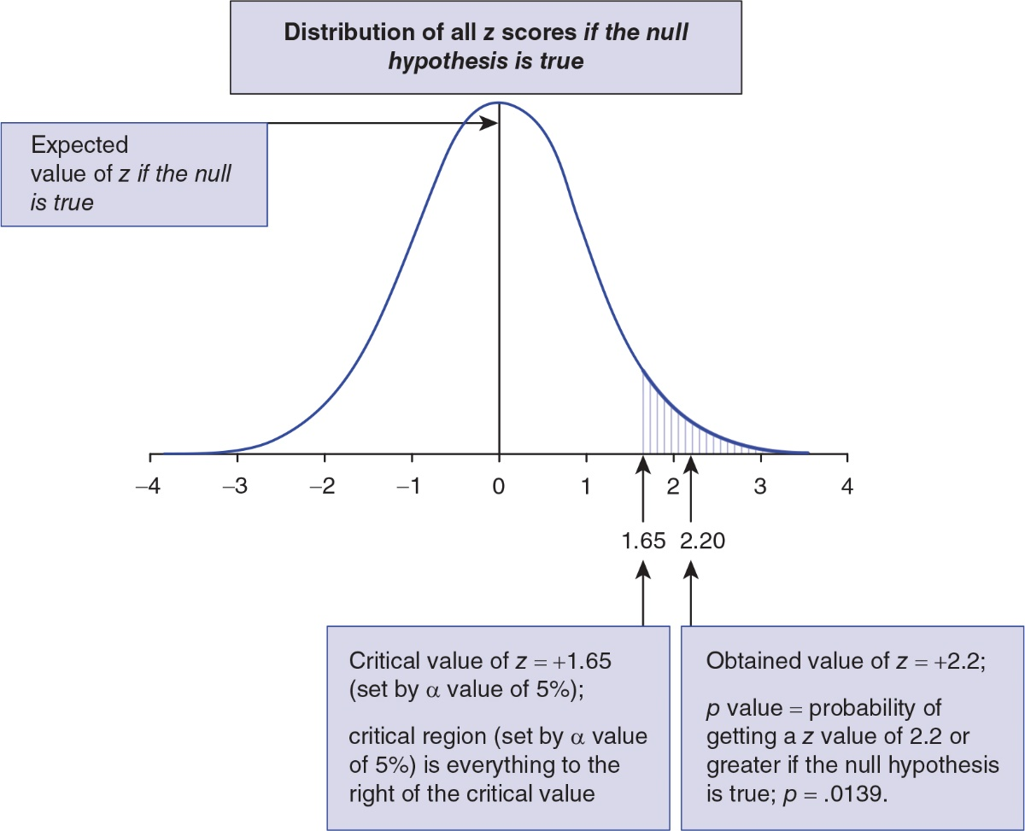
Table 6.5 : The Relationship Between Obtained z Values, Critical Values, and p Values
Notes:
Learning Objective: Provide a detailed description of a p value, critical value, and obtained value

Slide 43
Why Statisticians “Fail to Reject the Null” Rather Than “Accept the Null”
“Failing to reject the null” indicates that there is currently not enough evidence to reject the null hypothesis, but it acknowledges that future research might provide that evidence.

Slide 44
Why Scientists Say “This Research Suggests” Rather Than “This Research Proves”
Using this tentative language acknowledges that while the current information suggests the program works, it is possible that future work could change that conclusion.
One reason the scientific process is so powerful is that it is willing to change its position if new evidence suggests that a new position is more accurate.

