Slide 2
An Introduction to Statistics An Active Learning Approach
Chapter 7: Single Sample t Test

Slide 3
Topics to Cover
Explain when a single-sample t should be used rather than a z for a sample mean.
Explain why the z for a sample mean is superior to the single-sample t test but rarely used.
Write one- and two-tailed null and research hypotheses using population parameters and words.

Slide 4
Topics to Cover
Compute the degrees of freedom and define the critical region for one- and two-tailed single-sample t tests
Explain why a z for a sample mean test and a single-sample t test have different critical regions
Compute a single-sample t by hand and using SPSS

Slide 5
Topics to Cover
Determine whether or not you should reject the null hypothesis
Compute and interpret an effect size (d)
Interpret the SPSS output for a single-sample t
Summarize the results of the analysis using American Psychological Association (APA) style

Slide 6
Single Sample t Test
The single-sample t statistic is used to determine whether the difference between a sample mean and a population mean is likely to be due to sampling error when the population standard deviation (σ) is unknown.
The single-sample t test uses the standard deviation of the sample (SD) rather than the standard deviation of the population.
Notes:
Learning Objective: Explain when a single-sample t should be used rather than a z for a sample mean Learning Objective: Explain why a z for a sample mean test and a single-sample t test have different critical regions

Slide 7
Conceptual Information
The standard deviation for the sample is used to compute an estimate of the expected sampling error.
The critical region will be determined by t critical values rather than z critical values.
There are different t critical values for different sample sizes.
Notes:
Learning Objective: Explain when a single-sample t should be used rather than a z for a sample mean
Learning Objective: Explain why a z for a sample mean test and a single-sample t test have different critical regions

Slide 8
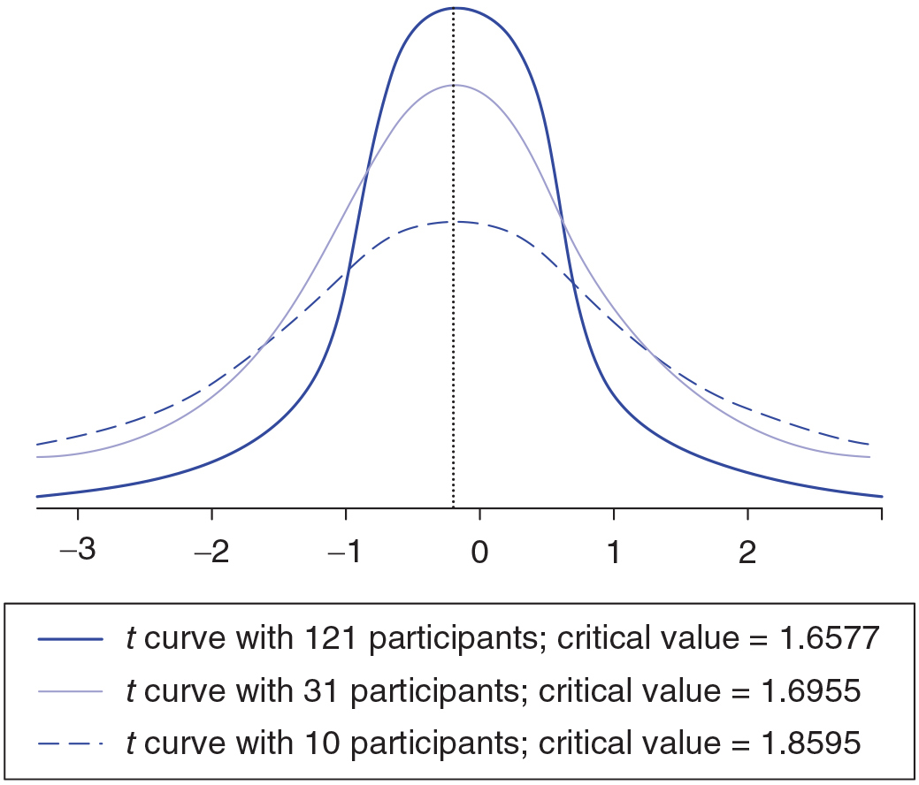
Figure 7.1: The Shape of the t Distribution for Three Different Sample Sizes
Notes:
p. 210

Slide 9
One-Tailed Single-Sample t Test Example

Slide 10
One-Tailed Single-Sample t Test Example
A financial aid counselor wants to see whether students are overly optimistic about their future salaries.
She knows that the distribution of starting salaries for psychology majors graduating from her school is normally distributed with a mean of US$36,000 a year, or μ = US$3,000 a month.
Notes:
Learning Objective: Explain when a single-sample t should be used rather than a z for a sample mean

Slide 11
One-Tailed Single-Sample t Test Example
The counselor obtains a random sample of 15 psychology majors from her school.
The mean expected starting salaries for the 15 students was M = 3,680.
Previous research (e.g., Weinstein, 1980) suggests that students will be overly optimistic in their estimates, and so the counselor chooses to do a one-tailed test.
Notes:
Learning Objective: Explain when a single-sample t should be used rather than a z for a sample mean

Slide 12
One-Tailed Single-Sample t Test Example
She also chooses an alpha of .05.
Is the students’ mean estimated starting salary significantly higher than the actual starting salary for psychology majors?
Notes:
Learning Objective: Explain when a single-sample t should be used rather than a z for a sample mean

Slide 13
Step 1: Examine the Statistical Assumptions
Data independence is met because the counselor collected the data carefully, not allowing any participants to influence other participants’ answers.
Notes:
Learning Objective: Explain when a single-sample t should be used rather than a z for a sample mean

Slide 14
Step 1: Examine the Statistical Assumptions
Appropriate measurement of the IV and the DV is met because the DV, expected monthly salary, is measured on an interval/ratio scale, and the IV, psychology students’ expectations versus actual salaries, identifies a group of students’ salary expectations versus a population’s actual salaries.
Notes:
Learning Objective: Explain when a single-sample t should be used rather than a z for a sample mean

Slide 15
Step 1: Examine the Statistical Assumptions
The distribution of sample means will have a normal shape is also met because the population of psychology majors’ expected salaries is normally shaped.
Notes:
Learning Objective: Explain when a single-sample t should be used rather than a z for a sample mean

Slide 16
Step 1: Examine the Statistical Assumptions
Homogeneity of variance is more difficult to assess.
Because the population standard deviation (σ) is not known, it is not clear whether the sample standard deviation (SD) is similar to the population standard deviation.
Researchers typically assess this assumption by using their knowledge of the variables they are studying.
Notes:
Learning Objective: Explain when a single-sample t should be used rather than a z for a sample mean

Slide 17
Step 2: State the Null and Research Hypotheses Symbolically and Verbally
The research hypothesis: the population of psychology majors’ mean estimated starting salary is higher than US$3,000/month.
The null hypothesis: the population of psychology majors’ mean estimated starting salary is not higher than US$3,000/month.
Notes:
Learning Objective: Explain when a single-sample t should be used rather than a z for a sample mean

Slide 18
Step 2: State the Null and Research Hypotheses Symbolically and Verbally
The null and research hypotheses will always be mutually exclusive and will cover all possible outcomes.
The one-tailed hypotheses indicate that researchers will only reject the null hypothesis if the t value is far from zero on the positive side of the t distribution.
Notes:
Learning Objective: Write one- and two-tailed null and research hypotheses using population parameters and words

Slide 19
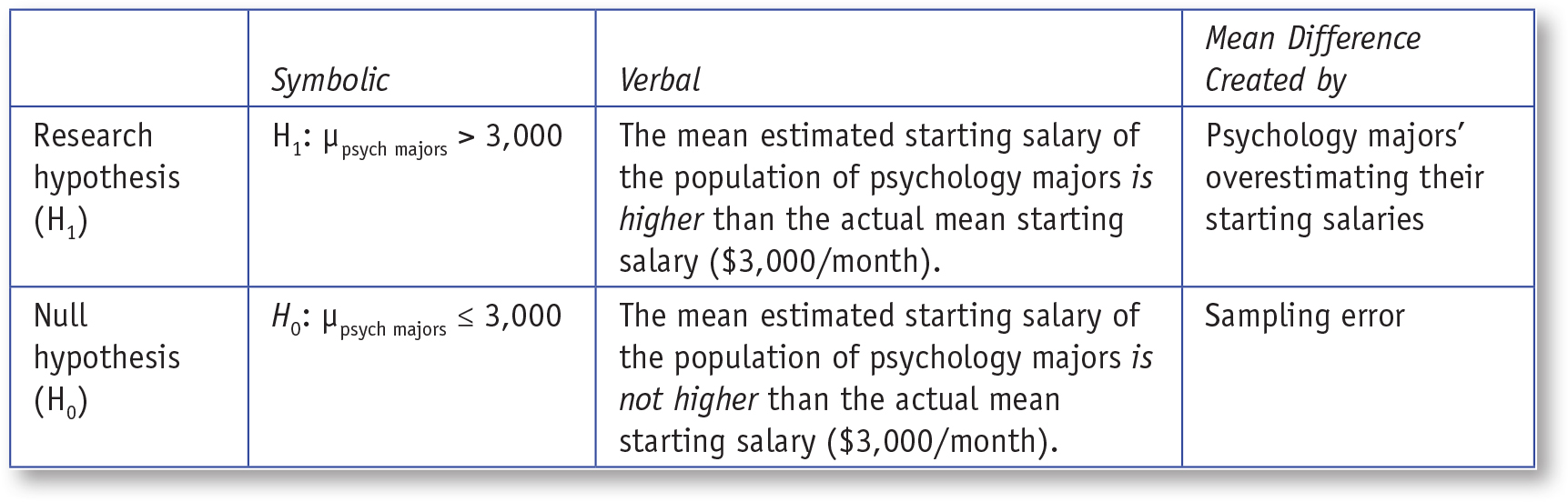
Table 7.2: Symbolic and Verbal Representations for One-Tailed Research and Null Hypotheses for Single-Sample t Test
Notes:
Learning Objective: Write one- and two-tailed null and research hypotheses using population parameters and words

Slide 20

Step 3: Use Sample Size to Compute Degrees of Freedom and Define the Critical Regions
Degrees of freedom (df)
For the single-sample t test, df = N – 1
Use the critical value t values table in Appendix B to find the t critical value when df = 14 and α is .05.
Notes:
Learning Objective: Compute the degrees of freedom and define the critical region for one- and two-tailed
single-sample t tests

Slide 21
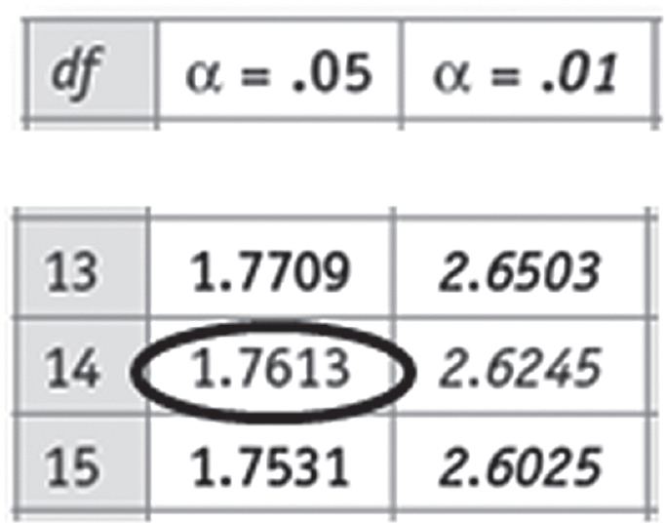
Figure 7.2: Finding the Critical t Value
Notes:
Learning Objective: Write one- and two-tailed null and research hypotheses using population parameters and words

Slide 22
Step 3: Use Sample Size to Compute Degrees of Freedom and Define the Critical Regions
In this case the critical t value is 1.7613.
The research hypothesis predicted that our sample mean would be greater than our population mean.
Therefore, the null hypothesis should be rejected if t obtained ≥ +1.7613.
Notes:
Learning Objective: Compute the degrees of freedom and define the critical region for one- and two-tailed
single-sample t tests
p. 214
“Thus, the critical region is on the positive side of the distribution, and the critical region starts at +1.7613. Therefore, the null hypothesis should be rejected if the obtained t we calculate in the next step is equal to or greater than +1.7613”

Slide 23
Step 4: Compute the Test Statistic (Single-Sample t Test)
4a. Compute the deviation between the sample mean and the population mean
4b. Compute the sampling error expected
4c. Compute the test statistic (single-sample t test)
Notes:
Learning Objective: Compute a single-sample t by hand and using SPSS

Slide 24

4a. Compute the Deviation Between the Sample Mean and the Population Mean
Compute the deviation between the sample mean and the population mean.
Notes:
Learning Objective: Compute a single-sample t by hand and using SPSS

Slide 25
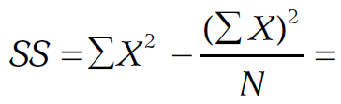
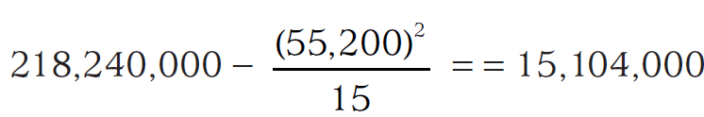
4b. Compute the Sampling Error Expected
First compute the sum of squared deviations, SS.
Notes:
Learning Objective: Compute a single-sample t by hand and using SPSS

Slide 26
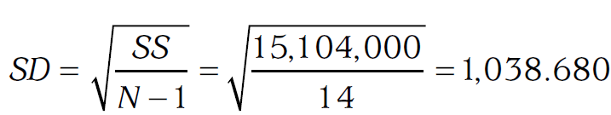
4b. Compute the Sampling Error Expected
Then, compute the standard deviation by dividing the SS by N − 1 and taking the square root of the quotient.
Notes:
Learning Objective: Compute a single-sample t by hand and using SPSS

Slide 27
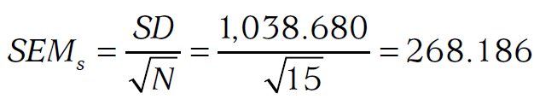
4b. Compute the Sampling Error Expected
Compute the standard error of the mean by dividing the standard deviation by the square root of the sample size.
Notes:
Learning Objective: Compute a single-sample t by hand and using SPSS

Slide 28
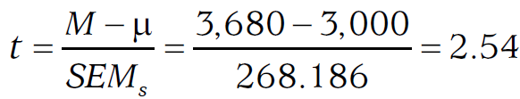
4c. Compute the Test Statistic (Single-Sample t Test)
The standard error of the mean is computed by dividing the standard deviation by the square root of the sample size.
Notes:
Learning Objective: Compute a single-sample t by hand and using SPSS

Slide 29
Step 4: Compute the Test Statistic (Single Sample t Test)
The obtained t value (+2.54) is greater than the t critical value of +1.7613.
You could also say that the obtained t value is in the critical region.
There is sufficient evidence to reject the null hypothesis.
The study suggests that psychology majors tend to overestimate their starting salaries after graduation.
Notes:
Learning Objective: Determine whether or not you should reject the null hypothesis

Slide 30
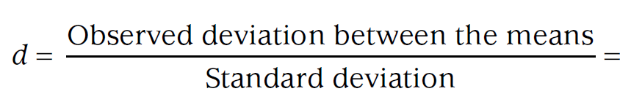
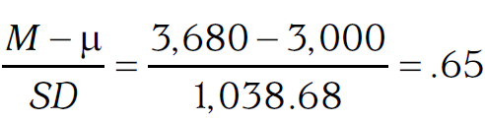
Step 5: Compute an Effect Size and Describe It
ds close to .2, .5, and .8 are small, medium, and large effects, respectively
Notes:
Learning Objective: Compute and interpret an effect size (d)
“In this case, the effect size of .65 is medium to large, meaning that psychology majors overestimate their starting salaries by a quite a bit. However, with such a small sample size, it is possible that this medium to large effect is the result of sampling error.”

Slide 31
Step 5: Compute an Effect Size and Describe It
In this case, the effect size of .65 is medium to large, meaning that psychology majors overestimate their starting salaries by a quite a bit.
However, with such a small sample size (N = 15), it is possible that this medium to large effect is the result of sampling error.
Notes:
Learning Objective: Compute and interpret an effect size (d)

Slide 32
Step 6: Interpreting the Results of the Hypothesis Test
The average expected monthly salary for psychology majors (M = 680, SD = 1,038.68) was significantly higher than the actual starting salary of US$3,000, t(14) = 2.54, p < .05, d = .65. This analysis suggests that psychology majors do tend to overestimate the starting salaries they can expect after graduation by quite a bit.
Notes:
Learning Objective: Summarize the results of the analysis using American Psychological Association (APA) style
P. 216
“In the previous chapter, you learned to report the exact p value in your summary statement of a z for
a sample mean (e.g., p = .02). If you know the exact p value of a statistical result, you should always report
It . . . [However] it is not practical for any book to provide all the probabilities for every t score and every sample size . . . the only reason you would ever write p < .05 or p > .05 would be if you don’t know the exact p value.”

Slide 33
Two-Tailed Single-Sample t Test Example

Slide 34
Two-Tailed Single-Sample t Example
Directional test
One-tailed tests have one critical region in one tail.
Nondirectional test
Two-tailed tests have two critical regions, one positive and one negative tail.
Notes:
Learning Objective: Compute the degrees of freedom and define the critical region for one- and two-tailed
single-sample t tests

Slide 35
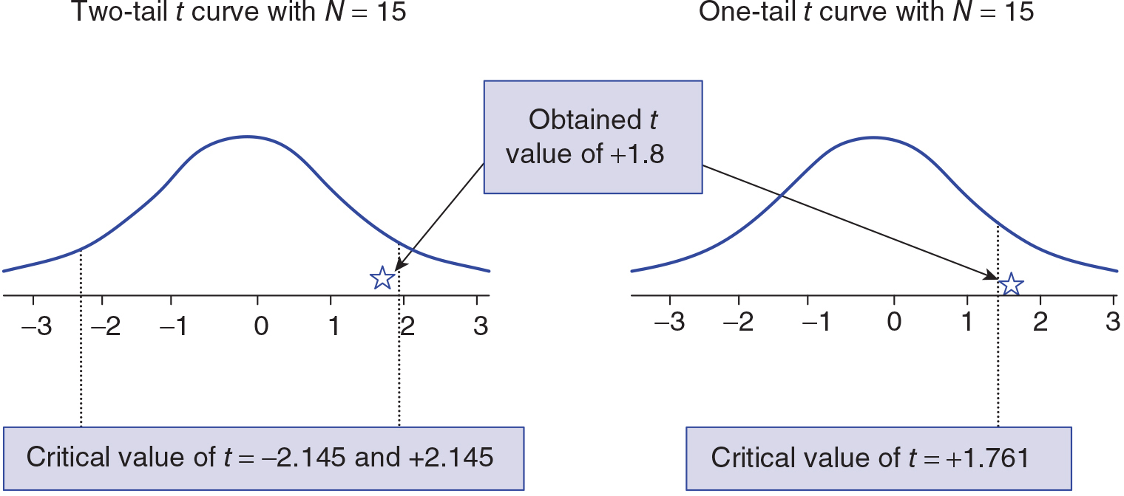
Figure 7.3: Visual Representation of the Two-Tailed and One-Tailed Critical Regions
Notes:
Learning Objective: Compute the degrees of freedom and define the critical region for one- and two-tailed
single-sample t tests

Slide 36
Two-Tailed Single-Sample t Example
After learning that psychology majors were overly optimistic about their own starting salaries, you want to know if students are similarly optimistic about others’ starting salaries.
You recruit 15 different psychology majors and ask them to estimate the average monthly salary that the typical psychology major can expect in his or her first job after graduation.

Slide 37
Two-Tailed Single-Sample t Example
The sample of 15 estimated salaries had a mean of 3,160 and a standard deviation of 561.630.
You know that the population’s actual monthly salary is normally shaped with μ = 3,000.
Notes:
p. 221 shows the mean of these scores as 3,160.

Slide 38
Two-Tailed Single-Sample t Example
You are not sure if students will be optimistic about others’ staring salaries, and so you correctly choose to do a two-tailed test rather than a one-tailed test.
You decide to use α = .05.

Slide 39
Step 1: Examine the Statistical Assumptions
Your study seems to meet all four statistical assumptions.
Assumption of data independence
Assumption of appropriate measurement of variables
Assumption of normality
Assumption of homogeneity of variance
Notes:
Learning Objective: Explain when a single-sample t should be used rather than a z for a sample mean
P. 219
“You collected data carefully to ensure that the students’ answers did not influence each other (assumption of data independence). You also worded your question carefully so students’ answers were not made more or less variable (assumption of homogeneity
of variance). You measured the DV of expected salary on an interval/ratio scale of measurement, and your IV identifies how the sample differs from the population (appropriate measurement of variables assumption). The distribution of sample means will have a normal shape (assumption of normality) because the original population of scores has a normal shape. Again, good experimental design is necessary for trustworthy statistics.”

Slide 40
Step 2: State the Null and Research Hypotheses Symbolically and Verbally
For a two-tailed test, the null hypothesis is always that the sample and population means will be the same.
The research hypothesis is that the means will differ, but it does not indicate which mean will be higher than the other.
Notes:
Learning Objective: Write one- and two-tailed null and research hypotheses using population parameters and words

Slide 41
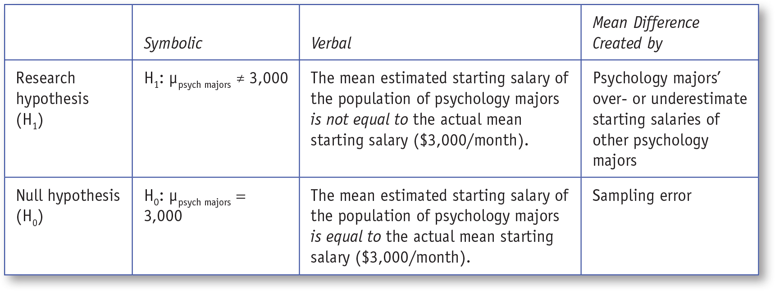
Table 7.3: Symbolic and Verbal Representations for Two-Tailed Research and Null Hypotheses for a Single-Sample t Test
Notes:
Learning Objective: Write one- and two-tailed null and research hypotheses using population parameters and words

Slide 42

Step 3: Use Sample Size to Compute Degrees of Freedom and Define the Critical Regions
The formula for df is the same for one- and two-tailed tests.
Notes:
Learning Objective: Compute the degrees of freedom and define the critical region for one- and two-tailed
single-sample t tests
p. 214
“Thus, the critical region is on the positive side of the distribution, and the critical region starts at +1.7613. Therefore, the null hypothesis should be rejected if the obtained t we calculate in the next step is equal to or greater than +1.7613”

Slide 43
Step 3: Use Sample Size to Compute Degrees of Freedom and Define the Critical Regions
Use Appendix B.
Find the df of 14 in the left-most column and then find the value in that row under the two-tailed .05 heading.
The critical value is 2.1448.
Therefore, the two cut lines that define the critical regions are located at +2.1448 and −2.1448, respectively.
Notes:
Learning Objective: Compute the degrees of freedom and define the critical region for one- and two-tailed
single-sample t tests

Slide 44
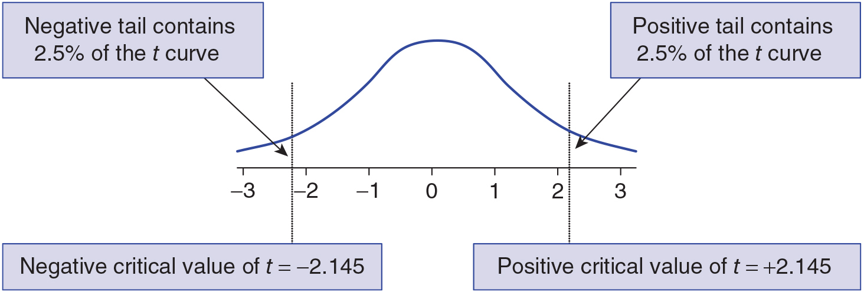
Figure 7.4: Visual Representation of the Two Critical Regions
Notes:
Learning Objective: Write one- and two-tailed null and research hypotheses using population parameters and words

Slide 45

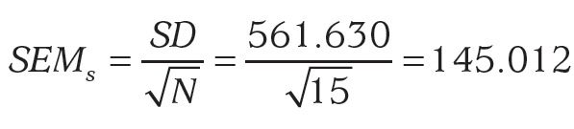
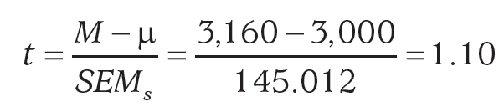
Step 4: Compute the Test Statistic (Single-Sample t Test)
Notes:
4a. Compute the Deviation Between the Sample Mean and the Population Mean
4b. Compute the Average Sampling Error Expected
4c. Compute the Test Statistics (Single-Sample t Test)

Slide 46
Step 4: Compute the Test Statistic (Single-Sample t Test)
The obtained t value of 1.10 is not less than −2.145 or greater than +2.145, so it is not in either critical region.
There is not enough evidence to reject the null hypothesis.
The results suggest that the psychology majors do not overestimate the starting salaries of others.
Notes:
Learning Objective: Determine whether or not you should reject the null hypothesis

Slide 47
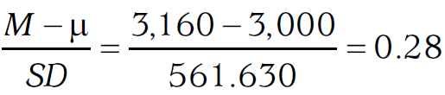
Step 5: Compute an Effect Size and Describe It
ds close to .2, .5, and .8 are small, medium, and large effects, respectively.
Notes:
Learning Objective: Compute and interpret an effect size (d)
“In this case, the effect size of .65 is medium to large, meaning that psychology majors overestimate their starting salaries by a quite a bit. However, with such a small sample size, it is possible that this medium to large effect is the result of sampling error.”

Slide 48
Step 5: Compute an Effect Size and Describe It
The effect size of 0.28 indicates that psychology majors only slightly overestimate the starting salaries of others.
The size if this effect is small, and because the sample size was very small, the effect size could very well be the result of sampling error.
Notes:
Learning Objective: Compute and interpret an effect size (d)

Slide 49
Step 6: Interpreting the Results of the Hypothesis Test
The average estimated salary for typical psychology students (M = 3160.00, SD = 561.63) was not significantly different from the actual average monthly salary of US$3,000, t(14) = 1.10, p > .05 (two-tailed), d = .28. These results suggest that psychology students are fairly accurate at estimating the future starting salaries of others. While there was a slight tendency to overestimate salaries, there was not sufficient evidence to conclude that the trend was more than just sampling error.
Notes:
Learning Objective: Summarize the results of the analysis using American Psychological Association (APA) style
P. 216
“In the previous chapter, you learned to report the exact p value in your summary statement of a z for
a sample mean (e.g., p = .02). If you know the exact p value of a statistical result, you should always report
It . . . [However] it is not practical for any book to provide all the probabilities for every t score and every sample size . . . the only reason you would ever write p < .05 or p > .05 would be if you don’t know the exact p value.”

Slide 50
Other α Levels
Choosing the correct α value is highly dependent on the research context.
Smaller α levels, such as .01, make it less likely to make a Type I error.
Smaller α levels also have less statistical power and make it more likely to make a Type II error.

Slide 51
Other α Levels
A researcher testing a treatment for a disorder that currently has no available treatment is going to be most concerned about making a Type II error (missing a treatment really works) and use a higher alpha level (e.g., .05 or even .10).

Slide 52
Other α Levels
A researcher studying gender differences in math test scores may have scores from millions of children. In this case, the researcher might use a lower α level (e.g., .01 or even .001) because they have high statistical power and don’t want to report effects that are statistically significant, but practically meaningless (i.e., have very small effect sizes).

Slide 53
SPSS
Compute a single-sample t by hand and using SPSS Interpret the SPSS output for a single-sample t
Notes:
Learning Objective: Compute a single-sample t by hand and using SPSS Learning Objective: Interpret the SPSS output for a single-sample t

Slide 54
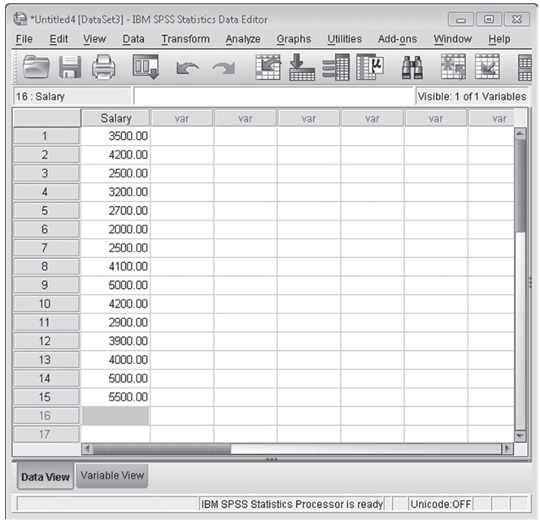
Figure 7.6: SPSS Screenshot of Data Entry Screen
Notes:
Learning Objective: Compute a single-sample t by hand and using SPSS

Slide 55
Computing a Single-Sample t
Click on the Analyze menu. Choose Compare Means and then One Sample t Test (see Figure 7.7).
Move the variable of interest into the Variables box (see Figure 7.8).
Change the Test Value if necessary (in this case it should be 3,000).
Notes:
Learning Objective: Compute a single-sample t by hand and using SPSS

Slide 56
Computing a Single-Sample t
The Test Value is the number you are comparing the sample mean to.
If your t is wrong, it is most likely because you left the Test Value as 0.
Click on the OK button.
Notes:
Learning Objective: Compute a single-sample t by hand and using SPSS

Slide 57
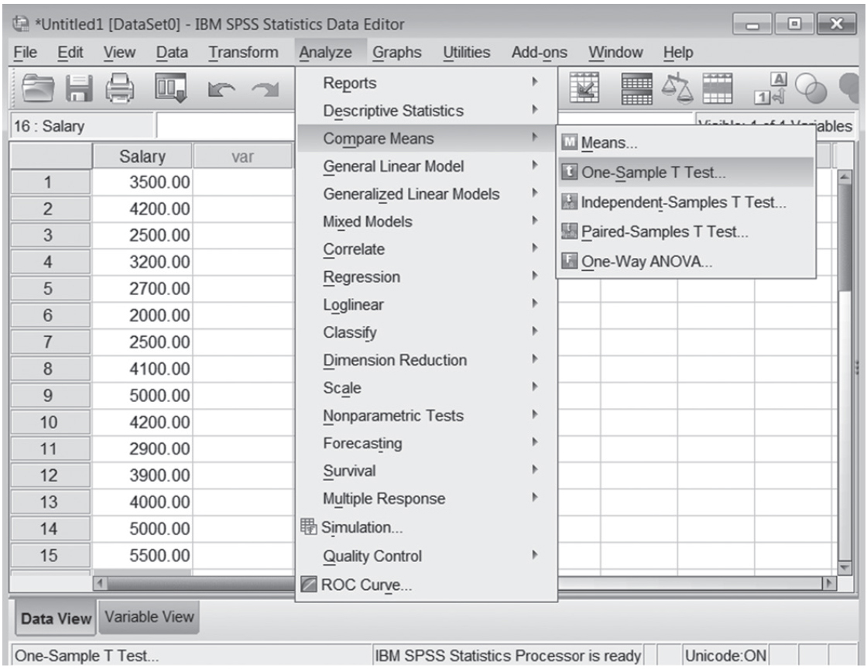
Figure 7.7: SPSS Screenshot of Selecting the One-Sample t Test
Notes:
Learning Objective: Interpret the SPSS output for a single-sample t

Slide 58
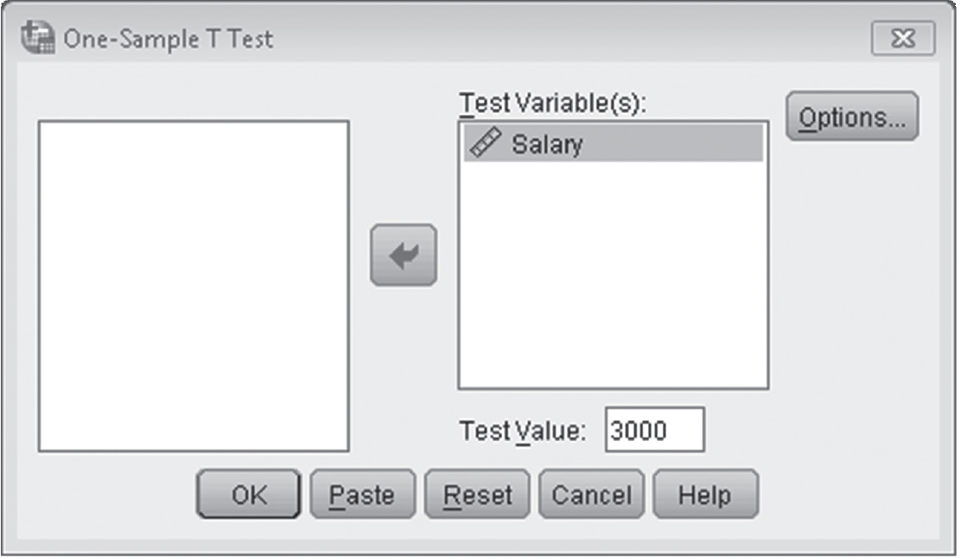
Figure 7.8: SPSS Screenshot of the Test Value and Test Variable for the One-Sample t Test
Notes:
Learning Objective: Interpret the SPSS output for a single-sample t

Slide 59
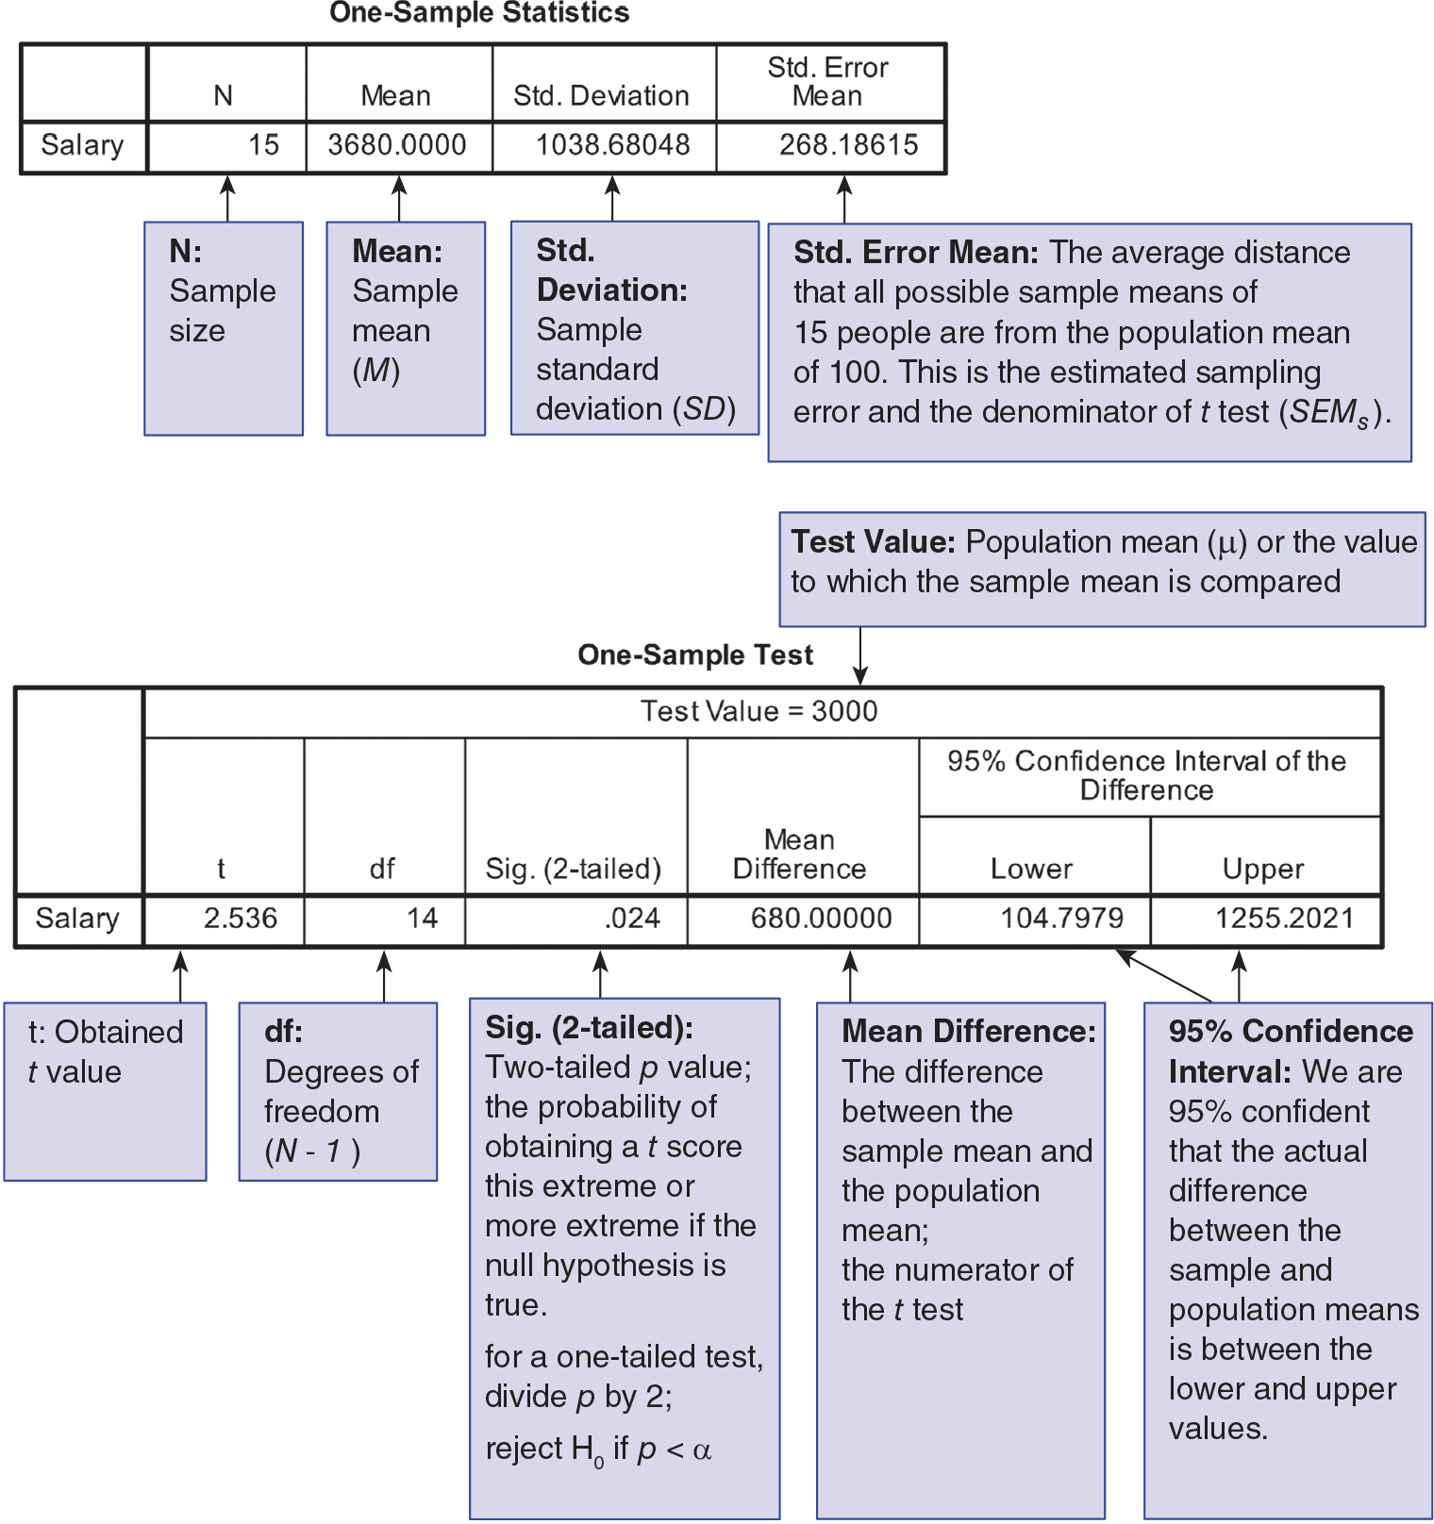
Figure 7.9: Annotated SPSS Output for a One-Sample t Test
Notes:
Learning Objective: Interpret the SPSS output for a single-sample t

