Slide 2
An Introduction to Statistics An Active Learning Approach
Chapter 8: Estimation With Confidence Intervals

Slide 3
Topics to Cover
Describe the distinct purposes of significance testing, effect sizes, and confidence intervals
Explain the logic of confidence intervals
Compute a confidence interval for a population mean

Slide 4
Topics to Cover
Compute a confidence interval for a mean difference between a sample mean and a population mean
Report confidence intervals in American Psychological Association (APA) style
Identify correct and incorrect interpretations of confidence intervals

Slide 5
Three Statistical Procedures With Three Distinct Purposes
Significance testing
determines whether the observed difference was likely to be created by sampling error.
Effect size
helps a researcher to determine whether an effect is large enough to be useful.
Confidence interval
estimates a population parameter with a specific level of confidence and precision.
Notes:
Learning Objective: Describe the distinct purposes of significance testing, effect sizes, and confidence intervals

Slide 6
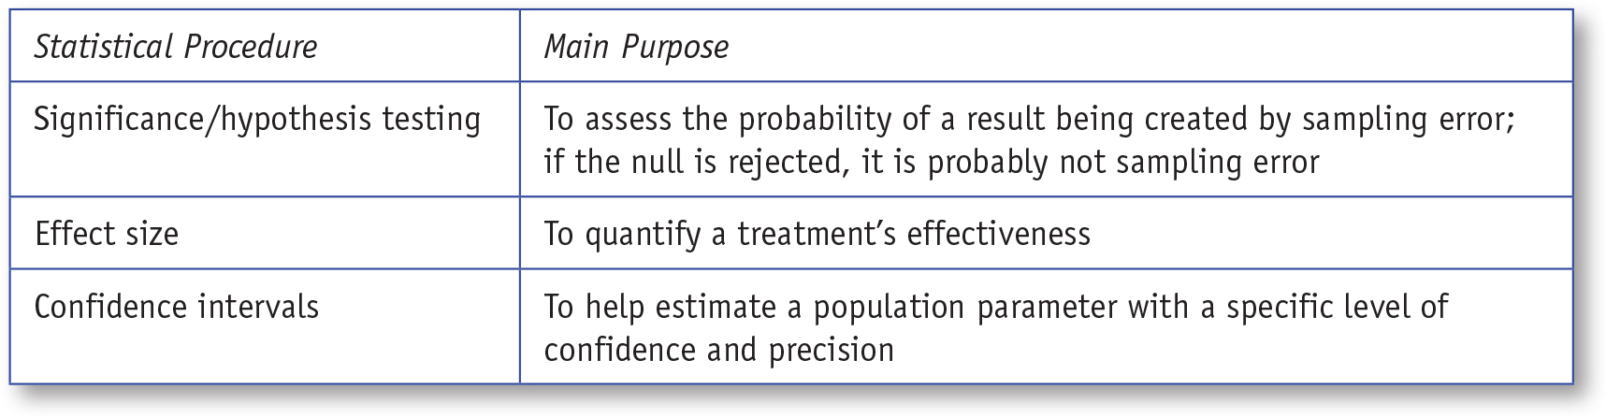
Table 8.1: Statistical Procedures and Their Main Purposes
Notes:
Learning Objective: Describe the distinct purposes of significance testing, effect sizes, and confidence intervals

Slide 7
Logic of Confidence Intervals
CIs provide a range of plausible values for a population parameter.
Upper boundary
is the largest plausible parameter value.
Lower boundary
Is the smallest plausible parameter value.
Notes:
Learning Objective: Explain the logic of confidence intervals
P. 244
“All values between these boundary values, including the boundary values themselves, are considered plausible
parameter values for the population. While there are many different kinds”

Slide 8
Logic of Confidence Intervals
When estimating a population mean, the point estimate
is the sample mean, which is the single most plausible value for μ.
Margin of error
determines the range of additional plausible values for that parameter.
Notes:
Learning Objective: Explain the logic of confidence intervals
P. 244
“All values between these boundary values, including the boundary values themselves, are considered plausible
parameter values for the population. While there are many different kinds”

Slide 9
Logic of Confidence Intervals
The conceptual formulas for the upper and lower boundaries are:
Upper boundary = Point estimate + Margin of error.
Lower boundary = Point estimate − Margin of error.
Notes:
Learning Objective: Explain the logic of confidence intervals
P. 244
“All values between these boundary values, including the boundary values themselves, are considered plausible
parameter values for the population. While there are many different kinds”

Slide 10
Logic of Confidence Intervals
The size of the margin of error around the sample mean is determined by: factors:
the expected amount of sampling error (SEM) and
the specific level of confidence (usually either 95% or 99% confidence).
Notes:
Learning Objective: Explain the logic of confidence intervals
P. 244
“All values between these boundary values, including the boundary values themselves, are considered plausible
parameter values for the population. While there are many different kinds”

Slide 11
Computing a Confidence Interval for a Population Mean
Compute a confidence interval for a population mean
Notes:
Learning Objective: Compute a confidence interval for a population mean

Slide 12
Logic of Confidence Intervals
More confidence requires a wider margin of error.
When all other things are equal, if you want to be 99% confident in your estimate, your CI will need to be wider than if you only need 95% confidence.
Notes:
Learning Objective: Compute a confidence interval for a population mean

Slide 13
Computing a Confidence Interval for a Population Mean
For example, the provost’s office surveyed 60 college students who took a healthy living class.
The average number of minutes students who took the healthy living class exercised each week was M = 155.67 (SD = 20.85).
Notes:
Learning Objective: Compute a confidence interval for a population mean

Slide 14
Computing a Confidence Interval for a Population Mean
The provost wants an estimate of what the mean exercise time of the entire population of students at the college would be if they took the healthy living class.
The best estimate of this parameter is the mean of the sample that took the class— namely, 155.67 min.
Notes:
Learning Objective: Compute a confidence interval for a population mean

Slide 15
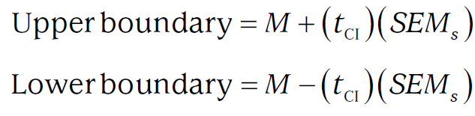
Computing a Confidence Interval for a Population Mean
Compute a 95% CI to estimate this population parameter.
Notes:
Learning Objective: Compute a confidence interval for a population mean

Slide 16
Computing a Confidence Interval for a Population Mean
For both equations, you need
The point estimate, M
The correct critical value from the t table for the CI, called the tCI
The expected sampling error, SEMs
Notes:
Learning Objective: Compute a confidence interval for a population mean

Slide 17
Computing a Confidence Interval for a Population Mean
The point estimate comes from the sample mean (M = 155.67).
The critical t score comes from the two-tailed .05 critical t table because we are computing a 95% CI.
df = N − 1 = 60 − 1 = 59
tCI = 2.001
Notes:
Learning Objective: Compute a confidence interval for a population mean

Slide 18
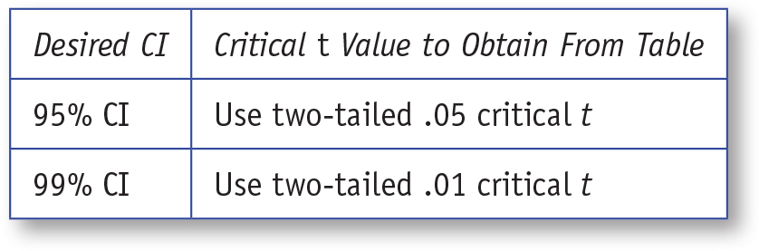
Table 8.2: Critical t Values for Desired CI
Notes:
Learning Objective: Compute a confidence interval for a population mean

Slide 19

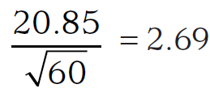
Computing a Confidence Interval for a Population Mean
The standard error of the mean, SEMs, is computed by dividing the sample standard deviation (20.85) by the square root of N (60).
Notes:
Learning Objective: Compute a confidence interval for a population mean

Slide 20
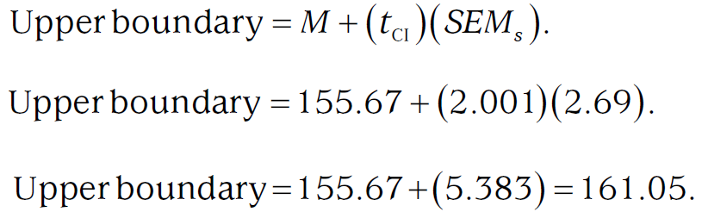
Computing a Confidence Interval for a Population Mean
The upper boundary of the 95% CI is
Notes:
Learning Objective: Compute a confidence interval for a population mean

Slide 21
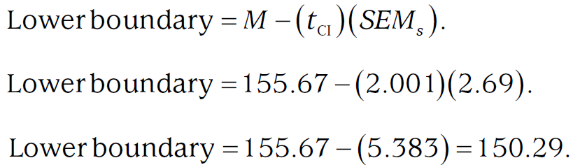
Computing a Confidence Interval for a Population Mean
The lower boundary of the 95% CI is
Notes:
Learning Objective: Compute a confidence interval for a population mean

Slide 22
Computing a Confidence Interval for a Population Mean
Based on these computations, we should be 95% confident that the actual mean exercise time of the population of college students if they took the healthy living class would be between 150.29 and 161.05 min per week.
Notes:
Learning Objective: Compute a confidence interval for a population mean Learning Objective: Identify correct and incorrect interpretations of confidence intervals

Slide 23
Computing a Confidence Interval for a Mean Difference
Compute a confidence interval for a mean difference between a sample mean and a population mean
Notes:
Learning Objective: Compute a confidence interval for a mean difference between a sample mean and a population mean

Slide 24
Computing Confidence Intervals for a Mean Difference
This CI estimates the mean difference rather than the mean itself.
For example, suppose policy makers wanted to know how much weekly exercise time would change in the population if the healthy living class was required.
Notes:
Learning Objective: Compute a confidence interval for a mean difference between a sample mean and a population mean

Slide 25
Computing Confidence Intervals for a Mean Difference
Like all other CIs, this one is computed with a point estimate, an expected sampling error, and a tCI.
The point estimate, in this case, is the mean difference between the sample mean (M = 155.67) and the population mean (μ = 150).
Mean difference = 155.67 − 150.0 = 5.67
The expected sampling error (SEMs) is the same as in the previous example (2.69).
Notes:
Learning Objective: Compute a confidence interval for a mean difference between a sample mean and a population mean

Slide 26
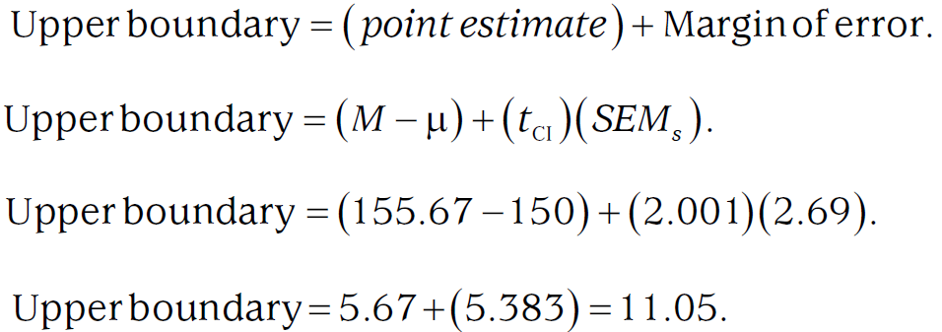
Computing Confidence Intervals for a Mean Difference
Notes:
Learning Objective: Compute a confidence interval for a mean difference between a sample mean and a population mean

Slide 27
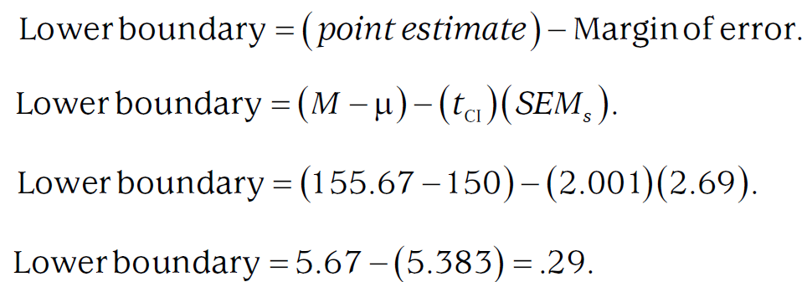
Computing Confidence Intervals for a Mean Difference
Notes:
Learning Objective: Compute a confidence interval for a mean difference between a sample mean and a population mean

Slide 28
Computing Confidence Intervals for a Mean Difference
Based on these computations, we should be 95% confident that if the population of college students took the healthy living class, their exercise time would increase by between 0.29 and 11.05 minutes each week.
Figure 8.1 illustrates the relative plausibility of each value in the CI.
Notes:
Learning Objective: Compute a confidence interval for a mean difference between a sample mean and a population mean

Slide 29
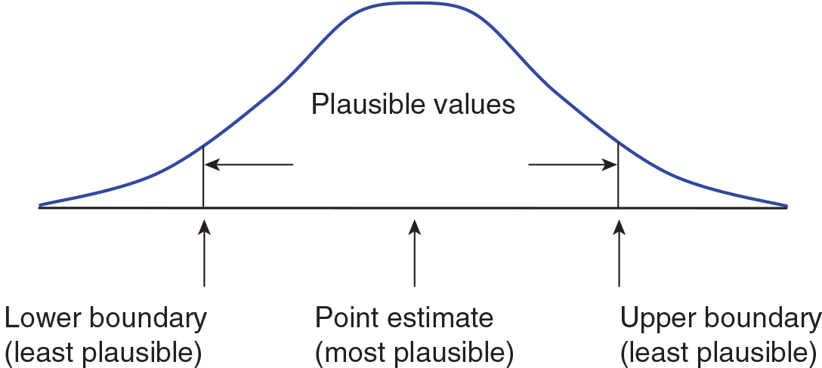
Figure 8.1: Plausibility of CI Values
Notes:
Learning Objective: Identify correct and incorrect interpretations of confidence intervals

Slide 30
Computing Confidence Intervals for a Mean Difference
You should you conduct a CI for a mean difference after conducting a significance test because the CI helps you generalize your results to the population by identifying plausible population parameter values.
Notes:
Learning Objective: Identify correct and incorrect interpretations of confidence intervals

Slide 31
Computing Confidence Intervals for a Mean Difference
CI values become less plausible with increased distance from the point estimate.
If a mean difference of zero is not between the upper and lower boundaries of the 95% CI for the mean difference, the sample mean of 155.67 and the population mean of 150 are significantly different from each other.
In contrast, if you fail to reject the null, the 95% CI will always contain zero.
Notes:
Learning Objective: Identify correct and incorrect interpretations of confidence intervals

Slide 32
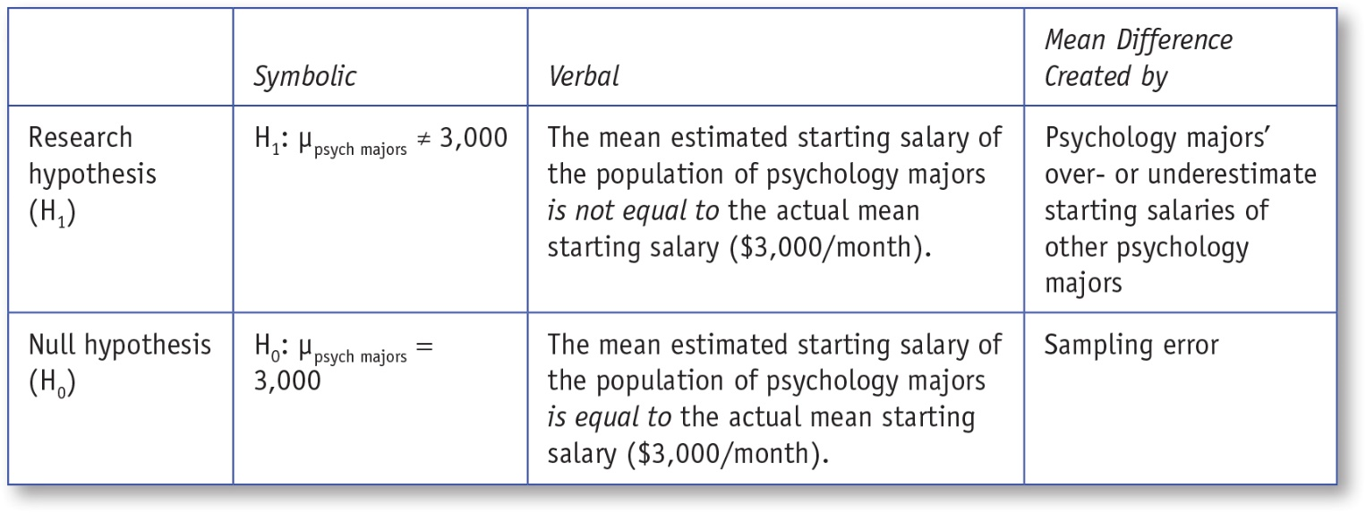
Table 8.3: CI Types, Their Degrees of Freedom, and Specific Formulas
Notes:
Learning Objective: Compute a confidence interval for a population mean
Learning Objective: Compute a confidence interval for a mean difference between a sample mean and a population mean

Slide 33
Reporting Confidence Intervals in APA Style
A single-sample t test revealed that students who took the healthy living class exercised more weekly (M = 155.67, SD = 2.69), 95% CI [150.29, 161.05], than students in the population (μ = 150), t(59) = 2.11, p = .04, d = .27, CI [0.29, 11.05].
Notes:
Learning Objective: Report confidence intervals in American Psychological Association (APA) style.

Slide 34
Confidence Intervals for Effect Sizes
The APA also recommends that CIs be reported for every effect size.
These computations are complex and beyond the scope of this book.
Cumming (2012) provides detailed discussions of CIs for effect sizes.
Notes:
Learning Objective: Report confidence intervals in American Psychological Association (APA) style.
p. 250
“He also provides a free Microsoft Excel spreadsheet for computing and graphing many types of CIs, including those for effect sizes. We highly recommend Cumming’s book to readers wanting a greater understanding of CIs.”

Slide 35
Interpretations of Confidence Intervals
A 95% CI suggests that you can be 95% confident that the true population mean falls between the lower and upper boundaries, including the boundary values themselves.
The boundaries identify a set of plausible values for the population parameter.
Values outside of the upper and lower boundaries are interpreted as implausible.
Notes:
Learning Objective: Identify correct and incorrect interpretations of confidence intervals.

Slide 36
Interpretations of Confidence Intervals
Narrower CIs (i.e., those with smaller margins of error) provide more precise estimates.
Notes:
Learning Objective: Identify correct and incorrect interpretations of confidence intervals.

Slide 37
Interpretations of Confidence Intervals
Replication recapture rate
the probability that the point estimate of a study that is replicating a previous study will fall between the upper and lower boundaries of the previous study.
A 95% CI has a .83 replication recapture rate.
Notes:
Learning Objective: Identify correct and incorrect interpretations of confidence intervals.

Slide 38
Interpretations of Confidence Intervals
When computing a 95% CI for a mean difference, if zero is not plausible, a two-tailed .05 t test would find that the two means are significantly different.
On the other hand, if zero is located between the upper and lower boundaries, the two means would not be significantly different.
Notes:
Learning Objective: Identify correct and incorrect interpretations of confidence intervals.

Slide 39
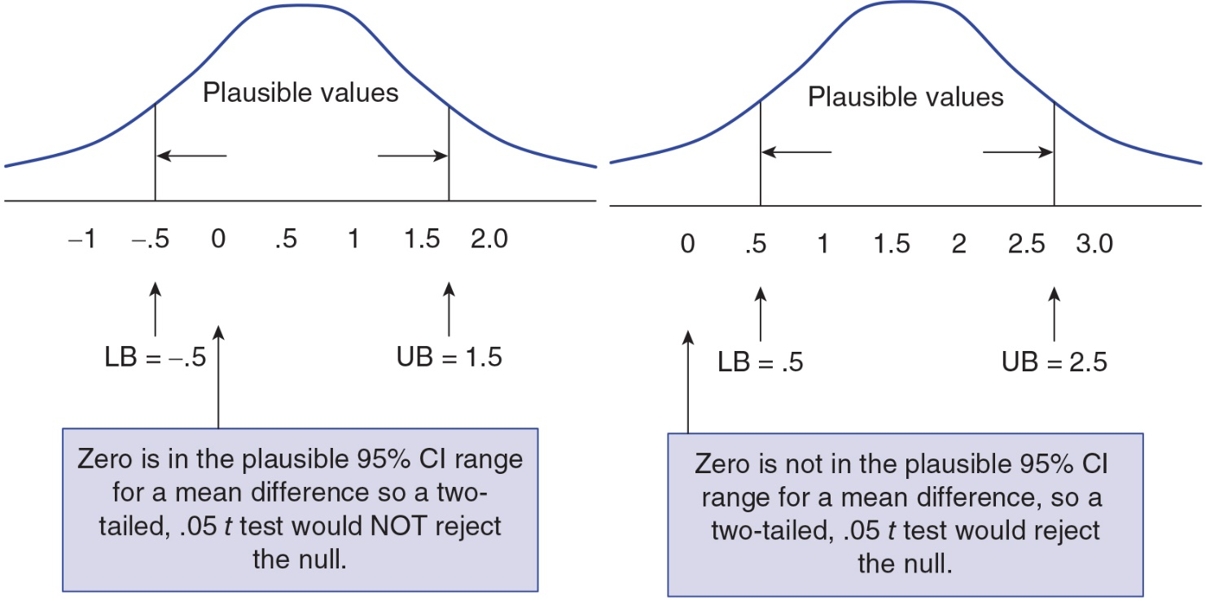
Figure 8.2: Example of Zero Mean Difference Being (a) Plausible and (b) Implausible
Notes:
Learning Objective: Identify correct and incorrect interpretations of confidence intervals

Slide 40
SPSS
Learning Objective: Compute a confidence interval for a population mean
Notes:
Learning Objective: Compute a confidence interval for a population mean

Slide 41
CI for a Mean
SPSS will compute a 95% or 99% CI for a mean through the Explore menu.
Click on Analyze, Descriptive Statistics, and then Explore.
Move the variable of interest (in this case, it is Exercise Minutes) into the Dependent List box.
Click on the Statistics button.
Notes:
Learning Objective: Compute a confidence interval for a population mean

Slide 42
CI for a Mean
In the Explore:Statistics box, select Descriptives and make sure the Confidence Interval for Mean is set at 95%.
Click on the Continue button.
Under Display, select Statistics.
Click on the OK button to run the analysis.
Notes:
Learning Objective: Compute a confidence interval for a population mean

Slide 43
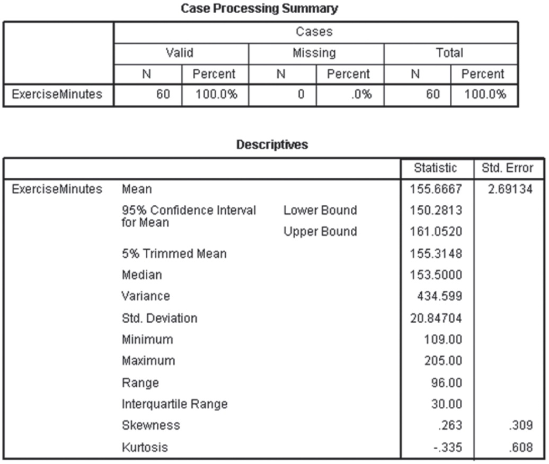
Figure 8.3: Annotated SPSS Output for a 95% Confidence Interval for a Mean
Notes:
Learning Objective: Identify correct and incorrect interpretations of confidence intervals

Slide 44
CI for a Single-Sample Mean Difference
SPSS automatically computes 95% confidence intervals for mean differences every time you run a single-sample t test.
You can click Options and change the confidence interval to 99%, if necessary.
Notes:
Learning Objective: Compute a confidence interval for a mean difference between a sample mean and a population mean

