Slide 2
An Introduction to Statistics An Active Learning Approach
Chapter 9: Related Samples
t Test

Slide 3
Topics to Cover
Identify when a related samples t test should be used
Explain the advantages of using a related samples design over an independent samples design
Explain the logic of the related samples t test

Slide 4
Topics to Cover
Write null and research hypotheses using symbols and words for both one- and two-tailed tests
Compute the degrees of freedom and define the critical region for one- and two-tailed tests
Compute a related samples t test by hand (using a calculator) and using SPSS

Slide 5
Topics to Cover
Determine whether you should reject the null hypothesis
Compute an effect size (d) and interpret it
Summarize the results of the analysis using American Psychological Association (APA) style
Interpret the SPSS output for a related samples t test

Slide 6
Repeated/Related Samples t Test
This new t test goes by different names depending on the experimental designs in which it can be used.
Repeated-measures t test
Participants are measured repeatedly, once before and once after a treatment.
Related samples t test
Each person in the first sample has something in common with or is linked to someone in the second sample.
Notes:
Learning Objective: Identify when a related samples t test should be used

Slide 7
Repeated/Related Samples t Test
Other names
paired samples t test
matched samples t test
dependent samples t test
within-subjects t test
Notes:
Learning Objective: Identify when a related samples t test should be used

Slide 8
Repeated/Related Samples t Test
The related measures t test is similar to the single-sample t test in that it compares the deviation between two means to determine whether it is likely to have been created by sampling error.
However, the related samples t test is different in that the two means it compares both come from the same sample, which is measured twice under different conditions.
Notes:
Learning Objective: Identify when a related samples t test should be used

Slide 9
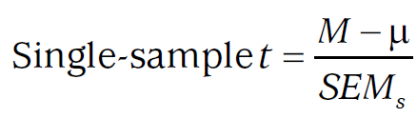
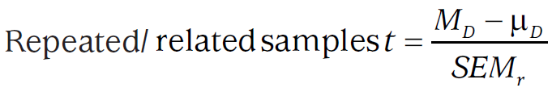
Logic of the Single-Sample and Repeated/Related Samples t Test
The denominators of both the single-sample t test and the related samples t test represent the typical amount of sampling error expected.
Notes:
Learning Objective: Identify when a related samples t test should be used

Slide 10
Logic of the Single-Sample and Repeated/Related Samples t Test
The numerator of the single-sample t test compares a sample mean (M) with an expected value if the null hypothesis were true (μ).
The numerator of the related samples t test compares the mean difference between two sample means (MD; the D stands for difference) with the mean difference expected if the null is true (μD).
Notes:
Learning Objective: Identify when a related samples t test should be used

Slide 11
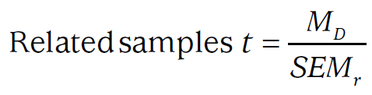
Logic of the Single-Sample and Repeated/Related Samples t Test
Researchers typically test to see if the observed difference is significantly different from 0.
In this book, we will always use μD = 0.
This simplifies the formula to:
Notes:
Learning Objective: Identify when a related samples t test should be used

Slide 12
Related Samples t (Two-Tailed) Example

Slide 13
Related Samples t (Two-Tailed) Example
A clinical researcher wants to determine whether a new drug for treating anxiety has side effects that change cholesterol levels.
Cholesterol levels are normally distributed and measured on an interval/ratio scale.
Six pairs of people are matched on their preexisting cholesterol levels.

Slide 14
Related Samples t (Two-Tailed) Example
Then, one person in each pair is given the new anxiety drug, while the other person is given a placebo.
Eighteen weeks later, the researcher measures their cholesterol levels.
You will use a two-tailed hypothesis test with α = .05 to determine whether the drug changes cholesterol levels.

Slide 15
Step 1: Examine the Statistical Assumptions
Independence of Data Assumption
This assumption is met because participants’ scores within a condition do not influence the scores of others in that same condition.
Notes:
Learning Objective: Compute a related samples t test by hand (using a calculator) and using SPSS

Slide 16
Step 1: Examine the Statistical Assumptions
Appropriate Measurement of Variables Assumption
This assumption is met because cholesterol levels are measured on an interval/ratio scale.
The IV identifies the two conditions of drug versus placebo.

Slide 17
Step 1: Examine the Statistical Assumptions
Normality assumption
A related samples t test requires that the distribution of sample mean differences be normally shaped.
According to the central limit theorem, the distribution of sample mean differences will have a normal shape if the original population of mean differences has a normal shape or if the sample size is sufficiently large (i.e., greater than 30).

Slide 18
Step 1: Examine the Statistical Assumptions
Normality assumption
This assumption is met because the population of cholesterol levels is known to have a normal shape, so the population of mean differences is also likely to have a normal shape.
It is typically necessary to do research with a larger sample size.

Slide 19
Step 1: Examine the Statistical Assumptions
Homogeneity of variance assumption
The related samples t test does not have a homogeneity of variance assumption.

Slide 20
Step 2: State the Null and Research Hypotheses Symbolically and Verbally
You are not sure what effect the antianxiety drug has on cholesterol levels, so you correctly choose to do a two-tailed hypothesis test.
The related samples t test uses the difference scores from each matched pair of participants.
It determines whether the mean of these difference scores is significantly different from 0.
Notes:
Learning Objective: Write null and research hypotheses using symbols and words for both one- and two-tailed tests

Slide 21
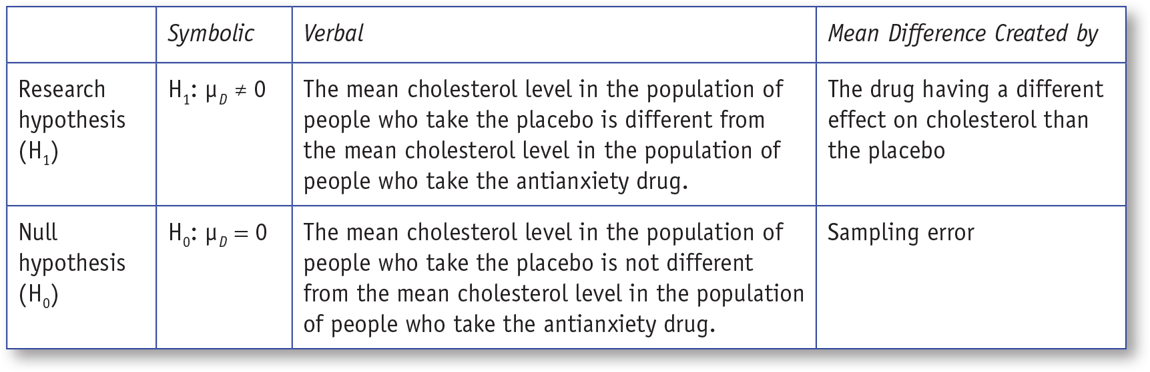
Table 9.1: Symbolic and Verbal Representations for Two-Tailed Research and Null Hypotheses for a Related Samples t Test
Notes:
Learning Objective: Write null and research hypotheses using symbols and words for both one- and two-tailed tests

Slide 22

Step 3: Compute the Degrees of Freedom and Define the Critical Regions
When computing the degrees of freedom (df) for a matched design, N is the number of paired scores. In this case, N would be 6, and the df would be:
Notes:
Learning Objective: Compute the degrees of freedom and define the critical region for one- and two-tailed tests

Slide 23
Step 3: Compute the Degrees of Freedom and Define the Critical Regions
To determine the critical value, use the table of critical t values and find it to be 2.5706 when α = .05.
The two-tailed critical regions are t < −2.5706 and t > +2.5706.
Notes:
Learning Objective: Compute the degrees of freedom and define the critical region for one- and two-tailed tests

Slide 24
Step 4: Compute the Test Statistic (Related Samples t Test)
4a. Compute D for Each Participant/ Matched Pair
4b. Compute the Observed Mean Difference (MD)
4c. Compute the Average Mean Difference Expected Due to Sampling Error
4d. Compute the Test Statistic (Related Samples t Test)
Notes:
Learning Objective: Compute a related samples t test by hand (using a calculator) and using SPSS

Slide 25
4a. Compute D for Each Participant/Matched Pair
First, compute the difference score (D) for each pair of scores, in the same way for each pair.
In this case, the difference score was computed as Drug Score minus Placebo Score.
Notes:
Learning Objective: Compute a single-sample t by hand and using SPSS

Slide 26
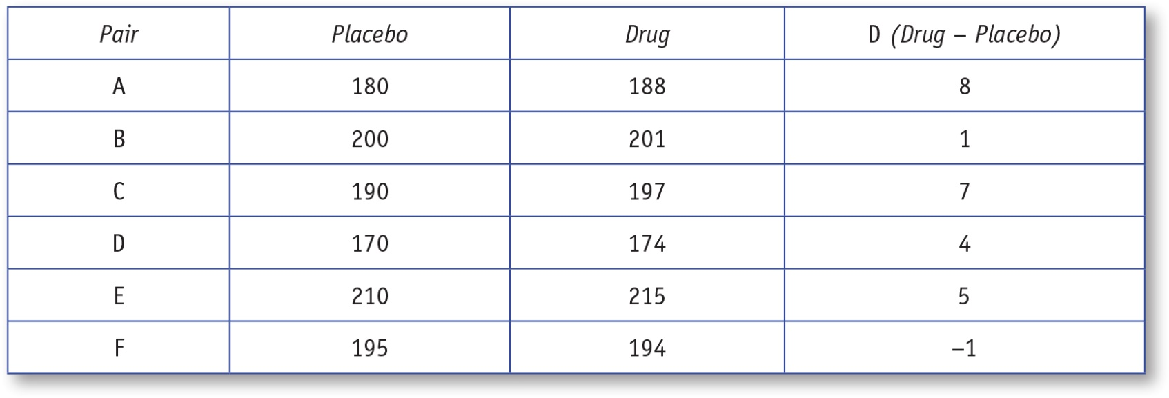
Table 9.2: Computation of D in a Related Samples t Test
Notes:
Learning Objective: Write null and research hypotheses using symbols and words for both one- and two-tailed tests

Slide 27
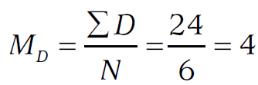
4b. Compute the Observed Mean Difference (MD)
Next compute the numerator of the t (i.e., the mean of the difference scores) by adding the Ds and dividing by the number of Ds (N):
Notes:
Learning Objective: Compute a related samples t test by hand (using a calculator) and using SPSS

Slide 28
4c. Compute the Average Mean Difference Expected Due to Sampling Error
Now compute the typical mean difference expected due to sampling error.
The following SS formula uses ΣD and ΣD2 because the related samples t test analyzes the Ds, not the scores themselves.
Notes:
Learning Objective: Compute a related samples t test by hand (using a calculator) and using SPSS

Slide 29
4c. Compute the Average Mean Difference Expected Due to Sampling Error
The computational process is identical to the SS formula we used in previous chapters; you just use the difference scores (Ds) instead of scores (Xs):
Notes:
Learning Objective: Compute a related samples t test by hand (using a calculator) and using SPSS

Slide 30
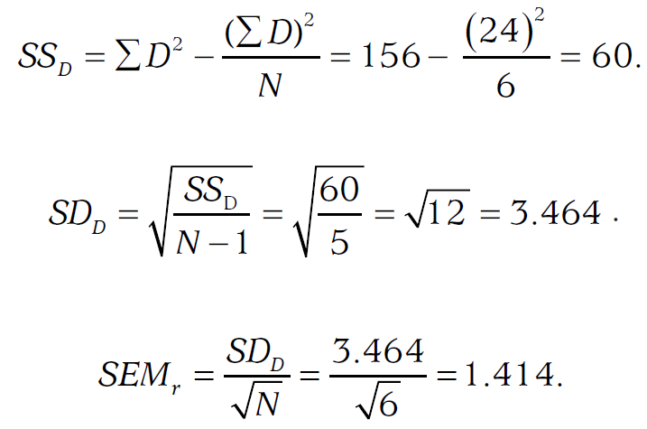
4c. Compute the Average Mean Difference Expected Due to Sampling Error
Notes:
Learning Objective: Compute a related samples t test by hand (using a calculator) and using SPSS

Slide 31
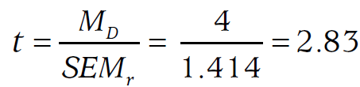
Step 4d: Compute the Test Statistic (Related Samples t Test)
The obtained t value for the related samples t test is computed as follows:
Notes:
Learning Objective: Compute a related samples t test by hand (using a calculator) and using SPSS

Slide 32
Step 4d: Compute the Test Statistic (Related Samples t Test)
The obtained t value of 2.83 is farther from 0 than the critical value of +2.5706; therefore, it is in the positive critical region.
You should reject the null hypothesis and conclude that people who took the antianxiety drug had higher cholesterol levels than those who took the placebo.
Notes:
Learning Objective: Determine whether you should reject the null hypothesis

Slide 33
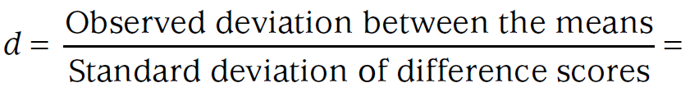
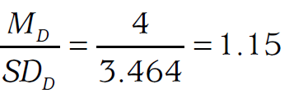
Step 5: Compute an Effect Size and Describe It
Computing the effect size (d) is done the same way as for the single-sample t test.
Notes:
Learning Objective: Compute an effect size (d) and interpret it p. 279
“Many researchers use this formula for computing d, but there are other options. For example, Cumming (2012)
recommends dividing the mean of the differences scores by the average of the standard deviations rather than the
standard deviation of the difference scores. Either calculation is acceptable as long as you tell the reader how you
computed the effect size. In this book, we are always using the same calculation, and so we do not say repeatedly
how it was done, but when you present data, you should state how d was calculated.”

Slide 34
Step 5: Compute an Effect Size and Describe It
As a reminder, the effect size is small if d is close to .2, medium if it is close to .5, and large if it is close to .8.
The difference in cholesterol scores between the placebo and drug conditions is 1.15 times larger than the standard deviation of D scores.
This suggests that the new antianxiety drug has a large effect on cholesterol levels.
Notes:
Learning Objective: Compute an effect size (d) and interpret it

Slide 35
Step 6: Interpreting the Results of the Hypothesis Test
People who took the antianxiety drug had substantially higher cholesterol levels (M = 194.83, SD = 13.64) than people who took the placebo (M = 190.83, SD = 14.29), t(5) = 2.83, p < .05, d = 1.15. The drug raised cholesterol levels by more than 1 standard deviation, suggesting the drug has a detrimental effect on cholesterol levels. However, the sample included just six pairs of people, and so the study should be replicated with a larger sample size.
Notes:
Learning Objective: Summarize the results of the analysis using American Psychological Association (APA) style

Slide 36
Related Samples t (One-Tailed) Example

Slide 37
Related Samples t (One-Tailed) Example
A new drug for treating anxiety has been developed that is expected to lower the anxiety scores of people who take it.
A psychiatrist recruits six people with high anxiety scores for an evaluation study of the new drug.

Slide 38
Related Samples t (One-Tailed) Example
All six volunteers complete an anxiety inventory before taking the drug and then again after taking the drug for 1 month.
You correctly decide to use a one-tailed related samples t test with an α of .05 to determine whether this new drug lowers anxiety scores.

Slide 39
Step 1: Examine the Statistical Assumptions
All three assumptions are met
The participants’ responses within each condition are independent of each other.
The IV identifies two conditions (before vs. after taking the drug) and the DV is measured on an interval/ratio scale.
The distribution of sample mean differences is likely to have a normal shape.
Notes:
Learning Objective: Compute a related samples t test by hand (using a calculator) and using SPSS
Recall the three assumptions for a Related samples t test are:
-Independence of Data Assumption
-Appropriate Measurement of Variables Assumption
-Normality Assumption

Slide 40
Step 2: State the Null and Research Hypotheses Symbolically and Verbally
Your hypotheses depend on how you compute the difference scores.
In this case, the difference scores were computed as After Drug minus Before Drug.
The research hypothesis predicts that anxiety scores will be higher before taking the drug and lower after taking the drug.
Notes:
Learning Objective: Write null and research hypotheses using symbols and words for both one- and two-tailed tests

Slide 41
Step 2: State the Null and Research Hypotheses Symbolically and Verbally
Therefore, if the research hypothesis is correct and the difference scores are computed as After Drug (lower anxiety)– Before Drug (higher anxiety), the mean difference score (μD) would be negative.
Notes:
Learning Objective: Write null and research hypotheses using symbols and words for both one- and two-tailed tests

Slide 42
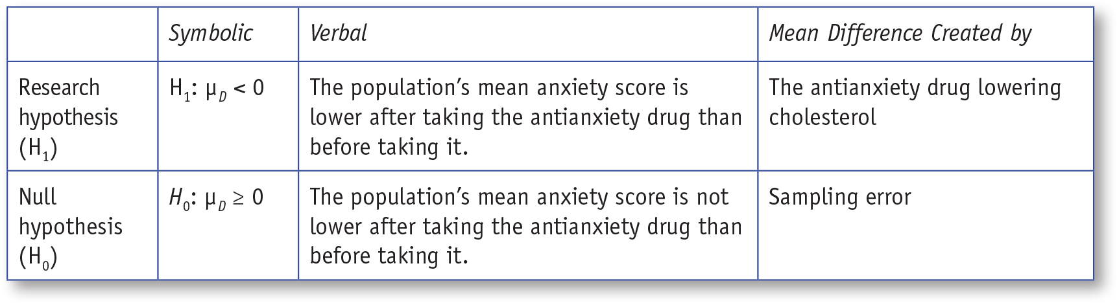
Table 9.3: Symbolic and Verbal Representations for One-Tailed Research and Null Hypotheses for a Related t Test
Notes:
Learning Objective: Write null and research hypotheses using symbols and words for both one- and two-tailed tests

Slide 43

Step 3: Compute the Degrees of Freedom and Define the Critical Regions
The df is computed identically for one- and two-tailed tests:
Use the table of t critical values to find the critical region is t < −2.0150.
Notes:
Learning Objective: Compute the degrees of freedom and define the critical region for one- and two-tailed tests

Slide 44
4a. Compute D for Each Participant/Matched Pair
All difference scores were computed by subtracting After Drug–Before Drug scores.
Notes:
Learning Objective: Compute a single-sample t by hand and using SPSS

Slide 45
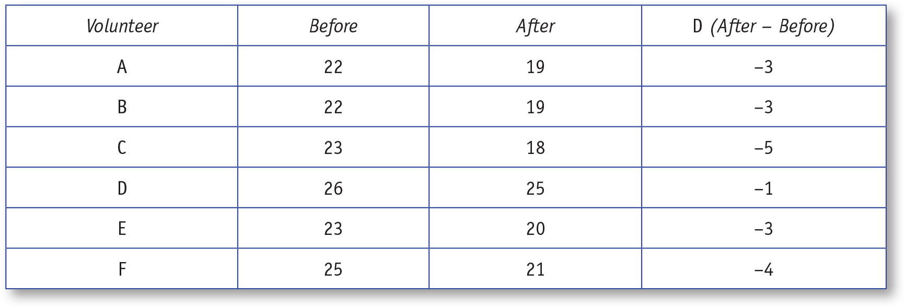
Table 9.4: Computing D for a Related t Test
Notes:
Learning Objective: Compute a related samples t test by hand (using a calculator) and using SPSS

Slide 46
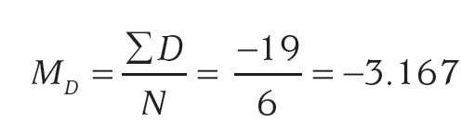
4b. Compute the Observed Mean Difference (MD)
The mean difference score is:
Notes:
Learning Objective: Compute a related samples t test by hand (using a calculator) and using SPSS

Slide 47
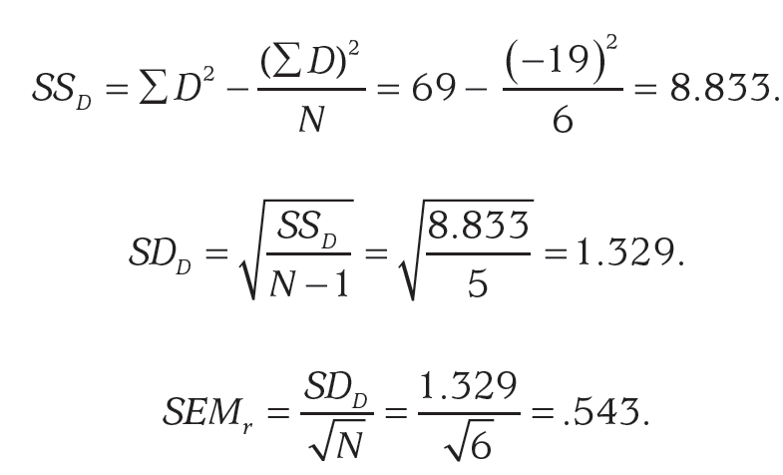
4c. Compute the Average Mean Difference Expected Due to Sampling Error
Notes:
Learning Objective: Compute a related samples t test by hand (using a calculator) and using SPSS
p. 282
“This value of .543 is the typical expected sampling error. It is the size of the anxiety difference between
the After Drug and Before Drug means that is expected due to sampling error.”

Slide 48
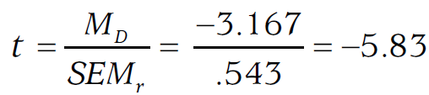
Step 4d: Compute the Test Statistic (Related Samples t Test)
The obtained t value for the related samples t test is computed as follows:
Notes:
Learning Objective: Compute a related samples t test by hand (using a calculator) and using SPSS

Slide 49
Step 4d: Compute the Test Statistic (Related Samples t Test)
The obtained t value of −5.83 is farther from 0 than the critical value of −2.0150; therefore, it is in the negative critical region.
You should reject the null hypothesis and conclude that the anxiety scores were lower after taking the drug than before taking the drug.
Notes:
Learning Objective: Determine whether you should reject the null hypothesis

Slide 50
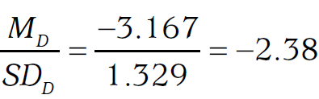
Step 5: Compute an Effect Size and Describe It
Notes:
Learning Objective: Compute an effect size (d) and interpret it p. 279
“Many researchers use this formula for computing d, but there are other options. For example, Cumming (2012)
recommends dividing the mean of the differences scores by the average of the standard deviations rather than the
standard deviation of the difference scores. Either calculation is acceptable as long as you tell the reader how you
computed the effect size. In this book, we are always using the same calculation, and so we do not say repeatedly
how it was done, but when you present data, you should state how d was calculated.”

Slide 51
Step 5: Compute an Effect Size and Describe It
A d of −2.38 is a large effect size.
This means that the difference in anxiety levels between the Before Drug and After Drug treatment conditions is 2.38 times larger than the standard deviation of difference scores.
This suggests that the new antianxiety drug is very effective at lowering anxiety levels.
Notes:
Learning Objective: Compute an effect size (d) and interpret it

Slide 52
Step 6: Interpreting the Results of the Hypothesis Test
People had lower anxiety levels (M = 20.33, SD = 2.50) after taking the drug than they had prior to taking the drug (M = 23.50, SD = 1.64), t(5) = −5.83, p < .05 (one-tailed), d = −2.38. The reduction in anxiety scores was quite large, more than 2 standard deviations. The sample size in this study was very small. A larger study should be done before any conclusions are drawn about the drug.
Notes:
Learning Objective: Summarize the results of the analysis using American Psychological Association (APA) style

Slide 53
Statistical Results, Experimental Designs, and Scientific Conclusions
When interpreting the statistical results of any study
you should consider if a confounding variable might have affected the results.
you should recognize that the experimental design is just as important to the scientific conclusion as the statistical results.
Notes:
p. 284
“In this study, the significance test indicates that something other than sampling error probably created the observed reduction in anxiety. Therefore, it may be tempting to conclude that the drug caused the reduction, but there is at least one other potential cause. In this pre–post design, participants’ anxiety scores were measured before and after taking the drug; these measurements were separated by 1 month. One possible explanation is that people naturally get better with the passage of time. Participants might have gotten better without any treatment. Therefore, the passage of time is a confound in this study. It is also correct to say that the passage of time and the drug treatment are confounded in this study because it is impossible to know whether the passage of time, the drug, or some combination of both caused the reduction in anxiety. The lesson here is that you must consider potential confounding variables carefully before you interpret any statistical result.”

Slide 54
SPSS
Compute a related samples t test by hand (using a calculator) and using SPSS
Interpret the SPSS output for a related samples t test
Notes:
Learning Objective: Compute a related samples t test by hand (using a calculator) and using SPSS Learning Objective: Interpret the SPSS output for a related samples t test

Slide 55
Data File
We used the data from the first example (i.e., the effect of an antianxiety drug vs. placebo on cholesterol levels) to demonstrate how to run a related samples t test.
Notes:
Learning Objective: Compute a related samples t test by hand (using a calculator) and using SPSS

Slide 56
Data File
Related measures data are entered into two columns in the data file. One column should have the placebo cholesterol levels, and the other column should have the drug cholesterol levels.
You must enter the data for each participant on the same row in the data file.
Notes:
Learning Objective: Compute a related samples t test by hand (using a calculator) and using SPSS

Slide 57
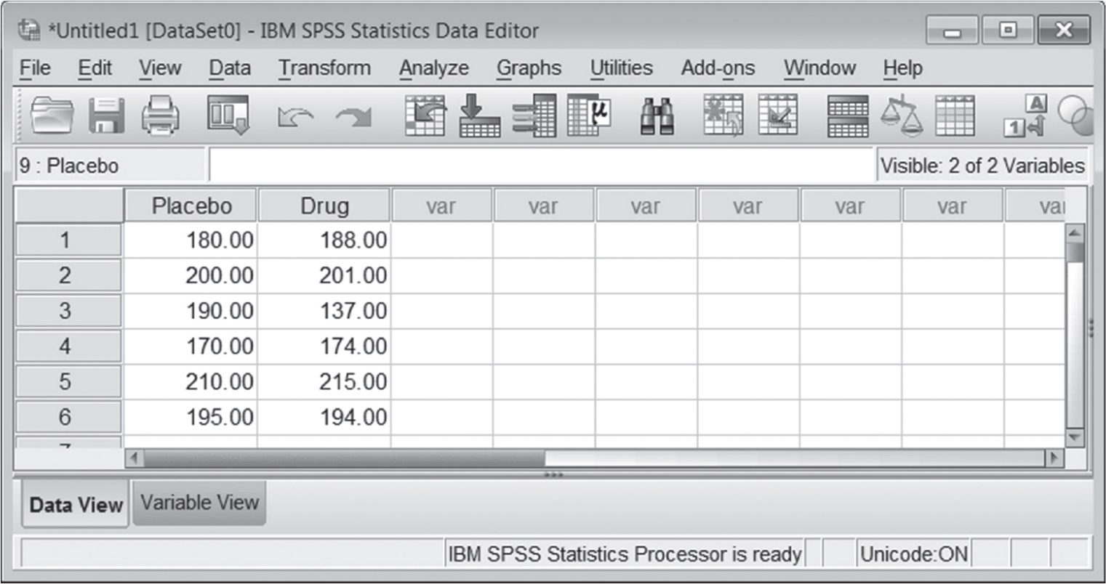
Figure 9.1: SPSS Screenshot of the Data Entry Screen
Notes:
Learning Objective: Compute a related samples t test by hand (using a calculator) and using SPSS

Slide 58
Computing a Related Samples t Test
Click on the Analyze menu. Choose Compare Means and then Paired Samples t Test (see Figure 9.2).
Move both independent variable conditions (in this case, Drug and Placebo) into the Paired Variables box. In some versions of SPSS, you have to move them into the box at the same time (see Figure 9.3).
Click on the OK button.
Notes:
Learning Objective: Compute a related samples t test by hand (using a calculator) and using SPSS

Slide 59
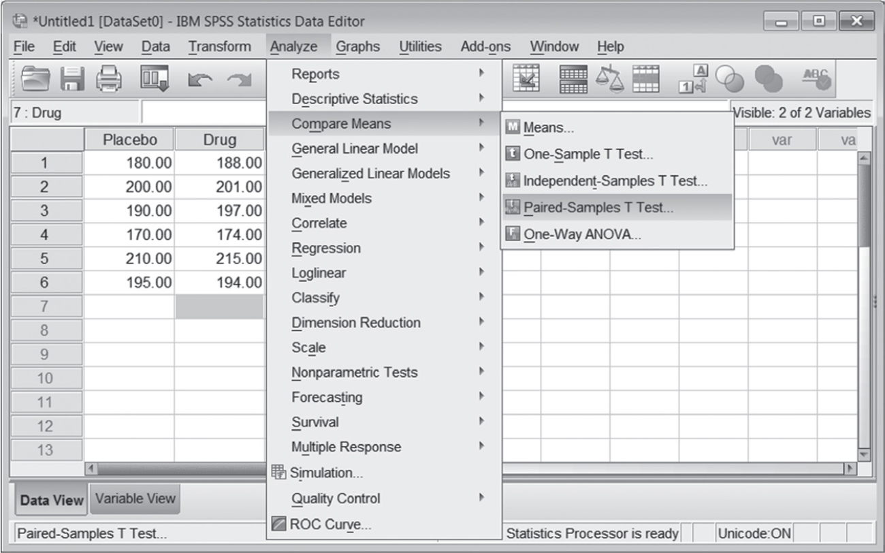
Figure 9.2: SPSS Screenshot of Choosing a Paired Samples t
Notes:
Learning Objective: Compute a related samples t test by hand (using a calculator) and using SPSS

Slide 60
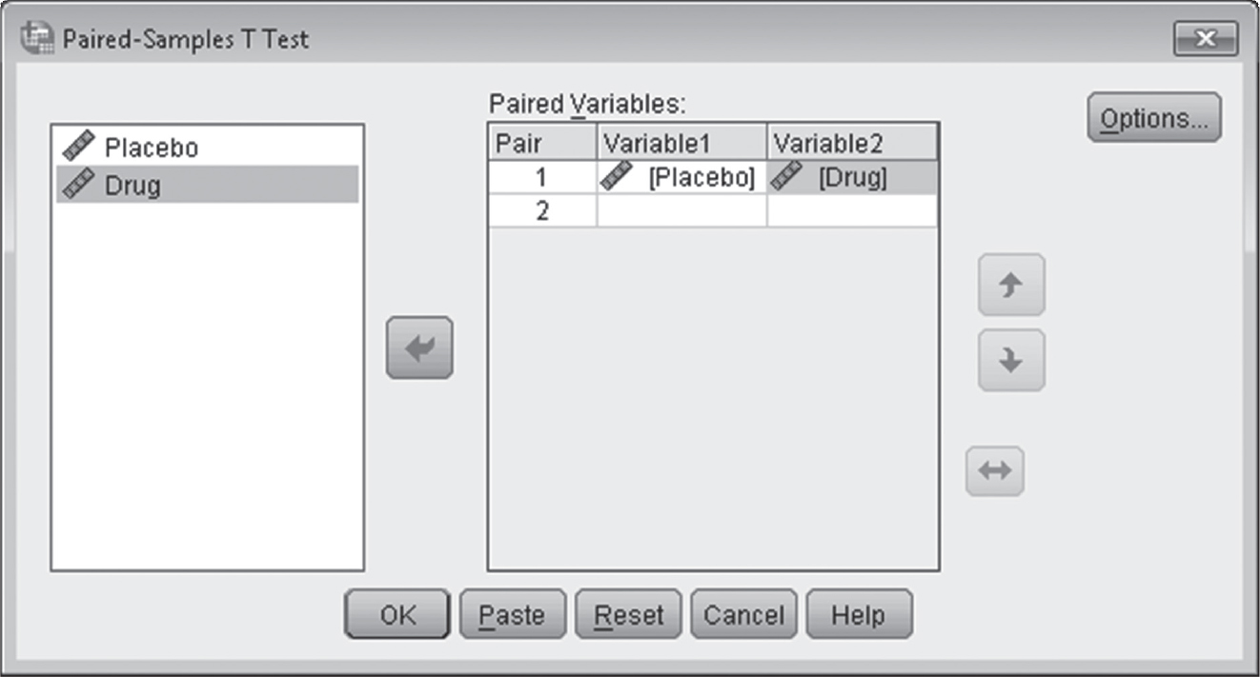
Figure 9.3: SPSS Screenshot of Selecting the Paired Variables
Notes:
Learning Objective: Compute a related samples t test by hand (using a calculator) and using SPSS

Slide 61
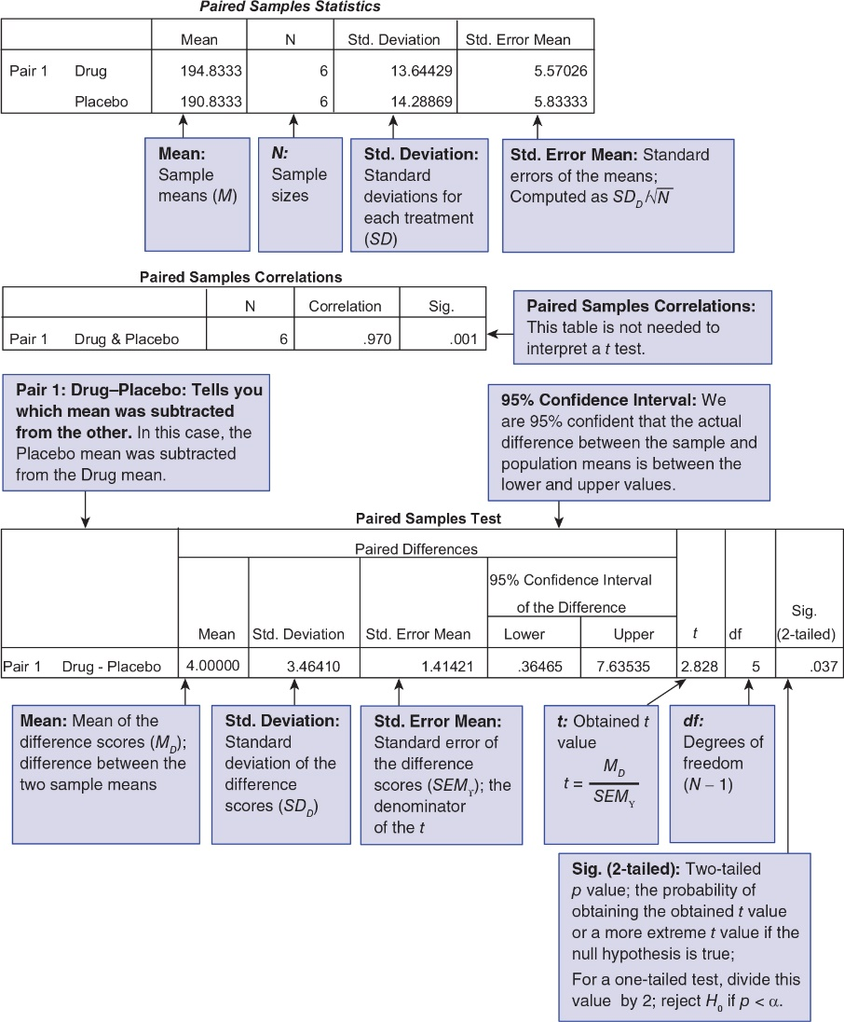
Figure 9.4: Annotated SPSS Output for a Related t Test
Notes:
Learning Objective: Interpret the SPSS output for a related samples t test

