Slide 2
An Introduction to Statistics An Active Learning Approach
Chapter 10: Independent Samples t Test

Slide 3
Topics to Cover
Explain when to use an independent samples t test
Explain the logic of the independent samples t test
Write null and research hypotheses using symbols and words for both one- and two-tailed tests

Slide 4
Topics to Cover
Compute degrees of freedom and define a critical region for both one- and two-tailed tests
Compute an independent samples t using a calculator and SPSS
Compute and interpret an effect size (d)
Summarize the results of the analysis using American Psychological Association (APA) style

Slide 5
Independent Samples t
Use an independent samples t test when you need to compare two sample means that are unrelated.
The independent t test uses two samples from the population to represent two different conditions.
Notes:
Learning Objective: Explain when to use an independent samples t test

Slide 6
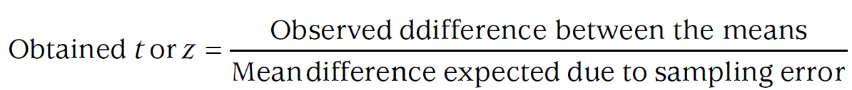
Independent Samples t
The logic of the independent t test, like the other three tests we have learned, is to compute a ratio of the observed deviation between two means over the deviation expected due to sampling error.
Notes:
Learning Objective: Explain the logic of the independent samples t test
p. 316
The other 3 tests are the “z for the sample mean, the single-sample t test, and the related samples t test.”

Slide 7
Independent Samples t
If the null hypothesis is true, the obtained t should be zero.
If the null hypothesis is false, the obtained t should be far from zero.
Notes:
Learning Objective: Explain the logic of the independent samples t test

Slide 8
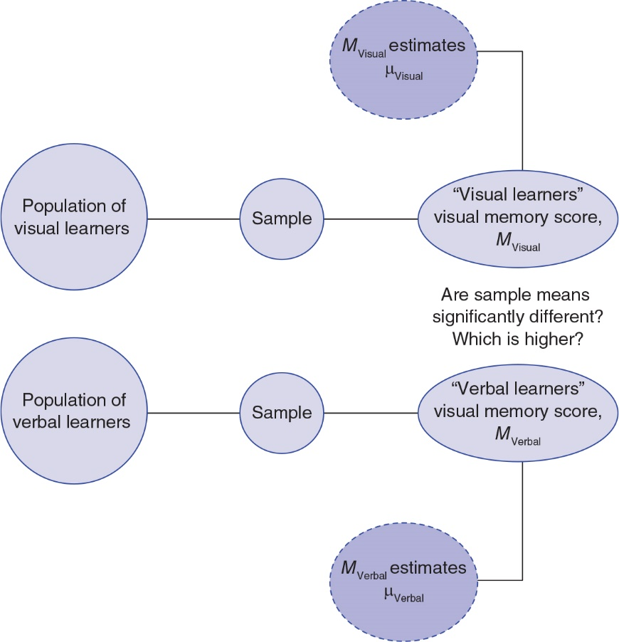
Figure 10.3: Research Approach of Obtaining Two Different Samples to Infer Difference Between Two Different Populations
Notes:
Learning Objective: Explain the logic of the independent samples t test

Slide 9
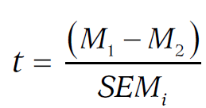
Conceptual Formula for the Independent Samples t
The independent t test is the ratio of the observed mean difference over the difference expected due to sampling error:
Notes:
Learning Objective: Explain the logic of the independent samples t test

Slide 10
Two-Tailed Independent t Test Example
Compute an independent samples t using a calculator and SPSS
Notes:
Learning Objective: Compute an independent samples t using a calculator and SPSS

Slide 11
Two-Tailed Independent t Test Example
Suppose you and Bill team up on a research project for your human cognition course.
The two of you want to test how verbal labels influence participants’ memory of pictures.
You investigate this question by showing all participants a series of 25 simple line drawings and asking them to recall the drawings 10 min later.
Notes:
Learning Objective: Explain the logic of the independent samples t test

Slide 12
Two-Tailed Independent t Test Example
However, half of the participants only saw the drawings while the other half also saw a verbal description of each drawing similar to that in Figure 10.1.
You took one sample from a single population and then divided that sample to create two different groups; one received no verbal labels (control condition) and the other received verbal labels (experimental condition).
Notes:
Learning Objective: Explain the logic of the independent samples t test

Slide 13
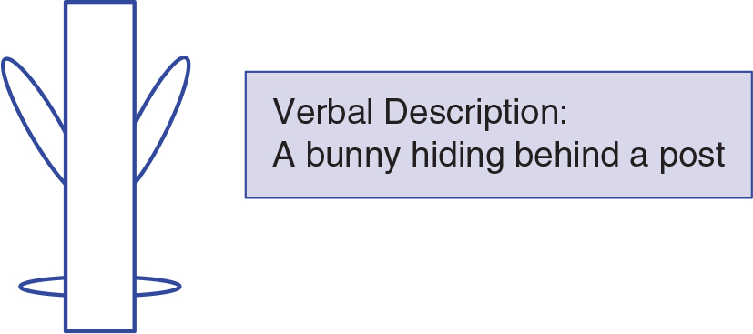
Figure 10.1: Simple Line Drawing and Its Verbal Description Used in Your Human Memory Experiment
Notes:
Learning Objective: Explain the logic of the independent samples t test

Slide 14
Two-Tailed Independent t Test Example
Twelve students volunteer to participate in your study.
Half of them see the 25 line drawings with verbal descriptions and the other half see the 25 line drawings without verbal descriptions.
You use a two-tailed t test with an α of .05 to test your research question.
Notes:
Learning Objective: Explain the logic of the independent samples t test

Slide 15
Two-Tailed Independent t Test Example
You then measured the mean number of drawings each sample recalled.
The sample mean from the control group estimates what the population’s mean memory score would be if the population only saw the drawings with no verbal labels.
The other sample estimates what the population’s mean memory score would be if everyone saw the drawings and verbal labels.
Notes:
Learning Objective: Explain the logic of the independent samples t test

Slide 16
Two-Tailed Independent t Test Example
You can use an independent samples t test to determine whether the difference between these two sample means was likely or unlikely to have occurred due to sampling error.
If the experimental group had a higher mean and the obtained t value is in the critical region, you could conclude that the verbal descriptions increased memory scores.
Notes:
Learning Objective: Explain the logic of the independent samples t test

Slide 17
Two-Tailed Independent t Test Example
If, however, the verbal description group had a significantly lower mean, you could conclude that the verbal descriptions decreased memory scores.
Figure 10.2 illustrates this research scenario.
Notes:
Learning Objective: Explain the logic of the independent samples t test

Slide 18
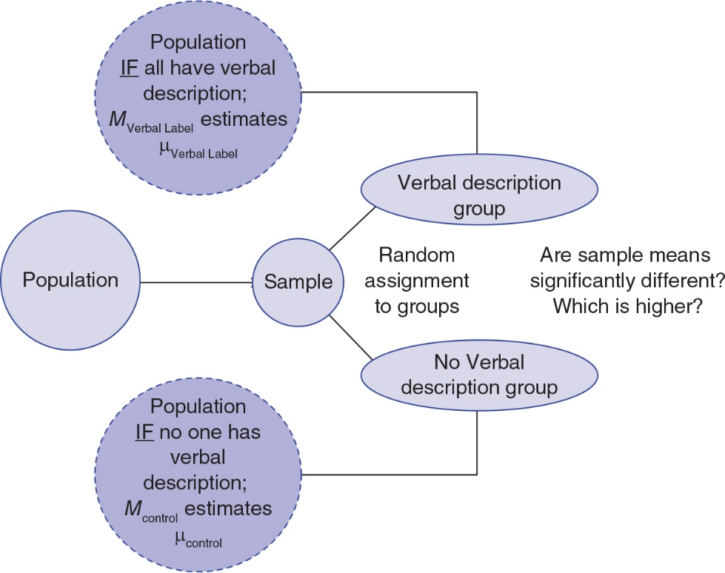
Figure 10.2: Research Approach of Creating Two Different Samples to Infer What the Population Would Be Like Under Two Different Situations
Notes:
Learning Objective: Explain the logic of the independent samples t test

Slide 19
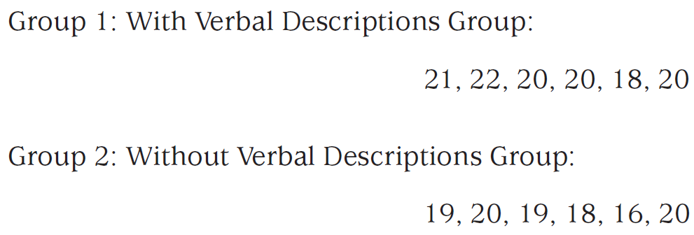
Two-Tailed Independent t Test Example
Data
Notes:
Learning Objective: Compute an independent samples t using a calculator and SPSS

Slide 20
Step 1: Examine the Statistical Assumptions
Data independence
This assumption is met because you collected your data carefully.
Notes:
Learning Objective: Compute an independent samples t using a calculator and SPSS

Slide 21
Step 1: Examine the Statistical Assumptions
Appropriate measurement of variables assumption
This assumption is met because the DV, number of line drawings correctly recalled, is on an interval/ratio scale.
The IV, presence or absence of verbal descriptions, identifies two different groups/conditions.
Notes:
Learning Objective: Compute an independent samples t using a calculator and SPSS

Slide 22
Step 1: Examine the Statistical Assumptions
Normality assumption
This assumption is met because distributions of memory scores tend to be normally shaped.
This study will probably have very low statistical power and a lot of sampling error because of its very small sample sizes, and you will need to be very cautious interpreting the results.
Notes:
Learning Objective: Compute an independent samples t using a calculator and SPSS

Slide 23
Step 1: Examine the Statistical Assumptions
Homogeneity of variance assumption
For the independent t test, this assumption is that the two groups have similar variability in their memory scores.
Notes:
Learning Objective: Compute an independent samples t using a calculator and SPSS
p. 320
“In previous chapters, we used the general rule that if the standard deviation in one condition is double
that of another condition, this assumption might be violated.”

Slide 24
Step 1: Examine the Statistical Assumptions
Homogeneity of variance assumption
There are actually two ways to compute expected sampling error when doing an independent t test.
One way assumes homogeneity of variance (i.e., that the two conditions have similar variances) and the other way does not.
Levene’s test in SPSS lets you choose between the t test that assumes equal variance or the one that does not.
Notes:
Learning Objective: Compute an independent samples t using a calculator and SPSS

Slide 25
Step 2: State the Null and Research Hypotheses Symbolically and Verbally
The two-tailed research hypothesis states that the two means are different (i.e., are not equal).
The null hypothesis is the opposite, stating that the two means are not different (i.e., are equal).
Notes:
Learning Objective: Compute an independent samples t using a calculator and SPSS
Learning Objective: Write null and research hypotheses using symbols and words for both one- and two-tailed tests

Slide 26
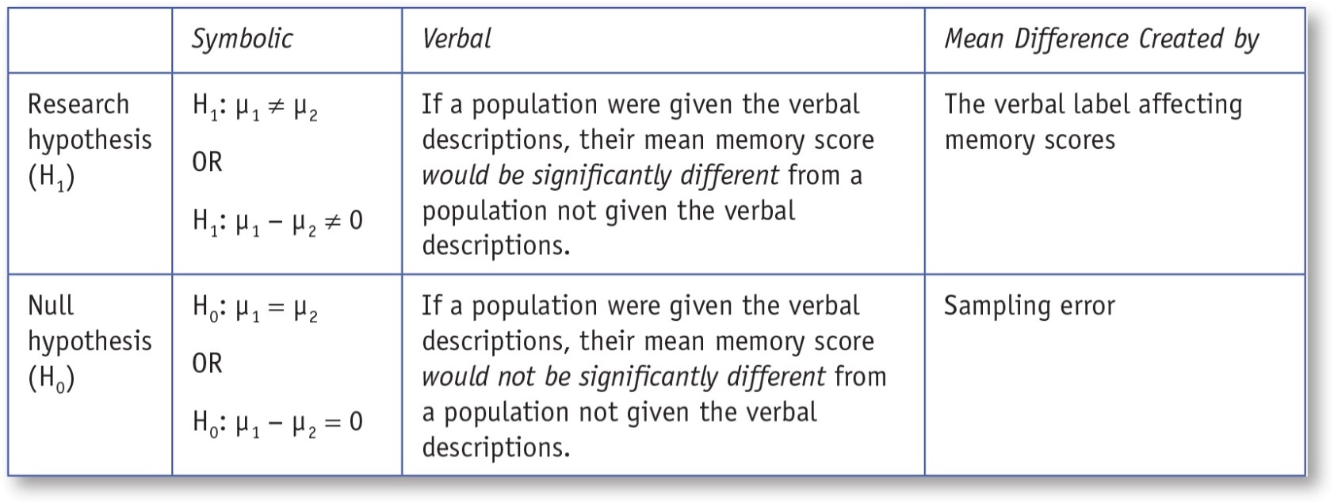
Table 10.1: Symbolic and Verbal Representations of Two-Tailed Research and Null Hypotheses for an Independent t Test
Notes:
Learning Objective: Compute an independent samples t using a calculator and SPSS Learning Objective: Write null and research hypotheses using symbols and words for both one- and two-tailed tests

Slide 27

Step 3: Compute the Degrees of Freedom and Define the Critical Regions
The independent t test df formula is df = (n₁ − 1) + (n₂ − 1), where n₁ and n₂ represent the sample sizes of the two samples, respectively.
Notes:
Learning Objective: Compute degrees of freedom and define a critical region for both one- and two-tailed tests Learning Objective: Compute an independent samples t using a calculator and SPSS
* This formula for df is used when homogeneity of variances is assumed.

Slide 28
Step 3: Compute the Degrees of Freedom and Define the Critical Regions
Use the two-tailed probabilities t table, df = 10, and α = .05 to find the critical value of 2.2281.
The two critical regions are t ≥ +2.2281 and t ≤ −2.2281.
Notes:
Learning Objective: Compute degrees of freedom and define a critical region for both one- and two-tailed tests Learning Objective: Compute an independent samples t using a calculator and SPSS

Slide 29
Step 4: Compute the Test Statistic (Independent t Test)
4a. Compute the Deviation Between the Two Sample Means
4b. Compute the Expected Sampling Error
4c. Compute the Test Statistic (Independent t Test)
Notes:
Learning Objective: Compute an independent samples t using a calculator and SPSS

Slide 30

4a. Compute the Deviation Between the Two Sample Means
Notes:
Learning Objective: Compute an independent samples t using a calculator and SPSS

Slide 31
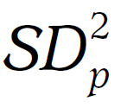
4b. Compute the Expected Sampling Error
Computing the denominator, or expected sampling error, requires several steps.
First, compute the standard deviation for Group 1 (SD₁)
Then compute the standard deviation for Group 2 (SD₂)
Next, compute the pooled variance,
Last, compute the estimated standard error of the mean difference, SEM_{i}
Notes:
Learning Objective: Compute an independent samples t using a calculator and SPSS

Slide 32
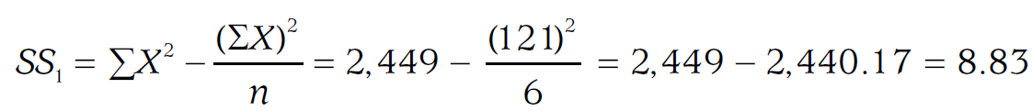
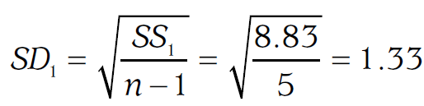
4b. Compute the Expected Sampling Error
Standard deviation for Group 1 (SD₁)
Notes:
Learning Objective: Compute an independent samples t using a calculator and SPSS

Slide 33
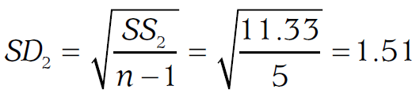
4b. Compute the Expected Sampling Error
Standard deviation for Group 2 (SD₂)
Notes:
Learning Objective: Compute an independent samples t using a calculator and SPSS

Slide 34
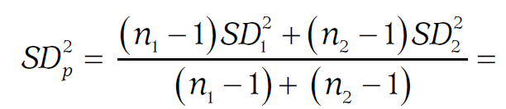
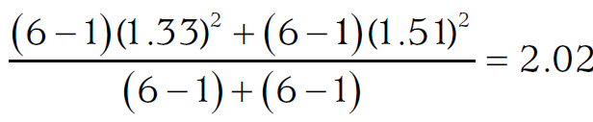
4b. Compute the Expected Sampling Error
Pooled variance,
Notes:
Learning Objective: Compute an independent samples t using a calculator and SPSS

Slide 35
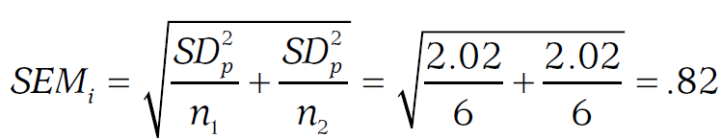
4c. Compute the Test Statistic (Independent t Test)
Estimated standard error of the mean difference, SEM_{i}
Notes:
Learning Objective: Compute an independent samples t using a calculator and SPSS
p. 324 “The estimated standard error of the mean difference, .82, is our estimate of expected sampling
error. A standard error of 0.82 indicates that the difference between the two means expected due to
sampling error is 0.82.”

Slide 36
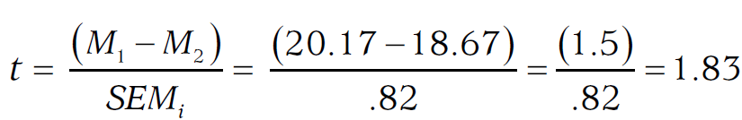
4c. Compute the Test Statistic (Independent t Test)
The independent t test is the ratio of the observed deviation between the two sample means divided by the estimated standard error of the mean difference:
Notes:
Learning Objective: Compute an independent samples t using a calculator and SPSS

Slide 37
4c. Compute the Test Statistic (Independent t Test)
The difference between the two means (20.17 − 18.67 = 1.50) was 1.83 times larger than the deviation expected due to sampling error (0.82).
The obtained t value of 1.83 was not ≥ 2.2281 or ≤ −2.2281 and so did not fall in the critical region.
The obtained t value is not sufficiently large to reject the null hypothesis.
Notes:
Learning Objective: Compute an independent samples t using a calculator and SPSS

Slide 38
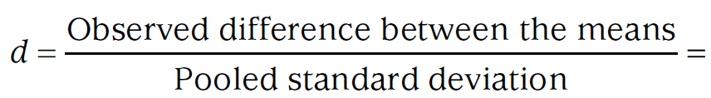
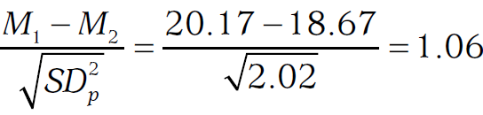
Step 5: Compute an Effect Size and Describe It
Compute the effect size of an independent t test
Notes:
Learning Objective: Compute and interpret an effect size (d) p. 325
“This is probably the most commonly used formula for computing d for independent measures designs. However,
some researchers choose different denominators (Cumming, 2012). Because there are different ways to calculate
d, it is important to tell the reader how you computed the effect size. In this book, we are always using the same
calculation and so we do not need to say repeatedly what denominator we used, but when you present data, you
should state how d was calculated.”

Slide 39
Step 5: Compute an Effect Size and Describe It
The effect size of 1.06 indicates that the difference between the two means is large.
Whenever the null is not rejected and yet there was a medium or large effect size, the sample size used in the study was too small for the statistical test or the effect size to be trusted.
Notes:
“When interpreting any study’s results, it is also important to consider the results from other similar studies. When Bower et al. (1975) conducted a similar study, they found that the verbal labels did improve memory performance. The combination of small sample sizes and the large effect size of your study and the fact that a similar study rejected the null suggests that you should interpret your null result with caution. In situations like this, you should obtain a larger sample size and then rerun the study.”

Slide 40
Step 6: Interpreting the Results of the Hypothesis Test
There was not a significant difference between the memory scores of those who got the verbal descriptions (M = 20.17, SD = 1.33) and those who did not (M = 18.67, SD = 1.51), t(10) = 1.83, p > .05, d = 1.06. However, it is important to note that the sample sizes were small, so this study should be repeated with larger sample sizes before conclusions are drawn.
Notes:
Learning Objective: Summarize the results of the analysis using American Psychological Association (APA) style

Slide 41
One-Tailed Independent t Test Example
Compute an independent samples t using a calculator and SPSS
Notes:
Learning Objective: Compute an independent samples t using a calculator and SPSS

Slide 42
One-Tailed Independent t Test Example
You and Bill turn your research efforts to studying “learning styles.”
Twenty-nine “verbal learners” and 31 “visual learners” participate.
All learners were presented with simple line drawings and then were asked to re-create as many as they could remember.
Notes:
Learning Objective: Compute an independent samples t using a calculator and SPSS

Slide 43
One-Tailed Independent t Test Example
You correctly use a one-tailed independent t test with an α level of .05 to determine whether “visual learners” recall more of the line drawings than “verbal learners.”
Notes:
Learning Objective: Compute an independent samples t using a calculator and SPSS

Slide 44
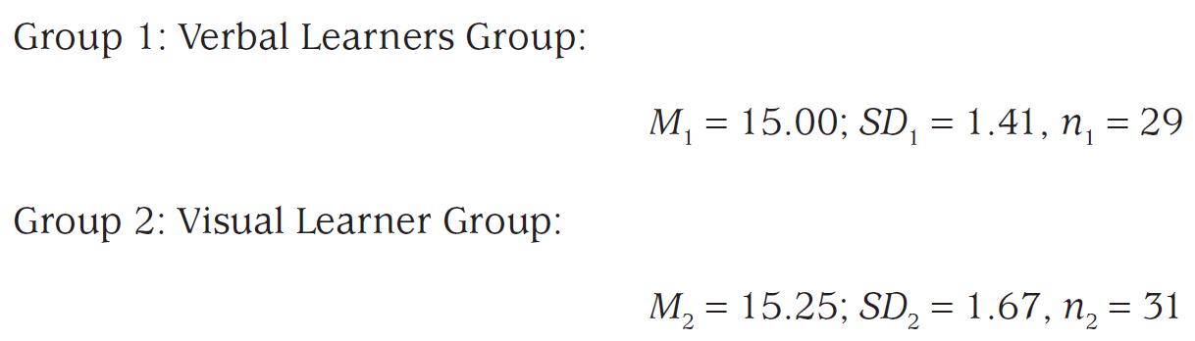
One-Tailed Independent t Test Example
Results
Notes:
Learning Objective: Compute an independent samples t using a calculator and SPSS

Slide 45
Step 1: Examine the Statistical Assumptions
As in the previous example, these data meet all of the statistical assumptions. The data within each condition are independent, and the DV is measured on an interval/ratio scale. Memory scores tend to be normally distributed, so the normality assumption is likely met. As before, the homogeneity of variance assumption will be assessed with Levene’s test provided by SPSS.
Notes:
Learning Objective: Compute an independent samples t using a calculator and SPSS

Slide 46
Step 2: State the Null and Research Hypotheses Symbolically and Verbally
The learning styles theory predicts that “visual learners” (Group 1) should learn visual information better than “verbal learners” do (Group 2).
The null hypothesis is that “visual learners” do not learn visual information any better than the “verbal learners.”
Notes:
Learning Objective: Write null and research hypotheses using symbols and words for both one- and two-tailed tests

Slide 47
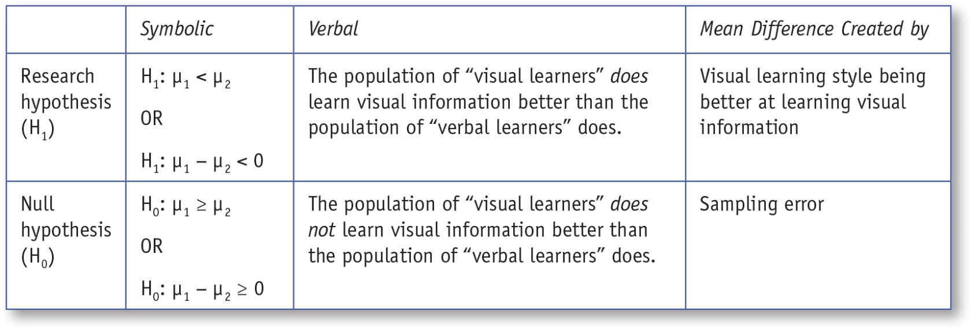
Table 10.2: Symbolic and Verbal Representations of One-Tailed Research and Null Hypotheses for an Independent t Test
Notes:
Learning Objective: Write null and research hypotheses using symbols and words for both one- and two-tailed tests

Slide 48
Step 3: Compute the Degrees of Freedom and Define the Critical Regions
Compute df
The one-tailed t table indicates that a study with a df = 58, when using α = .05, has a critical value of 1.6716.
The critical region is t ≤ −1.6716.
Notes:
Learning Objective: Write null and research hypotheses using symbols and words for both one- and two-tailed tests

Slide 49
Step 4: Compute the Test Statistic (Independent t Test)
4a. Compute the Deviation Between the Two Sample Means
4b. Compute the Average Sample Error that is Expected
4c. Compute the Test Statistic (Independent t Test)
Notes:
Learning Objective: Compute an independent samples t using a calculator and SPSS

Slide 50
4a. Compute the Deviation Between the Two Sample Means
Notes:
Learning Objective: Compute an independent samples t using a calculator and SPSS

Slide 51
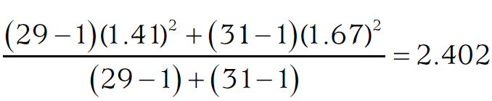
4b. Compute the Average Sample Error that is Expected
Pooled variance,
Notes:
Learning Objective: Compute an independent samples t using a calculator and SPSS

Slide 52
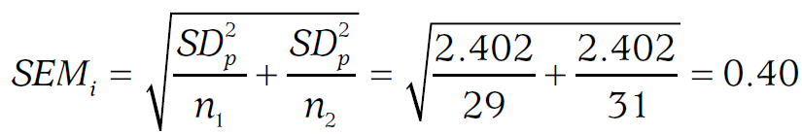
4b. Compute the Average Sample Error that is Expected
Estimated standard error of the mean, SEM_{i}
Notes:
Learning Objective: Compute an independent samples t using a calculator and SPSS

Slide 53
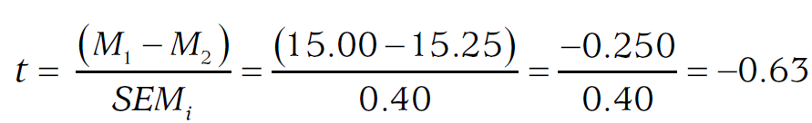
4c. Compute the Test Statistic (Independent t Test)
Notes:
Learning Objective: Compute an independent samples t using a calculator and SPSS
p. 324

Slide 54
4c. Compute the Test Statistic (Independent t Test)
The obtained t value of −0.31 is not further from zero than the critical value of −1.6716.
Therefore, you do not reject the null hypothesis.
Notes:
Learning Objective: Compute an independent samples t using a calculator and SPSS

Slide 55
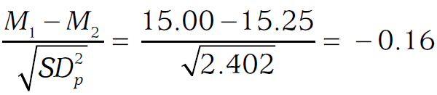
Step 5: Compute an Effect Size and Describe It
Compute the effect size of an independent t test
Notes:
Learning Objective: Compute and interpret an effect size (d)
p. 325
“This is probably the most commonly used formula for computing d for independent measures designs. However,
some researchers choose different denominators (Cumming, 2012). Because there are different ways to calculate
d, it is important to tell the reader how you computed the effect size. In this book, we are always using the same
calculation and so we do not need to say repeatedly what denominator we used, but when you present data, you
should state how d was calculated.”

Slide 56
Step 6: Interpreting the Results of the Hypothesis Test
Contrary to the prediction of learning styles theory, the visual learners (M = 15.25, SD = 1.41) did not learn significantly more visual information than the verbal learners (M = 15.00, SD = 1.67), t(58) = −0.63, p > .05 (one-tailed), d = −0.16. The study’s null result is consistent with the null results found by several other researchers investigating learning styles. Collectively, the null results of several studies on learning styles strongly suggest that there is very little, if any, merit in the learning styles theory of learning.
Notes:
Learning Objective: Summarize the results of the analysis using American Psychological Association (APA) style

Slide 57
SPSS
Compute an independent samples t using a calculator and SPSS
Notes:
Learning Objective: Compute an independent samples t using a calculator and SPSS

Slide 58
Data File
We are going to use the data from the first example in the chapter about memory for line drawings with and without labels to illustrate how to use SPSS to conduct an independent samples t test.
Notes:
Learning Objective: Compute an independent samples t using a calculator and SPSS

Slide 59
Data File
To enter data for an independent samples t test, you will need two columns.
The first is the IV (grouping variable). A number is used to indicate the group each person was in.
1 was used for verbal descriptions
2 was used for no verbal descriptions
Notes:
Learning Objective: Compute an independent samples t using a calculator and SPSS

Slide 60
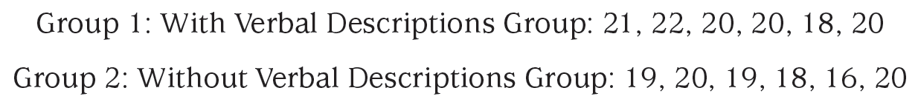
Data File
The second column is the DV (the dependent variable, that is, the variable on which the two groups are being compared). In this case, the DV is the visual memory score of each person.
Notes:
Learning Objective: Compute an independent samples t using a calculator and SPSS

Slide 61
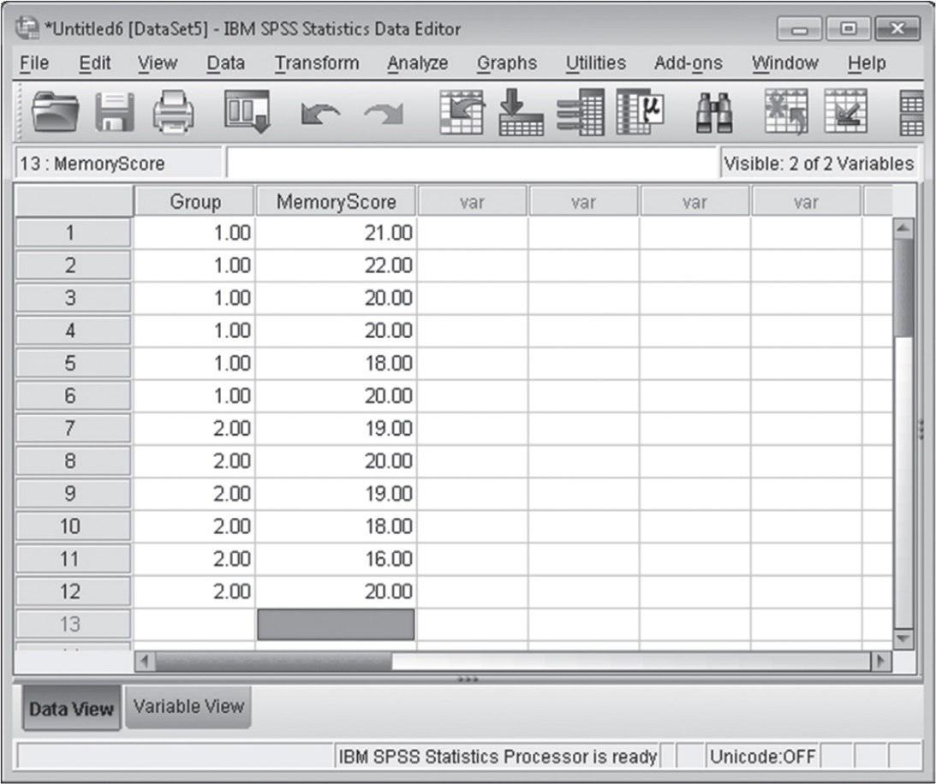
Figure 10.4: SPSS Screenshot of Data Entry Screen for an Independent t Test
Notes:
Learning Objective: Compute an independent samples t using a calculator and SPSS

Slide 62
Computing an Independent Samples t Test
Click on the Analyze menu. Choose Compare Means and then Independent Samples t Test (see Figure 10.5)
Notes:
Learning Objective: Compute an independent samples t using a calculator and SPSS

Slide 63
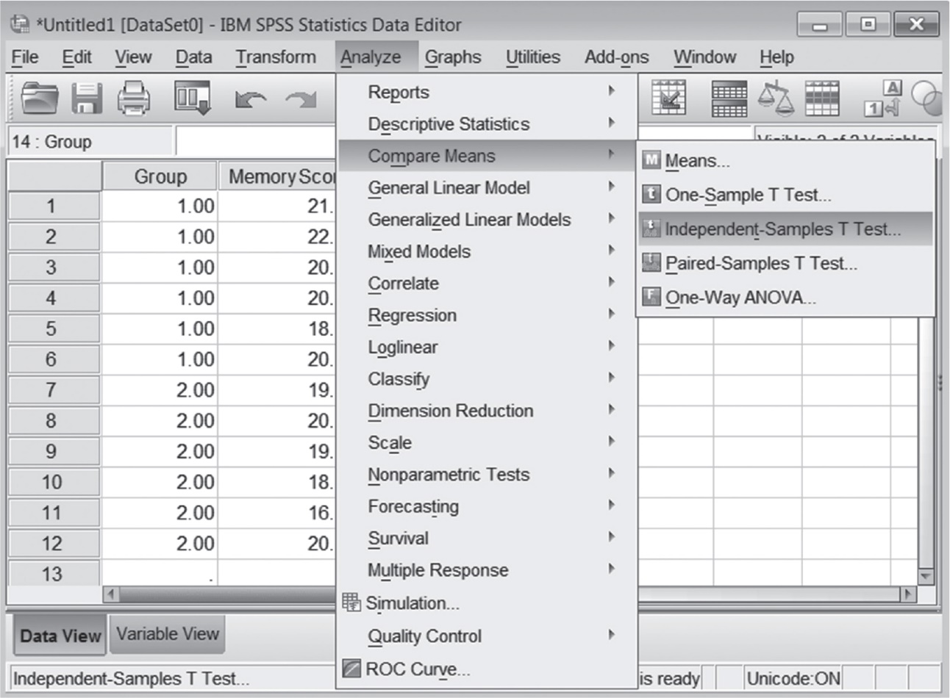
Figure 10.5: SPSS Screenshot of Choosing an Independent t
Notes:
Learning Objective: Compute an independent samples t using a calculator and SPSS

Slide 64
Computing an Independent Samples t Test
Move the Independent Variable (the one that indicates which group someone is in) into the Grouping Variable box, and click on Define. Enter the values you used to designate Group 1 and Group 2 in the appropriate boxes (you would enter the values 1 and 2, respectively; see Figure 10.6).
Notes:
Learning Objective: Compute an independent samples t using a calculator and SPSS

Slide 65
Computing an Independent Samples t Test
Move the Dependent Variable (the one that indicates the actual scores of the participants) into the Test Variables box (see Figure 10.6).
Click on the OK button.
Notes:
Learning Objective: Compute an independent samples t using a calculator and SPSS

Slide 66
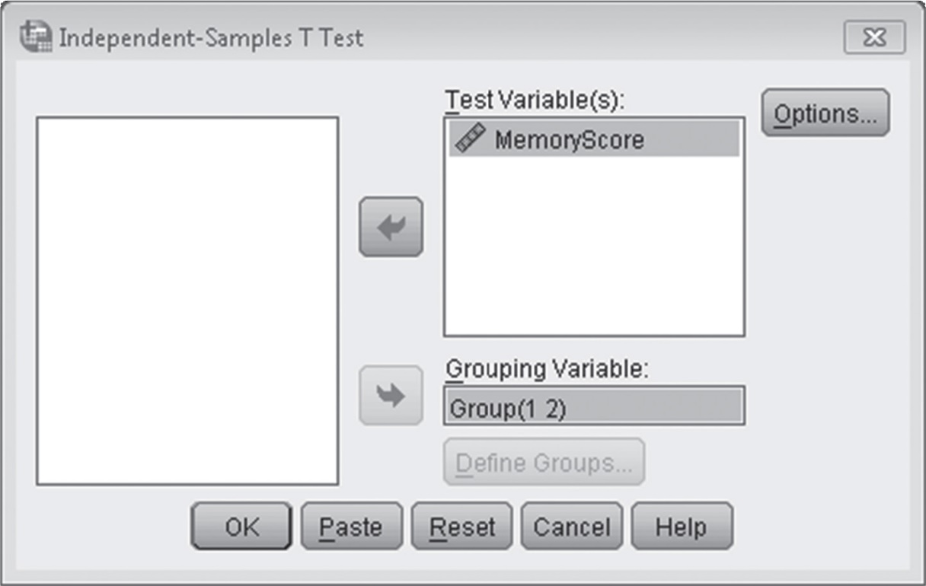
Figure 10.6: SPSS Screenshot of the IV and the DV for an Independent t Test
Notes:
Learning Objective: Compute an independent samples t using a calculator and SPSS

Slide 67
Output
Levene’s test (test for homogeneity of variance)
You can determine whether the variances are equal or not by looking at the “Sig.” value under the “Levene’s Test for Equality of Variances” label in the “Independent Samples Test” output.
If the Sig. value is less than or equal to .05, the variances are not similar and the equal variance assumption was violated.
Notes:
Learning Objective: Compute an independent samples t using a calculator and SPSS

Slide 68
Output
SPSS automatically computes two different t tests—one using the “equal variances” method and the other using the “not equal variances” method.
In this case, choose the obtained t value and degrees of freedom that is across from the “Equal variances assumed” heading (t = −1.830 and df = 10), because the Sig. of .676 was not less than or equal to .05.
Notes:
Learning Objective: Compute an independent samples t using a calculator and SPSS
Equal variances can be assumed based on the Levene’s test that shows a Sig. value of .676
See p. 335 for the df and SEM₁ formula when homogeneity of variances assumption is violated.
A t test computed when variances are not similar is called a Welch t test (Welch, 1947).

Slide 69
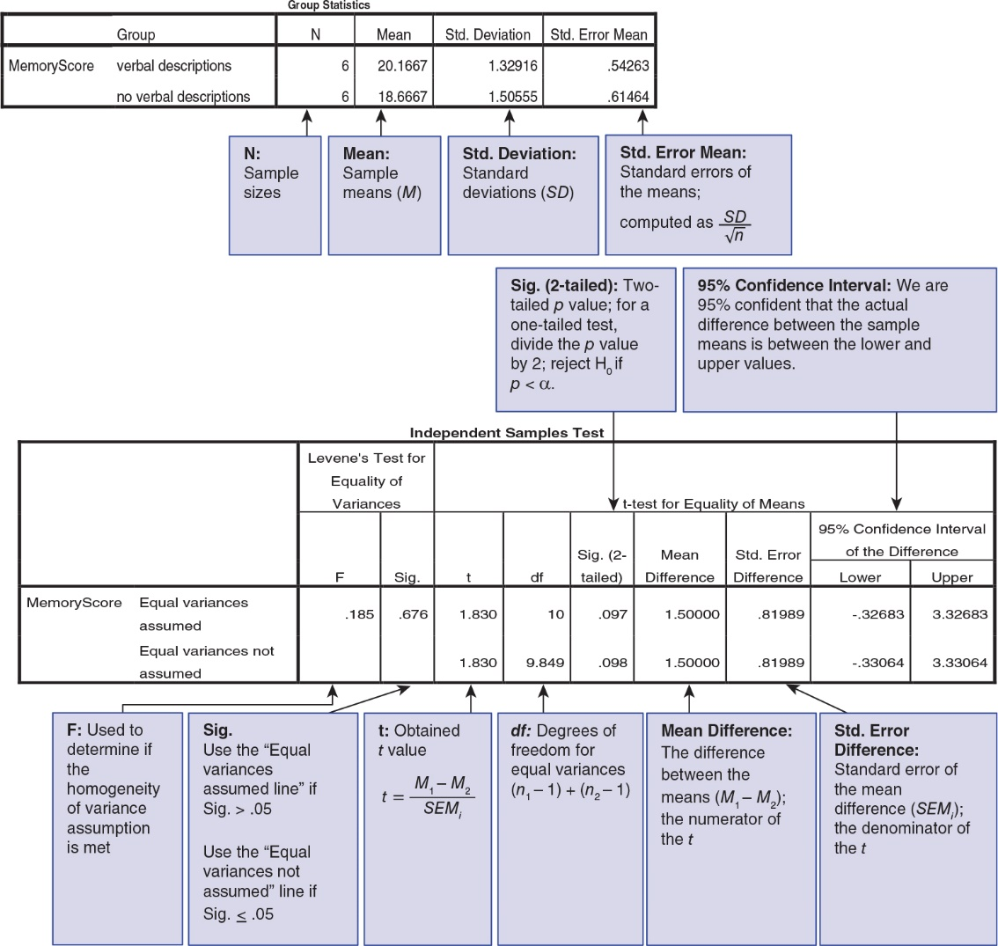
Figure 10.7: Annotated SPSS Output for an Independent t Test

