Slide 2
An Introduction to Statistics An Active Learning Approach
Chapter 12: Two-Factor ANOVA or Two-Way ANOVA

Slide 3
Topics to Cover
Explain when to use a two-factor analysis of variance (ANOVA)
Describe the three F ratios generated by a two-factor ANOVA
Write null and research hypotheses for the main effects and interaction F tests

Slide 4
Topics to Cover
Identify which means are compared when computing each main effect and interaction F tests
Complete an ANOVA summary table
Define the critical region for each F test
Determine whether you should reject each null hypothesis

Slide 5
Topics to Cover
Compute effect sizes for each main effect and the interaction and describe each as small, medium, or large
Use SPSS to perform a two-factor ANOVA and create a graph of the main effects and interaction

Slide 6
Topics to Cover
Use SPSS to compute simple effect analyses
Summarize the results of the ANOVA using American Psychological Association (APA) style
Interpret the SPSS output for a two-factor ANOVA

Slide 7
Purpose of Two-Way ANOVA
Two-way ANOVAs are used frequently in the behavioral sciences because they can test for the effects of two IVs (factors) at the same time.
Two-way ANOVAs allow you to determine whether the two IVs interact to affect the DV.
This is what makes the two-way ANOVA such a useful research tool.
Notes:
Explain when to use a two-factor analysis of variance (ANOVA)

Slide 8
Describing Factorial Designs
When you describe a two-way factorial design, you will need two numbers, each reflecting the number of levels one of the IVs has in that design.
For example, a 2 × 2 between-group factorial design has one IV with two levels and a second IV with two levels.
Notes:
Learning Objective: Explain when to use a two-factor analysis of variance (ANOVA)

Slide 9
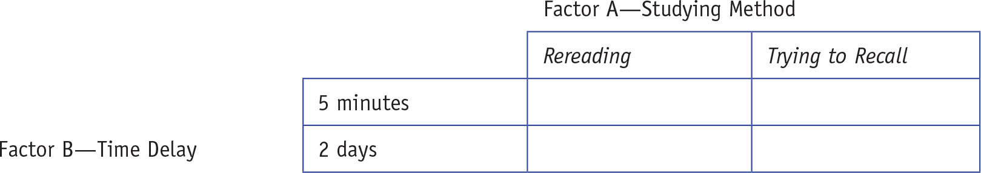
Table 12.1: Design of Two-Factor Study
Notes:
Explain when to use a two-factor analysis of variance (ANOVA)

Slide 10
Logic of the Two-Way ANOVA
Two-way ANOVAs produce three different significance tests, each with its own null hypothesis.
The main effect of Factor A.
The main effect of Factor B.
The interaction effect of Factor A and Factor B
considered the most important of the three tests
Notes:
Learning Objective: Describe the three F ratios generated by a two-factor ANOVA

Slide 11
Logic of the Two-Way ANOVA
A test of a main effect compares the cell means to determine whether they are significantly different from each other.
A test of an interaction compares the simple effects to determine whether they are significantly different from each other.
Notes:
Learning Objective: Identify which means are compared when computing each main effect and interaction F tests

Slide 12
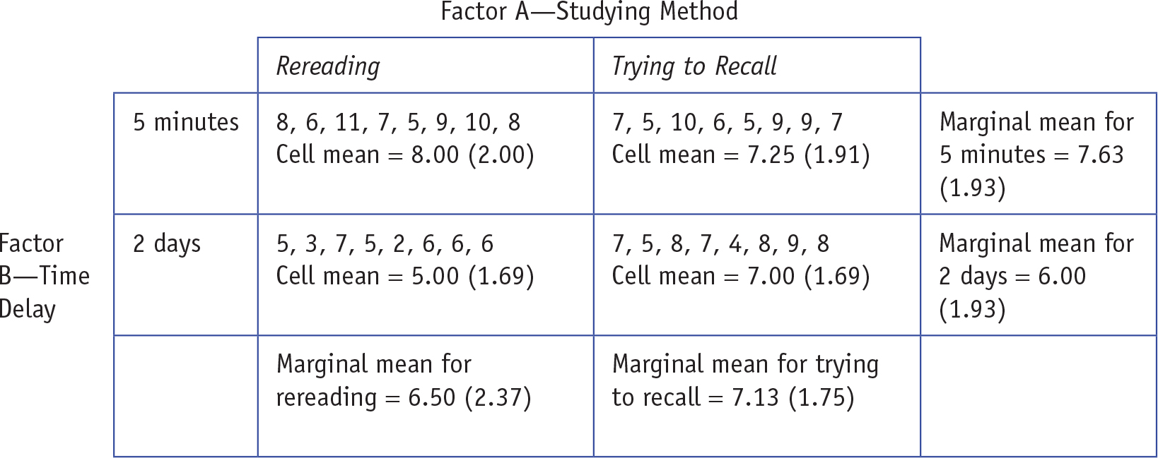
Table 12.2: 2 × 2 ANOVA With Cell Means and Marginal Means
Notes:
Learning Objective: Describe the three F ratios generated by a two-factor ANOVA
Learning Objective: Identify which means are compared when computing each main effect and interaction F tests

Slide 13
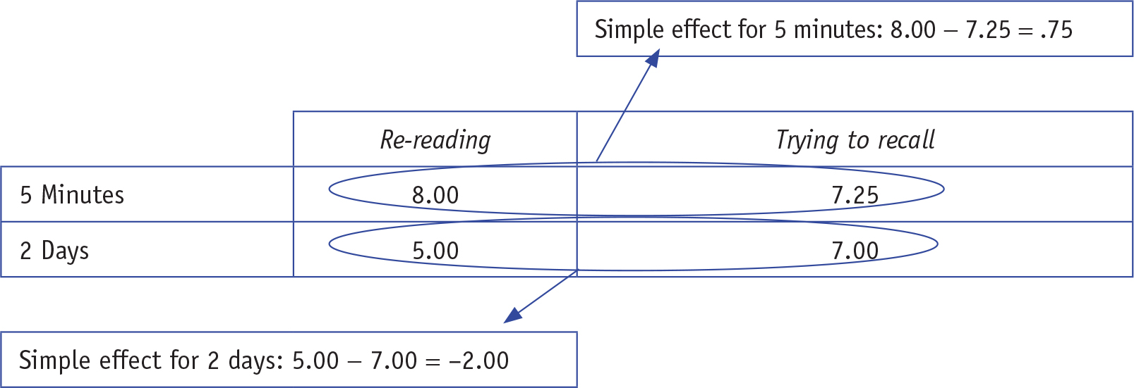
Table 12.3: 2 × 2 Simple Effects for 2 × 2 ANOVA
Notes:
Learning Objective: Describe the three F ratios generated by a two-factor ANOVA

Slide 14
Example of a Two-Way ANOVA

Slide 15
Example of a Two-Way ANOVA
Suppose you wanted to know the best way to study for college exams.
IV1: Type of studying method and it has two levels
rereading material
trying to recall material

Slide 16
Example of a Two-Way ANOVA
IV2: Time delay and it has two levels
5 min after studying
2 days after studying
DV: the number of correct answers on an exam

Slide 17
Step 1: Examine the Statistical Assumptions
Data independence
The responses within each condition must not be influenced by other responses within that same condition.
The procedural controls used in this study seem likely to provide data independence.

Slide 18
Step 1: Examine the Statistical Assumptions
Appropriate measurement of variables assumption
2 or more “grouping” IVs
1 interval/ratio DV

Slide 19
Step 1: Examine the Statistical Assumptions
Normality assumption
The distribution of sample means for each condition (cell) must have a normal shape.
This is met if the original populations are normal or if the sample size is large.

Slide 20
Step 1: Examine the Statistical Assumptions
Homogeneity of variance assumption
The variability within each cell should be similar.
The homogeneity of variance assumption is satisfied because none of the conditions’ standard deviations is double the size of any other conditions.

Slide 21
Step 2: Set Up the Null and Research Hypotheses
This two-way ANOVA tests for three different effects. Specifically, it determines
If studying method has an effect on exam scores.
If time delay until the exam has an effect on exam scores.
If studying method and time delay interact to jointly affect exam scores.
Notes:
Learning Objective: Write null and research hypotheses for the main effects and interaction F tests

Slide 22
2a. Interaction Null and Research Hypotheses
The interaction null hypothesis is that the effect of studying method is the same no matter when the exam takes place.
The interaction research hypothesis is that the effect of studying method is different for people with short time delays versus long time delays.
Notes:
Learning Objective: Write null and research hypotheses for the main effects and interaction F tests

Slide 23
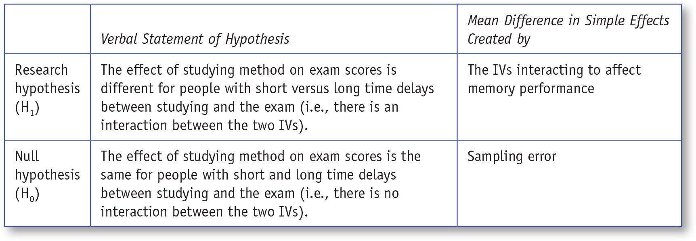
Table 12.4: Verbal Representations of the Research and Null Hypotheses for the Study Method × Time Delay Interaction

Slide 24
2b. Main Effect Null and Research Hypotheses
The null hypothesis for the main effect of studying method states that the different studying methods will produce similar exam scores.
The research hypothesis for the main effect of studying method states that the different studying methods will produce different exam scores.
Notes:
Learning Objective: Write null and research hypotheses for the main effects and interaction F tests

Slide 25
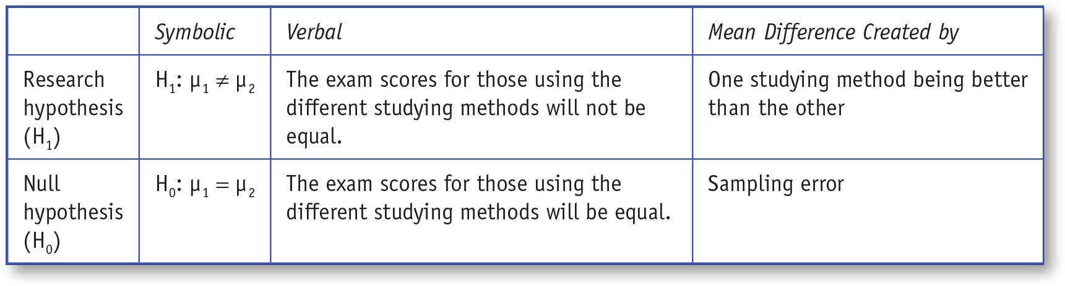
Table 12.5: Symbolic and Verbal Representations of the Research and Null Hypotheses for the Main Effect of Study Method

Slide 26
Marginal Means for Studying Method
This main effect compares the mean for all participants who studied by rereading to the mean for all participants who studied by trying to recall.
Notes:
Learning Objective: Identify which means are compared when computing each main effect and interaction F tests

Slide 27
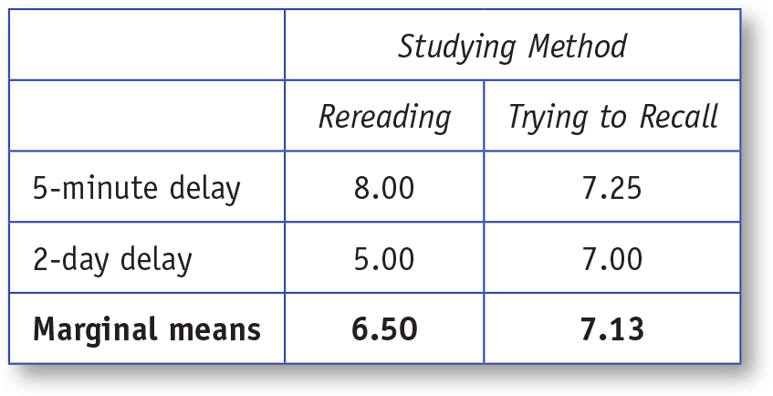
Table 12.6: Marginal Means for the Main Effect of Studying Method

Slide 28
2c. The Other Main Effect Null and Research Hypotheses
The null hypothesis for the main effect of time delay predicts that the mean number of correct answers for the 5-min delay group will be equal to the mean number of correct answers for the 2-day delay group.
The research hypothesis for the main effect of time delay predicts that the mean number of correct answers for the 5-min group will be different from the mean number of correct answers for the 2-day delay group.
Notes:
Learning Objective: Write null and research hypotheses for the main effects and interaction F tests

Slide 29
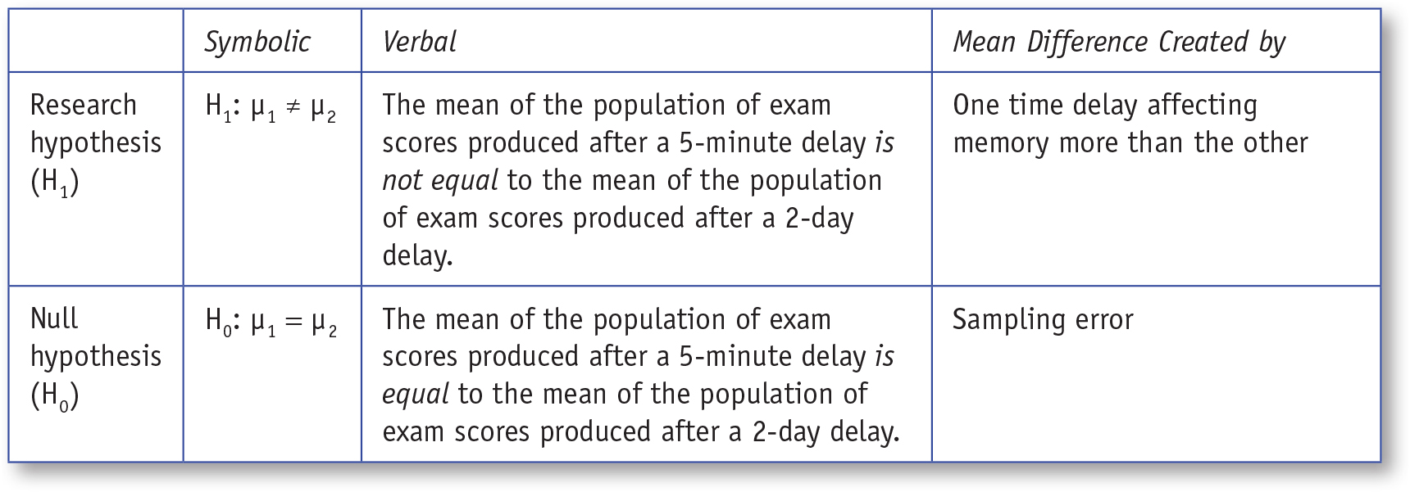
Table 12.7: Symbolic and Verbal Representations of the Research and Null Hypotheses for the Main Effect of Time Delay

Slide 30
Marginal Means for Time Delay
This main effect compares the mean exam score of all participants who had a 5-min delay to the mean of all participants who had a 2-day delay.
Notes:
Learning Objective: Identify which means are compared when computing each main effect and interaction F tests

Slide 31
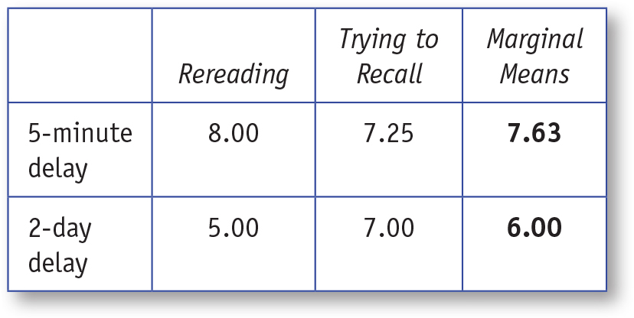
Table 12.8: Marginal Means for the Main Effect of Time Delay

Slide 32
Step 3: Define the Critical Region
The two-way ANOVA produces three F tests. Each test has its own critical region.
To determine the critical regions for each test, compute the degrees of freedom separately for each test.
We will use an α of .05 for this problem.
The F table for an α of .05 is located in Appendix C.
Notes:
Learning Objective: Define the critical region for each F test

Slide 33
3a: Define the Critical Region for the Interaction Test
The numerator df for the interaction is computed as df_{A × B} = (a − 1)(b − 1).
The denominator df is computed as df_{within(error)}= N − ab.
a is the number of levels of Factor A (studying method)
b is the number of levels of Factor B (time delay)
N is the number of people in the study
Notes:
Learning Objective: Define the critical region for each F test

Slide 34
3a: Define the Critical Region for the Interaction Test
numerator df
df_{A × B} = (a − 1)(b − 1)
df_{A × B} = (2 − 1)(2 − 1) = 1
denominator df
df_{within(error)} = N − ab
df_{within(error)} = N − ab = 32 − (2)(2) = 28
The critical F value with 1 and 28 degrees of freedom is 4.20
Notes:
Learning Objective: Define the critical region for each F test

Slide 35
3b: Define the Critical Region for the First Main Effect Test (Factor A, Study Method)
The numerator df for the main effect of study method is computed as df_{A} = (a − 1)
df_{A} = 2 – 1 = 1
The denominator df is computed as df_{within(error)}= N − ab and is the same as for the interaction
df_{within(error)} = N − ab = 32 − (2)(2) = 28
The critical value for 1 and 28 df = 4.20.
Notes:
Learning Objective: Define the critical region for each F test
Notice this is the same as for the interaction.

Slide 36
3c: Define the Critical Region for the First Main Effect Test (Factor B, Delay Time)
The numerator df for the main effect of study method is computed as df_{B} = (b − 1)
df_{B} = 2 – 1 = 1
The denominator df is computed as df_{within(error)} = N − ab
df_{within(error)} = N − ab = 32 − (2)(2) = 28
The critical value for 1 and 28 df = 4.20.
Notes:
Learning Objective: Define the critical region for each F test
Notice this is the same as for the interaction and the main effect for Factor A.

Slide 37
Step 4: Compute the Test Statistic (Three F Tests)
4a. F Test for the Interaction Test
4b. F Test for the First Main Effect (Study Method)
4c. F Test for the Second Main Effect (Time Delay)

Slide 38
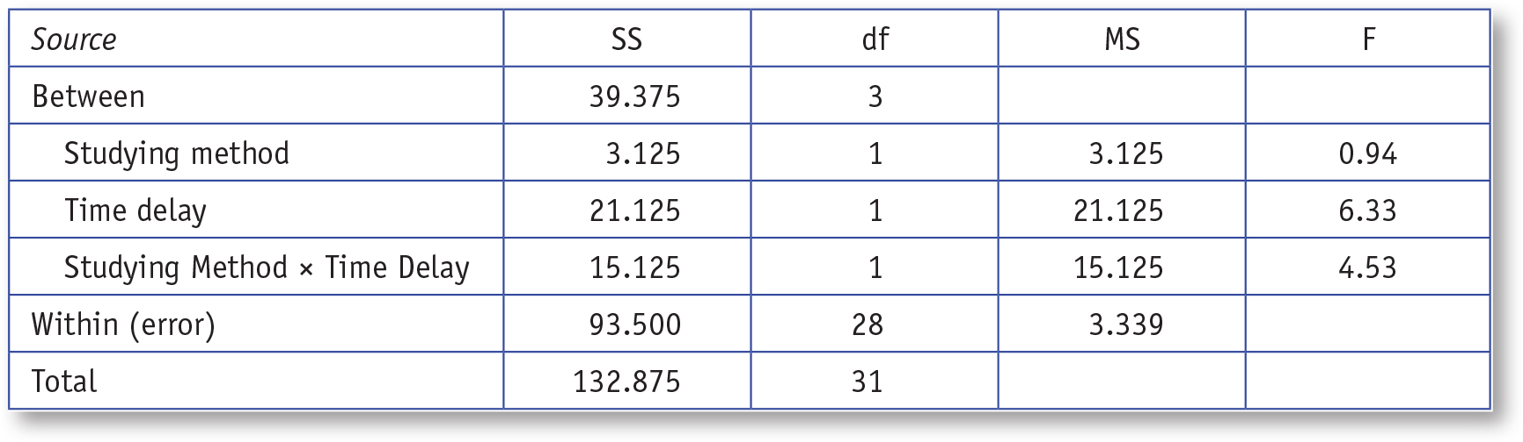
Table 12.9: ANOVA Source Table for a Two-Way Independent Samples ANOVA
Notes:
Use SPSS to perform a two-factor ANOVA and create a graph of the main effects and interaction

Slide 39
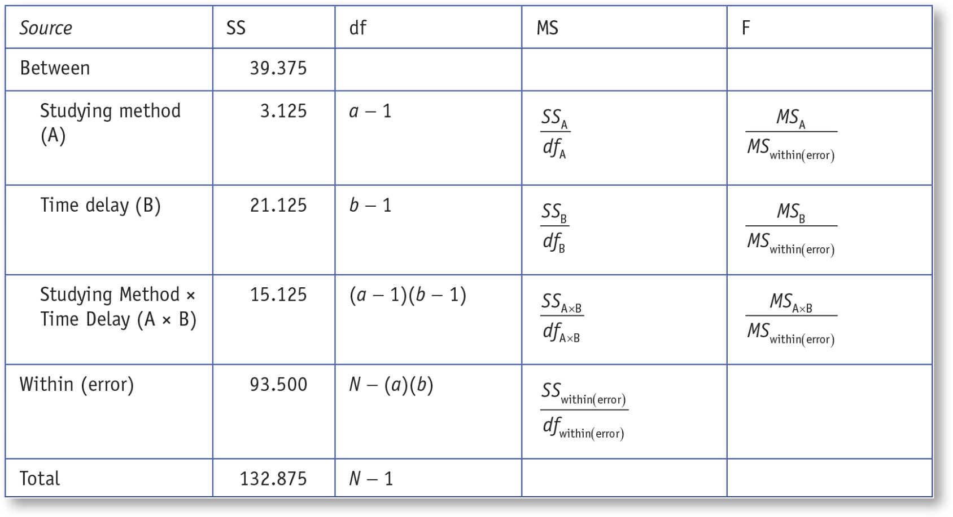
Table 12.10: Formulas for df, MS, and F for a Two-Way Independent Samples ANOVA
Notes:
Use SPSS to perform a two-factor ANOVA and create a graph of the main effects and interaction

Slide 40
4a. F Test for the Interaction
The F value testing the interaction between studying method and time delay is 4.53.
The obtained F value of 4.53 is larger than the critical F value, so you reject the interaction null hypothesis.
This means that the different pattern of simple effects for 5-min and 2-day delays shown in Figure 12.1 are not likely to be due to sampling error.
Notes:
Learning Objective: Compute a single-sample t by hand and using SPSS

Slide 41
4a. F Test for the Interaction
Specifically, this means that the difference between the simple effect for 5-min delay, 8.00 − 7.25 = .75, is significantly different from the difference between the simple effect for 2-day delay, 5.00 − 7.00 = −2.00.
The difference between .75 and −2.00 is unlikely to be created by sampling error.
Notes:
Learning Objective: Determine whether you should reject each null hypothesis

Slide 42
4a. F Test for the Interaction
The simple effect for 5 min (.75) was not a significant difference and the simple effect for 2 days was a significant difference (−2.00).
We will show you how to make SPSS perform these simple effects analyses later in the chapter.
Notes:
Learning Objective: Determine whether you should reject each null hypothesis

Slide 43
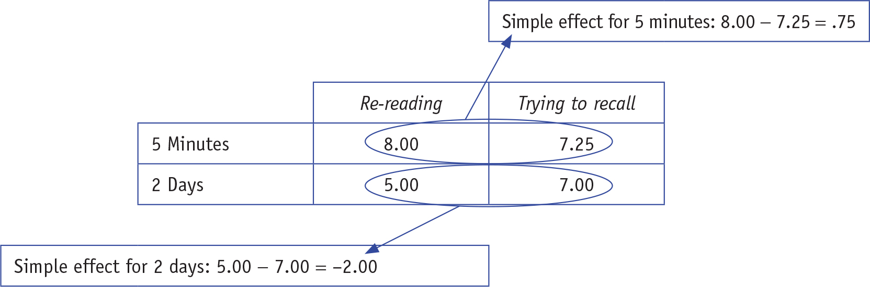
Figure 12.1: Simple Effects Tested by Interaction F Test
Notes:
Use SPSS to perform a two-factor ANOVA and create a graph of the main effects and interaction

Slide 44
4b. F Test for the First Main Effect (Study Method)
The F value for the main effect of study method is 0.94.
The critical value of F for this main effect is 4.20.
The obtained F is not greater than the critical value, so you do not reject the studying method null hypothesis.
Notes:
Learning Objective: Determine whether you should reject each null hypothesis

Slide 45
4b. F Test for the First Main Effect (Study Method)
You conclude that overall, the two studying methods lead to similar exam scores for those who reread (M = 6.50) and those who tried to recall (M = 7.13).
Notes:
Learning Objective: Determine whether you should reject each null hypothesis

Slide 46
4c. F Test for the Second Main Effect (Study Method)
The F value for the main effect of time delay is 4.529, and the critical value of F for this main effect is 4.20.
The obtained F is greater than the critical value, so you reject the time delay null hypothesis.
Notes:
Learning Objective: Determine whether you should reject each null hypothesis

Slide 47
4c. F Test for the Second Main Effect (Study Method)
Conclude that overall, the participants who experienced the longer time delay (M = 6.00) had significantly lower exam scores than those who took the exam 5 min after studying (M = 7.63).
Notes:
Learning Objective: Determine whether you should reject each null hypothesis

Slide 48
Step 5: Compute the Effect Sizes and Describe It
After determining if each null hypothesis is rejected, the next step is computing an effect size for each test and interpreting them.

Slide 49
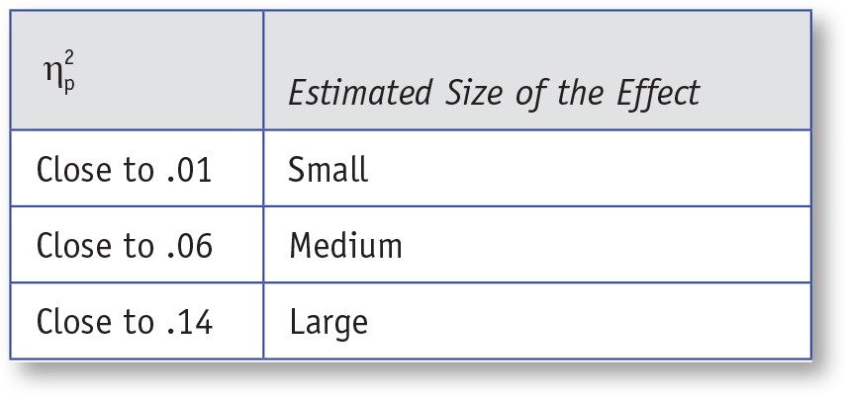

Table 12.11: General Guidelines for Interpreting
Notes:
Use SPSS to perform a two-factor ANOVA and create a graph of the main effects and interaction

Slide 50
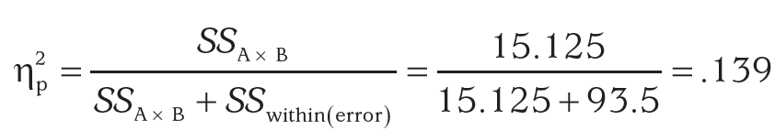
5a: Effect Size for the Interaction (Study Method by Time Delay)
The effect size for the interaction effect is .139, a large effect.
Notes:
Learning Objective: Compute effect sizes for each main effect and the interaction, and describe each as small, medium, or large

Slide 51
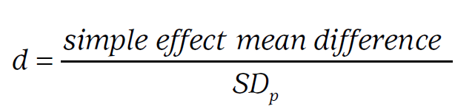
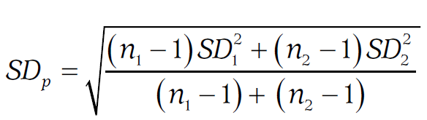
5a: Effect Size for the Interaction (Study Method by Time Delay)
Compute the effect size for each simple effect.
Notes:
Learning Objective: Compute effect sizes for each main effect and the interaction, and describe each as small, medium, or large
SD_{p} is the pooled standard deviation.
p. 455

Slide 52
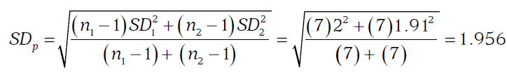

5a: Effect Size for the Interaction (Study Method by Time Delay)
The effect size for the simple effect study method (reread vs. recall) after a 5-min time delay is d = .383, a small to medium effect.
Notes:
Learning Objective: Compute effect sizes for each main effect and the interaction, and describe each as small, medium, or large

Slide 53
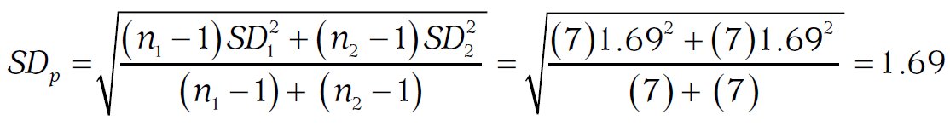
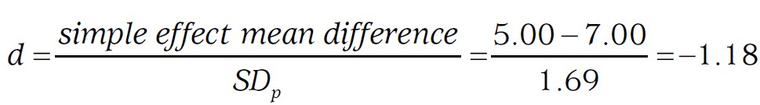
5a: Effect Size for the Interaction (Study Method by Time Delay)
The effect size for the simple effect of study method (reread vs. recall) after a 2-day delay is d = −1.18, a large effect.
Notes:
Learning Objective: Compute effect sizes for each main effect and the interaction, and describe each as small, medium, or large
p. 456
“Note that the sign of the effect sizes indicates the direction of the effect. After a 5-minute delay (i.e., the first simple effect), the people who reread the material did better than those who tried to recall the material, yielding a positive effect size that is small to medium. After a 2-day delay (i.e., the second simple effect), you subtracted in the same direction (reread - recall), which yielded a negative effect that is large.”

Slide 54
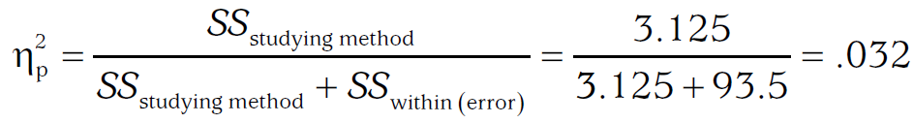
5b: Effect Size for the First Main Effect (Study Method)
The effect size for Study Method is 0.032, which is a small to medium effect.
Notes:
Learning Objective: Compute effect sizes for each main effect and the interaction, and describe each as small, medium, or large

Slide 55
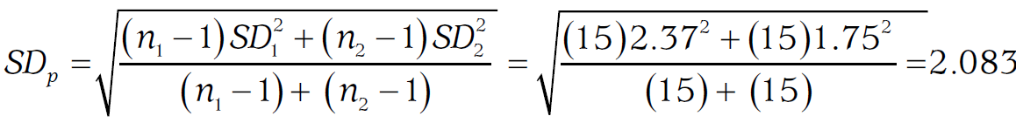
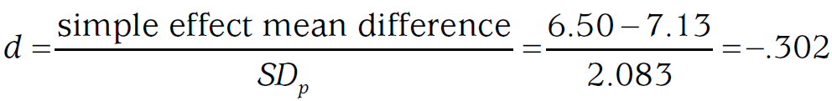
5b: Effect Size for the First Main Effect (Study Method)
d for the main effect of studying method is −.302, a small to medium effect.
Notes:
Learning Objective: Compute effect sizes for each main effect and the interaction, and describe each as small, medium, or large

Slide 56
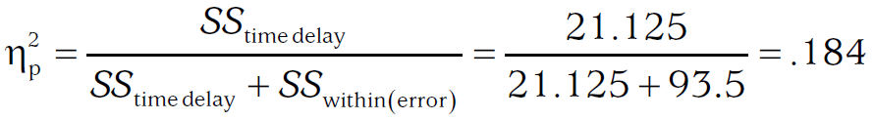
5c: Effect Size for the Second Main Effect (Time Delay)
The effect size for Time Delay is .184, which is a large effect.
Notes:
Learning Objective: Compute effect sizes for each main effect and the interaction, and describe each as small, medium, or large

Slide 57
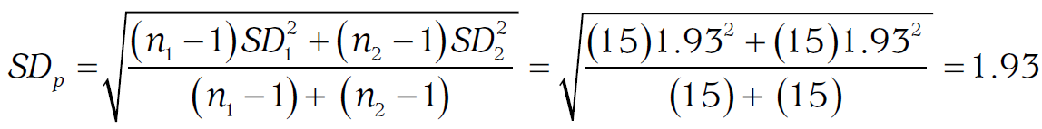
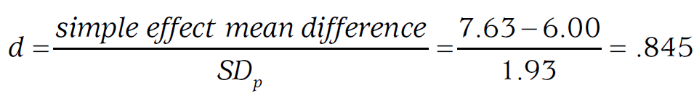
5c: Effect Size for the Second Main Effect (Time Delay)
d for the main effect of time delay is .845, which is a large effect.
Notes:
Learning Objective: Compute effect sizes for each main effect and the interaction, and describe each as small, medium, or large

Slide 58
Step 6: Writing Up the Results of a Two-Way ANOVA
Create a table to report the cell means and standard deviations as well as the marginal means and standard deviations. Once this information is in the table, you do not need to report the means and standard deviations in your write-up. Instead, refer the readers to the table.

Slide 59
Step 6: Writing Up the Results of a Two-Way ANOVA
Tell whether or not the interaction was significant and report the statistical information in the correct format.
If the interaction is significant, describe the interaction, using one sentence to describe each simple effect. Include the p value from the simple effect as well as the d.

Slide 60
Step 6: Writing Up the Results of a Two-Way ANOVA
Tell whether or not the first main effect was significant and report the statistical information in the correct format.
If the first main effect was significant, describe which marginal mean(s) was (were) significantly higher.

Slide 61
Step 6: Writing Up the Results of a Two-Way ANOVA
Tell whether or not the second main effect was significant and report the statistical information in the correct format.
If the second main effect was significant, describe which marginal mean(s) was (were) significantly higher.

Slide 62
SPSS

Slide 63
Data File
The SPSS data file should have three columns:
one for the first IV (studying method),
one for the second IV (time delay),
and one for the DV (exam score).
Your file should have 32 rows, 1 row for each person.
Notes:
Learning Objective: Use SPSS to perform a two-factor ANOVA and create a graph of the main effects and interaction

Slide 64
Data File
Coding the IVs
Studying method (Stidu_Method)
1 = person reread
2 = person recalled
Time delay (Time_Delay)
1 = the person took the exam 5 min later
2 = the person took the exam 2 days later
Notes:
Learning Objective: Use SPSS to perform a two-factor ANOVA and create a graph of the main effects and interaction

Slide 65
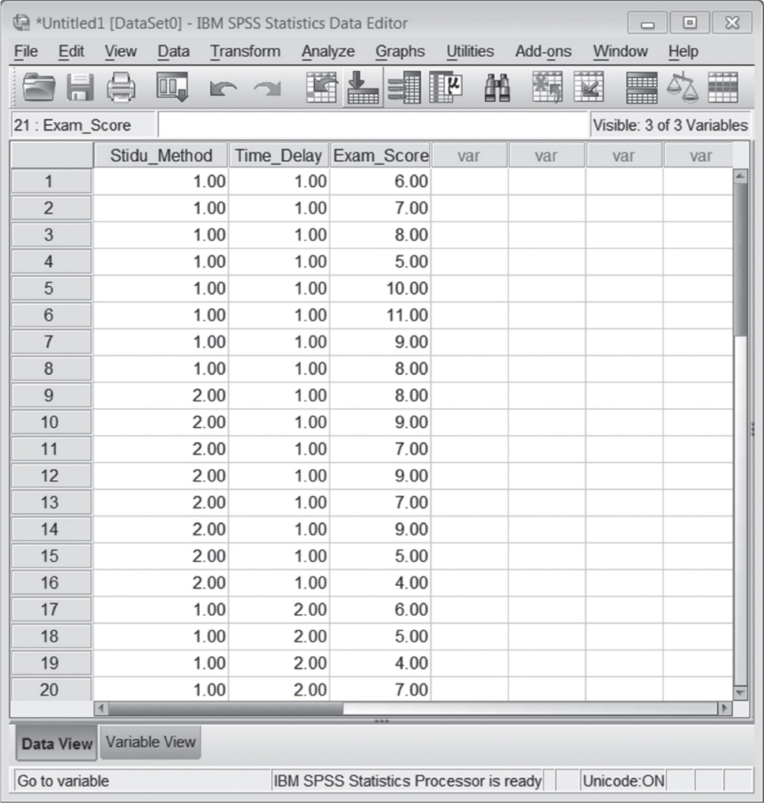
Figure 12.2: SPSS Screenshot of Data Entry Screen
Notes:
Learning Objective: Use SPSS to perform a two-factor ANOVA and create a graph of the main effects and interaction

Slide 66
Computing a Two-Way ANOVA
Click on the Analyze menu. Choose General Linear Model, and then select Univariate.
Move the DV into the Dependent Variable box.
Move both IVs to the Fixed Factors box.
Click on Options, and then Descriptive Statistics and Estimates of Effect Size.
Notes:
Learning Objective: Use SPSS to perform a two-factor ANOVA and create a graph of the main effects and interaction

Slide 67
Computing a Two-Way ANOVA
You can create graphs by clicking on the Plots button.
To graph the interaction, choose one IV (i.e., grouping variable) to put on the horizontal axis and one IV to make separate lines. Click Add and then Continue. In this case, we put time delay on the horizontal axis and made separate lines for studying method.

Slide 68
Computing a Two-Way ANOVA
To obtain confidence intervals:
Move everything that is in the Factor(s) and Factor interactions into the Display Means for box.
Click on Compare Main effects.
Select LSD(none) from the Confidence Interval Adjustment drop-down box.
Click on Continue and then OK.
Notes:
p. 459 “We did not include the confidence interval output for this analysis below. The confidence intervals are interpreted just like those in previous chapters.”

Slide 69
Computing a Two-Way ANOVA
To compute simple effects analysis for a two-factor ANOVA:
If you have a significant interaction, you need to rerun the ANOVA to obtain the simple effects analyses. Unfortunately, you cannot obtain simple effects tests through the point-and-click method, so you will need to learn a new procedure.
Notes:
Learning Objective: Use SPSS to compute simple effect analyses

Slide 70
Computing a Two-Way ANOVA
Begin the same way as when you conducted the ANOVA. Click on the Analyze menu.
Choose General Linear Model and then select Univariate.
Move the DV into the Dependent Variable box.
Move both IVs (in this case, study method and time delay) to the Fixed Factors box.
Notes:
Learning Objective: Use SPSS to compute simple effect analyses

Slide 71
Computing a Two-Way ANOVA
Click on Options and then
Move one IV (in this case, study method) into the Display Means for box
Click on Compare Main effects
Select Bonferroni from the Confidence Interval Adjustment drop-down box
Click on Continue
Notes:
Learning Objective: Use SPSS to compute simple effect analyses

Slide 72
Computing a Two-Way ANOVA
Click the Paste button. This will open a syntax window. You need to change one line of syntax to get SPSS to run the simple effects analyses.
Notes:
Learning Objective: Use SPSS to compute simple effect analyses

Slide 73
Computing a Two-Way ANOVA
In the syntax file, you will see something like the following:
/EMMEANS = TABLES(Study_Method) COMPARE ADJ(BONFERRONI)
This syntax needs to be edited so that it includes both IVs: /EMMEANS = TABLES(Study_Method*Time_Delay) COMPARE (Time_Delay) ADJ(BONFERRONI)
After you have edited this line, click on Run→All.
Notes:
Learning Objective: Use SPSS to compute simple effect analyses
p. 459
“After you run the analysis, much of the output will look like the output you obtained when doing the ANOVA. However, there is a new table that provides information about the simple effects. This table is titled “Pairwise comparisons” and is described at the end of the SPSS output.”

Slide 74
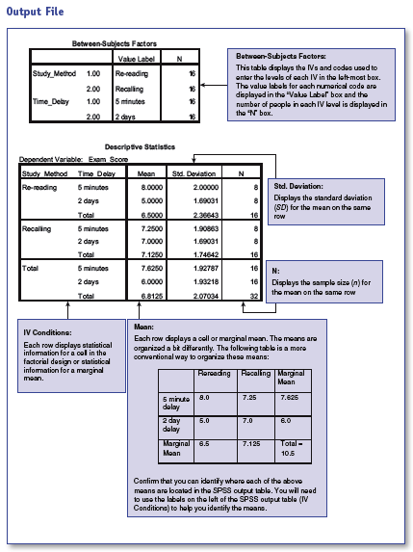
Notes:
p. 460, no table or figure number

Slide 75
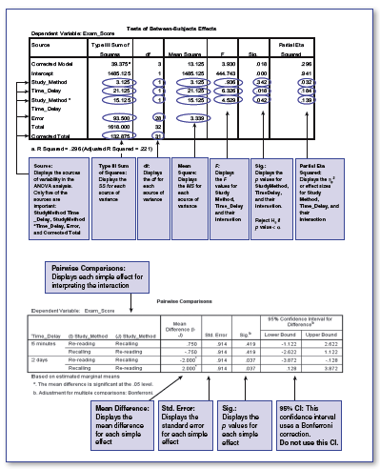
Notes:
p. 461. no table or figure number

Slide 76
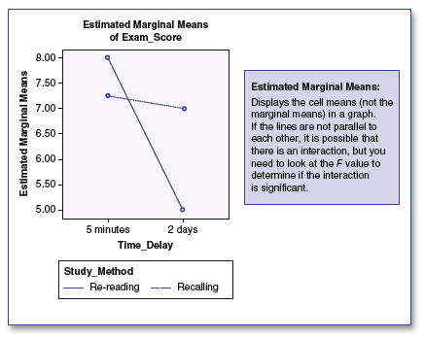
Notes:
p. 462, no table or figure number

Slide 77

APA Style Summary
A 2 (Studying Method: Rereading or Trying to Recall) × 2 (Time Delay: 5 Minutes or 2 Days) factorial ANOVA revealed a significant interaction between studying method and time delay on exam score, F(1, 28) = 4.53, p = .04, MSE = 3.34, = .14 (see Table 1 for means and standard deviations).
Notes:
p. 463, no table number for text

Slide 78
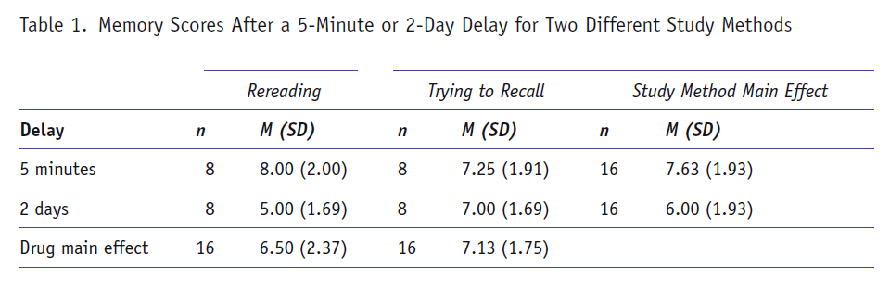
APA Style Summary
Notes:
p. 463, no table number for text

Slide 79
APA Style Summary
The results indicate that when taking an exam 5 min after studying, participants who studied by rereading versus recalling did not have meaningfully different exam scores, p = .42, d = 0.37. However, when taking an exam 2 days after studying, participants who studied by trying to recall material scored substantially higher than those who studied by rereading, p = .04, d = 1.18.

Slide 80
APA Style Summary
There was also a significant main effect of time delay: F(1, 28) = 6.33, p = .02, = .18. Overall, participants who took the exam 5 min after studying scored significantly higher than those who took the exam 2 days later, d = .84. Finally, the main effect of studying method was not significant, F(1, 28) = 0.94, p = .34, = .03.

Slide 81
APA Style Summary
When the results were averaged across time delay conditions, the participants who tried to recall the information did not receive significantly higher scores than the participants who reread the information (d = −.31). This main effect suggests that, overall, the studying methods were equally effective, but this main effect is misleading.

Slide 82
APA Style Summary
The significant interaction suggests that when students are studying immediately before an exam, rereading and trying to recall are equally effective studying methods, but when studying for a more distant exam, trying to recall material is a far superior studying strategy.

