Slide 2
An Introduction to Statistics An Active Learning Approach
Chapter 13: Correlation and Regression

Slide 3
Topics to Cover
Identify when to use Pearson’s and Spearman’s correlations
Interpret the sign and value of a correlation coefficient
Draw and interpret scatterplots by hand and using SPSS
Write null and research hypotheses using words and symbols

Slide 4
Topics to Cover
Compute the degrees of freedom (df) and determine the critical region
Compute a Pearson’s and Spearman’s correlation coefficients by hand (using a calculator)
Determine whether or not you should reject the null hypothesis

Slide 5
Topics to Cover
Compute an effect size (r²) and describe it
Summarize the results of the analysis using American Psychological Association (APA) style
Interpret the SPSS correlation output

Slide 6
When to Use Correlation and What They Can Tell You
A correlation coefficient is used to determine whether and how two variables might be related to each other.
Direction: positive or negative
Strength: close or far from 0
Notes:
Learning Objective: Identify when to use Pearson’s and Spearman’s correlations

Slide 7
Review of z Scores
A z score enables you to locate individual scores relative to other scores in the same or different distributions.
Positive z scores represent values that are above average.
The absolute value of a z score indicates how much better or worse a given score is than the mean score.
Notes:
Learning Objective: Identify when to use Pearson’s and Spearman’s correlations

Slide 8
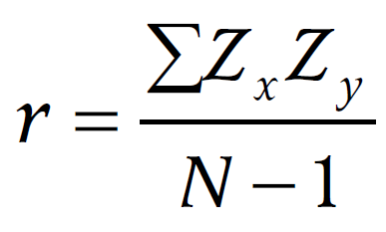
The Logic of Correlation
The correlation is the average product of each person’s pair of z scores.
Pearson’s r
Notes:
Learning Objective: Identify when to use Pearson’s and Spearman’s correlations

Slide 9
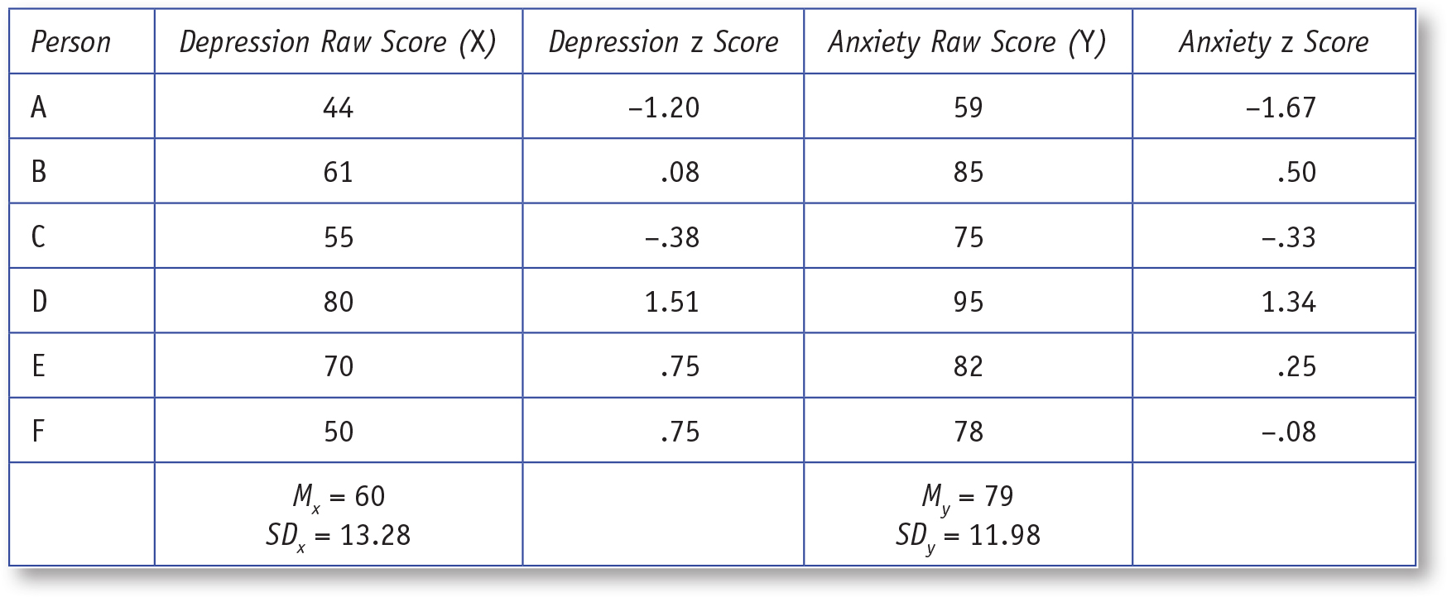
Table 13.1: Depression and Anxiety z Scores for Six People
Notes:
Learning Objective: Identify when to use Pearson’s and Spearman’s correlations

Slide 10
The Logic of Correlation
Depression and anxiety z scores are multiplied, and all the products are summed and then divided by the number of paired scores minus 1 (N − 1).
Notes:
Learning Objective: Interpret the sign and value of a correlation coefficient
p. 516
“A coefficient of 1 or −1 is the strongest association that is possible. Thus, the correlation of .89 indicates that the relationship between depression and anxiety is very strong.”

Slide 11
Direction and Strength of Correlation Coefficients
Correlation coefficients can vary between −1 and +1.
The sign of the coefficient reveals the direction of the variables’ relationship.
A positive correlation reveals that the variables tend to have similar values.
A negative correlation reveals that the variables tend to have opposing values.
A coefficient of 1 or −1 is the strongest association that is possible.
Notes:
Learning Objective: Interpret the sign and value of a correlation coefficient

Slide 12
Direction and Strength of Correlation Coefficients
Researchers frequently use scatterplot graphs to examine the relationship between variables.
Figure 13.1 shows that the relationship between depression and anxiety is positive and strong.
The trend from the lower left to the upper right indicates the relationship is positive.
The data points form an “organized” line which indicates a strong relationship.
Notes:
Learning Objective: Interpret the sign and value of a correlation coefficient

Slide 13
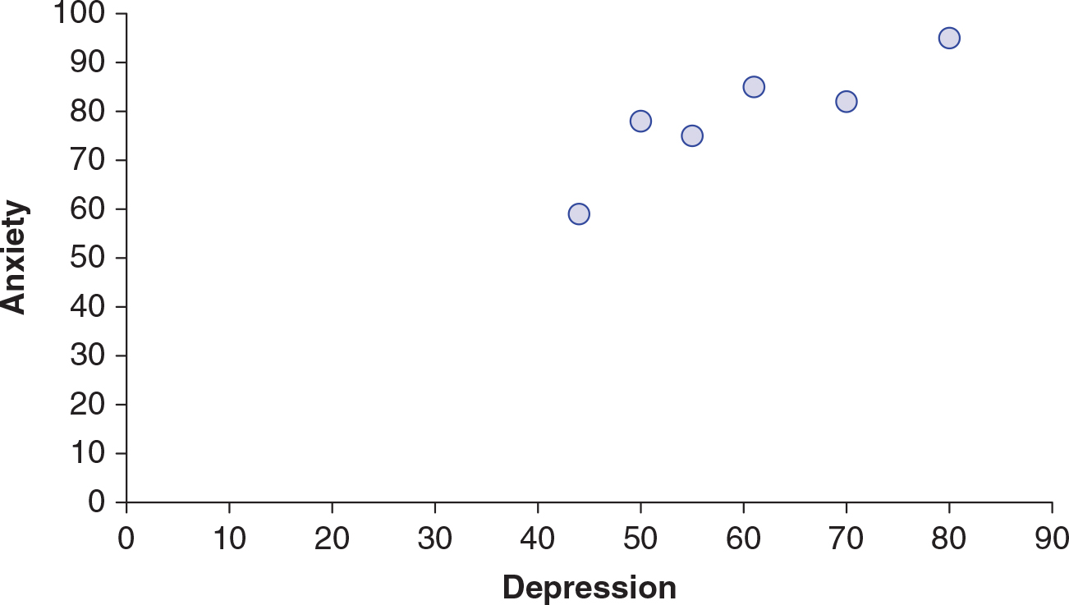
Figure 13.1: Scatterplot of Depression and Anxiety Scores
Notes:
Learning Objective: Interpret the sign and value of a correlation coefficient

Slide 14
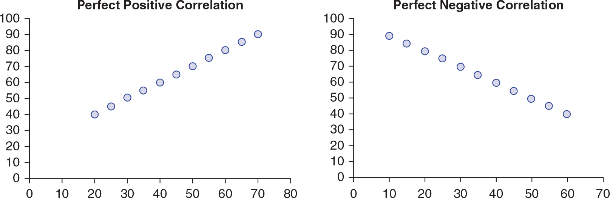
Figure 13.2: Perfect Positive and Negative Correlation Scatterplots
Notes:
Learning Objective: Interpret the sign and value of a correlation coefficient

Slide 15
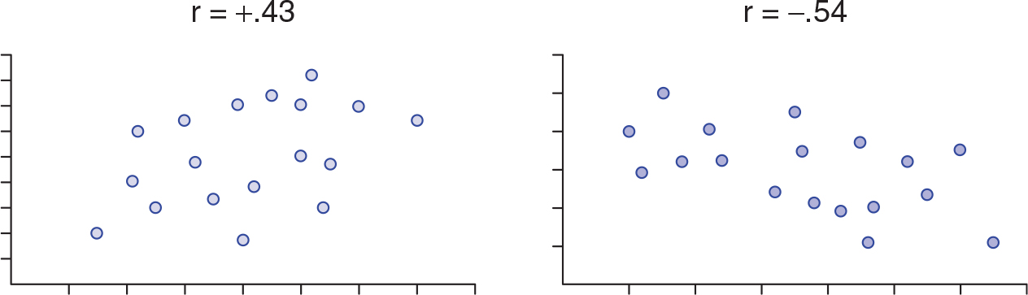
Figure 13.3: Scatterplots for Different Correlation Coefficients
Notes:
Learning Objective: Interpret the sign and value of a correlation coefficient

Slide 16
Computational Formulas
Definitional formulas
help explain the logic of a statistic but can be cumbersome when working with a large data set
Computational formulas
allow you to compute an r value directly from raw scores without first converting everything to z scores

Slide 17
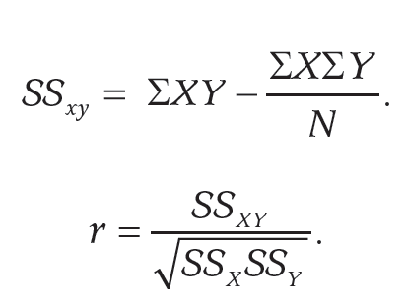
Computational Formulas
Pearson’s r
Used when both variables are measured on interval or ratio scales.
Notes:
Learning Objective: Compute a Pearson’s and Spearman’s correlation coefficients by hand (using a calculator) p. 520, no figure or table number

Slide 18
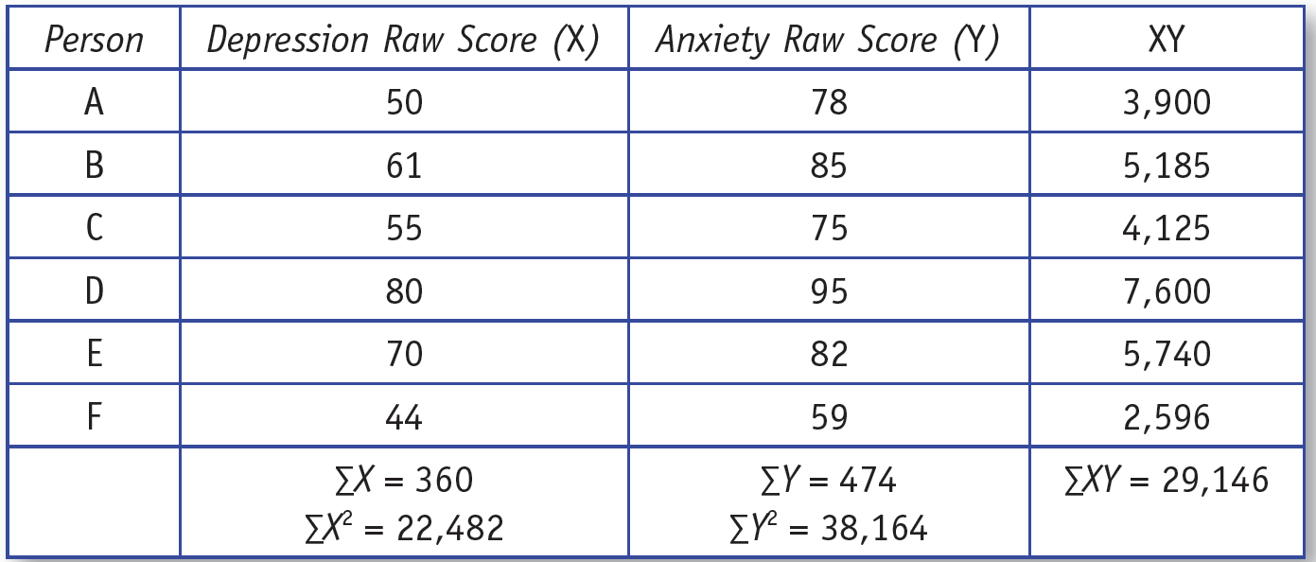
Computational Formulas
Notes:
Learning Objective: Compute a Pearson’s and Spearman’s correlation coefficients by hand (using a calculator)
p. 520, no table or figure number

Slide 19
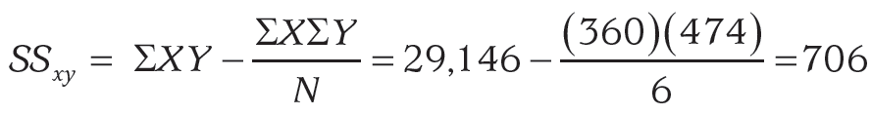
Computational Formulas
The numerator of the correlation (SS_{xy}) is
Notes:
Learning Objective: Compute a Pearson’s and Spearman’s correlation coefficients by hand (using a calculator)
p. 520, no figure or table number

Slide 20
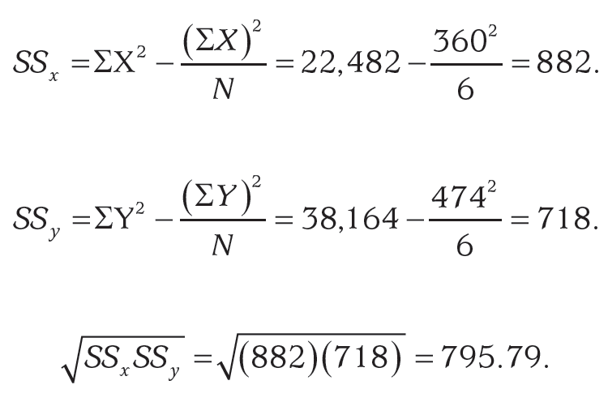
Computational Formulas
The denominator of the correlation (SS_{x}) is
Notes:
Learning Objective: Compute a Pearson’s and Spearman’s correlation coefficients by hand (using a calculator)
p. 520, no figure or table number

Slide 21
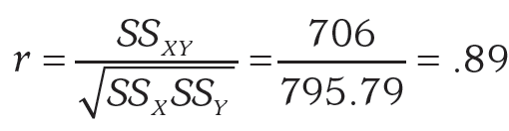
Computational Formulas
The r is .89, which is positive and strong, because it is near +1.00.
Notes:
Learning Objective: Compute a Pearson’s and Spearman’s correlation coefficients by hand (using a calculator) Learning Objective: Interpret the sign and value of a correlation coefficient
p. 520, no figure or table number

Slide 22
Spearman’s (rs) Correlations
Spearman’s rs is used to compute correlations when one or both variables are ordinal.
The computations for a Spearman’s correlation involve analyzing the rank orders of two variables rather than the variables themselves.
If one variable is ordinal and the other isn’t, you need to use a Spearman’s correlation and begin by converting the other variable to ranks.
Notes:
Learning Objective: Identify when to use Pearson’s and Spearman’s correlations

Slide 23
Using Scatterplots Prior to Correlation Coefficients
Pearson’s correlation is only appropriate if there is a linear trend between the variables.
A Spearman’s correlation can be used with monotonic trends, such as shown in Figure 13.4
Monotonic
the data have a trend in only one direction but not necessarily a linear trend.
Notes:
Learning Objective: Identify when to use Pearson’s and Spearman’s correlations

Slide 24
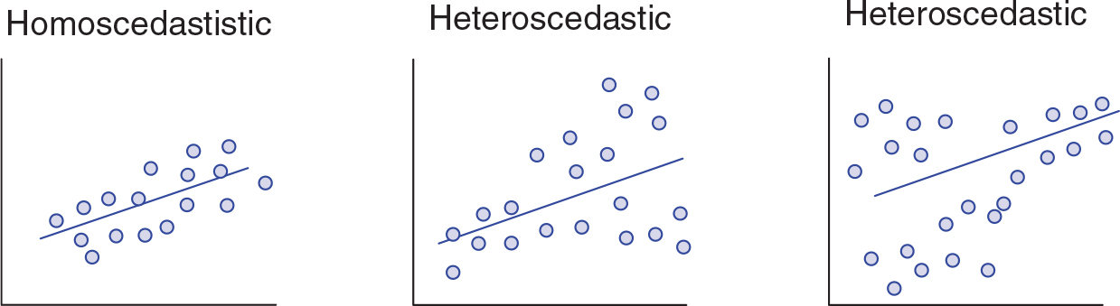
Figure 13.5: Graphs Representing Heteroscedasticity and Homoscedasticity
Notes:
Learning Objective: Identify when to use Pearson’s and Spearman’s correlations

Slide 25
Alternative Use for Correlation
A correlation can be used only if the scores on each variable are paired or linked to each other in some way.
Most of the time you have scores from the same person.
Sometimes you can have paired scores from different people, such as marital satisfaction scores from both people in a marriage.
Notes:
Learning Objective: Identify when to use Pearson’s and Spearman’s correlations

Slide 26
Correlation and Cauasation
Correlation does not equal causation.
In fact, no statistic, by itself, allows researchers to infer causality.
To support a causal claim, there are two requirements.
Establish that the two variables are significantly related to each other.
Establish that there are no confounds or alternative explanations for the statistical association.
Notes:
Learning Objective: Identify when to use Pearson’s and Spearman’s correlations
p. 524
“As mentioned in other chapters of this text, eliminating confounds is research methods issue. If you take a research methods course, you will learn how to control for confounds so you can eliminate alternative explanations. For now, you should understand that no statistic allows you to infer a causal relationship between an IV and a DV unless confounds are controlled. However, if confounds are controlled, every test statistic can support a causal conclusion, even correlation. So, the key point is “no statistical relationship equals causation.” We know it doesn’t
rhyme like the more famous phrase, but it is more accurate.”

Slide 27
Hypothesis Testing With Correlation
As with other statistics, researchers collect data from a representative sample and infer that the results they find approximate the results they would have found for the Pearson’s r or Spearman’s r if they had studied the entire population.

Slide 28
Hypothesis Testing With Correlation
The null hypothesis for correlation is that the two variables being studied are not associated.
If the null were true, the calculated r value would be close to 0.
If the calculated r value is far from 0, the null is not likely to be true.
Notes:
Learning Objective: Determine whether or not you should reject the null hypothesis

Slide 29
Hypothesis Testing With Correlation
As with other statistics, you use a critical value to define “far from 0.”
The critical value of r changes based on the sample size (df = N − 2).
Appendix E shows critical r values.
If the obtained r value is more extreme than the critical value (i.e., farther from 0), you should reject the null hypothesis.
Notes:
Learning Objective: Determine whether or not you should reject the null hypothesis

Slide 30
Two-Tailed Pearson’s Correlation Example
Notes:
Learning Objective: Compute a Pearson’s and Spearman’s correlation coefficients by hand (using a calculator) Learning Objective: Determine whether or not you should reject the null hypothesis Learning Objective: Compute an effect size (r2) and describe it Learning Objective: Summarize the results of the analysis using American Psychological Association (APA) style

Slide 31
Example
You want to know if people who feel grateful about their own lives are more or less likely to want to help others.
To investigate this relationship, you have participants complete a questionnaire that measures gratitude and another that measures attitudes toward helping others.
Notes:
Learning Objective: Compute a Pearson’s and Spearman’s correlation coefficients by hand (using a calculator)

Slide 32
Example
Both variables are measured on an interval/ratio scale and are computed such that higher scores indicate greater gratitude and stronger prosocial beliefs.
You do not understand these variables well enough to predict a positive or negative relationship; you just want to know if gratitude and prosocial beliefs are associated at all.
Notes:
Learning Objective: Compute a Pearson’s and Spearman’s correlation coefficients by hand (using a calculator)

Slide 33
Example
The data from this study are given in Table 13.2.
In this example, we will only use the computational formula for the r.
Notes:
Learning Objective: Compute a Pearson’s and Spearman’s correlation coefficients by hand (using a calculator)

Slide 34
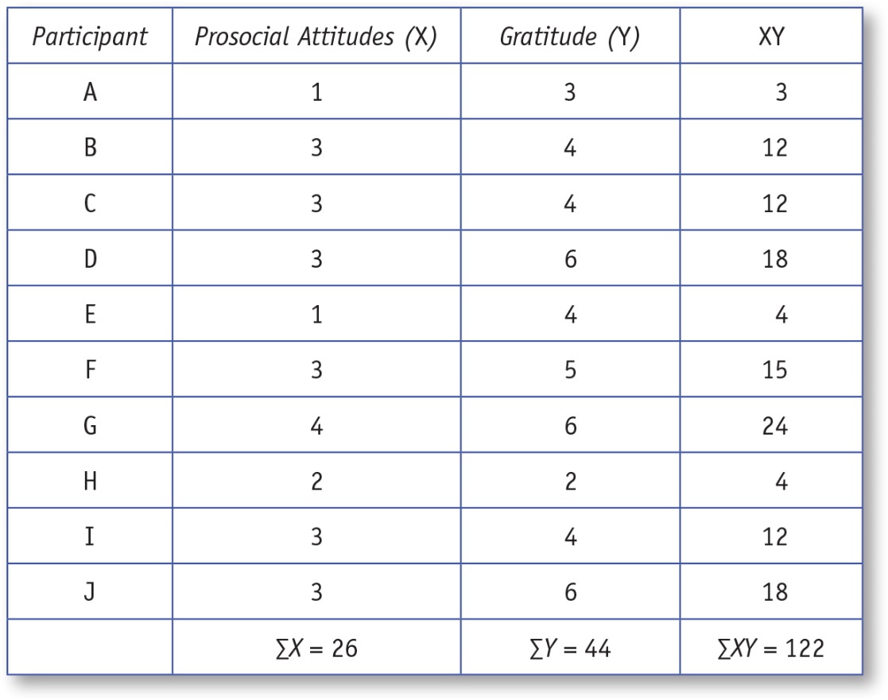
Table 13.2: Computation of a Correlation Coefficient Using the Definitional z Score Formulas
Notes:
Learning Objective: Identify when to use Pearson’s and Spearman’s correlations

Slide 35
Step 1: Assess Statistical Assumptions
Data independence
data collected from each participant must not be influenced by the responses of other participants.

Slide 36
Step 1: Examine the Statistical Assumptions
Appropriate measurement of variables assumption
For a Pearson’s Correlation both variables must be interval/ratio data.
For a Spearman’s Correlation one or both variables must be ordinal data.

Slide 37
Step 1: Examine the Statistical Assumptions
Normality assumption
Researchers typically assess this assumption by creating a histogram of each variable, and if the sample data have a normal shape, they assume that the population also has a normal shape.

Slide 38
Step 1: Examine the Statistical Assumptions
Linear trend versus monotonic trend
Review the scatterplot for the two variables.
If the data has a linear trend and interval/ratio data use a Pearson correlation.
If the data has a monotonic, but no linear trend, use a Spearman’s correlation. Transform the data into ranks if variables were interval/ratio data.

Slide 39
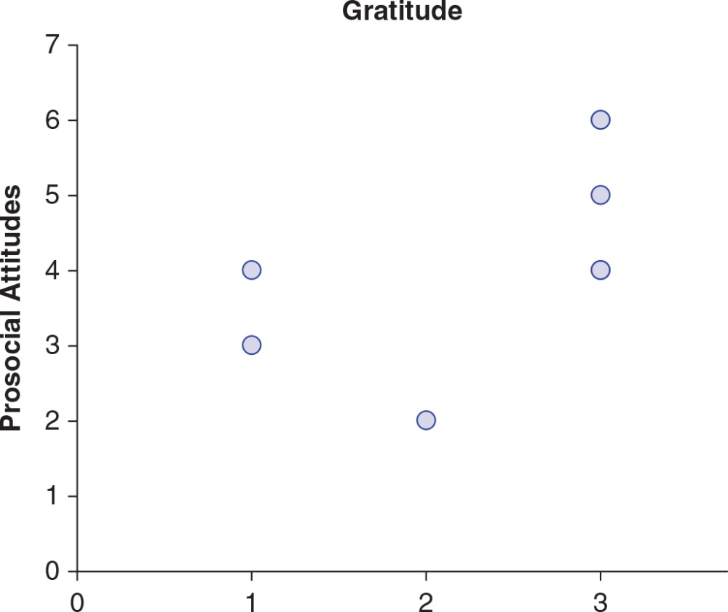
Figure 13.7: Scatterplot of Gratitude and Prosocial Attitudes
Notes:
Learning Objective: Identify when to use Pearson’s and Spearman’s correlations

Slide 40
Step 2: State Null and Research Hypotheses Symbolically and Verbally
For Pearson’s Correlation
The research hypothesis is that the two variables have a linear relationship.
The null hypothesis is that they do not have a linear relationship.
Notes:
Learning Objective: Write null and research hypotheses using words and symbols
Note, these are for Pearson’s correlation.

Slide 41
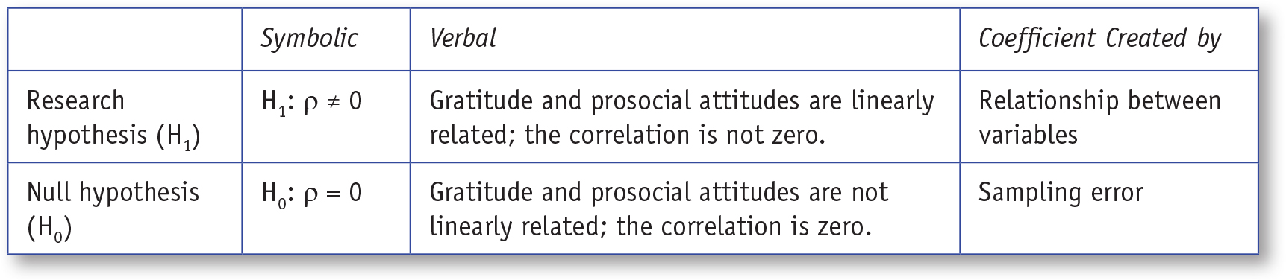
Table 13.3: Symbolic and Verbal Representations of Two-Tailed Research and Null Hypotheses for a Pearson’s Correlation
Notes:
Learning Objective: Write null and research hypotheses using words and symbols

Slide 42
Step 3: Define the Critical Region
The degrees of freedom formula for correlations is df = N − 2, where N is the number of paired scores.
df = N − 2 = 10 − 2 = 8
Appendix E shows the two-tailed critical values for Pearson’s r.
For df = 8, the critical r values = +.632 and −.632
If the obtained r value is more extreme than these values, the null hypothesis should be rejected.
Notes:
Learning Objective: Compute the degrees of freedom (df) and determine the critical region

Slide 43
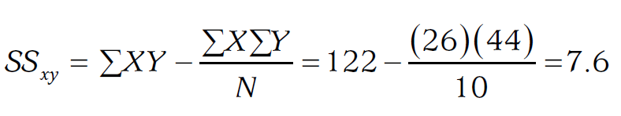
Step 4: Compute the Test Statistic (Pearson’s r)
See Table 13.2 for initial computations
The numerator of the correlation (SS_{xy}) is computed as
Notes:
Learning Objective: Compute a Pearson’s and Spearman’s correlation coefficients by hand (using a calculator)

Slide 44
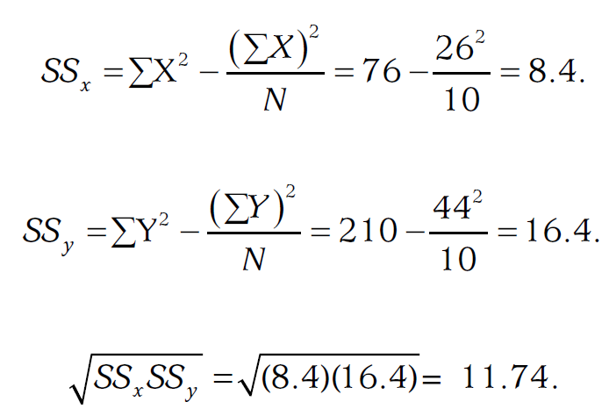
Step 4: Compute the Test Statistic (Pearson’s r)
See Table 13.2 for initial computations
The denominator of the correlation (SS_{x}) is computed as
Notes:
Learning Objective: Compute a Pearson’s and Spearman’s correlation coefficients by hand (using a calculator)

Slide 45
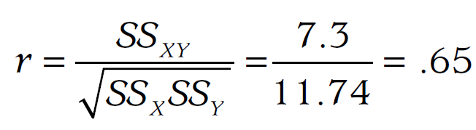
Step 4: Compute the Test Statistic (Pearson’s r)
The Pearson’s r is .65
Notes:
Learning Objective: Compute a Pearson’s and Spearman’s correlation coefficients by hand (using a calculator)

Slide 46
Step 5: Compute an Effect Size (r²) and Describe It
Coefficient of determination (r²)
r² = (.65)2 = .42
It is typically interpreted as a percentage (multiply it by 100 to get 42%).
It indicates that 42% of the variability in prosocial attitudes is predicted by the variability in gratitude scores
Notes:
Learning Objective: Compute an effect size (r²) and describe it

Slide 47
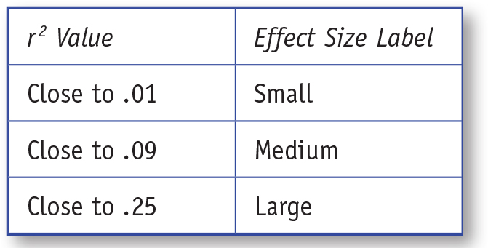
Table 13.4: General Guidelines for Interpreting r²
Notes:
Learning Objective: Write null and research hypotheses using words and symbols

Slide 48
Step 6: Interpreting the Results of the Hypothesis Test
There is a positive association between gratitude and prosocial attitudes, r(8) = .65, p < .05. That is, those with higher gratitude scores also tended to have more positive attitudes toward helping others.
Notes:
Learning Objective: Summarize the results of the analysis using American Psychological Association (APA) style

Slide 49
One-Tailed Pearson’s Correlation Example
Notes:
Learning Objective: Compute a Pearson’s and Spearman’s correlation coefficients by hand (using a calculator) Learning Objective: Determine whether or not you should reject the null hypothesis Learning Objective: Compute an effect size (r2) and describe it Learning Objective: Summarize the results of the analysis using American Psychological Association (APA) style

Slide 50
Example
Now, you are interested in replicating your previous work on gratitude and prosocial attitudes at your college.
In your previous study, you found a strong positive association and you expect to find a similar relationship at your college.
Notes:
Learning Objective: Compute a Pearson’s and Spearman’s correlation coefficients by hand (using a calculator)

Slide 51
Example
Therefore, your research hypothesis is that there will be a positive linear correlation between these variables.
You collect data from 10 students attending your college.
The data are presented in Table 13.5.
Notes:
Learning Objective: Compute a Pearson’s and Spearman’s correlation coefficients by hand (using a calculator)

Slide 52
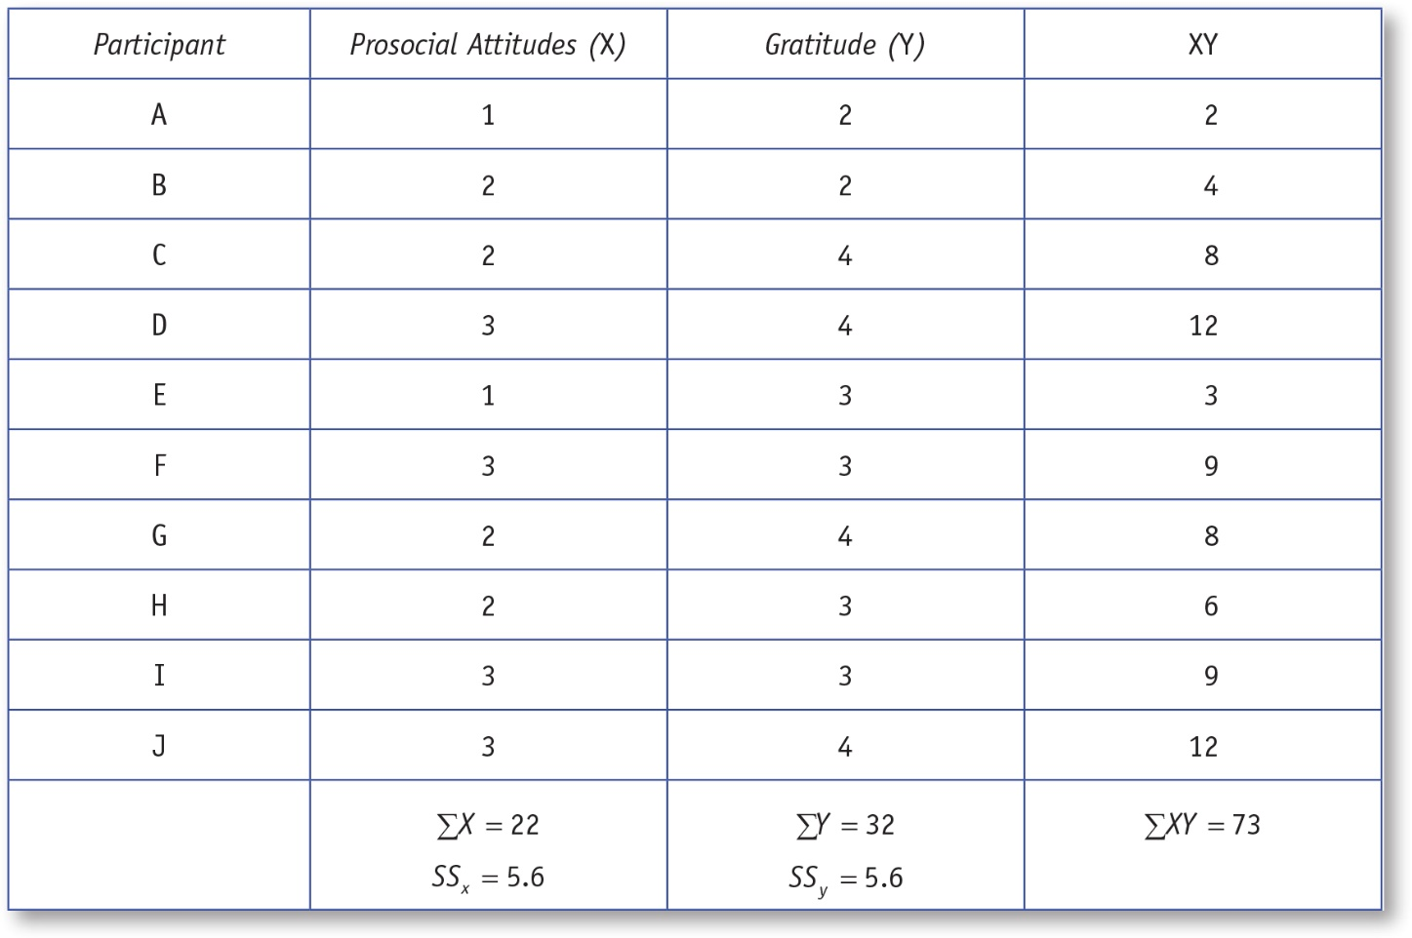
Table 13.5: Computation of a Correlation Coefficient Using the Computational Formulas
Notes:
Learning Objective: Compute a Pearson’s and Spearman’s correlation coefficients by hand (using a calculator)

Slide 53
Step 1: Assess Statistical Assumptions
All of the statistical assumptions are met.
Insepection of the scatterplot reveals a sufficiently linear trend to conduct a Pearson’s correlation.
The data for this example are plotted in Figure 13.8.
Notes:
Learning Objective: Identify when to use Pearson’s and Spearman’s correlations

Slide 54
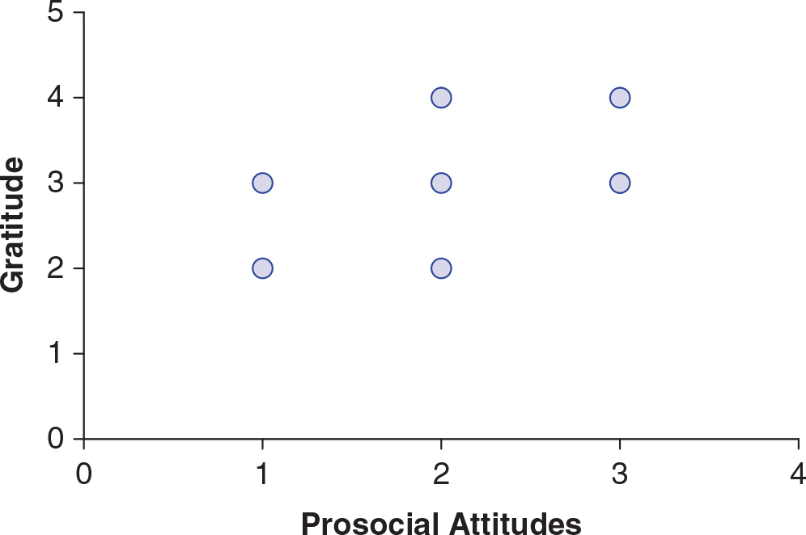
Figure 13.8: Scatterplot of Scores for Prosocial Attitudes and Gratitude
Notes:
Learning Objective: Draw and interpret scatterplots by hand and using SPSS

Slide 55
Step 2: State Null and Research Hypotheses Symbolically and Verbally
Given the results of your previous study, you are predicting a positive correlation between gratitude and prosocial attitudes, so you correctly choose to do a one-tailed significance test.
The null and research hypotheses are presented in Table 13.6.
Notes:
Learning Objective: Write null and research hypotheses using words and symbols
Note, these are for Pearson’s correlation.

Slide 56
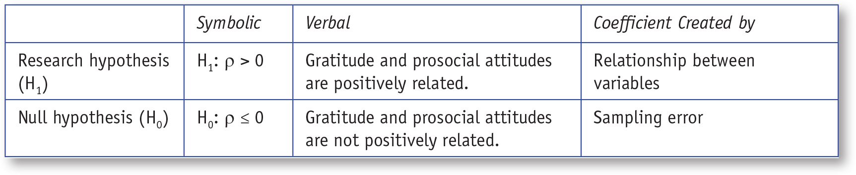
Table 13.6: Symbolic and Verbal Representations of the One-Tailed Research and Null Hypotheses for a Pearson’s Correlation

Slide 57
Step 3: Define the Critical Region
The degrees of freedom formula for correlations is df = N − 2, where N is the number of paired scores.
df = N − 2 = 10 − 2 = 8
Appendix E shows the one-tailed critical values for Pearson’s r.
For df = 8, the critical r value = +.549
If the obtained r value is larger than this value, the null hypothesis should be rejected.
Notes:
Learning Objective: Compute the degrees of freedom (df) and determine the critical region

Slide 58
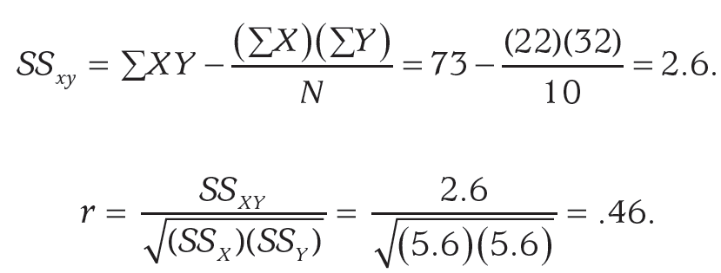
Step 4: Compute the Test Statistic (Pearson’s r)
See Table 13.5 for initial computations.
The obtained r value of .46 is Not greater than .549, which means gratitude and prosocial attitudes were not significantly positively correlated in your sample.
Notes:
Learning Objective: Compute a Pearson’s and Spearman’s correlation coefficients by hand (using a calculator)

Slide 59
Step 5: Compute an Effect Size (r²) and Describe It
Coefficient of determination (r²)
r² = (.46)2 = .21
This indicates a medium to large, positive association between gratitude and prosocial attitudes.
The medium to large effect size suggests that the two variables may be associated but the sample size was too small to detect the relationship between the variables.
Notes:
Learning Objective: Compute an effect size (r²) and describe it
It indicates that 21% of the variability in prosocial attitudes is predicted by the variability in gratitude scores.

Slide 60
Step 6: Interpreting the Results of the Hypothesis Test
The students’ gratitude scores and prosocial attitudes were not significantly correlated, r(8) = .46, p > .05. However, the medium to large association between the variables suggests that the null hypothesis may not have been rejected because the sample size (N = 10) was too small. A larger sample size is needed to study the relationship between these variables.
Notes:
Learning Objective: Summarize the results of the analysis using American Psychological Association (APA) style

Slide 61
What If You Need to Do a Spearman’s Correlation?
Spearman’s correlation analyzes the ranks of the scores rather than the scores themselves.
If a scatterplot is monotonic rather than linear, you must do a Spearman’s correlation rather than a Pearson’s correlation.
Notes:
Learning Objective: Compute a Pearson’s and Spearman’s correlation coefficients by hand (using a calculator)

Slide 62
What If You Need to Do a Spearman’s Correlation?
If your variables are not already ranks, you must first convert all of the scores for Variable 1 into ranks and all of the scores for Variable 2 into ranks.
Table 13.7 displays how the raw scores for each variable would be converted into ranks for a small data set of four scores for each variable.
Higher scores represent better scores for both Variable 1 and Variable 2.
Notes:
Learning Objective: Compute a Pearson’s and Spearman’s correlation coefficients by hand (using a calculator)

Slide 63
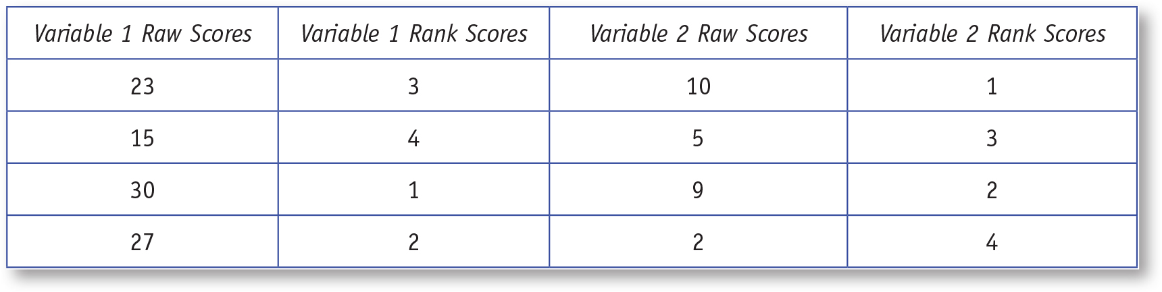
Table 13.7: Converting Raw Scores Into Rank Scores for Spearman’s Correlation
Notes:
p. 532
“After converting the raw scores for Variables 1 and 2 into ranks, the remaining steps for computing Spearman’s correlation are the same as those for Pearson’s correlation. If you are using SPSS to conduct a Spearman’s correlation, the program will convert the raw scores to ranked scores for you. The only thing you will have to do is indicate that you want a Spearman’s rather than a Pearson’s correlation.”

Slide 64
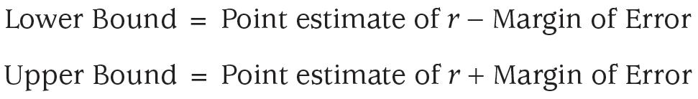
Confidence Intervals
You begin with a point estimate, which is the r you calculate, and then you subtract the margin of error to obtain the lower bound of the confidence interval and add the margin of error to obtain the upper bound.
Notes:
Learning Objective: Compute a Pearson’s and Spearman’s correlation coefficients by hand (using a calculator)
p. 533
“Although the format of the confidence interval is identical to the confidence intervals you computed around means and mean differences, there are some differences in the computations. These differences are discussed in Activity 13.2.”
The formulas can be found on p. 547 in Activity 13.2. You will also need Appendix G and Appendix A

Slide 65
SPSS
Draw and interpret scatterplots by hand and using SPSSInterpret the SPSS correlation output
Notes:
Learning Objective: Interpret the SPSS correlation output

Slide 66
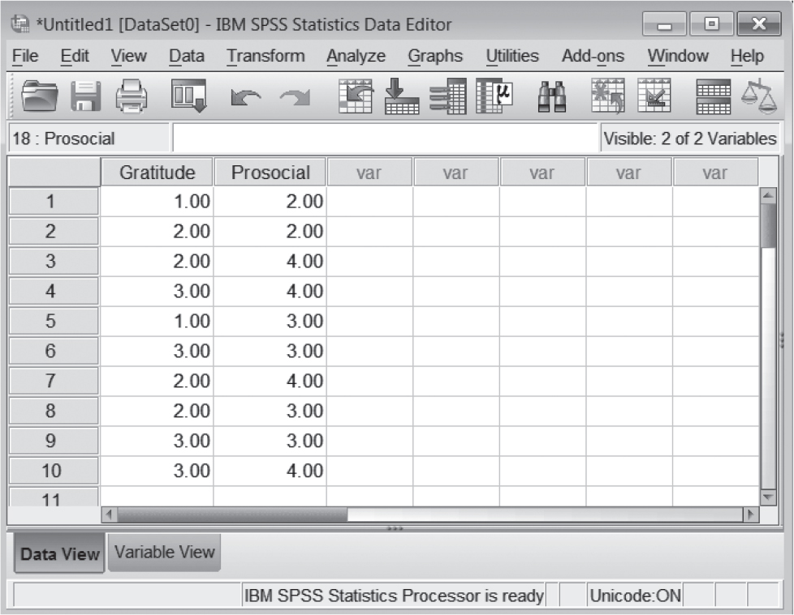
Figure 13.9: SPSS Screenshot of Data Entry Screen
Notes:
Learning Objective: Interpret the SPSS correlation output

Slide 67
Creating a Scatterplot
Option 1 (Legacy Dialogs)
Go to the Graphs menu. Choose Legacy Dialogs, and then select Scatter/Dot.
Choose Simple Scatter and click Define.
Put one variable on the x-axis and the other variable on the y-axis.
Notes:
Learning Objective: Draw and interpret scatterplots by hand and using SPSS

Slide 68
Creating a Scatterplot
Option 2 (Chart Builder)
Go to the Graphs menu and select Chart Builder.
A box may pop up that warns you to make sure that the appropriate level of measurement is specified in the data file. Close this box by clicking on OK.
Notes:
Learning Objective: Draw and interpret scatterplots by hand and using SPSS

Slide 69
Creating a Scatterplot
Option 2 (Chart Builder)
You will see two windows. One is labeled “Element Properties,” and the other is labeled “Chart Builder.” Close the Element Properties window.
To create the scatterplot, click on the Gallery tab on the lower half of the screen, and then click on “Scatter/Dot.”
Notes:
Learning Objective: Draw and interpret scatterplots by hand and using SPSS

Slide 70
Creating a Scatterplot
Option 2 (Chart Builder)
Once you have done that, there will be several pictures of different types of scatterplots.
Double click on the first one. If you hold your cursor over it, it will say “Simple Scatter.”
Notes:
Learning Objective: Draw and interpret scatterplots by hand and using SPSS

Slide 71
Creating a Scatterplot
Option 2 (Chart Builder)
Next, you need to indicate which variable you want on the x-axis and which you want on the y-axis. Just choose one variable from the Variable box and drag it onto the x-axis, and then drag the other variable onto the y-axis. Click OK to create the scatterplot.
Notes:
Learning Objective: Draw and interpret scatterplots by hand and using SPSS

Slide 72
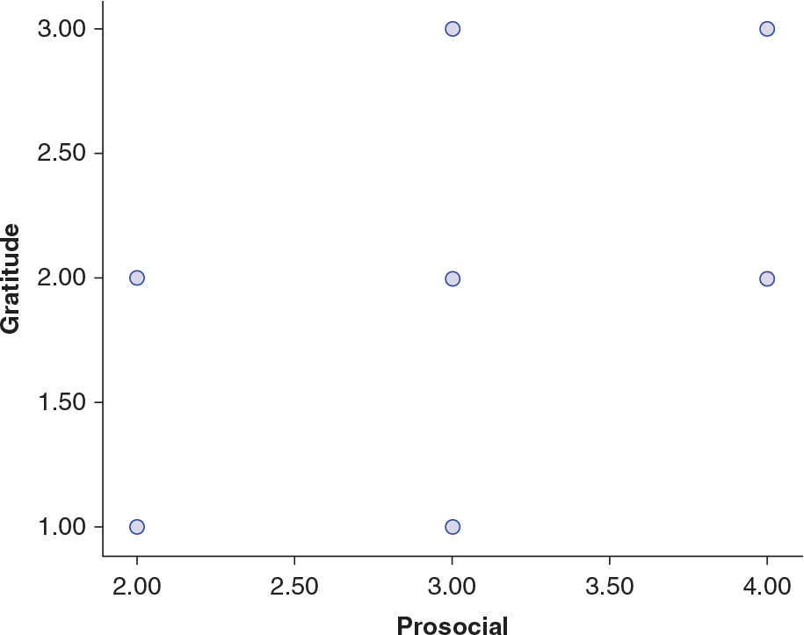
Figure 13.10: SPSS Screenshot of Scatterplot
Notes:
Learning Objective: Draw and interpret scatterplots by hand and using SPSS

Slide 73
Computing a Correlation
Go to the Analyze menu. Choose Correlate and then select Bivariate.
Move the variables you want a correlation for into the Variables box.
Check Pearson’s or Spearman’s correlation.
Notes:
Learning Objective: Interpret the SPSS correlation output

Slide 74
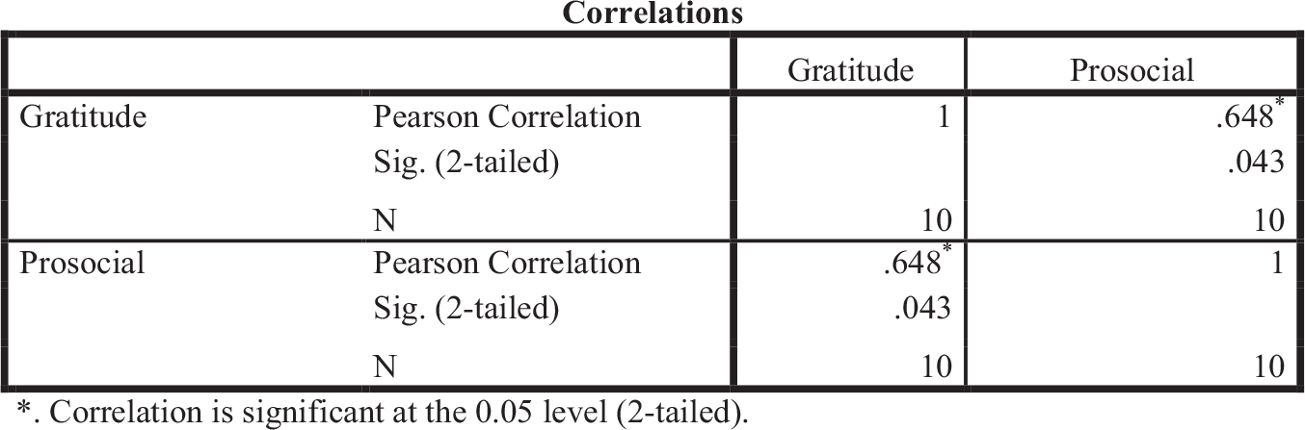
Figure 13.11: SPSS Screenshot of Correlation Output
Notes:
Learning Objective: Interpret the SPSS correlation output Learning Objective: Determine whether or not you should reject the null hypothesis

Slide 75
Computing a Correlation
Figure 13.11 shows a correlation matrix for a Pearson’s correlation.
The correlation, r, is .648 with a p-value of .043 (shown in the Sig. two-tailed row).
When the sample size is N = 10, an r value of .648 would be expected to occur about four times out of 100 due to sampling error.
Because the p-value of .043 is less than equal to an α of .05, you reject the null hypothesis.
Notes:
Learning Objective: Interpret the SPSS correlation output Learning Objective: Determine whether or not you should reject the null hypothesis

