Slide 2
An Introduction to Statistics An Active Learning Approach
Chapter 14: Goodness-of-Fit and Independence Chi-Square Statistics
Notes:
p. 567

Slide 3
Topics to Cover
Describe the difference between a goodness-of-fit chi-square and a chi-square test of independence and identify when to use each
Describe the logic of the chi-square statistic

Slide 4
Topics to Cover
Write the null and research hypotheses for goodness-of-fit chi-square and a chi-square test of independence
Compute the chi-square statistic and determine whether the null hypothesis should be rejected
Summarize the results of a chi-square

Slide 5
Overview of Chi-Square
You can use a chi-square statistic when the data are frequency counts for different categories.
goodness-of-fit chi-square
used to analyze the relative frequencies of different categories within a single variable.
chi-square test of independence
used to determine if the relative frequencies within the categories of one variable are associated with the relative frequencies within the categories of a second variable.
Notes:
Learning Objective: Describe the difference between a goodness-of-fit chi-square and a chi-square test of independence, and identify when to use each

Slide 6
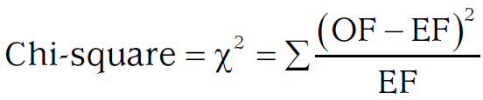
Logic of the Chi-Square Test
Both chi-square tests use the same logic and formula
Notes:
Learning Objective: Describe the logic of the chi-square statistic

Slide 7
Logic of the Chi-Square Test
Observed frequencies
the actual frequency counts collected from the sample.
Expected frequencies
the exact frequency counts expected if the null hypothesis is true, given the study’s sample size.
Notes:
Learning Objective: Describe the logic of the chi-square statistic

Slide 8
Logic of the Chi-Square Test
A very important assumption of both types of chi-squares is that if an expected frequency is less than 5, a chi-square should not be performed.
Notes:
Learning Objective: Describe the logic of the chi-square statistic
p. 569
The authors continue by saying “until after the sample size is increased.”

Slide 9
Logic of the Chi-Square Test
Numerator
computes the difference between the observed frequency (the actual data) and the expected frequency.
If the null is true and there were no sampling error, the observed frequency and the expected frequency would be identical and the numerator would be zero.
Notes:
Learning Objective: Describe the logic of the chi-square statistic
p. 569
The authors continue by saying “until after the sample size is increased.”

Slide 10
Logic of the Chi-Square Test
Denominator
contains only the expected frequency
helps determine how big the numerator difference must be to be considered “large”
Notes:
Learning Objective: Describe the logic of the chi-square statistic
p. 569
The authors continue by saying “until after the sample size is increased.”

Slide 11
Logic of the Chi-Square Test
If the null hypothesis is true, the final obtained chi-square value is likely to be close to zero.
If the null hypothesis is false, the obtained chi-square value is likely to be far from zero.
If the obtained chi-square is greater than the critical value, you should reject the null hypothesis.
Notes:
Learning Objective: Describe the logic of the chi-square statistic
p. 569
The authors continue by saying “until after the sample size is increased.”

Slide 12
Comparing the Goodness-of-Fit Chi-Square and the Chi-Square for Independence
Both
Analyze frequency counts
Test a null hypothesis
Use the same formula
Compare an obtained chi-square value with a critical value to determine if the null hypothesis should be rejected.
Goodness-of-Fit
analyzes a single variable
Chi-Square for Independence
analyzes the association between two variables.
Notes:
Learning Objective: Describe the difference between a goodness-of-fit chi-square and a chi-square test of independence, and identify when to use each

Slide 13
Goodness-of-fit Chi-Square Example
Compute the chi-square statistic and determine if the null hypothesis should be rejected
Notes:
Learning Objective: Compute the chi-square statistic and determine if the null hypothesis should be rejected

Slide 14
Example
Suppose you wanted to know if voters’ affiliation with political parties is significantly different today than it was 2 years ago.
Democrats = 50%
Republicans = 30%
Independents = 20%
A sample of voters indicate with which political party they most often affiliate: Democrat, Republican, or Independent.
Example data are presented in Table 14.1.
Notes:
Learning Objective: Compute the chi-square statistic and determine if the null hypothesis should be rejected

Slide 15
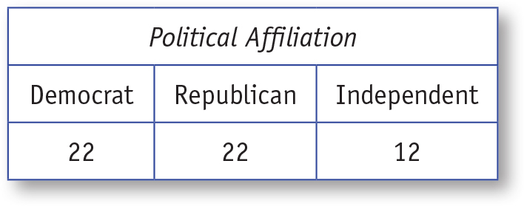
Table 14.1: Number of People Identifying With Each Political Affiliation
Notes:
Learning Objective: Compute the chi-square statistic and determine if the null hypothesis should be rejected

Slide 16
Step 1: Examine the Statistical Assumptions
Data independence
Collect data carefully so that the responses from each individual are uninfluenced by the responses of other participants
Notes:
Learning Objective: Compute the chi-square statistic and determine if the null hypothesis should be rejected

Slide 17
Step 1: Examine the Statistical Assumptions
Appropriate measurement of variables assumption
The data should be frequency counts of category membership.
Notes:
Learning Objective: Compute the chi-square statistic and determine if the null hypothesis should be rejected

Slide 18
Step 1: Examine the Statistical Assumptions
Expected frequency values must be larger than 5
If any of the expected frequencies are less than 5, you should collect more data before you run your chi-square analysis.
Notes:
Learning Objective: Compute the chi-square statistic and determine if the null hypothesis should be rejected

Slide 19
Step 2: State the Null and Research Hypotheses
In this scenario, the null hypothesis is that the proportions of people affiliating with each party will be the same as they were 2 years ago.
Democrats = 50%
Republicans = 30%
Independents = 20%
The research hypothesis is that the proportions of people affiliating with each party will be different from what they were 2 years ago.
Notes:
Learning Objective: Write the null and research hypotheses for goodness-of-fit chi-square and a chi-square test of independence

Slide 20
Step 3: Compute the Degrees of Freedom and Define the Critical Regions
In a chi-square, the df is based on the number of categories in the study.
The df for a goodness-of-fit chi-square is df = categories – 1.
In this example, df = 3 – 1 = 2.
Appendix G shows the critical value of 5.99 for df = 2 and a = .05.
If the computed chi-square value is >5.99, you should reject the null hypothesis.
Notes:
Learning Objective: Compute the chi-square statistic and determine if the null hypothesis should be rejected

Slide 21
Step 4: Compute the Test Statistic (Goodness-of-Fit Chi-Square)
4a. Determine the Expected Frequencies Defined by the Null Hypothesis
4b. Compute the Obtained Value
Notes:
Learning Objective: Compute the chi-square statistic and determine if the null hypothesis should be rejected

Slide 22
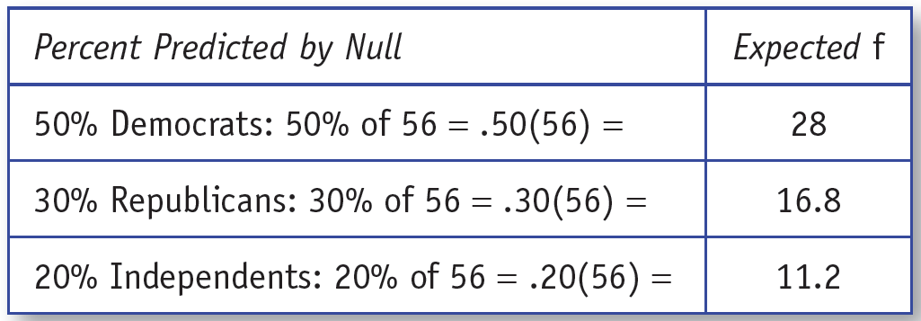
4a. Determine the Expected Frequencies Defined by the Null Hypothesis
Compute expected frequencies by converting the percentages (or proportions) stated in the null hypothesis into the exact frequencies expected, given the study’s sample size.
Notes:
Learning Objective: Compute the chi-square statistic and determine if the null hypothesis should be rejected
p. 572, no table or figure number
Remember to check the assumption that all cells expected frequencies of greater than 5
“In this case, all of the expected frequencies are larger than 5, so you can compute the chi-square test statistic.”

Slide 23
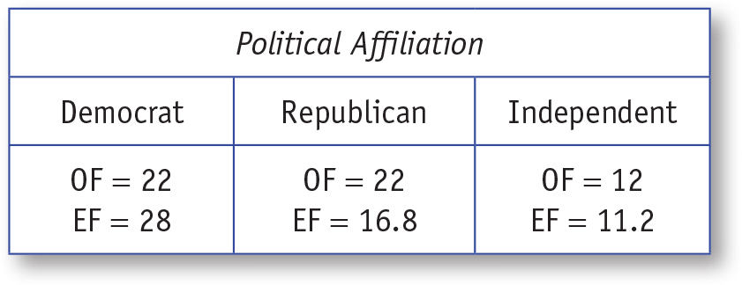
Table 14.4: Observed Frequencies (OF) and Expected Frequencies (EF) for Each Political Affiliation
Notes:
Learning Objective: Compute the chi-square statistic and determine if the null hypothesis should be rejected

Slide 24
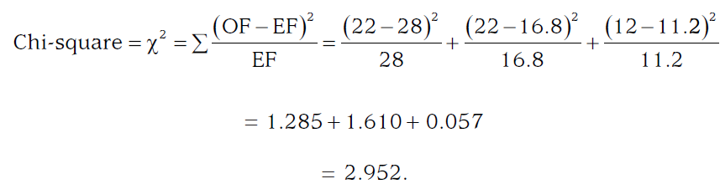
4b. Compute the Obtained Value
The observed and expected frequencies are presented in Table 14.4
Notes:
Learning Objective: Compute the chi-square statistic and determine if the null hypothesis should be rejected
P. 573 “Refer to Cohen (1988) if you are interested in computing effect sizes for a goodness-of-fit chi-square.”

Slide 25
4b. Compute the Obtained Value
The obtained chi-square value of 2.952 is not greater than the critical chi-square value of 5.99.
Therefore, you should not reject the null hypothesis.
Notes:
Learning Objective: Compute the chi-square statistic and determine if the null hypothesis should be rejected

Slide 26
Step 5: Interpreting the Results
The political affiliations with the Democratic, Republican, and Independent parties reported by the sample of voters from this county are not significantly different from those reported 2 years ago, χ²(2, N = 56) = 2.952, p > .05.
Notes:
Learning Objective: Summarize the results of a chi-square

Slide 27
Chi-Square for Independence
Compute the chi-square statistic and determine if the null hypothesis should be rejected
Notes:
Learning Objective: Compute the chi-square statistic and determine if the null hypothesis should be rejected

Slide 28
Example
Suppose you wanted to know if people’s political affiliation was associated with their opinion of a Democratic president’s policies.
A sample of voters indicate with which political party they most often affiliate (Democrat, Republican, or Independent) and their opinion of a Democratic president’s policies (approve or disapprove).
Example data are presented in Table 14.2.
Notes:
Learning Objective: Compute the chi-square statistic and determine if the null hypothesis should be rejected

Slide 29
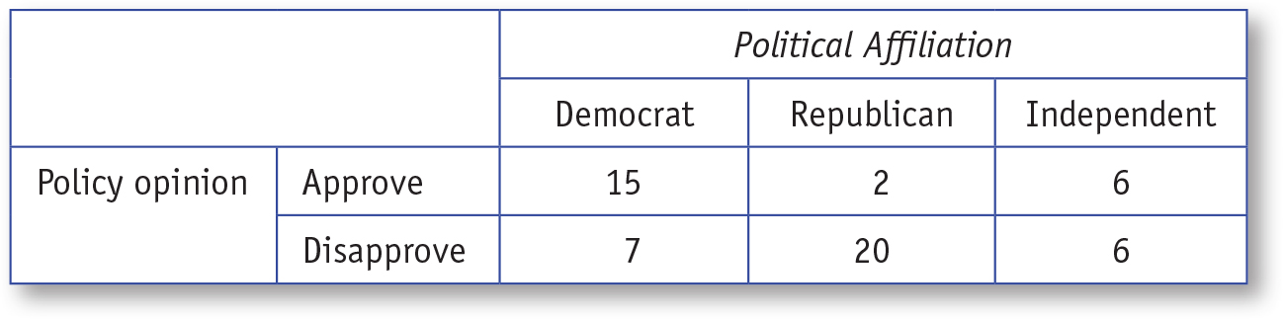
Table 14.2: Number of People Identifying With Each Political Affiliation by Approval of the President’s Policies
Notes:
Learning Objective: Compute the chi-square statistic and determine if the null hypothesis should be rejected

Slide 30
Step 1: Examine the Statistical Assumptions
The chi-square for independence has the same assumptions as the goodness-of-fit chi-square—specifically,
Individuals’ responses must not be influenced by other responses (data independence)
The data must be frequency counts (appropriate variable measurement),
All expected frequency values must be larger than 5
Notes:
Learning Objective: Compute the chi-square statistic and determine if the null hypothesis should be rejected

Slide 31
Step 2: State the Null and Research Hypotheses
This chi-square’s null hypothesis states that the two variables in the study are not associated (i.e., that the two variables are independent of each other).
The null hypothesis in this example would be “Policy opinion and political affiliation are not associated.”
The research hypothesis states that the two variables in the study are associated.
Notes:
Learning Objective: Write the null and research hypotheses for goodness-of-fit chi-square and a chi-square test of independence

Slide 32
Step 3: Compute the Degrees of Freedom and Define the Critical Regions
The df formula for a chi-square for independence
df = (Columns – 1) × (Rows – 1)
Where Columns = number of categories in the columns
Rows = number of categories in the rows
Notes:
Learning Objective: Compute the chi-square statistic and determine if the null hypothesis should be rejected

Slide 33
Step 3: Compute the Degrees of Freedom and Define the Critical Regions
In this example, Columns = 3 and Rows = 2.
The df is (3 − 1) × (2 − 1) = (2) × (1) = 2.
Appendix G shows the critical value of 5.99 for df = 2 and a = .05.
If the computed chi-square value is > 5.99, you should reject the null hypothesis.
Notes:
Learning Objective: Compute the chi-square statistic and determine if the null hypothesis should be rejected

Slide 34
Step 4: Compute the Test Statistic (Chi-Square for Independence)
4a. Determine the Expected Frequencies Defined by the Null Hypothesis
4b. Compute the Obtained Value
Notes:
Learning Objective: Compute the chi-square statistic and determine if the null hypothesis should be rejected

Slide 35
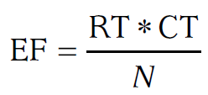
4a. Determine the Expected Frequencies Defined by the Null Hypothesis
Each cell’s expected frequency is based on the total frequency count of the row (RT) and column (CT) of which it is a part.
The total frequency counts for each row and column are presented in Table 14.5.
Notes:
Learning Objective: Compute the chi-square statistic and determine if the null hypothesis should be rejected
Remember to check the assumption that all cells expected frequencies of 5 or more.

Slide 36
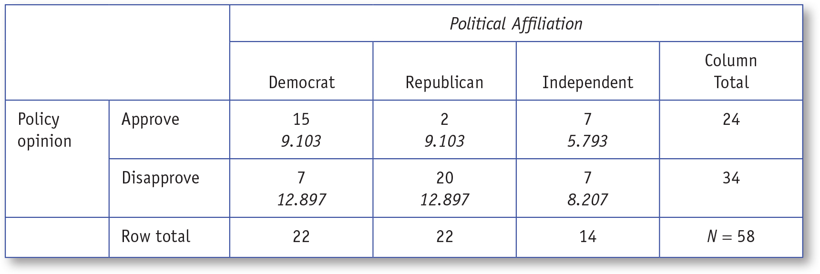
Table 14.5: Observed Frequencies (OF) and Expected Frequencies (EF) for Each Political Affiliation by Approval of the President’s Policies
Notes:
Learning Objective: Compute the chi-square statistic and determine if the null hypothesis should be rejected

Slide 37
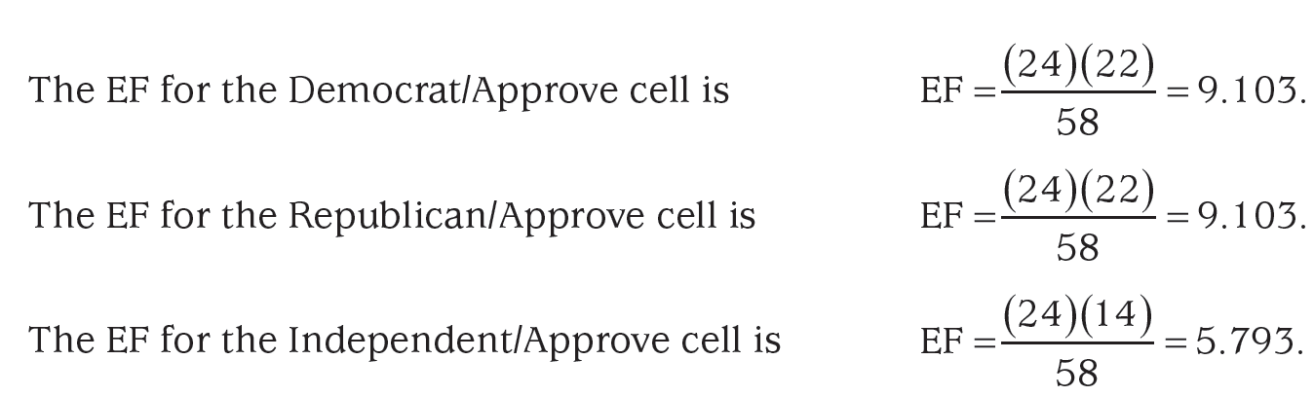
4a. Determine the Expected Frequencies Defined by the Null Hypothesis
Each expected frequencies are computed as follows:
Notes:
Learning Objective: Compute the chi-square statistic and determine if the null hypothesis should be rejected
Remember to check the assumption that all cells expected frequencies of 5 or more.

Slide 38
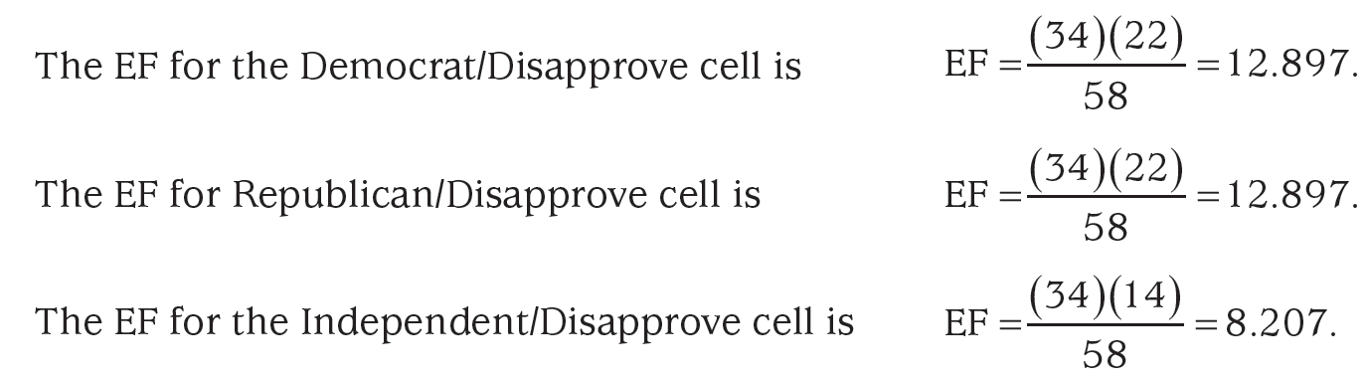
4a. Determine the Expected Frequencies Defined by the Null Hypothesis
Notes:
Learning Objective: Compute the chi-square statistic and determine if the null hypothesis should be rejected
Remember to check the assumption that all cells expected frequencies of 5 or more.

Slide 39
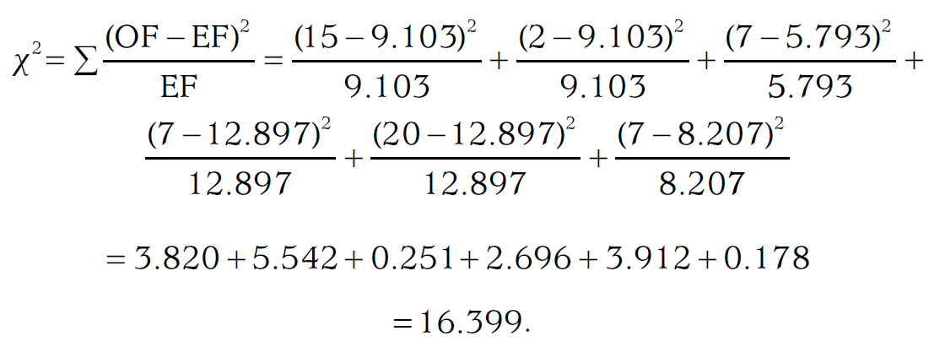
4b. Compute the Obtained Value
The observed and expected frequencies are presented in Table 14.5
Notes:
Learning Objective: Compute the chi-square statistic and determine if the null hypothesis should be rejected
P. 573 “Refer to Cohen (1988) if you are interested in computing effect sizes for a goodness-of-fit chi-square.”

Slide 40
4b. Compute the Obtained Value
The obtained chi-square value of 16.399 is greater than the critical chi-square value of 5.99.
Therefore, you should reject the null hypothesis.
Notes:
Learning Objective: Compute the chi-square statistic and determine if the null hypothesis should be rejected

Slide 41
4b. Compute the Obtained Value
The differences between the observed and expected frequency counts were large enough that they were unlikely to have been created by sampling error.
Instead, it is likely that voters’ opinions of the president’s policies and their political affiliation are associated.
Notes:
Learning Objective: Compute the chi-square statistic and determine if the null hypothesis should be rejected

Slide 42
Step 5: Compute the Effect Size and Interpret It as Small, Medium, or Large
When computing the effect size for a chi-square for independence, the statistic you should use depends on the size of the chi-square test you performed.
If the chi-square was a 2 × 2 (i.e., both variables had exactly two categories), the phi (f) coefficient is the correct measure of the study’s effect size.
Notes:
Learning Objective: Compute the chi-square statistic and determine if the null hypothesis should be rejected

Slide 43
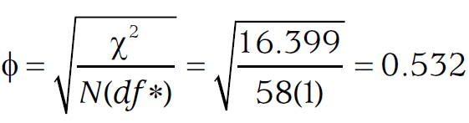
Step 5: Compute the Effect Size and Interpret It as Small, Medium, or Large
If either variable has more than three categories, Cramer’s (f) is the correct measure of effect size.
Notes:
Learning Objective: Compute the chi-square statistic and determine if the null hypothesis should be rejected

Slide 44
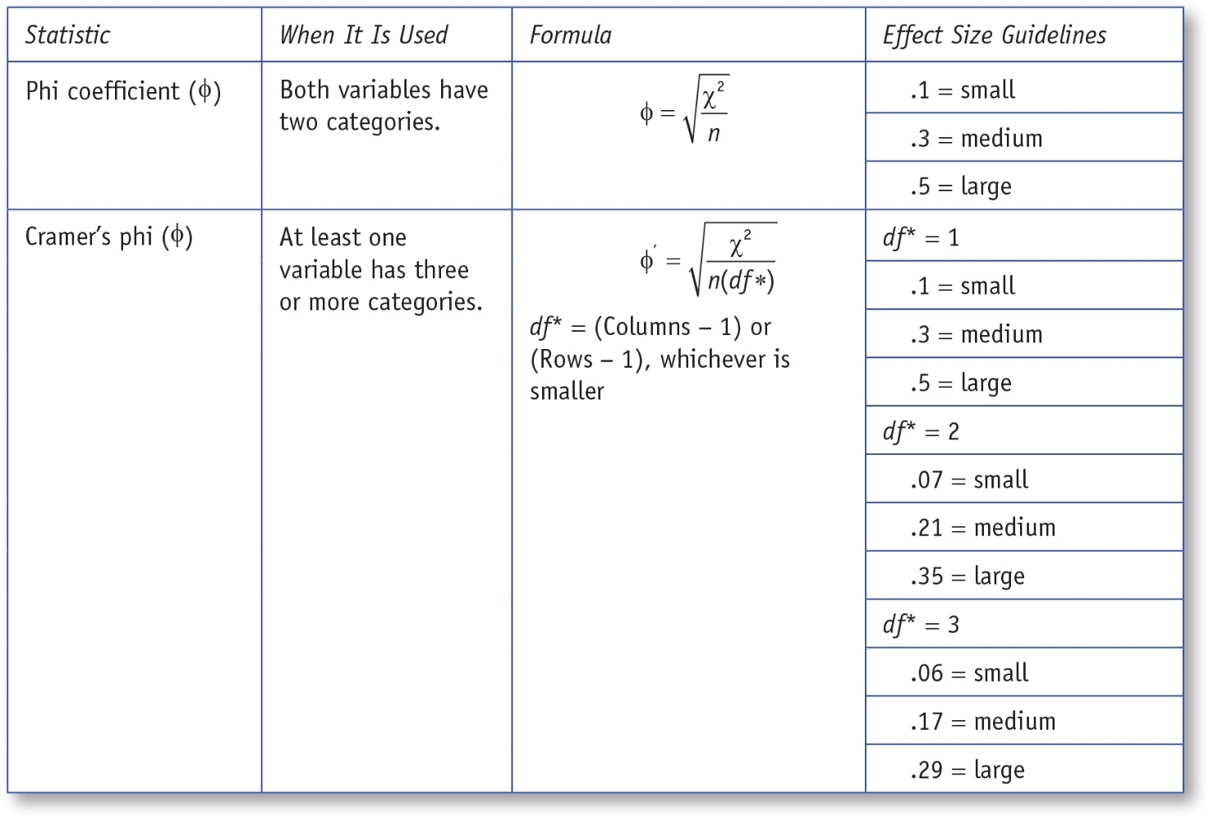
Table 14.6: Effect Sizes for Chi-Square and Guidelines for Interpretation
Notes:
Learning Objective: Compute the chi-square statistic and determine if the null hypothesis should be rejected

Slide 45
Step 6: Interpret the Results
The voters’ opinions of the president’s policies were associated with the voters’ political affiliations, χ²(2, N = 58) = 16.40, p < .05, f = .53. More Democrats and fewer Republicans approved of the president’s policies than would be expected by chance. More Republicans and fewer Democrats disapproved of the policies than would be expected by chance. The approval and disapproval of Independents were very close to what was expected by chance.
Notes:
Learning Objective: Summarize the results of a chi-square

Slide 46
SPSS
Compute the chi-square statistic and determine if the null hypothesis should be rejected
Notes:
Learning Objective: Compute the chi-square statistic and determine if the null hypothesis should be rejected

Slide 47
Goodness-of-Fit Chi Square
We will now analyze the political affiliation data using SPSS to perform a goodness-of-fit chi-square.
The data are provided in Table 14.7.
Notes:
Learning Objective: Compute the chi-square statistic and determine if the null hypothesis should be rejected

Slide 48
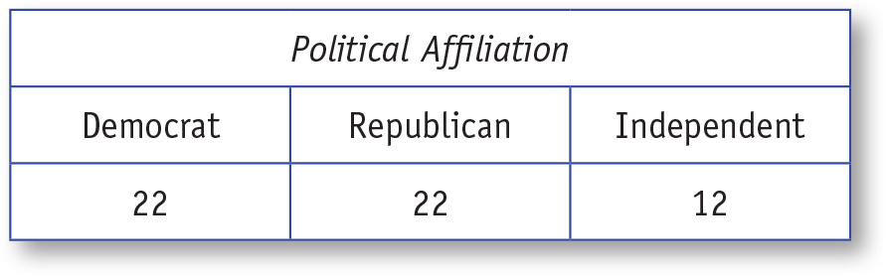
Table 14.7: Data Used for SPSS Example for Chi-Square Test of Goodness of Fit
Notes:
Learning Objective: Compute the chi-square statistic and determine if the null hypothesis should be rejected

Slide 49
Data File
The data file will have a single column labeled with the variable being measured and then a list of each person’s response.
See Figure 14.1
In this data set, the variable name is PoliticalAffiliation.
1 = Democrat
2 = Republican
3 = Independent
Notes:
Learning Objective: Compute the chi-square statistic and determine if the null hypothesis should be rejected

Slide 50
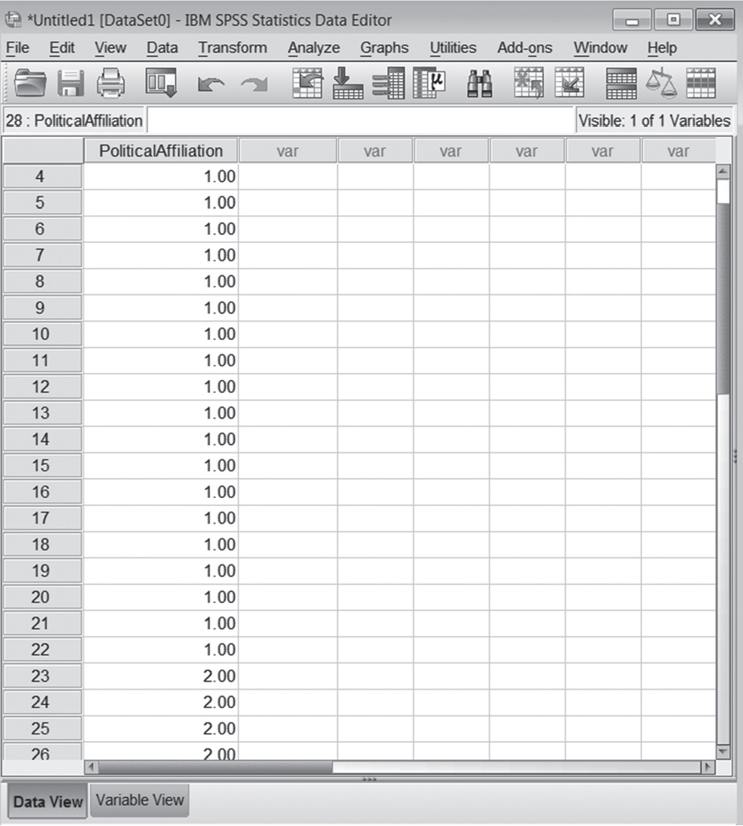
Figure 14.1: SPSS Screenshot of Data Entry for Chi-Square Test of Goodness of Fit
Notes:
Learning Objective: Compute the chi-square statistic and determine if the null hypothesis should be rejected

Slide 51
SPSS Analysis
To perform the chi-square analysis, do the following:
Click on the Analyze menu. Choose Non-parametric Tests, then click on Legacy Dialogs and select Chi-square.
Move the variable label PoliticalAffiliation to the Test Variable List.
Notes:
Learning Objective: Compute the chi-square statistic and determine if the null hypothesis should be rejected

Slide 52
SPSS Analysis
Click on the Values button and enter the exact expected frequencies based on the null hypothesis.
If all of the expected values were the same, you could click on the “All categories equal” button, but in this case, you must compute the expected frequencies by hand and then enter them in the correct order.
Notes:
Learning Objective: Compute the chi-square statistic and determine if the null hypothesis should be rejected

Slide 53
SPSS Analysis
(i.e., the expected frequency for value 1 [28], then value 2 [16.8], and finally value 3 [11.2]).
You must click on the Add button after you enter each value. Then, click OK.
Your screen should look like the one in Figure 14.2.
Notes:
Learning Objective: Compute the chi-square statistic and determine if the null hypothesis should be rejected

Slide 54
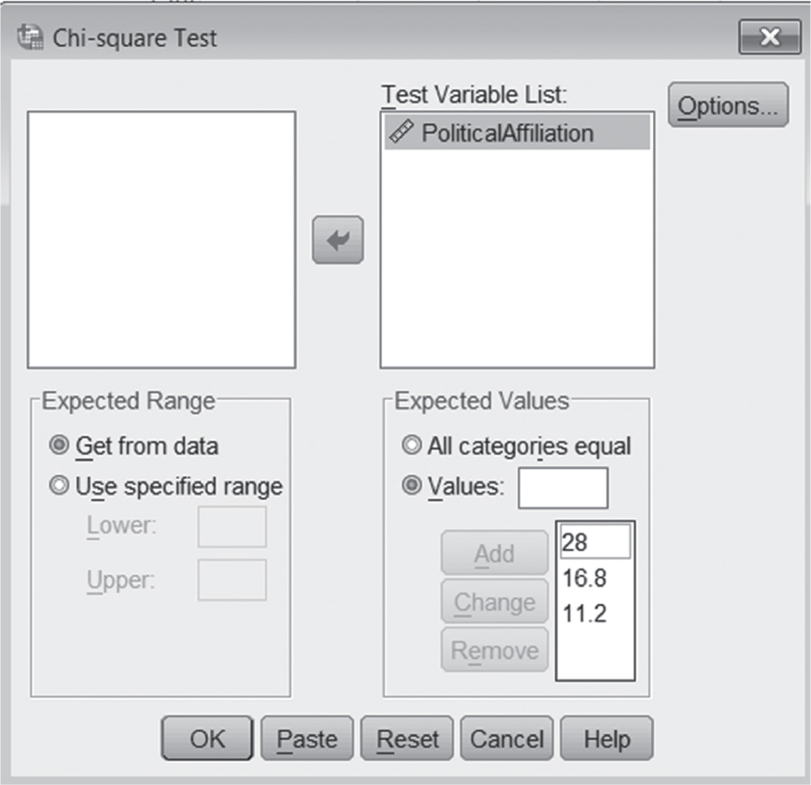
Figure 14.2: SPSS Screenshot for Setting Up the Chi-Square Test of Goodness of Fit
Notes:
Learning Objective: Compute the chi-square statistic and determine if the null hypothesis should be rejected

Slide 55
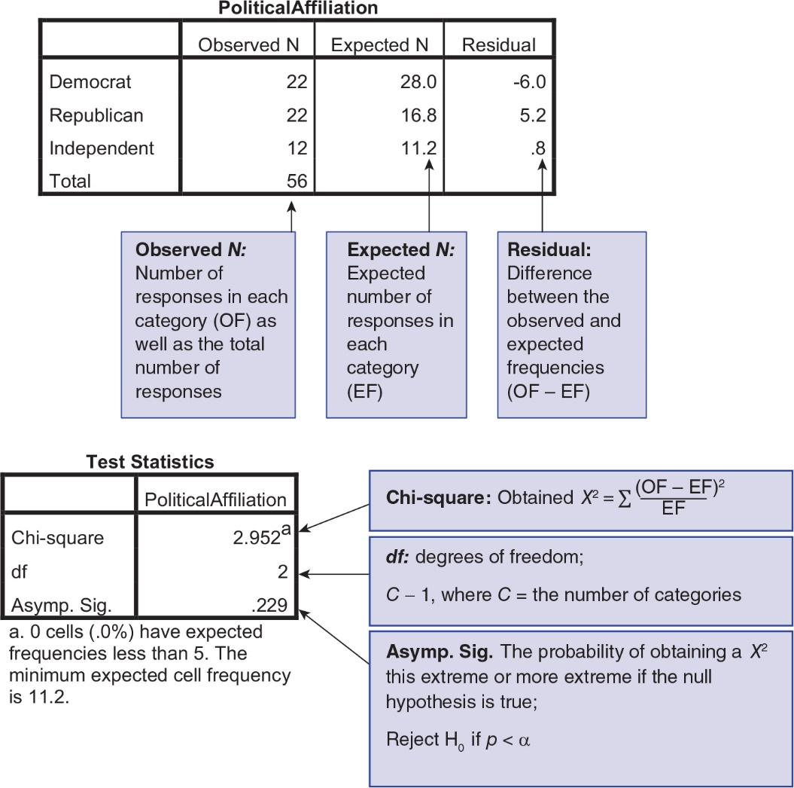
Figure 14.3: SPSS Screenshot of Observed and Expected Frequencies for Chi-Square Test of Goodness of Fit
Notes:
Learning Objective: Compute the chi-square statistic and determine if the null hypothesis should be rejected

Slide 56
Chi-Square for Independence
We will now analyze the political affiliation and policy opinion data using SPSS to perform a chi-square for independence.
The data are provided in Table 14.8.
Notes:
Learning Objective: Compute the chi-square statistic and determine if the null hypothesis should be rejected

Slide 57
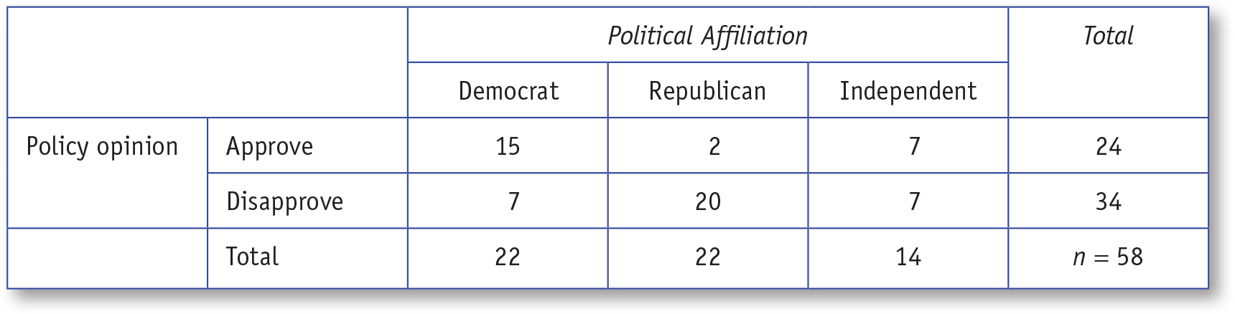
Table 14.8: Data Used for SPSS Example for Chi-Square Test of Independence
Notes:
Learning Objective: Compute the chi-square statistic and determine if the null hypothesis should be rejected

Slide 58
Data File
The data file for the chi-square for independence will have two columns.
See Figure 14.4
In this data set, the first variable name is PoliticalAffiliation
1 = Democrat
2 = Republican
3 = Independent
Notes:
Learning Objective: Compute the chi-square statistic and determine if the null hypothesis should be rejected

Slide 59
Data File
The second variable name is PolicyOpinion
1 = Approve
2 = Disapprove
Notes:
Learning Objective: Compute the chi-square statistic and determine if the null hypothesis should be rejected

Slide 60
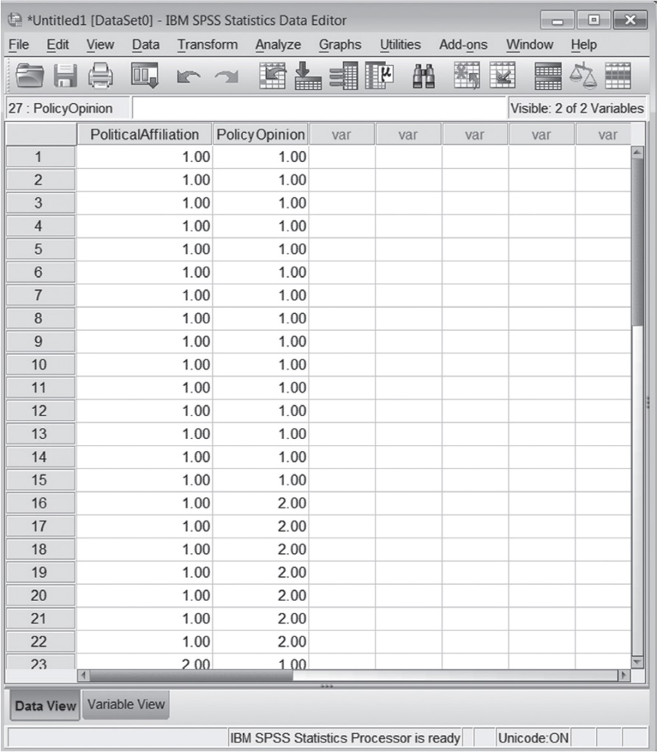
Figure 14.4: SPSS Screenshot of Data Entry for Chi-Square Test of Independence
Notes:
Learning Objective: Compute the chi-square statistic and determine if the null hypothesis should be rejected

Slide 61
SPSS Analysis
To perform the chi-square:
Click on the Analyze menu. Choose Descriptive Statistics and select Crosstabs.
Move the variable labeled “PoliticalAffiliation” to the Rows box and the variable labeled “PolicyOpinion” to the Column(s) box.
Click on the Statistics button and check the chi-square box and click Continue.
Notes:
Learning Objective: Compute the chi-square statistic and determine if the null hypothesis should be rejected

Slide 62
SPSS Analysis
Click the Cells button and make sure that the observed and expected boxes are both checked.
Click Continue; then click OK.
Notes:
Learning Objective: Compute the chi-square statistic and determine if the null hypothesis should be rejected

Slide 63
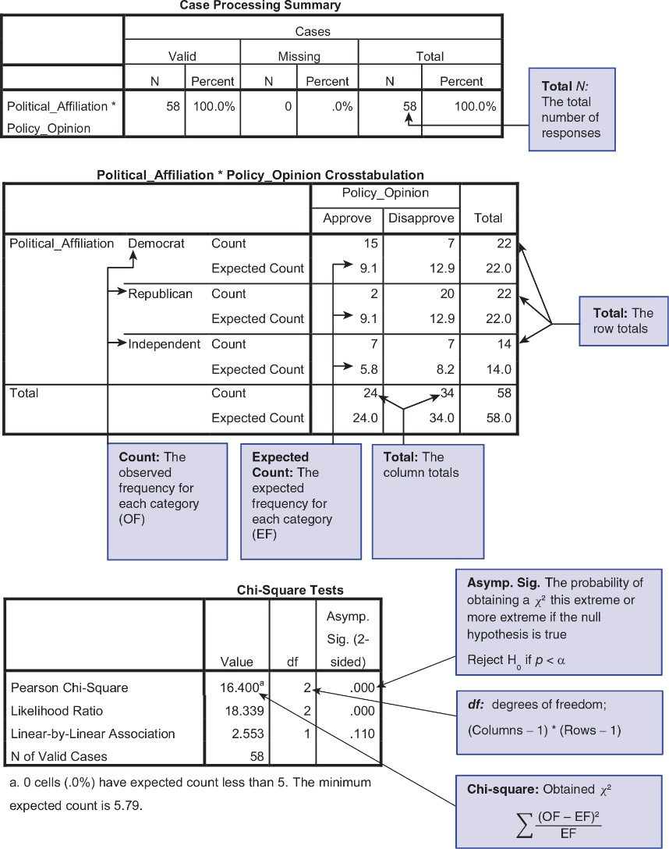
Figure 14.5: SPSS Screenshot of Output With Total Number of Responses; Output of Observed Frequencies, Row Totals, and Column Totals; and Chi-Square Test of Independence
Notes:
Learning Objective: Compute the chi-square statistic and determine if the null hypothesis should be rejected

