Slide 1
Applied Statistical Analysis
EDUC 6050
Week 4
Finding clarity using data

Slide 2
Today
Statistics terminology continued (hypothesis testing, descriptive and inferential statistics, effect sizes, confidence intervals, Type I and II errors)
Chapters 4, 5, and 6 in Book
Statistical Organizer due

Slide 3
Review
The figure to the right is reliable/unreliable and valid/invalid.
When should you use the mean? What about the median?
What does the standard deviation tell us?
Can we obtain a standard deviation with nominal data?
3

Slide 4
Reliability and Validity
Reliability: the consistency of the measure
Validity: does it measure what we think it measures?
Reliable Valid
Reliable Not Valid
Not Reliable Valid
Not Reliable Not Valid

Slide 5
Correlation and Experimentation
Correlation
observational, no treatment/intervention
Experimentation
treatment/intervention (best if groups are randomized)
Correlation does not imply causation
AND
Correlation does not imply it isn’t causal
Notes:
Observation: cheap, ethical (sometimes treatments are unethical), natural
Experimentation: causal, more controlled

Slide 6
Central Tendency
Measure | When to use it
Mean | With interval/ratio data that are ~normally distributed
Median | With ordinal data With interval/ratio data that are skewed or have outliers
Mode | With nominal data
Outliers = points far from the other points

Slide 7
Variability
Measure | When to Use | Possible Values
Range | Ordinal, Interval, Ratio | 0+
Standard Deviation | Interval, Ratio | 0+

Slide 8
Hypothesis Testing
Null Hypothesis
No effect
Alternative Hypothesis
Effect exists
Essentially, analyze data and see if null hypothesis seems plausible
If not plausible, we believe the alternative
If plausible, we assume there is no effect
Notes:
If the data are so far from what the null hypothesis would predict, we are going to think that maybe the null is wrong.

Slide 9
Hypothesis Testing
“P-Values”
The probability of observing an effect that large or larger, given the null hypothesis is true.
It is trying to tell us if an effect exists in the population
Usually a p-value < .05 is considered “statistically significant”

Slide 10
Hypothesis Testing
P-Values
Researchers rely on them too much (Cumming, 2014)
Effect sizes should be used with them
We need to highlight that effect sizes are uncertain
A “significant” finding may not be meaningful or reproducible

Slide 11
Reading
Questions from Chapter 4, 5, and 6 that you’d like us to cover today?

Slide 12
Z-Scores
Important Point:
There are distributions of single scores
There are distributions of statistics
This is generally in reference to the sample mean
Chapter 4 is about single scores

Slide 13
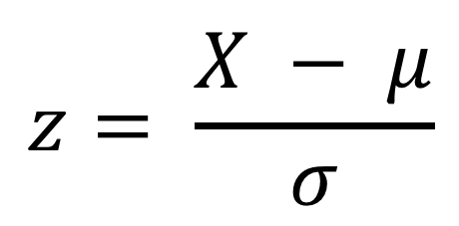
Z-Scores for an Individual Point
$$z= \frac{X − μ}{σ}$$
Tells us:
If the score is above or below the mean
How large (the magnitude) the deviation from the mean is to other data points
Notes:
What units are z scores in?
Standard deviation units

Slide 14
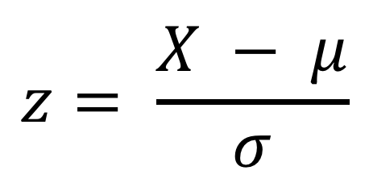
Z-Score Examples
$$z= \frac{X − μ}{σ}$$
M = 20, Score = 10, SD = 10, z = ?
M = 5, Score = 5, SD = 1, z = ?
M = 5, Score = 6, SD = 1, z = ?
Z = 1, Mean = 1, SD = 1, M = ?
Z = -1, Mean = 0, SD = 0.5, M = ?

Slide 15
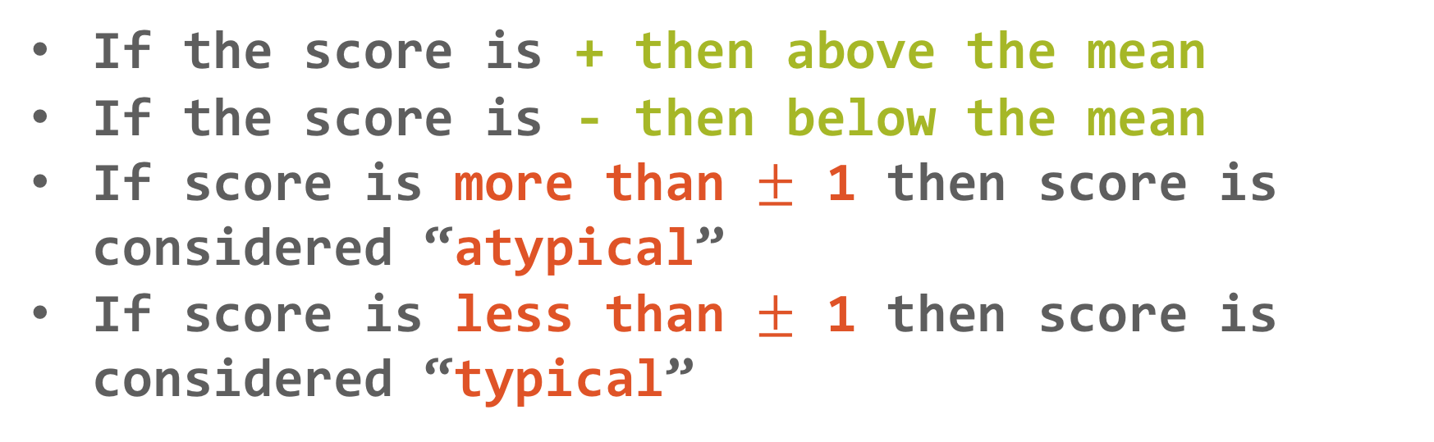
Z-Score Interpretations
If the score is + then above the mean
If the score is - then below the mean
If score is more than $±$ 1 then score is considered “atypical”
If score is less than $±$ 1 then score is considered “typical”
The z tells us more information than just a score. Why?

Slide 16
Z-Score and the Standard Normal Curve
Notes:
This only works if the distribution of the raw scores are normally-distributed!

Slide 17
Z-Score and the Standard Normal Curve
So...
We can use the same idea to estimate the probability of scoring higher or lower than a certain level
Example: If the scores on an exam have a mean of 70, an SD of 10, we know the distribution is normal, what is the probability of scoring 90 or higher.
Notes:
Introduce the Z score table in Appendix A

Slide 18
Normal Distributions and Shading
Page 101 of the book

Slide 19
Review of Z-Scores (Chapter 4)
What does a z-score about an individual point tell us?
Is it possible to make a specific probability statement about a z-score if the distribution is normal?
What proportion of scores are between z-scores of 0 and 1? (hint: use shading and the appendix)

Slide 20
Break Time

Slide 21
Distribution of Sample Means
Important Point:
There are distributions of single scores
There are distributions of statistics
This is generally in reference to the sample mean
Chapter 5 is about distributions of statistics

Slide 22
Distribution of Sample Means
Inferential statistics is all about using the sample to infer population parameters
But the sample is almost certainly going to differ from the population (at least a little)
So what if we took 5 different samples (or 10, or 50, etc.). Will each sample have the same mean?
Notes:
NO, it is almost certain they will differ (at least a little)

Slide 23
Distribution of Sample Means
Inferential statistics is all about using the sample to infer population parameters
But the sample is almost certainly going to differ from the population (at least a little)
So what if we took 5 different samples (or 10, or 50, etc.). Will each sample have the same mean?
http://shiny.stat.calpoly.edu/Sampling_Distribution/
Notes:
Website provides a little interactive example of sample distributions and the distributions of sample means

Slide 24
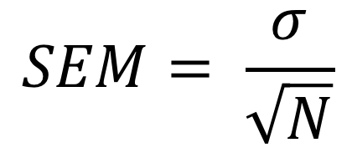
Standard Error of the Mean
“SEM” or “SE”
Depends on sample size (bigger sample, smaller SEM)
Tells us, if we were to collect many samples, how much the sample means would vary
$$SEM= \frac{σ}{\sqrt{N}}$$

Slide 25
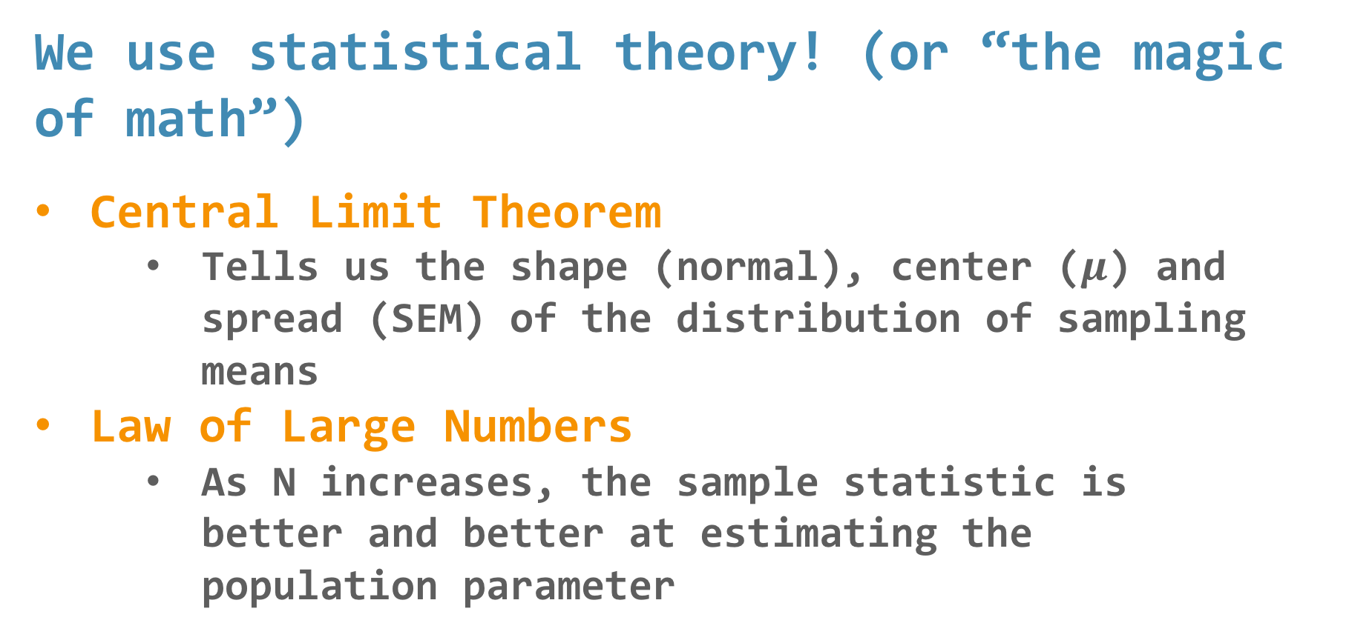
Since we don’t want to take lots of samples...
We use statistical theory! (or “the magic of math”)
Central Limit Theorem
Tells us the shape (normal), center ($μ$) and spread (SEM) of the distribution of sampling means
Law of Large Numbers
As N increases, the sample statistic is better and better at estimating the population parameter

Slide 26
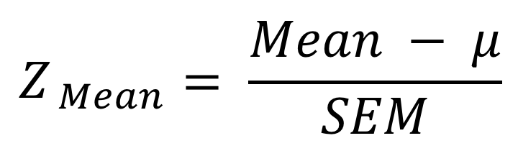
The Z for a Sample Mean
$$Z_{ Mean}= \frac{Mean − μ}{SEM}$$
This is important because of what we will talk about in Chapter 6
Hypothesis Testing with Z Scores

Slide 27
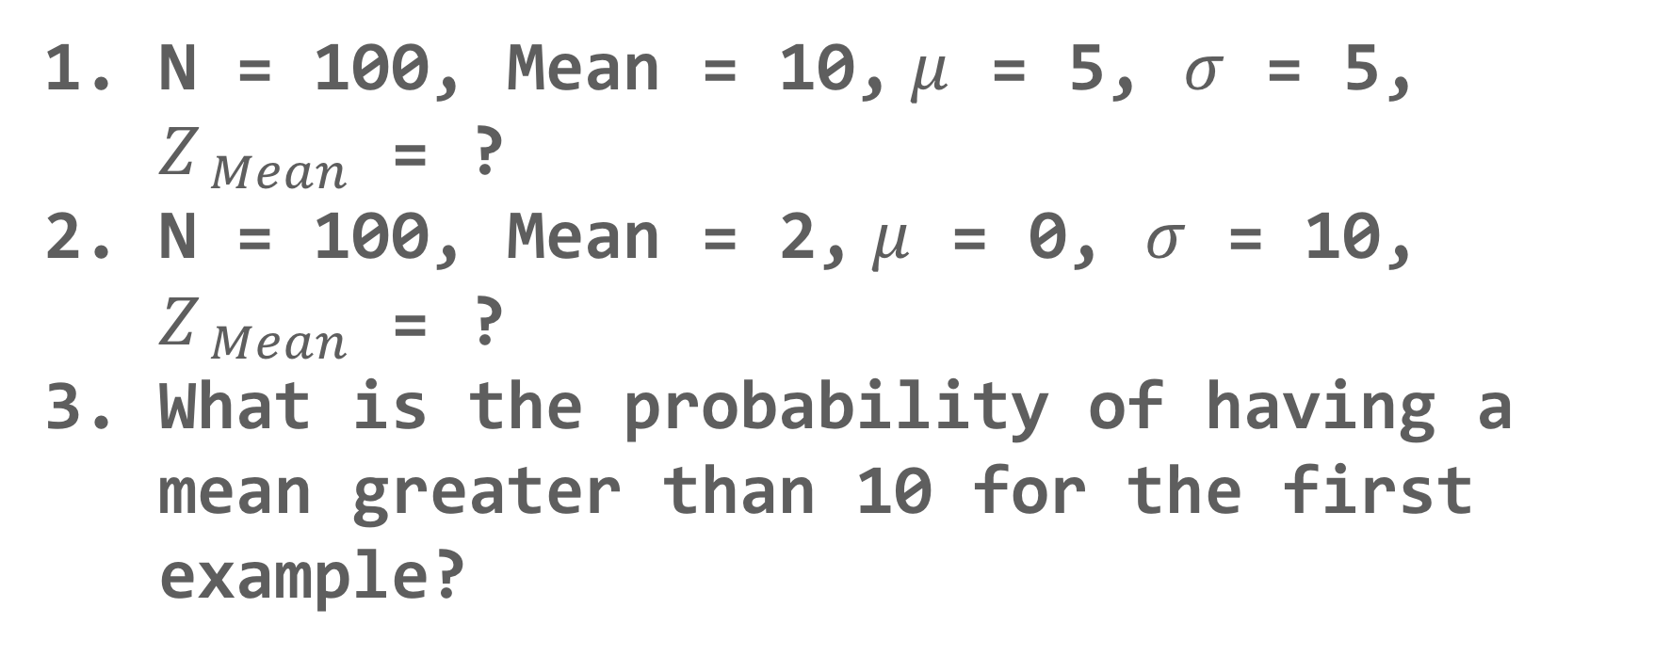
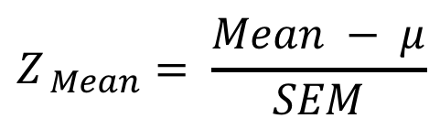
The Z for a Sample Mean
$$Z_{ Mean}= \frac{Mean − μ}{SEM}$$
N = 100, Mean = 10, $μ$ = 5, $σ$ = 5, $Z_{ Mean}$ = ?
N = 100, Mean = 2, $μ$ = 0, $σ$ = 10, $Z_{ Mean}$ = ?
What is the probability of having a mean greater than 10 for the first example?

Slide 28
Break Time

Slide 29
Hypothesis Testing with Z Scores
Hypothesis Testing uses Inferential Statistics
Is there evidence that this sample (maybe because of an intervention) is different than the population?

Slide 30
Hypothesis Testing with Z Scores
We’ll use a 6-step approach
We’ll use this throughout the class so get familiar with it
Examine Variables to Assess Statistical Assumptions
State the Null and Research Hypotheses (symbolically and verbally)
Define Critical Regions
Compute the Test Statistic
Compute an Effect Size and Describe it
Interpreting the results

Slide 31
Hypothesis Testing with Z Scores
Because assessing z-scores and t-tests are so similar, we will talk about both next week
Read Chapter 7

Slide 32
Review of Sample Mean Distributions (Chapter 5 and Intro to 6)
Why is understanding the distribution of sample means important?
What does the standard error of the mean tell us?
How would we get a smaller SEM?
What are the steps in the 6-step approach?

Slide 33
Another look at
Jamovi and Excel
Standardizing (getting z-scores)

Slide 34
Questions?

Slide 35
Next week:
Hypothesis Testing with Z Scores (continued)
Chapters 6 and 7 in Book
Keep updating your Statistical Organizer

