Slide 1
Applied Statistical Analysis
EDUC 6050
Week 8
Finding clarity using data

Slide 2
Homework and Such
Research Portfolio: How’s it coming along?
Any questions about the remainder of the class?

Slide 3
Today
Relationships!
Correlation and Intro to Regression
Chapter 13 in Book

Slide 4
https://www.youtube.com/watch?v=sxYrzzy3cq8

Slide 5
Comparing Means
Assessing Relationships
Is there a relationship between the two variables?
Correlation
Regression
Is one group different than the other(s)?
Z-tests
T-tests
ANOVA
We look at how much the variables “move together”
We compare the means and use the variability to decide if the difference is significant

Slide 6
Correlation
It is a whole class of methods
Generally used with observational designs
Has similar assumptions to t-test
Is a measure of effect size
Very related (and based on) z-scores
Tells us direction and strength of a relationship between two variables

Slide 7
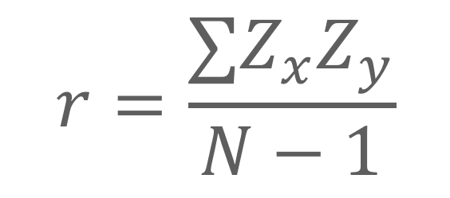
Correlation and Z-Scores
Z-score is a univariate statistic (only uses info from ONE variable)
Correlation is essentially the z-score between TWO variables
$$r=\frac{∑Z_{x}Z_{y}}{N−1}$$

Slide 8
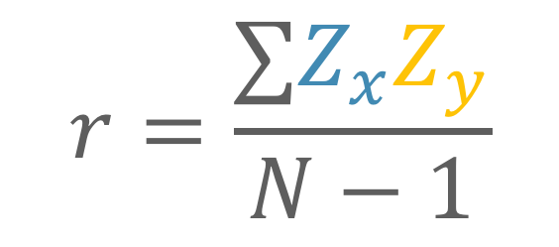
Correlation and Z-Scores
Z-score is a univariate statistic (only uses info from ONE variable)
Correlation is essentially the z-score between TWO variables
z-score of variable x
$$r=\frac{∑Z_{x}Z_{y}}{N−1}$$
z-score of variable y

Slide 9
General
Requirements
ID | Var 1 | Var 2
1 | 8 | 7
2 | 6 | 2
3 | 9 | 6
4 | 7 | 6
5 | 7 | 8
6 | 8 | 5
7 | 5 | 3
8 | 5 | 5
Two or more continuous variables,
Not necessarily directional (one causes the other)

Slide 10
General
Requirements
Two or more continuous variables,
Not necessarily directional (one causes the other)
Linear Relationship (or at least monotonic)

Slide 11
Hypothesis Testing with Correlation
The same 6 step approach!
Examine Variables to Assess Statistical Assumptions
State the Null and Research Hypotheses (symbolically and verbally)
Define Critical Regions
Compute the Test Statistic
Compute an Effect Size and Describe it
Interpreting the results

Slide 12
Examine Variables to Assess Statistical Assumptions
1
Basic Assumptions
Independence of data
Appropriate measurement of variables for the analysis
Normality of distributions
Homoscedastic

Slide 13
Examine Variables to Assess Statistical Assumptions
1
Basic Assumptions
Independence of data
Appropriate measurement of variables for the analysis
Normality of distributions
Homoscedastic
Individuals are independent of each other (one person’s scores does not affect another’s)

Slide 14
Examine Variables to Assess Statistical Assumptions
1
Basic Assumptions
Independence of data
Appropriate measurement of variables for the analysis
Normality of distributions
Homoscedastic
Here we need interval/ratio variables
Notes:
For F-test, DV needs to be interval/ratio

Slide 15
Examine Variables to Assess Statistical Assumptions
1
Basic Assumptions
Multivariate normality (the two variables are jointly normal)
Independence of data
Appropriate measurement of variables for the analysis
Normality of distributions
Homoscedastic

Slide 16
Examine Variables to Assess Statistical Assumptions
1
Basic Assumptions
Independence of data
Appropriate measurement of variables for the analysis
Normality of distributions
Homoscedastic
Variance around the line should be roughly equal across the whole line
Notes:
Example on board

Slide 17
Examine Variables to Assess Statistical Assumptions
1
Examining the Basic Assumptions
Independence: random sample
Appropriate measurement: know what your variables are
Normality: Histograms, Q-Q, skew and kurtosis
Homoscedastic: Scatterplots

Slide 18
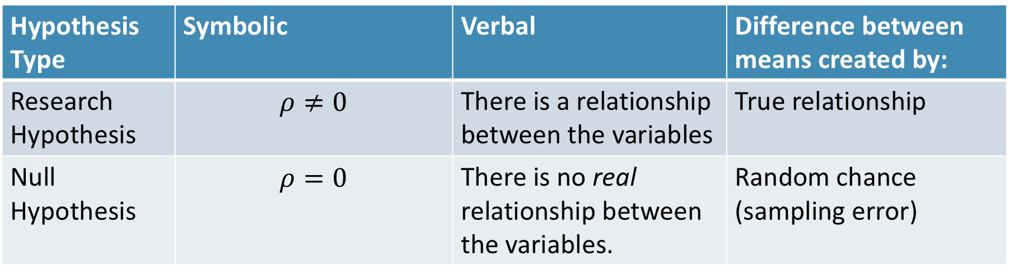
State the Null and Research Hypotheses (symbolically and verbally)
2
Hypothesis Type | Symbolic | Verbal | Difference between means created by:
Research Hypothesis | $$ρ≠0$$ | There is a relationship between the variables | True relationship
Null Hypothesis | $$ρ=0$$ | There is no real relationship between the variables. | Random chance (sampling error)
Notes:
Null and research hypotheses are mutually exclusive (they cover all possible outcomes)

Slide 19

Define Critical Regions
3
How much evidence is enough to believe the null is not true?
generally based on an alpha = .05
Use the table in the book (page 610)
Based on alpha and df
If we have an N = 10 and $α= .05$, then:
$$r_{critical}\left(8\right)=0.632$$

Slide 20
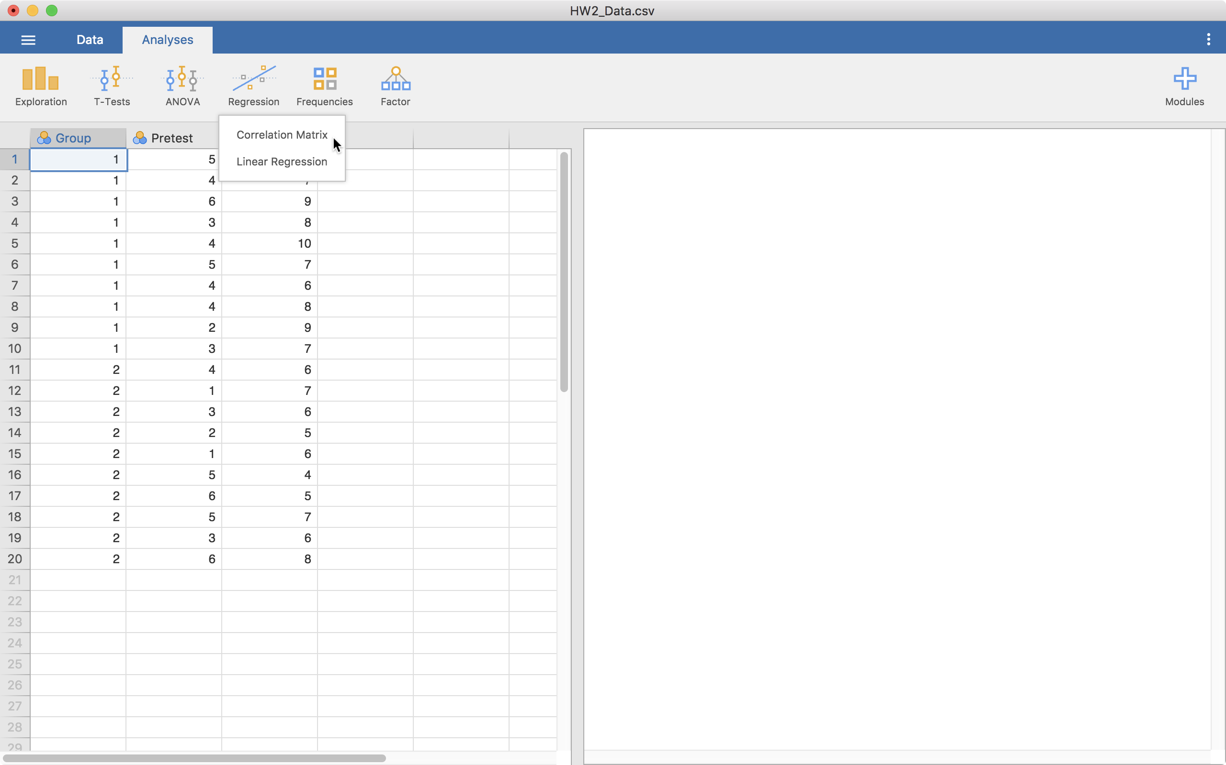
Compute the Test Statistic
4
Click on
“Correlation Matrix”

Slide 21
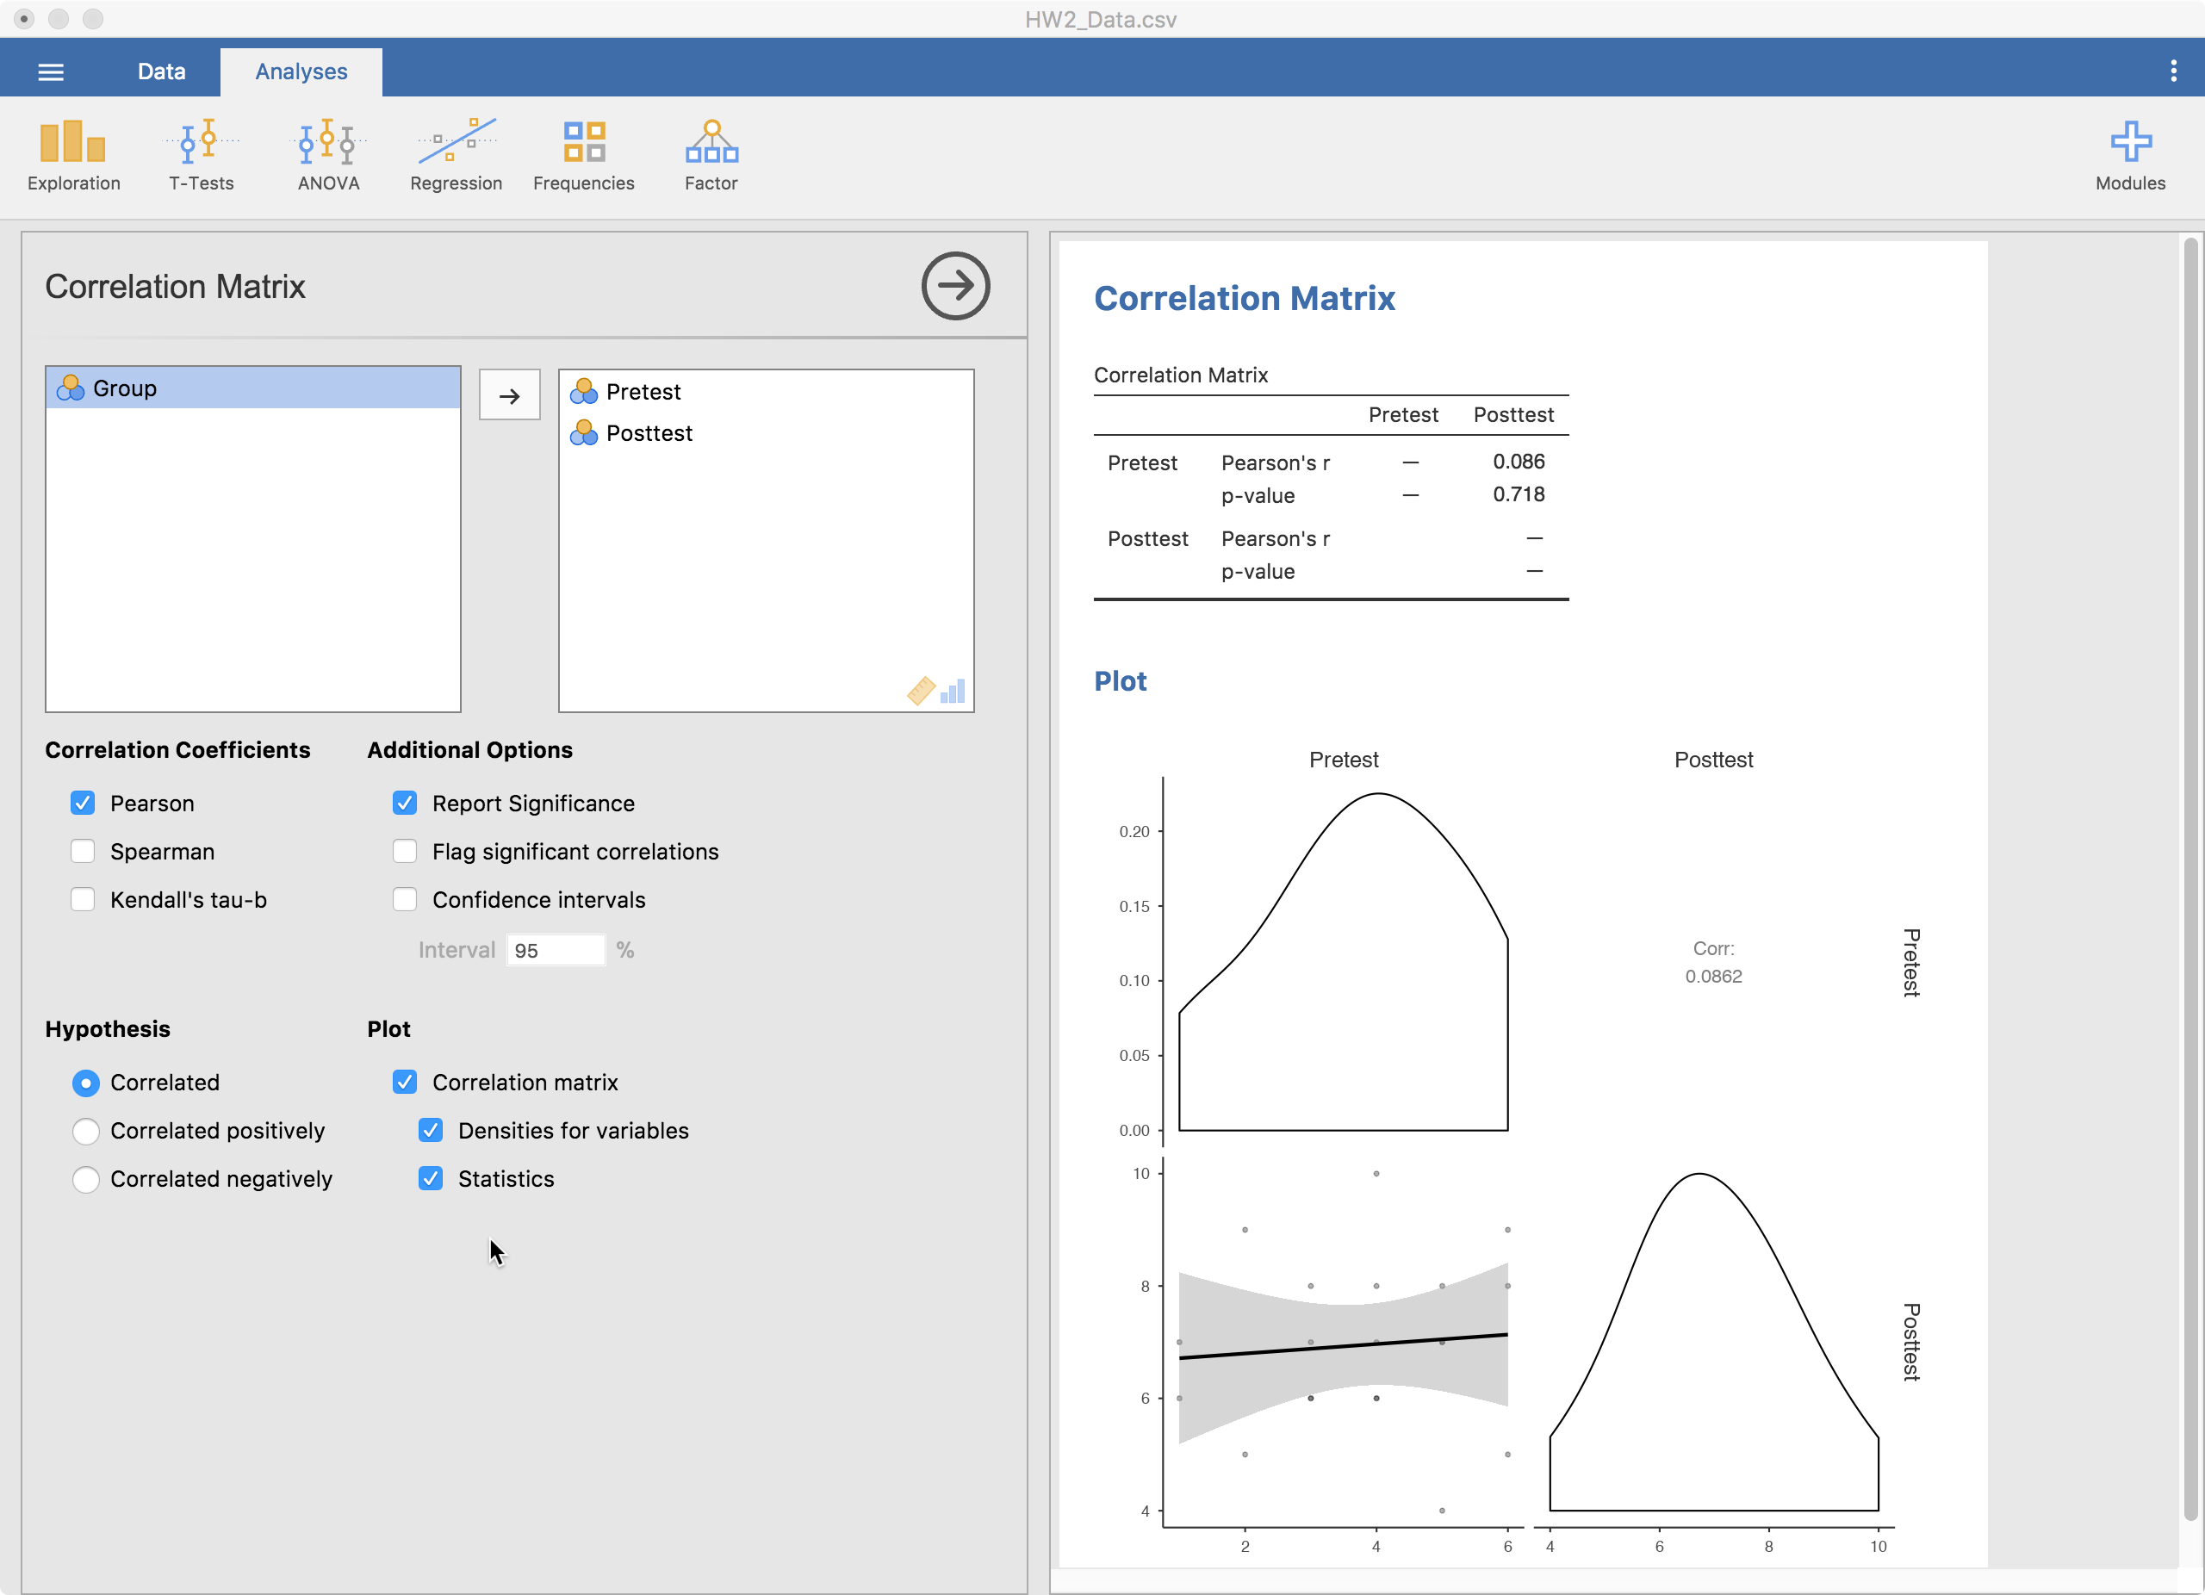
Compute the Test Statistic
4
Results
Bring variables to be correlated over here

Slide 22
Compute the Test Statistic
4
Average of X
Y
Average of Y
X

Slide 23
Compute the Test Statistic
4
Average of X
If more points are in the green than not, then correlation is positive
Y
Average of Y
X

Slide 24
Compute the Test Statistic
4
Average of X
Y
Average of Y
If more points are in the red than not, then correlation is negative
X

Slide 25
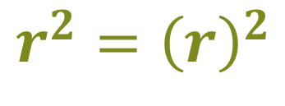
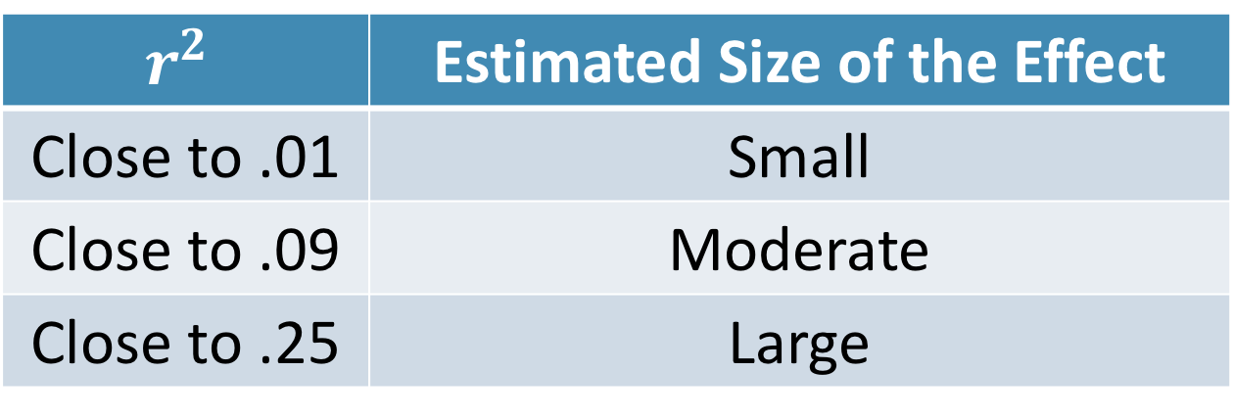
Compute an Effect Size and Describe it
5
One of the main effect sizes for correlation is r²
$$r_{ }^{2}={\left(r\right)}^{2}$$
$$r_{ }^{2}$$ | Estimated Size of the Effect
Close to .01 | Small
Close to .09 | Moderate
Close to .25 | Large
Notes:
Can also use Cohen’s d here as well for each mean difference

Slide 26
Interpreting the results
6
Put your results into words
Use the example around page 529 as a template

Slide 27
Let’s use
Jamovi
Correlation

Slide 28
Break Time

Slide 29
Intro to Regression

Slide 30
Intro to Regression
The foundation of almost everything we do in statistics
Comparing group means
Assess relationships
Compare means AND assess relationships at the same time
Can handle many types of outcome and predictor data types
Results are interpretable

Slide 31
Two Main Types of Regression
Simple
Multiple
Only one predictor in the model
When variables are standardized, gives same results as correlation
When using a grouping variable, same results as t-test or ANOVA
More than one variable in the model
When variables are standardized, gives “partial” correlation
Predictors can be any combination of categorical and continuous

Slide 32
Logic of Regression
We are trying to find the best fitting line
Y
X

Slide 33
Logic of Regression
We are trying to find the best fitting line
We do this by minimizing the difference between the points and the line (called the residuals)
Y
X

Slide 34
Logic of Regression
Average of X
Line always goes through the averages of X and Y
Y
Average of Y
X

Slide 35
Questions?

Slide 36
Next week:
More on Regression

