Slide 1
Applied Statistical Analysis
EDUC 6050
Review Week
Finding clarity using data

Slide 2
Today
Connect the Methods

Slide 3
Selecting the Right Method

Slide 4
Selecting Method Based on Research Question
Does research question have to do with looking at differences among groups or relationships among continuous variables?
Z-tests
T-tests
ANOVAs
Chi Square
Regression
Correlation
Regression

Slide 5
Z-tests compare our sample to known values
ANOVAs compare:
3+ independent samples (groups)
3+ repeated samples (time points)
Both groups and repeated samples at the same time
t-tests compare:
Our sample to known values
Two independent samples (groups)
Two paired-samples (time points)
Z-tests
T-tests
ANOVAs
Chi Square
Regression
Regression compares:
1+ categorical variable(s)
Controls for the effects of the covariates
Can also do a lot more...
Chi Squares compare:
1 categorical variable to known values
2 categorical variables

Slide 6
Z-tests compare our sample to known values
All but Chi Square has a continuous outcome
ANOVAs compare:
3+ independent samples (groups)
3+ repeated samples (time points)
Both groups and repeated samples at the same time
t-tests compare:
Our sample to known values
Two independent samples (groups)
Two paired-samples (time points)
Z-tests
T-tests
ANOVAs
Chi Square
Regression
Regression compares:
1+ categorical variable(s)
Controls for the effects of the covariates
Can also do a lot more...
Chi Squares compare:
1 categorical variable to known values
2 categorical variables

Slide 7
Correlation tells us the direction and magnitude of a relationship between two continuous variables
Correlation
Regression
Regression tells us the direction and magnitude (in the units of the outcome) of a relationship between two continuous variables
(Can also have categorical variables in the model at the same time)

Slide 8
Correlation tells us the direction and magnitude of a relationship between two continuous variables
Continuous outcomes
Correlation
Regression
Regression tells us the direction and magnitude (in the units of the outcome) of a relationship between two continuous variables
(Can also have categorical variables in the model at the same time)

Slide 9
Selecting Method Based on Available Data - Outcome
Is your outcome variable continuous (interval/ratio) or categorical (ordinal, nominal)?
Z-tests
T-tests
ANOVAs
Regression
Logistic Regression
Chi Square

Slide 10
Selecting Method Based on Available Data - IV
Is your independent variable(s) continuous (interval/ratio) or categorical (ordinal, nominal)?
Regression
Logistic Regression
Z-Tests
T-Tests
ANOVAs
Chi Square
Regression
Logistic Regression

Slide 11
Question 1
We hypothesize that test scores are caused by amount of time studying and note-taking style.
What approach could we use?

Slide 12
Question 2
We investigate the question of whether preferences for money/flying are different across degree types.
What approach could we use?

Slide 13
Question 3
We want to know the relationship between poverty level (continuous) and teen birth rate (continuous).
What approach could we use?

Slide 14
Question 4
We want to know if our intervention regarding adult mobility works. We have two groups (intervention and control) and test both groups at pretest and posttest.
What approach could we use?

Slide 15
Interpreting the Results

Slide 16
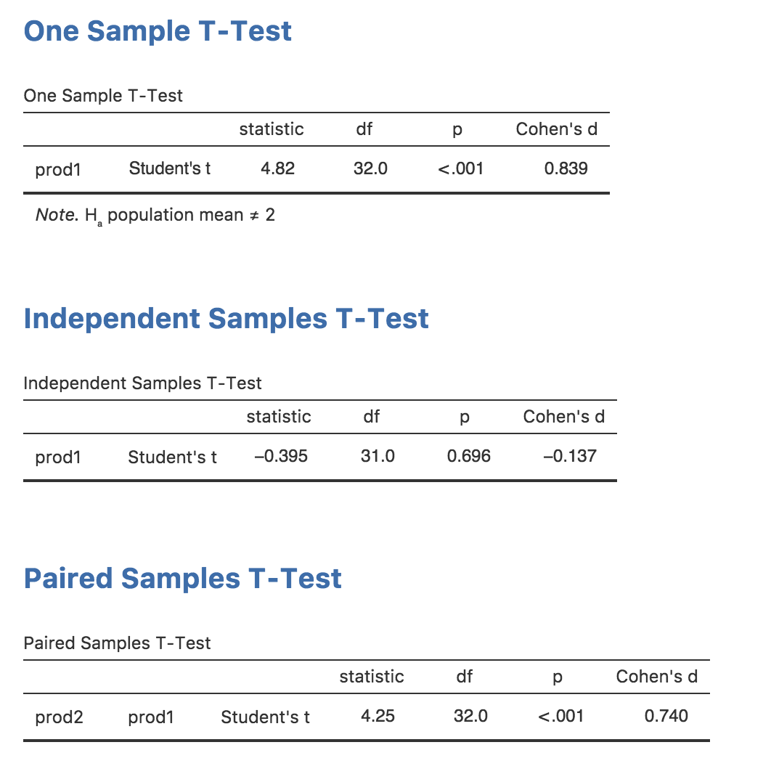
Common Threads Across Methods
Test Statistic
P-Value
Effect Size

Slide 17
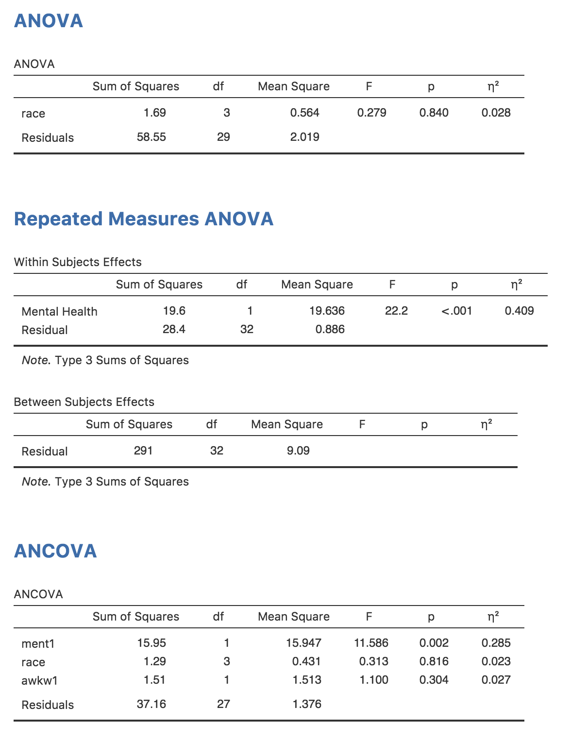
Common Threads Across Methods
Test Statistic
P-Value
Effect Size

Slide 18
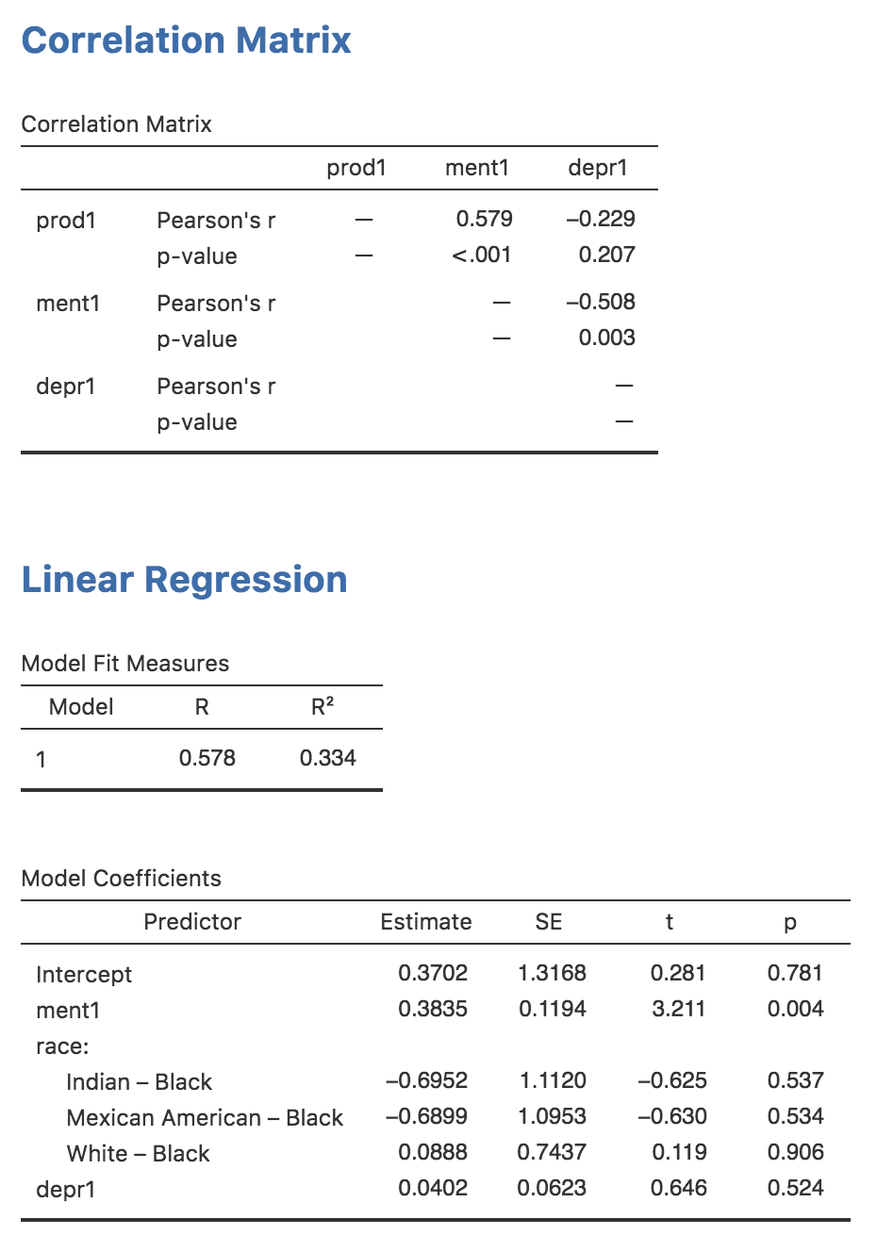
Common Threads Across Methods
Test Statistic
P-Value
Effect Size

Slide 19
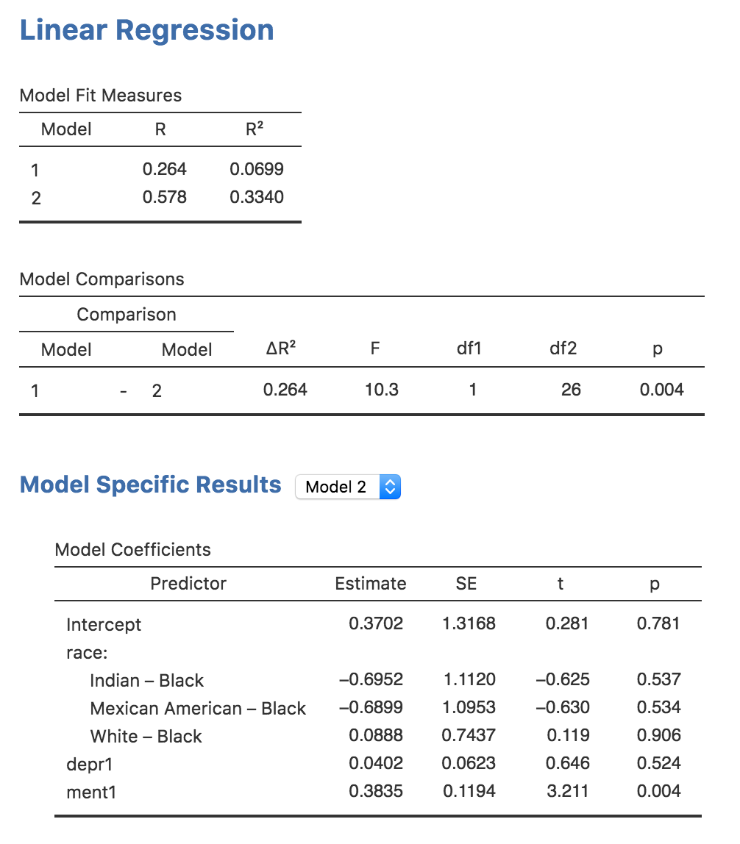
Unique Things
The Estimate
Model Comparisons

Slide 20
Question 5
Interpret the following output

Slide 21
Question 6
Interpret the following output

Slide 22
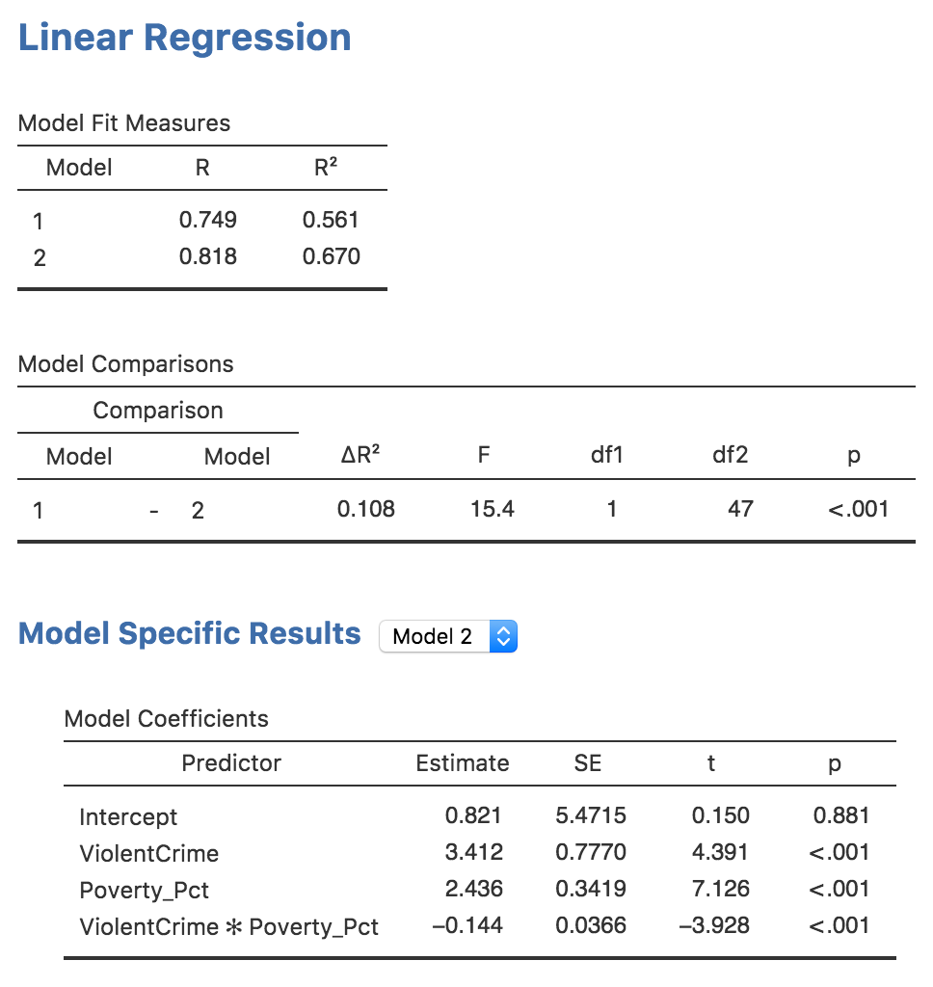
Question 7.1
Interpret the following output

Slide 23
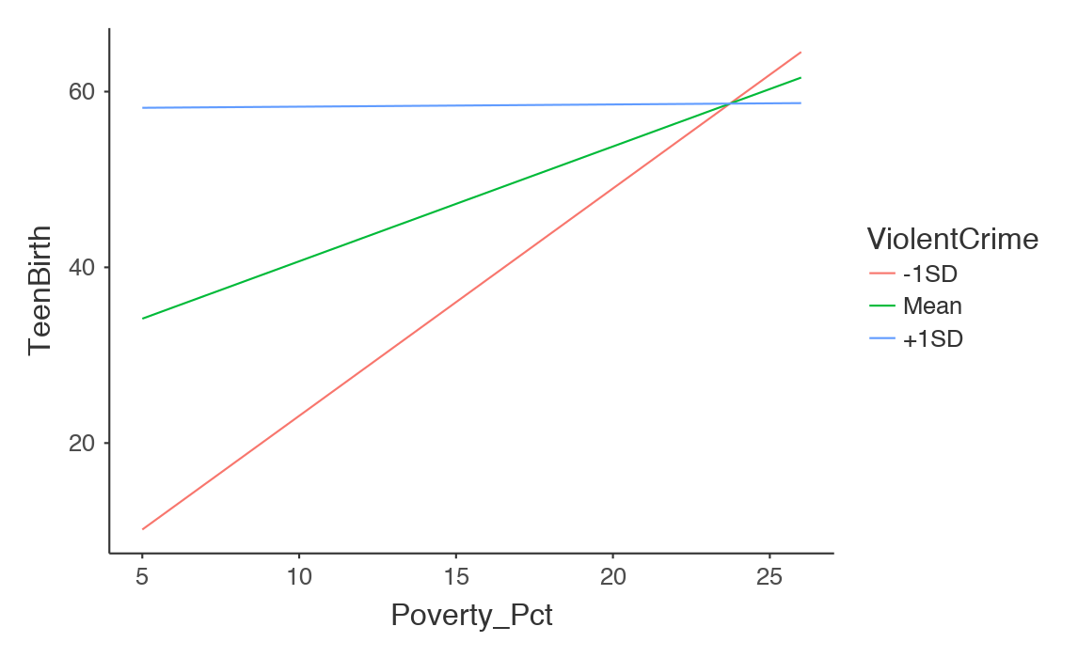
Question 7.2
Interpret the following output

Slide 24
Next week:
Final Exam :)

