Slide 1
Applied Statistical Analysis
EDUC 6050
Week 13
Finding clarity using data

Slide 2
Today
Categorical Outcomes

Slide 3
Categorical Outcomes
For simple research questions
Not controlling for other factors
Doesn’t provide a lot of information
(ie., only tells us difference or not)
Logistic
Regression
Chi
Square
Simple
Complex
Notes:
Activity:
Start with Goodness of Fit first with a milk chocolate (get expected frequencies and counts for each color of M&M or Skittle)
Then Test of Independence across milk chocolate, crispy, and minis.
Answer some questions together as a class

Slide 4
General
Requirements
ID | X | Y
1 | 0 | 0
2 | 2 | 1
3 | 1 | 0
4 | 2 | 1
5 | 0 | 1
6 | 0 | 1
7 | 2 | 0
8 | 1 | 0
One or more categorical variables
Test of Independence
Goodness of Fit

Slide 5
Hypothesis Testing with Chi Square (Independence)
The same 6 step approach!
Examine Variables to Assess Statistical Assumptions
State the Null and Research Hypotheses (symbolically and verbally)
Define Critical Regions
Compute the Test Statistic
Compute an Effect Size and Describe it
Interpreting the results

Slide 6
Examine Variables to Assess Statistical Assumptions
1
Basic Assumptions
Independence of data
Appropriate measurement of variables for the analysis
Expected frequency 5+

Slide 7
Examine Variables to Assess Statistical Assumptions
1
Basic Assumptions
Independence of data
Appropriate measurement of variables for the analysis
Expected frequency 5+
Individuals are independent of each other (one person’s scores does not affect another’s)

Slide 8
Examine Variables to Assess Statistical Assumptions
1
Basic Assumptions
Independence of data
Appropriate measurement of variables for the analysis
Expected frequency 5+
Here we need interval/ratio outcome

Slide 9
Examine Variables to Assess Statistical Assumptions
1
Basic Assumptions
Variance around the line should be roughly equal across the whole line
Independence of data
Appropriate measurement of variables for the analysis
Expected frequency 5+

Slide 10
Examine Variables to Assess Statistical Assumptions
1
Examining the Basic Assumptions
Independence: random sample
Appropriate measurement: know what your variables are
Expected frequency 5+: Check expected frequencies

Slide 11
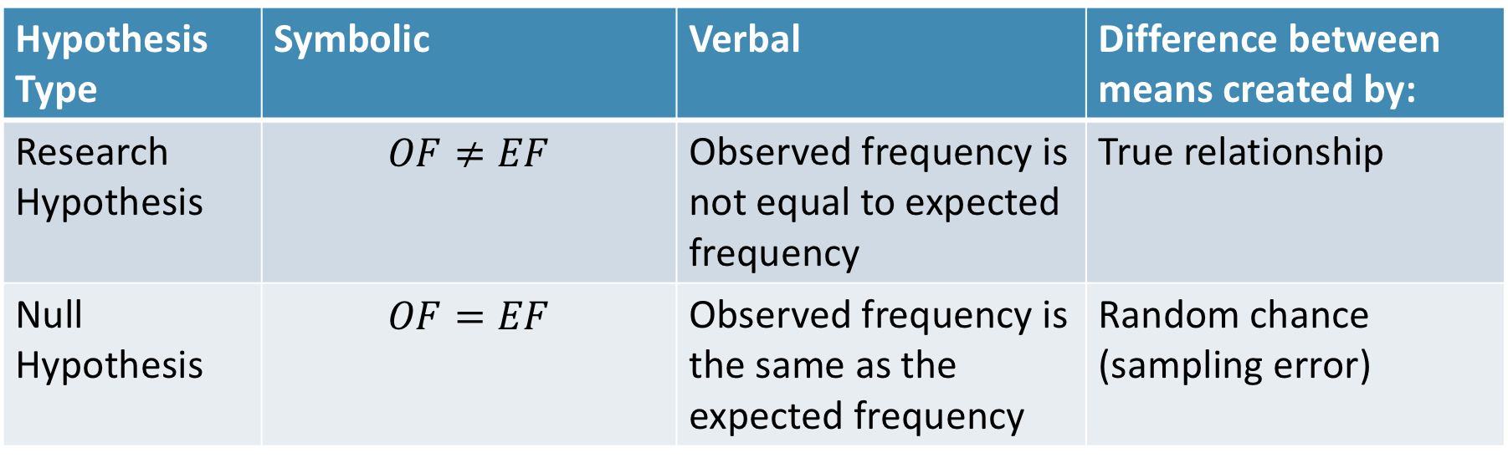
State the Null and Research Hypotheses (symbolically and verbally)
2
Hypothesis Type | Symbolic | Verbal | Difference between means created by:
Research Hypothesis | $$OF≠EF$$ | Observed frequency is not equal to expected frequency | True relationship
Null Hypothesis | $$OF=EF$$ | Observed frequency is the same as the expected frequency | Random chance (sampling error)
Notes:
Null and research hypotheses are mutually exclusive (they cover all possible outcomes)

Slide 12
Define Critical Regions
3
How much evidence is enough to believe the null is not true?
generally based on an alpha = .05
Use software’s p-value to judge if it is below .05

Slide 13
Compute the Test Statistic
4
Jamovi
Tutorial

Slide 14
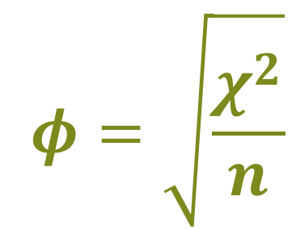
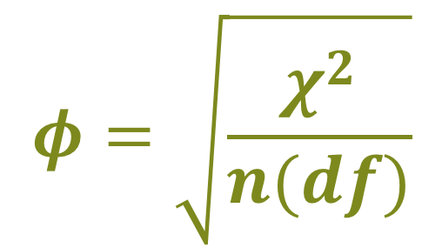
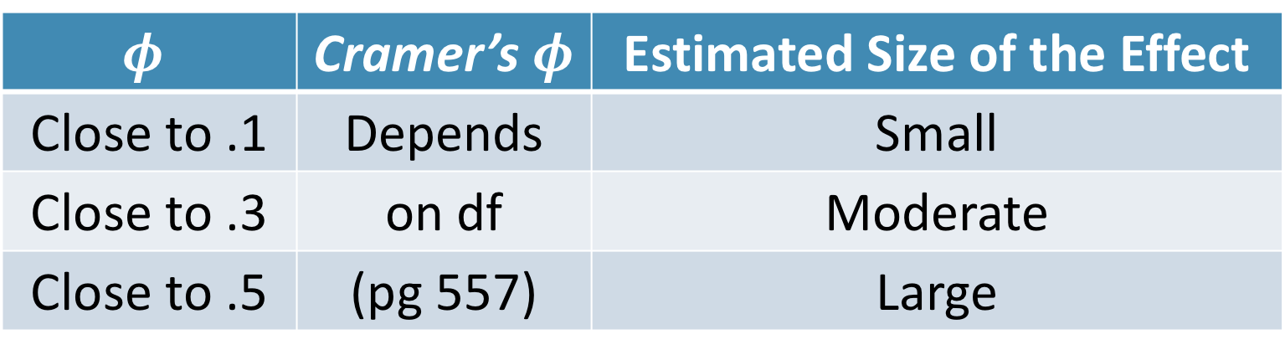
Compute an Effect Size and Describe it
5
$$φ=\sqrt{\frac{χ^{2}}{n}}$$
$$φ=\sqrt{\frac{χ^{2}}{n(df)}}$$
Cramer’s
“Phi”
$$φ$$ | Cramer’s $φ$ | Estimated Size of the Effect
Close to .1 | Depends | Small
Close to .3 | on df | Moderate
Close to .5 | (pg 557) | Large

Slide 15
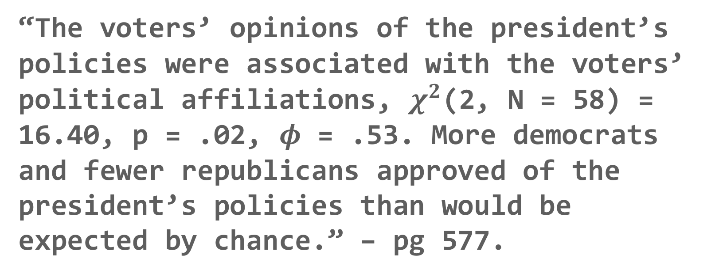
Interpreting the results
6
“The voters’ opinions of the president’s policies were associated with the voters’ political affiliations, $χ^{2}$(2, N = 58) = 16.40, p = .02, $φ$ = .53. More democrats and fewer republicans approved of the president’s policies than would be expected by chance.” – pg 577.

Slide 16
Logistic
Regression
Notes:
The main type of “Generalized Linear Model” that you will see

Slide 17
Intro to Logistic Regression
So far, we have always wanted continuous outcome variables
But what if our outcome is a categorical variable??
Logistic Regression is just like linear regression but works with binary (dichotomous) outcomes
Substance Use or Not
Cancer or Not
Buy it or Not

Slide 18
Logic of Logistic Regression
We are trying to find the best fitting S curve
1
Y
0
X

Slide 19
Logic of Logistic Regression
We are trying to find the best fitting S curve
1
Y
The curve is the model estimated probability of Y = 1
0
X

Slide 20
Logistic Regression
Simple
Multiple
Only one predictor in the model
Tells you if that one predictor is associated with the odds of Y = 1
More than one variable in the model
Tells you if, while holding the other variables constant, if that predictor is associated with the odds of Y = 1

Slide 21

Logistic Regression
Logistic does what regression does but with a little bit of mathematical magic
$$logit(Y)=β_{0}+β_{1}X+ε$$

Slide 22

Logistic Regression
Logistic does what regression does but with a little bit of mathematical magic
slope
$$logit(Y)=β_{0}+β_{1}X+ε$$
intercept

Slide 23

Logistic Regression
Logistic does what regression does but with a little bit of mathematical magic
slope
$$logit(Y)=β_{0}+β_{1}X+ε$$
unexplained stuff in the odds of Y
intercept

Slide 24

Logistic Regression
$$logit(Y)=β_{0}+β_{1}X+ε$$
We have two variables, X and Y. X is continuous, Y is binary. We want to know if increases/decreases in X are associated (or predict) changes in the chance of Y equaling 1.
Example

Slide 25
Logistic Regression
It is trying to predict the outcome accurately using the information from the predictor
Better prediction tells us that the predictor(s) is/are more strongly related to the outcome

Slide 26
General
Requirements
ID | X | Y
1 | 8 | 0
2 | 6 | 1
3 | 9 | 1
4 | 7 | 1
5 | 7 | 0
6 | 8 | 0
7 | 5 | 1
8 | 5 | 0
Two or more variables,
Outcome needs to be binary
Others can be continuous or categorical

Slide 27
Hypothesis Testing with Logistic Regression
The same 6 step approach!
Examine Variables to Assess Statistical Assumptions
State the Null and Research Hypotheses (symbolically and verbally)
Define Critical Regions
Compute the Test Statistic
Compute an Effect Size and Describe it
Interpreting the results

Slide 28
Examine Variables to Assess Statistical Assumptions
1
Basic Assumptions
Independence of data
Appropriate measurement of variables for the analysis
Normality of distributions
Homoscedastic

Slide 29
Examine Variables to Assess Statistical Assumptions
1
Basic Assumptions
Independence of data
Appropriate measurement of variables for the analysis
Normality of distributions
Homoscedastic
Individuals are independent of each other (one person’s scores does not affect another’s)

Slide 30
Examine Variables to Assess Statistical Assumptions
1
Basic Assumptions
Independence of data
Appropriate measurement of variables for the analysis
Normality of distributions
Homoscedastic
Here we need nominal outcome
Notes:
For F-test, DV needs to be interval/ratio

Slide 31
Examine Variables to Assess Statistical Assumptions
1
Basic Assumptions
Residuals should be normally distributed
Independence of data
Appropriate measurement of variables for the analysis
Normality of distributions
Homoscedastic

Slide 32
Examine Variables to Assess Statistical Assumptions
1
Basic Assumptions
Independence of data
Appropriate measurement of variables for the analysis
Normality of distributions
Homoscedastic
Variance around the line should be roughly equal across the whole line
Notes:
Example on board

Slide 33
Examine Variables to Assess Statistical Assumptions
1
Basic Assumptions
Independence of data
Appropriate measurement of variables for the analysis
Normality of distributions
Homoscedastic
Logistic Relationship
No omitted variables
Notes:
Example on board

Slide 34
Examine Variables to Assess Statistical Assumptions
1
Basic Assumptions
Independence of data
Appropriate measurement of variables for the analysis
Normality of distributions
Homoscedastic
Logistic Relationships
No omitted variables
The “S-shaped” curve should fit to the data
Notes:
Example on board

Slide 35
Examine Variables to Assess Statistical Assumptions
1
Basic Assumptions
Independence of data
Appropriate measurement of variables for the analysis
Normality of distributions
Homoscedastic
Logistic Relationships
No omitted variables
Any variable that is related to both the predictor and the outcome should be included in the regression model
Notes:
Example on board

Slide 36
Examine Variables to Assess Statistical Assumptions
1
Examining the Basic Assumptions
Independence: random sample
Appropriate measurement: know what your variables are
Normality: Histograms, Q-Q, skew and kurtosis
Homoscedastic: Scatterplots
Logistic: Scatterplots
No Omitted: check correlations, know the theory

Slide 37
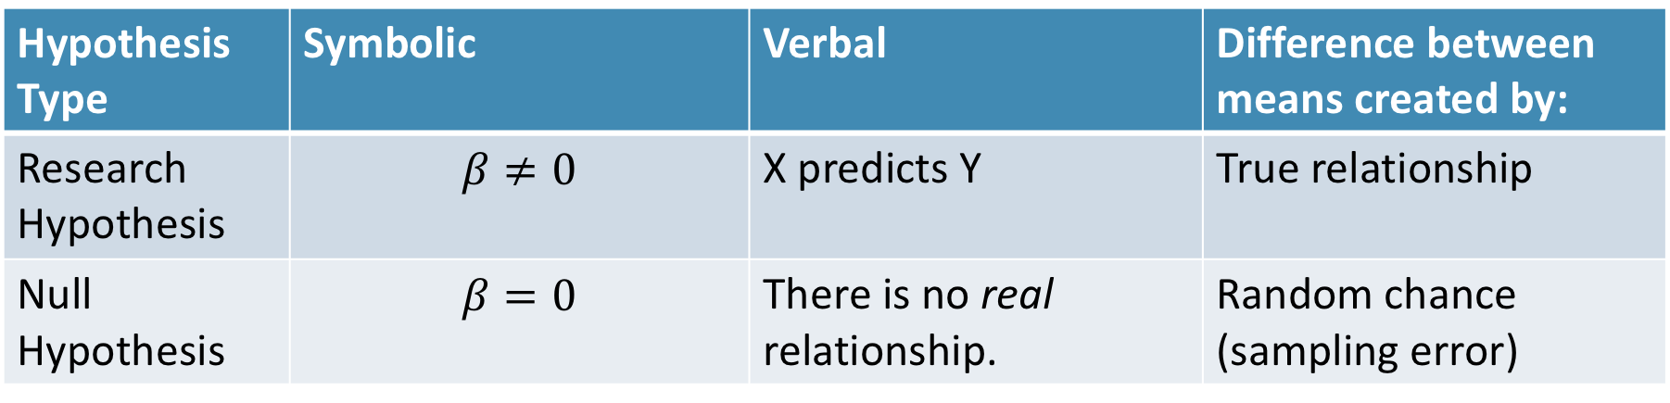
State the Null and Research Hypotheses (symbolically and verbally)
2
Hypothesis Type | Symbolic | Verbal | Difference between means created by:
Research Hypothesis | $$β≠0$$ | X predicts Y | True relationship
Null Hypothesis | $$β=0$$ | There is no real relationship. | Random chance (sampling error)
Notes:
Null and research hypotheses are mutually exclusive (they cover all possible outcomes)

Slide 38
Define Critical Regions
3
How much evidence is enough to believe the null is not true?
generally based on an alpha = .05
Use software’s p-value to judge if it is below .05

Slide 39
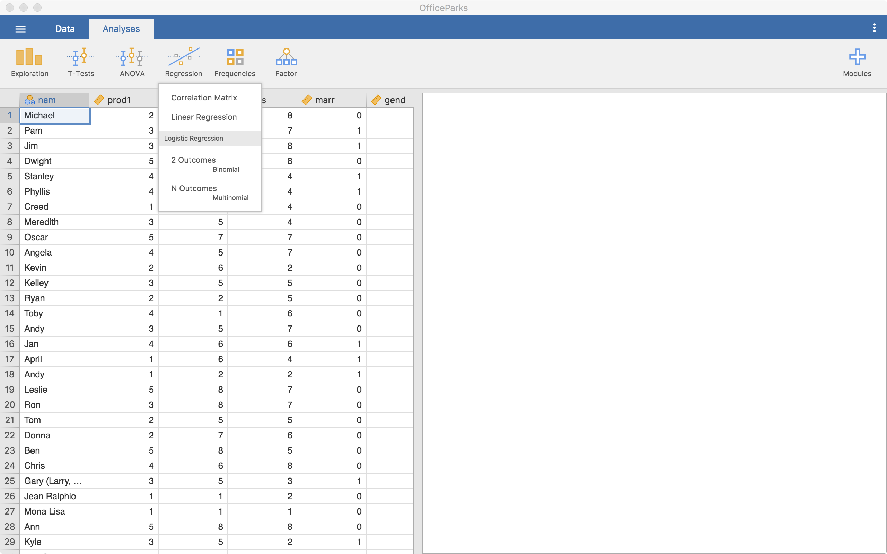
Compute the Test Statistic
4
Click on
“2 Outcomes
Binomial”

Slide 40
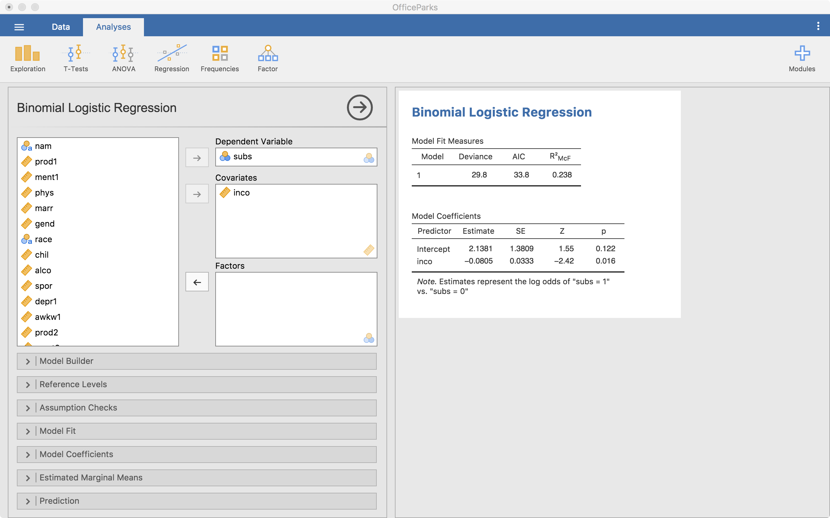
Compute the Test Statistic
4
Results
Outcome goes here
Continuous predictors go here
Other model options
Categorical predictors go here

Slide 41
Continuous Predictor
4
Model Coefficients
 |  |  |  |  |  | 95% Confidence Interval
Predictor | Estimate | SE | Z | p | Odds ratio | Lower | Upper
Intercept | 2.1381 | 1.3809 | 1.55 | 0.122 | 8.483 | 0.566 | 127.060
Income | -0.0805 | 0.0333 | -2.42 | 0.016 | 0.923 | 0.864 | 0.985
Note. Estimates represent the log odds of "subs = 1" vs. "subs = 0"
Estimate in “log-odds” units
The odds ratio is below 1 so as income increases, the odds of using substances decreases by ~1 - .923 = .077 (7.7% decrease)
Significant

Slide 42
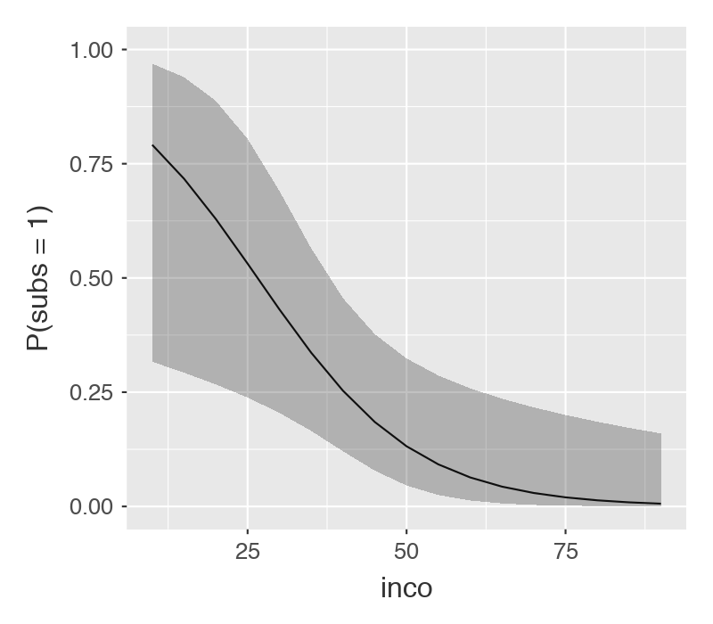
4
Continuous Predictor
Probability of using substances by income level
How well can we predict substance use with just income?
Classification Table – subs
 |  | Predicted
Observed |  | 0 |  | 1 |  | % Correct
0 |  | 29 |  | 1 |  | 96.7
1 |  | 5 |  | 3 |  | 37.5
Note. The cut-off value is set to 0.5
Notes:
Only high probability of using substances in very low income levels
Does not predict well (It doesn’t predict using substances very well)

Slide 43
Categorical Predictor
4
Model Coefficients
 |  |  |  |  |  |  |  |  |  |  |  | 95% Confidence Interval
Predictor |  | Estimate |  | SE |  | Z |  | p |  | Odds ratio |  | Lower |  | Upper
Intercept |  | -1.504 |  | 0.553 |  | -2.721 |  | 0.007 |  | 0.222 |  | 0.0752 |  | 0.657
Show:
The Office – Parks and Rec |  | 0.405 |  | 0.799 |  | 0.507 |  | 0.612 |  | 1.500 |  | 0.3131 |  | 7.186
Note. Estimates represent the log odds of "subs = 1" vs. "subs = 0"
Estimate in “log-odds” units
The odds ratio is above 1 so individuals on The Office have an odds of using substances 50% (1.5 – 1 = .5 = 50%) higher than PR
Not Significant

Slide 44
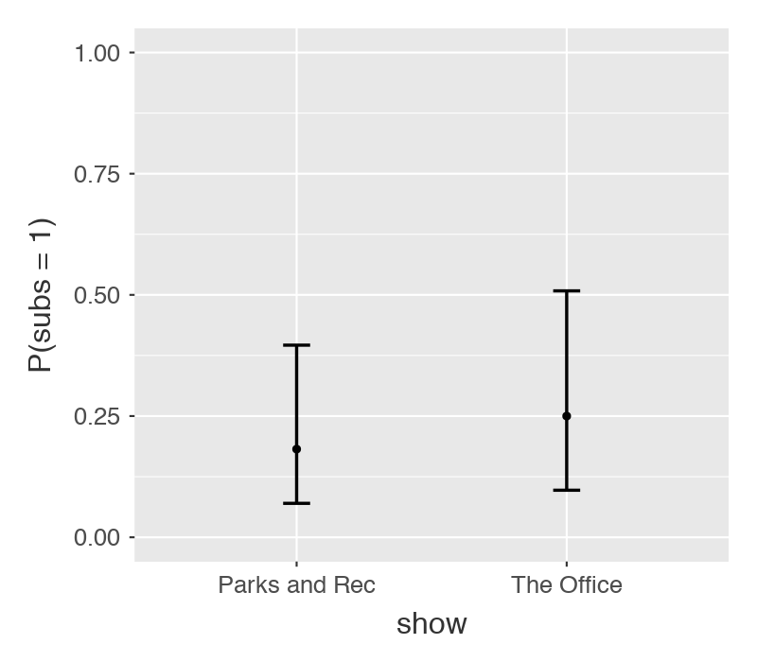
Categorical Predictor
4
Probability of using substances by show
How well can we predict substance use with just income?
Classification Table – subs
 |  | Predicted
Observed |  | 0 |  | 1 |  | % Correct
0 |  | 30 |  | 0 |  | 100
1 |  | 8 |  | 0 |  | 0.00
Note. The cut-off value is set to 0.5
Notes:
Neither show has high probability of using substances
Does not predict well (it only predicts no substance use)

Slide 45
Compute the Test Statistic
4
Intercept = Odds of Y when
X is zero
Slope = The change in the
odds of Y = 1 for a
one unit change in X,
on average.

Slide 46

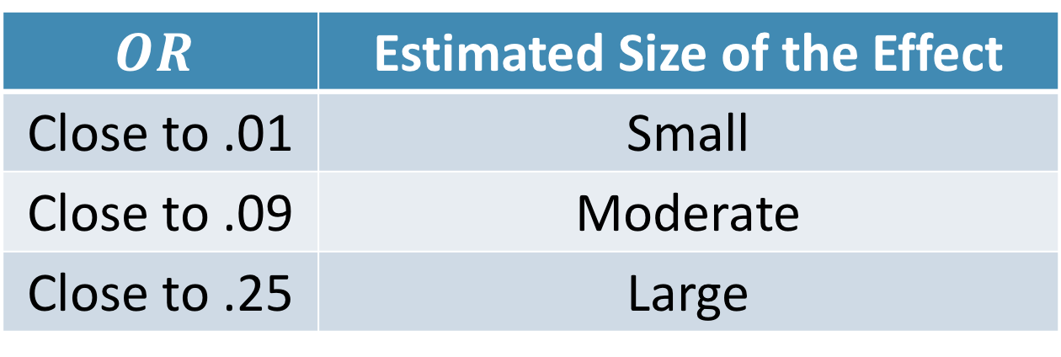
Compute an Effect Size and Describe it
5
One of the main effect sizes for regression is R²
$$Odds Ratio=\frac{Odds of Y when X is one unit higher}{Odds of Y when X is not one unit higher}$$
$$OR$$ | Estimated Size of the Effect
Close to .01 | Small
Close to .09 | Moderate
Close to .25 | Large
Notes:
Can also use Cohen’s d here as well for each mean difference

Slide 47
Interpreting the results
6
The logistic regression analysis showed that income significantly predicted the odds of substance use (OR = -.923, p = .016). As income increased by $1000, the odds of using substances decreased by 7.7%.

Slide 48
Multiple Logistic Regression

Slide 49
Multiple Logistic Regression
More than one predictor in the same model
This change the interpretation just a little:
Slope is now the change in the odds of Y = 1 for a one unit change in X, while holding the other predictors constant.

Slide 50
Multiple Regression
Provides us with a few more things to think about
1. Variable Selection
2. Assumption Checks (much more
difficult in logistic regression)
3. Multi-collinearity
4. Interactions

Slide 51
Variable Selection
Several Approaches
1. Forward
2. Backward
3. Lasso
4. Covariates then predictor of interest

Slide 52
Variable Selection when theory isn’t clear
Several Approaches
1. Forward
2. Backward
3. Lasso
4. Covariates then predictor of interest
I’d recommend these two
Notes:
Can report both the “adjusted” and “unadjusted” effects as well

Slide 53
Assumption Checks
Difficult (we won’t cover it in this class)
Jamovi doesn’t provide many checks (only collinearity)

Slide 54
Multi-Collinearity
When two or more predictors are very related to each other or are linear combinations of each other
Check correlations
Dummy codes are correct (Jamovi does this automatically)

Slide 55
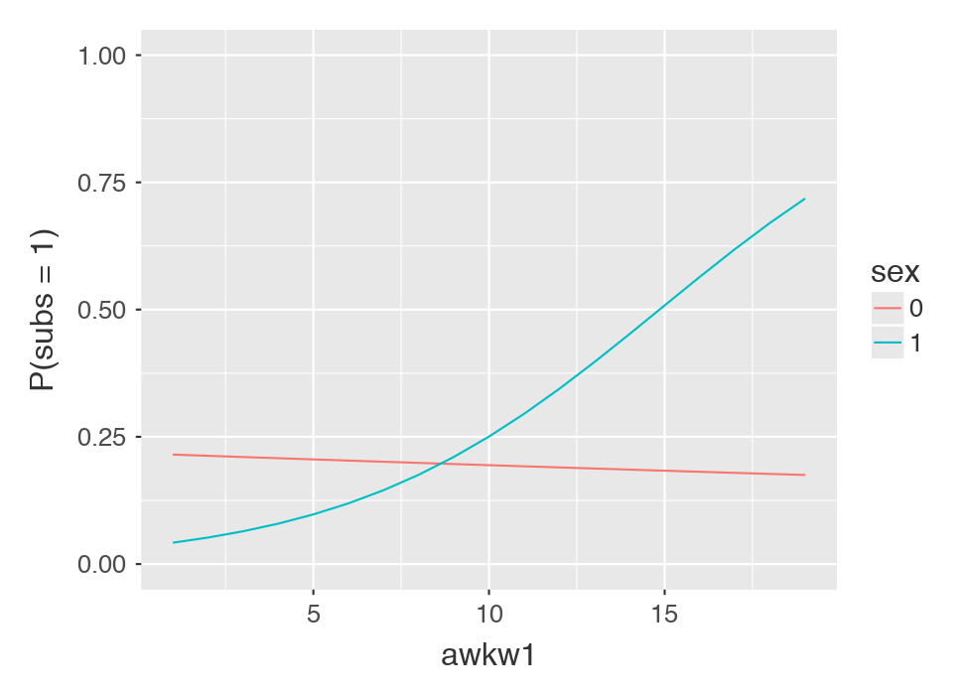
Interactions
Just as we do in linear models
Can have 2+ variables in the interaction

Slide 56
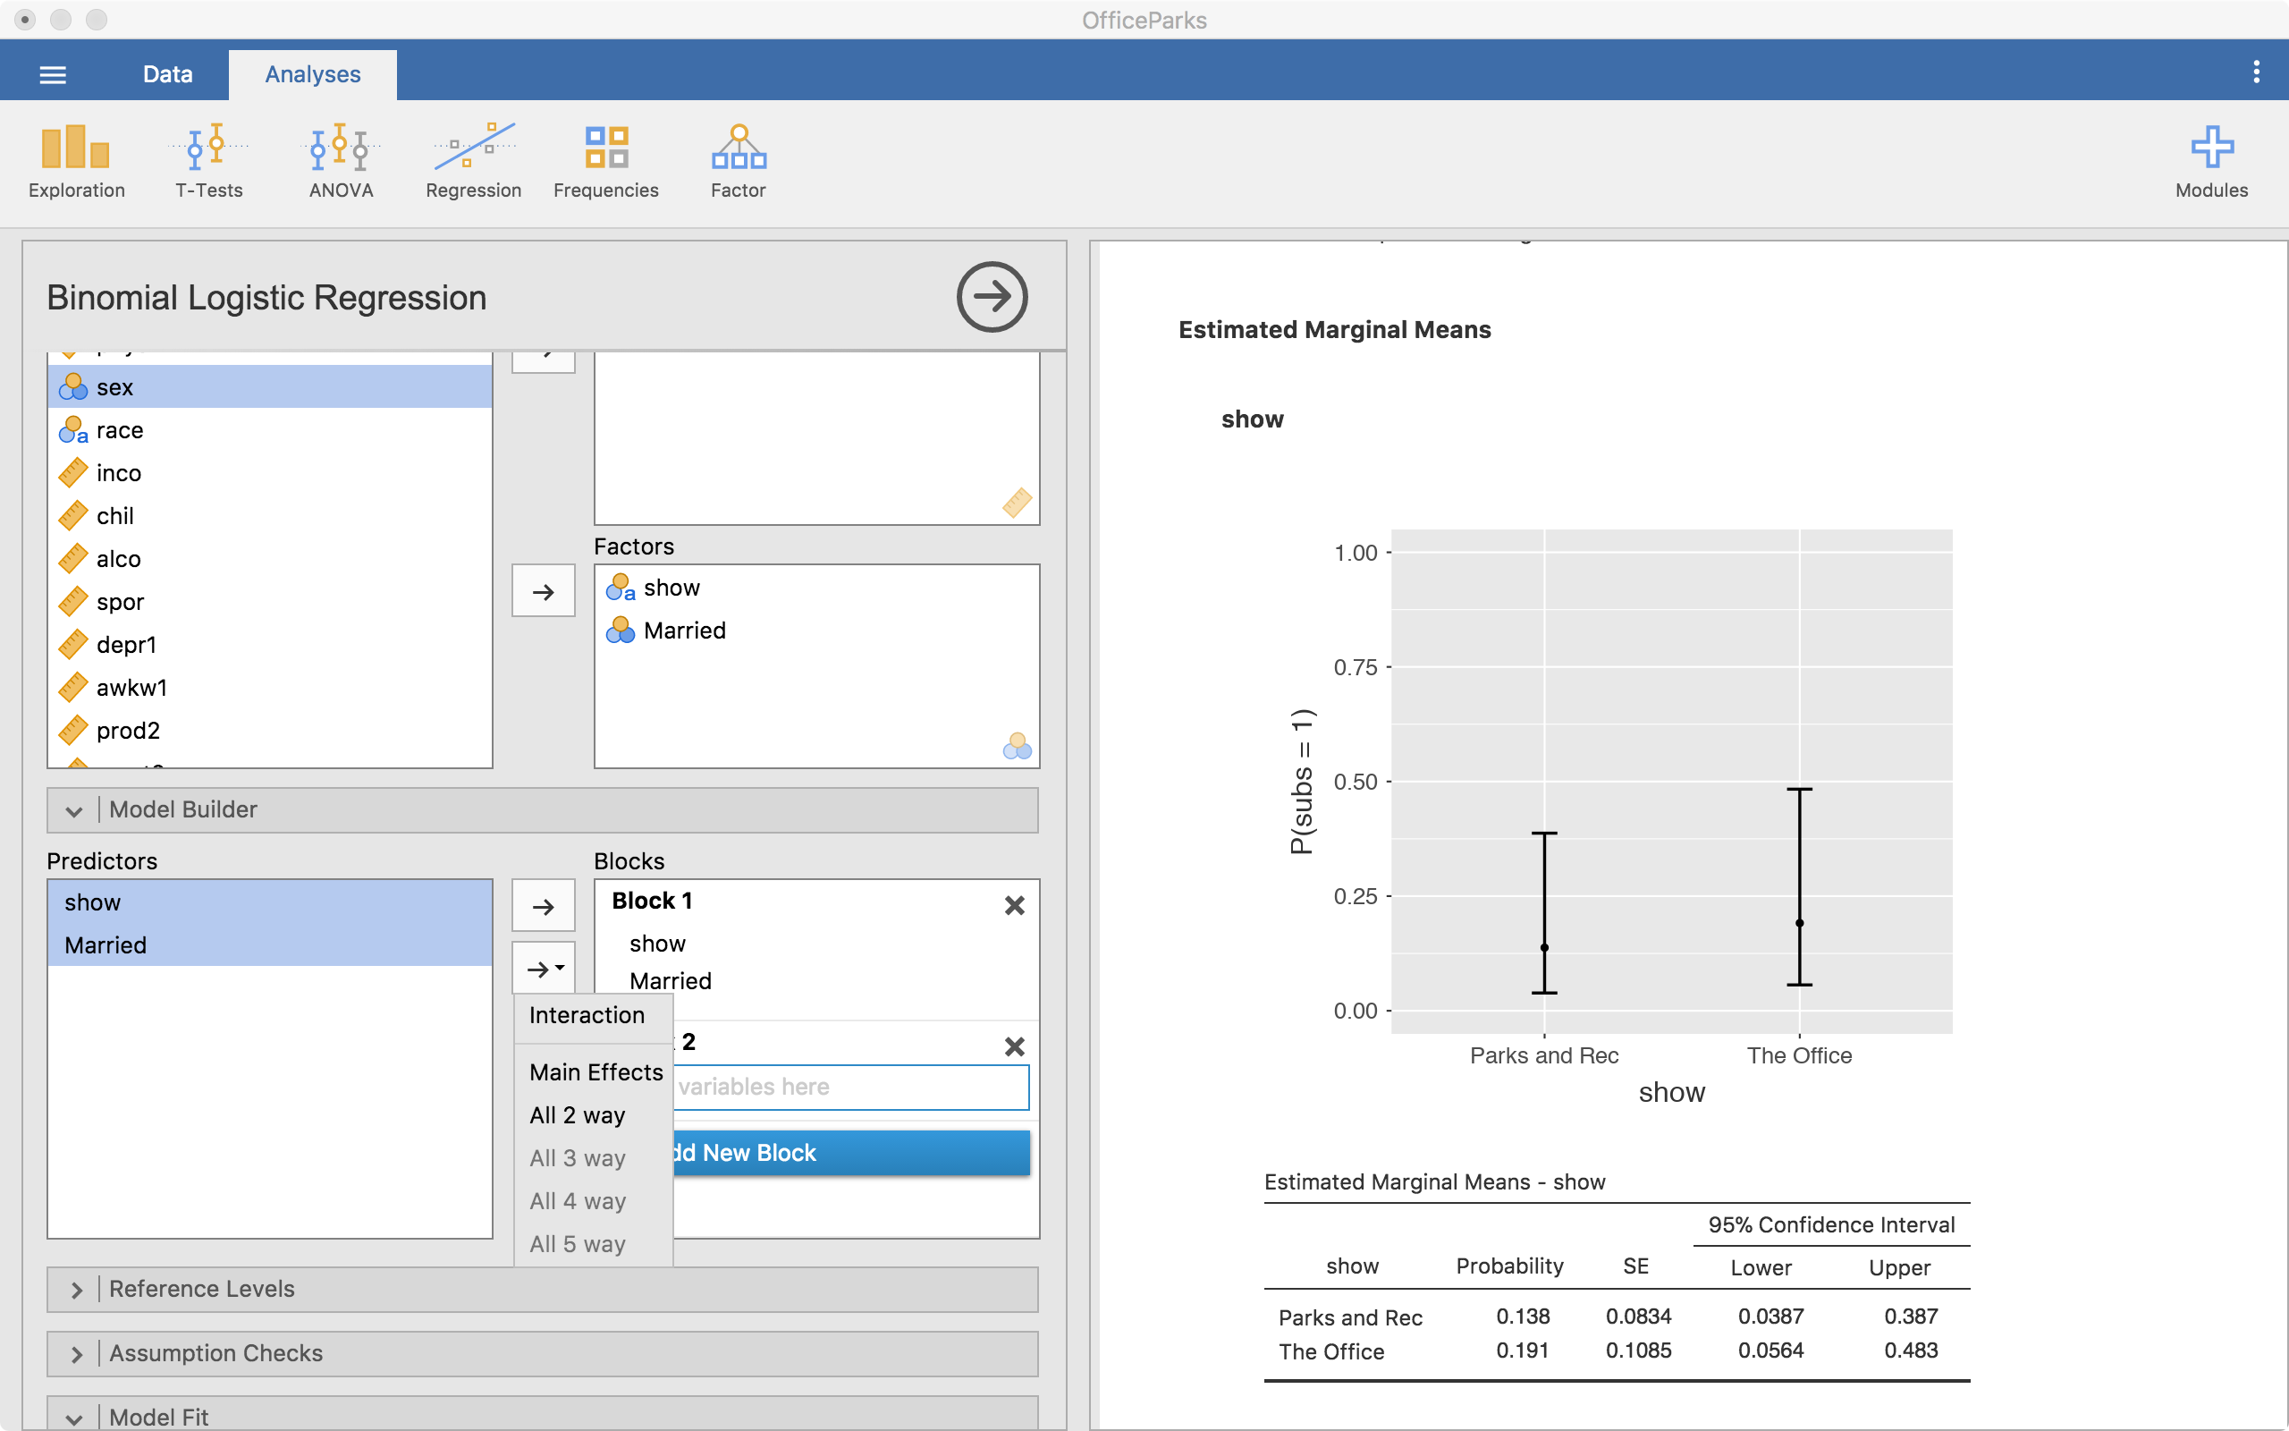
Interactions
Can tell Jamovi to do an interaction

Slide 57
Questions?
Please post them to the discussion board before class starts
End of Pre-Recorded Lecture Slides

Slide 58
In-class discussion
slides

Slide 59
Application
Example Using
The Office/Parks and Rec Data Set
Hypothesis Test with
Logistic Regression

