Slide 1
Applied Statistical Analysis
EDUC 6050
Week 2
Finding clarity using data

Slide 2
Today
Working with Data
Overview of Statistics
Intro to Statistical Terminology
Intro to Jamovi

Slide 3
Reading
Data in Spreadsheets

Slide 4
2 Be Consistent 3 Choose good names for things 4 Write dates as YYYY-MM-DD 6 Put just one thing in a cell 7 Make it a rectangle 8 Create a data dictionary
Data in Spreadsheets

Slide 5
Statistics helps us understand our data
Data and Statistics

Slide 6
Statistics helps us understand our data
Data and Statistics
Summarize the data easily
Ask questions about what the data mean

Slide 7
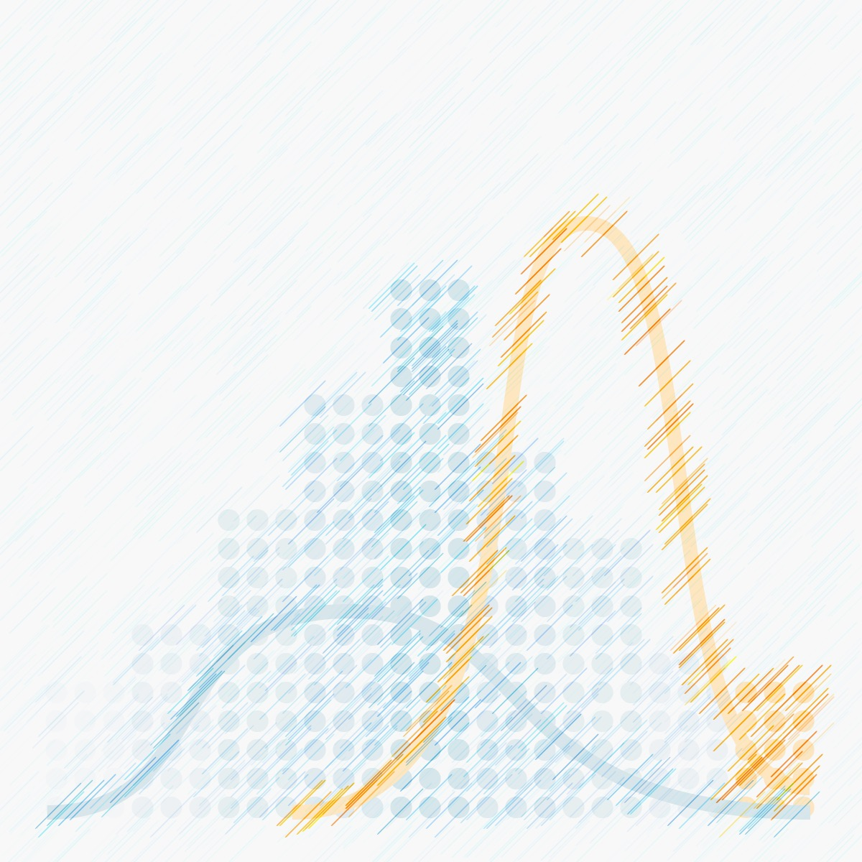
Statistics
A statistic is some sort of summary of the data
The average is a statistic

Slide 8
The Vocabulary of Statistics
Population
Sample

Slide 9
The Vocabulary of Statistics
Descriptive Statistics
Describing the data that you have (your sample)
Inferential Statistics
Understanding what your data say about the population

Slide 10
The Vocabulary of Statistics
Independent Variables
Dependent
Variables
“predictors” or “IV”
These are the variables that we think are causing or influencing the outcome
“outcomes” or “DV”
These are the variables that we think are caused by an independent variable

Slide 11
The Vocabulary of Statistics
Hypothesis Testing (Inferential Statistics)
Null Hypothesis Significance Testing
Gives us an idea about what the population may look like based on our sample (accounts for sampling error)

Slide 12
The Vocabulary of Statistics
Effect Sizes
Gives us an idea about what the population may look like based on our sample (accounts for sampling error)

Slide 13
Why Learn Statistics?
Simply: the understanding of data using summaries and probability
A statistic is some sort of summary of the data
The average is a statistic

Slide 14
Break Time

Slide 15
Why Learn Statistics?
Simply: the understanding of data using summaries and probability
A statistic is some sort of summary of the data
The average is a statistic

Slide 16
Questions?

Slide 17
Next week:
Statistics terminology (Hypothesis, IV and DV, Measurement, Validity and Reliability, Correlation and Experimentation, Distributions, Central Tendency and Variability)
Chapters 1, 2, and 3 in Book
Start looking for articles

