Slide 1
Applied Statistical Analysis
EDUC 6050
Week 12
Finding clarity using data

Slide 2
Today
Moderation vs. Mediation

Slide 3
Mediation
Moderation
Tells us about the path of an effect
from one variable to an intermediate one then to the outcome
Jamovi does not have built in ways to performs this
“The effect of X goes through M to Y”
Synonym for interaction
Jamovi performs this
“The effect of X on Y depends on M”

Slide 4
Moderation
Mod
X
Y
Notes:
The effect of Type of Food interacts with Type of Topping on enjoyment of the food.

Slide 5
Mediation
Med
X
Y
Notes:
Bully victimization -> Depression -> Substance Use

Slide 6
Mediation
Use specialized software for this (Jamovi can’t do it yet)
Be aware of it but you do not need to know how to do it for this class

Slide 7
Why Do We Talk About Mediation?
Helps us think more about how things are actually happening in the real world
Helps us think about confounding better

Slide 8
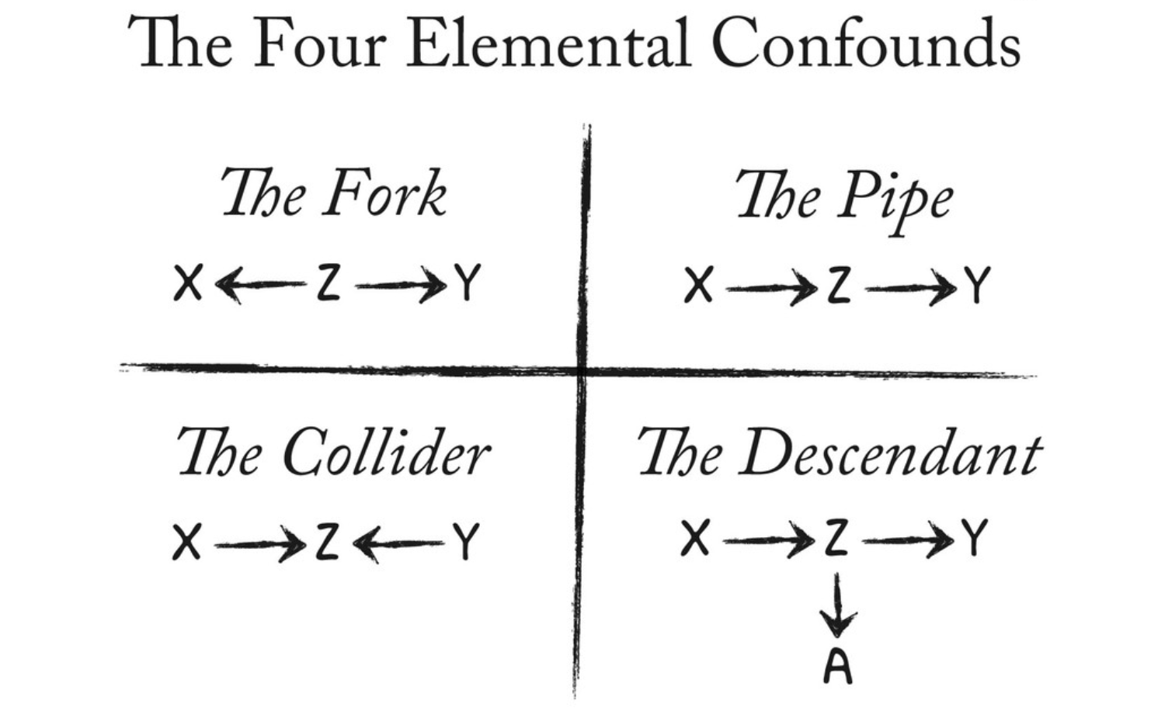
The Four Confounds
From Richard McElreath

Slide 9
No Application
This Week

Slide 10
Questions?
Please post them to the discussion board before class starts

