Slide 1
Applied Statistical Analysis
EDUC 6050
Week 7
Finding clarity using data

Slide 2
Today
Hypothesis Testing with ANOVA
Repeated Measures ANOVA
Mixed ANOVA

Slide 4
Repeated Measures ANOVA

Slide 5





Time 1
Time 2
Time 3
Same people at each time point with same dependent variable at each time point

Slide 6
Difference Score 1
Time 2 – Time 1
Difference Score 2
Time 3 – Time 2

Slide 7
General
Requirements
ID | Time 1 | Time 2
1 | 8 | 7
2 | 8 | 8
3 | 9 | 6
4 | 7 | 6
5 | 7 | 8
6 | 9 | 5
7 | 5 | 3
8 | 5 | 3
Need a DV on an interval/ratio scale measured at 2+ time points
The participants need to be present at each time point

Slide 8
Hypothesis Testing with RM-ANOVA
The same 6 step approach!
Examine Variables to Assess Statistical Assumptions
State the Null and Research Hypotheses (symbolically and verbally)
Define Critical Regions
Compute the Test Statistic
Compute an Effect Size and Describe it
Interpreting the results

Slide 9
Examine Variables to Assess Statistical Assumptions
1
Basic Assumptions
Independence of data
Appropriate measurement of variables for the analysis
Normality of distributions
Sphericity (difference scores must have equal variances)

Slide 10
Examine Variables to Assess Statistical Assumptions
1
Basic Assumptions
Independence of data
Appropriate measurement of variables for the analysis
Normality of distributions
Sphericity (difference scores must have equal variances)
Individuals are independent of each other (one person’s scores does not affect another’s)

Slide 11
Examine Variables to Assess Statistical Assumptions
1
Basic Assumptions
Independence of data
Appropriate measurement of variables for the analysis
Normality of distributions
Sphericity (difference scores must have equal variances)
Here we need interval/ratio DV
Notes:
For F-test, DV needs to be interval/ratio

Slide 12
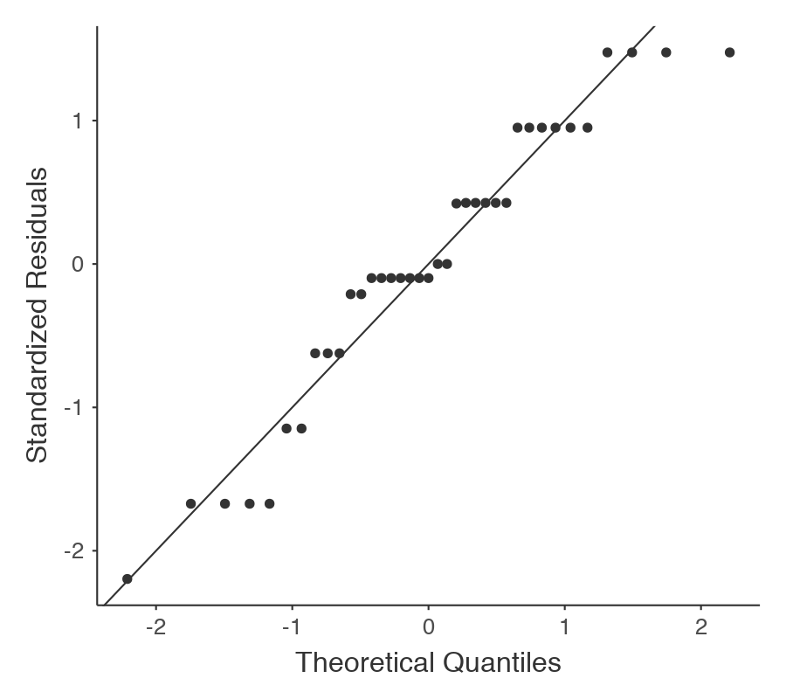
Examine Variables to Assess Statistical Assumptions
1
Basic Assumptions
Normality of the residuals
Independence of data
Appropriate measurement of variables for the analysis
Normality of distributions
Sphericity (difference scores must have equal variances)

Slide 13
Examine Variables to Assess Statistical Assumptions
1
Basic Assumptions
Independence of data
Appropriate measurement of variables for the analysis
Normality of distributions
Sphericity (difference scores must have equal variances)
The variances of the difference scores should be equal

Slide 14
Examine Variables to Assess Statistical Assumptions
1
Examining the Basic Assumptions
Independence: random sample
Appropriate measurement: know what your variables are
Normality: Histograms, Q-Q, skew and kurtosis
Sphericity: Mauchly’s test

Slide 15
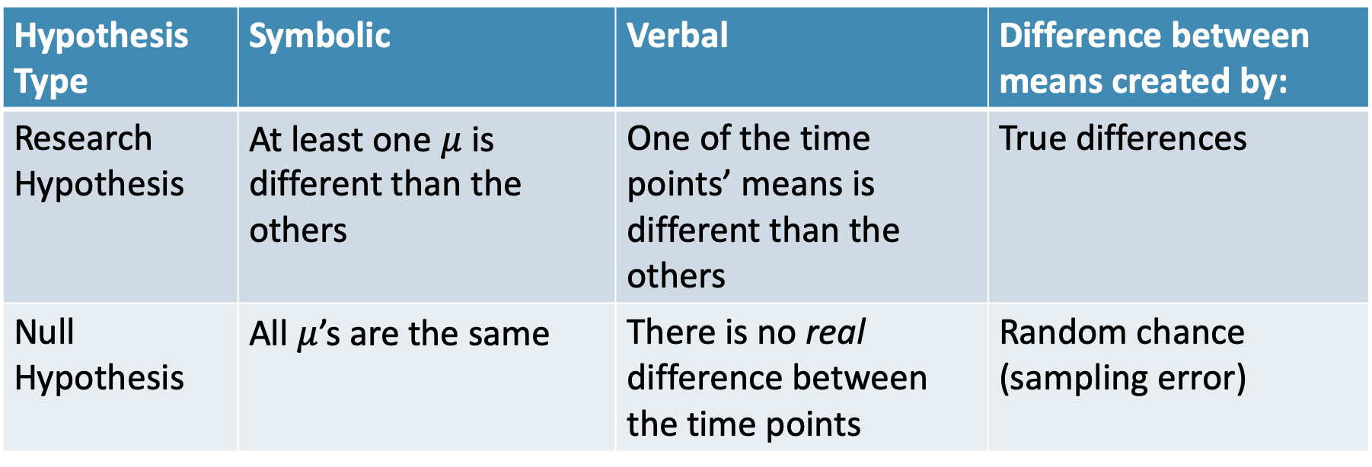
State the Null and Research Hypotheses (symbolically and verbally)
2
Hypothesis Type | Symbolic | Verbal | Difference between means created by:
Research Hypothesis | At least one $μ$ is different than the others | One of the time points’ means is different than the others | True differences
Null Hypothesis | All $μ$’s are the same | There is no real difference between the time points | Random chance (sampling error)
Notes:
Null and research hypotheses are mutually exclusive (they cover all possible outcomes)

Slide 16
Define Critical Regions
3
How much evidence is enough to believe the null is not true?
Before analyzing the data, we define the critical regions (generally based on an alpha = .05)

Slide 17


Define Critical Regions
3
We decide on an alpha level first
And compare the p-values (in Step 4) to our alpha level
$df_{num}=k −1$
where k is number of time points
$df_{den}=N −k$

Slide 18
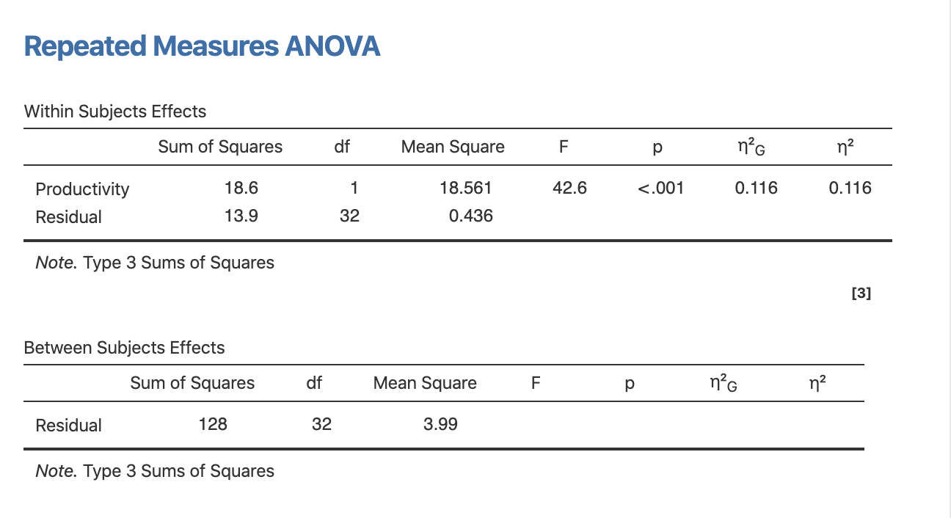
Compute the Test Statistic
4

Slide 19
Compute the Test Statistic
4
Shows us if at least one time point is different from the others

Slide 20
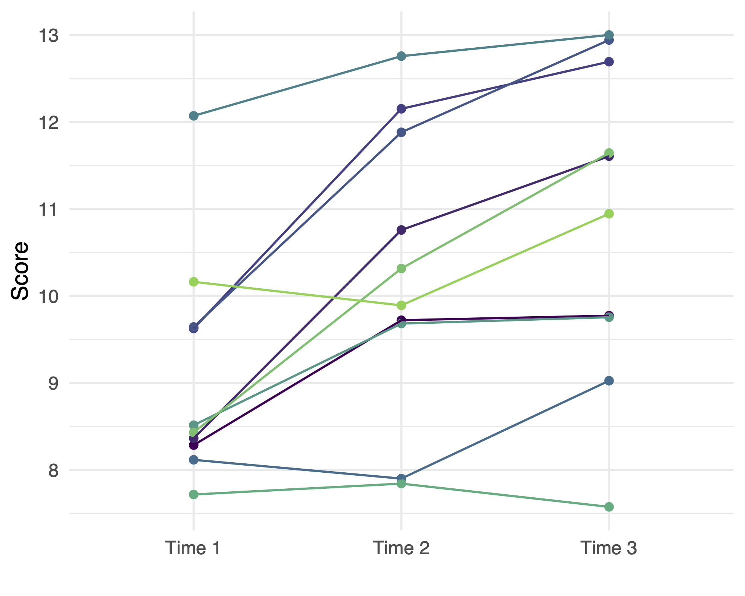
Compute the Test Statistic
4
Notes:
Plot Code in R:
library(tidyverse)
set.seed(843)
d = tibble(
ID = 1:10,
`Time 1` = rnorm(10, 10, 1),
`Time 2` = `Time 1` + 1 + rnorm(10),
`Time 3` = `Time 2` + .5 + rnorm(10)
)
d %>%
pivot_longer(cols = c(`Time 1`, `Time 2`, `Time 3`)) %>%
ggplot(aes(x = name, y = value, group = ID, color = ID)) +
geom_point(show.legend = FALSE) +
geom_line(show.legend = FALSE) +
theme_minimal() +
labs(x = "",
y = "Score") +
scale_color_viridis_c(end = .8)

Slide 21
Compute the Test Statistic
4
F-statistic and p-value tell you if one of the times is different than the others
Post Hoc Tests
But it doesn’t tell you which ones are different if you have 3+ time points...

Slide 22
Compute the Test Statistic
4
Post Hoc Tests
(or Contrasts)
Post hoc usually refers to comparing all groups with each other (and making an adjustment for the multiple comparisons)
Contrasts usually refers to comparing some of the groups with each other (or a combination of groups with each other)

Slide 23

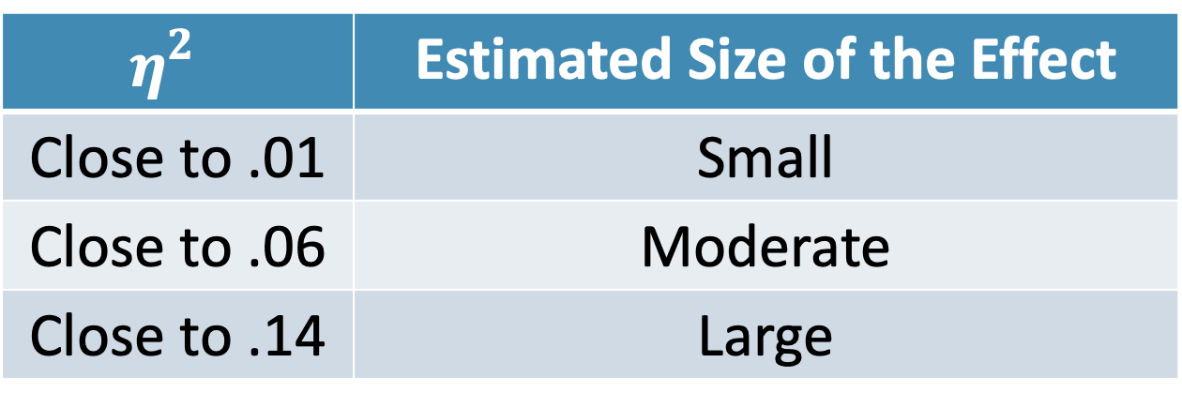
Compute an Effect Size and Describe it
5
One of the main effect sizes for ANOVA is “Eta Squared”
$$η_{}^{2}=\frac{SS_{Time}}{SS_{Time}+SS_{residual}}$$
$$η_{}^{2}$$ | Estimated Size of the Effect
Close to .01 | Small
Close to .06 | Moderate
Close to .14 | Large
Notes:
Can also use Cohen’s d here as well for each mean difference

Slide 24
Interpreting the results
6
Put your results into words

Slide 25
Repeated Measures
vs. Mixed
RM ANOVA has one time variable
Mixed ANOVA combines One-Way ANOVA and RM ANOVA
Tests for any differences across the groups on one time variable
Tests for any differences across the times/groups (and their combinations)
“Interaction”

Slide 26
Mixed ANOVA Interaction
When the changes over time depends on another variable
Notes:
Sometimes the effect of one of the predictors depends on the other predictor
library(tidyverse)
set.seed(843)
d1 = tibble(
ID = 1:10,
`Time 1` = rnorm(10, 10, 1),
`Time 2` = `Time 1` + 1 + rnorm(10),
`Time 3` = `Time 2` + .5 + rnorm(10),
grp = "Treatment"
)
d2 = tibble(
ID = 11:20,
`Time 1` = rnorm(10, 10, 1),
`Time 2` = `Time 1` - 1 + rnorm(10),
`Time 3` = `Time 2` - .5 + rnorm(10),
grp = "Control"
)
bind_rows(d1, d2) %>%
pivot_longer(cols = c(`Time 1`, `Time 2`, `Time 3`)) %>%
ggplot(aes(x = name, y = value, group = ID, color = grp)) +
geom_point(show.legend = FALSE) +
geom_line(show.legend = FALSE) +
theme_minimal() +
labs(x = "",
y = "Score") +
scale_color_viridis_d(end = .6, begin = .2) +
theme(panel.grid.minor = element_blank(),
panel.grid.major = element_line(linetype = "dashed"),
panel.border = element_rect(fill = NA, color = "lightgrey")) +
facet_wrap(~grp)

Slide 27
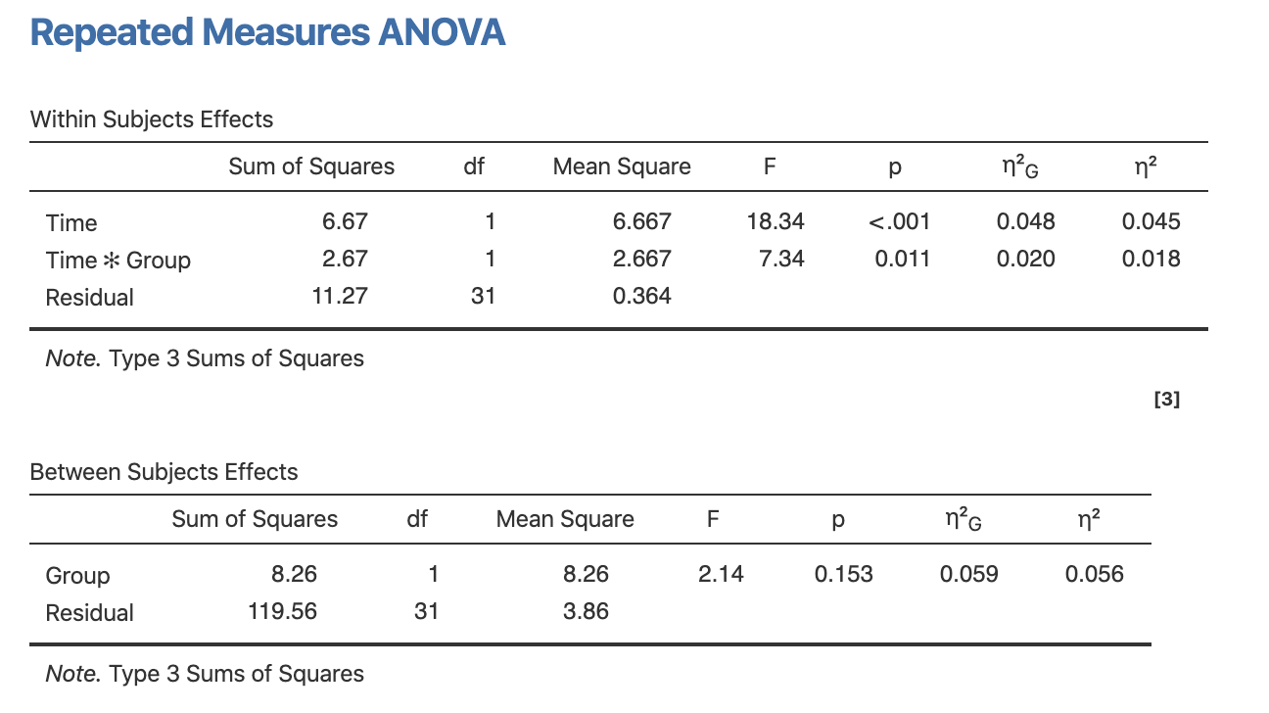
Mixed ANOVA
Notes:
Sometimes the effect of one of the predictors depends on the other predictor
library(tidyverse)
set.seed(843)
d1 = tibble(
ID = 1:10,
`Time 1` = rnorm(10, 10, 1),
`Time 2` = `Time 1` + 1 + rnorm(10),
`Time 3` = `Time 2` + .5 + rnorm(10),
grp = "Treatment"
)
d2 = tibble(
ID = 11:20,
`Time 1` = rnorm(10, 10, 1),
`Time 2` = `Time 1` - 1 + rnorm(10),
`Time 3` = `Time 2` - .5 + rnorm(10),
grp = "Control"
)
bind_rows(d1, d2) %>%
pivot_longer(cols = c(`Time 1`, `Time 2`, `Time 3`)) %>%
ggplot(aes(x = name, y = value, group = ID, color = grp)) +
geom_point(show.legend = FALSE) +
geom_line(show.legend = FALSE) +
theme_minimal() +
labs(x = "",
y = "Score") +
scale_color_viridis_d(end = .6, begin = .2) +
theme(panel.grid.minor = element_blank(),
panel.grid.major = element_line(linetype = "dashed"),
panel.border = element_rect(fill = NA, color = "lightgrey")) +
facet_wrap(~grp)

Slide 28
Mixed ANOVA
Notes:
Sometimes the effect of one of the predictors depends on the other predictor
library(tidyverse)
set.seed(843)
d1 = tibble(
ID = 1:10,
`Time 1` = rnorm(10, 10, 1),
`Time 2` = `Time 1` + 1 + rnorm(10),
`Time 3` = `Time 2` + .5 + rnorm(10),
grp = "Treatment"
)
d2 = tibble(
ID = 11:20,
`Time 1` = rnorm(10, 10, 1),
`Time 2` = `Time 1` - 1 + rnorm(10),
`Time 3` = `Time 2` - .5 + rnorm(10),
grp = "Control"
)
bind_rows(d1, d2) %>%
pivot_longer(cols = c(`Time 1`, `Time 2`, `Time 3`)) %>%
ggplot(aes(x = name, y = value, group = ID, color = grp)) +
geom_point(show.legend = FALSE) +
geom_line(show.legend = FALSE) +
theme_minimal() +
labs(x = "",
y = "Score") +
scale_color_viridis_d(end = .6, begin = .2) +
theme(panel.grid.minor = element_blank(),
panel.grid.major = element_line(linetype = "dashed"),
panel.border = element_rect(fill = NA, color = "lightgrey")) +
facet_wrap(~grp)

Slide 29
Questions?
Please post them to the discussion board before class starts
End of Pre-Recorded Lecture Slides

Slide 30
In-class discussion
slides

Slide 31
Application
Example Using
The Office/Parks and Rec Data Set
Hypothesis Test with RM ANOVA
and
Mixed ANOVA

