Slide 1
https://www.youtube.com/watch?v=nUdsTizSxSI&t=978s

Slide 2
Applied Statistical Analysis
EDUC 6050
Week 10
Finding clarity using data

Slide 3
Today
Logistic
Regression
Notes:
The main type of “Generalized Linear Model” that you will see

Slide 4
Intro to Logistic Regression
So far, we have always wanted continuous outcome variables
But what if our outcome is a categorical variable??
Logistic Regression is just like linear regression but works with binary (dichotomous) outcomes
Substance Use or Not
Cancer or Not
Buy it or Not

Slide 5
Logic of Logistic Regression
We are trying to find the best fitting S curve
1
Y
0
X

Slide 6
Logic of Logistic Regression
We are trying to find the best fitting S curve
1
Y
The curve is the model estimated probability of Y = 1
0
X

Slide 7
Logistic Regression
Simple
Multiple
Only one predictor in the model
Tells you if that one predictor is associated with the odds of Y = 1
More than one variable in the model
Tells you if, while holding the other variables constant, if that predictor is associated with the odds of Y = 1

Slide 8
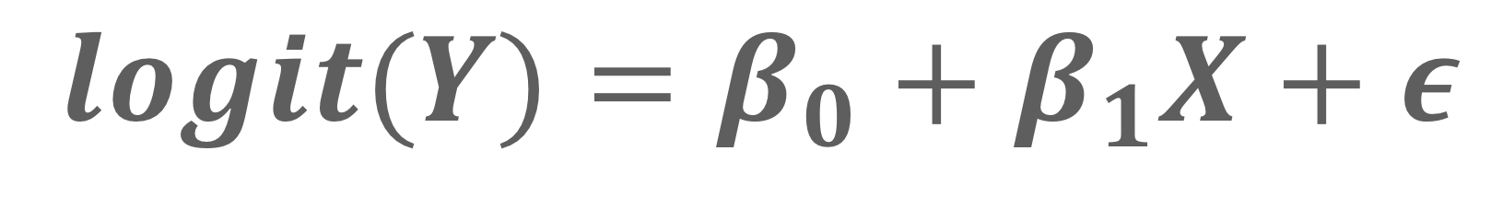
Logistic Regression
Logistic does what regression does but with a little bit of mathematical magic
$$logit(Y)=β_{0}+β_{1}X+ε$$

Slide 9
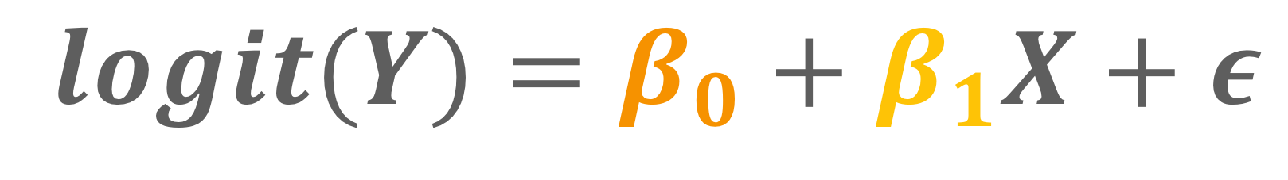
Logistic Regression
Logistic does what regression does but with a little bit of mathematical magic
slope
$$logit(Y)=β_{0}+β_{1}X+ε$$
intercept

Slide 10
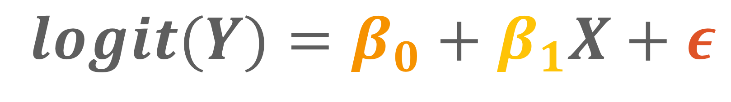
Logistic Regression
Logistic does what regression does but with a little bit of mathematical magic
slope
$$logit(Y)=β_{0}+β_{1}X+ε$$
unexplained stuff in the odds of Y
intercept

Slide 11

Logistic Regression
$$logit(Y)=β_{0}+β_{1}X+ε$$
We have two variables, X and Y. X is continuous, Y is binary. We want to know if increases/decreases in X are associated (or predict) changes in the chance of Y equaling 1.
Example

Slide 12
Logistic Regression
It is trying to predict the outcome accurately using the information from the predictor
Better prediction tells us that the predictor(s) is/are more strongly related to the outcome

Slide 13
General
Requirements
ID | X | Y
1 | 8 | 0
2 | 6 | 1
3 | 9 | 1
4 | 7 | 1
5 | 7 | 0
6 | 8 | 0
7 | 5 | 1
8 | 5 | 0
Two or more variables,
Outcome needs to be binary
Others can be continuous or categorical

Slide 14
Hypothesis Testing with Logistic Regression
The same 6 step approach!
Examine Variables to Assess Statistical Assumptions
State the Null and Research Hypotheses (symbolically and verbally)
Define Critical Regions
Compute the Test Statistic
Compute an Effect Size and Describe it
Interpreting the results

Slide 15
Examine Variables to Assess Statistical Assumptions
1
Basic Assumptions
Independence of data
Appropriate measurement of variables for the analysis
Normality of distributions
Homoscedastic

Slide 16
Examine Variables to Assess Statistical Assumptions
1
Basic Assumptions
Independence of data
Appropriate measurement of variables for the analysis
Normality of distributions
Homoscedastic
Individuals are independent of each other (one person’s scores does not affect another’s)

Slide 17
Examine Variables to Assess Statistical Assumptions
1
Basic Assumptions
Independence of data
Appropriate measurement of variables for the analysis
Normality of distributions
Homoscedastic
Here we need nominal outcome
Notes:
For F-test, DV needs to be interval/ratio

Slide 18
Examine Variables to Assess Statistical Assumptions
1
Basic Assumptions
Residuals should be normally distributed
Independence of data
Appropriate measurement of variables for the analysis
Normality of distributions
Homoscedastic

Slide 19
Examine Variables to Assess Statistical Assumptions
1
Basic Assumptions
Independence of data
Appropriate measurement of variables for the analysis
Normality of distributions
Homoscedastic
Variance around the line should be roughly equal across the whole line
Notes:
Example on board

Slide 20
Examine Variables to Assess Statistical Assumptions
1
Basic Assumptions
Independence of data
Appropriate measurement of variables for the analysis
Normality of distributions
Homoscedastic
Logistic Relationship
No omitted variables
Notes:
Example on board

Slide 21
Examine Variables to Assess Statistical Assumptions
1
Basic Assumptions
Independence of data
Appropriate measurement of variables for the analysis
Normality of distributions
Homoscedastic
Logistic Relationships
No omitted variables
The “S-shaped” curve should fit to the data
Notes:
Example on board

Slide 22
Examine Variables to Assess Statistical Assumptions
1
Basic Assumptions
Independence of data
Appropriate measurement of variables for the analysis
Normality of distributions
Homoscedastic
Logistic Relationships
No omitted variables
Any variable that is related to both the predictor and the outcome should be included in the regression model
Notes:
Example on board

Slide 23
Examine Variables to Assess Statistical Assumptions
1
Examining the Basic Assumptions
Independence: random sample
Appropriate measurement: know what your variables are
Normality: Histograms, Q-Q, skew and kurtosis
Homoscedastic: Scatterplots
Logistic: Scatterplots
No Omitted: check correlations, know the theory

Slide 24
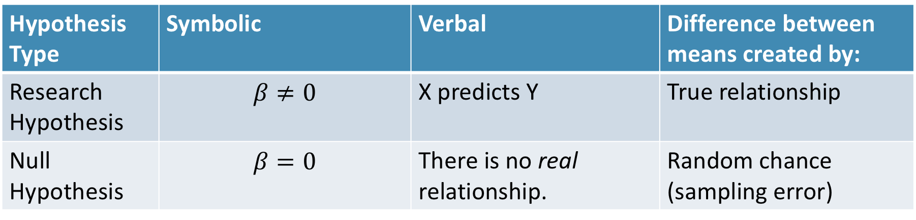
State the Null and Research Hypotheses (symbolically and verbally)
2
Hypothesis Type | Symbolic | Verbal | Difference between means created by:
Research Hypothesis | $$β≠0$$ | X predicts Y | True relationship
Null Hypothesis | $$β=0$$ | There is no real relationship. | Random chance (sampling error)
Notes:
Null and research hypotheses are mutually exclusive (they cover all possible outcomes)

Slide 25
Define Critical Regions
3
How much evidence is enough to believe the null is not true?
generally based on an alpha = .05
Use software’s p-value to judge if it is below .05

Slide 26
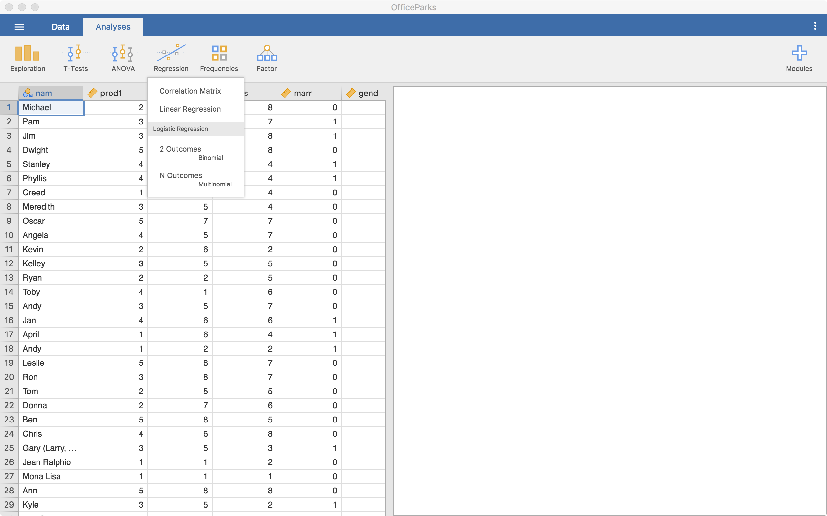
Compute the Test Statistic
4
Click on
“2 Outcomes
Binomial”

Slide 27
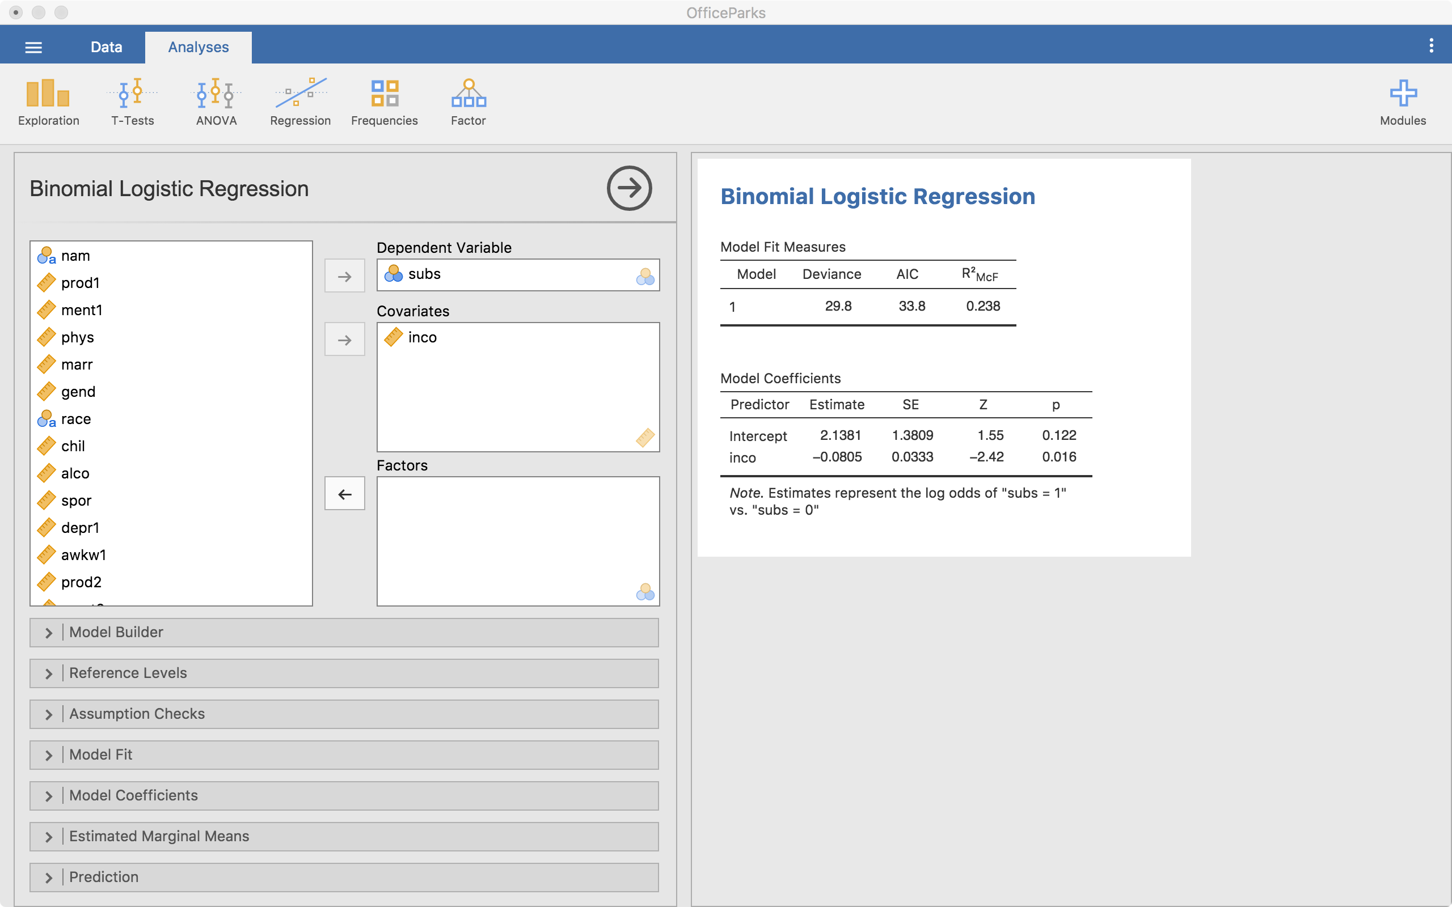
Compute the Test Statistic
4
Results
Outcome goes here
Continuous predictors go here
Other model options
Categorical predictors go here

Slide 28
Continuous Predictor
4
Model Coefficients
 |  |  |  |  |  | 95% Confidence Interval
Predictor | Estimate | SE | Z | p | Odds ratio | Lower | Upper
Intercept | 2.1381 | 1.3809 | 1.55 | 0.122 | 8.483 | 0.566 | 127.060
Income | -0.0805 | 0.0333 | -2.42 | 0.016 | 0.923 | 0.864 | 0.985
Note. Estimates represent the log odds of "subs = 1" vs. "subs = 0"
Estimate in “log-odds” units
The odds ratio is below 1 so as income increases, the odds of using substances decreases by ~1 - .923 = .077 (7.7% decrease)
Significant

Slide 29
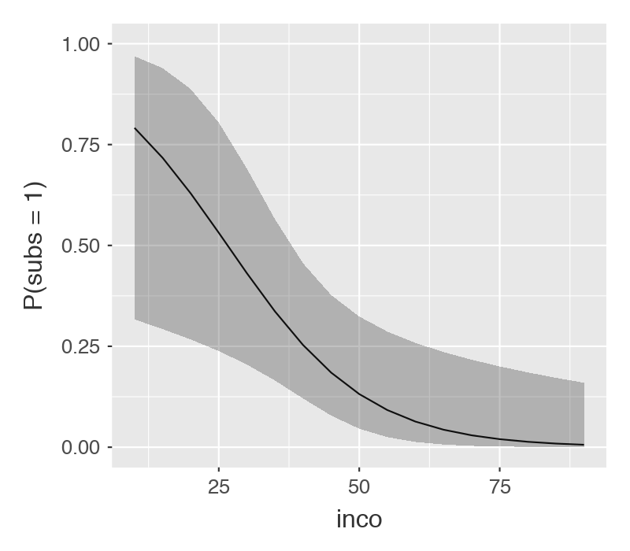
4
Continuous Predictor
Probability of using substances by income level
How well can we predict substance use with just income?
Classification Table – subs
 |  | Predicted
Observed |  | 0 |  | 1 |  | % Correct
0 |  | 29 |  | 1 |  | 96.7
1 |  | 5 |  | 3 |  | 37.5
Note. The cut-off value is set to 0.5
Notes:
Only high probability of using substances in very low income levels
Does not predict well (It doesn’t predict using substances very well)

Slide 30
Categorical Predictor
4
Model Coefficients
 |  |  |  |  |  |  |  |  |  |  |  | 95% Confidence Interval
Predictor |  | Estimate |  | SE |  | Z |  | p |  | Odds ratio |  | Lower |  | Upper
Intercept |  | -1.504 |  | 0.553 |  | -2.721 |  | 0.007 |  | 0.222 |  | 0.0752 |  | 0.657
Show:
The Office – Parks and Rec |  | 0.405 |  | 0.799 |  | 0.507 |  | 0.612 |  | 1.500 |  | 0.3131 |  | 7.186
Note. Estimates represent the log odds of "subs = 1" vs. "subs = 0"
Estimate in “log-odds” units
The odds ratio is above 1 so individuals on The Office have an odds of using substances 50% (1.5 – 1 = .5 = 50%) higher than PR
Not Significant

Slide 31
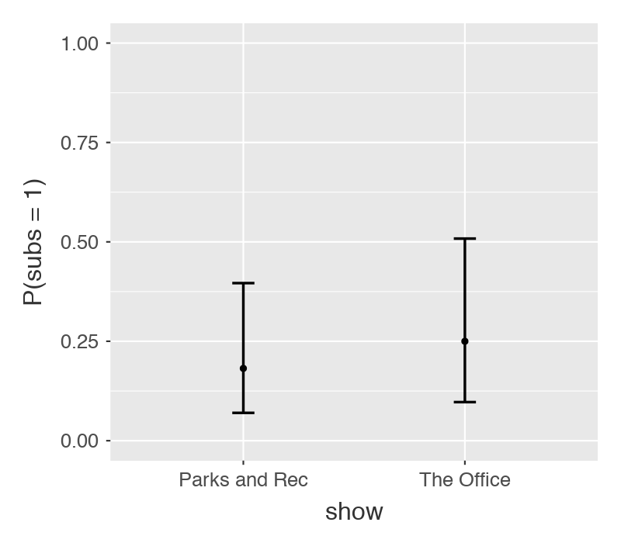
Categorical Predictor
4
Probability of using substances by show
How well can we predict substance use with just income?
Classification Table – subs
 |  | Predicted
Observed |  | 0 |  | 1 |  | % Correct
0 |  | 30 |  | 0 |  | 100
1 |  | 8 |  | 0 |  | 0.00
Note. The cut-off value is set to 0.5
Notes:
Neither show has high probability of using substances
Does not predict well (it only predicts no substance use)

Slide 32
Compute the Test Statistic
4
Intercept = Odds of Y when
X is zero
Slope = The change in the
odds of Y = 1 for a
one unit change in X,
on average.

Slide 33

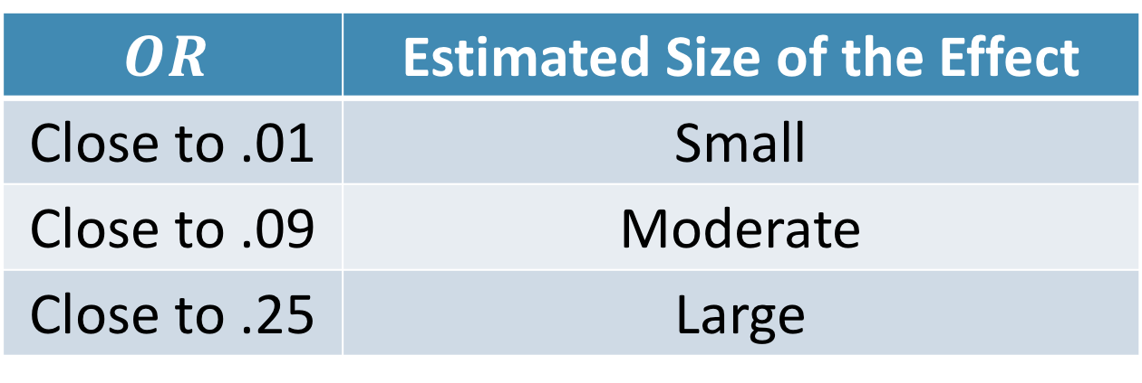
Compute an Effect Size and Describe it
5
One of the main effect sizes for regression is R²
$$Odds Ratio=\frac{Odds of Y when X is one unit higher}{Odds of Y when X is not one unit higher}$$
$$OR$$ | Estimated Size of the Effect
Close to .01 | Small
Close to .09 | Moderate
Close to .25 | Large
Notes:
Can also use Cohen’s d here as well for each mean difference

Slide 34
Interpreting the results
6
The logistic regression analysis showed that income significantly predicted the odds of substance use (OR = -.923, p = .016). As income increased by $1000, the odds of using substances decreased by 7.7%.

Slide 35
Break Time

Slide 36
Multiple Logistic Regression

Slide 37
Multiple Logistic Regression
More than one predictor in the same model
This change the interpretation just a little:
Slope is now the change in the odds of Y = 1 for a one unit change in X, while holding the other predictors constant.

Slide 38
Multiple Regression
Provides us with a few more things to think about
1. Variable Selection
2. Assumption Checks (much more
difficult in logistic regression)
3. Multi-collinearity
4. Interactions

Slide 39
Variable Selection
Several Approaches
1. Forward
2. Backward
3. Lasso
4. Covariates then predictor of interest

Slide 40
Variable Selection
Several Approaches
1. Forward
2. Backward
3. Lasso
4. Covariates then predictor of interest
I’d recommend these two
Notes:
Can report both the “adjusted” and “unadjusted” effects as well

Slide 41
Assumption Checks
Difficult (we won’t cover it in this class)
Jamovi doesn’t provide many checks (only collinearity)

Slide 42
Multi-Collinearity
When two or more predictors are very related to each other or are linear combinations of each other
Check correlations
Dummy codes are correct (Jamovi does this automatically)

Slide 43
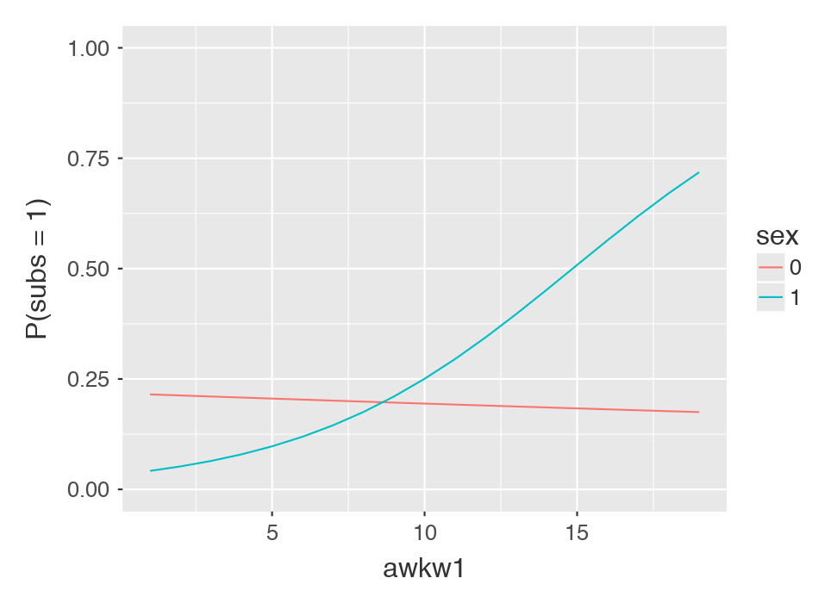
Interactions
Just as we do in linear models
Can have 2+ variables in the interaction

Slide 44
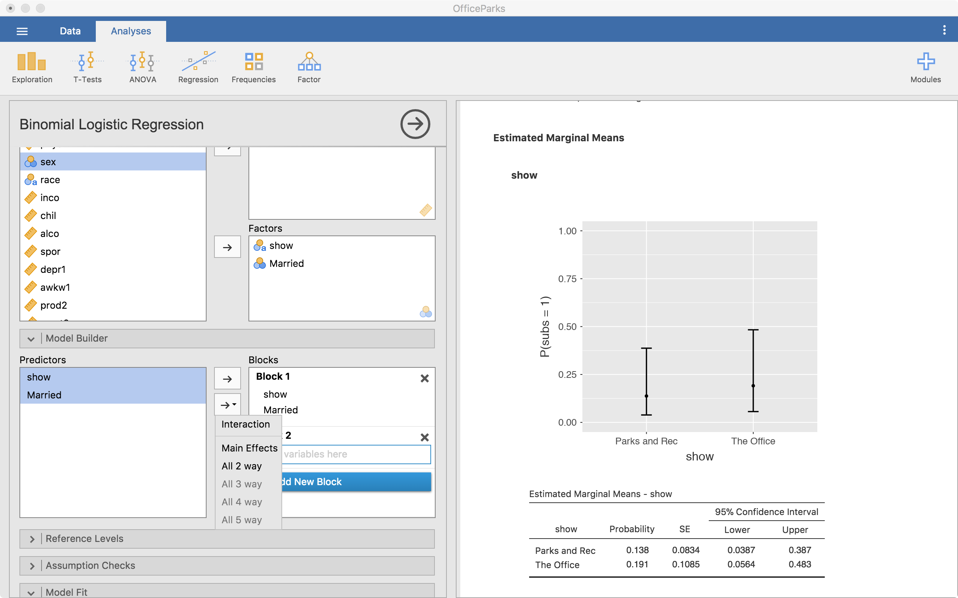
Interactions
Can tell Jamovi to do an interaction

Slide 45
Let’s use
Jamovi
Simple and Multiple
Logistic Regression

Slide 46
Break Time

Slide 47
Mediation vs. Moderation

Slide 48
Mediation vs. Moderation
Mediation
Moderation
Tells us about the path of an effect (from one variable to an intermediate one then to the outcome)
Jamovi performs this
“The effect of X goes through M to Y”
Synonym for interaction
Jamovi performs this
“The effect of X on Y depends on M”

Slide 49
Mediation
Med
X
Y
Notes:
Bully victimization -> Depression -> Substance Use

Slide 50
Moderation
Mod
X
Y

Slide 51
Mediation
Use specialized software for this (Jamovi can’t do it yet)
Be aware of it but you do not need to know how to do it for this class

Slide 52
Questions?

Slide 53
Next week:
Other categorical data analyses and miscellaneous topics

