Slide 1
Applied Statistical Analysis
EDUC 6050
Week 2
Engaging | Applied | Useful

Slide 2
Today
Working with Data
Overview of Statistics
Intro to Statistical Terminology
Intro to Jamovi

Slide 3
Reading
Tidy Data

Slide 4
Exercises with tidy data

Slide 5
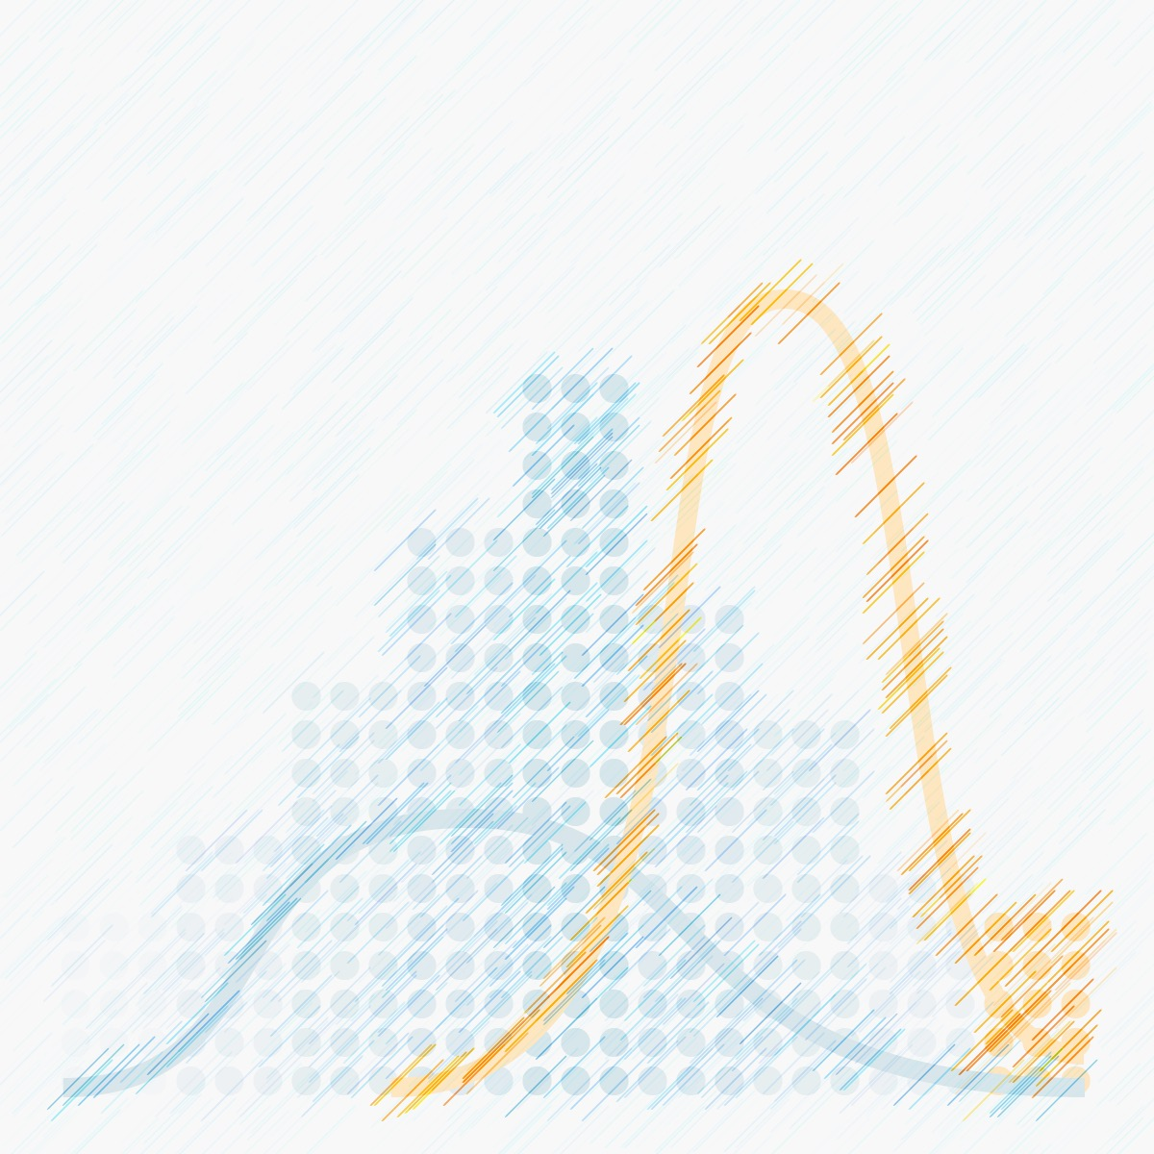
Statistics
Simply: the understanding of data using summaries and probability
A statistic is some sort of summary of the data
The average is a statistic

Slide 6
Statistics
More on the overview of statistics

Slide 7
Questions?

Slide 8
Next week:
Statistics terminology (Hypothesis, IV and DV, Measurement, Validity and Reliability, Correlation and Experimentation, Distributions, Central Tendency and Variability)
Chapters 1, 2, and 3 in Book
Start looking for articles

