Slide 1
Applied Statistical Analysis
EDUC 6050
Week 5
Finding clarity using data

Slide 2
Today
Hypothesis Testing with Z Scores (continued)
Chapters 6 and 7 in Book

Slide 3
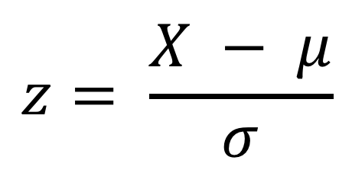
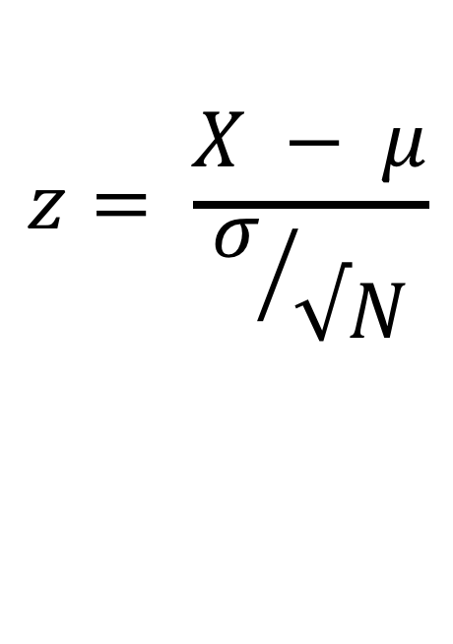
Review
$$z= \frac{X − μ}{σ}$$
$$z= \frac{X − μ}{σ/{√N}}$$
Which formula is for individual z scores and which is for z scores for sample means?
What are the six steps to hypothesis testing?
What are we trying to accomplish with hypothesis testing?
3

Slide 4
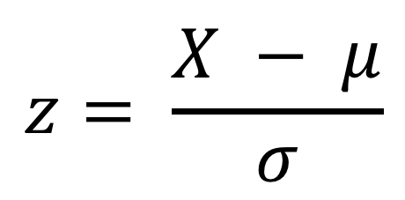
Z-Scores for an Individual Point
$$z= \frac{X − μ}{σ}$$
Tells us:
If the score is above or below the mean
How large (the magnitude) the deviation from the mean is to other data points
Notes:
What units are z scores in?
Standard deviation units

Slide 5
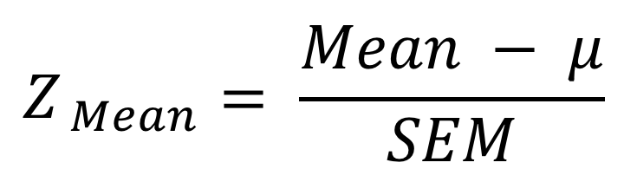
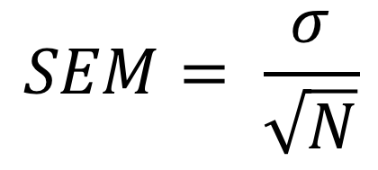
The Z for a Sample Mean
$$Z_{ Mean}= \frac{Mean − μ}{SEM}$$
$$SEM= \frac{σ}{\sqrt{N}}$$
Depends on sample size (bigger sample, smaller SEM)

Slide 6
Z-Score and the Standard Normal Curve
Appendix A shows more exact p-values
Notes:
This only works if the distribution of the raw scores are normally-distributed!

Slide 7
Hypothesis Testing with Z Scores
We’ll use a 6-step approach
We’ll use this throughout the class so get familiar with it
Examine Variables to Assess Statistical Assumptions
State the Null and Research Hypotheses (symbolically and verbally)
Define Critical Regions
Compute the Test Statistic
Compute an Effect Size and Describe it
Interpreting the results

Slide 8
Examine Variables to Assess Statistical Assumptions
1
Basic Assumptions
Independence of data
Appropriate measurement of variables for the analysis
Normality of distributions
Homogeneity of variance

Slide 9
Examine Variables to Assess Statistical Assumptions
1
Basic Assumptions
Independence of data
Appropriate measurement of variables for the analysis
Normality of distributions
Homogeneity of variance
Individuals are independent of each other
eg Jim and Pam could impact each other’s scores so they are NOT independent

Slide 10
Examine Variables to Assess Statistical Assumptions
1
Basic Assumptions
Independence of data
Appropriate measurement of variables for the analysis
Normality of distributions
Homogeneity of variance
Type of variable controls what analyses we can do
eg nominal, ordinal, interval, ratio

Slide 11
Examine Variables to Assess Statistical Assumptions
1
Basic Assumptions
Independence of data
Appropriate measurement of variables for the analysis
Normality of distributions
Homogeneity of variance
Usually the outcome needs to be normal (for small samples)

Slide 12
Examine Variables to Assess Statistical Assumptions
1
Basic Assumptions
Independence of data
Appropriate measurement of variables for the analysis
Normality of distributions
Homogeneity of variance
Variances across groups should be approximately the same

Slide 13
Examine Variables to Assess Statistical Assumptions
1
Examining the Basic Assumptions
Independence: random sample
Appropriate measurement: know what methods work with that type of variable
Normality: Histograms, skew and kurtosis
Homogeneity: Histograms, compare SD’s
Notes:
There are tests we can do but we won’t go into those now.

Slide 14
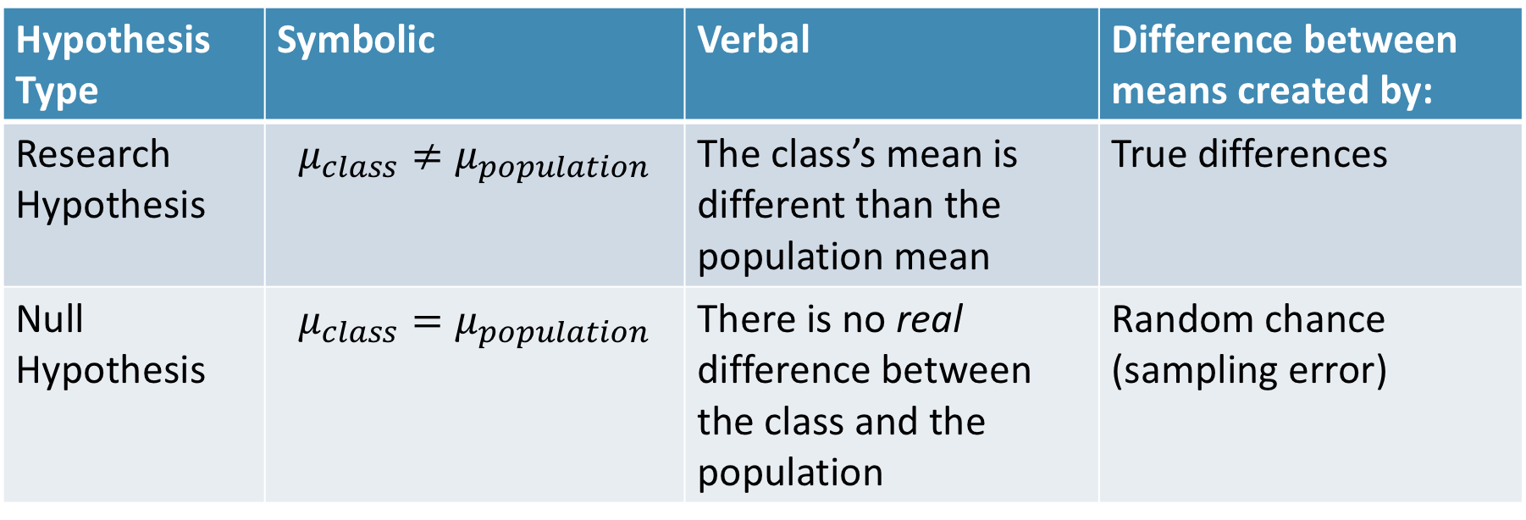
State the Null and Research Hypotheses (symbolically and verbally)
2
Hypothesis Type | Symbolic | Verbal | Difference between means created by:
Research Hypothesis | $$μ_{class}≠μ_{population}$$ | The class’s mean is different than the population mean | True differences
Null Hypothesis | $$μ_{class}=μ_{population}$$ | There is no real difference between the class and the population | Random chance (sampling error)
Notes:
Null and research hypotheses are mutually exclusive (they cover all possible outcomes)

Slide 15
Define Critical Regions
3
How much evidence is enough to believe the null is not true?
Before analyzing the data, we define the critical regions (generally based on an alpha = .05)

Slide 16


Define Critical Regions
3
We decide on an alpha level first
Then calculate the critical value
Look in the book for the z value
at alpha = .05 (two tails)
$$Z_{critical}=1.96$$
So our critical regions is defined as:
$$α= .05$$
$$z_{critical}=1.96$$
Notes:
If our computed z score is beyond 1.96 OR our p-value is below .05, then we REJECT the null (the findings are statistically significant)

Slide 17
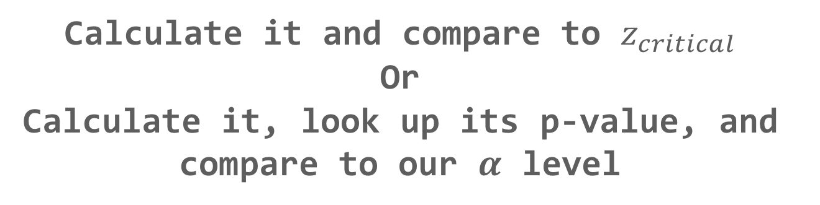
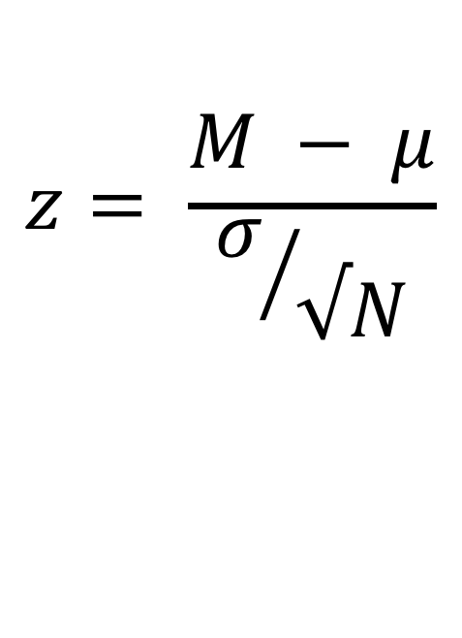
Compute the Test Statistic
4
$$z= \frac{M − μ}{σ/{√N}}$$
The SEM, $μ$, and M will be given to you
Calculate it and compare to $z_{critical}$
Or
Calculate it, look up its p-value, and compare to our $α$ level

Slide 18
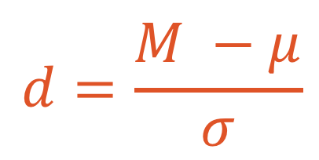
Compute an Effect Size and Describe it
5
One of the main effect size estimates is Cohen’s d
$$d=\frac{M −μ}{σ}$$
d | Estimated Size of the Effect
Close to .2 | Small
Close to .5 | Moderate
Close to .8 | Large

Slide 19
Interpreting the results
6
Put your results into words
Use the example on page 157 as a template

Slide 20
Break Time

Slide 21
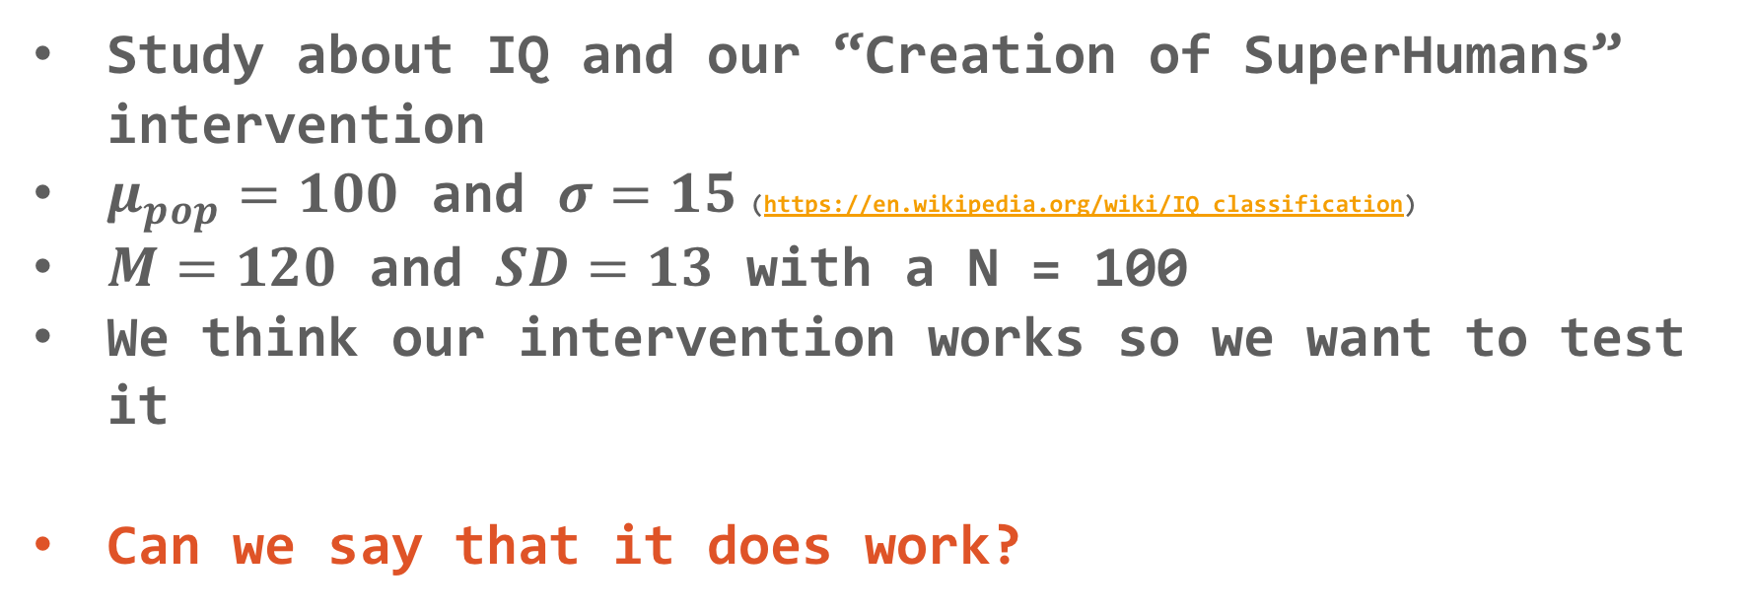
Hypothesis Testing with Z Scores
Let’s practice!
Study about IQ and our “Creation of SuperHumans” intervention
$μ_{pop}=100$ and $σ=15$(https://en.wikipedia.org/wiki/IQ_classification)
$M=120$ and $SD=13$ with a N = 100
We think our intervention works so we want to test it
Can we say that it does work?

Slide 22
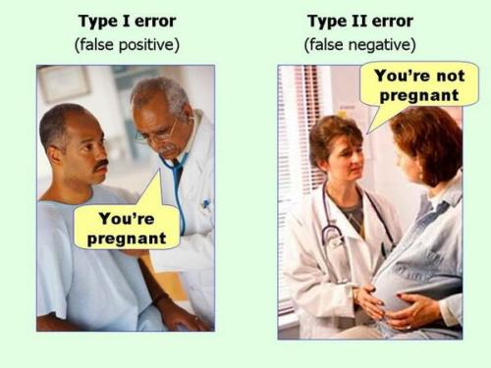
Errors in Hypothesis Testing (any type)
Notes:
Which is more dangerous in your field?

Slide 23
Hypothesis Testing Rules
We make a handful of decisions along this process
Alpha level
Research and Null Hypotheses
These are related to Type I and Type II errors
Notes:
Alpha level is the chance of a Type I error
Make it smaller (e.g., .01) then Type I error decreases, but Type II error increases
Two-tailed tests are more conservative than one-tailed tests (let’s stick with two-tailed)

Slide 24
What is a p-value?
The probability of getting an obtained value or a more extreme value assuming the null is true
Whether results are due to chance (sampling error)
Page 163

Slide 25
Reject that Null!
We don’t accept either the research or null hypotheses
Rather it is either evidence for or against the null
We do say that we “reject” or “fail to reject” the null

Slide 26
Evidence vs. Proof
Since we use p-values, there is always a chance that we made a Type I or Type II error
So we have evidence for or against it but we do NOT have PROOF of the research or null hypotheses
I like the discussion on Page 165 about this

Slide 27
Break Time

Slide 28
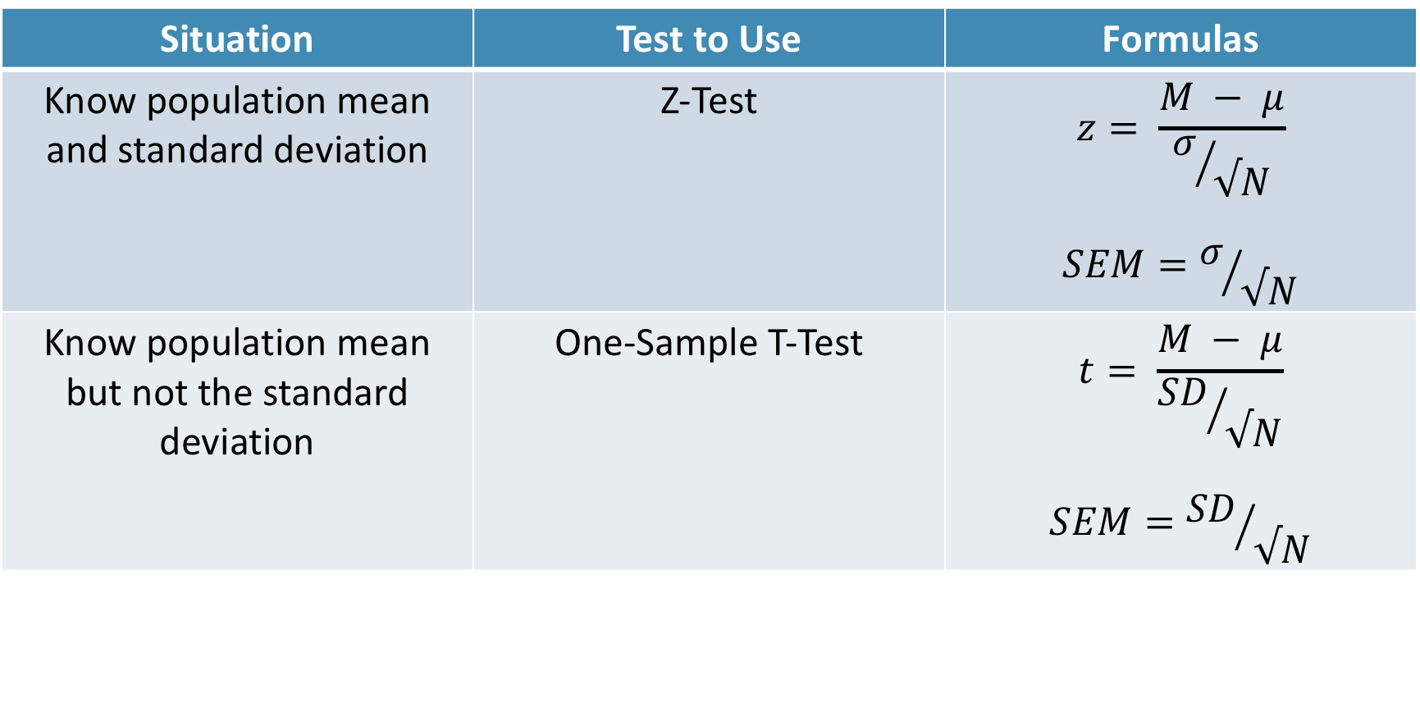
Single-Sample T-tests
Situation | Test to Use | Formulas
Know population mean and standard deviation | Z-Test | $$z= \frac{M − μ}{σ/{√N}}$$ $$SEM=σ/{√N}$$
Know population mean but not the standard deviation | One-Sample T-Test | $$t= \frac{M − μ}{{SD}/{√N}}$$ $$SEM={SD}/{√N}$$

Slide 29
Single-Sample T-tests
Slightly different distribution
Requirements
Need a DV on an interval/ratio scale,
IV defines one sample, and
you do not know the population standard deviation
Notes:
As your sample size increases, the t gets closer and closer to the normal distribution

Slide 30
Single-Sample T-tests
Slightly different distribution
Requirements
Need a DV on an interval/ratio scale,
IV defines one sample, and
you do not know the population standard deviation
Notes:
As your sample size increases, the t gets closer and closer to the normal distribution

Slide 31
Hypothesis Testing with T-Tests
The same 6 step approach!
Examine Variables to Assess Statistical Assumptions
State the Null and Research Hypotheses (symbolically and verbally)
Define Critical Regions
Compute the Test Statistic
Compute an Effect Size and Describe it
Interpreting the results

Slide 32
Examine Variables to Assess Statistical Assumptions
1
Basic Assumptions
Independence of data
Appropriate measurement of variables for the analysis
Normality of distributions
Homogeneity of variance

Slide 33
Examine Variables to Assess Statistical Assumptions
1
Basic Assumptions
Independence of data
Appropriate measurement of variables for the analysis
Normality of distributions
Homogeneity of variance
Individuals are independent of each other (one person’s scores does not affect another’s)

Slide 34
Examine Variables to Assess Statistical Assumptions
1
Basic Assumptions
Independence of data
Appropriate measurement of variables for the analysis
Normality of distributions
Homogeneity of variance
Here we need interval/ratio DV and an IV that is for a single sample (group)
Notes:
For t-test, DV needs to be interval/ratio

Slide 35
Examine Variables to Assess Statistical Assumptions
1
Basic Assumptions
Independence of data
Appropriate measurement of variables for the analysis
Normality of distributions
Homogeneity of variance
The outcome needs to be normal (for small samples)

Slide 36
Examine Variables to Assess Statistical Assumptions
1
Basic Assumptions
Independence of data
Appropriate measurement of variables for the analysis
Normality of distributions
Homogeneity of variance
The variance of our sample is supposed to match the population variance (but do we know it?)

Slide 37
Examine Variables to Assess Statistical Assumptions
1
Examining the Basic Assumptions
Independence: random sample
Appropriate measurement: know what your variables are
Normality: Histograms, skew and kurtosis
Homogeneity: Hard to assess
Notes:
There are tests we can do but we won’t go into those now.

Slide 38
State the Null and Research Hypotheses (symbolically and verbally)
2
Hypothesis Type | Symbolic | Verbal | Difference between means created by:
Research Hypothesis | $$μ_{class}≠μ_{population}$$ | The class’s mean is different than the population mean | True differences
Null Hypothesis | $$μ_{class}=μ_{population}$$ | There is no real difference between the class and the population | Random chance (sampling error)
Notes:
Null and research hypotheses are mutually exclusive (they cover all possible outcomes)

Slide 39
Define Critical Regions
3
How much evidence is enough to believe the null is not true?
Before analyzing the data, we define the critical regions (generally based on an alpha = .05)

Slide 40
Define Critical Regions
3
We decide on an alpha level first
Then calculate the critical value (based on sample size)
Notes:
If our computed t-stat is beyond 1.96 OR our p-value is below .05, then we REJECT the null (the findings are statistically significant)

Slide 41

Define Critical Regions
3
We decide on an alpha level first
Then calculate the critical value (based on sample size)
I’ll provide a table for you for the t values
Base on alpha and a specific df
$$df=N −1$$
Notes:
If our computed t-stat is beyond 1.96 OR our p-value is below .05, then we REJECT the null (the findings are statistically significant)

Slide 42
Define Critical Regions
3
We decide on an alpha level first
Then calculate the critical value (based on sample size)
I’ll provide a table for you for the t values
Base on alpha and a specific df
$$df=N −1$$
Notes:
If our computed t-stat is beyond 1.96 OR our p-value is below .05, then we REJECT the null (the findings are statistically significant)

Slide 43


Define Critical Regions
3
We decide on an alpha level first
Then calculate the critical value (based on sample size)
$$t_{critical, 29}=2.05$$
So our critical regions is defined as:
$$α= .05$$
$$t_{critical, 29}=2.05$$
Notes:
If our computed z score is beyond 2.05 OR our p-value is below .05, then we REJECT the null (the findings are statistically significant)

Slide 44

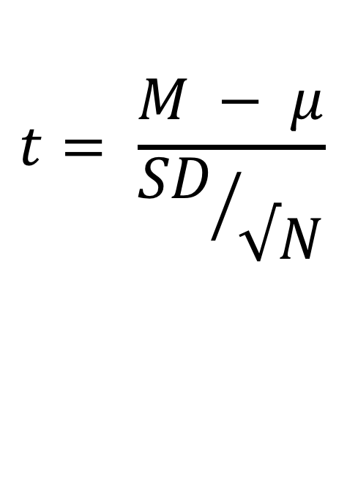
Compute the Test Statistic
4
$$t= \frac{M − μ}{{SD}/{√N}}$$
The SEM, $μ$, and M will be given to you
Calculate it and compare to $t_{critical}$
Or
Calculate it, look up its p-value, and compare to our $α$ level

Slide 45
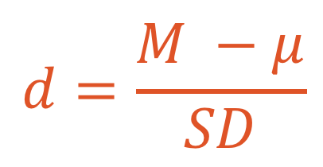
Compute an Effect Size and Describe it
5
One of the main effect size estimates is Cohen’s d
$$d=\frac{M −μ}{SD}$$
d | Estimated Size of the Effect
Close to .2 | Small
Close to .5 | Moderate
Close to .8 | Large

Slide 46
Interpreting the results
6
Put your results into words
Use the example on page 216 as a template

Slide 47
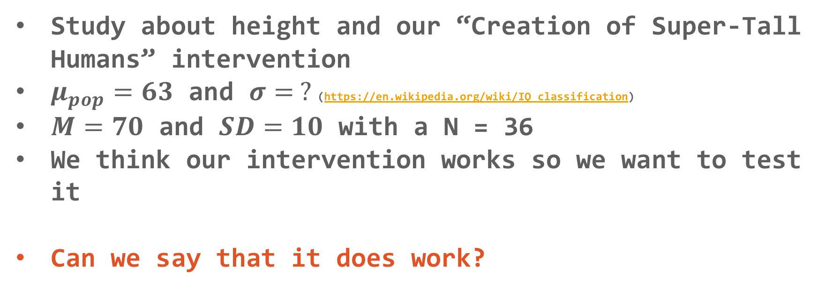
Hypothesis Testing with T-tests
Let’s practice!
Study about height and our “Creation of Super-Tall Humans” intervention
$μ_{pop}=63$ and $σ= ?$(https://en.wikipedia.org/wiki/IQ_classification)
$M=70$ and $SD=10$ with a N = 36
We think our intervention works so we want to test it
Can we say that it does work?

Slide 48
Review Hypothesis Testing
When can we say a result is “significant”?
How would we get a smaller SEM?
What is Cohen’s d?
What is the difference between a Z-test and a T-test?

Slide 49
Another look at
Jamovi
One-Sample T-test

Slide 50
Questions?

Slide 51
Next week:
Hypothesis Testing with T-tests and Confidence Intervals
Chapters 7 and 8 in Book
Keep updating your Statistical Organizer

Slide 52
Application
Example Using the Class Data &
The Office/Parks and Rec Data Set
Full Hypothesis Test Example
(outside of Jamovi)

