Slide 1
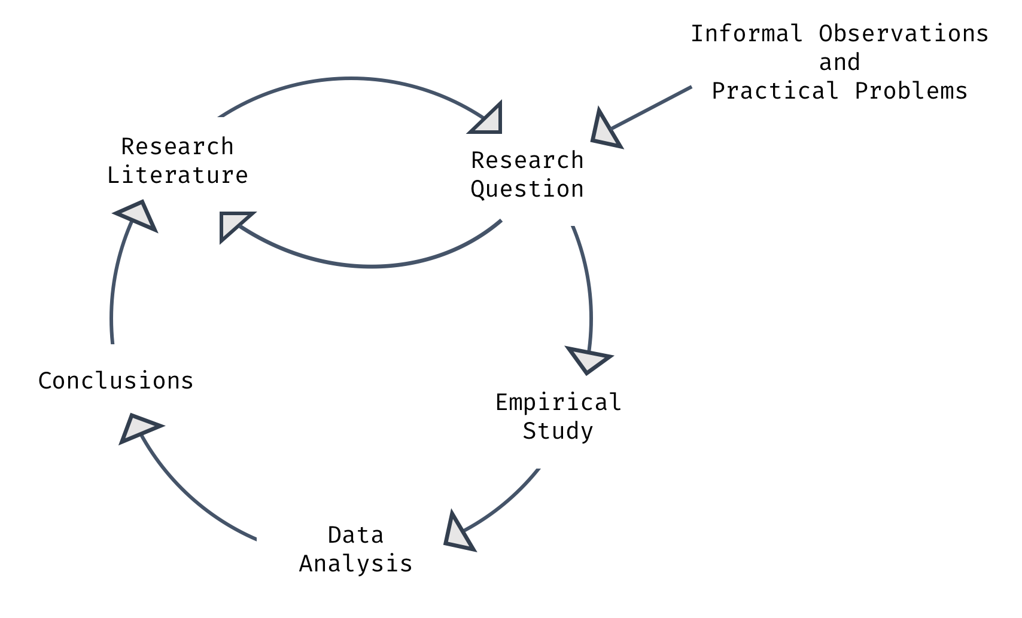
Psychological
Research
Methods

